Slide 1
Building Microservice architecture - Case Study
Case Study Overview Case Study Solution
Notes:
20535A
8: Networking Azure Application Components

Slide 2
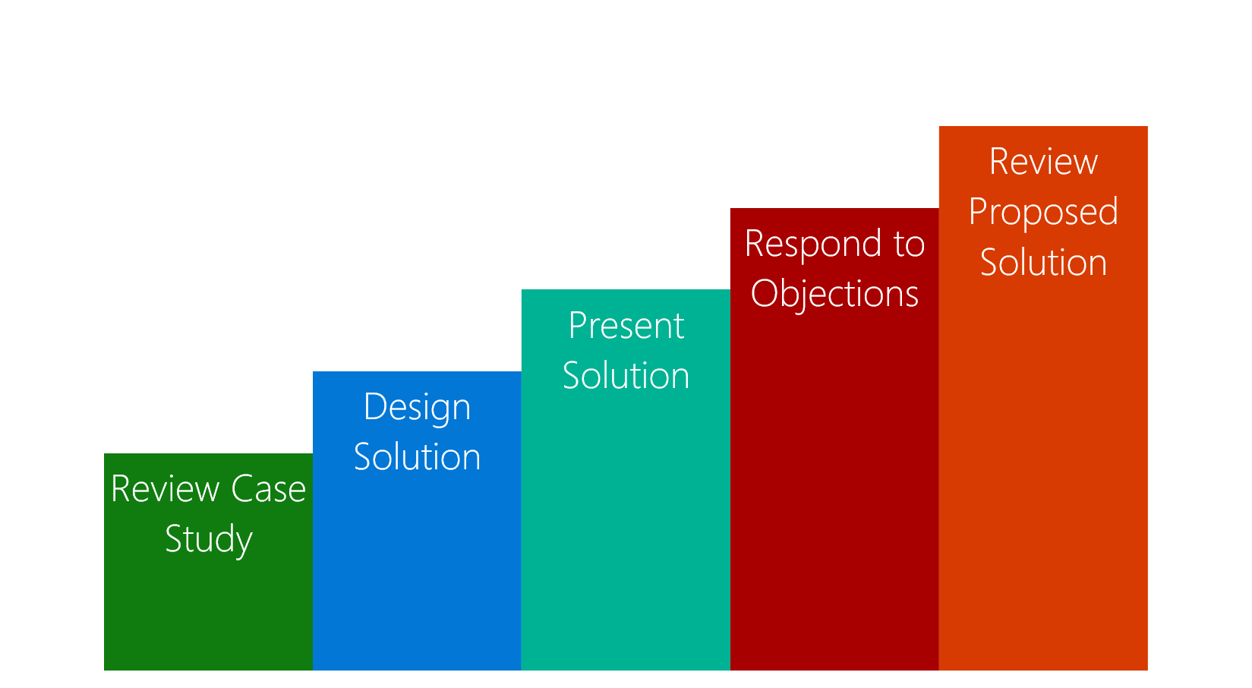
Case Study Overview
Review the case study requirements
Design a solution to the customer business problem
Present your solution
Respond to questions and objections
Review a potential solution
Notes:
Review the “Case Study Flow.”
20535A
8: Networking Azure Application Components

Slide 3
Customer Situation
Fabrikam Medical Conferences provides conference web site services tailored to the medical community.
After starting with a few small conferences, they now have evolved into a well-known brand and handle over 100 conferences per year, and growing.
Notes:
20535A
8: Networking Azure Application Components

Slide 4
Customer Situation
Each conference site has limited budget, but the conference owners have significant customization and change demands.
These changes can impact various aspects of the system from UI to back end, including conference registration and payment terms.
Notes:
20535A
8: Networking Azure Application Components

Slide 5
Customer Situation
12 developers handle
Development
Testing
Deployment
Operational management of all customer sites
Due to customer demands, they have issues with the efficiency and reliability of their development and DevOps workflows.
Notes:
20535A
8: Networking Azure Application Components

Slide 6
Customer Situation
The technology used is the MEAN stack
Mongo, Express, Angular, and Node.js
Web sites and APIs are built as microservices hosted on Linux servers.
The on-prem data backend is MongoDB; also running on a separate cluster of Linux servers.
There is relational data stored in PostgreSQL running on Linux servers.
Notes:
20535A
8: Networking Azure Application Components

Slide 7
Customer Situation
The technology used is the MEAN stack
Mongo, Express, Angular, and Node.js
Web sites and APIs are built as microservices hosted on Linux servers.
The on-prem data backend is MongoDB; also running on a separate cluster of Linux servers.
There is relational data stored in PostgreSQL running on Linux servers.

Slide 8
Customer Situation
Conference owners (“customers”) are considered “tenants”, and each tenant is treated as a unique deployment including:
Each tenant has a database in the MongoDB cluster with its own collections, and a database in PostgreSQL.
A copy of the most recent functional conference code base is taken and configured to point at the tenant database
Modifications are made to support the customer’s needs
The tenant’s code is deployed to a specific group of load balanced Linux server dedicated to one or more tenant.
Once the conference site is live, the inevitable requests for customizations to the deployment begins.

Slide 9

Customer Situation
They are looking to achieve the following:
Reduce potential regressions introduced to functional tenant code when changes are made
Ideally, changes to individual areas should not require a full regression test of the site functionality
Reduce the time to onboard new tenants
Reduce overhead managing changes, and related deployments
Improve ability to roll back and recover post change
Increase visibility into system operations and health

Slide 10
Customer Needs
Simplify new tenant deployment
Improve reliability of tenant updates
Choose a suitable Docker container strategy on Azure
Migrate MongoDB data to Cosmos DB without application changes
Migrate relational data from PostgreSQL on-premises databases to Microsoft Azure
Continue to use Git repositories for source control
Look at GitHub Actions as the CICD tool of choice

Slide 11
Customer Needs
Use tools for deployment, CICD integration, container scheduling, orchestration, monitoring, and alerts
They wish to complete an implementation of the proposed solution for a single tenant to train the team and perfect the process
Enhance attendee session feedback with AI to prevent inappropriate content from being posted, and real-time language translation to better accommodate growing worldwide conference attendance.
Notes:
20535A
8: Networking Azure Application Components

Slide 12

Customer Objection
There are many ways to deploy Docker containers on Azure, how do those options compare and what are motivations for each?
Is there an option in Azure that provides container orchestration platform features that are easy to manage and migrate to, that can also handle our scale and management workflow requirements?

Slide 13
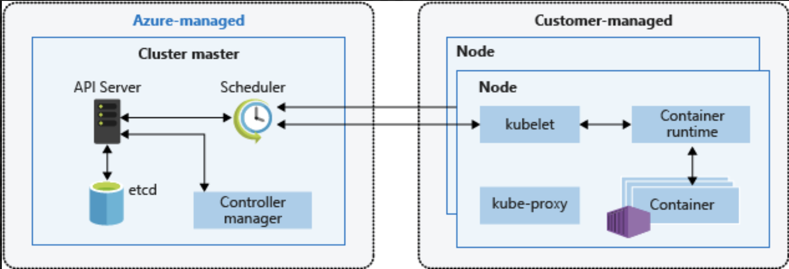
Common Scenario
Kubernetes Architecture

Slide 14
Call to Action
Case Study Timing: 60 Minutes
Who are the business decision makers and stakeholders?
What customer business needs do you need to address with your solution?
Diagram your proposed solution
Notes:
20535A
8: Networking Azure Application Components

Slide 15

Preferred solution
After evaluating the options for container platforms on Azure, Fabrikam Medical Conferences decided to move forward with Azure Kubernetes Service (AKS).
They also decided to move forward with GitHub Actions for infrastructure and container DevOps workflows.

Slide 16
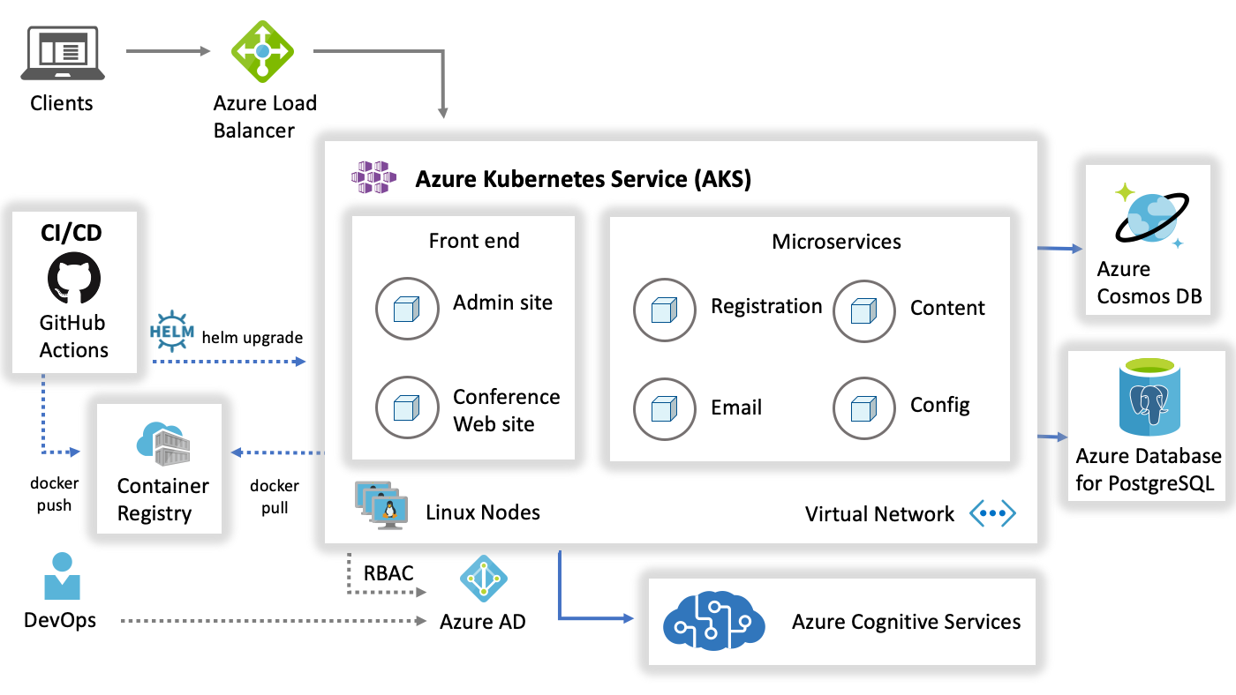
Preferred solution
1
AKS Cluster with Load balancer
1
2
Github along with HELM
3
4
2
3
AKS Cluster with Microservices
4
Migrating and hosting SQL & NoSQL db on targeted PaaS platforms
5
Cluster security will be managed with Azure AD
6
Azure AI Services
6
5
Notes:
Reference Links:
https://docs.microsoft.com/en-us/azure/architecture/reference-architectures/microservices/aks

Slide 17
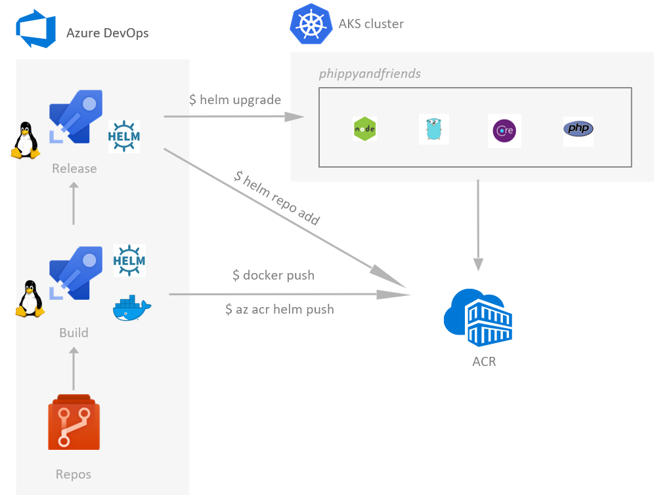
CI/CD to Azure Kubernetes Service with Azure DevOps
https://cloudblogs.microsoft.com/opensource/2018/11/27/tutorial-azure-devops-setup-cicd-pipeline-kubernetes-docker-helm/

Slide 18
Preferred objections handling
There are many ways to deploy Docker containers on Azure. How do those options compare and what are motivations for each?
Azure Kubernetes Services (AKS) – the ideal solution for a fully managed experience
Azure Container Instances – simple, isolated, without management tooling, enabling workload scale on demand
Web App for Containers – simple PaaS without full-featured container orchestration
Notes:
The easiest way to move to containers on Azure is to deploy containers to the Linux variant of App Service. However, this option does not provide a full-featured container orchestration platform with highly customizable load balancing, dynamic service discovery, and a holistic approach to container monitoring.
Azure Container Instances also provide a simple way to manage individual containers without management tooling providing a way to do on demand scaling for workloads that need that flexibility.
Ideally, Azure Kubernetes Service (AKS) will provide a fully managed service with the full set of orchestration and management tools. Working with AKS is the best choice to enable migration to AKS while still benefiting from a complete container orchestration experience to support the growth trajectory of the solution.

Slide 19
Preferred objections handling
Is there an option in Azure that provides container orchestration platform features that are easy to manage and migrate to, that can also handle our scale and management workflow requirements?
The best option is to go with a managed cluster such as Azure Kubernetes Service (AKS), native to Azure
Notes:
The best of all worlds is to go with a managed orchestration platform like AKS – native to Azure. It reduces the cost and management overhead of the cluster, while still providing a solution that supports growth, scale, and native management tooling.
With Kubernetes, you will have additional features at your fingertips beyond the pure Docker approach including:
The Kubernetes management dashboard which includes the web interface and remote APIs for managing, running, and scaling containers, including CICD integration options.
The kubectl command line tool for engaging remote Kubernetes APIs and assisting with automation.
Built-in dynamic service discovery simplifying the deployment of new container instances to a load balanced environment.

Slide 20

Preferred objections handling
We heard Azure Cosmos DB is compatible with MongoDB. Will this provide a migration that minimized code changes?
Azure Cosmos DB supports multiple NoSQL data models; including supporting a MongoDB API. This provides compatibility for code written for MongoDB to communicate with Cosmos DB without code changes; for easier migration and interoperability.

Slide 21

Preferred objections handling
We know Microsoft offers Cognitive Services with pre-built AI models. What models offer the features we are looking to use for enhancing our conference web site?
Azure Cognitive Services brings AI within reach for every developer - without requiring machine-learning expertise. All it takes is an API call to embed the ability to implement ML models managed by Microsoft.
Content Moderator API can be used to add machine-assisted content moderation and human review tools for images, text, and videos. You can enhance your ability to detect potentially offensive or unwanted images through machine learning-based classifiers, custom lists, and optical character recognition (OCR).
Translator API can be used to integrate an AI service for real-time text translation. It can translate text in real-time across more than 70 languages.

Slide 22
Additional Reference
Description | Links
Azure Kubernetes Services (AKS) | https://docs.microsoft.com/azure/aks/intro-kubernetes/
Kubernetes | https://kubernetes.io/docs/home/
AKS FAQ | https://docs.microsoft.com/azure/aks/faq
Autoscaling AKS | https://github.com/kubernetes/autoscaler
AKS Cluster Autoscaler | https://docs.microsoft.com/azure/aks/cluster-autoscaler
Upgrading an AKS cluster | https://docs.microsoft.com/azure/aks/upgrade-cluster
Azure Pipelines | https://docs.microsoft.com/azure/devops/pipelines/
Container Security | https://docs.microsoft.com/azure/container-instances/container-instances-image-security/
Image Quarantine | https://github.com/Azure/acr/tree/master/docs/preview/quarantine/
Container Monitoring Solution | https://docs.microsoft.com/azure/azure-monitor/insights/containers
Azure Cosmos DB | https://docs.microsoft.com/azure/cosmos-db/introduction
Azure Database for PostgreSQL | https://azure.microsoft.com/services/postgresql/
Azure Cognitive Services | https://azure.microsoft.com/services/cognitive-services/

