Slide 1
Building Microservice architecture - Case Study
Case Study Overview Case Study Solution
Notes:
20535A
8: Networking Azure Application Components

Slide 2
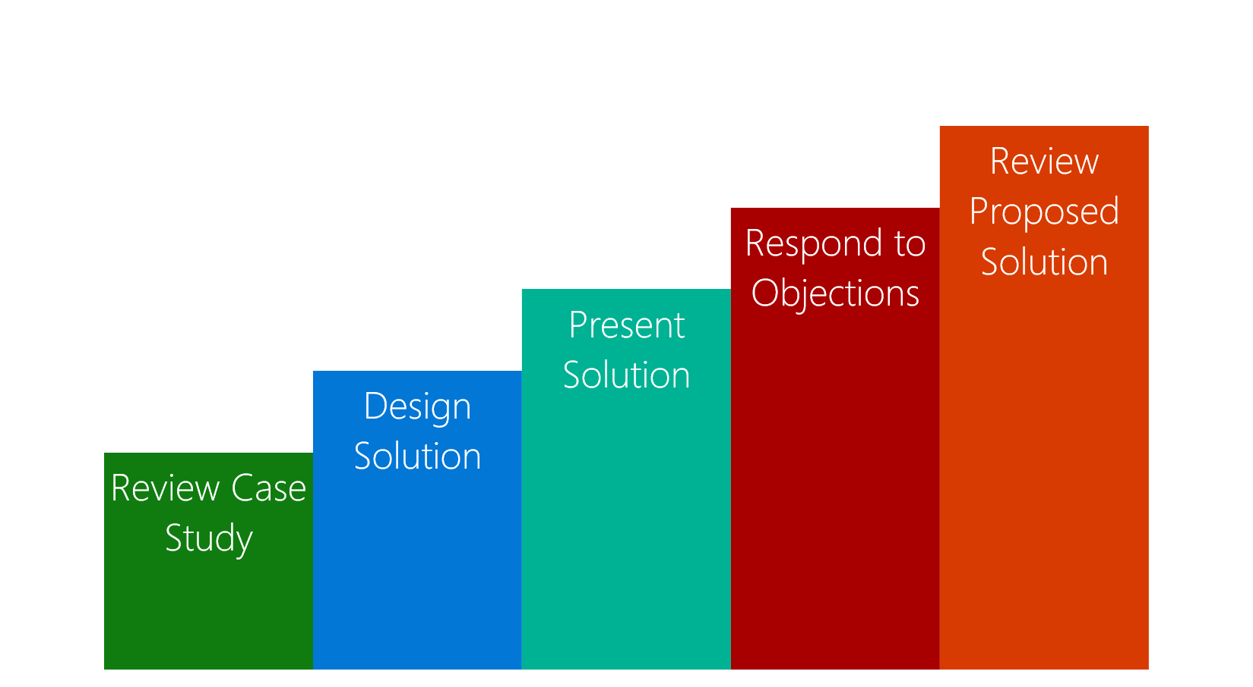
Case Study Overview
Review the case study requirements
Design a solution to the customer business problem
Present your solution
Respond to questions and objections
Review a potential solution
Notes:
Review the “Case Study Flow.”
20535A
8: Networking Azure Application Components

Slide 3
Customer Situation
Fabrikam Medical Conferences provides conference web site services tailored to the medical community.
After starting with a few small conferences, they now have evolved into a well-known brand and handle over 100 conferences per year, and growing.
Notes:
20535A
8: Networking Azure Application Components

Slide 4
Customer Situation
Each conference site has limited budget, but the conference owners have significant customization and change demands.
These changes can impact various aspects of the system from UI to back end, including conference registration and payment terms.
Notes:
20535A
8: Networking Azure Application Components

Slide 5
Customer Situation
12 developers handle
Development
Testing
Deployment
Operational management of all customer sites
Due to customer demands, they have issues with the efficiency and reliability of their development and DevOps workflows.
Notes:
20535A
8: Networking Azure Application Components

Slide 6
Customer Situation
The technology used is the MEAN stack
Mongo, Express, Angular, and Node.js
Web sites and APIs are built as microservices hosted on Linux servers.
The on-prem data backend is MongoDB; also running on a separate cluster of Linux servers.
There is relational data stored in PostgreSQL running on Linux servers.

Slide 7
Customer Situation
Conference owners (“customers”) are considered “tenants”, and each tenant is treated as a unique deployment including:
Each tenant has a database in the MongoDB cluster with its own collections, and a database in PostgreSQL.
A copy of the most recent functional conference code base is taken and configured to point at the tenant database
Modifications are made to support the customer’s needs
The tenant’s code is deployed to a specific group of load balanced Linux server dedicated to one or more tenant.
Once the conference site is live, the inevitable requests for customizations to the deployment begins.

Slide 8
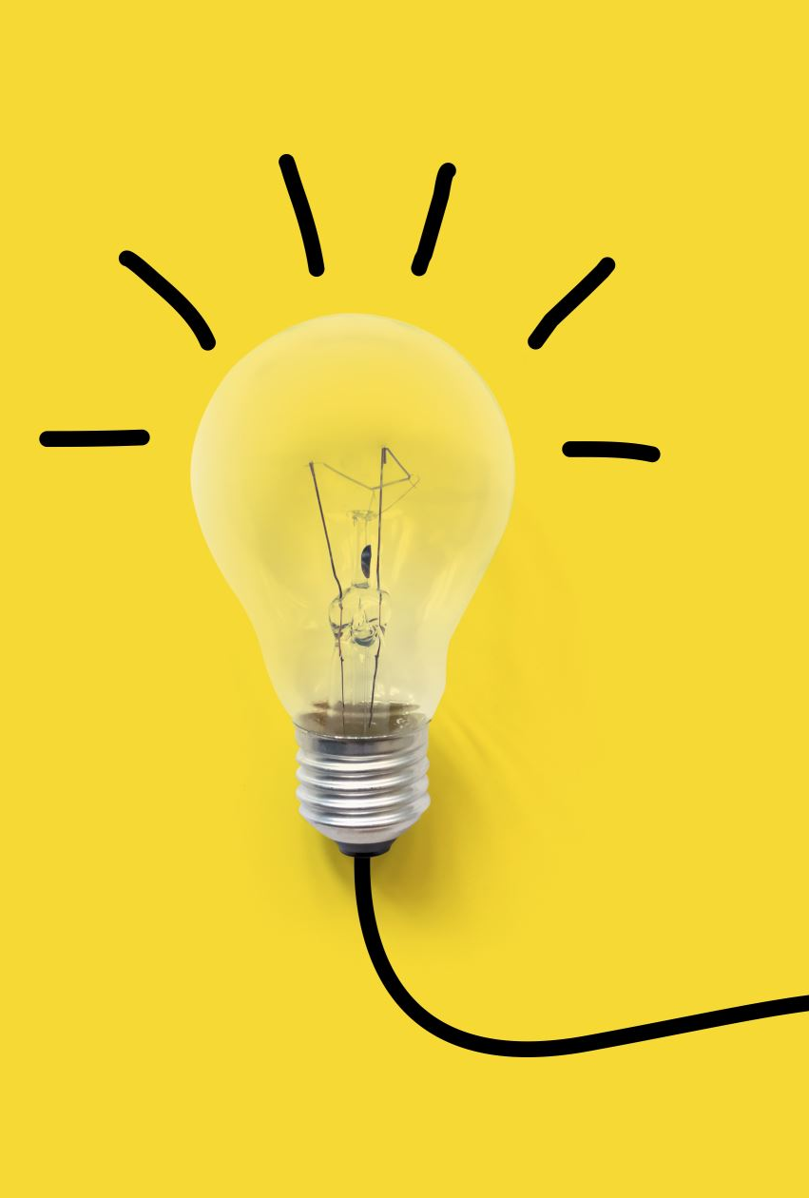
Customer Situation
They are looking to achieve the following:
Reduce potential regressions introduced to functional tenant code when changes are made
Ideally, changes to individual areas should not require a full regression test of the site functionality
Reduce the time to onboard new tenants
Reduce overhead managing changes, and related deployments
Improve ability to roll back and recover post change
Increase visibility into system operations and health

Slide 9
Customer Needs
Simplify new tenant deployment
Improve reliability of tenant updates
Choose a suitable Docker container strategy on Azure
Migrate MongoDB data to Cosmos DB without application changes
Migrate relational data from PostgreSQL on-premises databases to Microsoft Azure
Continue to use Git repositories for source control
Look at GitHub Actions as the CICD tool of choice

Slide 10
Customer Needs
Use tools for deployment, CICD integration, container scheduling, orchestration, monitoring, and alerts
They wish to complete an implementation of the proposed solution for a single tenant to train the team and perfect the process
Enhance attendee session feedback with AI to prevent inappropriate content from being posted, and real-time language translation to better accommodate growing worldwide conference attendance.
Notes:
20535A
8: Networking Azure Application Components

Slide 11

Customer Objection
There are many ways to deploy Docker containers on Azure, how do those options compare and what are motivations for each?
Is there an option in Azure that provides container orchestration platform features that are easy to manage and migrate to, that can also handle our scale and management workflow requirements?

Slide 12
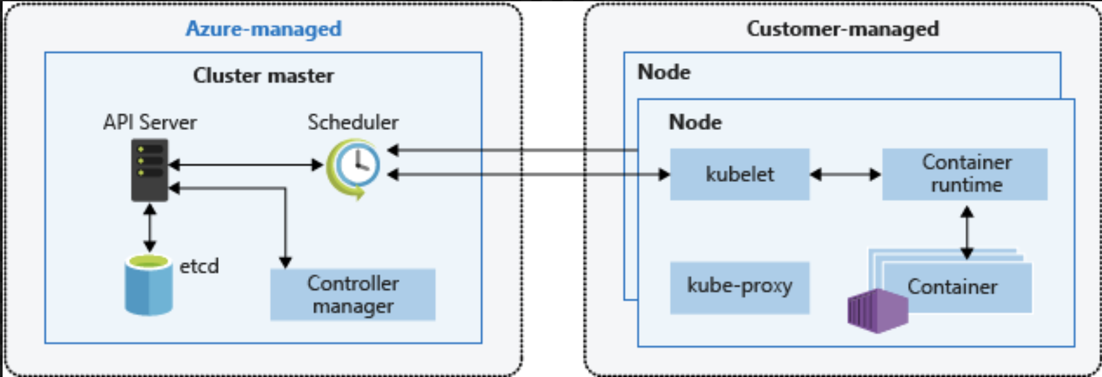
Common Scenario
Kubernetes Architecture

Slide 13
Call to Action
Case Study Timing: 60 Minutes
Who are the business decision makers and stakeholders?
What customer business needs do you need to address with your solution?
Diagram your proposed solution
Notes:
20535A
8: Networking Azure Application Components

