Slide 1
Task 4 — Interactive Sales Dashboard
Prepared by: Badam Sri Vidya
Elevate Internship

Slide 2
Key Performance Indicators
Total Sales: 280,802.33
Total Profit: 44,832.66
Orders: 1500
Avg Order Value: 187.20
Profit Margin: 15.97%

Slide 3
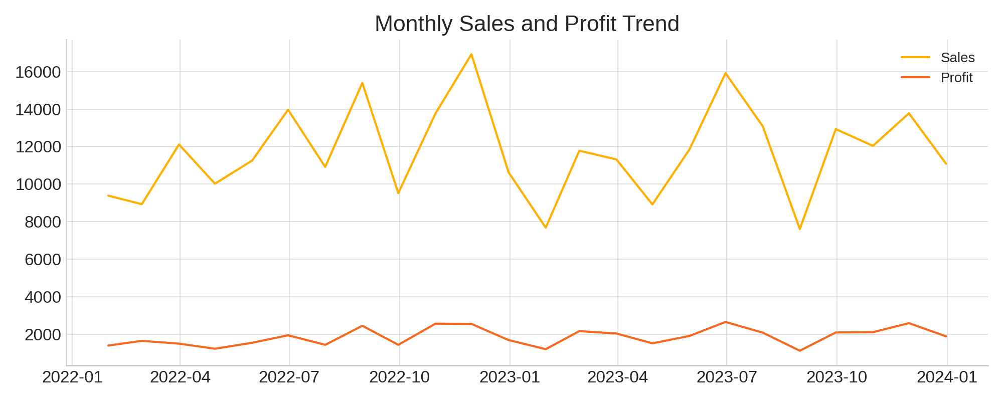
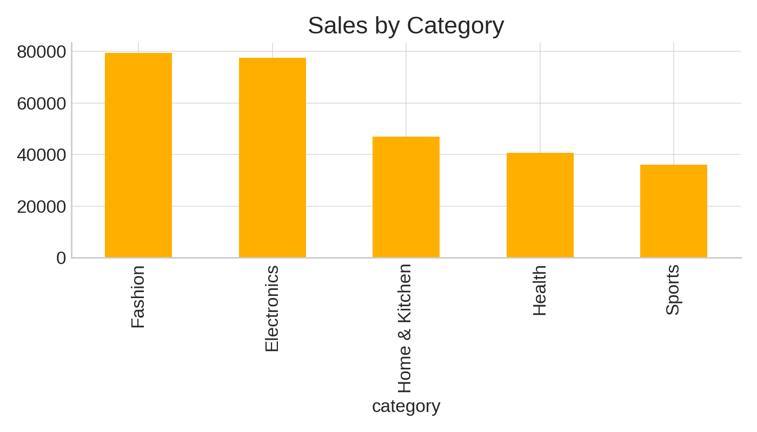
Dashboard Visual Samples

Slide 4
Recommendations
1. Cap excessive discounts for low-margin categories.
2. Invest in Mobile App channel to increase conversion.
3. Focus promotions on high-margin sub-categories.
4. Regional campaigns for top regions.

