Slide 1
AMALITECH TECHNICAL ASSESSMENT · DATA ANALYTICS
Abdelhakim Moustapha Mahamat
Veridi Logistics Audit
Delivery Performance & Customer Sentiment Analysis

Slide 2
Problem Overview & Project Context
PROBLEM STATEMENT
96,478
orders audited
27
Brazilian states
Veridi Logistics faces growing customer dissatisfaction linked to late deliveries across Brazil. Negative reviews threaten retention, yet no systematic audit had identified the geographic and seasonal root causes behind these delays.
Objective
Audit last-mile delivery performance across 27 Brazilian states to pinpoint root causes of negative reviews, with focus on geographic disparities and seasonal delay patterns.
Dataset & Tools
Olist Brazilian E-Commerce (Kaggle) · 96,478 delivered orders · 2016-2018 · Analysed with Python, Pandas, Seaborn, Matplotlib and GeoPandas.
-58%
review score drop super-late vs on-time
5
Northeast states critical late rate >=15%

Slide 3
Agenda
01
Delivery Status Overview
02
Customer Sentiment Analysis
Overall distribution across on-time, late, and super-late categories
Review scores correlated with delivery punctuality
03
Review Score Distribution
04
Seasonality & Peak Periods
Breakdown of review scores per delivery status group
Monthly late delivery rate with event annotations
05
Geographic Analysis
06
Key Findings & Recommendations
Late delivery rate by Brazilian state with volume context
Actionable insights for the logistics team

Slide 4
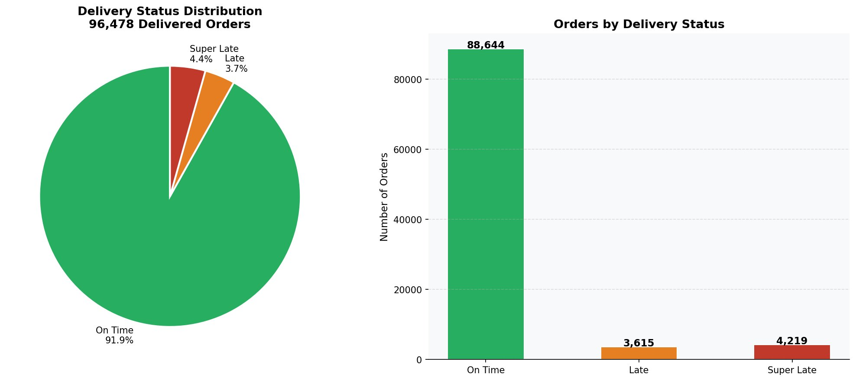
01 | Delivery Status Overview
88,644
3,615
4,219
On Time
Late
Super Late
91.9% of orders
3.7% of orders
4.4% of orders

Slide 5
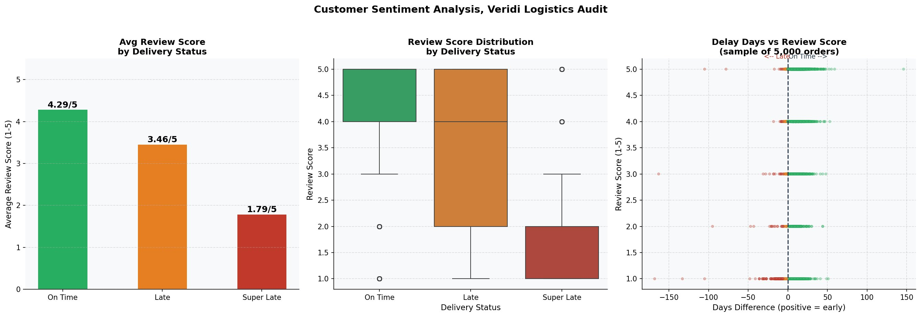
02 | Customer Sentiment Analysis
Key Insight: Delivery delays have a strong negative impact on customer satisfaction; super-late orders score 58% lower than on-time deliveries.
4.29 / 5
3.46 / 5
1.79 / 5
On Time
Late
Super Late

Slide 6
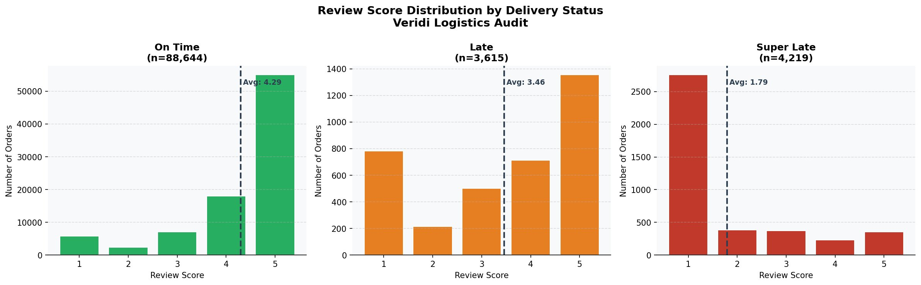
03 | Review Score Distribution by Delivery Status
Score 5 dominates; customers highly satisfied
Bimodal: score 1 & 5 spikes; polarized reactions
Score 1 overwhelmingly dominant; severe dissatisfaction

Slide 7
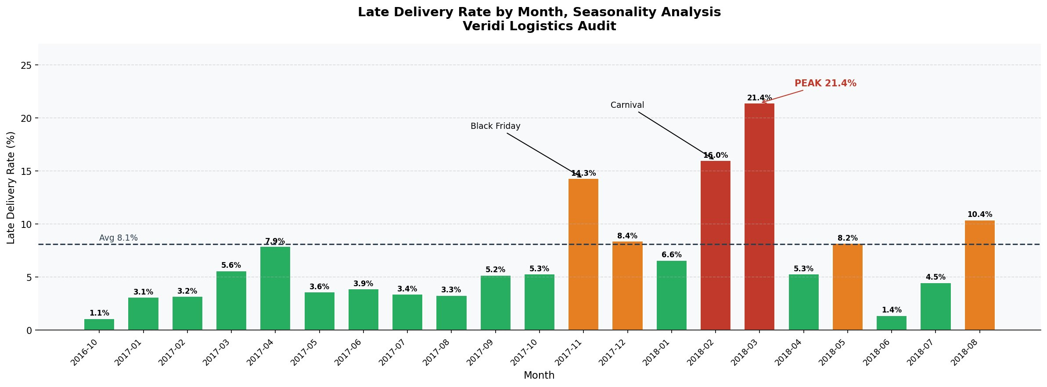
04 | Seasonality & Peak Late Delivery Periods
14.3%
16.0%
21.4%
8.1%
Black Friday · November 2017
Carnival · January 2018
Peak Month · March 2018
National Average · Baseline

Slide 8
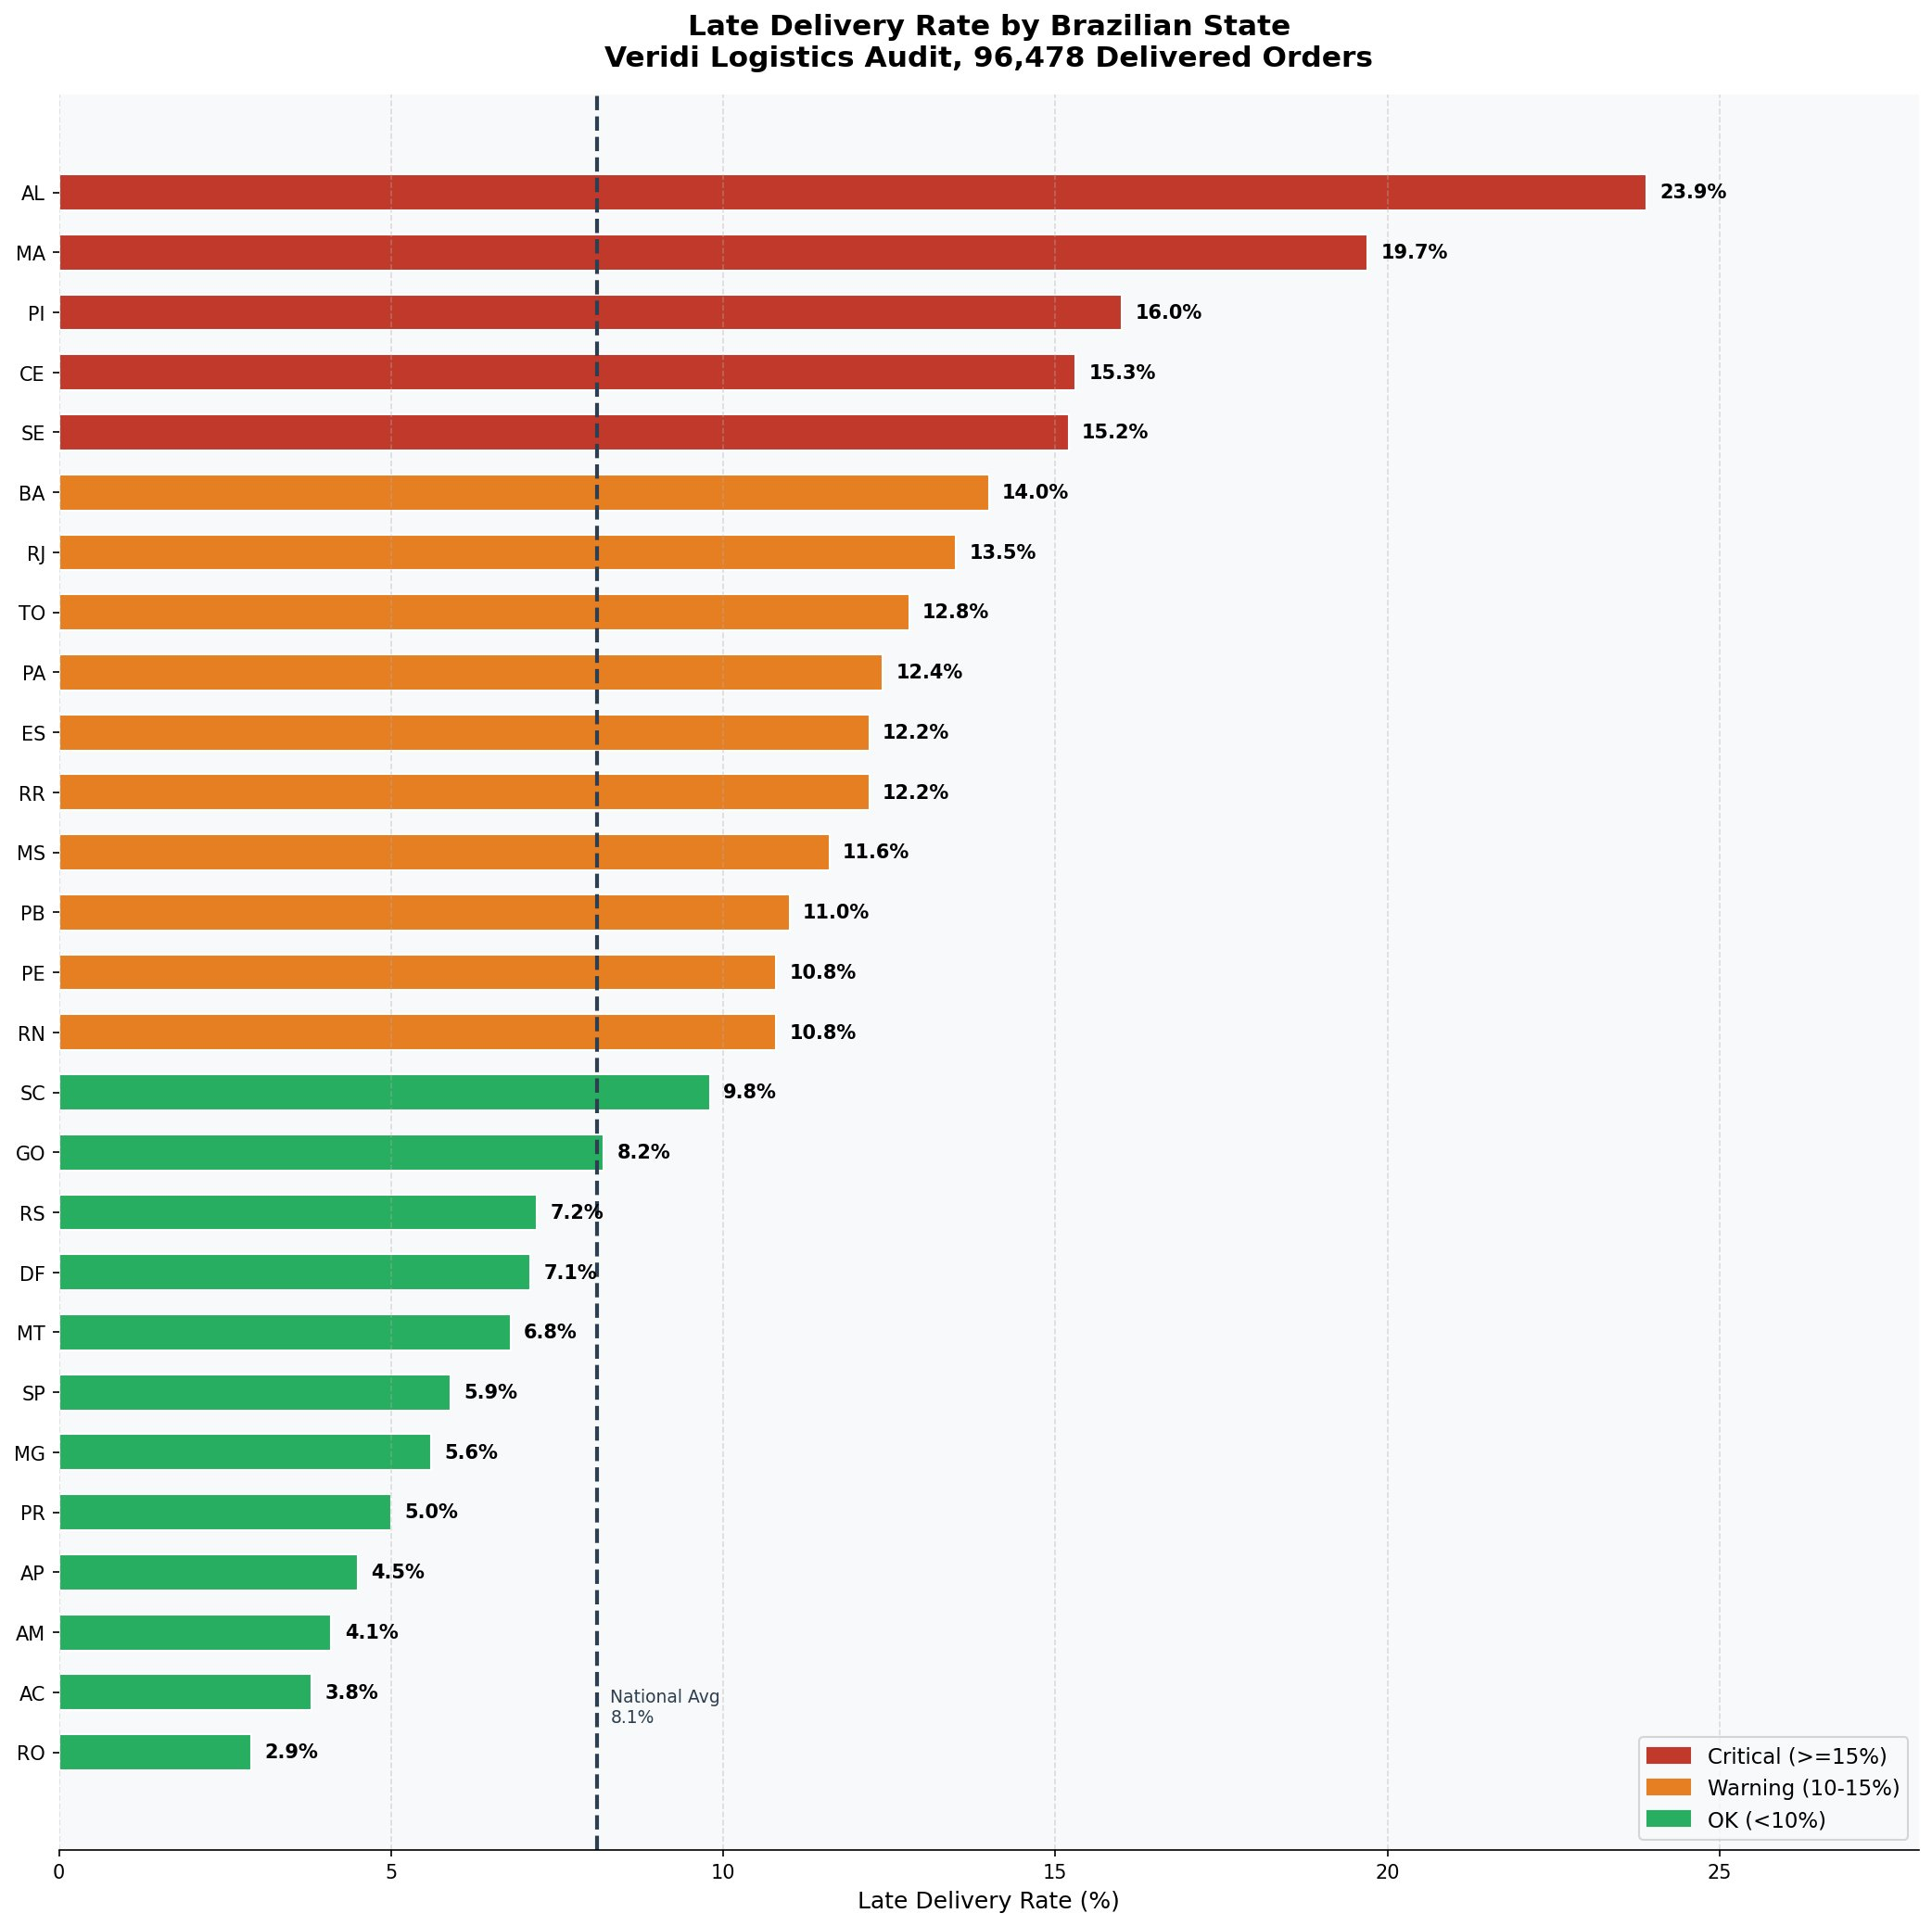
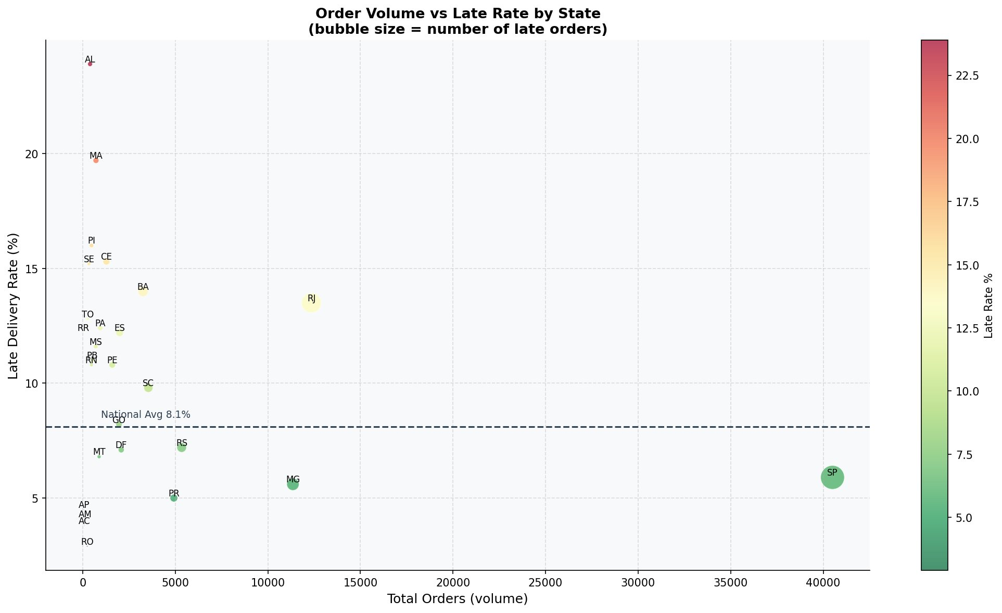
05 | Late Delivery Rate by Brazilian State
Critical (≥15%)
Warning (10–15%)
OK (<10%)
AL · MA · PI · CE · SE
BA · RJ · TO · PA · ES · RR · MS · PB · PE · RN
SC · GO · RS · DF · MT · SP · MG · PR · AP · AM · AC · RO

Slide 9
06 | Key Findings & Recommendations
Key Findings
Recommendations
Strong baseline on-time performance; the majority of deliveries meet customer expectations.
R1
Deploy surge-capacity carrier contracts for November to March period to handle seasonal volume spikes.
Super-late orders cause disproportionate satisfaction damage; review scores collapse vs. on-time deliveries.
R
Prioritize logistics partnerships in the Northeast corridor, critical states require urgent carrier investment.
Carnival and Black Friday drive predictable seasonal surges demand spikes are foreseeable and preventable.
R3
Implement proactive delay notifications: even a 1-point review improvement has significant revenue impact.
Alagoas (AL) leads critical states at 23.9%; Northeast corridor systemically underperforms.
R4
Investigate RJ anomaly: high volume + 13.5% late rate represents the largest addressable risk pool.
São Paulo (SP) has highest absolute volume but maintains a healthy 5.9% late rate.
R5
Set Service Level Agreement targets: reduce super-late orders by 50% within 6 months as primary Key Performance Indicator.

Slide 10
Thank You
Questions & Discussion
Olist Brazilian E-Commerce Dataset | Brazil

