Slide 1

EC-835 Digital Image Processing
A New Simulation of Spiral Architecture
Badar Abbas
MSc-57
College of EME

Slide 2
Outline
Overview of Hexagonal Grid
Construction of Hexagonal Pixels
Spiral Addressing
Locating Hexagonal Pixels
Simulation of Spiral Architecture
MATLAB Simulation of Spiral Architecture
Resources

Slide 3
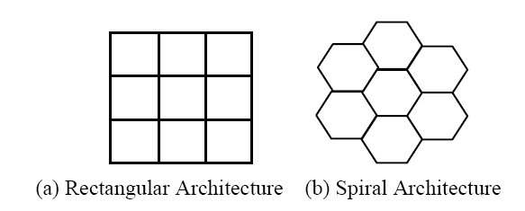
Overview of Hexagonal Grid
Square Pixels – Traditional Pixels
  Traditional system, using rectangular arrays.
Hexagonal Pixels - Hexagons
  Hexagonally-spaced arrays.

Slide 4
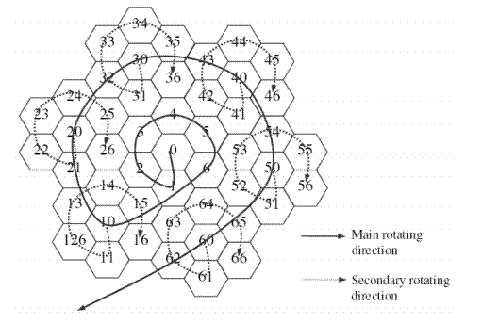
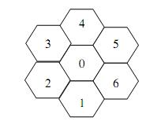
Spiral Addressing
Spiral Architecture
  One Dimensional 7-base addressing scheme.
  Addresses referred to as the hexagons.
  Collection of hexagons grow in powers of seven.

Slide 5
Spiral Addressing
function hept = dec2hept(num)
%DEC2HEPT Converts decimal number into a base 7 number.
hept = 0;
temp = fix(num/7);
r = mod(num,7);
exp = 0;
while temp ~= 0;
hept = hept + r * 10 ^ exp;
r = mod(temp,7);
exp = exp + 1;
temp = fix(temp/7);
end
hept = hept + r * 10 ^ exp;

Slide 6
Spiral Addressing
function dec = hept2dec(num)
%HEPT2DEC Converts base 7 number into decimal number.
len = length(num2str(num)) - 1;
dec = 0;
for n = len:-1:0
digit = fix(num / 10 ^ n);
dec = dec + digit * 7 ^ n;
num = mod(num, 10 ^ n);
end

Slide 7
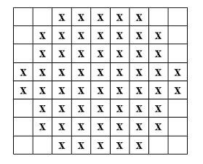
Construction of Hexagonal Pixels
A hexagonal pixel, called a hyperpel, is simulated as shown below.
function mat = hypel( mat, row, col, val )
%HYPEL Returns hexagonal pixels
mat(row:row + 7, col:col + 4) = val;
mat(row + 1:row + 6, col - 1) = val;
mat(row + 1:row + 6, col + 5) = val;
mat(row + 3:row + 4, col - 2) = val;
mat(row + 3:row + 4, col + 6) = val;

Slide 8
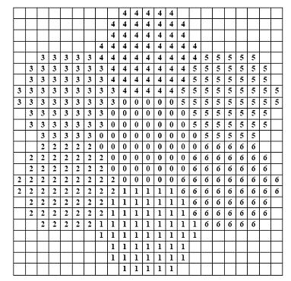

Locating Hexagonal Pixels
Derive the way to locate the pixels
Base Case: Addresses 0 to 6.
  L(1) = [8 0], L(2) = [4 -7]
  L(3) = [-4 -7], L(4) = [-8 0]
  L(5) = [-4 7], L(6) = [4 7]

Slide 9
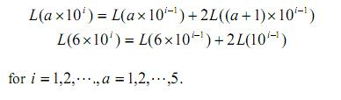


Locating Hexagonal Pixels
Recursive Case for Addresses of Powers of 10:
Recursive Case for a General Address:
Implemented as a MATLAB Function spl_shift

Slide 10

Simulation of Spiral Architecture
Collection of seven hexagonal pixels.
The distance from pixel 0 to pixel 2, pixel 3, pixel 5 or pixel 6 is .

Slide 11

MATLAB Simulation of Spiral Architecture
MATLAB functions sprl2rect is used to simulate a hexagonal image represented in spiral architecture.

Slide 12
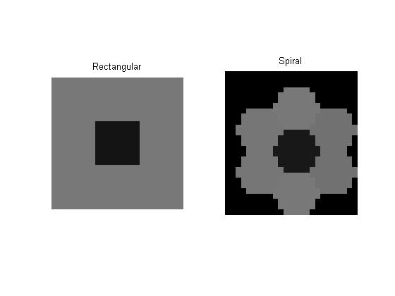
MATLAB Simulation of Spiral Architecture
The MATLAB script rect2spr gives a simple conversion of an image from rectangular architecture to spiral architecture

Slide 13
References
Xiangjian He, Wenjing Jia, Qiang Wu, Namho Hur, Tom Hintz, Huaqing Wang and Jinwoong Kim, ” Basic Transformations on Virtual Hexagonal Structure”, Proceedings of the international conference on Computer Graphics, Imaging and Visualization, 2006.
Wang, H., Wang, M., Hintz, T., He, X. and Wu,” Fractal Image Compression on a Pseudo Spiral Architecture”, In Proc. ACSC2005.
H. Wang, M. Wang, T. Hintz, et al., “VSA-based Fractal Image Compression, Journal of WSCG”, 2005.
Xiangjian He, Tom Hintz, Qiang Wu, Huaqing Wang and Wenjing Jia, “A New Simulation of Spiral Architecture”
P. Sheridan, T. Hintz, and D. Alexander, "Pseudo-invariant Image Transformations on a Hexagonal Lattice," Image and Vision Computing, 2000.

