Slide 1
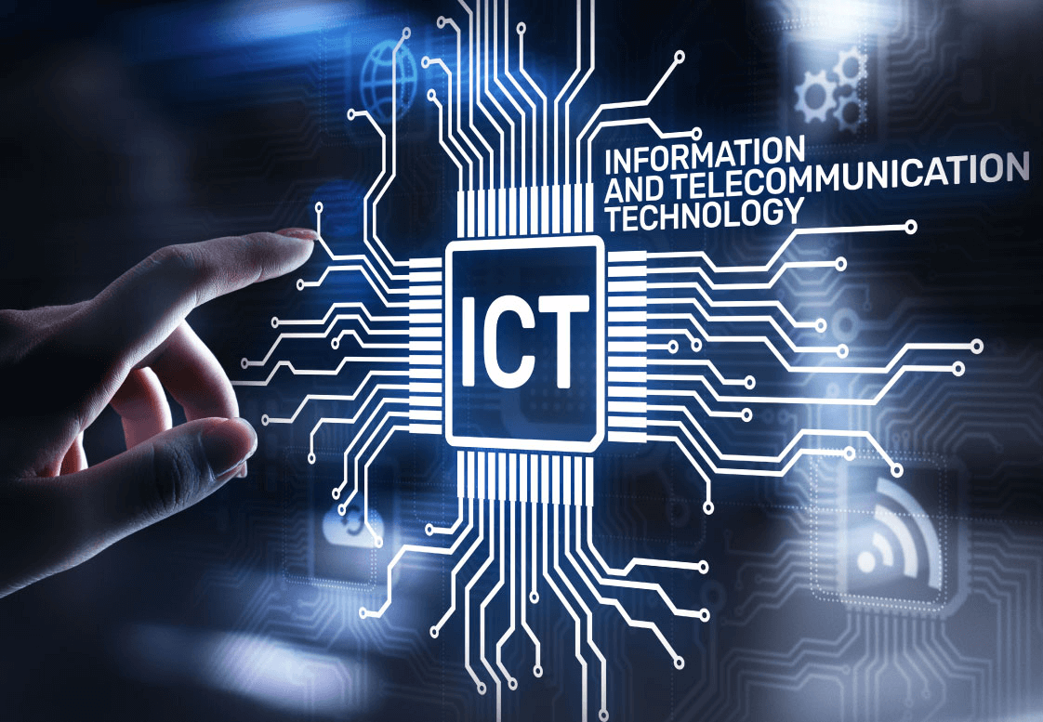

The Role of Information and Communication Technologies in Modern Society
Presented by:-
Syed Badar Ali Naqvi 24K-3079

Slide 2
Components of ICT
Impact of ICT on Society
ICT in Business and Education
Challenges in ICT
Future Trends
Introduction
Conclusion

Slide 3
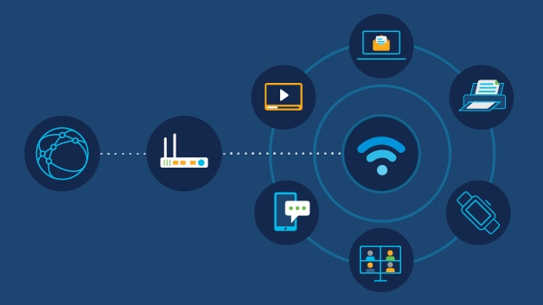
Introduction to ICT
“ICT refers to technologies that provide access to information through telecommunications, including the internet, wireless networks, cell phones, computers, software, and other media.”

Slide 4
Components of ICT:-
Hardware: Computers, mobile devices, servers.
Telecommunication Networks: The internet, broadband, 4G/5G networks.
Software: Operating systems, applications.
Data Management Systems: Cloud computing, databases

Slide 5
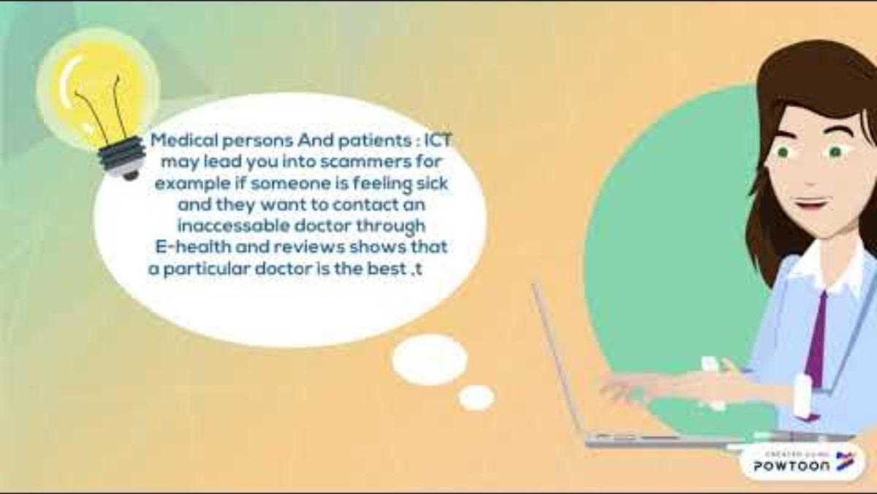
Impact of ICT on Society
The positive and negative effects of ICT:
A short video clip
the influence of
ICT on everyday life:-
Positive | Negative
Global communication | Digital divide
Increased access to information | Privacy concerns
Improved healthcare | Cybersecurity threats

Slide 6
ICT in Business
How businesses leverage ICT for:
E-commerce: Online shopping, payment systems.
Data Analysis: Big Data, AI, decision-making.
Communication: Emails, video conferencing, VoIP.

Slide 7
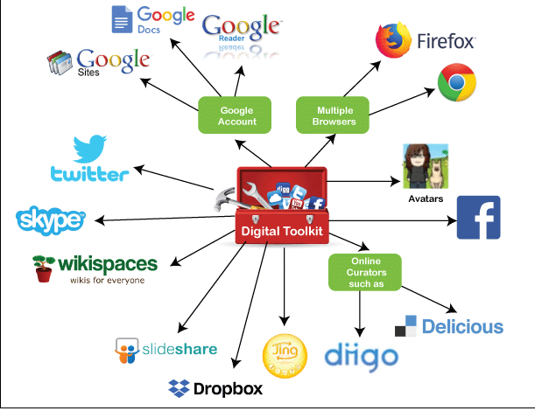
ICT in Education
Online Learning: E-learning platforms (Coursera, Udemy).
Digital Classrooms: Smartboards, virtual reality, interactive applications.
Collaboration Tools: Google Classroom, Zoom, MS Teams.

Slide 8
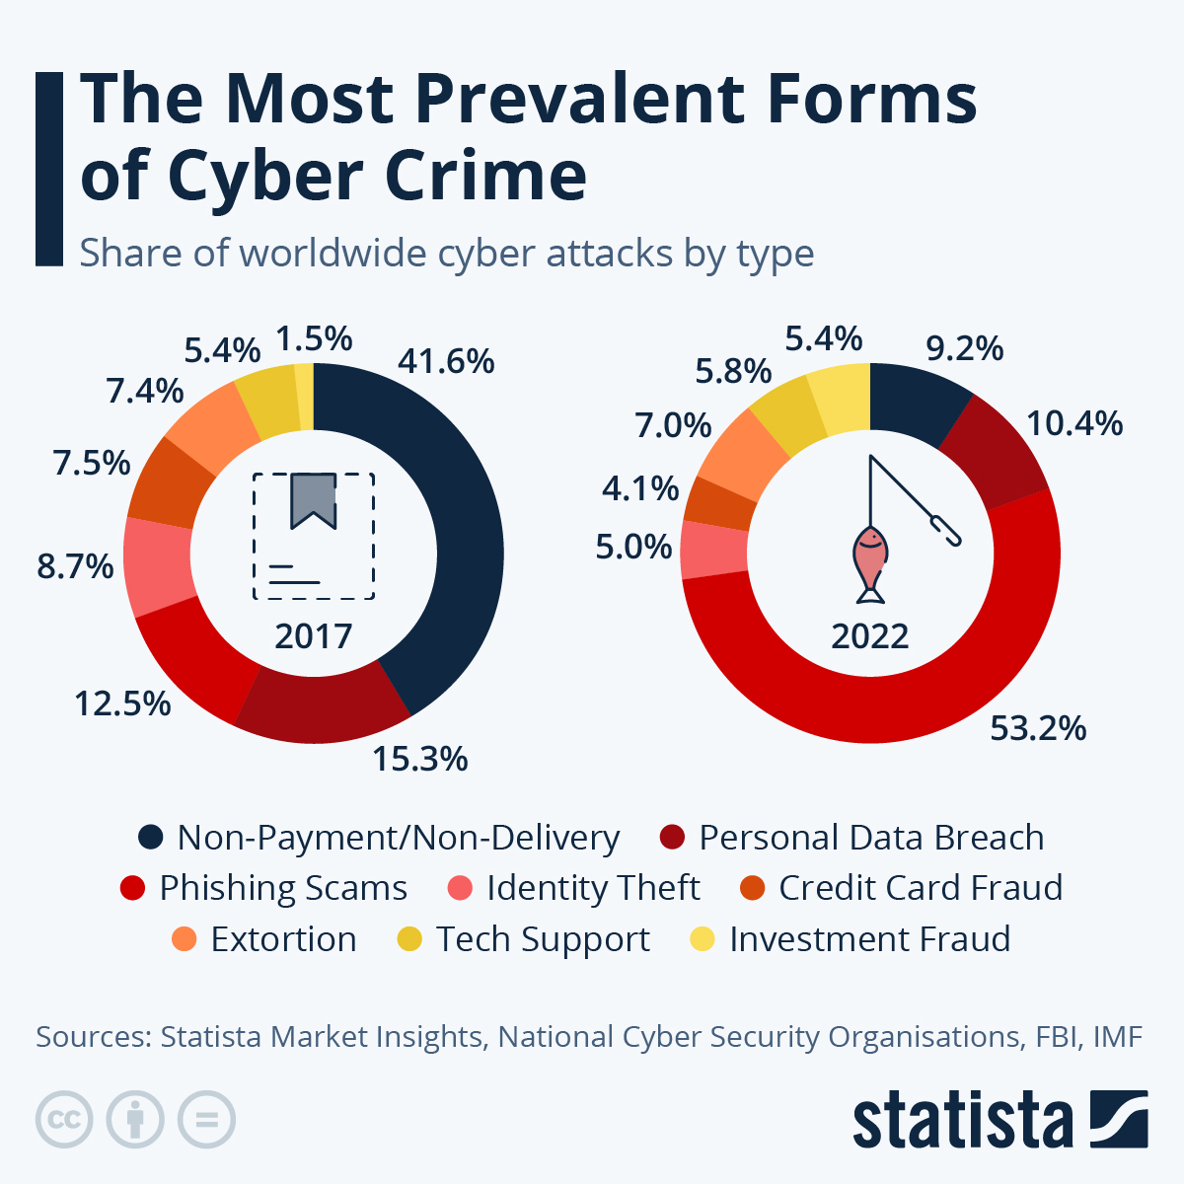
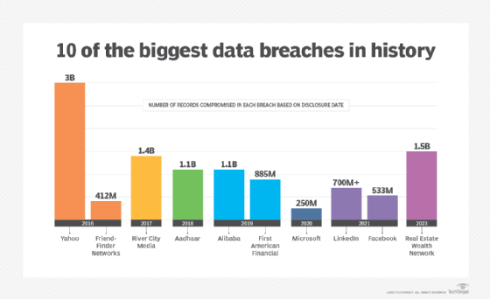
Challenges of ICT
Cybersecurity Threats: Hacking, phishing, data breaches.
Digital Divide: Inequality in access to technology.
Privacy Concerns: Data surveillance, tracking.

Slide 9
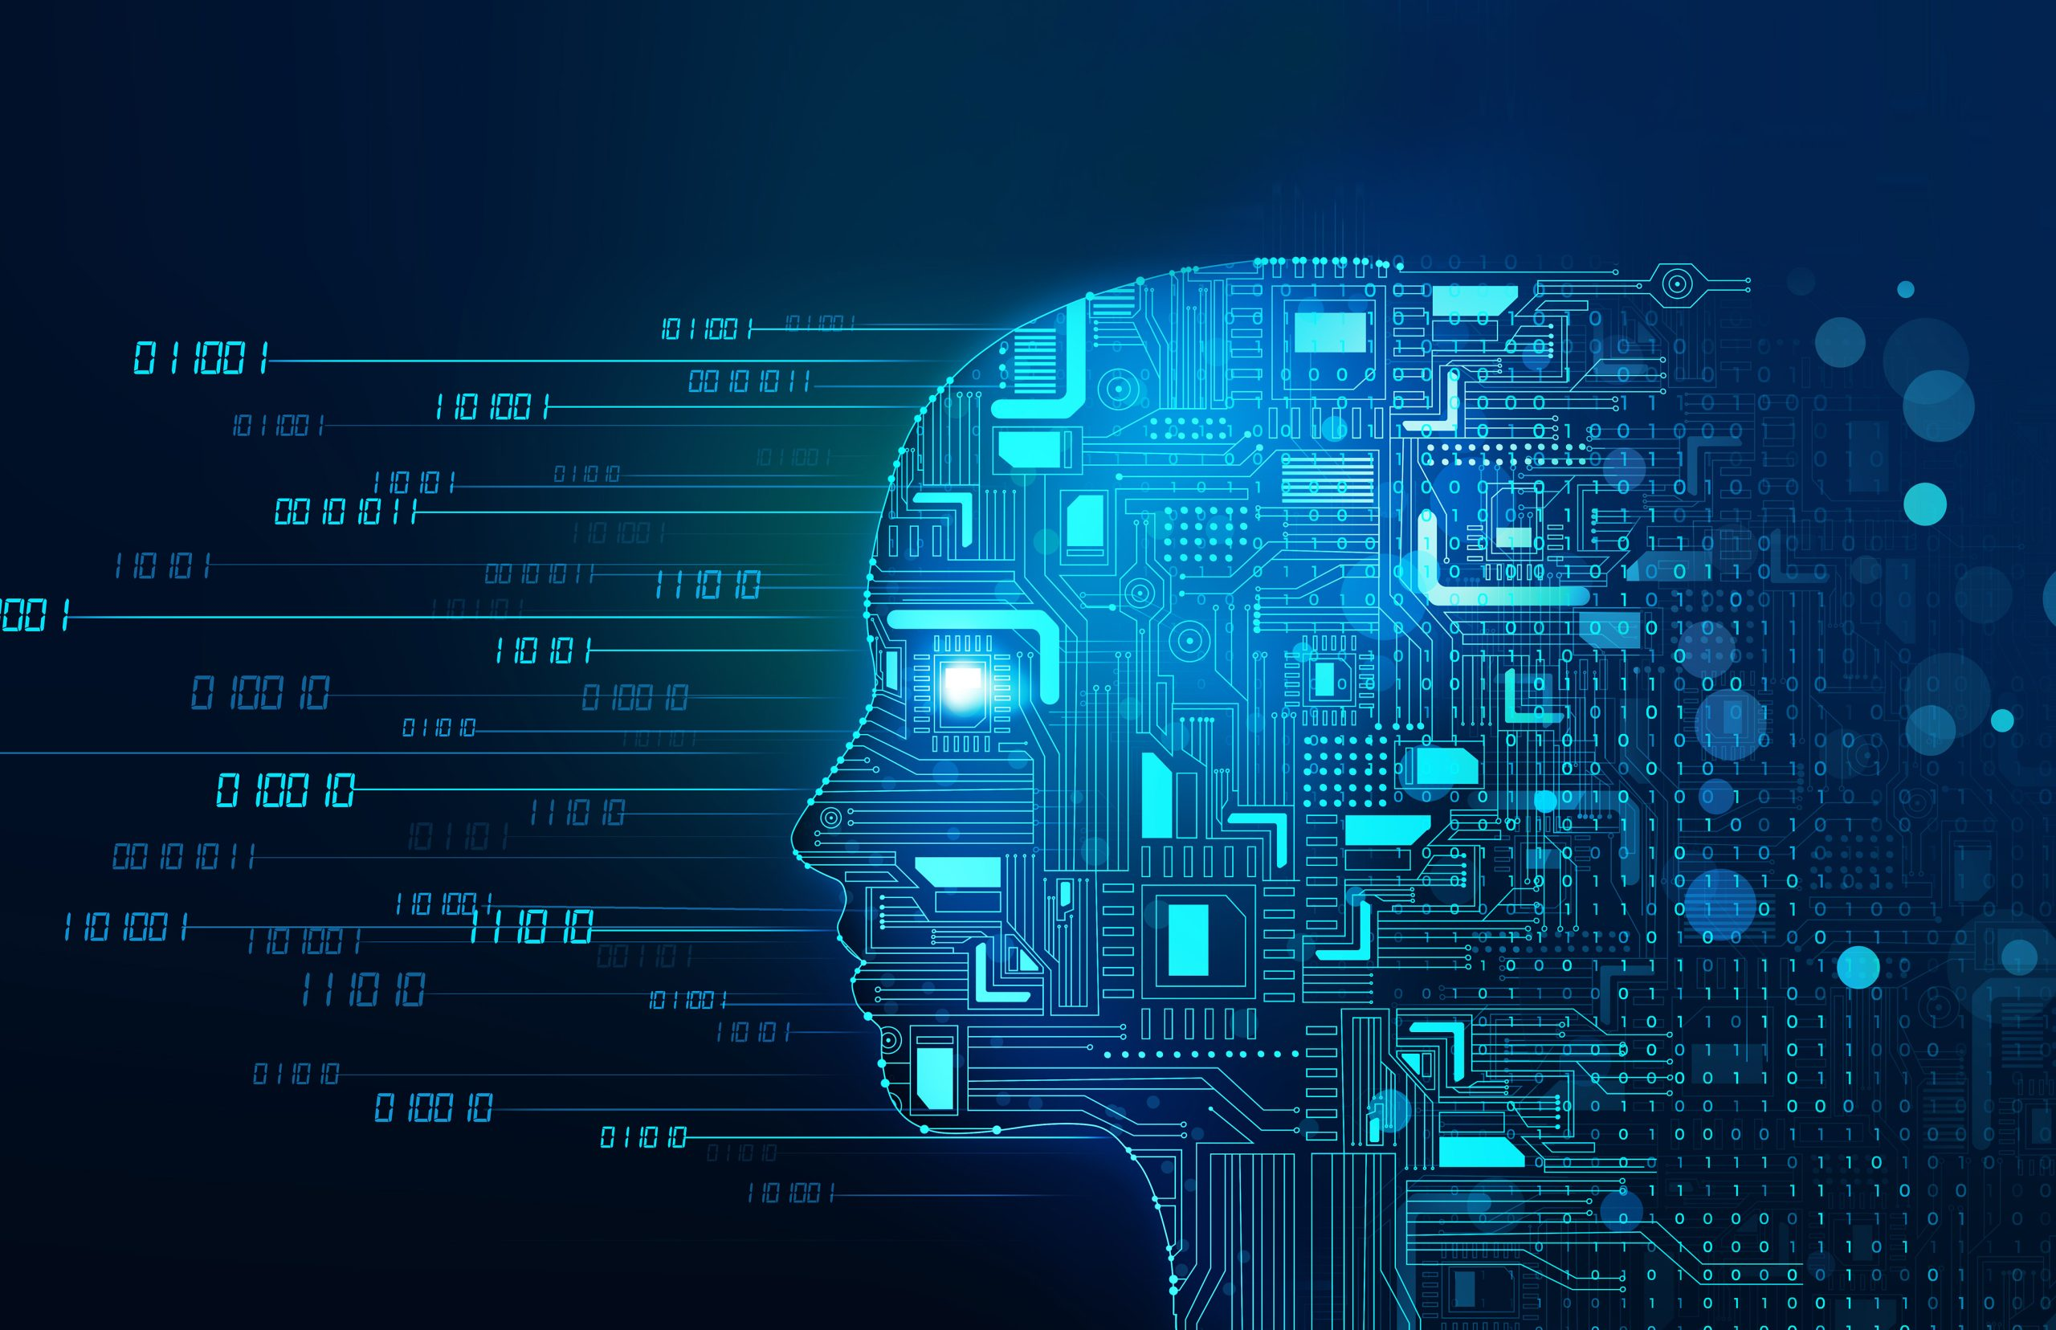
Future Trends in ICT
AI and Machine Learning: Automating decision-making processes.
5G Networks: Faster internet and connectivity.
Quantum Computing: Revolutionizing data processing speeds.
Internet of Things (IoT): Smart homes, wearable technology.

Slide 10

Conclusion
ICT has transformed communication, business, and education.
Challenges exist, but future innovations will further integrate ICT into daily life.

