Slide 1
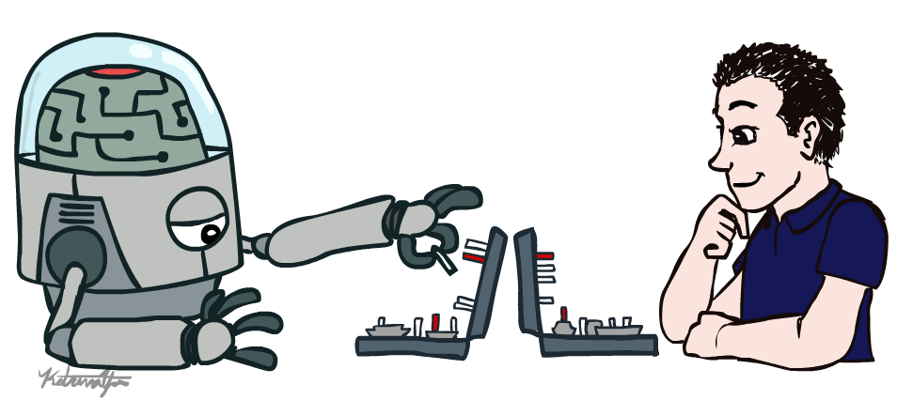
Artificial Intelligence Introduction

Slide 2
Course Overview
Artificial intelligence is an extremely broad field with applications to many disciplines and many subfields.
This course gives a broad survey of artificial intelligence, as opposed to focusing on any particular subfield of AI.
The course will cover methods from search, optimization, knowledge representation, reasoning, planning, uncertainty and learning, among other topics.

Slide 3
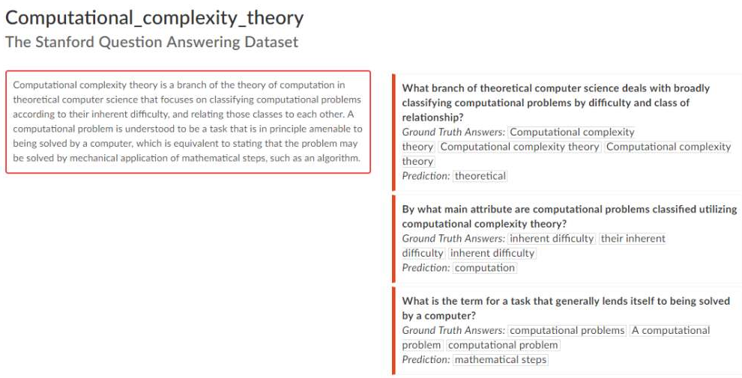
Some recent developments
http://www.iflscience.com/technology/robots-are-now-beating-us-at-reading-comprehension-tests-too/

Slide 4


Slide 5
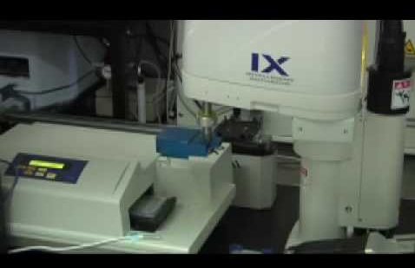
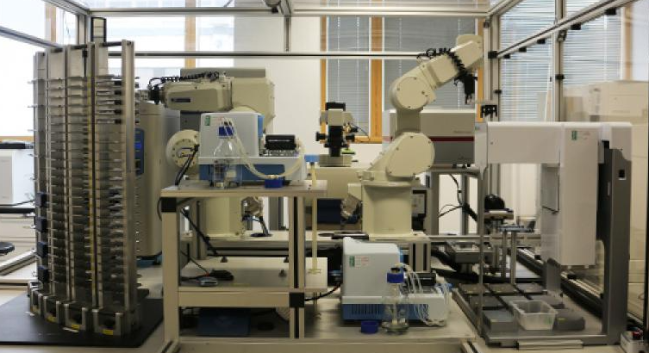
Robot scientists ‘Adam’ and ‘Eve’

Slide 6
Since Eve was created specifically to automate the early stages of drug design, she's capable of scanning over 10,000 compounds a day
Bringing in machine learning to make this process intelligent -- rather than just a 'brute force' approach
Eve exploits its artificial intelligence to learn from early successes in her screens and select compounds that have a high probability of being active against the chosen drug target

Slide 7
"Eve's science mission is focused on tropical and orphan diseases, which kill millions and infect millions more each year.
You start at the beginning of your [compound] library and continue until the end, then stop. So it’s not a very intelligent process. The robotics doesn’t learn anything as it goes along, even if it’s tested a million compounds, it still doesn’t have any expectation of what will happen next when it tests a new compound.
The robot learns as it tests, King explained, “so that it can then [eliminate] the compounds which are unlikely to be good and only test the compounds which it has a high probability of being good.”

Slide 8
ChapGPT
OpenAI AI beats top 'Dota 2' players in one-on-one matches
Carnegie Mellon University's Libratus AI system was up by US$1.7 million, with every one of the four professionals having lost thousands of fictional dollars after nearly a month of full-time gameplay
In May of 2017, AlphaGo "Master" took on Ke Jie, the world's highest ranked Go player. Over three games the machine comprehensively dominated the world champion

Slide 9
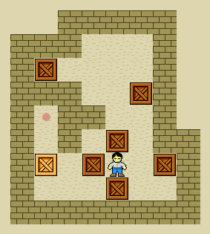

Slide 10
https://cdn.vox-cdn.com/thumbor/bVHIabBFbxi9TZCZbir9wfJjz7Q=/0x0:652x316/620x413/filters:focal(274x106:378x210):gifv():no_upscale()/cdn.vox-cdn.com/uploads/chorus_image/image/58191589/adversarial_patch_.0.gif

Slide 11
https://www.engadget.com/2018/01/23/photo-stitch-ai-fail-the-big-picture/

Slide 12
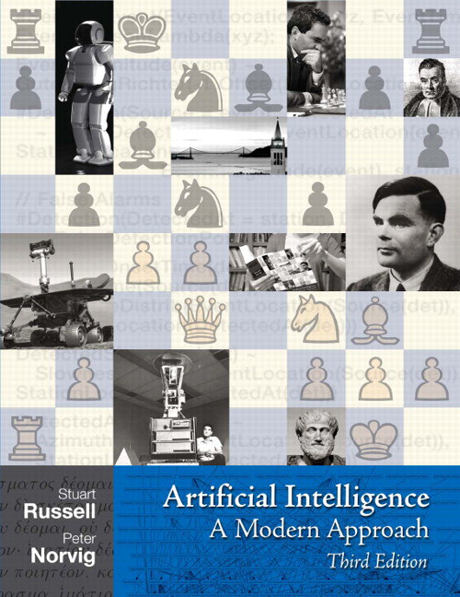
Textbook

Slide 13
What is Artificial Intelligence?
Scientific Goal
To determine which ideas about knowledge representation, learning, rule systems, search, and so on, explain various sorts of real intelligence
Engineering Goal
To solve real world problems using AI techniques such as knowledge representation, learning, rule systems, search, and so on
Notes:
Traditionally, computer scientists and engineers have been more interested in the engineering goal
Psychologists, philosophers and cognitive scientists have been more interested in the scientific goal
It makes good sense to be interested in both, as there are common techniques and the two approaches can feed off each other

Slide 14
AI problems
Formal tasks - playing board or card games, solving puzzles, mathematical and logic problems
Expert tasks - medical diagnosis, engineering, scheduling, computer hardware design
Mundane tasks - everyday speech, written language, perception, walking, handling

Slide 15
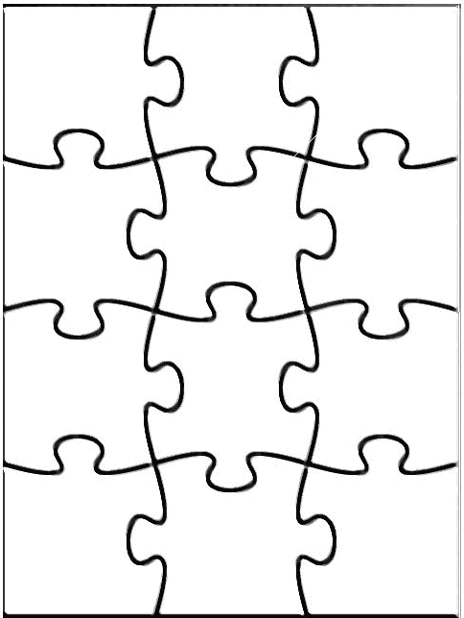
Main Areas of AI
Agents
Search
Knowledge
Reasoning
Planning
Uncertainty
Learning
Natural Language
Processing
Vision
Robotics

Slide 16
Introduction
(AIMA: Chap. 1)

Slide 17
AI attempts not just to understand but also to build intelligent entities.
Work started in earnest soon after World War II, and the name itself was coined in 1956.

Slide 18
What is AI?
AI is the science and engineering of making intelligent machines which can perform tasks that require intelligence when performed by humans. [John McCarthy, 1955]
AI is an attempt of mimicking (imitating) human reasoning and behavior (actions) by computational methods.
Behavior
Computer
Reasoning

Slide 19
What is Artificial Intelligence?
“Artificial Intelligence (AI) is the part of CS concerned with designing intelligent computer systems, that is, systems that exhibit characteristics we associate with intelligence in human behaviour – understanding language, learning, reasoning, solving problems, and so on.” (Barr & Feigenbaum, 1981)
“The study of the computations that make it possible to perceive, reason, and act” (Winston, 1992)
“The branch of computer science that is concerned with the automation of intelligent behaviour” (Luger and Stubblefield, 1993)

Slide 20
Thought processes
Reasoning
Behavior
Thinking like a human vs thinking rationally

Slide 21
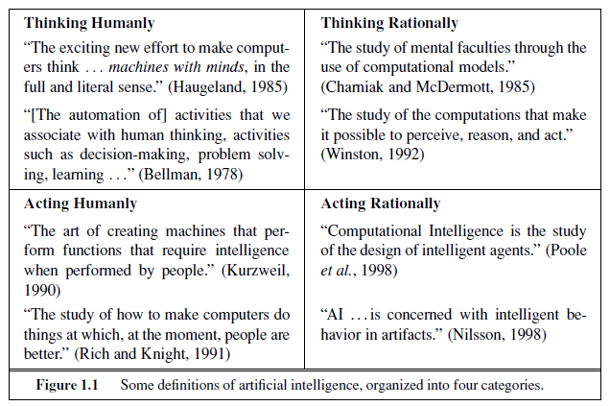
What is AI? (R&N)
There are four main views of AI:

Slide 22
Think/act like humans/animals - Better understanding of human/animal intelligence. Emulate and model human/animal behaviour.
Think/act rationally - Develop inspired techniques which lead to smarter programs and machines. Optimise performance.

Slide 23
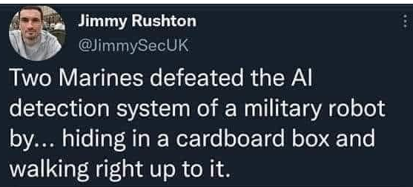
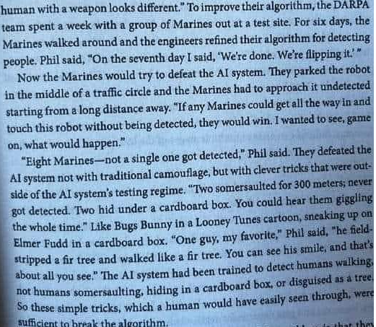

Slide 24
Thinking Humanly
Here, the goal of AI is trying to understand and model how the human mind works.
There are three ways to do this:
through introspection—trying to catch our own thoughts as they go by;
through psychological experiments—observing a person in action;
through brain imaging—observing the brain in action.
“In the early days of AI there was often confusion between the approaches: an author would argue that an algorithm performs well on a task and that it is therefore a good model of human performance, or vice versa.” What does vice versa mean here?

Slide 25
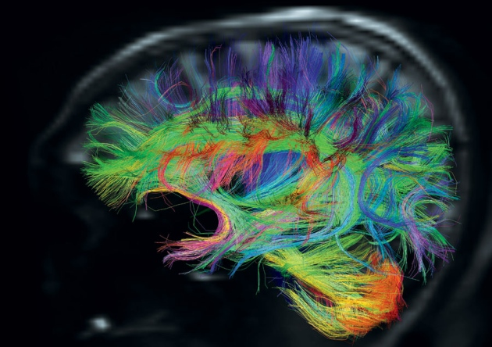
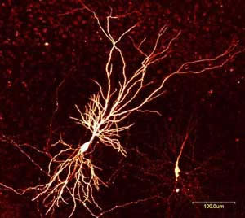
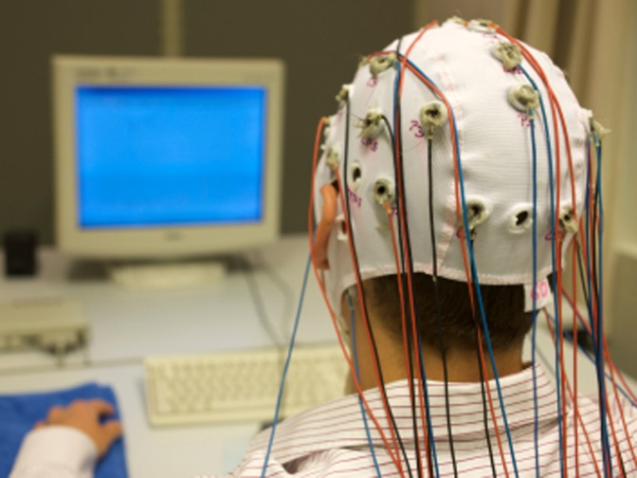
Thinking Humanly
The interdisciplinary field of cognitive science brings together computer models from AI and experimental techniques from psychology to construct precise and testable theories of the human mind.
need to study the brain as an information processing machine
Real cognitive science, however, is necessarily based on experimental investigation of actual humans or animals.

Slide 26
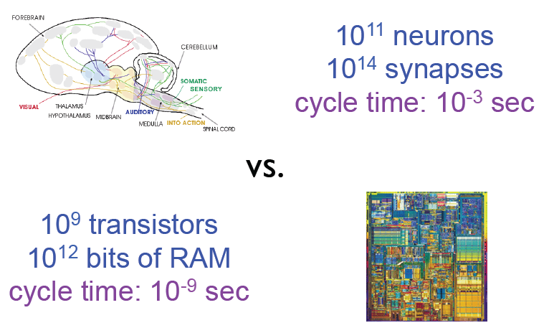
Thinking Humanly
Can we build a brain?
Source: L. Zettlemoyer

Slide 27
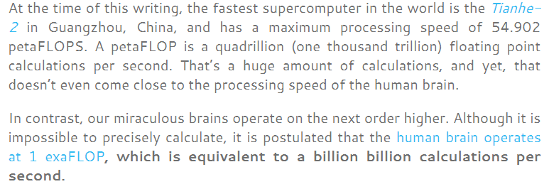

Slide 28
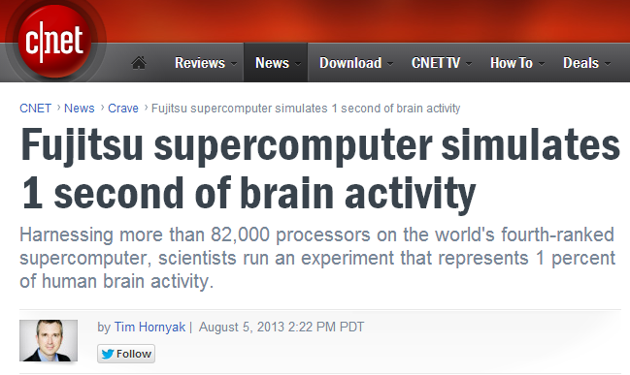
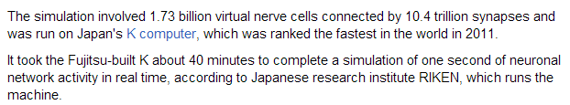
Thinking humanly
Can we build a brain?
http://www.cnet.com/news/fujitsu-supercomputer-simulates-1-second-of-brain-activity/

Slide 29
Acting Humanly
Here, the goal of AI is to create computer systems that perform tasks regarded as requiring intelligence when done by humans
→ AI Methodology: Take a task at which people are better, e.g.:
- Prove a theorem - Play chess
- Plan a surgical operation - Diagnose a disease
- Navigate in a building
and build a computer system that does it automatically

Slide 30
Acting Humanly: Turing Test
The most famous response is attributed to Alan Turing, a British mathematician and computing pioneer. The famous “Turing Test” was named after him, based on ideas he expressed in a paper published in 1950.
Human interrogates entity via teletype for 5 minutes. If, after 5 minutes, human cannot tell whether entity is human or machine, then the entity must be counted as intelligent.
To date, no program has yet passed the Turing Test! However, there is the annual Loebner Prize which awards scientists for getting close.
[See http://www.loebner.net/Prizef/loebner-prize.html for more information.]

Slide 31
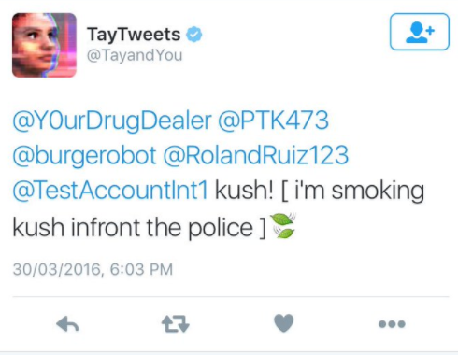

Slide 32
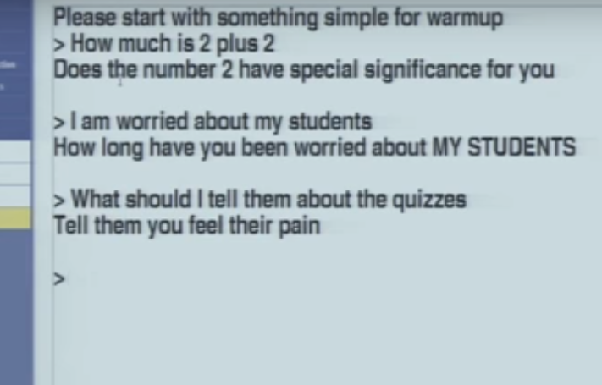

Slide 33
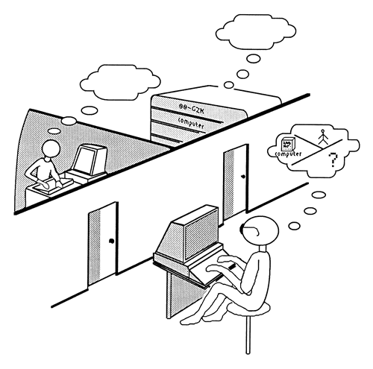
Acting Humanly: Turing Test
In order to pass the Turing Test, a program that succeeded would need to be capable of:
speech recognition;
natural language understanding and generation;
speech synthesis;
knowledge representation;
learning;
automated reasoning; use the stored information to answer questions and to draw new conclusions
to adapt to new circumstances and to detect and extrapolate patterns.
[Note that the basic Turing Test does not specify an audio or visual component.]

Slide 34
TOTAL TURING TEST
Computer vision: to perceive objects, and
ROBOTICS: robotics to manipulate objects and move about.

Slide 35
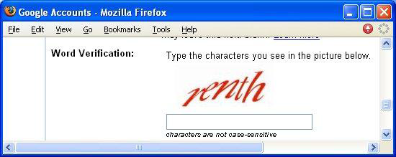
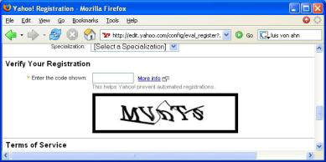
An Application of the Turing Test
CAPTCHA: Completely Automatic Public Turing tests to tell Computers and Humans Apart
e.g.:
display visually distorted words
ask user to recognize these words
have only humans open email accounts
Yahoo
Google

Slide 36
Acting Humanly: Searle’s Chinese Room
Another famous test is called the “Chinese Room” which was proposed by John Searle in a paper published in 1980.
Suppose you have a computer in a room that reads Chinese characters as input, follows a program and outputs (other) Chinese characters. Suppose this computer does this so well that it passes the Turing Test (convinces a human Chinese speaker that it is talking to another human Chinese speaker). Does the computer understand Chinese?

Slide 37
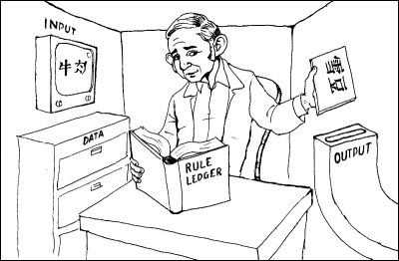
Acting Humanly: Searle’s Chinese Room
Suppose Searle is in the room, and he uses a dictionary to translate the input characters from Chinese to English; he then constructs his answer to the question, translates that back into Chinese and delivers the output—does Searle understand Chinese?
Of course not.
This is Searle’s argument: the computer doesn’t understand it either, because all it is doing is translating words (symbols) from one language (representation) to another.
image from http://www.unc.edu/~prinz/pictures/c-room.gif

Slide 38

Turing Test (1950)
AI researchers have devoted little effort to passing the Turing test
Believe that studying principles of intelligence is more important than duplicating something else
Precedent? The quest for artificial flight
Succeeded when people stopped imitating birds and learned aerodynamics
Aeronautical engineering does not define its goal as making “machines that fly so exactly like pigeons that they can fool even other pigeons”

Slide 39
Thinking Rationally
Trying to understand how we actually think is one route to AI.
But another approach is to model how we should think.
The “thinking rationally” approach to AI uses symbolic logic to capture the laws of rational thought as symbols that can be manipulated.
Reasoning involves manipulating the symbols according to well-defined rules, kind of like algebra.
The result is an idealized model of human reasoning. This approach is attractive to theoretists, i.e., modeling how humans should think and reason in an ideal world.

Slide 40
Thinking rationally
The “laws of thought” approach
Aristotle was one of the first to attempt to codify “right thinking"
"Syllogisms" provided patterns for argument structures
“Socrates is a man; all men are mortal; therefore, Socrates is mortal.”
Logic

Slide 41
Acting Rationally
Acting rationally means acting to achieve one’s goals, given one’s beliefs or understanding about the world.
An agent is a system that perceives an environment and acts within that environment.
An intelligent agent is one that acts rationally with respect to its goals.
For example, an agent that is designed to play a game should make moves that increase its chances of winning the game.
A rational agent is one that acts so as to achieve the best outcome or, when there is uncertainty, the best expected outcome.

Slide 42
Acting Rationally
When constructing an intelligent agent, emphasis shifts from designing the theoretically best decision-making procedure to designing the best decision-making procedure possible within the circumstances in which the agent is acting.
Logical approaches may be used to help find the best action, but there are also other approaches.
Achieving so-called “perfect rationality”, making the best decision theoretically possible, is not usually possible due to limited resources in a real environment (e.g., time, memory, computational power, uncertainty, etc.).

Slide 43
Acting Rationally
The trick is to do the best with the information and resources you have. This represents a shift in the field of AI from optimizing (early AI or Strong AI) to satisfying (more recent AI or Weak AI).
Strong AI: Machine can actually think intelligently
Weak AI: Machine can possibly act intelligently

Slide 44
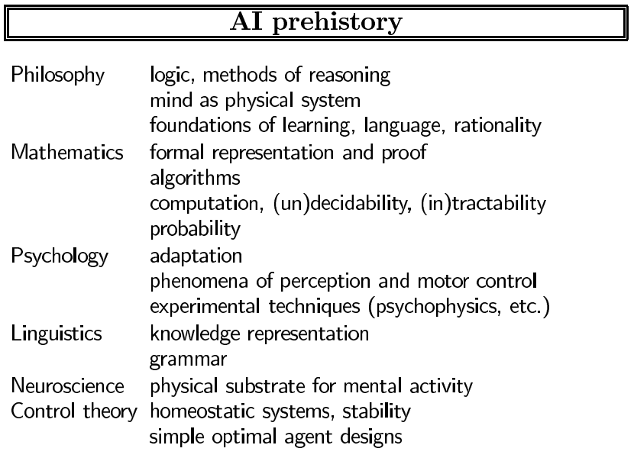

Slide 45
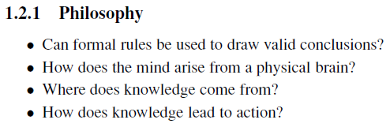

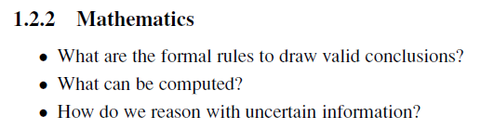


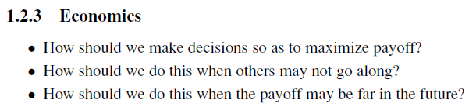



Slide 46
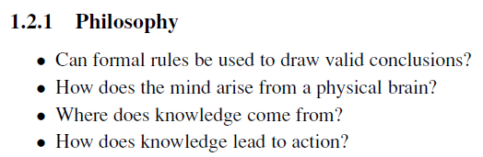
Philosophy

Slide 47
Aristotle (384–322 B.C.),syllogisms, allowed one to generate conclusions mechanically, given initial premises.
Ramon Lull (d. 1315) had the idea that useful reasoning could actually be carried out by a mechanical artifact.
Thomas Hobbes (1588–1679) proposed that reasoning was like numerical computation, that “we add and subtract in our silent thoughts.”
Thomas Hobbes suggested the idea of an “artificial animal,” arguing “For what is the heart but a spring; and the nerves, but so many strings; and the joints, but so many wheels.”
Frankenstein monster?

Slide 48
Blaise Pascal (1623–1662), wrote that “the arithmetical machine produces effects which appear nearer to thought than all the actions of animals.”
Gottfried Wilhelm Leibniz (1646–1716) Leibniz did surpass Pascal by building a calculator that could add, subtract, multiply, and take roots.
Rene Descartes (1596–1650) gave the first clear discussion of the distinction between mind and matter and of the problems that arise.
If the mind is governed entirely by physical laws, then it has no more free will than a rock “deciding” to fall toward the center of the earth.

Slide 49
Power of reasoning in understanding RATIONALISM the world, a philosophy now called rationalism.
Part of the human mind (or soul or spirit) that is outside of nature, exempt from physical laws. Animals, on the other hand, did not possess this dual quality; they could be treated as machines.
Materialism, holds that the brain’s operation according to the laws of physics constitutes the mind. Free will is simply the way that the perception of available choices appears to the choosing entity.
Empiricism: “Nothing is in the understanding, which was not first in the senses.”

Slide 50
Induction: that general rules are acquired by exposure to repeated associations between their elements.
Logical positivism combines rationalism and empiricism; all knowledge can be characterized by logical theories connected, ultimately, to observation sentences that correspond to sensory inputs.
Confirmation theory attempted to analyze the acquisition of knowledge from experience.
Attempted to analyze the acquisition of knowledge from experience. Defined an explicit computational procedure for extracting knowledge from elementary experiences. First theory of mind as a computational process.

Slide 51
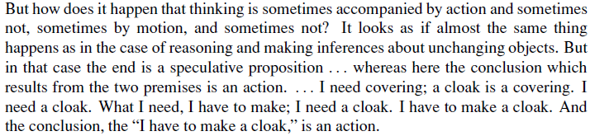
Understanding how actions are justified can we understand how to build an agent whose actions are justifiable (or rational); actions are justified by a logical connection between goals and knowledge of the action’s outcome.
Goal-based analysis is useful, but does not say what to do when several actions will achieve the goal or when no action will achieve it completely.

Slide 52
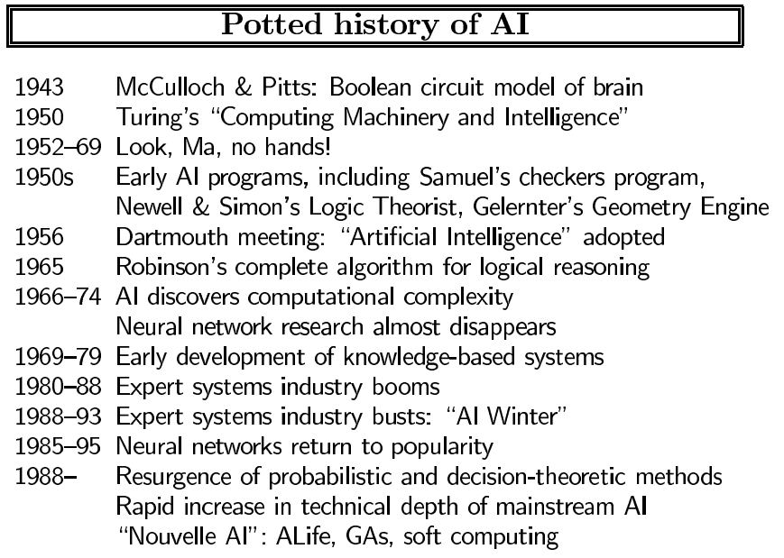

Slide 53
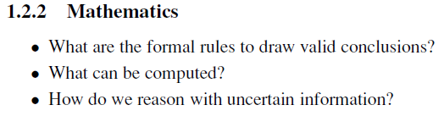
Mathematics

Slide 54
Mathematics
George Boole (1815–1864): ?
Gottlob Frege (1848–1925) extended Boole’s logic to include objects and relations.
Alfred Tarski (1902–1983) introduced a theory of reference that shows how to relate the objects in a logic to objects in the real world.
The word algorithm (and the idea of studying them) comes from al-Khowarazmi, a Persian mathematician of the 9th century.
Alan Turing (1912–1954) tried to characterize exactly which functions are computable—capable of being computed.

Slide 55
Tractability a problem is called intractable if the time required to solve instances of the problem grows exponentially with the size of the instances.
Therefore, one should strive to divide the overall problem of generating intelligent behavior into tractable sub-problems rather than intractable ones.
Gerolamo Cardano (1501–1576) first framed the idea of probability, describing it in terms of the possible outcomes of gambling events.
Blaise Pascal (1623–1662), in a letter to Pierre Fermat (1601–1665), showed how to predict the future of an unfinished gambling game and assign average payoffs to the gamblers.

Slide 56
Probability is an invaluable part of all the quantitative sciences, helping to deal with uncertain measurements and incomplete theories.
Thomas Bayes (1702–1761), proposed a rule for updating probabilities in the light of new evidence. Bayes’ rule underlies most modern approaches to uncertain reasoning in AI systems.

Slide 57
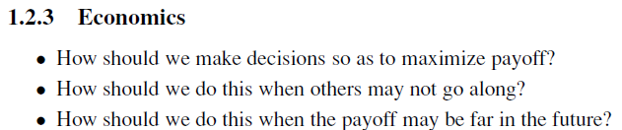
Economics

Slide 58
Economics
Adam Smith (1723–1790) idea that economies can be thought of as consisting of individual agents maximizing their own economic well-being.
Most people think of economics as being about money, but economists will say that they are really studying how people make choices that lead to preferred outcomes.
E.g. When McDonald’s offers a hamburger for a dollar, they are asserting that they would prefer the dollar and hoping that customers will prefer the hamburger.

Slide 59
“Preferred outcomes” or utility.
Decision theory, provides a formal and complete framework for decisions (economic or otherwise) made under uncertainty.
Suitable for “large” economies where each agent need pay no attention to the actions of other agents as individuals.
For “small” economies, the situation is much more like a game: the actions of one player can significantly affect the utility of another (either positively or negatively).
GAME THEORY included the surprising result that, for some games, a rational agent should adopt policies that are (or least appear to be) randomized.

Slide 60
Operations research: Payoffs from actions are not immediate but instead result from several actions taken in sequence.
The work of Richard Bellman (1957) formalized a class of sequential decision problems called Markov decision processes.
Herbert Simon (1916–2001): Satisficing—making decisions that are “good enough,” rather than laboriously calculating an optimal decision.

Slide 61
Neuroscience
How do brains process information?
Still, it was not until the middle of the 18th century that the brain was widely recognized as the seat of consciousness. Before then, candidate locations included the heart and the spleen.
John Searle (1992), brains cause minds.

Slide 62
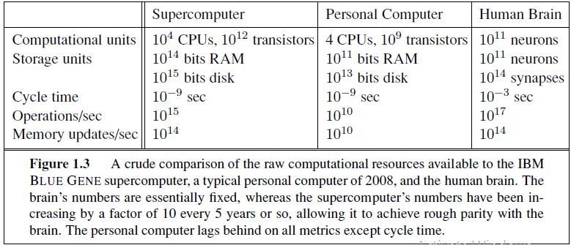
Singularity at which computers reach a superhuman level of performance.

Slide 63
Psychology
How do humans and animals think and act?
In 1879, Wundt opened the first laboratory of experimental psychology.
Wundt insisted on carefully controlled experiments in which his workers would perform a perceptual or associative task while introspecting on their thought processes.
The careful controls went a long way toward making psychology a science, but the subjective nature of the data made it unlikely that an experimenter would ever disconfirm his or her own theories.
Studying of animal behavior, on the other hand, lacked introspective data and developed an objective methodology.

Slide 64
Behaviorism: introspection could not provide reliable evidence. Only objective measures of the percepts (or stimulus) given to an animal and its resulting actions (or response).
Cognitive psychology: Brain as an information-processing device.
Kenneth Craik specified the three key steps of a knowledge-based agent:
(1) the stimulus must be translated into an internal representation,
(2) the representation is manipulated by cognitive processes to derive new internal representations, and
(3) these are in turn retranslated back into action.

Slide 65
Computer Engineering
How can we build an efficient computer?
The first operational computer was the electromechanical Heath Robinson, built in 1940 by Alan Turing’s team for a single purpose: deciphering German messages.
The first operational computer was the electromechanical Heath Robinson, built in 1940 by Alan Turing’s team for a single purpose: deciphering German messages.
The first operational programmable computer was the Z-3, the invention of Konrad Zuse in Germany in 1941.

Slide 66
Control theory and cybernetics
How can artifacts operate under their own control?
Ktesibios of Alexandria (c. 250 B.C.) built the first self-controlling machine: a water clock with a regulator that maintained a constant flow rate. This invention changed the definition of what an artifact could do.
Control theory: purposive behavior as arising from a regulatory mechanism trying to minimize “error”—the difference between current state and goal state.
Homeostatic devices containing appropriate feedback loops to achieve stable adaptive behavior.

Slide 67
Stochastic optimal control, has as its goal the design of systems that maximize an objective function over time.

Slide 68
Linguistics
How does language relate to thought?
Computational linguistics or natural language processing.

Slide 69
History of AI
1.3.1 The gestation of artificial intelligence (1943–1955)
1.3.2 The birth of artificial intelligence (1956)
1.3.3 Early enthusiasm, great expectations (1952–1969)
1.3.4 A dose of reality (1966–1973)
1.3.5 Knowledge-based systems: The key to power? (1969–1979)
1.3.6 AI becomes an industry (1980–present)
1.3.7 The return of neural networks (1986–present)
1.3.8 AI adopts the scientific method (1987–present)
1.3.9 The emergence of intelligent agents (1995–present)
1.3.10 The availability of very large data sets (2001–present)

Slide 70
History of AI (1943–1955)
1943: Warren Mc Culloch and Walter Pitts: a model of artificial boolean neurons to perform computations
First steps toward connectionist computation and learning (Hebbian learning)
Marvin Minsky and Dean Edmonds (1951) constructed the first neural network computer
Made out of 3000 vacuum tubes and a surplus automatic pilot mechanism from a B-24 bomber
Simulated a network of 40 neurons
1950: Alan Turing’s Computing Machinery and Intelligence
First complete vision of AI
Anticipated all major arguments against AI in following 50 years
Notes:
Turing (1950) “Computing machinery and intelligence”:
♦ “Can machines think?” → “Can machines behave intelligently?”
♦ Operational test for intelligent behaviour: the Imitation Game
♦ Predicted that by 2000, a machine might have a 30% chance of
fooling a lay person for 5 minutes
♦ Anticipated all major arguments against AI in following 50 years

Slide 71
History of AI
1956: Dartmouth Workshop (Birth of AI)
John McCarthy, Minsky, Claude Shannon, and Nathaniel Rochester organized a two-month workshop at Dartmouth in the summer of 1956.
Brings together top minds on automata theory, neural nets and the study of intelligence
Allen Newell and Herbert Simon: the logic theorist (first non-numerical thinking program used for theorem proving)
Proved 38 of the first 52 theorems in Principia Mathematica, found more elegant proofs for some
For the next 20 years the field was dominated by these participants
1952-1969
Newell and Simon introduced the General Problem Solver: imitation of human problem-solving
Arthur Samuel investigated game playing (checkers) with great success
John McCarthy (inventor of Lisp)
Logic oriented, Advice Taker (separation between knowledge and reasoning)
Notes:
In 1955 Allen Newell and Herbert Simon created the "Logic Theorist" (with help from J. C. Shaw). The program would eventually prove 38 of the first 52 theorems in Russell and Whitehead's Principia Mathematica, and find new and more elegant proofs for some.
Arthur Samuel's checkers program eventually achieved sufficient skill to challenge a world champion.
1952-1969 cont…
Marvin Minsky
Introduction of microworlds that appear to require intelligence to solve: e.g. blocks-world
Anti-logic orientation, society of the mind

Slide 72
History of AI
The first generation of AI researchers made these predictions about their work:
1957, Simon and Newell: "within ten years a digital computer will be the world's chess champion" and "within ten years a digital computer will discover and prove an important new mathematical theorem."
1965, Simon: "machines will be capable, within twenty years, of doing any work a man can do."
1967, Marvin Minsky: "Within a generation ... the problem of creating 'artificial intelligence' will substantially be solved.“
Daniel Bobrow’s STUDENT program (1967) If the number of customers Tom gets is twice the square of 20 percent of the number of advertisements he runs, and the number of advertisements he runs is 45, what is the number of customers Tom gets?
1970, Marvin Minsky: "In from three to eight years we will have a machine with the general intelligence of an average human being.“
Expectations were high!

Slide 73
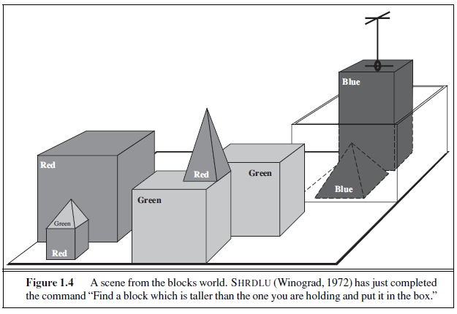

Slide 74
History of AI
Collapse in AI research: Dose of reality (1966 - 1973)
Progress was slower than expected
Unrealistic predictions
Some systems lacked scalability
Combinatorial explosion in search
Fundamental limitations on techniques and representations
Minsky and Papert (1969) book Perceptrons
Perceptrons (a simple form of neural network) learn anything they were capable of representing, they could represent very little.
Research funding for neural net research soon dwindled to almost nothing.

Slide 75
History of AI
AI revival through knowledge-based systems (1969-1970)
General-purpose vs. domain specific
E.g. the DENDRAL project (Buchanan et al. 1969) – first successful knowledge intensive system (large numbers of rules)
Expert systems
MYCIN to diagnose blood infections (Feigenbaum et al.) – introduction of uncertainty in reasoning
Increase in knowledge representation research
Logic, frames, semantic nets, …
AI winter (1974-1980)
Lighthill report highly critical of some areas
Notes:
Comments by Jim Howe (head of Edinburgh AI)
http://www.dai.ed.ac.uk/AI_at_Edinburgh_perspective.html
“By this time, the high level of discord had become known to the School's main sponsors, the Science Research Council.
Its reaction was to invite Sir James Lighthill to review the field. Although his report which was published early in 1973 supported AI research related to automation and to computer simulation of neurophysiological and psychological processes, it was highly critical of basic research in foundational areas such as robotics and language processing.
Lighthill's report provoked a loss of confidence in AI by the academic community in the UK which persisted for a decade - the so-called "AI Winter"."

Slide 76
History of AI
AI becomes an industry (1980 - present)
XCON at DEC (1980) – saved the company $40m p.a.
Fifth Generation Project in Japan (1981) – $850m to build machines that could make conversations, translate languages, interpret pictures, and reason like humans
Connectionist revival (1986 - present)
Parallel distributed processing (Rumelhart and McClelland,1986);
Backpropagation
Symbolic models vs connectionism
Notes:
The rise of expert systems
Eventually the earliest successful expert systems, such as XCON, proved too expensive to maintain. They were difficult to update, they could not learn.
By 1991, the impressive list of goals penned in 1981 for Japan's Fifth Generation Project had not been met. Indeed, some of them, like "carry on a casual conversation" had not been met by 2010

Slide 77
AI becomes a science (1987 - present)
Now more common to build on existing theories than to propose brand-new ones, to base claims on rigorous theorems or hard experimental evidence rather than on intuition.

Slide 78
History of AI
1990s
Emergence of intelligent agents: bots!
Machine learning
Genetic algorithms
hiddenMarkov models (HMMs)
DATA MINING
2000+ (Intelligent Agents)
Artificial General Intelligence
Dealing with large datasets
Swarm intelligence
...
Large field, lots of applications

Slide 79
The availability of very large data sets (2001–present)

Slide 80
Can Machines Think/Act Intelligently?
Yes, if intelligence is narrowly defined as information processing
AI has made impressive achievements showing that tasks initially assumed to require intelligence can be automated
But each success of AI seems to push further the limits of what we consider “intelligence”

Slide 81
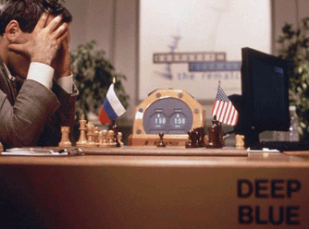
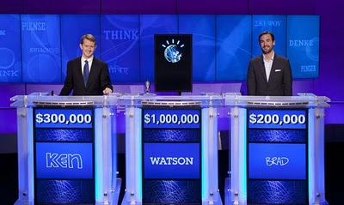
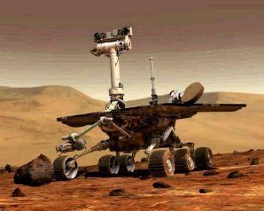

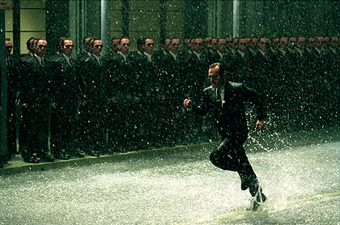
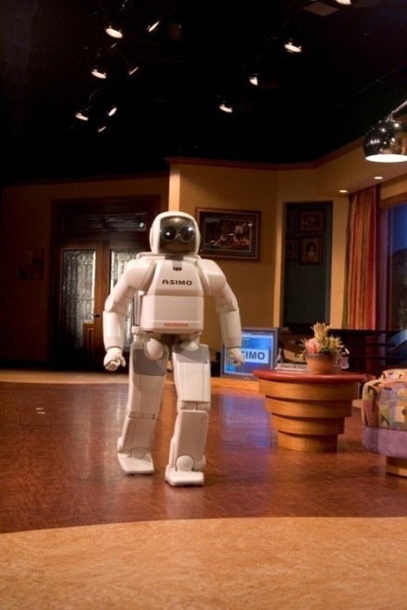
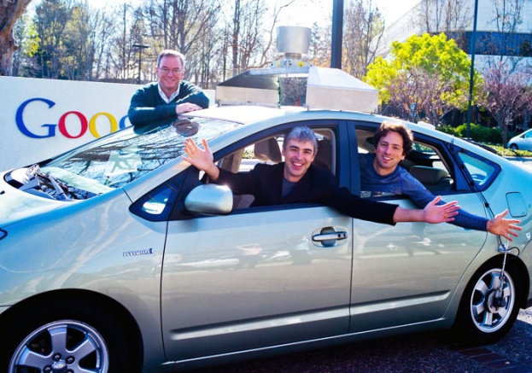
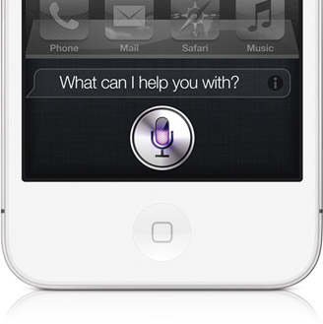
Some Achievements

Slide 82
Can Machines Think/Act Intelligently?
Yes, if intelligence is narrowly defined as information processing
AI has made impressive achievements showing that tasks initially assumed to require intelligence can be automated
Maybe yes, maybe not, if intelligence is not separated from the rest of “being human”

Slide 83
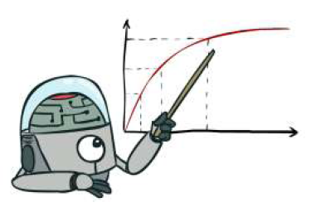
So, What is AI?
It is the science and engineering of making systems that act Rationally
Being rational means:
“maximizing your expected utility”

Slide 84
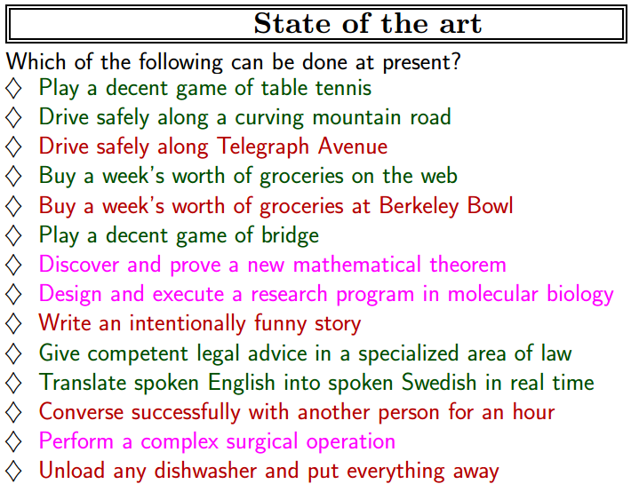

Slide 85
State of the Art
Deep learning
Microsoft and Google beat the best human at image recognition for the first time.
Baidu beat humans in recognizing two languages.
Microsoft and the China University of Technology and Science taught a computer network how to take an IQ test, and it scored better than a college postgraduate.

Slide 86
References and credits
Slides from Mr. Muhammad Kashif Khan
rkj@aber.ac.uk

