Slide 1
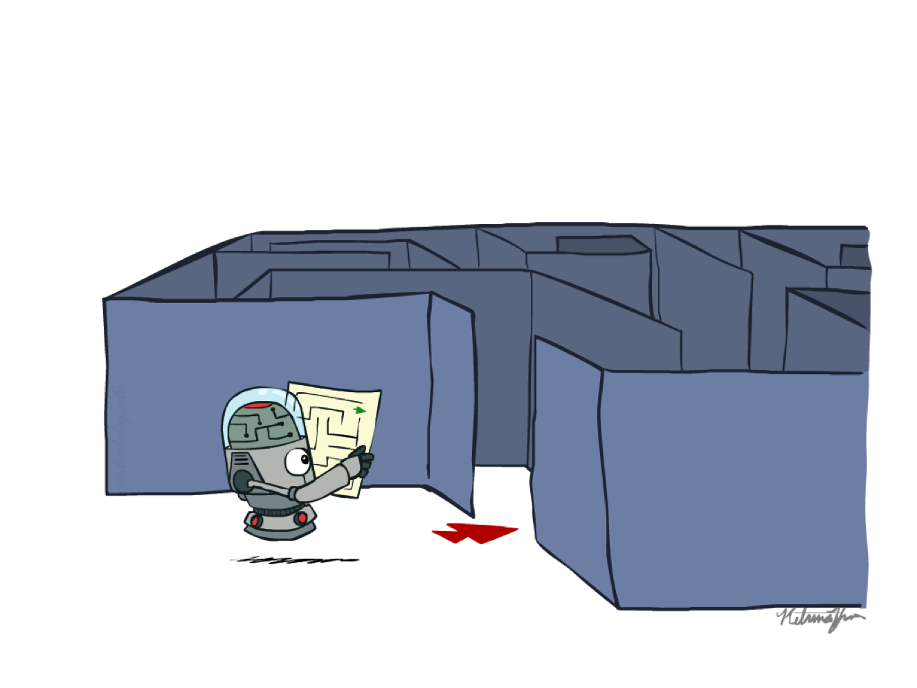
AI2002 – Artificial Intelligence Spring – 2023 Search

Slide 2
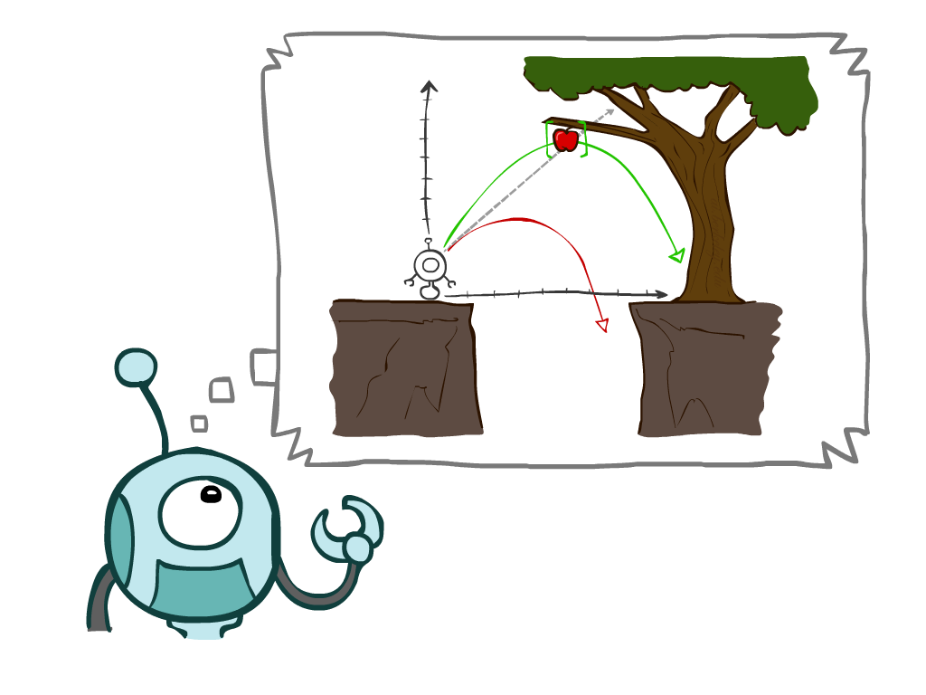
Today’s Agenda
Solving Problems by Searching
(Russell and Norvig: Chap. 3 [Sections 3.1-4])

Slide 3
Acknowledgements
Stuart Russell and Pat Virtue, Berkeley
Jean-Claude Latombe, Stanford University
Richard H. Lathrop, University of California
Svetlana Lazebnik, University of Illinois

Slide 4
Solving Problems by Searching (where reasoning consists of exploring alternatives)

Slide 5
Why Search?
We are engaged in a bigger more important problem, and we hit a search sub-problem we need to solve.
We need to search in order to solve it and then get back quickly to what we really wanted to do in the first place.
To predict the result of our actions in the future.
There are many sequences of actions, each with its utility; we wish to maximize our performance measure.
We wish only to achieve a goal; by any means at all.
We wish to find the best (optimal) way to achieve it.

Slide 6
Problem Solving Agents
Simple-reflex agents directly maps states to actions.
Therefore, they cannot operate well in environments where the mapping is too large to store or takes too much time to learn
Goal-based agents can succeed by considering future actions based on the desirability of their outcomes.

Slide 7
Two types of Goal based agents:
Problem-solving agents that use atomic representations. Decide what to do by finding sequences of actions that lead to desirable states
Planning agents that use more advanced factored or structured .

Slide 8
Problem Solving Agents
Intelligent (Rational) agents are supposed to maximize their performance measure
This can be simplified if the agent can adopt a goal and aim at satisfying it
The agent’s task is to find out which sequence of actions will get it to a goal state
Goal formulation, is the first step in problem solving, based on the current situation and the agent’s performance measure
Problem formulation, is the process of deciding what actions and states to consider, given a goal

Slide 9
Uninformed: Algorithms—algorithms that are given no information about the problem other than its definition.
Informed: Informed search algorithms, can do quite well given some guidance on where to look for solutions.

Slide 10
Types of Search Problems
Idea:
problems can be solved by searching in a space of states
states can be evaluated by domain-specific heuristics
test to see whether they are goal states.
state is atomic, or indivisible — a black box with no internal structure

Slide 11
Problem Solving Agents
An agent with several immediate options of unknown value can decide what to do by first examining different possible sequences of actions that lead to states of known value, and then choosing the best sequence
Looking for such a sequence is called search
A search algorithm takes a problem as input and returns a solution in the form of action sequence
Once a solution is found the actions it recommends can be carried out – execution phase

Slide 12
Problem Solving Agents
“formulate, search, execute” design for the agent
After formulating a goal and a problem to solve the agent calls a search procedure to solve it
It then uses the solution to guide its actions, doing whatever the solution recommends as the next thing to do (typically the first action in the sequence)
Then removing that step from the sequence
Once the solution has been executed, the agent will formulate a new goal

Slide 13
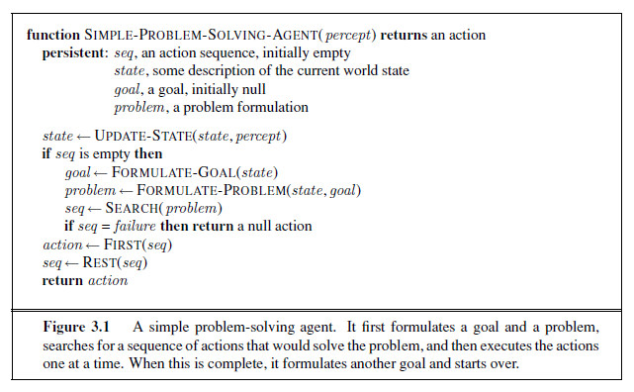
Problem Solving Agents

Slide 14
Lets consider an agent driving in Romania.

Slide 15
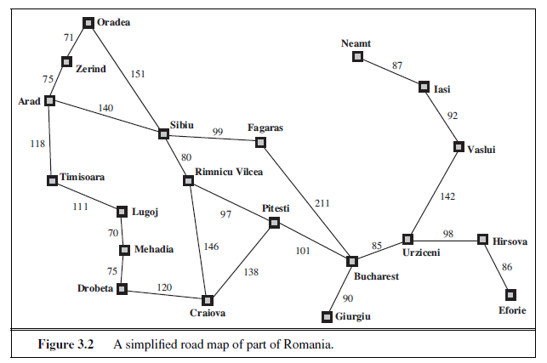
Example: Romania

Slide 16
Environment Assumptions
Fully Observable; initial and goal states are known
Deterministic; solutions to problems are single sequences of actions, so they cannot handle any unexpected events, and solutions are executed without paying attention to the percepts
Static; formulating and solving the problem is done without paying attention to any changes that might be occurring in the environment
Discrete; enumerate alternative courses of actions
Single-agent;

Slide 17
Example: Romania
On holiday in Romania; currently in Arad.
Flight leaves tomorrow from Bucharest
Formulate goal:
– be in Bucharest
Formulate problem:
– states: various cities
– actions: drive between cities
Find solution:
– sequence of cities, e.g., Arad, Sibiu, Fagaras, Bucharest

Slide 18
Example: Romania

Slide 19
PROBLEM
INITIAL STATE
(APPLICABLE) ACTIONS
TRANSITION MODEL, SUCCESSOR -> RESULT
GOAL TEST
PATH
PATH COST
STEP COST

Slide 20
Well-defined Problems & Solutions
A problem can be defined formally by five components:
The initial state that the agent starts in;
For example, the initial state for our agent in Romania might be described as: In(Arad)
A description of the possible actions available to the agent;
Given a particular state s, ACTIONS(s) returns the set of actions that can be executed in s. We say that each of these actions is applicable in s.
For example, from the state In(Arad), the applicable actions are {Go(Sibiu), Go(Timisoara), Go(Zerind)}

Slide 21
Well-defined Problems & Solutions
A description of what each action does; (aka transition model) -> RESULT(s, a)
For example, we have:
RESULT(In(Arad),Go(Zerind)) = In(Zerind)
Together, the initial state, actions, and transition model implicitly define the state space of the problem—the set of all states reachable from the initial state by any sequence of actions.
A path in the state space is a sequence of states connected by a sequence of actions.
The goal test, which determines whether a given state is a goal state.
For example, the agent’s goal in Romania is: {In(Bucharest )}

Slide 22
Well-defined Problems & Solutions
A path cost function that assigns a numeric cost to each path.
The problem-solving agent chooses a cost function that reflects its performance measure.
For the agent trying to get to Bucharest, time is of the essence, so the cost of a path might be its length in kilometers.
We assume that the cost of a path can be described as:
the sum of the costs of the individual actions along the path
The step cost of taking action a in state s to reach state s’ is denoted by c(s, a, s’)
An optimal solution has the lowest path cost among all solutions

Slide 23
Abstraction
The process of removing detail from a representation.
E.g. it takes up time, consumes fuel, generates pollution.
The abstraction is valid if we can expand any abstract solution into a solution in the
more detailed world.
The abstraction is useful if carrying out each of the actions in the solution is easier than the original problem.

Slide 24
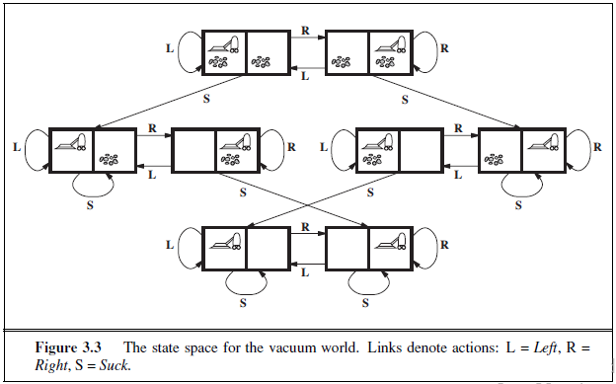

Slide 25
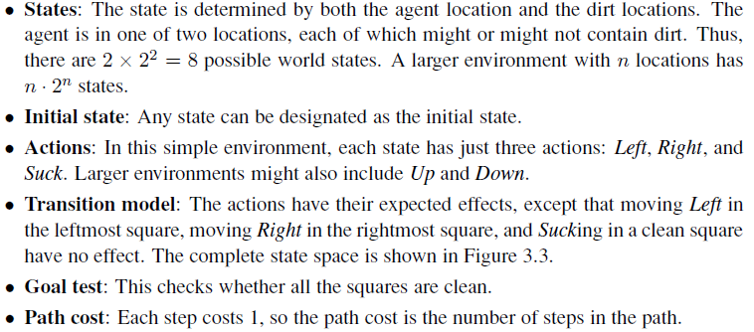

Slide 26
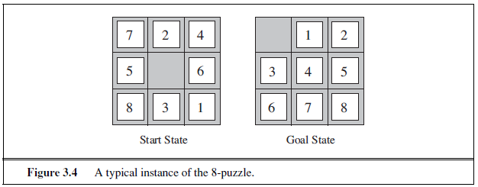
Example Problem: 8-Puzzle
The 8-puzzle, consists of a 3×3 board with eight numbered tiles and a blank space.
A tile adjacent to the blank space can slide into the space.
The objective is to reach a specified goal state.

Slide 27
Example Problem: 8-Puzzle
The problem formulation is as follows:
Initial state: Any state
Actions: Left, Right, Up, or Down.
Transition model: if we apply Left to the start state, the resulting state has the 5 and the blank switched.
Goal test: This checks whether the state matches the goal configuration.
Path cost: Each step costs 1, so the path cost is the number of steps in the path.

Slide 28
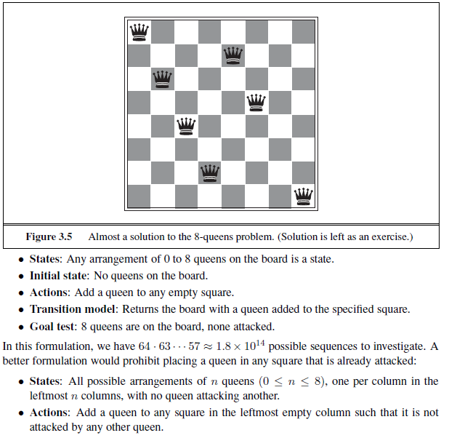

Slide 29
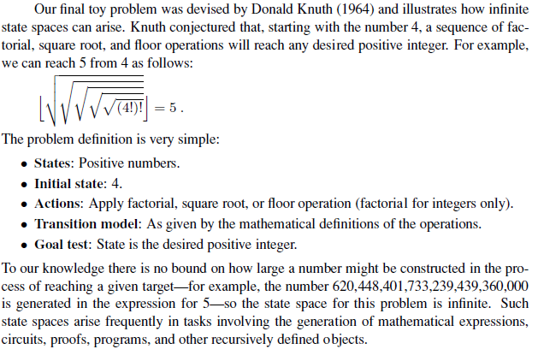

Slide 30
Example Problem: Route-Finding
The problem formulation is as follows:
Initial state: specified by the user’s query.
Actions: take any flight from the current location, in any seat class, leaving after the current time, leaving enough time for within-airport transfer if needed.
Transition model: state resulting from taking a flight will have the flight’s destination as the current location and the flight’s arrival time as the current time.
Goal test: are we at the final destination specified by the user?
Path cost: depends on monetary cost, waiting time, flight time, seat quality, time of day, type of airplane, and so on.

Slide 31
Search and AI
Search methods are ubiquitous in AI systems. They often are the backbones of both core and peripheral modules
An autonomous robot uses search methods:
to decide which actions to take and which sensing operations to perform,
to quickly anticipate collision,
to plan trajectories,
to interpret large numerical datasets provided by sensors into compact symbolic representations,
to diagnose why something did not happen as expected,
etc...
Many searches may occur concurrently and sequentially

Slide 32
Applications of Search
Search plays a key role in many applications, e.g.:
Route finding: airline travel, networks
Package/mail distribution
Pipe routing, VLSI routing
Comparison and classification of protein folds
Pharmaceutical drug design
Design of protein-like molecules
Video games

