Slide 1

Data Analytics Process Automation using Alteryx Designer
Exploratory Data Analysis (EDA) is essential for understanding complex data sets. Alteryx Designer provides a powerful platform to perform EDA quickly and easily. In this presentation, we will explore the benefits of using Alteryx Designer for EDA, its key features, and real-world case studies.

Slide 2

The Benefits of Alteryx Designer for EDA
1
Speed 🏎
The intuitive interface and drag and drop workflow make EDA faster than ever.
2
Power 🔋
Alteryx Designer provides access to over 100 built-in tools to help you maximize the insights available from your data.
3
Intelligence 🔬
The AI/ML-powered workflows and data enrichment can automatically clean your data and create impactful visualizations.

Slide 3
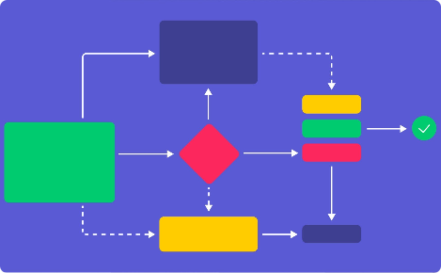
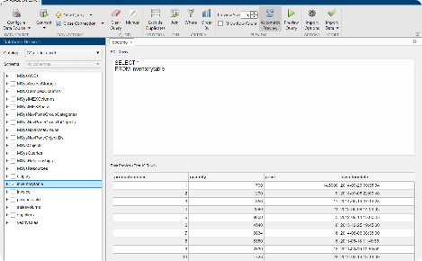
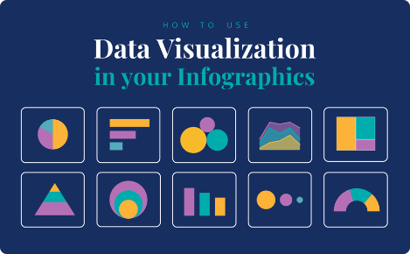

The Key Features of Alteryx Designer for EDA
Drag and Drop Workflow Builder
Database Integration
Build complex workflows with ease and use macros to create reusable configurations.
Connect to a variety of data sources and perform advanced queries without any SQL knowledge.
Data Visualizations
Predictive Modeling
Create beautiful visualizations using Alteryx Designer's built-in visualizations and connectors to BI tools like Tableau.
Use Alteryx Designer's machine learning tools to create predictive models and make data-driven decisions.

Slide 4

Demo: EDA using Alteryx Designer
Let's explore Alteryx Designer in action. We will perform an EDA on a sample data set and showcase some of the key features of the platform.

Slide 5
Real-world Case Studies
Financial Analysis 📈
Customer Segmentation 🎯
Social Listening 💬
A financial services firm used Alteryx Designer to perform EDA on customer data, helping to identify patterns and improve marketing campaigns.
A consumer goods company used Alteryx Designer to analyze social media data, informing customer service strategy and product development decisions.
A retail organization used Alteryx Designer to create customer segments based on buying habits, improving product recommendations and driving sales growth.

Slide 6
Tips and Best Practices for EDA using Alteryx Designer
Start with a Question
Keep it Simple
Collaborate
Don't overcomplicate your workflow. Stick to the basics and build more complex workflows as needed.
Alteryx Designer makes it easy to collaborate with others, so tap into your team's expertise and work together to find new insights.
Define your objective and work backwards to create a workflow that will help you achieve it.

