Slide 1
Online Quiz System Project
http://freeprojectscode.com/

Slide 2
Requirement Analysis
Purpose:
Providing an online comprehensive solution to manage quiz where the individuals are participating in a team.
Scope:
Providing accessibility to the administrators who have a valid userid and password. This system also provides the following facilities such as:
‘N ’number of teams can participate in a quiz.
Automation of scores of the teams.
Depending upon the pass marks requested by the organization/institution final teams can participate ‘N’ number of rounds until one team is declared as winners.
Based on the requirement of organization or institution all the quiz details (including negative marking) are entered by the administrator .
Viewing and deleting the results of the quiz.

Slide 3
Users of the System
Organizations, Institutions, Academicians etc
Administrators
Industrialists

Slide 4
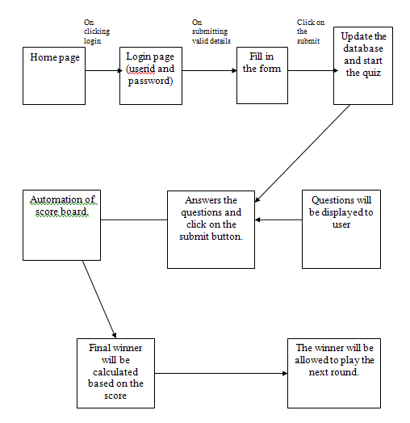
Proposed System Architecture

Slide 5
Client Server Architecture
HTML client
(Customer)
HTTP/HTTPS
Apache Tomcat
MySql
Client
Software
(System user)
TCP/IP
Application server
Database server
Client side

Slide 6
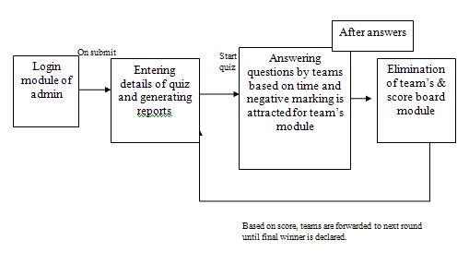
Architecture Diagram of system basing on modules

Slide 7
System Requirements
Technologies Used:
UML
J2EE
XML
JavaScript
Tools Used:
Eclipse 3.3
2. Web Sphere Portal 2.0.
My Sql
Edraw Max

Slide 8
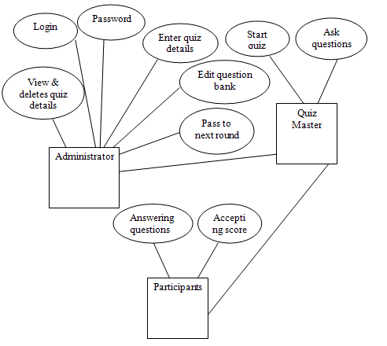
E-R Diagrams

Slide 9
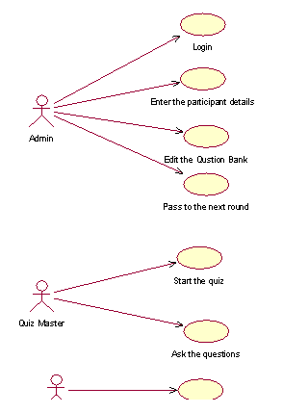
Use case Diagram

Slide 10
Class diagram

Slide 11
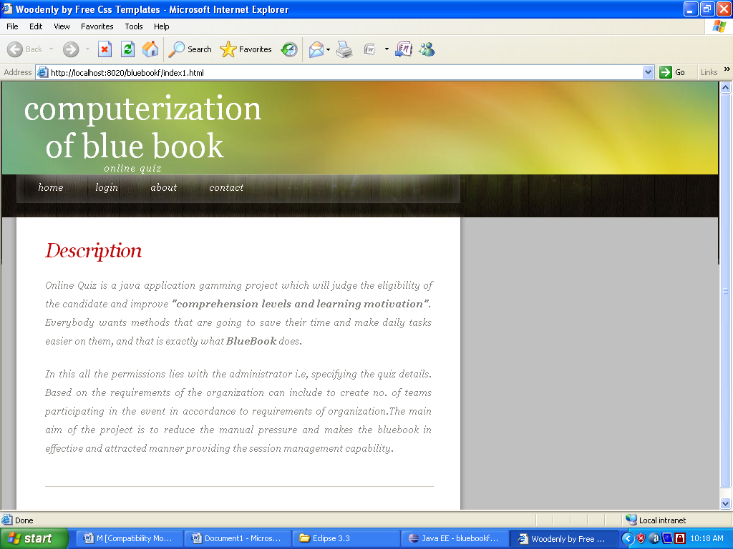
Screen Shots
Home page

Slide 12
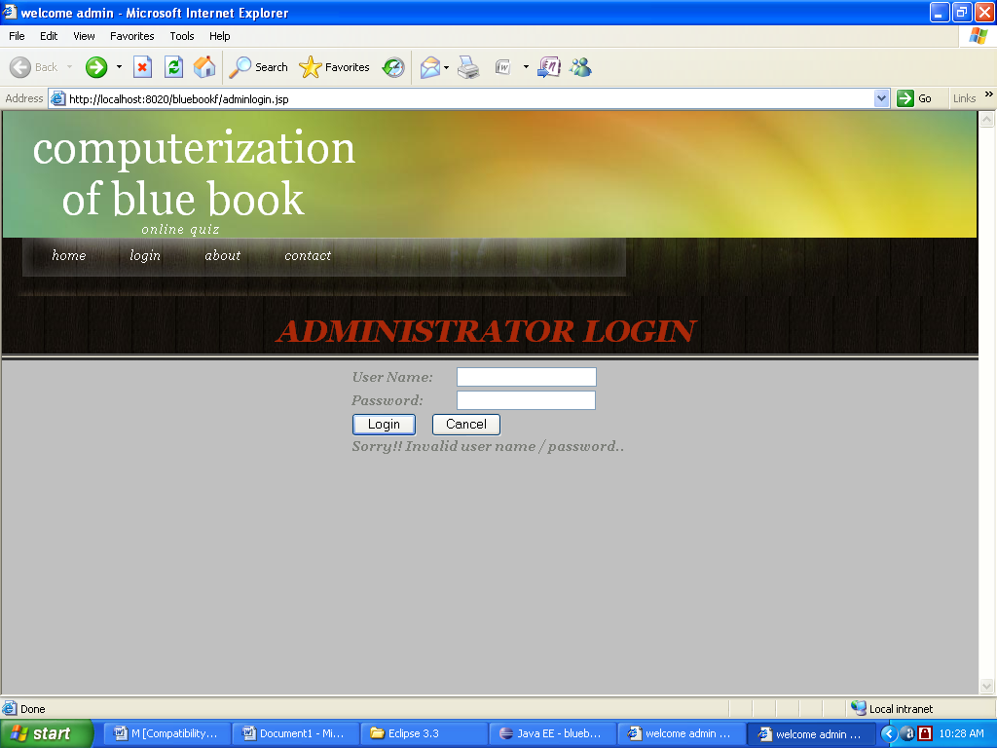
Login page

Slide 13
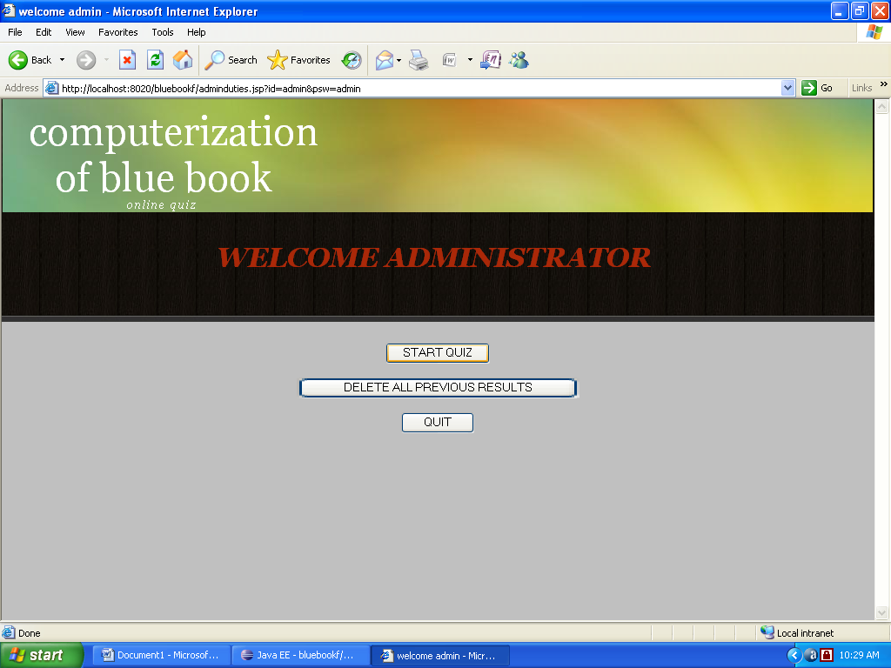
: Welcome page of the Admin

Slide 14
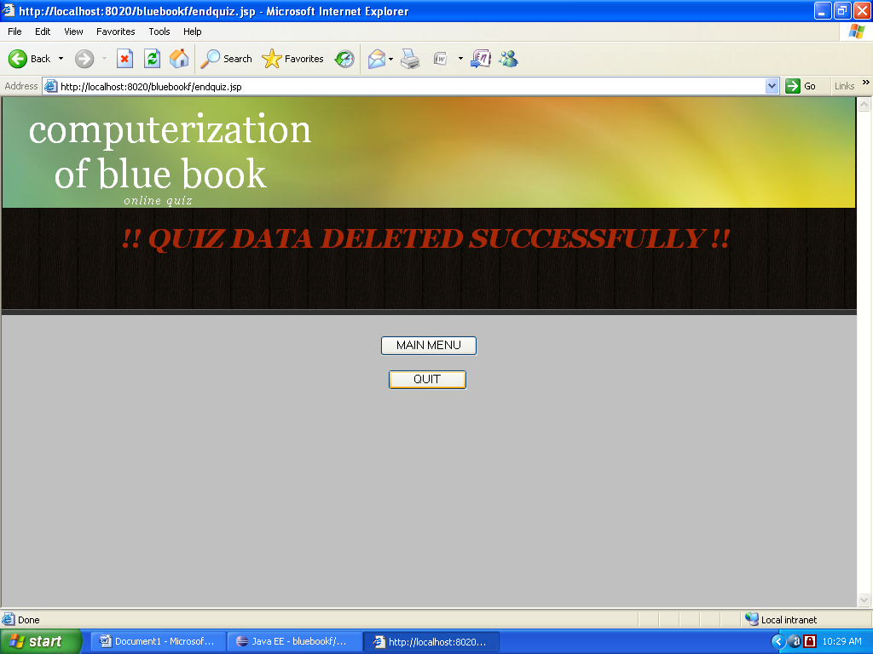

Slide 15
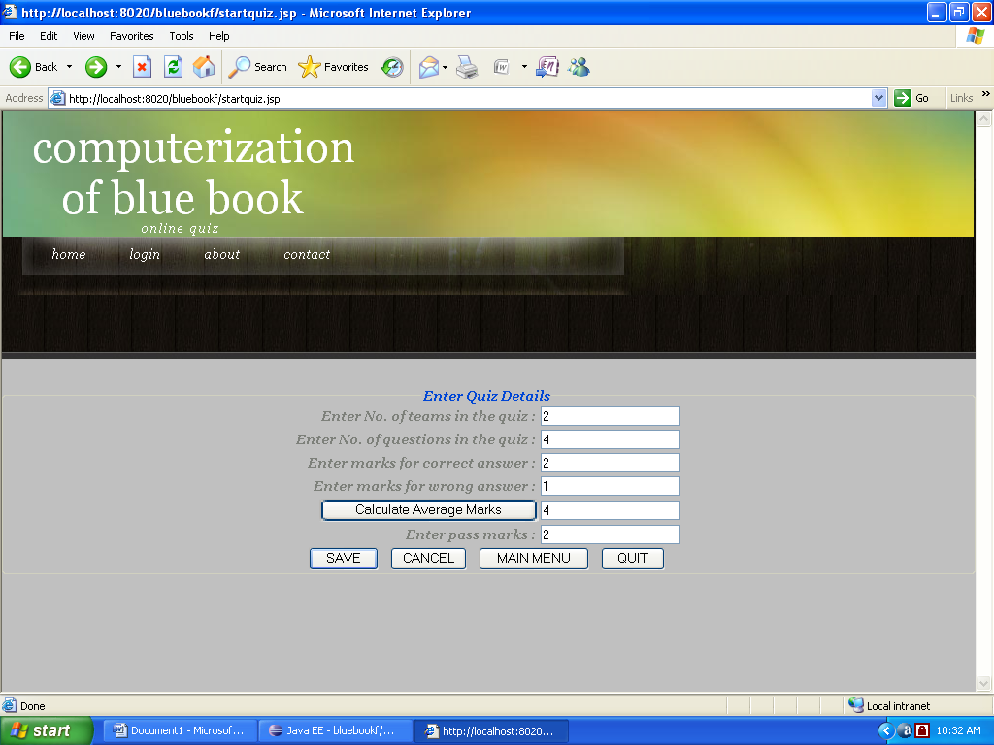
Clicking on start quiz

Slide 16
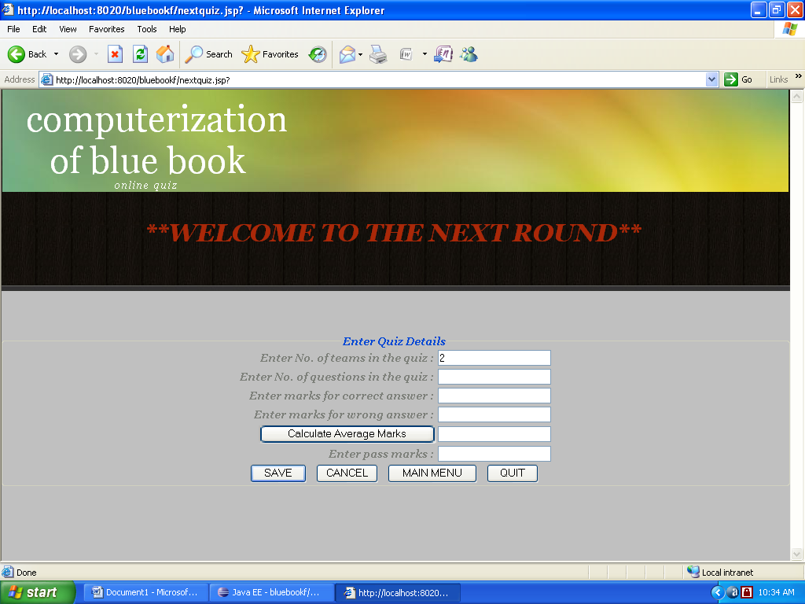

Slide 17
For full project details visit http://freeprojectscode.com/java-projects/online-quiz-system-project/648/

