Slide 1
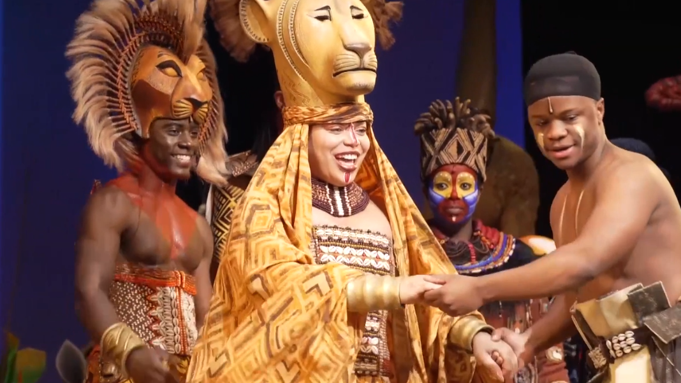

Slide 2
First 2 Points of Musical’s 10 Plot Points
2. Inciting Incident
Opening Number

Slide 3

OPENING NUMBER
The worldbuilding song; it lays down to you the:
Characters
Settings
Musicality & Theatricality
Genre(s) of music
Tone
Choreography

Slide 4
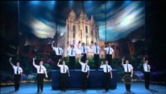

Slide 5
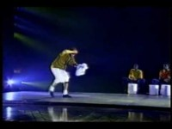

Slide 9

INCITING INCIDENT
The worldbuilding song; it lays down to you the:
Characters
Settings
Musicality & Theatricality
Genre(s) of music
Tone
Choreography

