Slide 1
The Prairie Initiative:
Making Drupal.org an Effective Place to Collaborate
Derek “dww” Wright
drupal.org/user/46549
3281d.com/bio/derek
BADCamp 2011

Slide 2
Prairie Initiative Project Goals:
1. Improve the collaboration tools on Drupal.org so that we can do more and better work together and make Drupal better, faster.
2. Grow the pool of contributors by making Drupal.org a better and easier place to become a contributor -- to make it less intimidating to people who want to get started contributing.

Slide 3
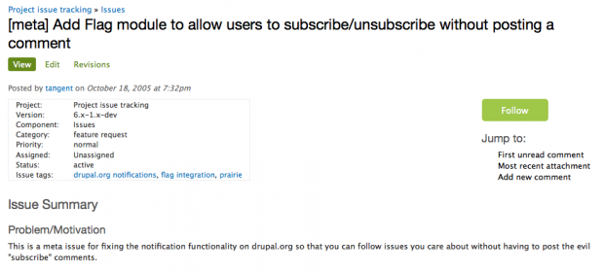
Accomplishments: Issue Following
(drupal.org/node/1306444)

Slide 4
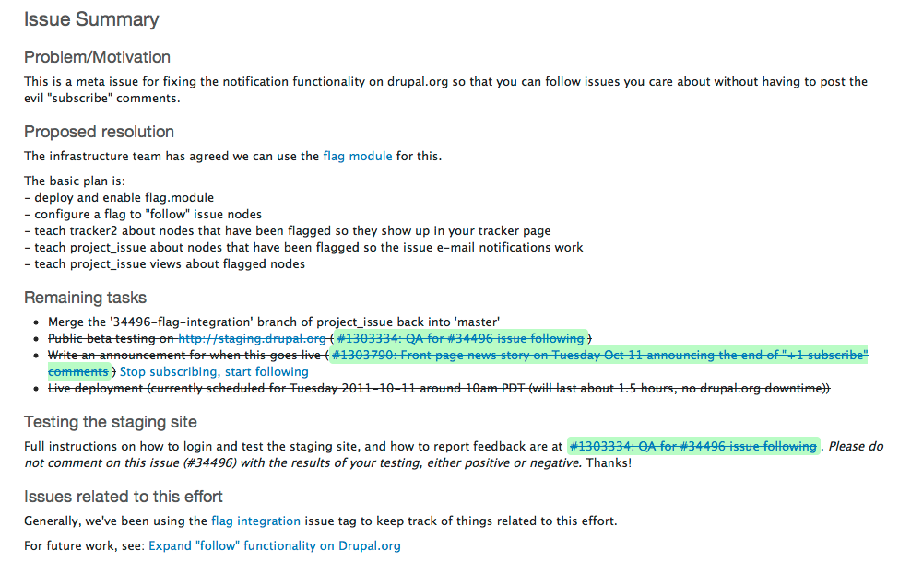
Accomplishments: Issue Summaries
(drupal.org/node/1036132)

Slide 5
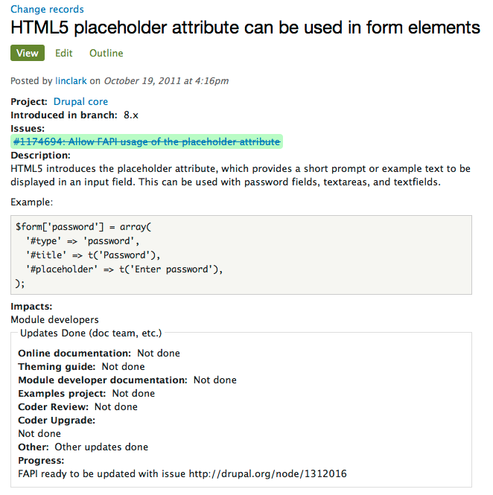
Accomplishments: Change Nodes
(drupal.org/node/648218)

Slide 6
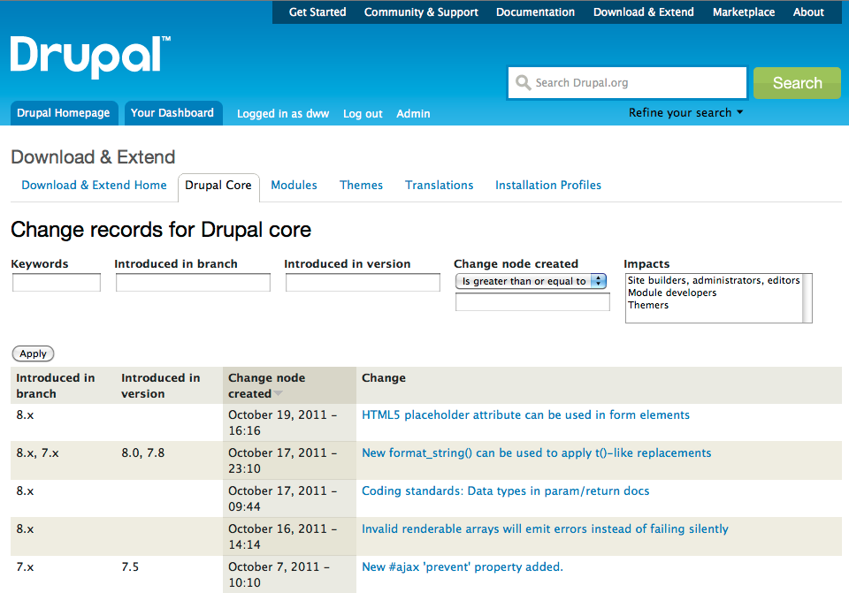

Slide 7
Current Projects
Topic pages
Initiative pages
Redesigning issue pages
Better Drupal.org profile pages
Lots of other things... ;)

Slide 8
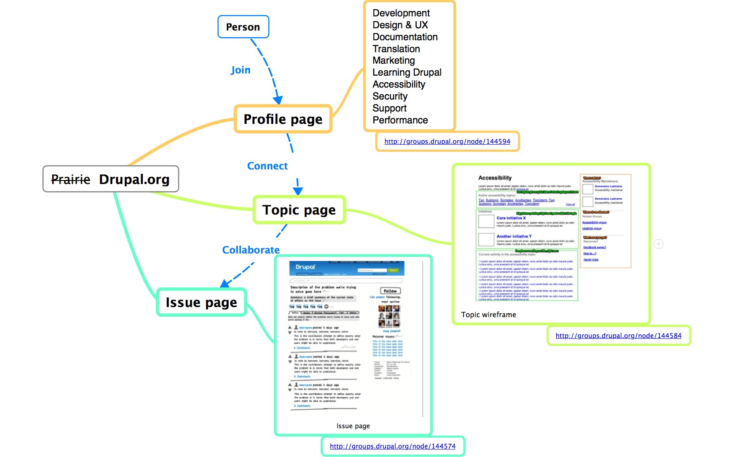

Slide 9
Topic pages

Slide 10
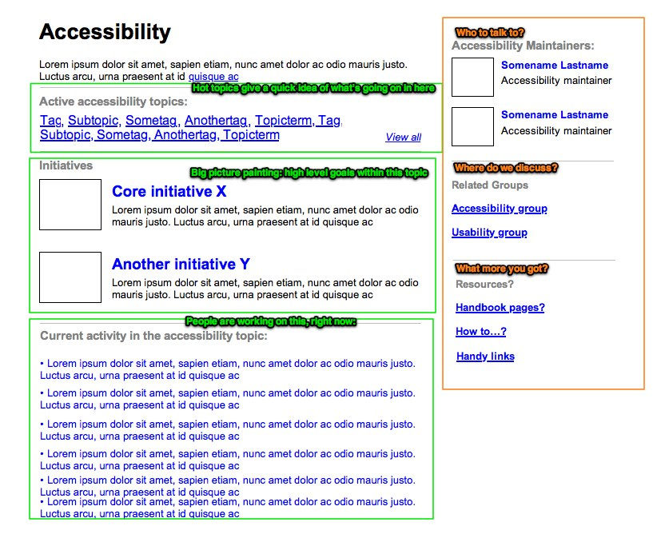

Slide 11
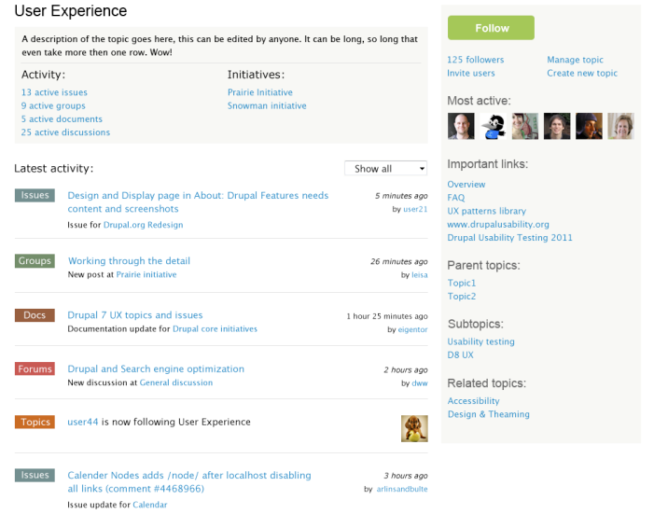

Slide 12
Initiative pages

Slide 13
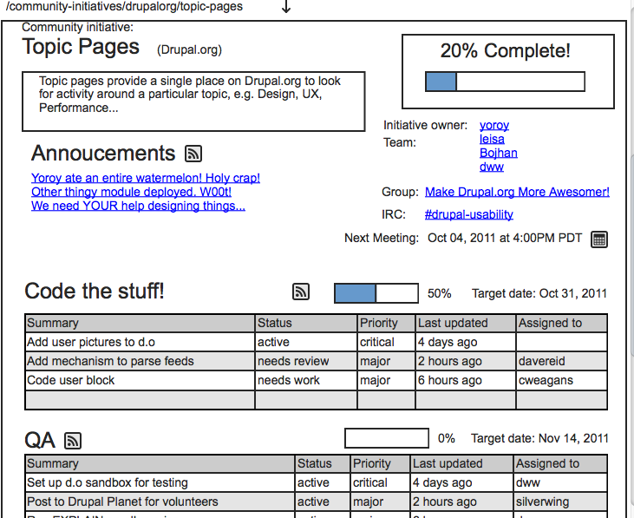

Slide 14
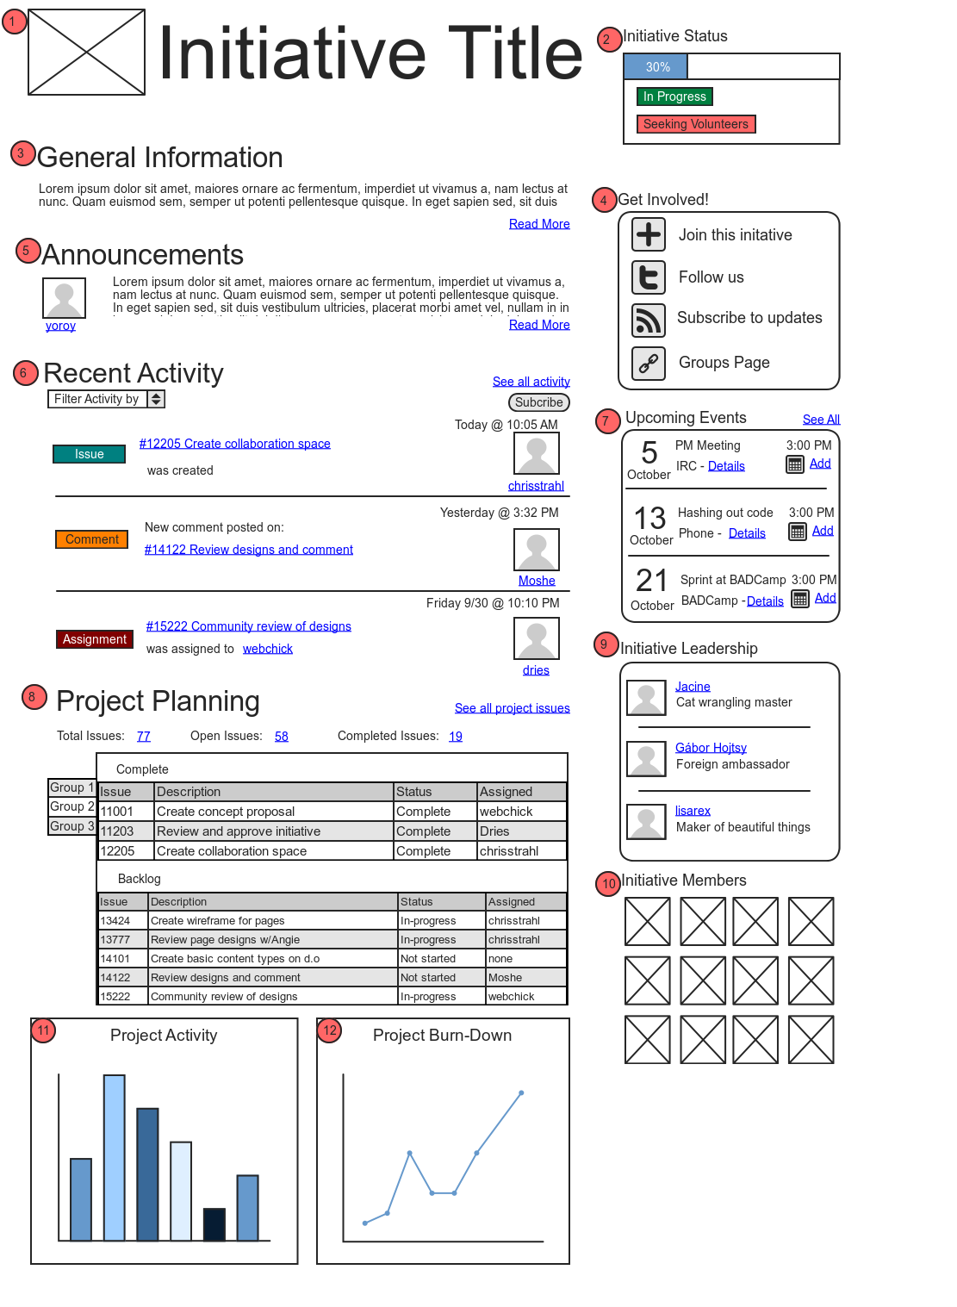
Initiative page mockup proposed from the Project Manager point of view...

Slide 15
Redesign issue pages

Slide 16
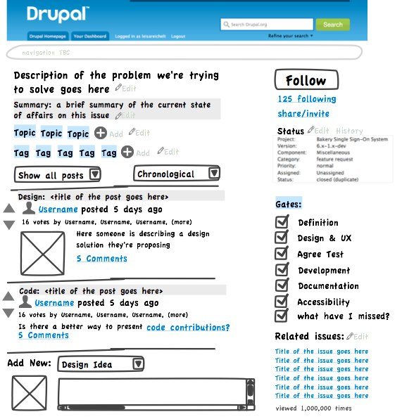

Slide 17
Finding the Prairie and Contributing
groups.drupal.org/prairie-initiative
drupal.org/project/issues/search?issue_tags=prairie
#drupal-usability on IRC (freenode.net)

Slide 18
Specific Prairie Projects
Topic pages:
groups.drupal.org/node/144584
Initiative pages:
drupal.org/node/1300972
Redesigning issue pages:
groups.drupal.org/node/144574
Better Drupal.org profile pages:
groups.drupal.org/node/144594

