Slide 1



Slide 2
Presentación Arquitectura

Slide 3
Lo vamos ver hoy…
Diseño Arquitectura
Implementación de Arquitectura

Slide 4
Arquitectura a nivel de componentes

Slide 5
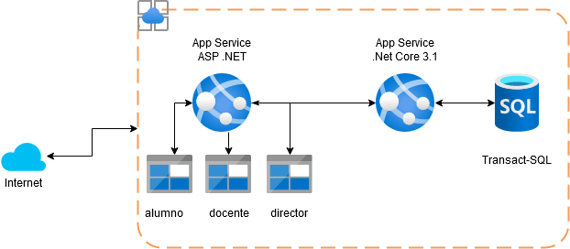
General pricing
Free tier
Pricing calculator
Total Cost of Ownership

Slide 6
Arquitectura de aplicación

Slide 7
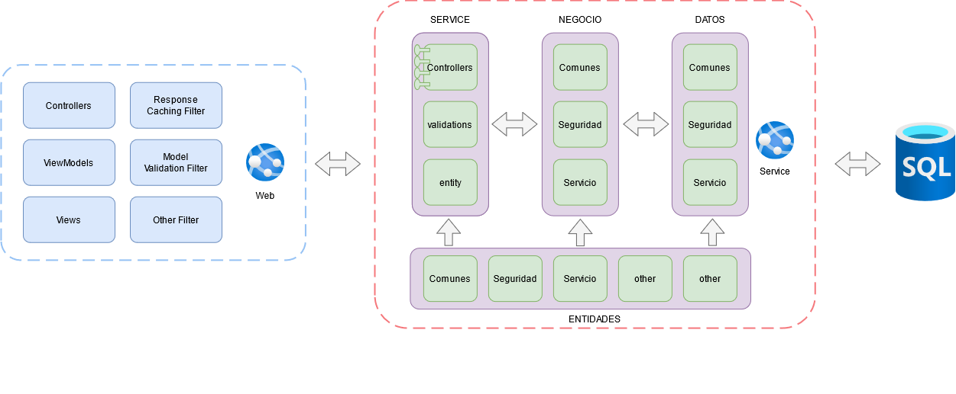

Slide 8
Diseño de base de datos

Slide 9
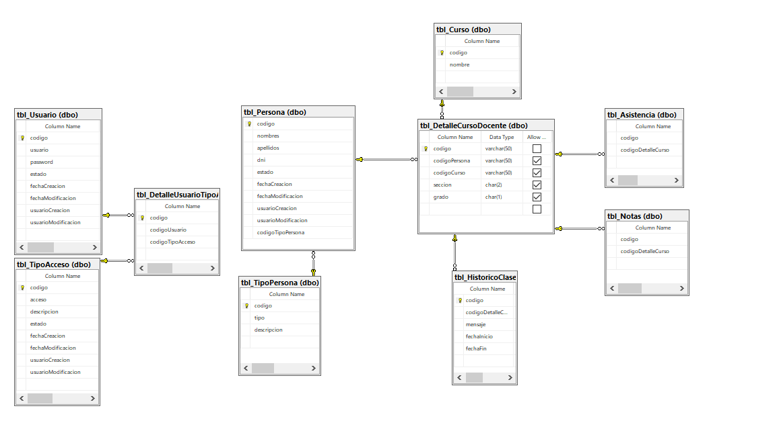

Slide 10
Demo y consultas

Slide 11

© 2014 Microsoft Corporation. All rights reserved. Microsoft, Windows, and other product names are or may be registered trademarks and/or trademarks in the U.S. and/or other countries.
The information herein is for informational purposes only and represents the current view of Microsoft Corporation as of the date of this presentation. Because Microsoft must respond to changing market conditions, it should not be interpreted to be a commitment on the part of Microsoft, and Microsoft cannot guarantee the accuracy of any information provided after the date of this presentation. MICROSOFT MAKES NO WARRANTIES, EXPRESS, IMPLIED OR STATUTORY, AS TO THE INFORMATION IN THIS PRESENTATION.

