Slide 1
Social engineering
Ethical hacking

Slide 2
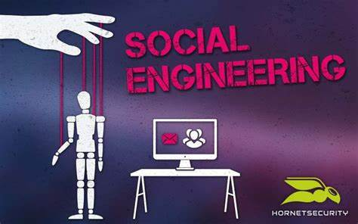

Slide 3
AGENDA
Introduction​
Types of Social Engineering
Tactics and Techniques
Real-Life Examples
Protecting Yourself
Conclusion

Slide 4
Introduction
Definition: Social engineering is the art of manipulating people to gain access to confidential information or to perform certain actions.
It exploits the inherent human tendency to trust and cooperate with others.
In this presentation, we will explore various tactics used in social engineering and discuss ways to protect ourselves.

Slide 5
Types of social engineering
Phishing
Pretexting
Baiting
Tailgating
Quid pro quo

Slide 6
Tactics and Techniques
Authority: Posing as an authority figure, such as a manager or IT technician, to gain trust and convince individuals to comply with requests.
Urgency: Creating a sense of urgency to pressure individuals into making quick decisions without proper verification.
Intimidation: Using fear or intimidation tactics to coerce individuals into providing information or taking specific actions.
Familiarity: Establishing a personal connection or relationship with individuals to exploit their trust and willingness to help.
Tailoring: Customizing the approach based on the target's interests, preferences, or known information to increase the chances of success.

Slide 7
Real-Life Examples
The Nigerian Prince Scam: A classic example where scammers claim to be Nigerian royalty in need of financial assistance, promising large rewards in return.
CEO Fraud: Impersonating a company executive to trick employees into making unauthorized financial transfers.
Tech Support Scams: Pretending to be technical support representatives to gain remote access to computers and steal sensitive information.
Phishing Emails: Sending emails with links or attachments that appear legitimate but actually lead to malicious websites or malware downloads.

Slide 8
Protecting Yourself
“
”

Slide 9
Awareness and Education: Educate yourself and others about social engineering tactics and red flags to watch out for.
Verify Requests: Always verify requests for sensitive information or actions, especially when they come unexpectedly or seem urgent.
Use Strong Authentication: Implement strong passwords, multi-factor authentication, and other security measures to protect your accounts.
Be Cautious Online: Exercise caution when sharing personal information on social media platforms or other online channels.
Report Suspicious Activity: Report any suspected social engineering attempts to your organization's security team or relevant authorities.

Slide 10
Kali Linux social engineering tool: Wifiphisher
Wifiphisher is a unique social engineering tool that automates phishing attacks on Wi-Fi networks to get the WPA/WPA2 passwords of a target user base. The tool can choose any nearby Wi-Fi access point, jam it (de-authenticate all users) and create a clone access point that doesn’t require a password to join.

Slide 11
#include <string.h> void storeName (char *input) { char name[12]; strcpy(name, input); } int main (int argc, char **argv) { storeName(argv[1]); return 0; }

Slide 12
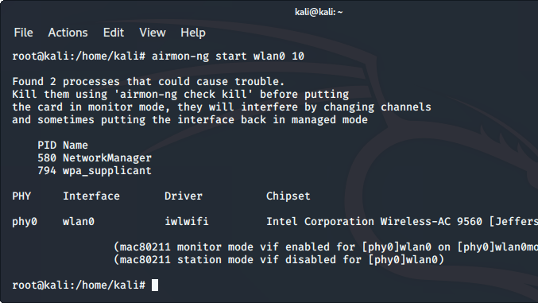

Slide 13
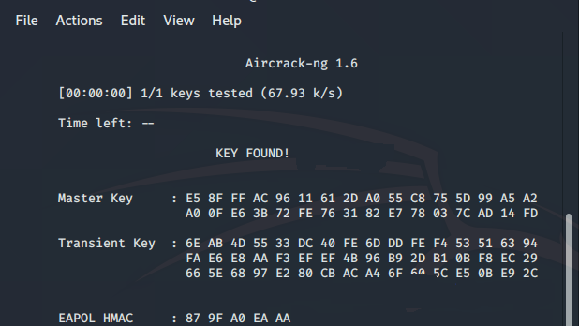

Slide 14


Slide 15
SUMMARY
Social engineering continues to be a significant threat to individuals and organizations.
By understanding the tactics used and implementing preventive measures, we can protect ourselves and stay safe in an increasingly interconnected world.

Slide 16
THANK YOU

