Slide 1
Fake News Truthfulness Classification
LIAR2 Dataset | Logistic Regression, CNN & DistilBERT

Slide 2
Objective
• Classify political statements on a 6-level truthfulness scale
• Dataset: LIAR2, an expanded PolitiFact fact-check dataset
• Compare three models: Logistic Regression, CNN, and DistilBERT

Slide 3
Dataset Overview
• 18,369 training statements, 2,296 test statements
• 6 classes: Pants-fire, False, Barely-true, Half-true, Mostly-true, True
• Average statement length: 17.7 words
• Classes imbalanced — False most common (5,284), True least common (2,068)

Slide 4
Methodology
• Logistic Regression: TF-IDF (5,000 features)
• CNN: Embedding + Conv1D + GlobalMaxPooling, early stopping applied
• DistilBERT: Fine-tuned distilbert-base-uncased, 2 epochs, full dataset

Slide 5
Results Summary
• Logistic Regression: 32.01% accuracy
• CNN: 32.88% accuracy
• DistilBERT: 33.97% accuracy
• Random baseline (6 classes): ~16.7%
• Published statement-only benchmarks: 20-27% accuracy

Slide 6
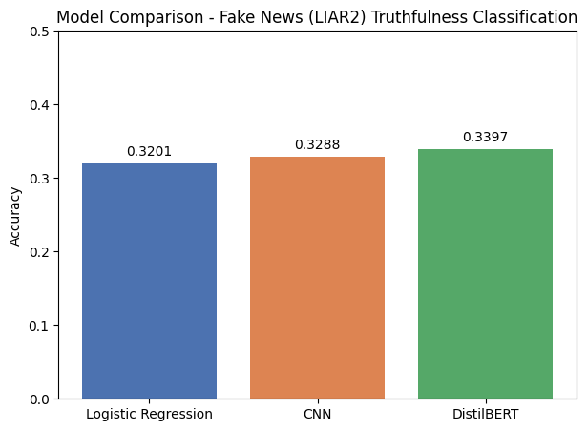
Model Comparison

Slide 7
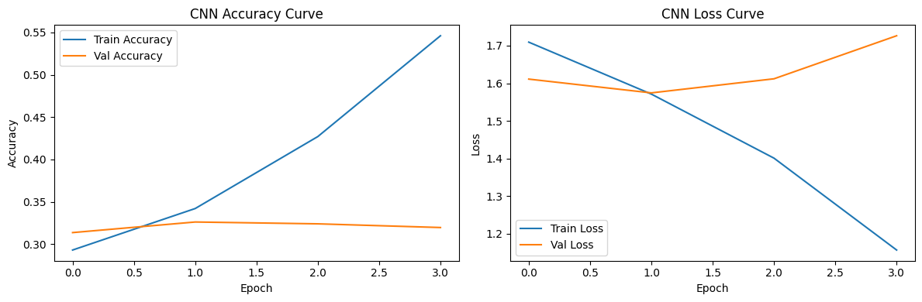
CNN Training Curve

Slide 8
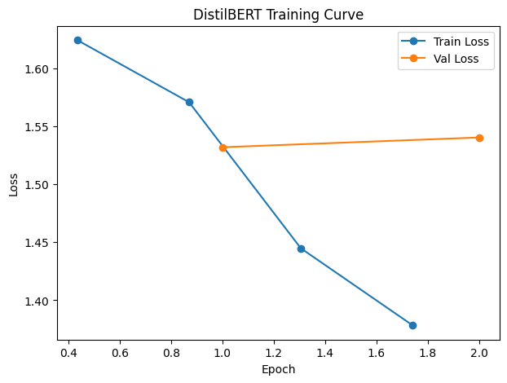
DistilBERT Training Curve

Slide 9
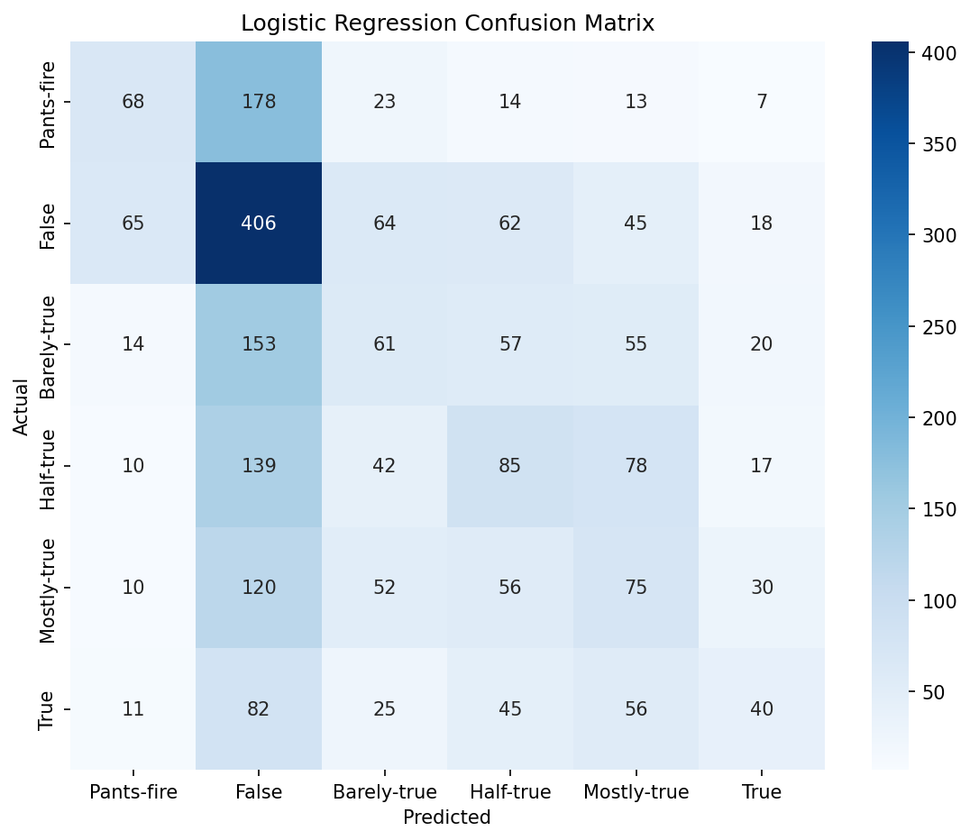
Logistic Regression — Confusion Matrix

Slide 10
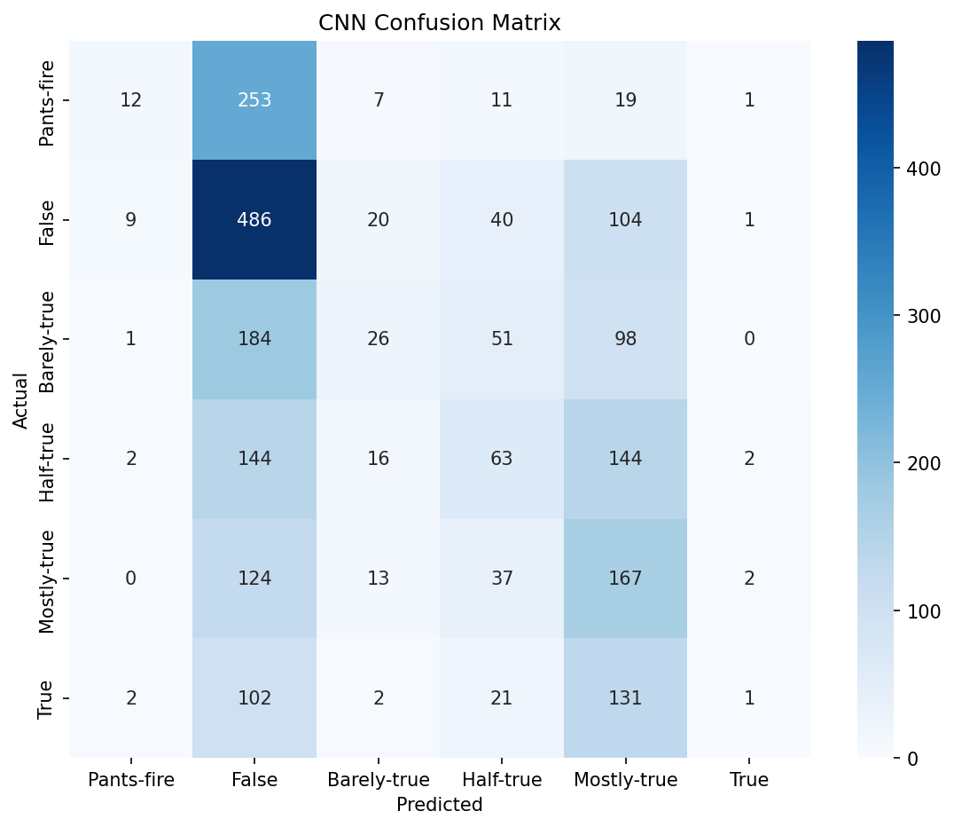
CNN — Confusion Matrix

Slide 11
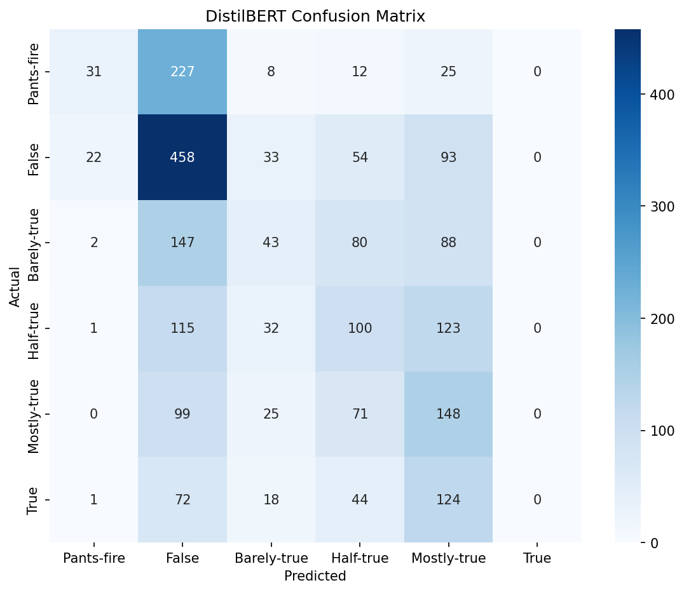
DistilBERT — Confusion Matrix

Slide 12
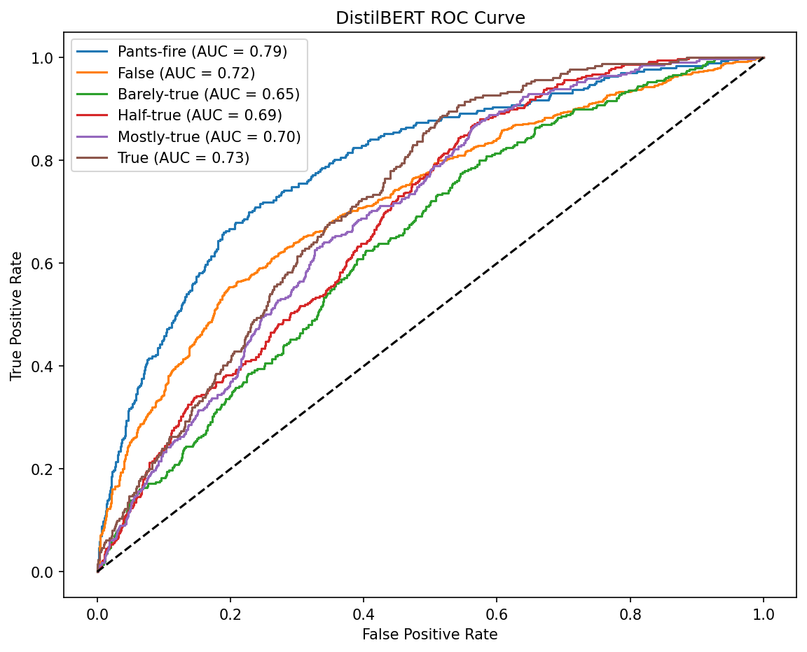
DistilBERT — ROC Curve

Slide 13
Key Finding: The 'True' Class Problem
• DistilBERT scored 0.00 precision and recall on the 'True' class
• Despite having the highest overall accuracy
• Model leaned on majority class ('False') instead of learning all 6 levels
• Highlights why accuracy alone can mislead on imbalanced data

Slide 14
Discussion
• All models performed similarly — bottleneck is information, not model complexity
• Short statements alone lack enough signal for 6-way truthfulness judgments
• Class imbalance contributed to DistilBERT's 'True' class failure
• Middle categories (Barely/Half/Mostly-true) hardest to separate

Slide 15
Conclusion & Future Work
• DistilBERT: best accuracy, but unreliable due to class imbalance
• Logistic Regression/CNN: more balanced, lower overall accuracy
• Next steps: class weighting, add speaker history & justification fields
• Consider simplifying to 3-class version for practical deployment

