Slide 1
GeekOut BootCamp HDB Resale Analysis Machine Learning & Data Visualization
Dr Amit Satpathy
Quantitative Strategy, DSAID

Slide 2
Prerequisites

Slide 3
Software Needed
Windows OS (preferably)
Anaconda Distribution in Python 3.7
https://www.anaconda.com/distribution/
Download version according to OS running on system (Windows or Mac, 32bit or 64 bit)
Tableau Public
https://public.tableau.com/en-gb/s/

Slide 4
Data Needed
HDB resale prices data from data.gov.sg
https://data.gov.sg/dataset/resale-flat-prices
MRT Station Locations
https://www.mytransport.sg/content/dam/datamall/datasets/Geospatial/TrainStation.zip

Slide 5
Agenda

Slide 6
Programme
Data Pre-processing
Cleaning, transformation and merging (joining)
Building Tableau Dashboards for visualization
Machine Learning
Regression
Classification

Slide 7
Jupyter Notebook

Slide 8
What is a Jupyter Notebook?
An open-source web application that allows creation and sharing of documents that contain live code, equations, visualizations and narrative text
Popular application used by data scientists for interactive Python scripting
Allows code to be run in cells
Visualize outputs from cells for debugging and understanding
Already comes pre-installed in Anaconda

Slide 9
Installing necessary libraries and running Jupyter Notebook
Click on the search icon on the taskbar and type cmd
Click on Anaconda Prompt
Once prompts opens, type the following line by line:
conda install --yes pyshp numpy pandas requests tqdm scipy scikit-learn matplotlib
pip install vptree geopy jupyter_contrib_nbextensions jupyter_nbextensions_configurator
jupyter contrib nbextension install –user
jupyter nbextensions_configurator enable –user
To run Jupyter Notebook, type jupyter notebook
You should see something opening automatically in your web browser

Slide 10
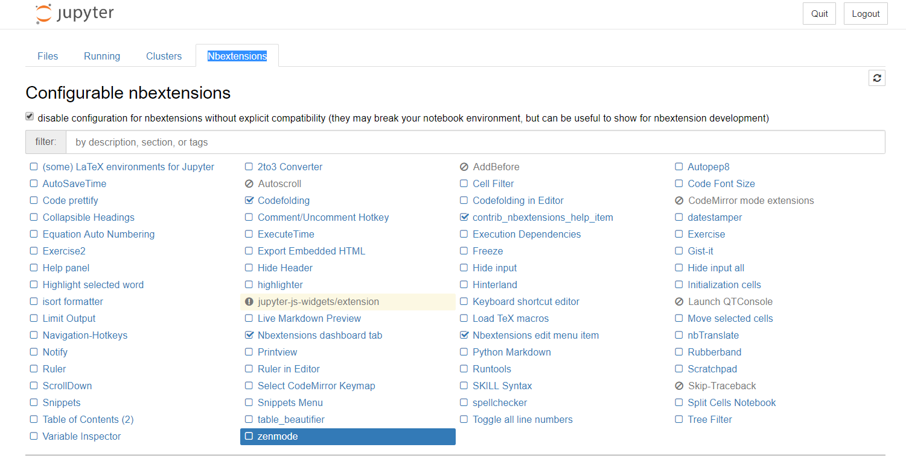
Installing necessary libraries and running Jupyter Notebook
Once Jupyter Notebook opens, click on Nbextensions tab and check Codefolding

