Slide 1
Topic 9: Optimize price to handle request
Alexander Tampier, Jan Köck, Milena Meier, Sofiia Badera

Slide 2
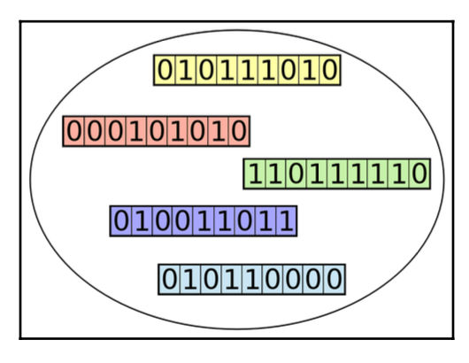
Genetic Algorithms
Inspired by the theory of natural selection
Principle: Treat solutions as individuals in a population
Set of parameters genes
Fitness
effectiveness in solving the problem
Strengths:
Technique is robust
wide range of difficult problems
Acceptably good solution in a reasonably quick time
Mechanism is robust
Degree of flexibility in parameter settings
Weaknesses:
Risk of converging on a local maximum
A population of individuals representated by binary-coded chromosed
Source: E. Wirsansky, Hands-On Genetic Algorithms with Python: Applying genetic algorithms to solve real-world deep learning and artificial intelligence problems. Packt Publishing Ltd, 2020.
Notes:
Speaker: Milena - Maximum 1:30

Slide 3
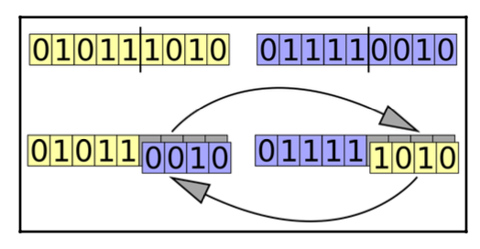
Mechanisms of Genetic Algorithms
Simulate the different mechanisms of natural selection and evaluation
Selection
Determines how individuals are chosen for reproduction
Selected based on fitness
Crossover
Genetic material from two parent individuals is combined to produce offspring
Mutation
After Crossover to each offspring
Introduces random changes in the genetic information
Maintains genetic diversity in population
Crossover operation between two binary-coded chromosomes Source: https://commons.wikimedia.org/wiki/File:Computational.science.Genetic.algorithm.Crossover.One.Point.svg.Image by Yearofthedragon. Licensed under Creative Commons CC BY-SA 3.0: https://creativecommons.org/licenses/by-sa/3.0/deed.en
Notes:
Speaker: Milena - Maximum 1:30

Slide 4
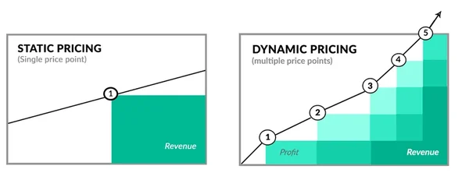
Shortly the problem / issue to solve
Implementing GA to develop optimal pricing strategy
Defining optimization goals
Optimize for company profit
Optimize for customer price
Optimize for customer satisfaction
Evolving factors like customer behavior and external influences
Customer loyalty
Weather
Time/day
Geographic and demographic factors
Figure 1: Static Pricing vs. Dynamic Pricing
Source from HubSpot Blog
Notes:
Speaker: Alex - Maximum 1:30

Slide 5
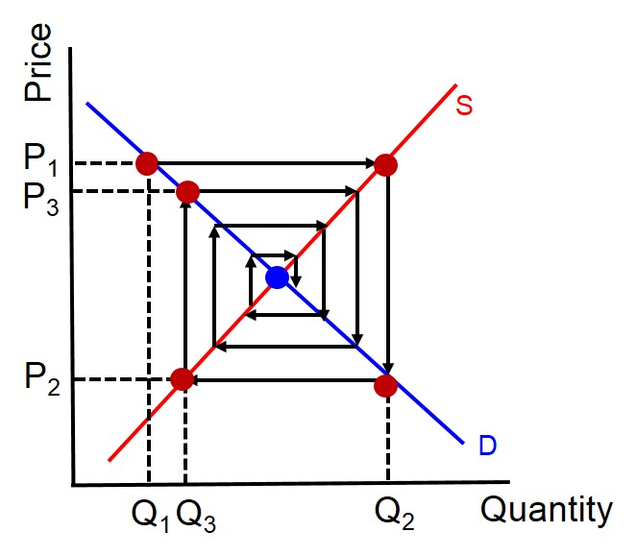
Company Profit Optimization
Dynamic Parameters
Customer loyalty, Weather conditions, Day of the week, Remoteness
Static Constants
Baseline prices, Loyalty Surcharges, Weather Surcharges, Weekend Surcharges, Remoteness Surcharges
GA Process
Selection, crossover, and mutation operations
Optimization
Runs through multiple generations to improve the pricing strategy
Bounds are set to keep the adjustments within realistic limits
Result → Optimized price considering all variables
Figure 2: Influenced by Cobweb Model Price Convergence
Source from ezyeducation.co.uk
Notes:
Speaker: Alex - Maximum 1:30

Slide 6
Customer Price Optimization
Finding a solution for an optimal price for one ride
Parameters
Dynamic basic tariff
Based on the time of day
Vehicle class factor
Standard - Premium - Luxury
Cost per km
Distance of the ride
Start - Destination
Remotnesse
Loyalty discount
Discounts based on the total distance traveled
GA Process
Based on min Problem
Selection, crossover, and mutation operations
Fitness Function
Valuation based on the total cost calculation
Optimization
Execution of the genetic algorithm over several generations
Result
Minimal costs for one ride from start to destination
Notes:
Speaker: Jan - Maximum 1:30

Slide 7
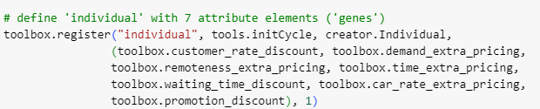
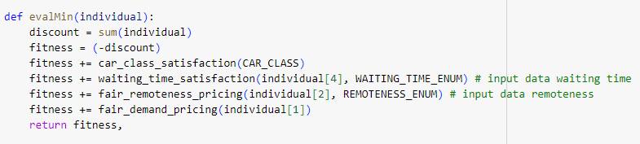
Customer Satisfaction Optimization
Input Parameters
Customer Rate, Car Class, Base Price, Car / Customer / Destination Locations (Addresses)
Real Time Parameters
Date, Number of events, Distance / Time calculations from Google Maps
Fitness Function
Based on price, car class, waiting time and balanced pricing percent
Result → Individual with best pricing strategies
Notes:
Speaker: Sofiia - Maximum 1:30

Slide 8
Live Demonstration

Slide 9
Evaluation of the solution
Challenges
Ensuring realistic prices through the genetic algorithm
Use of max(individual) in the evaluate function to limit the parameters
Subsequent solution: checkBounds for offsprings
Monitoring and adaptation of each gene in each individual in the offspring
More effective method of limiting the parameter values
Notes:
Speaker: Jan - Maximum 1:30

