Slide 1
Othello TITANS: AI project CHV HARSHA,130050063 BADE SAIRAM,130050079 VENKATA KALYAN,130050081

Slide 2
AIM
Implementing a game of Othello using search strategies based on mini-max using alpha-beta pruning.
Comparing different heuristics by making them play against each other.
We used a variant of mini-max search in our algorithm called nega-max which relies on the zero-sum property of the Othello game.

Slide 3
USER INTERFACE
We used C++ library FLTK graphics to show the game.
User can click on the interface to put his coin which based on the location of the mouse click will show a coin placed on the interface.
Then computer program looks ahead the game and places a best possible move according to algorithm the player chose.
It also contains options for quitting the game ,restarting the game along with the score board.

Slide 4
Game of Othello
Othello belongs to the family of board games.
It consists of an 8*8 board which contains white and black coins.
The initial configuration of the board is as shown.

Slide 5
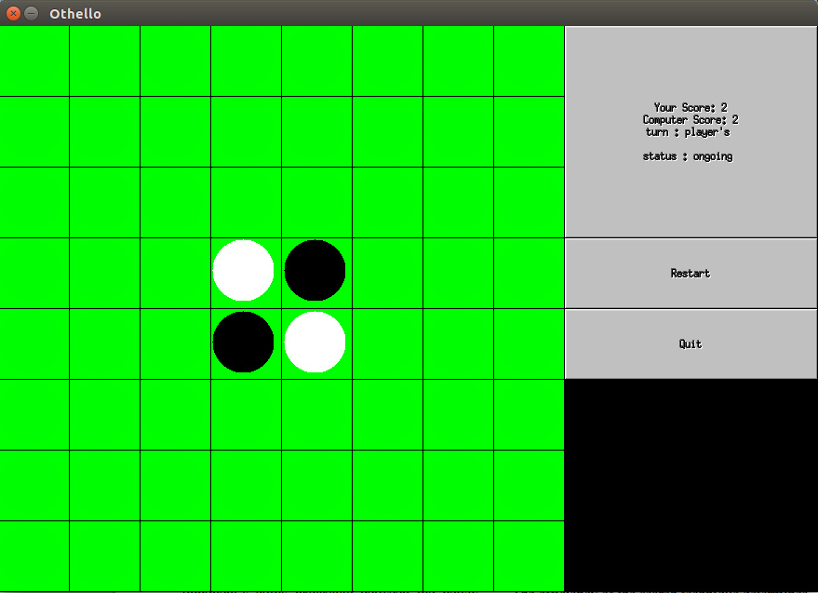
Initial configuration

Slide 6
Game of othello
The game progresses as each player makes valid moves.
A move is a made by placing a coin in an empty square. When a player does so all of the opponents coins present between the newly placed coin and another coin of same colour get flipped.
A valid move is a move if it flips at least of the opponent’s coins. When such a move does not exist the player skips the turn and the opponent makes a move.
Image in next page shows a state before and after a move is made

Slide 7
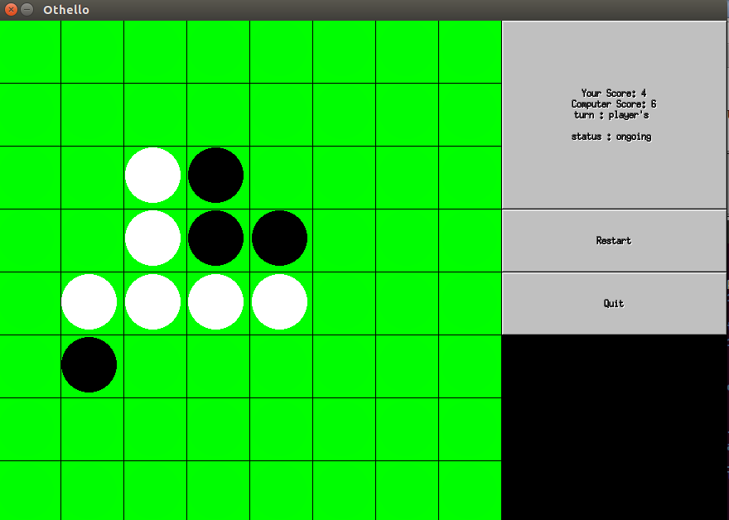
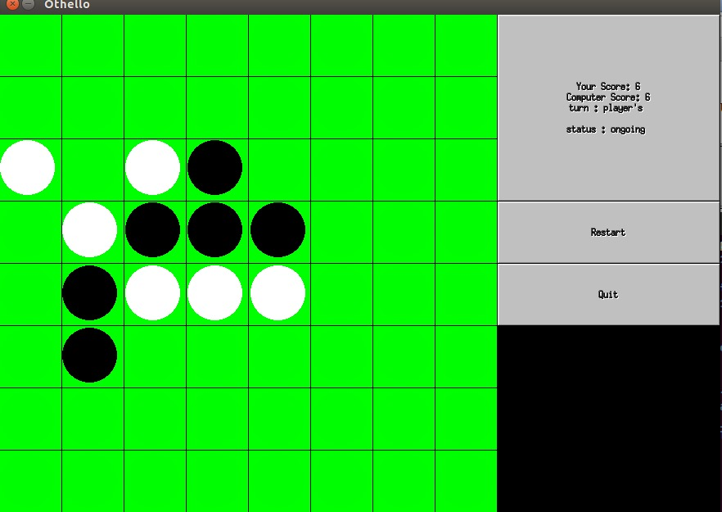

Slide 8
Game Of othello – End of game
The game ends when at least one of the following conditions hold true:-
The board is full.
The board has coins of only one colour.
When no player has a valid move.
Winner of the game is decided based on the number of coins he owns.
Image shown in next page shows a game played against stability.

Slide 9
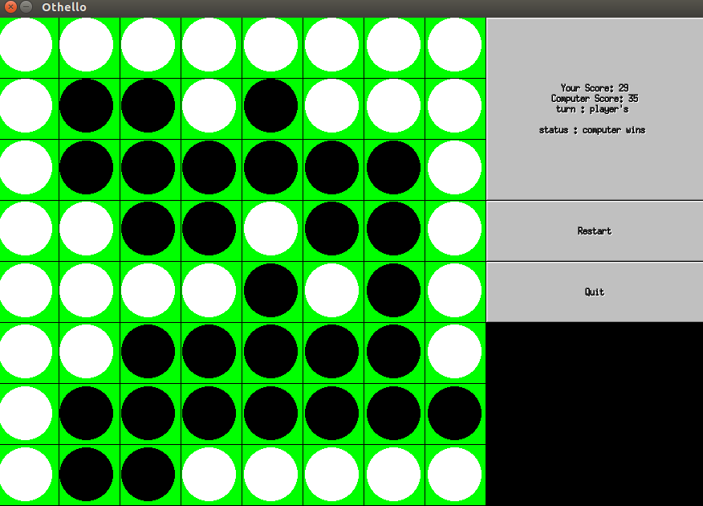
Game OVER

Slide 10
Search strategy
We used Nega-Max algorithm with alpha-beta pruning.
function negamax(node, depth, α, β, color)
if depth = 0 or node is a terminal node
return color * the heuristic value of node
bestValue := -∞
childNodes := GenerateMoves(node)
foreach child in childNodes
val := -negamax(child, depth - 1, -β, -α, -color)
bestValue := max( bestValue, val )
α := max( α, val )
if α ≥ β
break
return bestValue

Slide 11
Search STRATEGY
The code in the previous slide shows the negamax pseudocode.
Cost from the negamax algorithm is used to find the bestmove possible at this state.
We also can control the depth upto which the computer has to search.This is gven as an argument .

Slide 12
Heuristics
The heuristic functions control the ability of the computer to correctly determine how good particular state is for a player.
Evaluation of a particular state of game is done in Scorecoins function.
We implememted heuristics based on coin parity,stability,mobility and corners a player owns.
There is a option to select which heuristic to be played with in case of single player game.

Slide 13
Heuristics
COIN PARITY:
This component of the utility function captures
the difference in coins between the max player
and min player. This a natural greedy strategy.
MOBILITY:
This restricts the mobility of our opponent to mobilize ourself.The score is simply valid moves available.

Slide 14
HEURISTICS
CORNERS:
After capturing corners, they cannot be flipped ever again.Capturing this will ensure stability in those regions.The score will be number of corners a player has.
STABILITY:
The stability measure of the coin is a how hard to get it flipped. Stabilities given to each position can be viewed in next table.
A heuristic based on all these i.e giving weights for each of them is also made.

Slide 15
STABILITY TABLE
4 | -3 | 2 | 2 | 2 | 2 | -3 | 4
-3 | -4 | -1 | -1 | -1 | -1 | -4 | -3
2 | -1 | 1 | 0 | 0 | 1 | -1 | 2
2 | -1 | 0 | 1 | 1 | 0 | -1 | 2
2 | -1 | 0 | 1 | 1 | 0 | -1 | 2
2 | -1 | 1 | 0 | 0 | 1 | -1 | 2
-3 | -4 | -1 | -1 | -1 | -1 | -4 | -3
4 | -3 | 2 | 2 | 2 | 2 | -3 | 4

Slide 16
SUMMARY OF CODE
We wrote 2 codes one for the game between a player and a computer, the other between two programs to check which is better.
Number of lines :ONEPLAYER:585
COMPUTERS:612
Compiling fltk-config –compile filename.cpp
For running oneplayer ./oneplayer heuristic depth
computers ./computers heuristic1 heuristic2 depth
Heuristic 1:coin parity2:stability3:corners4:mobility5:combine

Slide 17
SUMMARY OF CODE
Functions used are:
Validmoves: possible moves for player.
Makemove: make a move and flip the necessary rows or columns or diagonals.
Scorecoins: find score of the present state.
Negamax: max score at this point
Bestmove: best possible move from the present state.
Handle: mouseclick takes us to this function

Slide 18
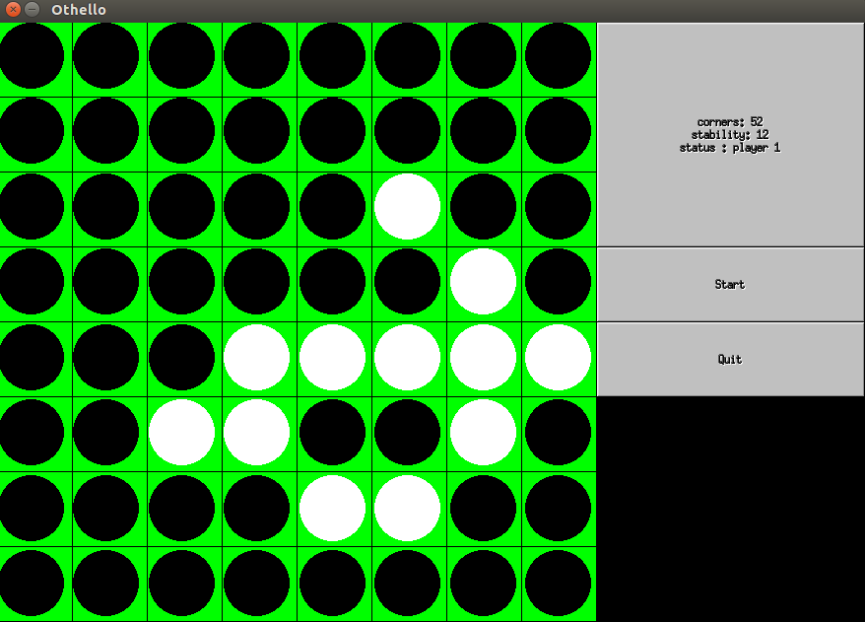
CORNERS VS stability

Slide 19
EVALUATion
We made one heuristic play against another and values are noted using our computers.cpp with a depth of 4.
./computers heuristic1(column) heuristic2(row) depth(4)
Each grid gives who is the winner and with what score.
From the table we can clearly say corners heuristic is good.

Slide 20
Evaluation
 | COINS | STABILITY | CORNERS | MOBILITY
COINS |  | DRAW 32-32 | CORNERS 54-0 | MOBILITY 45-19
STABILITY | COINS 57-7 |  | CORNERS 57-7 | MOBILITY 57-7
CORNERS | CORNERS 58-6 | CORNERS 52-12 |  | CORNERS 58-6
MOBILITY | COINS 45-19 | DRAW 32-32 | CORNERS 54-0

Slide 21
THANK YOU

