Slide 1


Episodul III

Slide 2

Node.js® is a JavaScript runtime built on Chrome's V8 JavaScript engine. Node.js uses an event-driven, non-blocking I/O model that makes it lightweight and efficient.

Slide 3
Node.js® is a JavaScript runtime built on Chrome's V8 JavaScript engine. Node.js uses an event-driven, non-blocking I/O model that makes it lightweight and efficient.

Slide 4
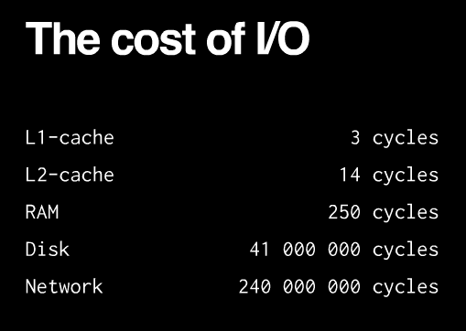

Slide 5
event-driven programming is application flow control that is determined by events or changes in state.
everything runs in parallel except your code

Slide 6
Node.js originally used libev
libev relies on kqueue or (e)poll only supported by UNIXes
libuv started as abstraction
libev for UNIX
IOCP for Windows
http://thlorenz.com/learnuv/book/what_is_libuv/what_is_libuv_0.html
https://www.youtube.com/watch?v=nGn60vDSxQ4

Slide 7
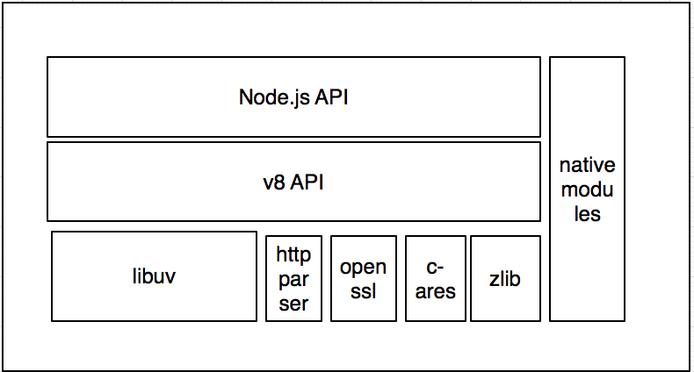

Slide 8
vanilla node.exe
iisnode
application
application
http
http
libuv
libuv
TCP
named pipes
iisnode
IIS
HTTP.SYS
TCP

Slide 9

Process management.
Side by side with other content types.
Scalability on multi-core servers.
Integrated debugging (with node-inspector)
Auto-update when your application changes
Access to logs over HTTP
Minimal changes to node.js application code (process.env.PORT)
Other IIS benefits (Port sharing, security, URL rewriting, compression, caching, logging)

Slide 10


Slide 11
libuv
Network I/O
File I/O
DNS
TCP
UDP
Pipe
TTY
uv__io_t io_watcher;
IOCP
(Windows)
Thread Pool
epoll (Linux)
kqueue (BSD)
event ports (Solaris)

Slide 12
Registered IO (RIO)

Slide 13
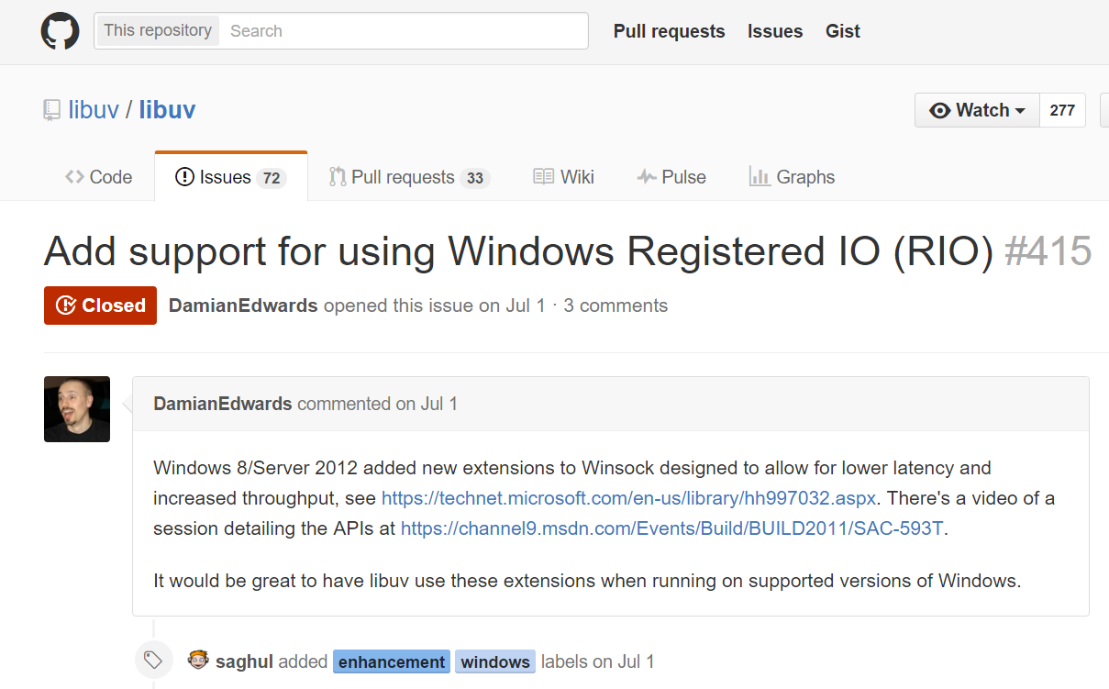

Slide 14
Stack | Server | Req/sec | Load Params | Implementation | Observations
libuv C# | perfsvr | 2,379,267 | 36 threads, 288 connections, pipelining 16 deep | Simple TCP server, load spread across 12 ports (port/thread/CPU) | CPU is 100%, mostly in user mode
RIO C# | perfsvr | 5,905,000 | 32 threads, 512 connections, pipelining 16 deep | Simple TCP server using Windows Registered IO (RIO) via P/Invoke from C# | CPU is 100%, 95% in user mode
Source:
ASP.NET 5 Experimental Benchmark
https://github.com/aspnet/benchmarks/blob/master/README.md

Slide 15

application
http
libuv
named pipes
iisnode
IIS
HTTP.SYS
TCP

Slide 16
application
HTTP Kernel-mode output caching
http
libuv
named pipes
iisnode
IIS
HTTP.SYS
TCP

Slide 17


