Slide 1


Descoperiti avantajele folosirii Linux si Open Source in Azure
Episodul III
Alex Badescu
Adrian Ionescu
Adrian Calinescu

Slide 2
Plaforma Azure App Services
Ce este PaaS?
WebDeploy
Deployment slots
Continuous Integration
Auto healing
Scaling
Traffic Manager
NODE
Ce este?
De ce, pentru ce?
Cross-platform – diferenta arhitectura pe diverse platforme (Linux, Win32)

Slide 3
Azure Web Apps
What is PaaS?
Why choose PaaS?

Slide 4
Azure Web Apps
Demo

Slide 5

App Service - one integrated offering
Web Apps
Mobile Apps
Web apps that scale with your business
Build Mobile apps for any device
LOGIC Apps
API Apps
Automate business process across SaaS and on-premises
Easily build and consume APIs in the cloud

Slide 6
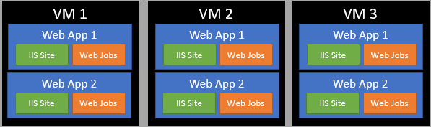
App Service Plan

Slide 7
Continuous Integration
Visual Studio Team Services (ex. VS Online)
Local Git Repository
Github (hooks)
Bitbucket (hooks)
https://azure.microsoft.com/en-us/documentation/articles/web-sites-publish-source-control/

Slide 8
Continuous Integration
Demo
https://azure.microsoft.com/en-us/documentation/articles/web-sites-publish-source-control/

Slide 9
Continuous Integration
Demo

Slide 10
Deployment slots
Actual live apps (up to 20 slots available)
Can swap slots with Production app
Great for beta-testing features
Assures no downtime on deployment
Can have specific settings for every slot

Slide 11

Staging

Slide 12
Staging

Slide 13
Scaling & Auto Scaling
Can Scale up & out
Up to 4 cores & 7 GB RAM per Instance
Up to 250 GB per Instance
Up to 20 Instances (*50)

Slide 14
Scaling & Auto Scaling
Demo

Slide 15
Kudu
General Environment Info
Debug Console
Process Explorer
File Browser
Real Time File Editing
https://github.com/projectkudu/

Slide 16
Auto-Healing
https://github.com/projectkudu/

Slide 17

Node.js was invented in 2009 by Ryan Dahl and other developers working at Joyent. Node.js was created and first published for Linux use in 2009.

Slide 18
Event-driven programming is application flow control that is determined by events or changes in state.
Everything runs in parallel except your code.

Slide 19
Event Queue
db.query(…)
Thread pool
Network call
Event loop
Network
Shift array
FIlesystem
Read from file
…
console.log()
Callback

Slide 20
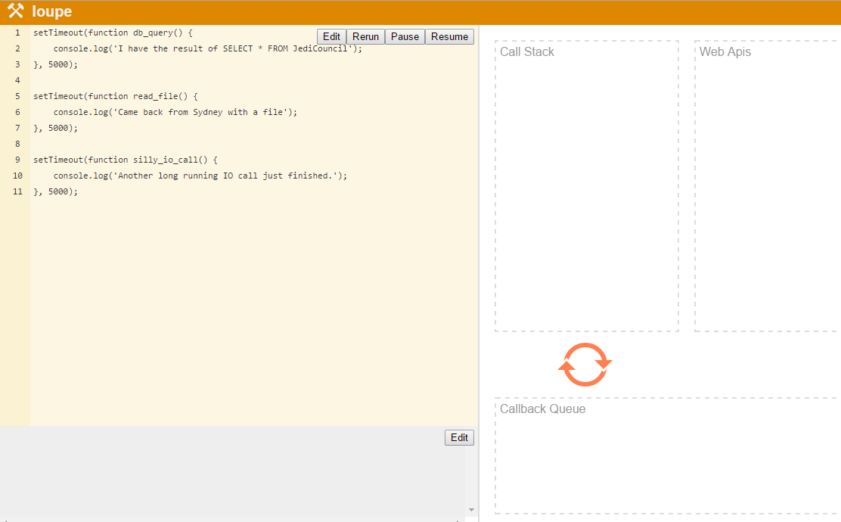
http://latentflip.com/loupe/
http://tinyurl.com/loupedemo

Slide 21
Node.js® is a JavaScript runtime built on Chrome's V8 JavaScript engine. Node.js uses an event-driven, non-blocking I/O model that makes it lightweight and efficient.

Slide 22
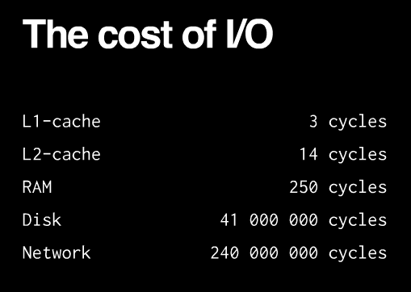

Slide 23
Blocking = Network, Disk
Non-blocking = L1, L2, RAM

Slide 24
Main thread
Thread #2
Thread #3
Node standard library
JavaScript
C
Node bindings
}
V8
Thread pool and event loop
(libuv)
The unit of parallelization is the PROCESS.

Slide 25
Node.js originally used libev
libev relies on kqueue or (e)poll only supported by UNIXes
libuv started as abstraction:
libev for UNIX
IOCP for Windows

Slide 26
libuv
Network I/O
File I/O
DNS
TCP
UDP
Pipe
TTY
uv__io_t io_watcher;
IOCP
(Windows)
Thread Pool
select()
epoll (Linux)
kqueue
(OSX & BSD)
event ports (Solaris)

Slide 27

select() system call
Available on most *NIXES
The prototype of this system call :
The select() mechanism was introduced in 4.2BSD.
It allows one to specify three sets of file descriptors (as bit masks) and a timeout. The call returns when the timeout expires or when one of the file descriptors in readfds has data available for reading.
Notify me when something happens on a set of given file descriptors!

Slide 28
event-driven non-blocking I/O model
Event Loop
Non-blocking
epoll on Linux, IOCP on Windows

Slide 29


request
response
blue_dragon_by_deskridge [deviantart]

Slide 30
vanilla node.exe
(*NIXES and Windows)
iisnode
application
application
http
http
libuv
libuv
TCP
named pipes
iisnode
IIS
HTTP.SYS
TCP

Slide 31

Process management.
Side by side with other content types.
Scalability on multi-core servers.
Integrated debugging (with node-inspector)
Auto-update when your application changes
Access to logs over HTTP
Minimal changes to node.js application code (process.env.PORT)
Other IIS benefits (Port sharing, security, URL rewriting, compression, caching, logging)

Slide 32


Slide 33
RIO (Registered I/O) Sockets
Extension of WinSock
Use Request Queues and Completion Queues
Use previously Registered Buffers for I/O
Allow for fast polling of I/O completions
Can be used with IOCP and Win32 Events for efficient waits

Slide 34
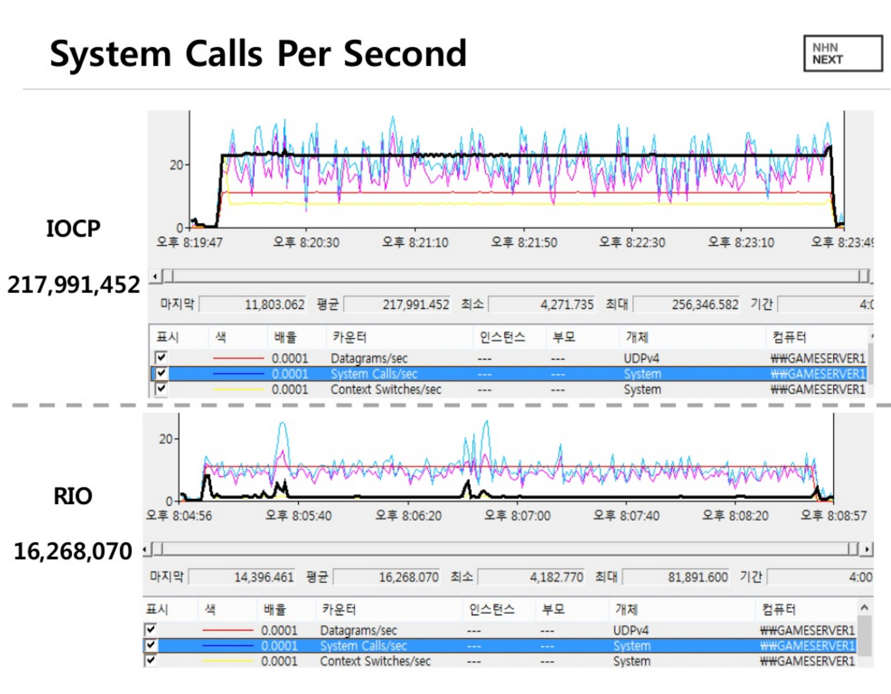

Slide 35
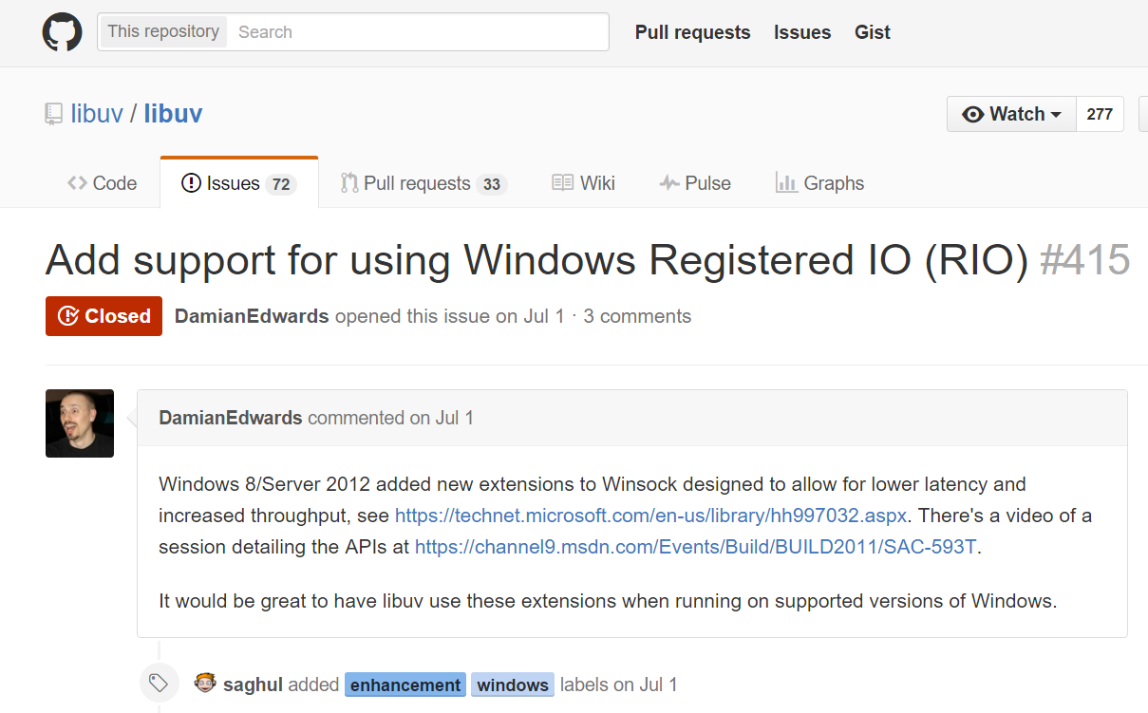

Slide 36
Stack | Server | Req/sec | Load Params | Implementation | Observations
libuv C# | perfsvr | 2,379,267 | 36 threads, 288 connections, pipelining 16 deep | Simple TCP server, load spread across 12 ports (port/thread/CPU) | CPU is 100%, mostly in user mode
RIO C# | perfsvr | 5,905,000 | 32 threads, 512 connections, pipelining 16 deep | Simple TCP server using Windows Registered IO (RIO) via P/Invoke from C# | CPU is 100%, 95% in user mode
Source:
ASP.NET 5 Experimental Benchmark
https://github.com/aspnet/benchmarks/blob/master/README.md

Slide 37

application
http
libuv
named pipes
iisnode
IIS
HTTP.SYS
TCP

Slide 38
application
HTTP Kernel-mode output caching
http
libuv
named pipes
iisnode
IIS
HTTP.SYS
TCP

Slide 39

LIVE DEMO
Image Copyright Lucasfilm LTD

Slide 40
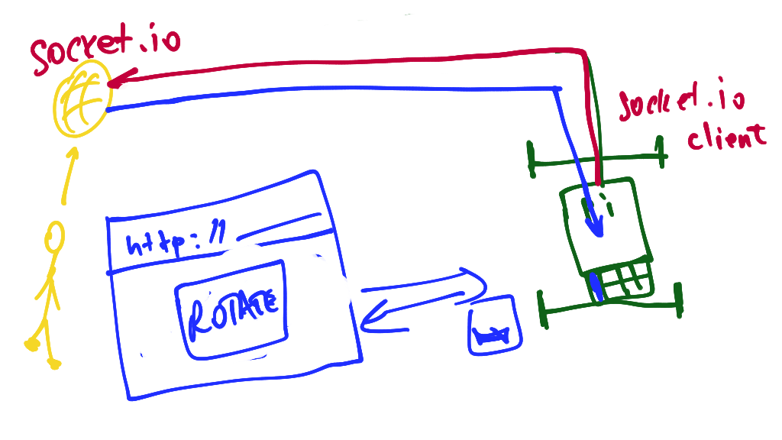
1st draft (AKA all we had one week ago):

Slide 41


