Slide 1


Descoperiti avantajele folosirii Linux si Open Source in Azure
Episodul III
Alex Badescu
Adrian Ionescu
Adrian Calinescu

Slide 2
Plaforma Azure App Services
Ce este PaaS?
WebDeploy
Deployment slots
Continuous Integration
Auto healing
Scaling
Traffic Manager
NODE
Ce este?
De ce, pentru ce?
Cross-platform – diferenta arhitectura pe diverse platforme (Linux, Win32)

Slide 3

App Service - one integrated offering
Web Apps
Mobile Apps
Web apps that scale with your business
Build Mobile apps for any device
LOGIC Apps
API Apps
Automate business process across SaaS and on-premises
Easily build and consume APIs in the cloud

Slide 4
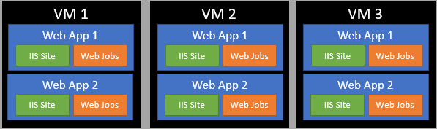
App Service Plan

Slide 5

Staging

Slide 6
Staging

Slide 7

Node.js® is a JavaScript runtime built on Chrome's V8 JavaScript engine. Node.js uses an event-driven, non-blocking I/O model that makes it lightweight and efficient.

Slide 8
Node.js® is a JavaScript runtime built on Chrome's V8 JavaScript engine. Node.js uses an event-driven, non-blocking I/O model that makes it lightweight and efficient.

Slide 9
Event-driven programming is application flow control that is determined by events or changes in state.
Everything runs in parallel except your code

Slide 10
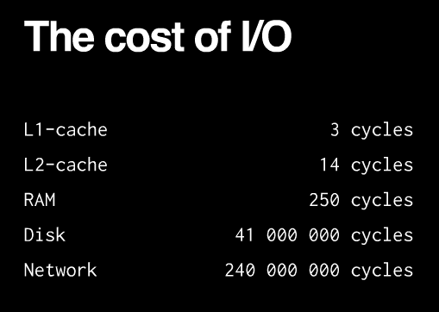

Slide 11
Event Queue
db.query(…)
Thread pool
Event loop
Network call
Network
Shift array
FIlesystem
Read from DIsk
…
console.log()
Callback

Slide 12
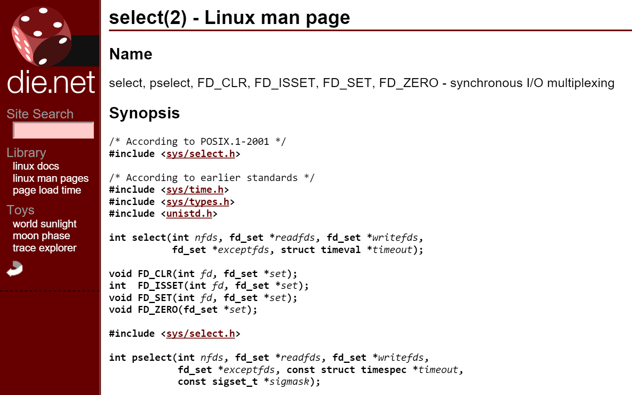
Notify me when something happens on a set of given file descriptors!

Slide 13
Main thread
Thread #2
Thread #3
Node standard library
JavaScript
C
Node bindings
}
V8
Thread pool and event loop
(libuv)
The unit of parallelization is the PROCESS.

Slide 14
vanilla node.exe
(*NIXES and Windows)
iisnode
application
application
http
http
libuv
libuv
TCP
named pipes
iisnode
IIS
HTTP.SYS
TCP

Slide 15

Process management.
Side by side with other content types.
Scalability on multi-core servers.
Integrated debugging (with node-inspector)
Auto-update when your application changes
Access to logs over HTTP
Minimal changes to node.js application code (process.env.PORT)
Other IIS benefits (Port sharing, security, URL rewriting, compression, caching, logging)

Slide 16


Slide 17
Node.js originally used libev
libev relies on kqueue or (e)poll only supported by UNIXes
libuv started as abstraction
libev for UNIX
IOCP for Windows
http://thlorenz.com/learnuv/book/what_is_libuv/what_is_libuv_0.html
https://www.youtube.com/watch?v=nGn60vDSxQ4

Slide 18
libuv
Network I/O
File I/O
DNS
TCP
UDP
Pipe
TTY
uv__io_t io_watcher;
IOCP
(Windows)
Thread Pool
epoll (Linux)
kqueue
(OSX & BSD)
event ports (Solaris)

Slide 19
RIO (Registered I/O) Sockets
Extension of WinSock
Use Request Queues and Completion Queues
Use previously Registered Buffers for I/O
Allow for fast polling of I/O completions
Can be used with IOCP and Win32 Events for efficient waits

Slide 20
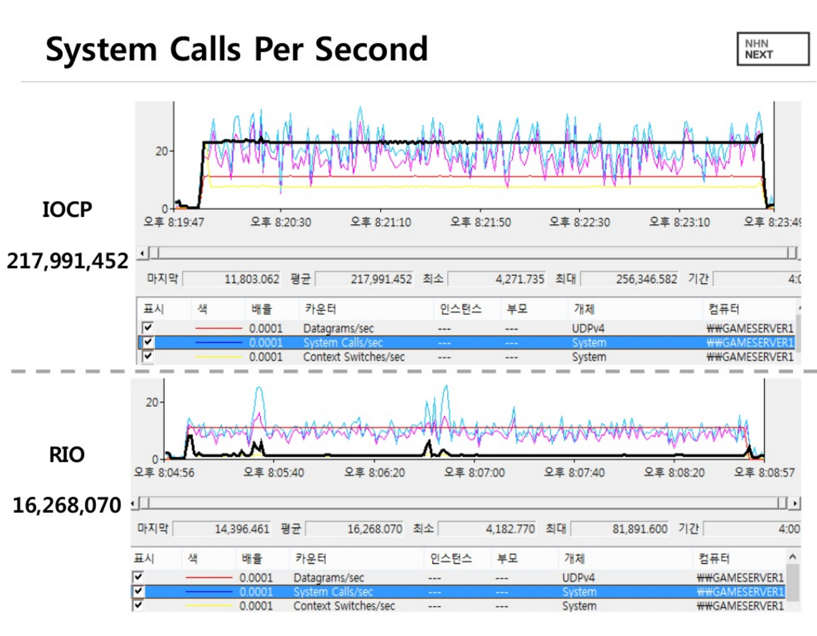

Slide 21
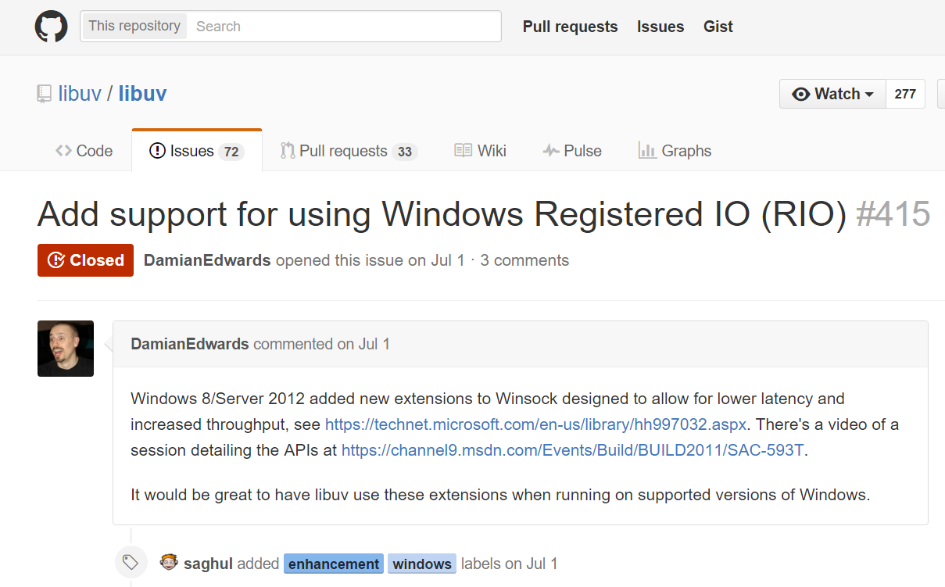

Slide 22
Stack | Server | Req/sec | Load Params | Implementation | Observations
libuv C# | perfsvr | 2,379,267 | 36 threads, 288 connections, pipelining 16 deep | Simple TCP server, load spread across 12 ports (port/thread/CPU) | CPU is 100%, mostly in user mode
RIO C# | perfsvr | 5,905,000 | 32 threads, 512 connections, pipelining 16 deep | Simple TCP server using Windows Registered IO (RIO) via P/Invoke from C# | CPU is 100%, 95% in user mode
Source:
ASP.NET 5 Experimental Benchmark
https://github.com/aspnet/benchmarks/blob/master/README.md

Slide 23

application
http
libuv
named pipes
iisnode
IIS
HTTP.SYS
TCP

Slide 24
application
HTTP Kernel-mode output caching
http
libuv
named pipes
iisnode
IIS
HTTP.SYS
TCP

Slide 25


