Slide 1




SECURITY OPERATIONS · DEPLOYMENT REPORT
Azure Security &
SIEM Deployment
Microsoft Sentinel, Azure Monitor Agent and KQL-driven log validation across a hybrid Windows and Linux estate
Azure Portal
Microsoft Sentinel
East US
Prepared by a SOC Analyst | September 2026
Notes:
Opening slide. This report walks through a hands-on Microsoft Sentinel deployment in Azure: building the SIEM foundation, provisioning Windows and Linux virtual machines, onboarding telemetry through the Azure Monitor Agent with Data Collection Rules, and validating ingestion with KQL.

Slide 2





EXECUTIVE SUMMARY
The deployment at a glance
2
3
2
1
Virtual machines
Data connectors
Data collection rules
Log Analytics workspace
Windows 11 Pro + Ubuntu 24
Activity, Security Events, Syslog
One per operating system
LAWmuler — Sentinel enabled
What was built
Validated in the portal
A single resource group, rgSIEM, hosts the full lab estate in the East US region. A Log Analytics workspace collects every log generated by the virtual machines and other log-producing systems, and Microsoft Sentinel is layered on top of that workspace to deliver security information and event management. Kusto Query Language is then used to interrogate the collected data and turn raw events into meaningful security insight.
All three connectors report Connected
SecurityEvent table populated from WindowsVM
Syslog table populated from UbuntuVM
Queries return results in both portals
Azure Security & SIEM Deployment
2
Notes:
Headline numbers for the build: two virtual machines, three data connectors, two data collection rules and one Log Analytics workspace, all co-located in East US. Every connector reported a Connected status and both the SecurityEvent and Syslog tables returned data on query.

Slide 3


PURPOSE
Objectives and scope of the exercise
Stand up the SIEM foundation
Provision hybrid compute
Create a dedicated resource group and Log Analytics workspace, then enable Microsoft Sentinel on that workspace to act as the central security analytics plane.
Deploy a Windows 11 Pro virtual machine and an Ubuntu 24 virtual machine to generate representative operating-system telemetry for a mixed estate.
Onboard telemetry through AMA
Validate ingestion with KQL
Install the Azure Activity, Windows Security Events and Syslog connectors, and configure Data Collection Rules so the Azure Monitor Agent forwards the right events.
Query the workspace with Kusto Query Language to confirm events are landing, and compare the legacy Azure portal experience with the new Defender portal.
Azure Security & SIEM Deployment
3
Notes:
Four objectives framed the exercise: build the SIEM foundation, provision hybrid compute, onboard telemetry through the Azure Monitor Agent, and prove ingestion with KQL. Scope was deliberately limited to a single subscription and region so latency and cost stayed predictable.

Slide 4




TOOLING
Technology stack
Azure Portal
Microsoft Sentinel
Log Analytics workspace
Primary control plane used to create and configure every resource in the lab.
Cloud-native SIEM and SOAR layered directly on the Log Analytics workspace.
LAWmuler — the single store for all ingested machine and platform logs.
Azure Monitor Agent
Data Collection Rules
Kusto Query Language
Modern unified agent that replaces the legacy MMA for log collection.
mywindowsDCR and myubuntuDCRnew define what each agent actually sends.
Query language used to verify ingestion and extract security insight.
Region: East US · Subscription: Azure subscription 1 · Resource group: rgSIEM
Azure Security & SIEM Deployment
4
Notes:
The stack is deliberately Microsoft-native. Sentinel sits on the Log Analytics workspace, the Azure Monitor Agent is the single collection agent for both operating systems, Data Collection Rules decide what that agent sends, and KQL is the query layer over everything.

Slide 5




ARCHITECTURE
Subscription, resource group and resource topology
Azure subscription 1
REGION: EAST US
Resource group · rgSIEM
COMPUTE
COLLECTION
ANALYTICS & SIEM
WindowsVM
mywindowsDCR
LAWmuler
Windows 11 Pro · Standard_F1ads_v7
Security events → workspace
Log Analytics workspace
Microsoft Sentinel
UbuntuVM
myubuntuDCRnew
SecurityInsights (lawmuler)
Ubuntu 24 · Standard_D2alds_v7
Syslog facilities → workspace
Azure Monitor Agent installed on both machines
Tables: SecurityEvent · Syslog · AzureActivity
Supporting infrastructure
vnet-eastus-1
Bastion
Network security group
Public IP
SSH key
Managed disks
Azure Security & SIEM Deployment
5
Notes:
Architecture view. Azure subscription 1 is the outer boundary, drawn dashed. Inside it, the rgSIEM resource group holds everything: the two virtual machines on the left, the Data Collection Rules that scope what the Azure Monitor Agent sends in the middle, and on the right the Log Analytics workspace with Microsoft Sentinel enabled on top of it. Networking and access resources support the estate underneath.

Slide 6

METHOD
End-to-end deployment workflow
1
2
3
4
5
Foundation
Compute
Enable SIEM
Ingest
Verify
Create the rgSIEM resource group and the LAWmuler Log Analytics workspace in East US.
Provision WindowsVM and UbuntuVM into the same resource group and the same region.
Turn on Microsoft Sentinel against the workspace to add security analytics.
Install Azure Activity, Windows Security Events and Syslog connectors, then bind Data Collection Rules to the Azure Monitor Agent.
Run KQL queries against SecurityEvent and Syslog to confirm events are arriving.
Design rule applied throughout: the virtual machines and the Log Analytics workspace are deployed in the same Azure region to minimise latency and avoid cross-region data egress.
Azure Security & SIEM Deployment
6
Notes:
Five stages, each dependent on the one before it. Sentinel cannot be enabled before the workspace exists, connectors cannot report data before the agent and Data Collection Rules are in place, and verification is only meaningful once ingestion has had time to flow.

Slide 7
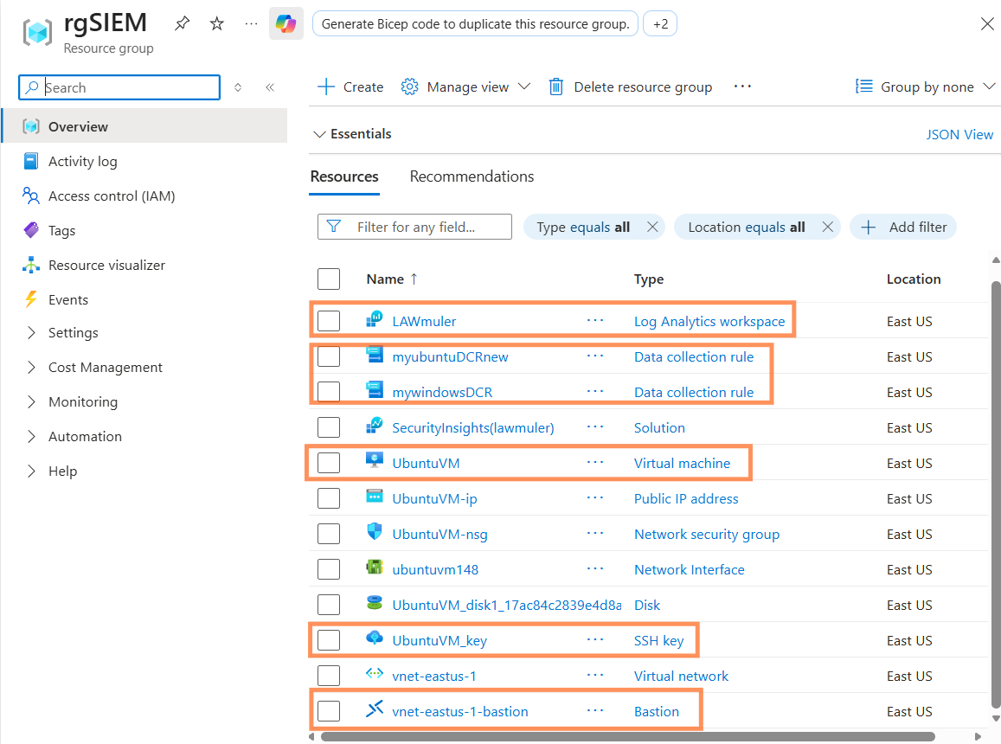

FOUNDATION
Resource group: rgSIEM
Core SIEM resources
LAWmuler
Log Analytics workspace
SecurityInsights (lawmuler)
Microsoft Sentinel solution
mywindowsDCR / myubuntuDCRnew
Data collection rules
UbuntuVM · WindowsVM
Virtual machines
Why one resource group
Grouping the workspace, rules and machines together keeps lifecycle, access control and cost reporting in one place, and lets the whole lab be torn down in a single operation.
Figure 1 — rgSIEM resource group blade, Azure portal
Azure Security & SIEM Deployment
7
Notes:
The resource group blade confirms every component landed in East US: the workspace, the Sentinel solution, both data collection rules, both virtual machines and their supporting network, disk and access resources.

Slide 8
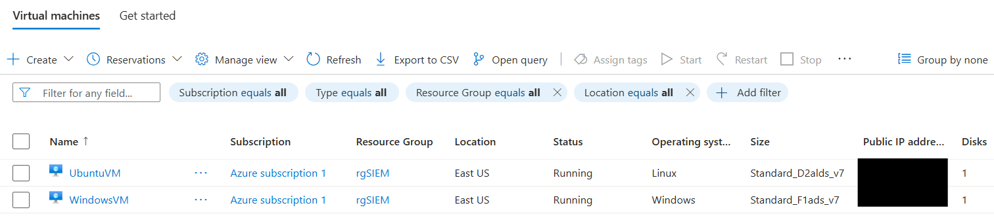
COMPUTE
Virtual machine estate
Figure 2 — Virtual machines blade, both instances running
WindowsVM
RUNNING
UbuntuVM
RUNNING
Operating system
Windows 11 Pro
Operating system
Ubuntu 24
Size
Standard_F1ads_v7
Size
Standard_D2alds_v7
Telemetry
Security event log
Telemetry
rsyslog facilities
Azure Security & SIEM Deployment
8
Notes:
Both machines sit in Azure subscription 1, resource group rgSIEM, region East US, and both were running at the point of capture. The Windows machine supplies security event log data and the Ubuntu machine supplies syslog, giving coverage of a realistically mixed estate.

Slide 9


LOG INGESTION
Data connectors installed
CONNECTED
CONNECTED
CONNECTED
Azure Activity
Windows Security Events via AMA
Syslog via AMA
Control-plane audit trail
WindowsVM
UbuntuVM
Captures subscription-level operations — who created, changed or deleted a resource and when.
Streams the full Windows security event log into the workspace for dashboards, custom alerts and investigation.
The Linux agent configures the local syslog daemon to forward messages, which the agent then sends to the workspace.
Agent model: AMA with Data Collection Rules
Collection is handled by the Azure Monitor Agent rather than the retired Log Analytics agent. Each machine is associated with a Data Collection Rule — mywindowsDCR for security events, myubuntuDCRnew for syslog — which defines exactly which events are gathered and which workspace receives them. Scoping collection at the rule level keeps noise and ingestion cost under control.
Azure Security & SIEM Deployment
9
Notes:
Three connectors were installed from the Content Hub. Azure Activity gives the control-plane audit trail, Windows Security Events via AMA covers the Windows host, and Syslog via AMA covers the Linux host. All three must show a Connected status before any detection work is meaningful.

Slide 10
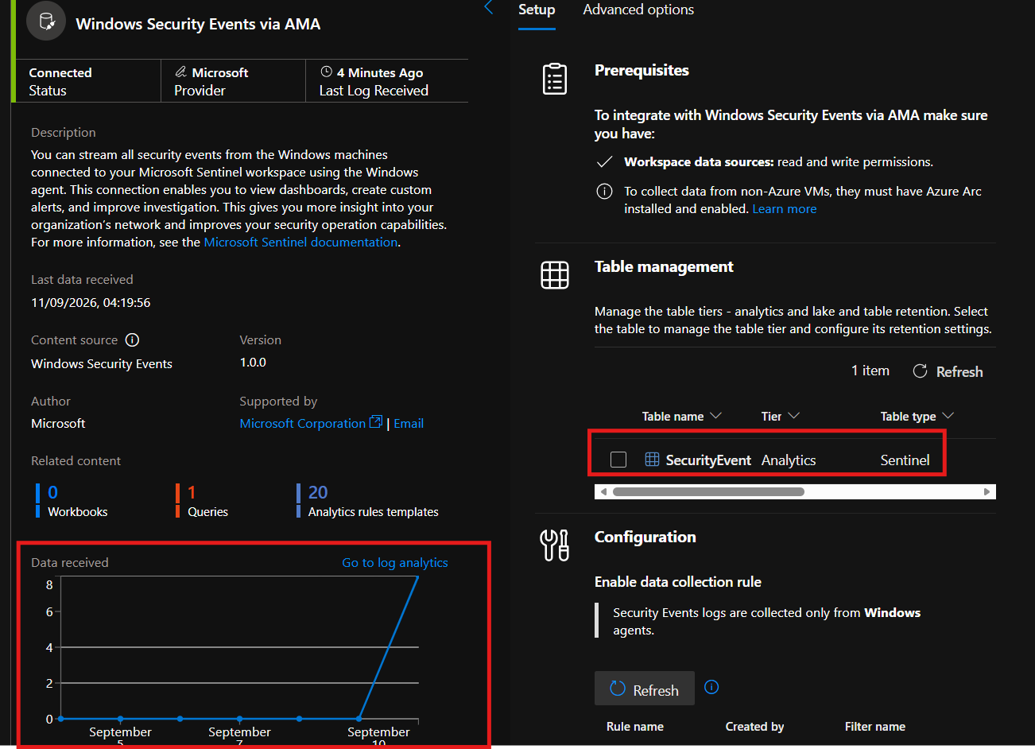


CONNECTOR DETAIL
Windows Security Events via AMA
Status: Connected
Provider Microsoft, last log received four minutes before capture.
Table: SecurityEvent
Analytics tier, Sentinel table type — queryable immediately in KQL.
Data collection rule enabled
Security event logs are collected only from Windows agents, as defined by mywindowsDCR.
Content available
One query and twenty analytics rule templates ship with the connector.
Figure 3 — Connector page: status, table management and data received
Prerequisite noted on the page: to collect from machines outside Azure, Azure Arc must be installed and enabled.
Azure Security & SIEM Deployment
10
Notes:
This connector streams all security events from Windows machines connected to the Sentinel workspace. That feed is what makes dashboards, custom alerts and investigations possible, and it is the single biggest source of visibility into activity on the Windows estate. Always confirm the status reads Connected and that a recent log timestamp is shown.

Slide 11
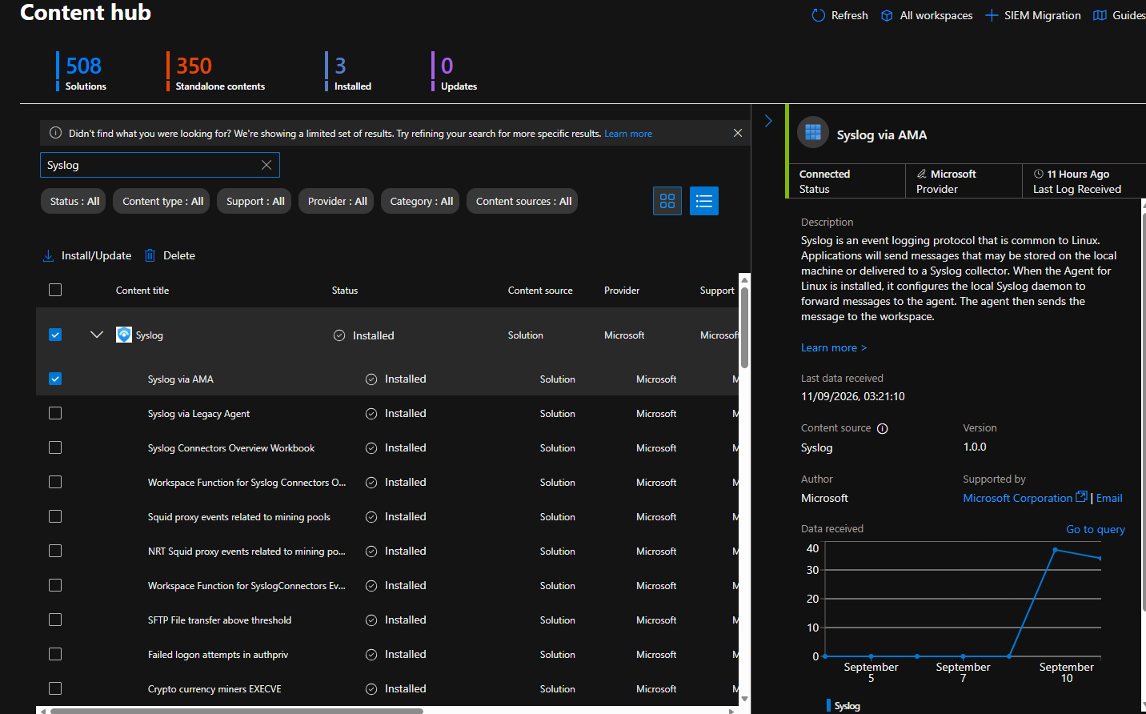
CONNECTOR DETAIL
Syslog via AMA
How the pipeline works
Syslog is the common event logging protocol on Linux. Applications hand messages to the local syslog daemon; installing the agent reconfigures that daemon to forward messages to the Azure Monitor Agent, which then ships them to the LAWmuler workspace.
INGESTION PATH
1. Application
2. rsyslog daemon
3. Azure Monitor Agent
Figure 4 — Content hub: Syslog solution installed, connector reporting Connected
Connector reported its last log received eleven hours before capture, confirming a steady feed.
4. LAWmuler workspace
Azure Security & SIEM Deployment
11
Notes:
The Syslog solution was installed from the Content Hub, which also brings in ready-made detections such as failed logon attempts in authpriv and crypto-currency miner execution. The connector page shows the Connected status and a data-received chart confirming the feed.

Slide 12
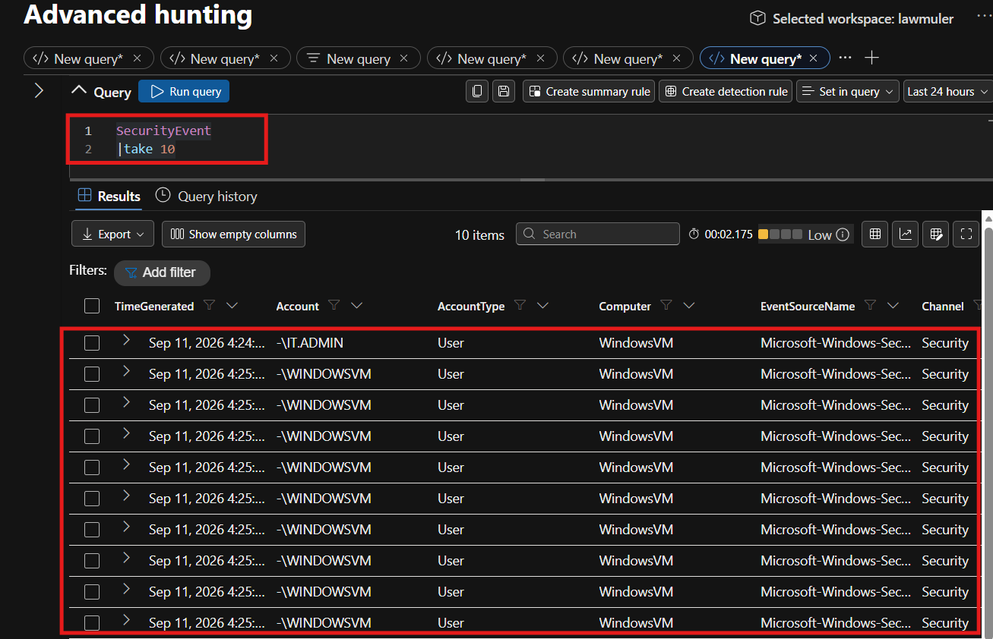
VERIFICATION
Log verification with KQL — Windows
QUERY RUN
SecurityEvent
| take 10
What the result confirms
Ten rows returned in roughly two seconds
Computer column resolves to WindowsVM
Event source is Microsoft-Windows-Security-Auditing
Channel is Security, account type User
Accounts observed include IT.ADMIN and the machine account
Figure 5 — Advanced hunting, SecurityEvent results for the lawmuler workspace
Azure Security & SIEM Deployment
12
Notes:
Running SecurityEvent with a take of ten is the quickest sanity check that the Windows pipeline is alive. The returned rows name the source computer, the event provider and the account involved, which is enough to prove that the connector, the agent and the data collection rule are all working together.

Slide 13
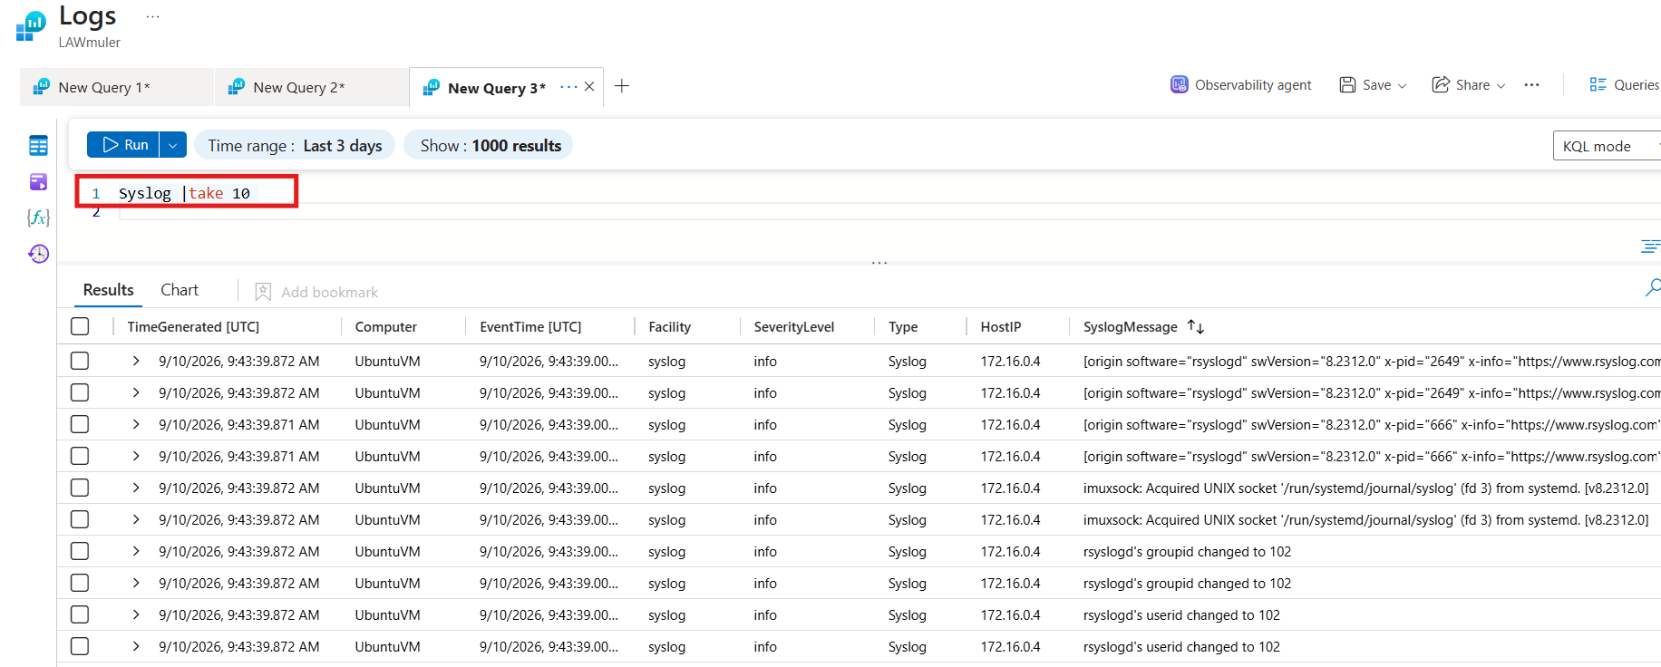
VERIFICATION
Log verification with KQL — Ubuntu
Syslog | take 10
Run in the Logs blade of the LAWmuler workspace, time range last three days.
Figure 6 — Legacy Logs interface on the Azure portal, LAWmuler workspace
10 rows returned
UbuntuVM
172.16.0.4
Azure Security & SIEM Deployment
13
Notes:
The Linux side is verified the same way. Ten syslog records come back from UbuntuVM at host IP 172.16.0.4, with facility syslog and severity info, including rsyslog start-up messages. That confirms the daemon is forwarding and the agent is delivering to the workspace.

Slide 14
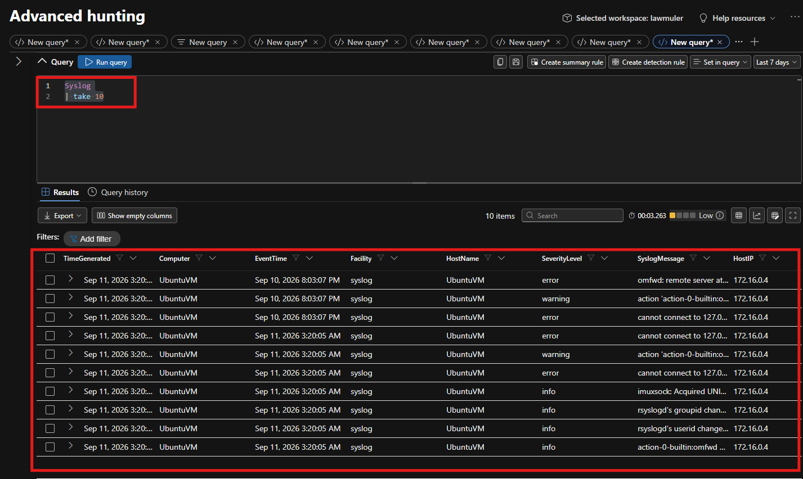

PLATFORM CHANGE
From the Azure portal to the Defender portal
What is changing
Microsoft Sentinel has moved to the unified security portal at security.microsoft.com. It can still be reached from the Azure portal today, but that route is slated for retirement.
Azure portal
BEING PHASED OUT
Logs blade on the workspace
Defender portal
TARGET EXPERIENCE
Advanced hunting, multi-tab queries
Figure 7 — The same Syslog query in the new Advanced hunting interface
The same KQL runs unchanged in both experiences, so query skill transfers directly. What changes is navigation, tab handling and the incident workflow built around the results.
Analyst action: work in the new portal by default.
Azure Security & SIEM Deployment
14
Notes:
Worth flagging to any team following this build: the same KQL runs unchanged in both places, so the query skill transfers directly. What changes is navigation, tab handling and the surrounding incident experience, so it is sensible to work in the Defender portal by default from now on.

Slide 15
RESULTS
Validation summary
Resource group provisioned
rgSIEM contains all lab resources in East US
PASS
Workspace and SIEM enabled
LAWmuler active with the SecurityInsights solution
PASS
Virtual machines running
WindowsVM and UbuntuVM both reachable and reporting
PASS
Connectors healthy
Azure Activity, Windows Security Events and Syslog all Connected
PASS
Windows ingestion proven
SecurityEvent returns rows sourced from WindowsVM
PASS
Linux ingestion proven
Syslog returns rows sourced from UbuntuVM at 172.16.0.4
PASS
Azure Security & SIEM Deployment
15
Notes:
Every check in the build passed. This table is the evidence summary a reviewer would ask for: what was tested, what proved it, and the outcome.

Slide 16


LESSONS
Observations and good practice
Co-locate workspace and workloads
Standardise on the Azure Monitor Agent
Deploying the virtual machines and the Log Analytics workspace in the same Azure region keeps latency low and avoids cross-region transfer charges.
AMA is the supported collection path; the legacy agent is retired. One agent covers both Windows and Linux, which simplifies rollout and troubleshooting.
Scope collection at the rule, not the agent
Treat connector status as a daily check
Data Collection Rules decide which events are gathered and where they land. Tight rules keep ingestion volume, and therefore cost, predictable.
A connector showing Connected with a recent last-log timestamp is the fastest early warning that a telemetry source has gone silent.
Sentinel is billed on data ingested and retained — collection design is a cost decision as much as a security one.
Azure Security & SIEM Deployment
16
Notes:
Four takeaways that generalise beyond this lab. The region point protects latency and cost, the agent point keeps the deployment supportable, the rule-scoping point is the main lever on ingestion spend, and the connector-health point is an operational habit worth building early.

Slide 17




ROADMAP
Where this build goes next
Analytics rules
MITRE ATT&CK mapping
Workbooks and dashboards
Automation with playbooks
Enable the twenty rule templates shipped with the Windows connector and tune thresholds to the estate.
Map active detections to tactics and techniques to expose coverage gaps rather than assume them.
Build workbooks over SecurityEvent and Syslog to give the SOC an at-a-glance operational view.
Use Logic App playbooks to enrich, notify and contain, shortening mean time to respond.
Further additions under consideration
UEBA
Threat intelligence
Watchlists
Azure Arc for non-Azure hosts
Long-term retention
Azure Security & SIEM Deployment
17
Notes:
Ingestion is the foundation, not the finish line. The natural next moves are turning on and tuning detections, mapping them to ATT&CK for honest coverage reporting, giving analysts visual context through workbooks, and automating the repetitive parts of response.

Slide 18

PART TWO
Attack simulation
& detection
Validating the SIEM the only way that really counts — by launching a live SSH brute-force attack against a target VM and confirming Sentinel captures it.
1. Deploy target
›
2. Brute force
›
3. Compromise
›
4. Detect in Sentinel
Notes:
Section break. Everything up to here proved the pipeline collects logs. This second part proves it detects a real intrusion: a new target VM is stood up deliberately weak, attacked with Hydra over SSH, compromised, and the resulting authentication failures are then hunted down in Sentinel.

Slide 19

ATTACK SIMULATION
Scenario: SSH brute force on a target VM
The objective
Lab set-up
Attacker
UbuntuVM — existing lab host, via Azure Cloud Shell
Stand up a deliberately weak Linux VM, break into it over SSH with a password-guessing attack, and then confirm the whole intrusion is visible in Sentinel. This closes the loop between collecting logs and actually detecting an attack in them.
Target
TargetUbuntuVM — new VM, password auth enabled
Target public IP
20.81.249.104 · East US 2
Tool
Hydra v9.5, parallel SSH login attempts
Exposure
NSG rule UserRule_SSH allows port 22 inbound
Create the target
Connect to attacker
Prepare wordlists
Deploy TargetUbuntuVM with a username and password set, since a brute force needs credentials to guess.
Use SSH via Azure CLI to reach the source UbuntuVM and open a Cloud Shell session.
Build UsernameList and PasswordList files holding candidate credential combinations.
Azure Security & SIEM Deployment
19
Notes:
The target is intentionally soft: password authentication is left on and an NSG rule opens port 22 to the source. That is what makes the brute force viable and gives Sentinel something to catch. In a real environment these are exactly the misconfigurations you would be hunting for.

Slide 20
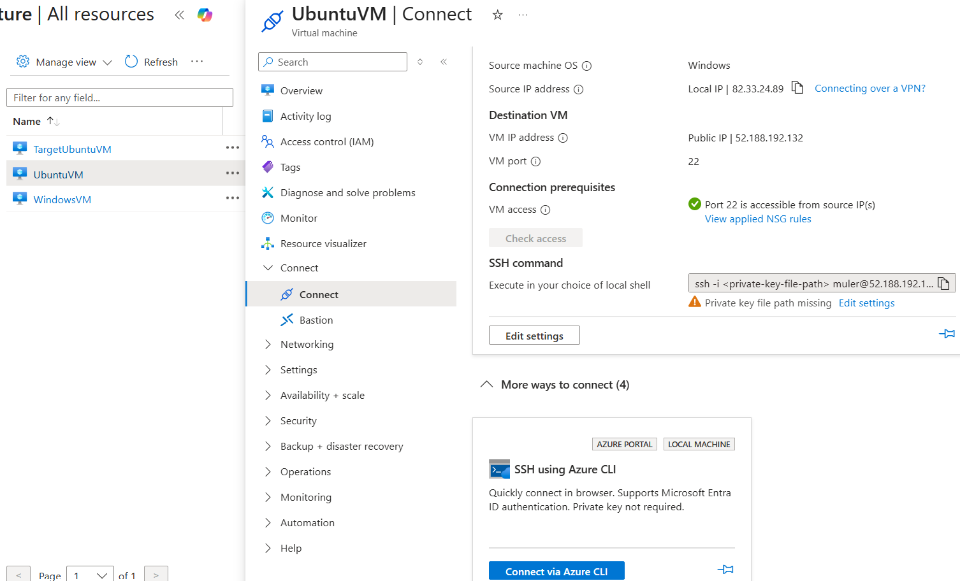
ATTACK SIMULATION
Reaching the target: SSH, NSG and prerequisites
Port 22 reachable
The Connect blade confirms port 22 is accessible from the source IP before any attempt is made.
NSG rule in place
NSG diagnostics show UserRule_SSH on UbuntuVM-nsg explicitly allowing SSH traffic to the interface.
Connect via Cloud Shell
Entra ID SSH extension and a system-assigned managed identity are configured, so Cloud Shell connects with no private key.
Figure 8 — UbuntuVM Connect blade: destination, port 22 and the SSH-via-CLI option
Azure Security & SIEM Deployment
20
Notes:
Before attacking, the analyst confirms the path in: the destination VM, its public IP, port 22 open from the source, and the NSG rule that allows it. Connecting through SSH via Azure CLI opens a browser Cloud Shell that authenticates with managed identity, so no key file is needed.

Slide 21
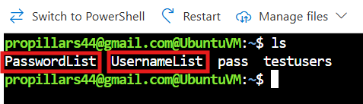
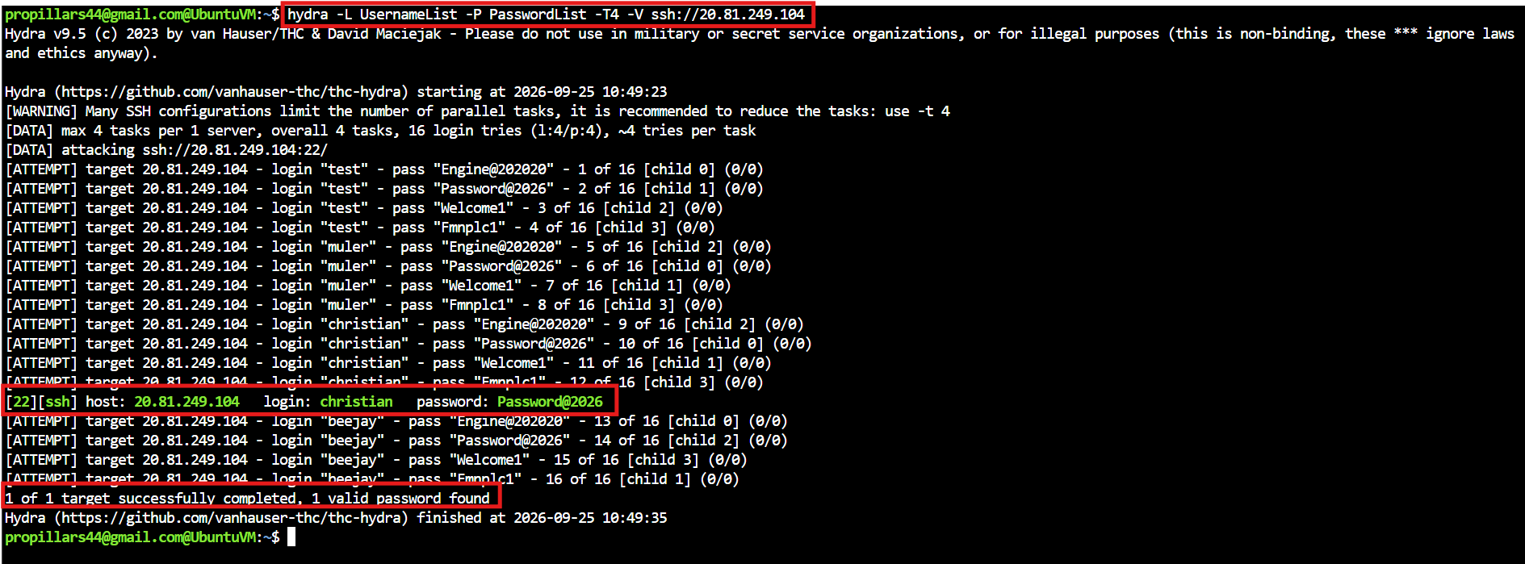

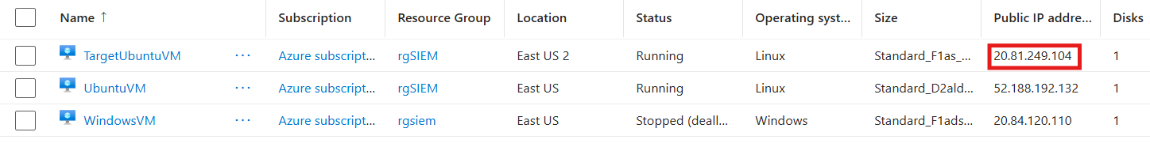
ATTACK SIMULATION
Launching the Hydra brute force
PREPARATION
Wordlists staged in Cloud Shell: UsernameList + PasswordList
$ sudo apt update && sudo apt upgrade
$ sudo apt install hydra
$ hydra -L UsernameList -P PasswordList \
-T4 -V ssh://20.81.249.104
Figure 9 — Hydra output: one valid credential found
Update the repos, install Hydra, then run parallel SSH login attempts against the target's public IP.
Result: target compromised
16 login attempts ran across 4 parallel tasks. Hydra recovered a working SSH credential:
login christian password Password@2026
Target identified
Azure Security & SIEM Deployment
21
Notes:
With the wordlists in place, Hydra is installed and pointed at the target's public IP. Sixteen combinations are tried across four parallel tasks and one succeeds — the christian account with Password@2026. At this point the target is compromised. Every one of those attempts also generated an authentication event, which is what we go looking for next.

Slide 22
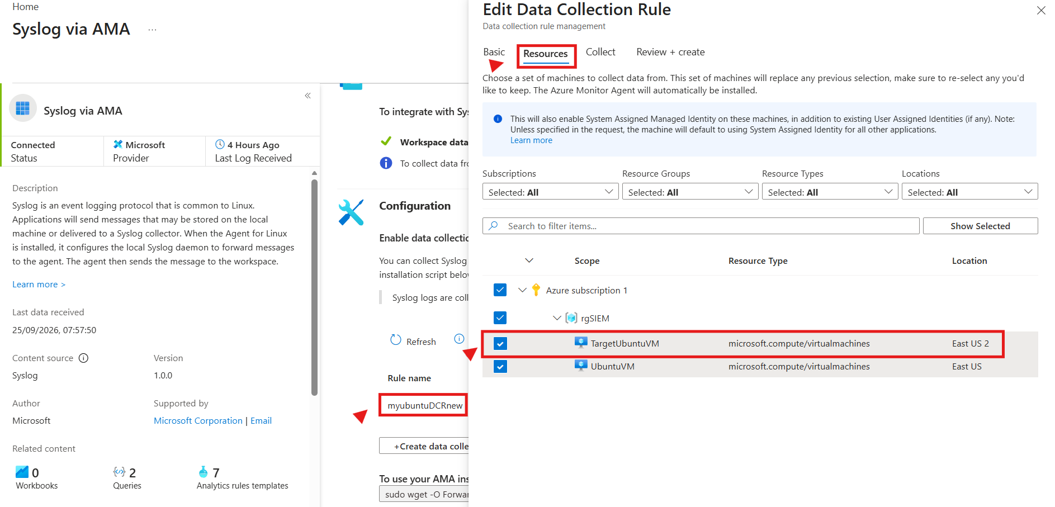
DETECTION
Bringing the target into Sentinel via the DCR
Why this step matters
A VM only appears in Sentinel once a Data Collection Rule scopes it in. The new target is added to myubuntuDCRnew under the Resources tab, which also installs the Azure Monitor Agent and enables a system-assigned managed identity on the machine.
TargetUbuntuVM selected alongside UbuntuVM
AMA installed automatically on selection
Syslog now flows to LAWmuler
Figure 10 — Editing myubuntuDCRnew to add TargetUbuntuVM as a collected resource
Key takeaway: if the target had not been added to the DCR, the attack would have succeeded silently — Sentinel can only detect what it is told to collect.
Azure Security & SIEM Deployment
22
Notes:
Detection depends entirely on collection. The target is added to the existing Ubuntu DCR under the Resources tab, which pushes the Azure Monitor Agent onto it and starts forwarding syslog. Miss this step and the brute force leaves no trace in Sentinel.

Slide 23
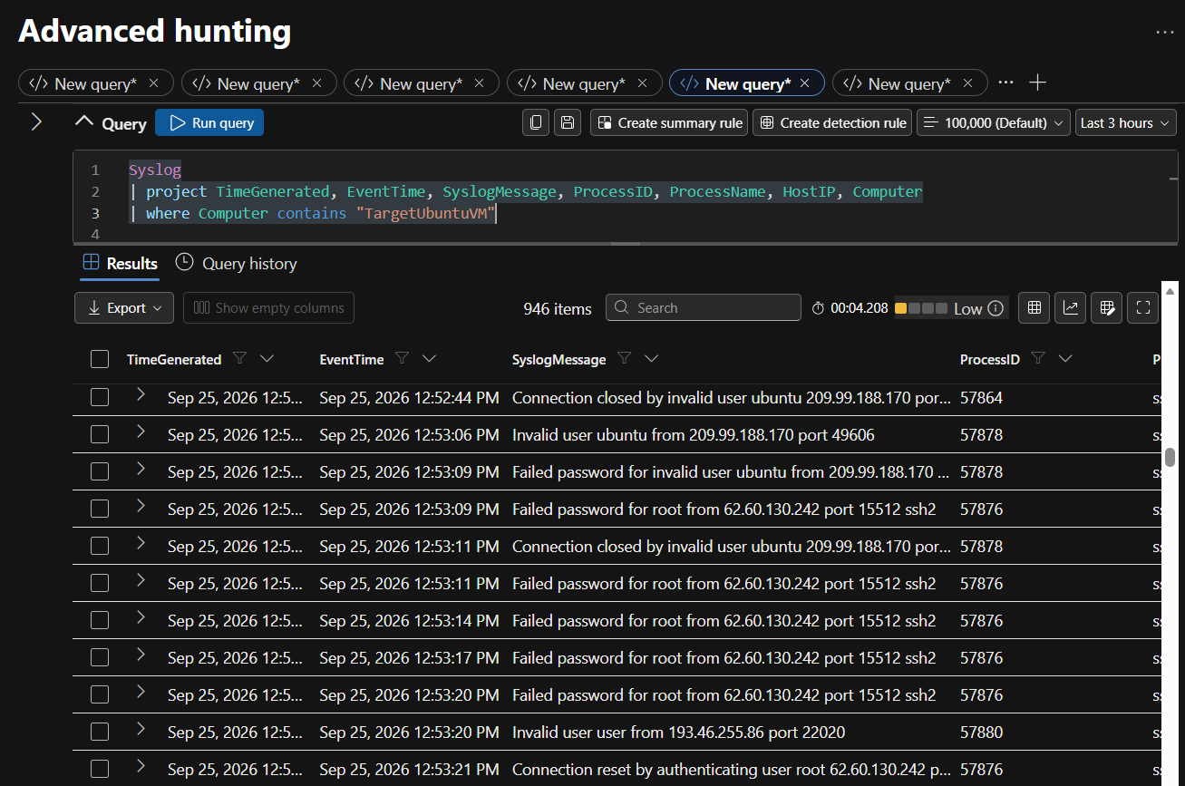
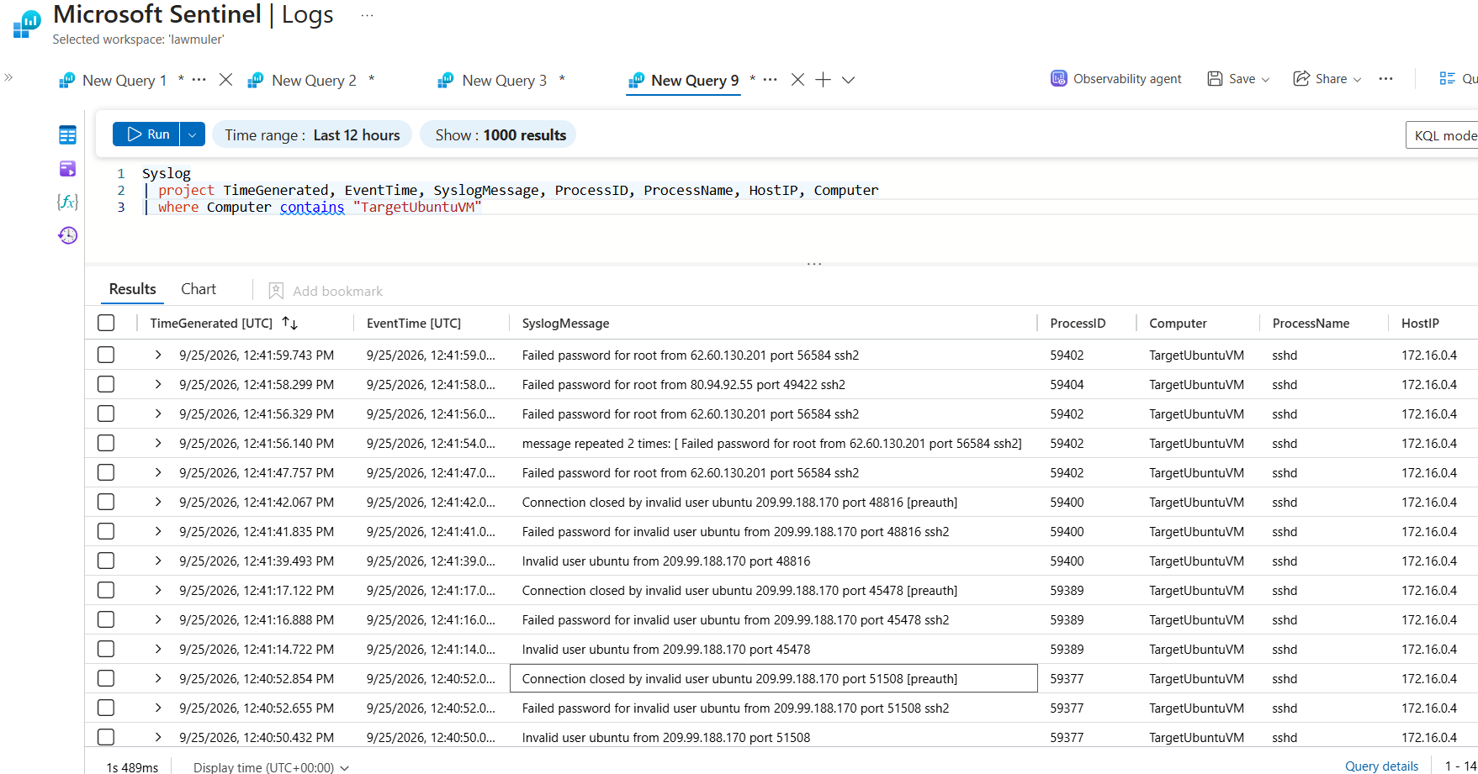
DETECTION
Catching the attack in Sentinel logs
Syslog
| project TimeGenerated, EventTime, SyslogMessage, ProcessID, ProcessName, HostIP, Computer
| where Computer contains "TargetUbuntuVM"
Figure 11 — Advanced hunting (Defender portal)
Figure 12 — Same query in the Azure portal Logs blade
Azure Security & SIEM Deployment
23
Notes:
The detection query filters Syslog down to the target machine and projects the fields that matter for an intrusion. Both portals return the same story: a flood of failed-password and invalid-user events against TargetUbuntuVM from external IPs — the signature of the brute force, now fully visible in Sentinel.

Slide 24


DETECTION
What the captured logs reveal
Repeated authentication failures
External source addresses
Hundreds of failed-password and invalid-user events for root and ubuntu accounts — the classic brute-force fingerprint.
Attempts arrive from public IPs such as 209.99.188.170 and 62.60.130.242, flagging internet-facing exposure.
Rich per-event context
Both portals agree
Projecting ProcessID, ProcessName, HostIP and Computer ties every event to sshd on TargetUbuntuVM at 172.16.0.4.
Advanced hunting and the legacy Logs blade return the same 900-plus events, confirming the pipeline is consistent.
Natural next step: promote this query into a scheduled analytics rule so Sentinel raises an incident automatically the next time this pattern appears — moving from manual hunt to real-time detection.
Azure Security & SIEM Deployment
24
Notes:
The captured logs tell the whole story: repeated failures against common accounts, coming from external IPs, each tied to sshd on the target. The obvious follow-up is to turn this hunting query into a scheduled analytics rule so the same pattern trips an incident automatically in future.

Slide 25
IN SUMMARY
A working SIEM, proven end to end
Foundation first
One resource group, one workspace, Sentinel enabled on top — simple to govern and simple to tear down.
Collection by design
The Azure Monitor Agent plus targeted Data Collection Rules put deliberate limits on what is ingested.
Tested against a real attack
A live Hydra brute force on a target VM was captured end to end — the pipeline detects, not just collects.
Thank you · Questions welcome
Notes:
Close on the three things that matter: a clean foundation, deliberate collection design, and verification by query rather than assumption. Invite questions on any part of the pipeline.

