Slide 1
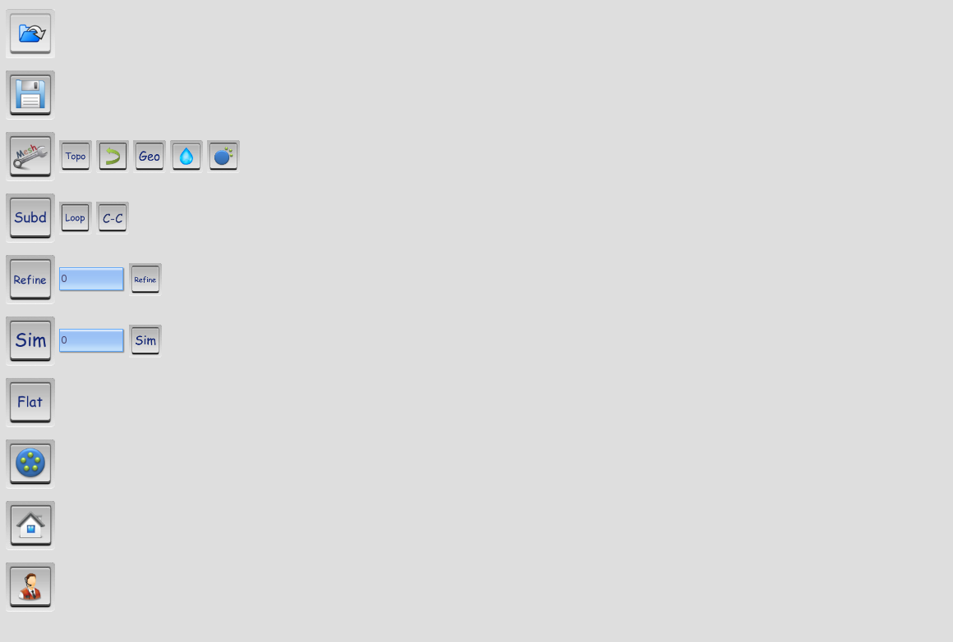
Import Mesh: OBJ, STL
Export Mesh: OBJ, STL
Consolidate topology: Remove singular vertex and non-manifold structure
Reverse normal direction
Consolidate geometry: Optimize degenerate and flipped triangles
Smooth Mesh
Enhance mesh detail
Loop Subdivision
C-C Subdivision
Refine Mesh: Add vertices on triangles
Simplify Mesh
Parameterization: Angle preserving parameterization
Sampling: Sample vertex to point cloud format
Back to Homepage
Online Help

Slide 2
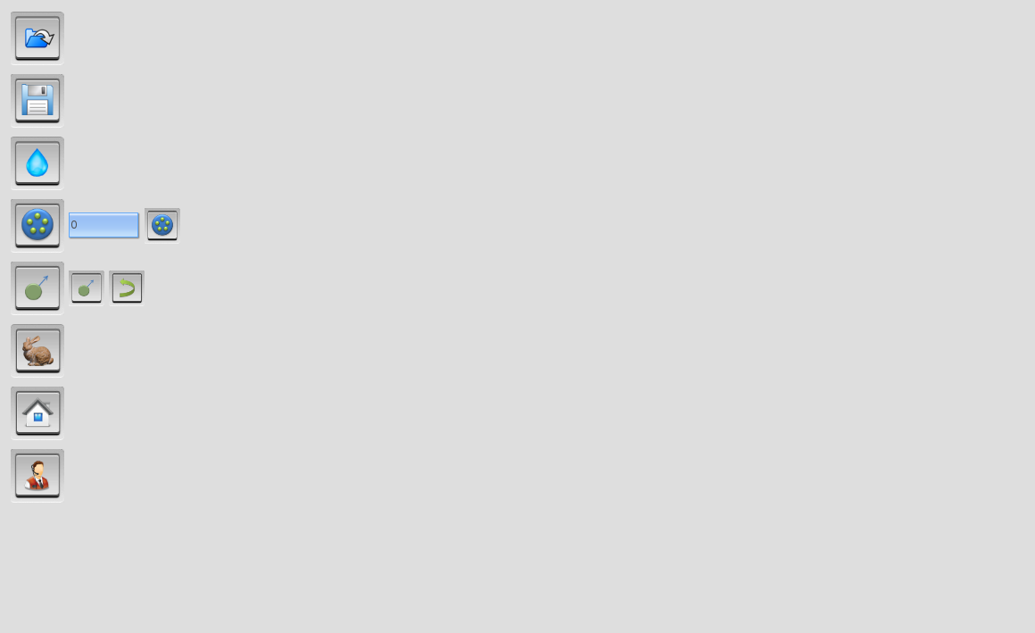
Import point cloud: OBJ
Export point cloud: OBJ, PLY
Smooth
Sampling: Uniform sampling
Normal calculation
Reverse normal direction
Mesh reconstruction
Back to Homepage
Online Help

