Slide 1

Introduction to
Solidity

Slide 2

Solidity TLDR
High level language
Needs to be compiled
Statically typed
Supports inheritance

Slide 3
Development Environments
Remix
Online IDE for developing smart contracts
VSCode plugin
Includes the Solidity compiler
Vim Syntax highlighting
Emacs syntax highlighting
Truffle Framework
Full framework for developing smart contracts <3

Slide 4
Installing the Solidity Compiler
NPM package
npm install -g solc
Docker Container
docker run ethereum/solc:stable solc --version
PPA for Ubuntu
sudo add-apt-repository ppa:ethereum/ethereum sudo apt-get update sudo apt-get install solc
More ways to install solc here

Slide 5
A Quick Note on Solc
Compiles bytecode to optimize gas usage
Might not be the most optimal for performance
Generates EVM Bytecode
ISA cheatsheet and explanations here
Also generates an ABI
Application Binary Interface - specifies how contracts can interact with your
code

Slide 6
Types
Value Types
Arguments that are Passed by Value (copied)
Typically smaller (fits into 256 bits)
Reference Types
Arguments Passed by Reference
Makes use of memory (costs gas to access) or…
Make use of Storage (costs more gas to access)

Slide 7
Value Types
Booleans - true or false
Integers - sign = int/uint
size = 8 to 256 bit
declaration = <sign><size> ie uint224
Fixed Point Numbers -
sign = fixed/ufixed
type = MxN (M bits . N bits) (8 -> 256, 0-> 80)

Slide 8
Value Types continued
Addresses - 20 bytes in length (160bit)
Has to members,
.balance returns uint256 of Wei in address
.transfer(uint256 amount) transfers amount from calling address to receiving
address
Fixed-size byte arrays - bytes1, bytes2, … , bytes32 fixed length size
Address Literals - hexademical addresses ie 0xdCad3a6d3569DF655070DEd06cb7A1b2Ccd1D3AF
40 digits (20 bytes) long

Slide 9
Values Types continued
Rational and Integer literals - numbers with a ‘.’ and scientific notation 2e10
String literals - Signaled by quotes - if they fit into bytes they’re implicitly convertable
Enums - enum NAME {option1, option2, option3}
Function types
function (<parameter types>) {internal|external} [pure|constant|view|payable] [returns (<return types>)]

Slide 10
Reference Types
Data Location - can specify explicitly whether to be stored in storage or in memory
Storage is persistent and more expensive
Memory is non persistent and less expensive
Arrays - <Name of Array>[]
bytes should be used over byte[] whenever possible
Memory arrays - uint[] memory name = new uint[](size)
Structs - struct NameOfStruct {
uint item1;
address p1;
}

Slide 11
Reference Types continued
Mappings - mapping(<key type> => <value type>)
Hashmap of Solidity
Useful for state variables

Slide 12
Units
Ether units
wei, finney, szabo, ether are natively available
if(1 ether == 1000 finney) // equals true
Time Units
Seconds, minutes, hours, days, weeks, year
1 minutes == 60 seconds
1 hours == 60 minutes …
DOES NOT SUPPORT LEAP YEAR UNITS

Slide 13
Error Handling
Built in methods
assert(bool condition) used for internal errors
require(bool condition) used for inputs or external component checking
revert() revert state changes and stop executing

Slide 14
Contract Related Members
this - the current contract, can be converted to an Address type
selfdestruct(address recipient) - destroy contract and send contract funds to recipient
suicide(address recipient) - alias of selfdestruct. Preferred use is selfdestruct because
People matter more than code.
DO NOT SEND ETH TO selfdestruct/suicide CONTRACTS BECAUSE YOU WILL BURN YOUR ETH

Slide 15
Function Declarations
function name(type a …) visibility function-detail returns(type/s)
Name - whatever you want
Type a … - arguments to the function
Visibility - public / private
Function Detail - pure | constant | view | payable
Return - list of returnable objects

Slide 16
Control Structures
If, else, while, do, for, break, continue, return, ? :, switch, goto
There is no boolean / int conversion in solidity (while(1) would not work)

Slide 17
Pragma
Specifies the solidity version
Usage: pragma solidity ^0.X.Y;

Slide 18
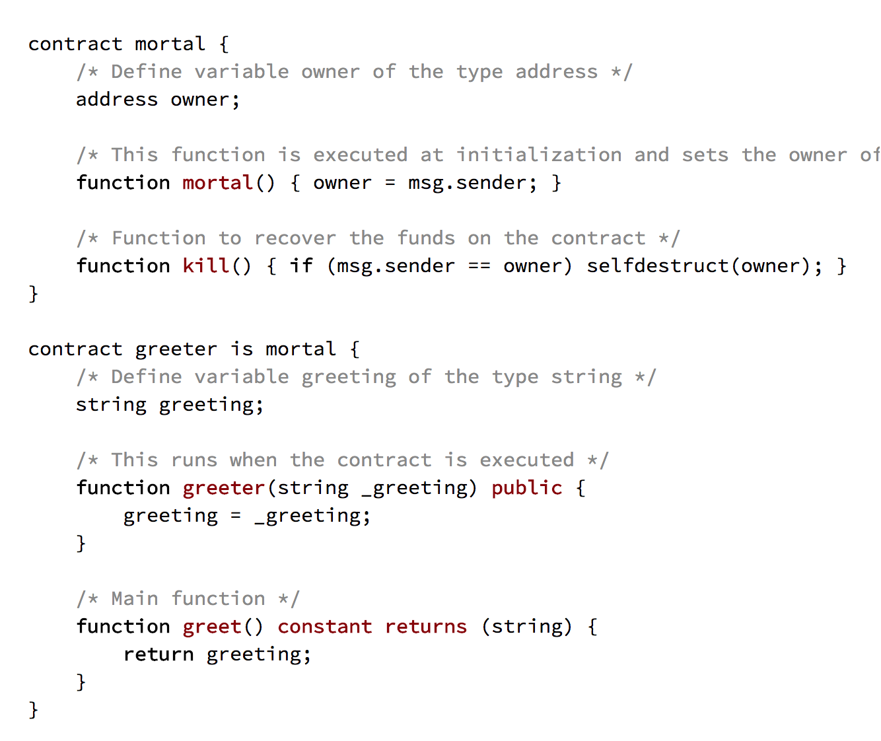
Contract Example

Slide 19
Compile Your Contract
solc -o target --bin --abi Greeter.sol
solc - compiler command
-o output directory flag
--bin tells the compiler to create EVM Bytecode
--abi tells compiler to create Application Binary Interface (defines how to interact with
the smart contract created)

Slide 20
Deploy Your Contract!
Use truffle to deploy your smart contract! Note that truffle takes care of just about everything except for writing the solidity and writing the test / deploy scripts.

