Slide 1
PCB Bring-up Seminar
2/14/2019 & 2/15/2019
Ryan Castle

Slide 2
Objectives / Questions to Answer
Developing Production Hardware
Where do I find information to build a board?
What Atlium tools do I need to know how to use?
What materials do I need?
Soldering 101
Build up test PCBs

Slide 3
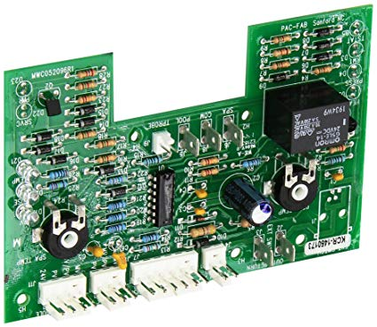
End Goal
Functional Circuit Board capable of going into the pod
Populated PCBs
Soldering components is only ½ of the task
Bring-up instructions include basic testing information
Be able to blame issues on the software and controls team

Slide 4
Disclaimer
We’ve spent a lot of time designing these PCBs and have spent ~$800 on components (~$2000 including sponsored components/PCBs)
If you aren’t sure, ask
Definitely possible a mistake was made in schematic design or layout
Practice on a test PCB
Follow bring up instructions closely
Inspect, inspect, inspect before you power on
No boards should be powered on for the first time without approval from Ethan or Ryan
Magic Smoke
Mistakes are ok, we just want to avoid them
Material might be really boring if you’ve done this before

Slide 5
Altium Repository
https://github.com/badgerloop-software/podiv-altium
Primary source for all PCB information
Possible to build a board from outputs
However, cloning the repo can speed up process
Schematics, Layout files
Podiv-Altium/board_release/<pcb_name>/<revision_letter>/output/<*SCH*>
Bringup Documentation
Podiv-Altium/bringup/<pcb_name>/<pcb_name>_bringup.docx

Slide 6
Altium Tools
Search for a Reference Designator (R1, U3, LED2)
In Schematics: <CTRL> + <F>
In Layout: <J>+<C>
More information on a component
In Schematic:
Double click on Component and the properties window will appear
Click on the Properties Tab
Manufacturer, P/N, Digikey P/N, link will appear.
Disclaimer: Sometimes, the parts to be populated won’t match with what’s in the schematic. This is because sometimes 2 components will have the same footprint or a BOM change was required for part availability

Slide 7
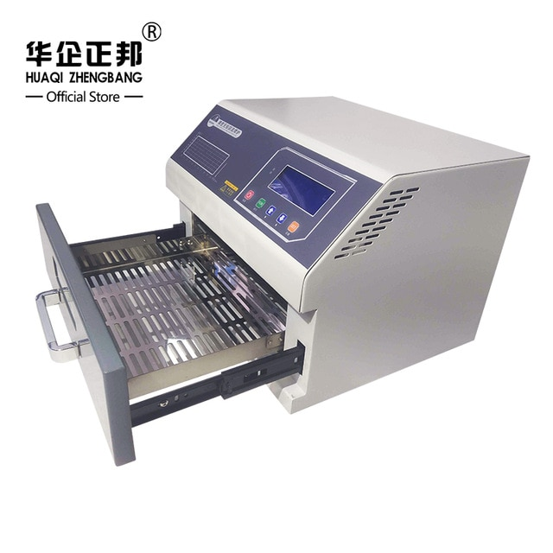
Material Required
See Bring-up Documentation
Example for Ideal Diode PCB:
P4_LV_IdealDiode_001_REVA PCBs
Soldering iron
Solder
Solder Paste
Side cutters (snips)
PCB BOM
Oven

Slide 8
SMD Soldering
https://mediaspace.wisc.edu/media/ECE370PowerSupplySM2-DVD/0_qaluf0im
Courtesy of Mark Allie, ECE 370
Check Oven Settings
For this seminar, see if other groups are almost ready to use the oven. Possible to do multiple boards at once.

Slide 9
What do I do if I find a problem with a board? Feature Request?
Possible Answers:
Scream
Shout
Ignore it and hope it will go away
Submit a Feature Request or Bug Report on Github
Answer: All Except C
https://github.com/badgerloop-software/podiv-altium/issues

Slide 10
Bring-up PCBs
2-3 people per PCB
Boards:
Test PCBs (x2)
Processor (x5)
Ideal Diode (x2)
High Voltage Battery Breakout (x6) (Through Hole Only)
Parts are all in the Digikey Box
Probably going to be a bottle neck. Be patient

