Slide 1
OPTIMAL CLUSTERING AND ROUTING PROTOCOL FOR WSN
By- Ankush Badgujar (18BEC1054)

Slide 2
PROPOSED WORK
To improve the current routing protocol – hierarchical clustering protocol- LEACH, using the concept of circular clustering.
This aims to improve the overall lifetime of WSN by reducing the energy consumption.
The restriction on [circular clusters] is based on the width of the network (W) and the diameter of each circular cluster equals the width divided by the number of segments on each side. It will be obvious that the circular clustering will increase the lifetime of the network by organizing the process of sending packets to the base station or sink.

Slide 3
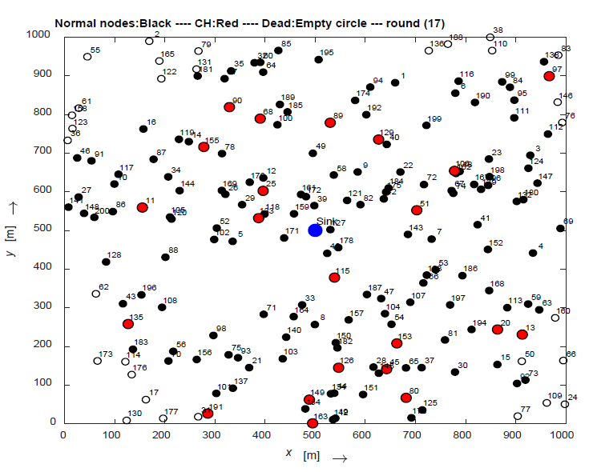
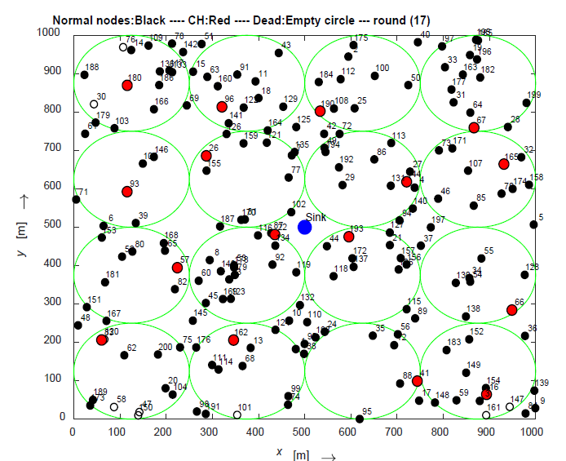

Slide 4
WORK DONE
Setting the parameters for the WSN field – parametrizing the nodes, field-dimensions, base station location, circular cluster creation and creating a model for them.
Configuring the sensor nodes for their energies, distance to base-station, distance to cluster-Head etc.

Slide 5
PENDING WORK
Cluster head selection algorithm within the circular cluster.
Algorithm for steady-state phase.
Comparison with LEACH protocol.

