Slide 1
OPTIMAL CLUSTERING AND ROUTING PROTOCOL FOR WSN
By- Ankush Badgujar (18BEC1054)

Slide 2
PROPOSED WORK
To improve the current routing protocol – hierarchical clustering protocol- LEACH, using the concept of circular clustering.
This aims to improve the overall lifetime of WSN by reducing the energy consumption.
The restriction on [circular clusters] is based on the width of the network (W) and the diameter of each circular cluster equals the width divided by the number of segments on each side. It will be obvious that the circular clustering will increase the lifetime of the network by organizing the process of sending packets to the base station or sink.

Slide 3
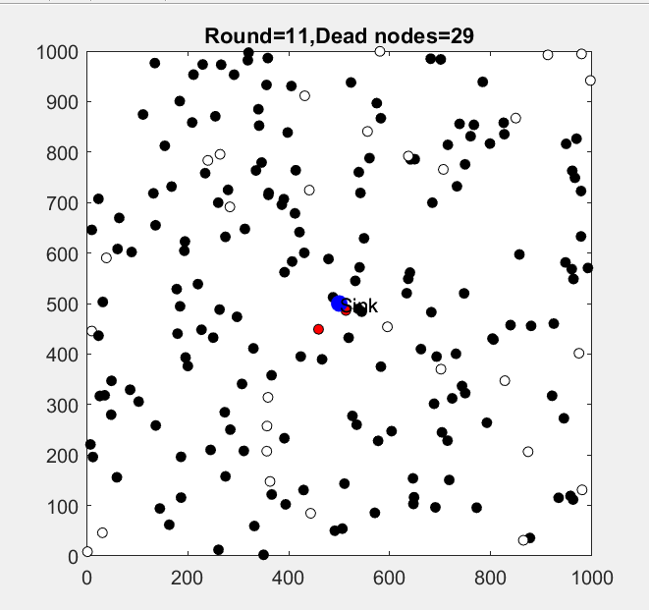
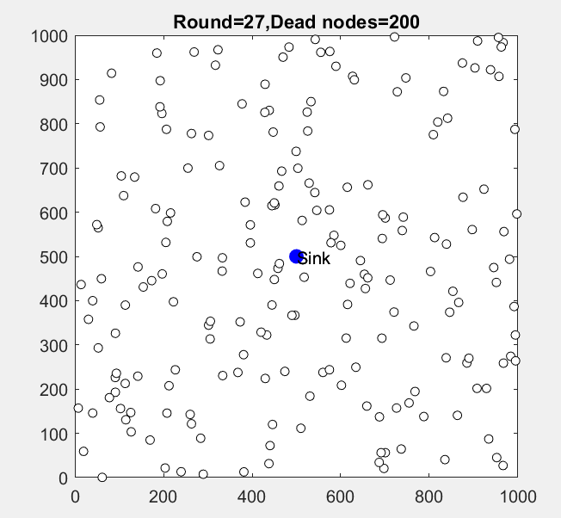
LEACH

Slide 4
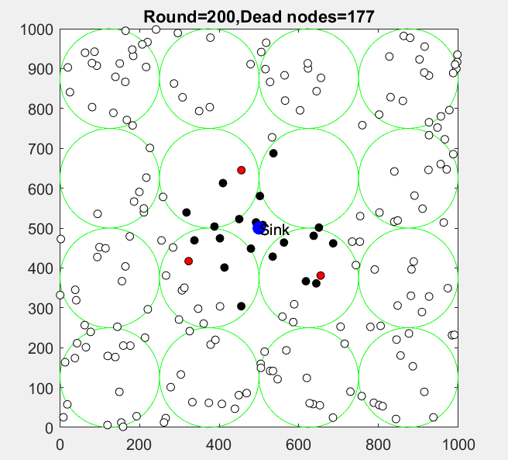
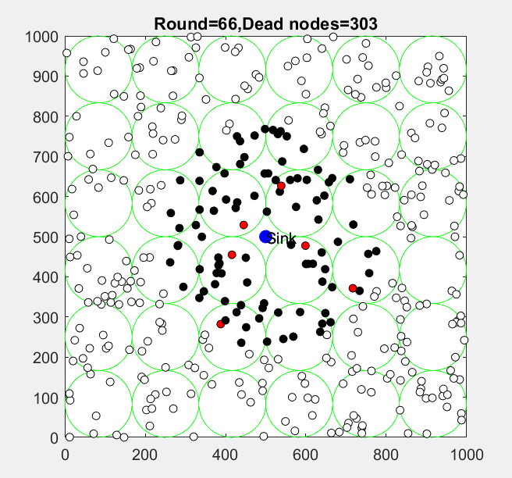
I-LEACH

Slide 5
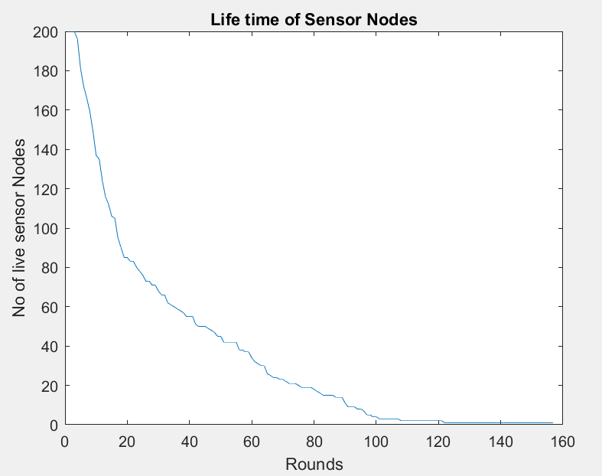
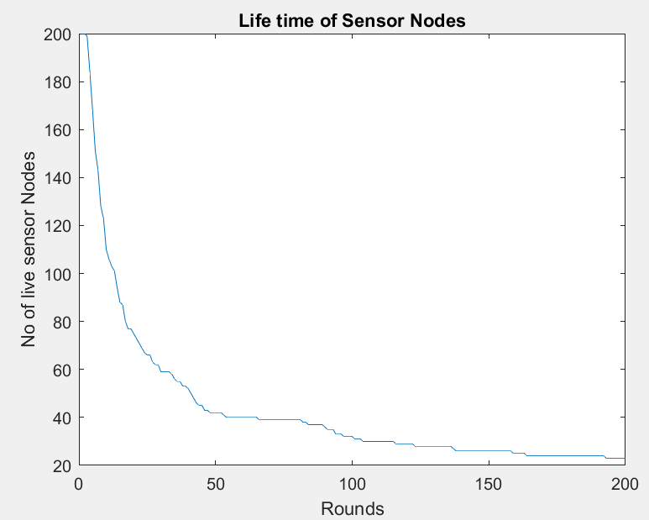
BASIC LEACH
200 nodes
I-LEACH

Slide 6
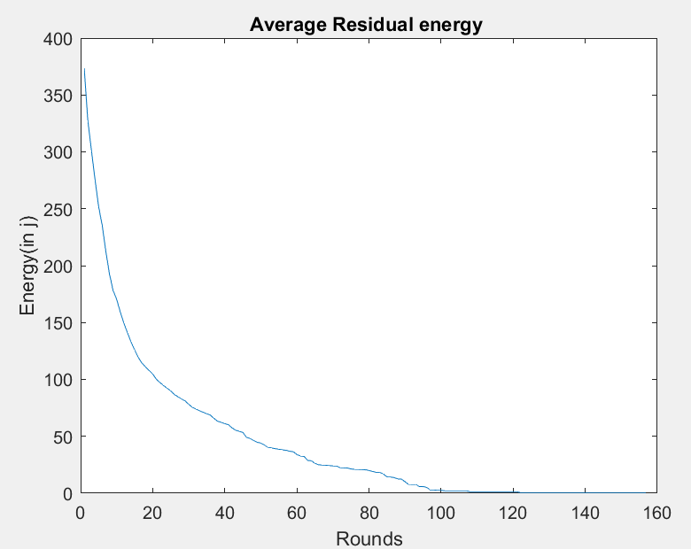
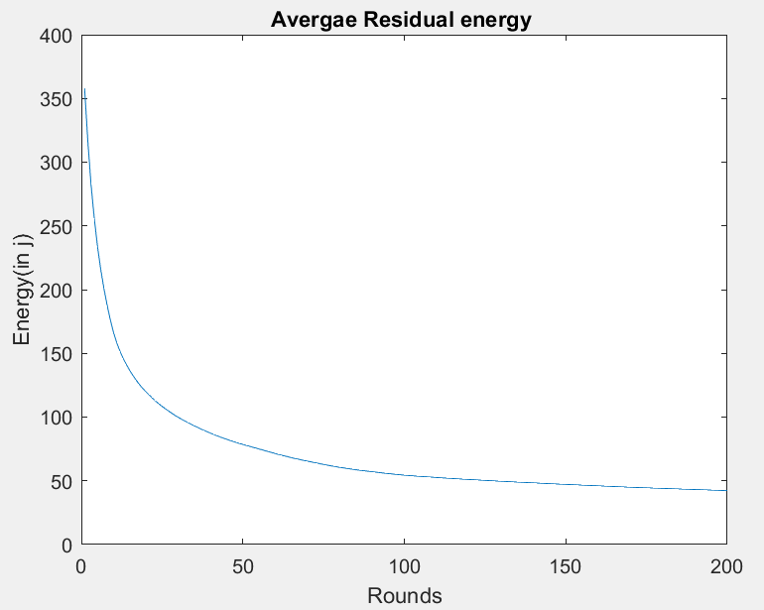
BASIC LEACH
I-LEACH

Slide 7
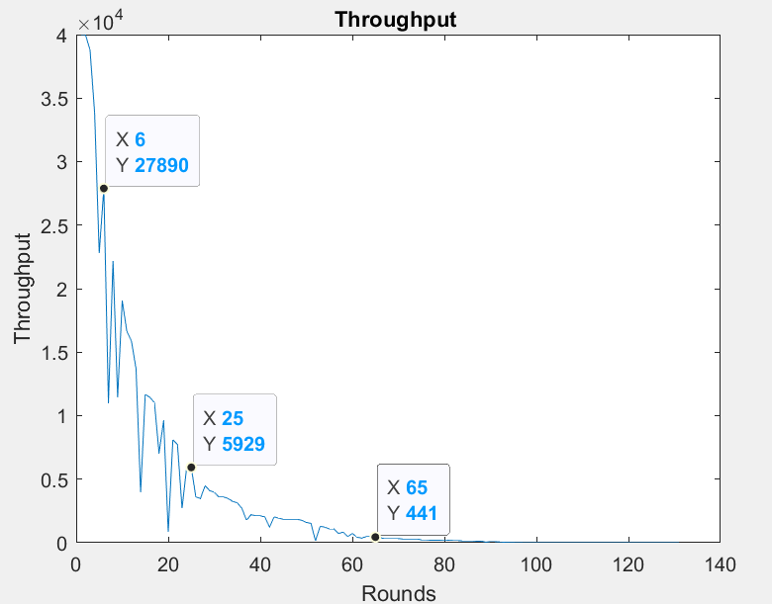
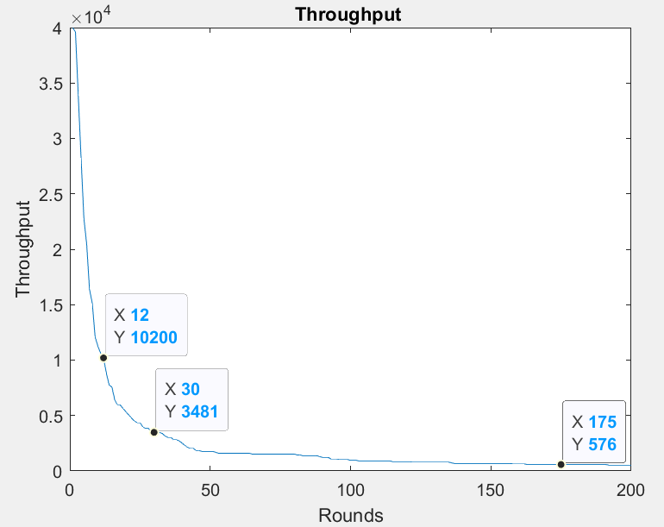
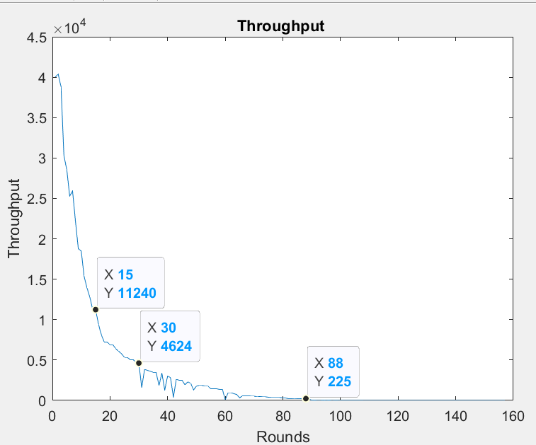
BASIC LEACH
I-LEACH

Slide 8
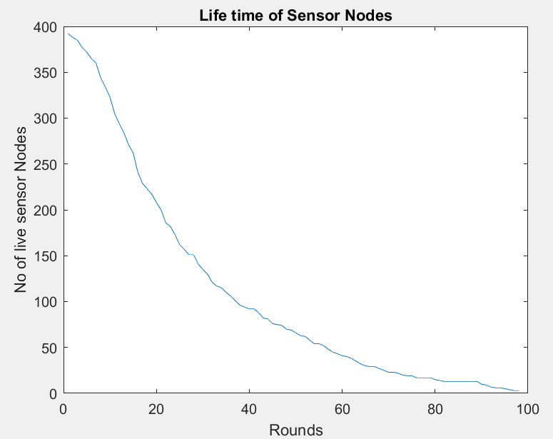
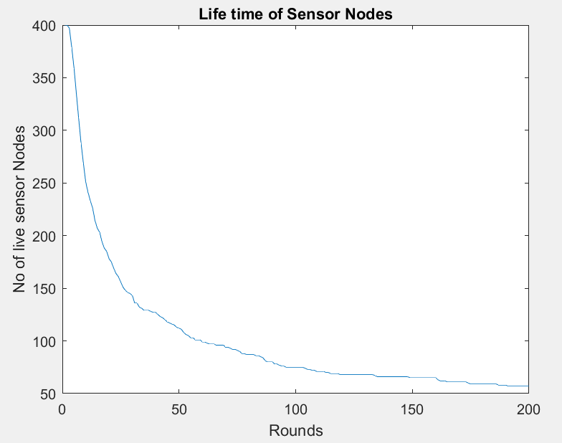
BASIC LEACH
400 nodes
I-LEACH

Slide 9
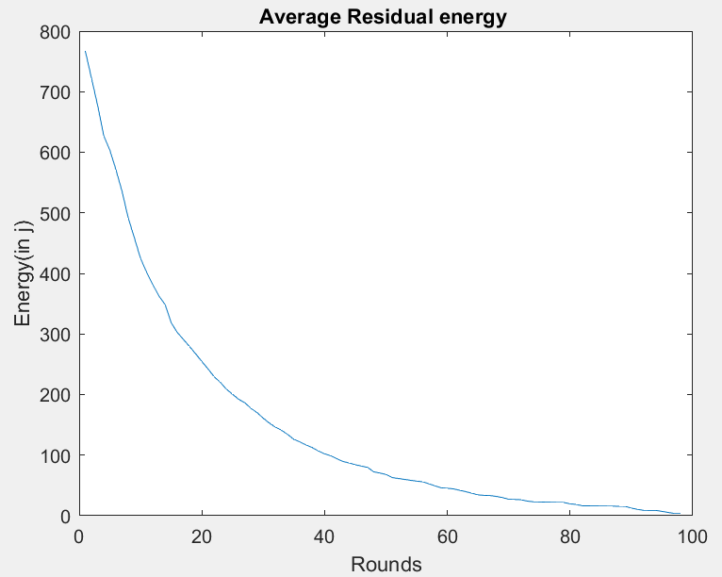
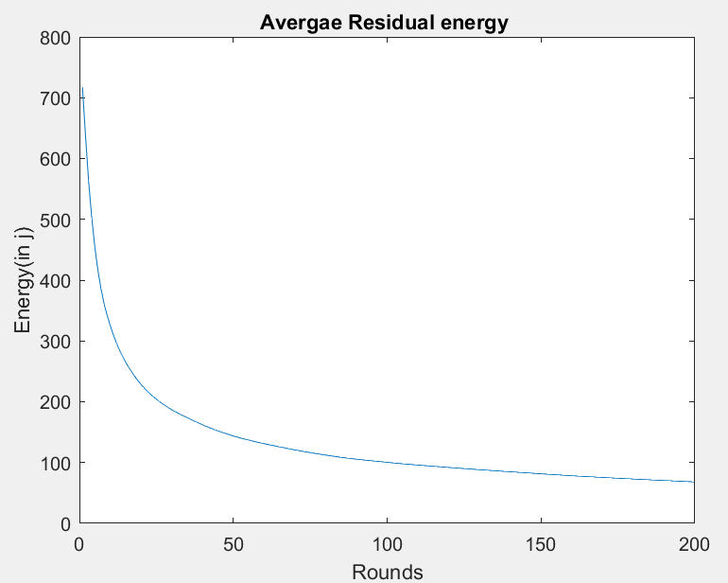
BASIC LEACH
I-LEACH

Slide 10
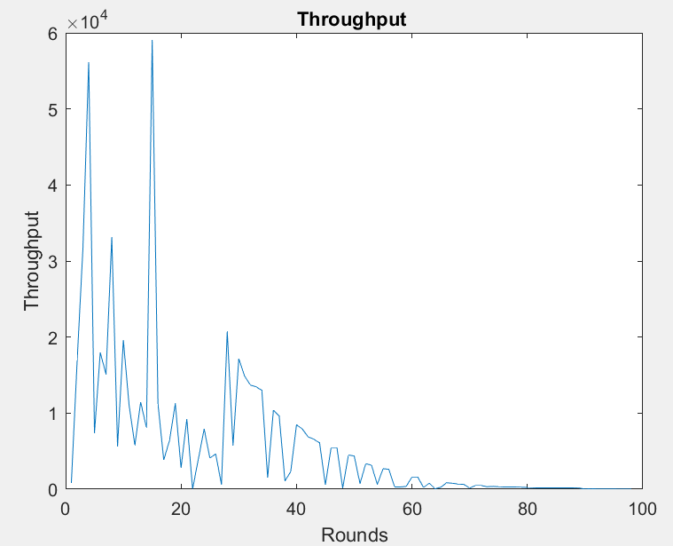
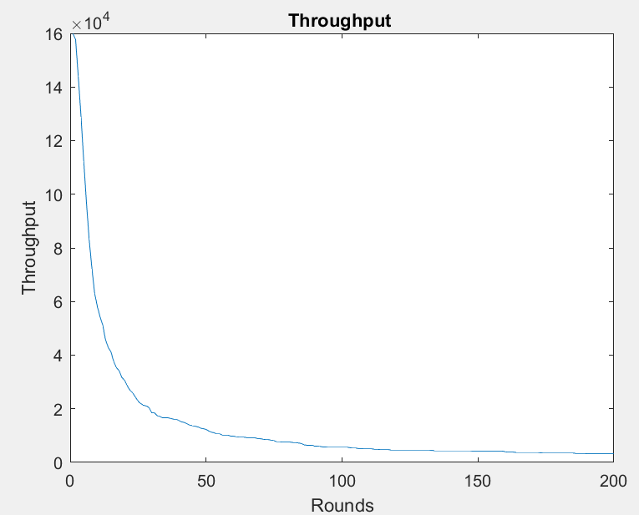
BASIC LEACH
I-LEACH

Slide 11
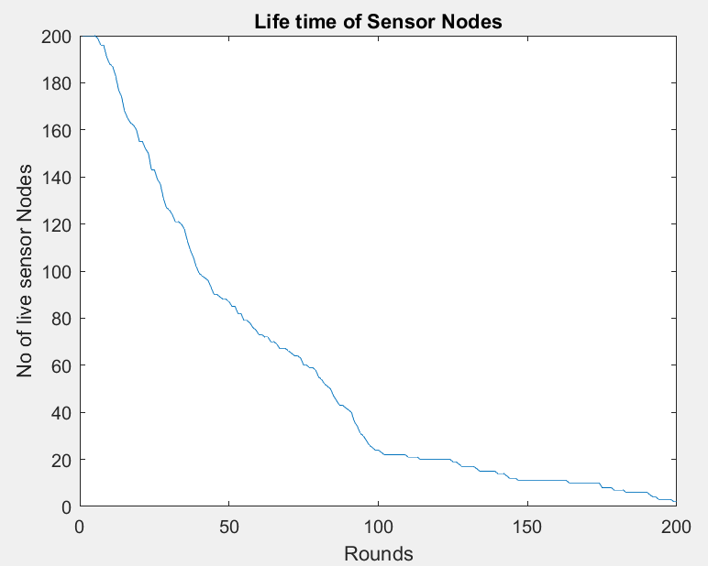
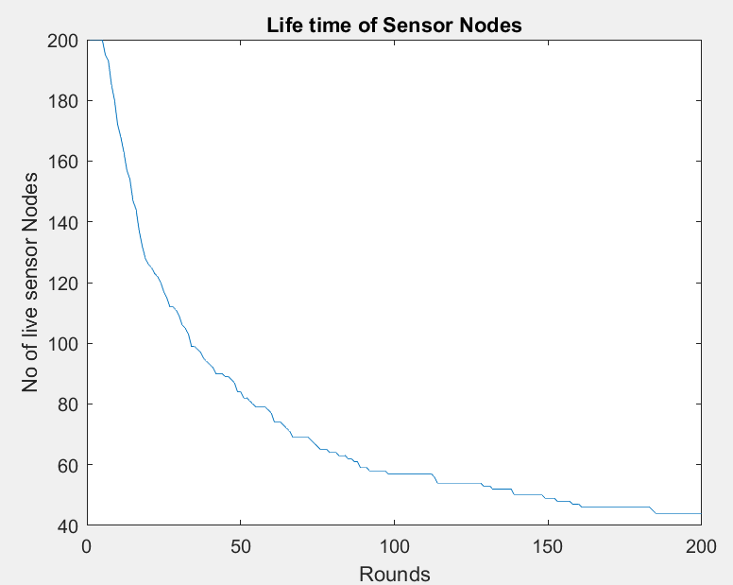
BASIC LEACH
ENERGY OF NODES INCREASED TO 4J
I-LEACH

Slide 12
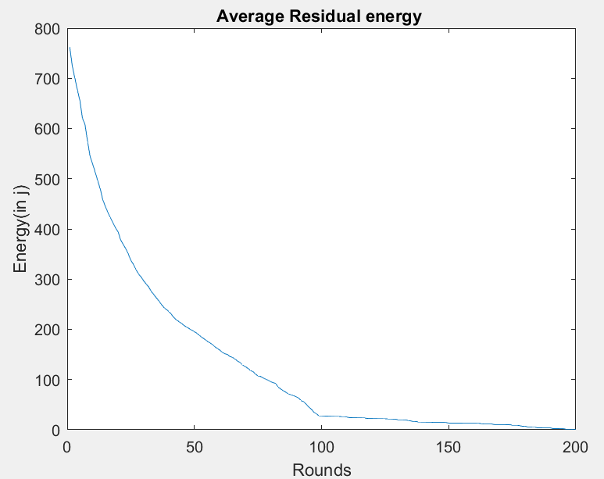
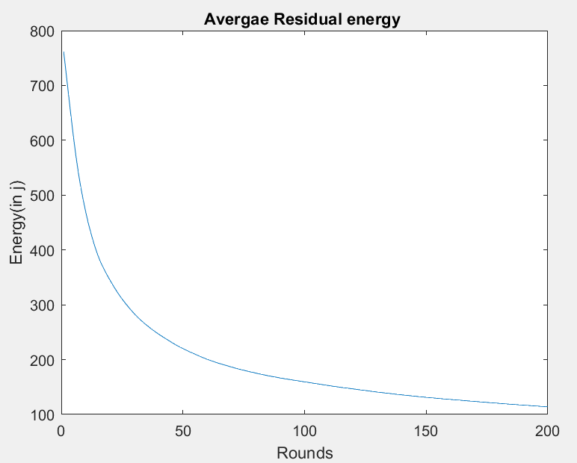
BASIC LEACH
ENERGY OF NODES INCREASED TO 4J
I-LEACH

Slide 13
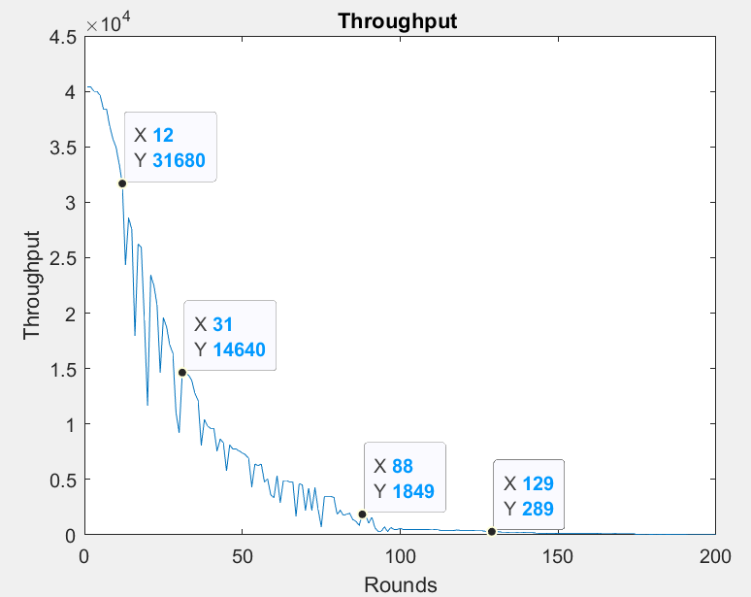
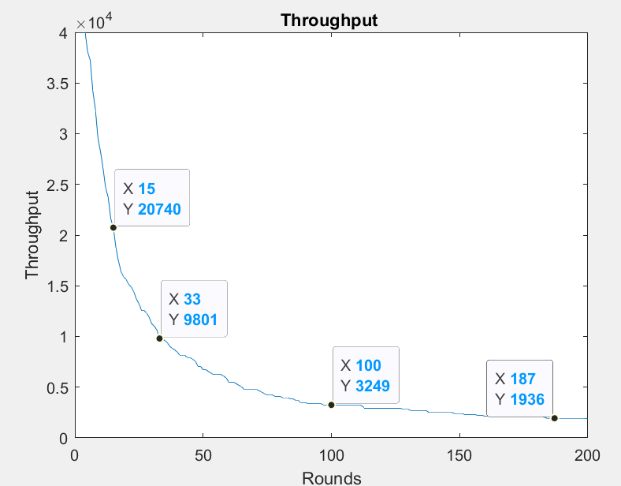
BASIC LEACH
ENERGY OF NODES INCREASED TO 4J
I-LEACH

Slide 14
CONCLUSION
A new improved LEACH protocol is proposed, and this new modification on the LEACH protocol is achieved by dividing the network into circular clusters.
The proposed I-LEACH protocol is superior to classic LEACH in many aspects. From the simulation results, I-LEACH protocol decreases the energy consumption and significantly increases the network lifetime as compared to the original LEACH protocol by decreasing the number of dead nodes and increasing the number of alive nodes through the 200 rounds to continue the process of transmitting data in WSN.

