Slide 1
REDI PROJECT Cardio Good Fitness
Jyoti Badgujar

Slide 2

Who Am I?
badgujarjyoti@gmail.com
https://www.linkedin.com/in/jyotibadgujar/
Jyoti Badgujar
Pune, Maharashtra , India
Bachlore’s of Electronics Engineering
Post Graduate Diploma In Advanced Computing
Worked with Tech Mahindra as
Solution designer and Data Analyst.
Skills : SQL Server 2005, Oracle, Microsoft Office, Python
Interest : Learn new technology, Travel, Gym.

Slide 3
Cardio Good Fitness
Dataset Information
Problem Statement
Dataset column Information
Data cleaning
Data Processing
Data Visvalization
Conclusion
Recommendation

Slide 4
Dataset Information
The market research team at AdRight is assigned the task to identify the profile of the typical customer for each treadmill product offered by CardioGood Fitness.
The market research team decides to investigate whether there are differences across the product lines with respect to customer characteristics.
The team decides to collect data on individuals who purchased a treadmill at a CardioGoodFitness retail store during the prior three months.

Slide 5
Problem Statement / Objective
Customer profile
Characteristics of a customer based on the different products
New Customer Analysis
Based on the data we have to generate a set of insights and recommendations that will help the company in targeting new customers

Slide 6
Dataset Column Details
Following Customer Variables to study :
Product - the model no. of the treadmill
TM195
TM498
TM798
Age - in no of years, of the customer
Age between 18 to 50 years
Gender - of the customer
Male
Female
Education - in no. of years, of the customer
Marital Status - of the customer
Single
Partnered
Usage - Avg. # times the customer wants to use the treadmill every week
Fitness - Self rated fitness score of the customer
5 - very fit - 1 - very unfit
Income - of the customer
Miles- expected to run

Slide 7
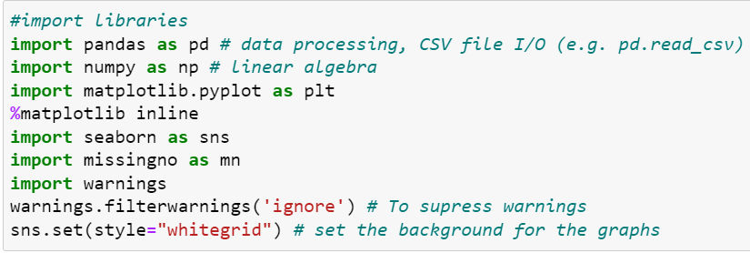

Import Library and Dataframe creation
Notes:
#import libraries
import pandas as pd # data processing, CSV file I/O (e.g. pd.read_csv)
import numpy as np # linear algebra
import matplotlib.pyplot as plt
%matplotlib inline
import seaborn as sns
import missingno as mn
import warnings
warnings.filterwarnings('ignore') # To supress warnings
sns.set(style="whitegrid") # set the background for the graphs
df = pd.read_csv("Data/CardioGoodFitness.csv")
cgf_df = df.copy()

Slide 8

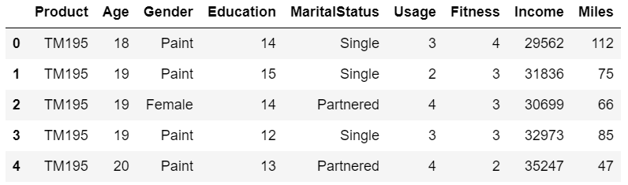
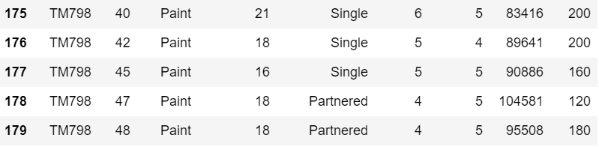
Dataframe size and first / last 5 records
Dataframe shape
Dataset contains 180 rows and 9 columns.
Dataframe head and tail
Notes:
#get the size of dataframe
print("Shape: ",cgf_df.shape)
print("Length: ",len(cgf_df))
print("Size: ",cgf_df.size)
#Examine the data by looking at the first 5 rows of the data
cgf_df.head()
#Examine the data by looking at the last 5 rows of the data
cgf_df.tail()

Slide 9
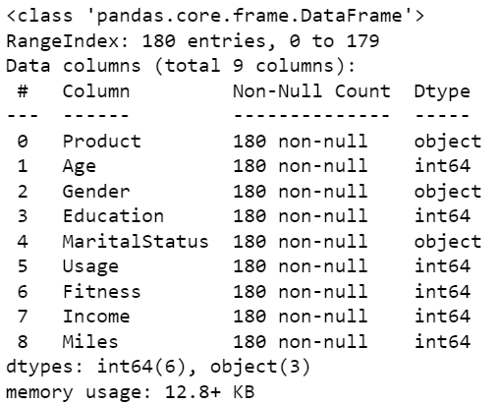
Dataset Information
Observations
Product, Gender and Martial status are string datatype .
While Age, Education, Usage, Fitness, Income, Miles are integer datatype.
All columns are not null
Notes:
cgf_df.info()

Slide 10
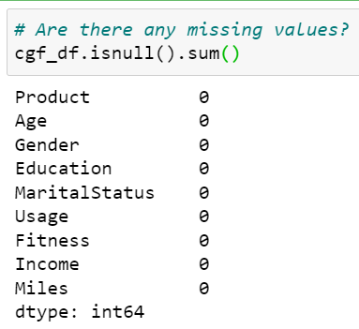
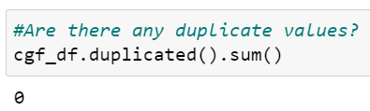
Missing / Duplicate value check
Observation:
Dataset does not contains any missing or duplicate values.
Notes:
cgf_df.isnull().sum()
cgf_df.duplicated().sum()

Slide 11
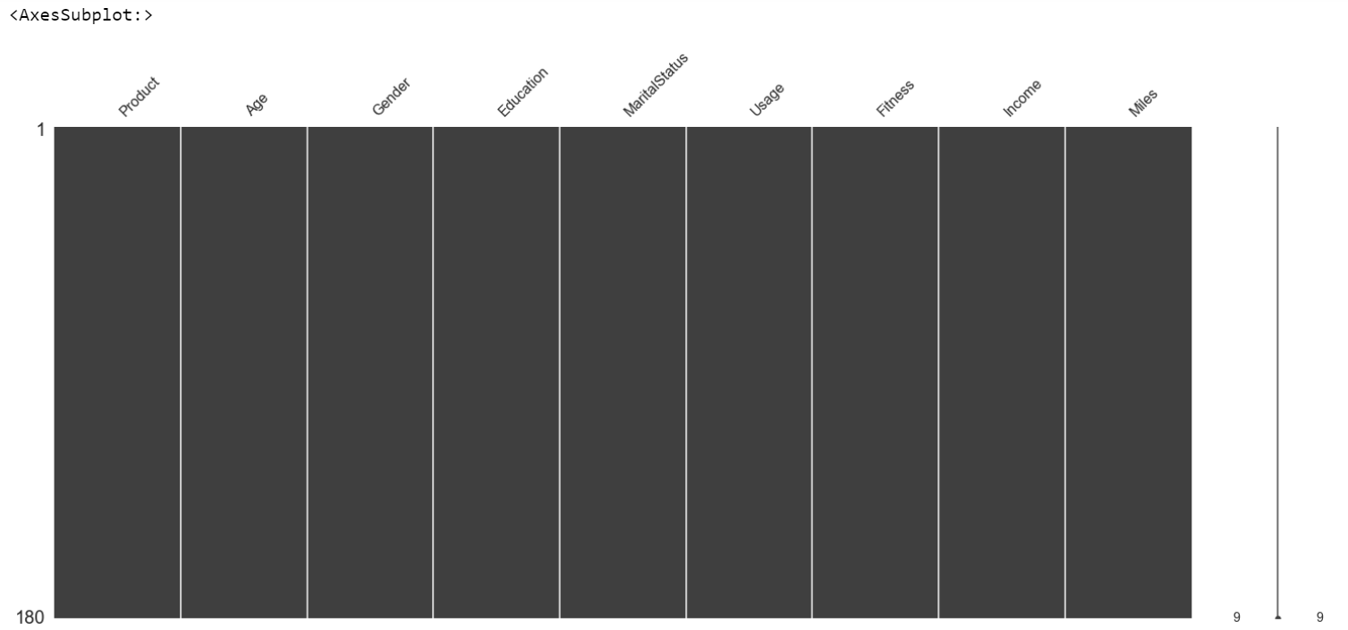
Missing value check using sns
Observation:
Dataset does not contains any missing or duplicate values.
Notes:
# Check all columns for null data.
mn.matrix(cgf_df)

Slide 12
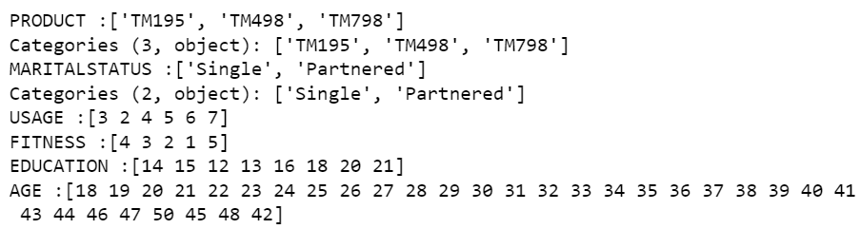
Examine the Data
Observations:
How many product models we have?
There are 3 different treadmills products.
What is Martial status of customers?
There are both Partnered and single customers
How many days people expect to use treadmill?
Usage is from 2 days to 7 days a week
What is self rated fitness of customers buying treadmill?
Fitness level of customers from 1 -5
What is education of customer buying treadmill?
Education in years is from 12 -21
What is the age of the customer?
Age of customers ranges from 18 to 50
Notes:
#look at what all unique values have in all columns.
list_col=['Product','MaritalStatus','Usage','Fitness','Education','Age']
for col in list_col:
print('{} :{} ' . format(col.upper(),cgf_df[col].unique()))

Slide 13
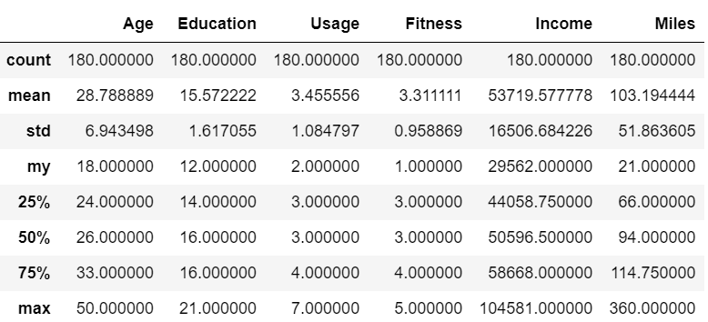
Examine the Data
Observations:
Age of customer using treadmill is between range 18 - 50 . Average age is 28.78 and median is 26.
Customer education is between 12 -21 years, with average and median of 16 years and maximum of 21 years
Expected Treadmill usage is atleast Once a week , maximum is 7 hours a week and on Average 3 hours a week
Average self rated fitness is 3.
Maximum income of treadmill user is 100K , Average income approx. 54K (while median is is) 51K.
Customer expects to run at an average of 103.19 miles per week, median 94 miles per week.
Notes:
cgf_df.describe()

Slide 14

Examine the Data
Observations:
Which is most sold Model?
TM195 treadmill model is most sold model.
Are Male customers buying treadmill more than female customers?
There are 76 female and 104 males customers. More Male customers are buying treadmill compared to female customer
Are married customer buying Treadmill more than Single customers?
There are 107 Partnered and 73 single customers. Customers who are Partnered are buying treadmill more compared to single customer.
Notes:
#Which is most sold Model?
cgf_df.Product.value_counts()
#Are Male customers buying treadmill more than female customers?
cgf_df.Gender.value_counts()
#Are married customer buying Treadmill more than Single customers?
cgf_df.MaritalStatus.value_counts()

Slide 15
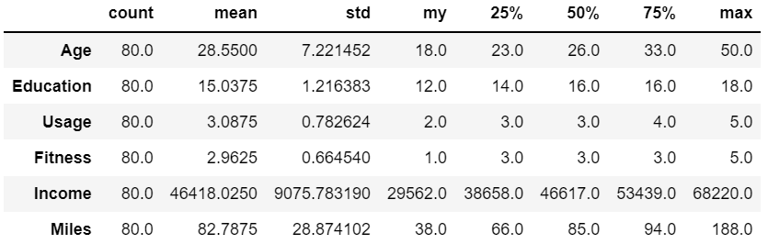
Examine the Data : Product Model TM195
Observations:
80 customers bought TM195 model
Average age of customer who purchases TM195 is 28.5 , Median is 26.
Average Education is 15 and median is 16.
Expected usage is 3 days a week
Self rated fitness is 3 that is average fitness level
Average income and median is around $46K.
Expected Miles to run is on an Average 82.78 miles per week and the median is 85.
Notes:
cgf_df[cgf_df['Product'] == 'TM195'].describe().T # T used to change format rows to column

Slide 16
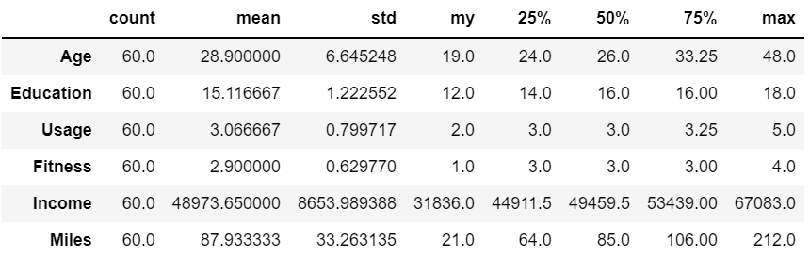
Examine the Data : Product Model TM498
Observations:
There are 60 customers who purchased TM 498 Model
Average age of customer who purchases TM498 is 28.9 , Median is 26.
Average Education is 15 and median is 16.
Expected usage is 3 days a week
Self rated fitness is 3 that is average fitness level
Average Income is 48973. Median Income is 49459
Expected Miles to run is on an Average 87 miles per week and the median is 85.
Notes:
cgf_df[cgf_df['Product'] == 'TM498'].describe().T

Slide 17
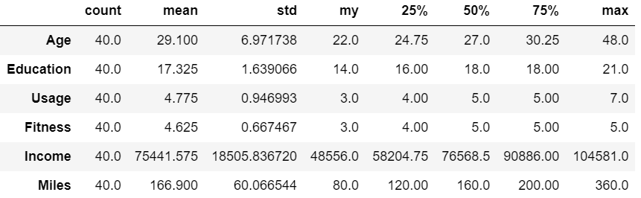
Examine the Data : Product Model TM798
Observations:
There are 40 customers who purchased TM 798 Model
Average age of customer who purchases TM798 is 29 , Median is 27 .
Average Education is 17 and median is 18.
Expected usage is 4-5 day a week
Self rated fitness is 4.6 that is average fitness level
Average Income is 75K and median is 76K
Expected Miles to run is on an Average 166 miles per week and median is 160.
Notes:
cgf_df[cgf_df['Product'] == ‘TM798'].describe().T

Slide 18
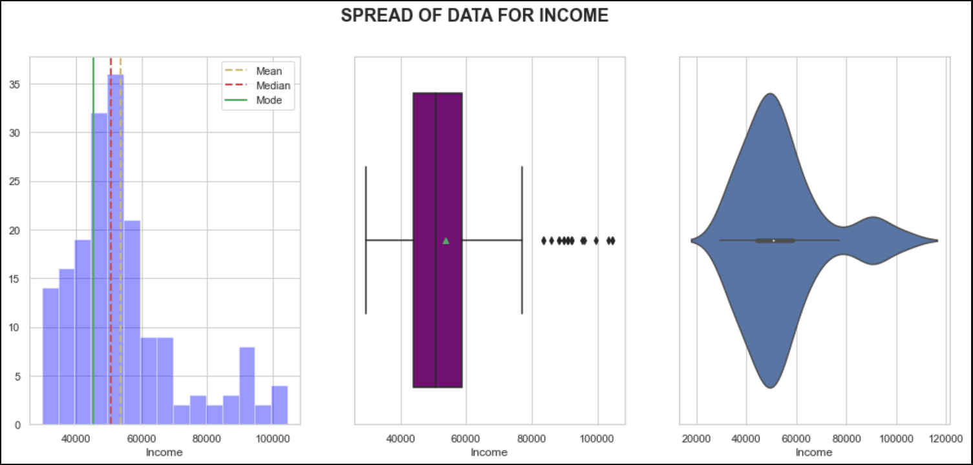
Visualize the Data : Income Univariate Analysis
Observations:
Income is skewed towards right , Median is 50K , Mean is 55k and mode is 45K.
Most of the customers are in lower pay range and earn less than 60K.
Income has some outliers. Few customers earn beyond 80K.
Notes:
def dist_box_violin(data):
# function plots a combined graph for univariate analysis of continous variable
#to check spread, central tendency , dispersion and outliers
Name=data.name.upper()
fig, axes =plt.subplots(1,3,figsize=(17, 7))
fig.suptitle("SPREAD OF DATA FOR "+ Name , fontsize=18, fontweight='bold')
sns.distplot(data,kde=False,color='Blue',ax=axes[0])
axes[0].axvline(data.mean(), color='y', linestyle='--',linewidth=2)
axes[0].axvline(data.median(), color='r', linestyle='dashed', linewidth=2)
axes[0].axvline(data.mode()[0],color='g',linestyle='solid',linewidth=2)
axes[0].legend({'Mean':data.mean(),'Median':data.median(),'Mode':data.mode()})
sns.boxplot(x=data,showmeans=True, orient='h',color="purple",ax=axes[1])
#just exploring violin plot
sns.violinplot(data,ax=axes[2],showmeans=True)
dist_box_violin(cgf_df.Income)

Slide 19
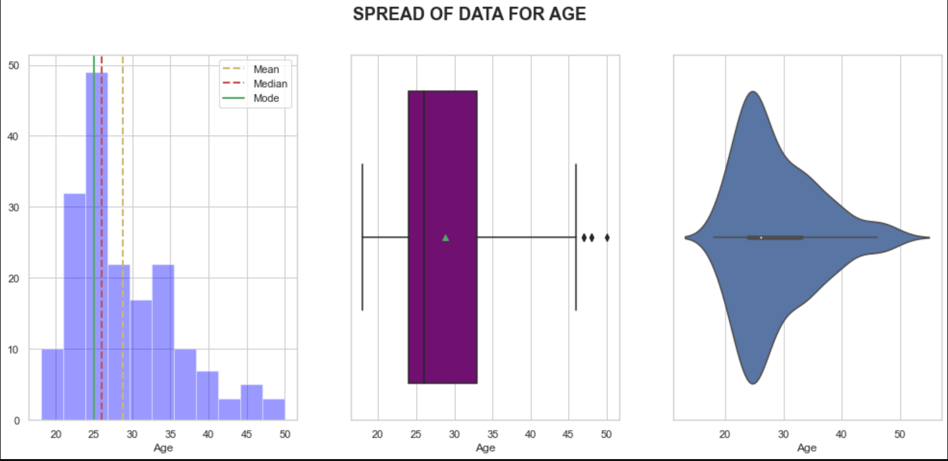
Visualize the Data : Age Univariate Analysis
Observations:
Age is skewed towards right.
Customers buying treadmill are younger and average age of customer is 28 , median is 26 and mode is 25
Customers buying treadmill after age of 40 and before 20 are very less.
Notes:
def dist_box_violin(data):
# function plots a combined graph for univariate analysis of continous variable
#to check spread, central tendency , dispersion and outliers
Name=data.name.upper()
fig, axes =plt.subplots(1,3,figsize=(17, 7))
fig.suptitle("SPREAD OF DATA FOR "+ Name , fontsize=18, fontweight='bold')
sns.distplot(data,kde=False,color='Blue',ax=axes[0])
axes[0].axvline(data.mean(), color='y', linestyle='--',linewidth=2)
axes[0].axvline(data.median(), color='r', linestyle='dashed', linewidth=2)
axes[0].axvline(data.mode()[0],color='g',linestyle='solid',linewidth=2)
axes[0].legend({'Mean':data.mean(),'Median':data.median(),'Mode':data.mode()})
sns.boxplot(x=data,showmeans=True, orient='h',color="purple",ax=axes[1])
#just exploring violin plot
sns.violinplot(data,ax=axes[2],showmeans=True)
dist_box_violin(cgf_df.Age)

Slide 20
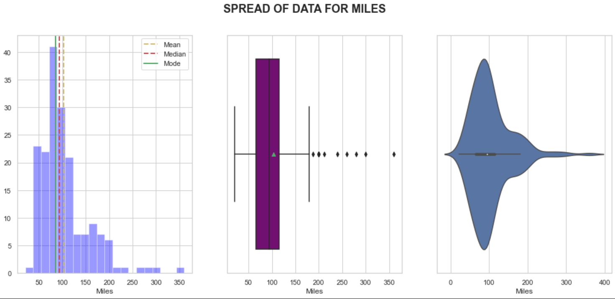
Visualize the Data : Miles Univariate Analysis
Observations:
Miles is skewed towards right.
Customers expect to run on an average 80 miles per week.
There are some outliers, where customers are expecting to run more than 200 miles per weak.
Notes:
def dist_box_violin(data):
# function plots a combined graph for univariate analysis of continous variable
#to check spread, central tendency , dispersion and outliers
Name=data.name.upper()
fig, axes =plt.subplots(1,3,figsize=(17, 7))
fig.suptitle("SPREAD OF DATA FOR "+ Name , fontsize=18, fontweight='bold')
sns.distplot(data,kde=False,color='Blue',ax=axes[0])
axes[0].axvline(data.mean(), color='y', linestyle='--',linewidth=2)
axes[0].axvline(data.median(), color='r', linestyle='dashed', linewidth=2)
axes[0].axvline(data.mode()[0],color='g',linestyle='solid',linewidth=2)
axes[0].legend({'Mean':data.mean(),'Median':data.median(),'Mode':data.mode()})
sns.boxplot(x=data,showmeans=True, orient='h',color="purple",ax=axes[1])
#just exploring violin plot
sns.violinplot(data,ax=axes[2],showmeans=True)
dist_box_violin(cgf_df.Miles)

Slide 21
Visualize the Data : Fitness Univariate Analysis
Observations:
Most of the customers have self-rated their fitness as 3( average).
Notes:
def dist_box_violin(data):
# function plots a combined graph for univariate analysis of continous variable
#to check spread, central tendency , dispersion and outliers
Name=data.name.upper()
fig, axes =plt.subplots(1,3,figsize=(17, 7))
fig.suptitle("SPREAD OF DATA FOR "+ Name , fontsize=18, fontweight='bold')
sns.distplot(data,kde=False,color='Blue',ax=axes[0])
axes[0].axvline(data.mean(), color='y', linestyle='--',linewidth=2)
axes[0].axvline(data.median(), color='r', linestyle='dashed', linewidth=2)
axes[0].axvline(data.mode()[0],color='g',linestyle='solid',linewidth=2)
axes[0].legend({'Mean':data.mean(),'Median':data.median(),'Mode':data.mode()})
sns.boxplot(x=data,showmeans=True, orient='h',color="purple",ax=axes[1])
#just exploring violin plot
sns.violinplot(data,ax=axes[2],showmeans=True)
dist_box_violin(cgf_df.Fitness)

Slide 22
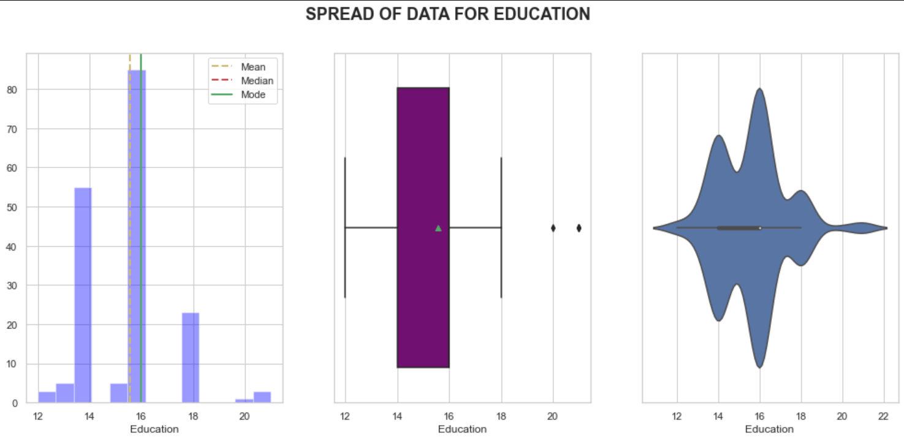
Visualize the Data : Education Univariate Analysis
Observations:
Most of the customers have 16 year of education (assuming them to be college graduates or bachelors).
There are few outliers.
Notes:
def dist_box_violin(data):
# function plots a combined graph for univariate analysis of continous variable
#to check spread, central tendency , dispersion and outliers
Name=data.name.upper()
fig, axes =plt.subplots(1,3,figsize=(17, 7))
fig.suptitle("SPREAD OF DATA FOR "+ Name , fontsize=18, fontweight='bold')
sns.distplot(data,kde=False,color='Blue',ax=axes[0])
axes[0].axvline(data.mean(), color='y', linestyle='--',linewidth=2)
axes[0].axvline(data.median(), color='r', linestyle='dashed', linewidth=2)
axes[0].axvline(data.mode()[0],color='g',linestyle='solid',linewidth=2)
axes[0].legend({'Mean':data.mean(),'Median':data.median(),'Mode':data.mode()})
sns.boxplot(x=data,showmeans=True, orient='h',color="purple",ax=axes[1])
#just exploring violin plot
sns.violinplot(data,ax=axes[2],showmeans=True)
dist_box_violin(cgf_df.Education)

Slide 23
Visualize the Data : Usage Univariate Analysis
Observations:
Most of customers expect they will be using the treadmill 3-4 days per week.
There are few outliers where customer are expecting to use treadmill for 6 or 7 times a week
Notes:
def dist_box_violin(data):
# function plots a combined graph for univariate analysis of continous variable
#to check spread, central tendency , dispersion and outliers
Name=data.name.upper()
fig, axes =plt.subplots(1,3,figsize=(17, 7))
fig.suptitle("SPREAD OF DATA FOR "+ Name , fontsize=18, fontweight='bold')
sns.distplot(data,kde=False,color='Blue',ax=axes[0])
axes[0].axvline(data.mean(), color='y', linestyle='--',linewidth=2)
axes[0].axvline(data.median(), color='r', linestyle='dashed', linewidth=2)
axes[0].axvline(data.mode()[0],color='g',linestyle='solid',linewidth=2)
axes[0].legend({'Mean':data.mean(),'Median':data.median(),'Mode':data.mode()})
sns.boxplot(x=data,showmeans=True, orient='h',color="purple",ax=axes[1])
#just exploring violin plot
sns.violinplot(data,ax=axes[2],showmeans=True)
dist_box_violin(cgf_df.Usage)

Slide 24
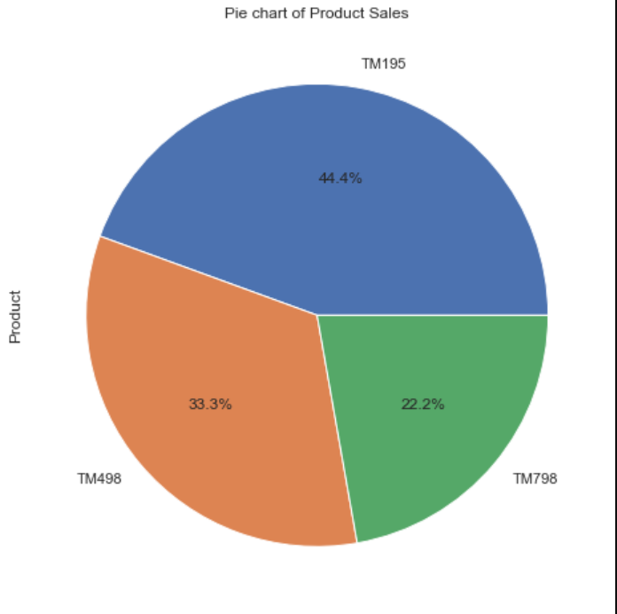
Visualize the Data : Product Univariate Analysis
Observations:
TM195 model sold 44.4%
TM498 model sold 33.3%
TM798 model sold 22.2%
Notes:
#Univariate Analysis
#categorical variables
plt.figure(figsize=(14,7))
cgf_df['Product'].value_counts().plot.pie(autopct='%1.1f%%',figsize=(8,8))
plt.title("Pie chart of Product Sales")
plt.show()

Slide 25
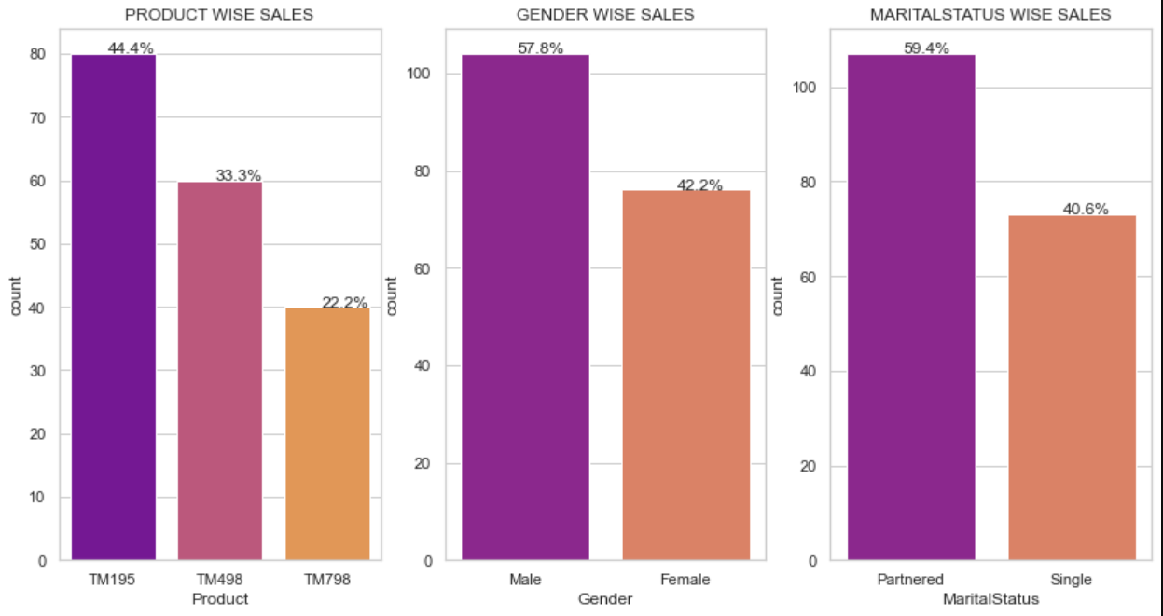
Visualize the Data : Bar Plot (Univariate Analysis)
Observations:
44.4% customers brought TM195. TM195 model is the most purchased model. TM498 was purchased more than TM798.
57.8% male brought trademill. There are more Male customers than Female customers.
59.4% of the customers who purchased treadmill are Married.
Notes:
# Function to create barplots that indicate percentage for each category.
def bar_perc(plot, feature):
'''
plot
feature: 1-d categorical feature array
'''
total = len(feature) # length of the column
for p in plot.patches:
percentage = '{:.1f}%'.format(100 * p.get_height()/total) # percentage of each class of the category
x = p.get_x() + p.get_width() / 2 - 0.05 # width of the plot
y = p.get_y() + p.get_height() # hieght of the plot
plot.annotate(percentage, (x, y), size = 12) # annotate the percentage
fig1, axes1 =plt.subplots(1,3,figsize=(14, 7))
list_col=['Product','Gender','MaritalStatus']
j=0
for i in range(len(list_col)):
order = cgf_df[list_col[i]].value_counts(ascending=False).index # to display bar in ascending order
axis=sns.countplot(x=list_col[i], data=cgf_df , order=order,ax=axes1[i],palette='plasma').set(title=list_col[i].upper() + ' WISE SALES')
bar_perc(axes1[i],cgf_df[list_col[i]])

Slide 26
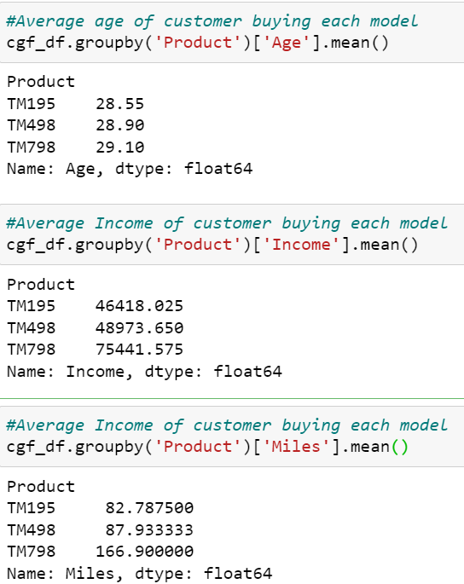
Visualize the Data : Bivariate Analysis
Notes:
#Average age of customer buying each model
cgf_df.groupby('Product')['Age'].mean()
#Average Income of customer buying each model
cgf_df.groupby('Product')['Income'].mean()
#Average Income of customer buying each model
cgf_df.groupby('Product')['Miles'].mean()

Slide 27
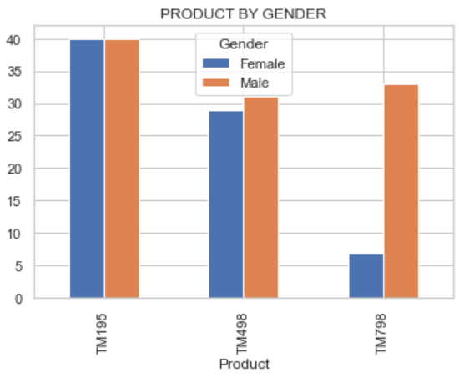
Visualize the Data : Bivariate Analysis (Product & Gender)
Observations:
TM195 model was equally bought my Male and Female
Compared to females, male bought TM498 model .
TM798 model is popular in Males than in female.
Notes:
plt.figure(figsize=(10,10))
prd_gender=pd.crosstab(cgf_df['Product'],cgf_df['Gender'] )
print(prd_gender)
ax=prd_gender.plot(kind='bar')
plt.title("PRODUCT BY GENDER")

Slide 28
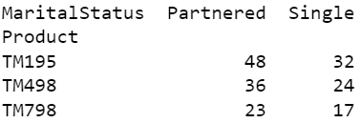
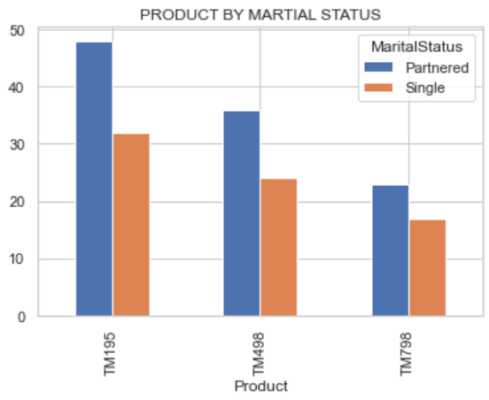
Visualize the Data : Bivariate Analysis (Product & Marital status)
Observations:
All model was bought Partnered compared to single.
Notes:
prd_mar_status=pd.crosstab(cgf_df['Product'],cgf_df['MaritalStatus'] )
print(prd_mar_status)
prd_mar_status.plot(kind='bar')
plt.title("PRODUCT BY MARTIAL STATUS")

Slide 29
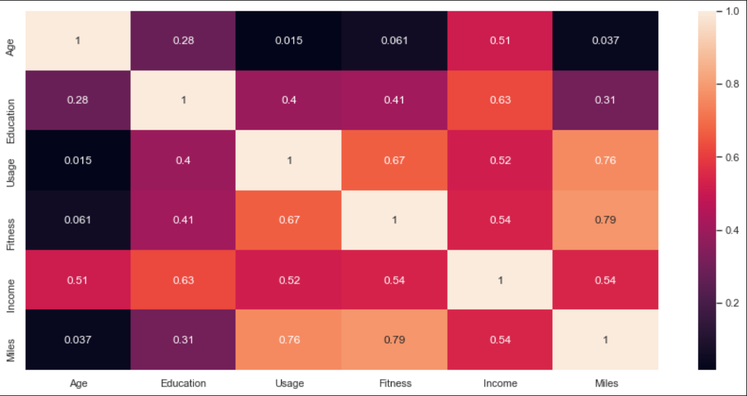
Visualize the Data : Correlational graph
Notes:
plt.figure(figsize=(15,7))
sns.heatmap(cgf_df.corr(), annot=True)

Slide 30
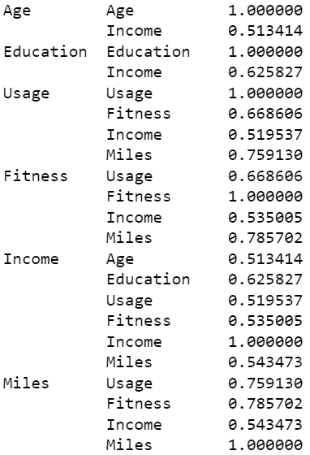
Visualize the Data : Correlation
Observations:
Age and Income has some in significant correlation
Education and Income has very strong correlation
There is some correlation between Usage and Income
Fitness and miles are corelated
Income is correlated to Education, Usage, Fitness, Age and Miles.
Miles and usage are positively correlated
Notes:
corr_pairs = cgf_df.corr().unstack() # give pairs of correlation
print( corr_pairs[abs(corr_pairs)>0.5]) # Gives us correlated data

Slide 31
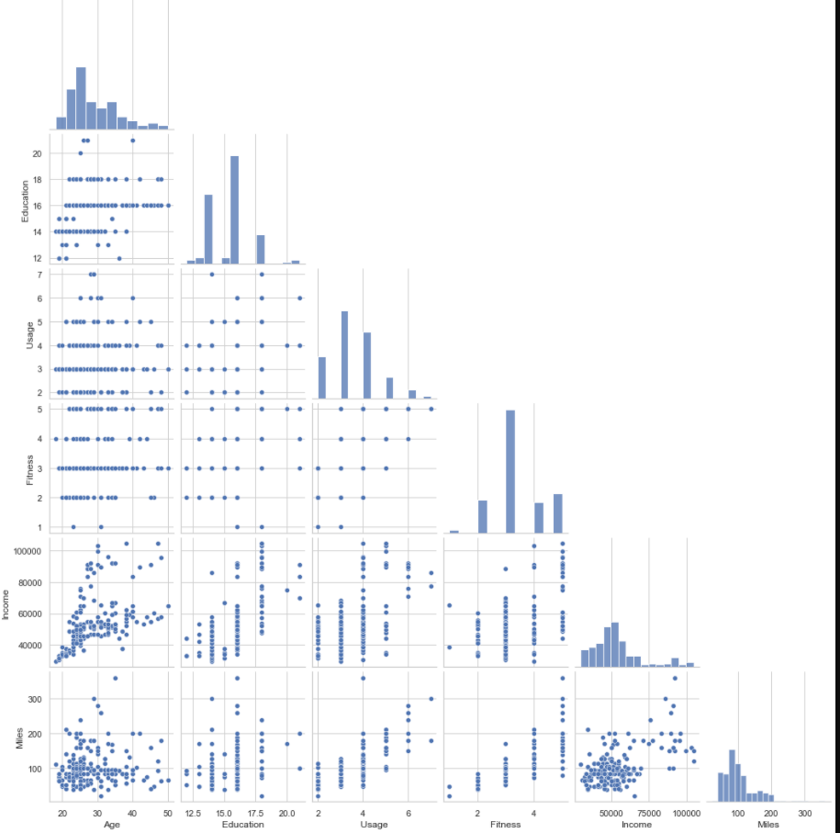
Visualize the Data : Pair plot
Observations:
we get the same observation as from the correlation plot.
Notes:
plt.figure(figsize=(15,7))
sns.pairplot(data=cgf_df,corner=True)

Slide 32
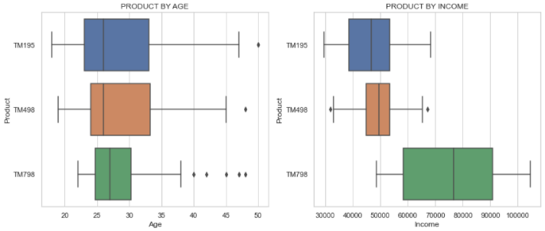
Visualize the Data : Bivariate Analysis (Product wise)
Observations:
There are many outliers for TM798 ,customers are more than age of 40 .
Age of customers buying TM195 and TM498 is between 20-35, where as customers buying TM798 are primarily in 25-30
Customers with higher income have purchased TM798 model.
Customers with lower income purchase TM195 and TM498 model may be because of cost of the Treadmill.
Notes:
#Bi Varaite Analysis for
#1.Product & Age
#2.Product & Income
#3.Product & Education
#4.Product & Usage
#5.Product & Fitness
#6.Product & Miles
fig1, axes1 =plt.subplots(3,2,figsize=(14, 19))
list1_col=['Age','Income','Education','Usage','Fitness','Miles']
#instead of writing boxplot 6 times using for loop
for i in range(len(list1_col)):
row=i//2
col=i%2
ax=axes1[row,col]
sns.boxplot(cgf_df[list1_col[i]],cgf_df['Product'],ax=ax).set(title='PRODUCT BY ' + list1_col[i].upper() )

Slide 33
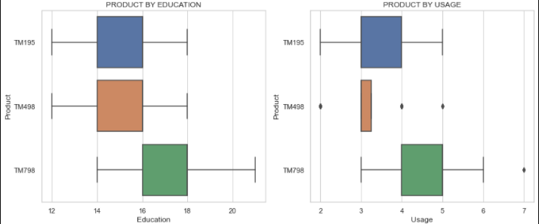
Visualize the Data : Bivariate Analysis (Product wise)
Observations:
Customers with more education have purchased TM798 model.
Customer with TM195 expect to use treadmill 3-4 times a week.
Customer with TM798 expect to use treadmill 4-5 times a week.
Notes:
#Bi Varaite Analysis for
#1.Product & Age
#2.Product & Income
#3.Product & Education
#4.Product & Usage
#5.Product & Fitness
#6.Product & Miles
fig1, axes1 =plt.subplots(3,2,figsize=(14, 19))
list1_col=['Age','Income','Education','Usage','Fitness','Miles']
#instead of writing boxplot 6 times using for loop
for i in range(len(list1_col)):
row=i//2
col=i%2
ax=axes1[row,col]
sns.boxplot(cgf_df[list1_col[i]],cgf_df['Product'],ax=ax).set(title='PRODUCT BY ' + list1_col[i].upper() )

Slide 34
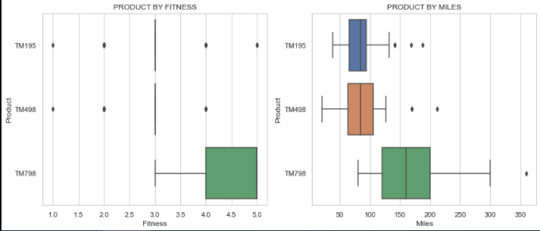
Visualize the Data : Bivariate Analysis (Product wise)
Observations:
Customer with TM195 have average self rated fitness as 3 and some unfits.
Customers who bought TM498 model expecting to use Treadmill less frequently but to run more miles a week.
Customer buying TM798 plan to use it more frequently , run more miles and have high self rated fitness .They seem to be more health conscious or professionals.
Notes:
#Bi Varaite Analysis for
#1.Product & Age
#2.Product & Income
#3.Product & Education
#4.Product & Usage
#5.Product & Fitness
#6.Product & Miles
fig1, axes1 =plt.subplots(3,2,figsize=(14, 19))
list1_col=['Age','Income','Education','Usage','Fitness','Miles']
#instead of writing boxplot 6 times using for loop
for i in range(len(list1_col)):
row=i//2
col=i%2
ax=axes1[row,col]
sns.boxplot(cgf_df[list1_col[i]],cgf_df['Product'],ax=ax).set(title='PRODUCT BY ' + list1_col[i].upper() )

Slide 35
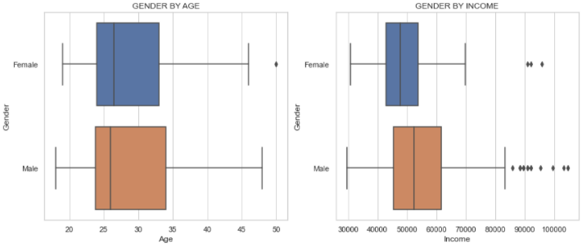
Visualize the Data : Bivariate Analysis (Gender wise)
Observations:
Female and Male in age range 23-33 purchased the treadmill.
Male customers earn more than Female customers.
Notes:
#Bi Varaite Analysis for
#1.Gender & Age
#2.Gender & Income
#3.Gender & Education
#4.Gender & Usage
#5.Gender & Fitness
#6.Gender & Miles
fig1, axes1 =plt.subplots(3,2,figsize=(14, 19))
list1_col=['Age','Income','Education','Usage','Fitness','Miles']
# to plot graph side by side.
for i in range(len(list1_col)):
row=i//2
col=i%2
ax=axes1[row,col]
sns.boxplot(cgf_df[list1_col[i]],cgf_df['Gender'],ax=ax).set(title='GENDER BY ' + list1_col[i].upper())

Slide 36
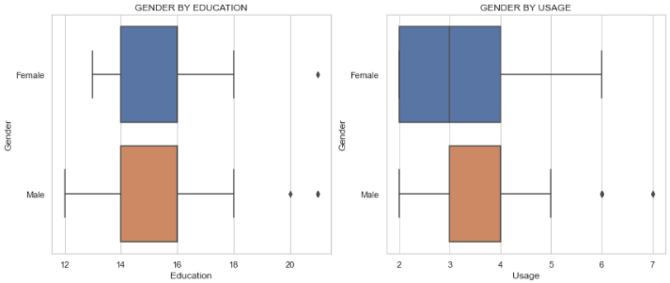
Visualize the Data : Bivariate Analysis (Gender wise)
Observations:
Expected Usage covered on trade mill is less in male customers than female customers.
Education of Male and Female customers is same.
Notes:
#Bi Varaite Analysis for
#1.Gender & Age
#2.Gender & Income
#3.Gender & Education
#4.Gender & Usage
#5.Gender & Fitness
#6.Gender & Miles
fig1, axes1 =plt.subplots(3,2,figsize=(14, 19))
list1_col=['Age','Income','Education','Usage','Fitness','Miles']
# to plot graph side by side.
for i in range(len(list1_col)):
row=i//2
col=i%2
ax=axes1[row,col]
sns.boxplot(cgf_df[list1_col[i]],cgf_df['Gender'],ax=ax).set(title='GENDER BY ' + list1_col[i].upper())

Slide 37
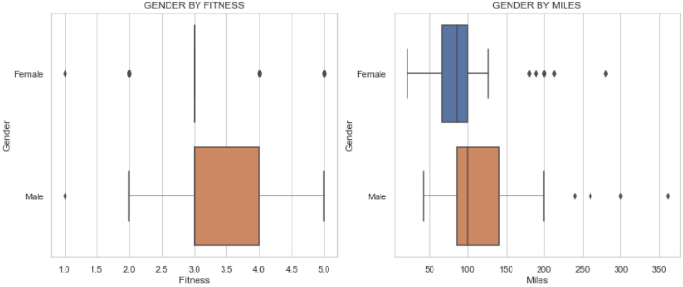
Visualize the Data : Bivariate Analysis (Gender wise)
Observations:
Males Customer have higher self rated fitness than female.
Males Customer run more miles than female.
Notes:
#Bi Varaite Analysis for
#1.Gender & Age
#2.Gender & Income
#3.Gender & Education
#4.Gender & Usage
#5.Gender & Fitness
#6.Gender & Miles
fig1, axes1 =plt.subplots(3,2,figsize=(14, 19))
list1_col=['Age','Income','Education','Usage','Fitness','Miles']
# to plot graph side by side.
for i in range(len(list1_col)):
row=i//2
col=i%2
ax=axes1[row,col]
sns.boxplot(cgf_df[list1_col[i]],cgf_df['Gender'],ax=ax).set(title='GENDER BY ' + list1_col[i].upper())

Slide 38
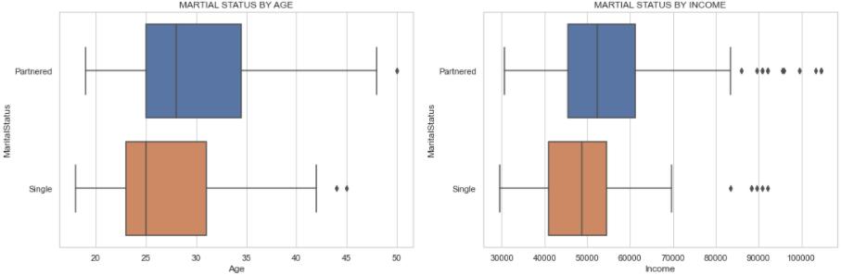
Visualize the Data : Bivariate Analysis (Marital Status wise)
Observations:
Income of Partnered customer is more than income of single customer.
Age of Partnered customer is more than Age of single customer
Notes:
#Bi Variate Analysis for
#1.Martial Status & Age
#2.Martial Status & Income
#3.Martial Status & Education
#4.Martial Status & Usage
#5.Martial Status & Fitness
#6.Martial Status & Miles
plt.figure(figsize=(7,7))
fig1, axes1 =plt.subplots(3,2,figsize=(18, 19))
list1_col=['Age','Income','Education','Usage','Fitness','Miles']
for i in range(len(list1_col)):
row=i//2
col=i%2
ax=axes1[row,col]
sns.boxplot(cgf_df[list1_col[i]],cgf_df['MaritalStatus'],ax=ax).set(title='MARTIAL STATUS BY ' + list1_col[i].upper())

Slide 39
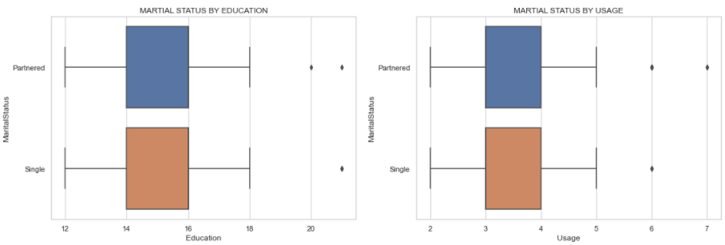
Visualize the Data : Bivariate Analysis (Marital Status wise)
Observations:
Education and Usage of both Partnered and Single customer is same
Notes:
#Bi Varaite Analysis for
#1.Martial Status & Age
#2.Martial Status & Income
#3.Martial Status & Education
#4.Martial Status & Usage
#5.Martial Status & Fitness
#6.Martial Status & Miles
plt.figure(figsize=(7,7))
fig1, axes1 =plt.subplots(3,2,figsize=(18, 19))
list1_col=['Age','Income','Education','Usage','Fitness','Miles']
for i in range(len(list1_col)):
row=i//2
col=i%2
ax=axes1[row,col]
sns.boxplot(cgf_df[list1_col[i]],cgf_df['MaritalStatus'],ax=ax).set(title='MARTIAL STATUS BY ' + list1_col[i].upper())

Slide 40
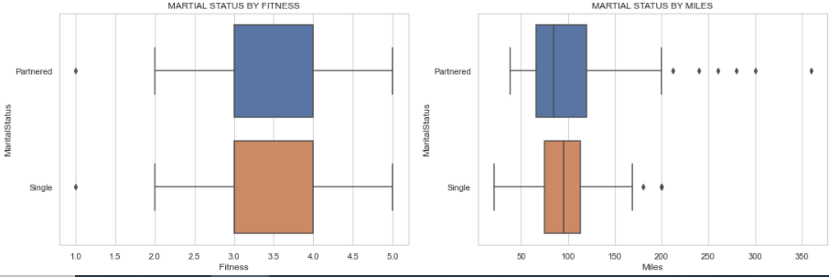
Visualize the Data : Bivariate Analysis (Marital Status wise)
Observations:
Partnered customer expects to run more miles compared to single
Self rated Fitness of both Partnered and Single customer are same.
Notes:
#Bi Varaite Analysis for
#1.Martial Status & Age
#2.Martial Status & Income
#3.Martial Status & Education
#4.Martial Status & Usage
#5.Martial Status & Fitness
#6.Martial Status & Miles
plt.figure(figsize=(7,7))
fig1, axes1 =plt.subplots(3,2,figsize=(18, 19))
list1_col=['Age','Income','Education','Usage','Fitness','Miles']
for i in range(len(list1_col)):
row=i//2
col=i%2
ax=axes1[row,col]
sns.boxplot(cgf_df[list1_col[i]],cgf_df['MaritalStatus'],ax=ax).set(title='MARTIAL STATUS BY ' + list1_col[i].upper())

Slide 41
Visualize the Data : Bivariate Analysis (Marital Status wise)
Observations:
Male are more in Partnered / Single status than female.
Notes:
plt.figure(figsize=(7,7))
sns.countplot(cgf_df['Gender'],hue=cgf_df["MaritalStatus"]).set(title='MARTIAL STATUS BY GENDER')

Slide 42
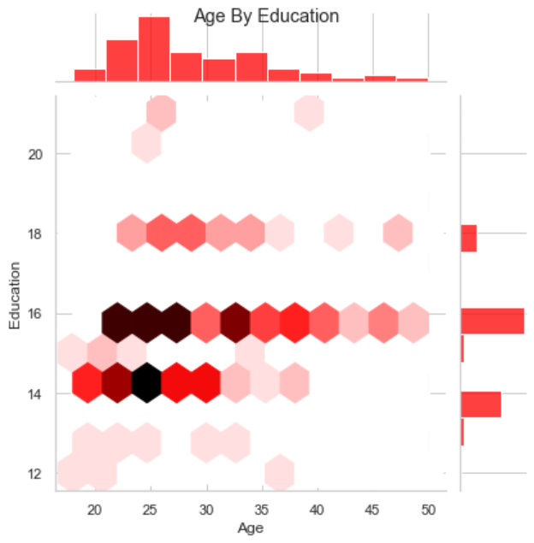
Visualize the Data : Bivariate Analysis (Age & Education)
Observations:
Customer between age 20-40 have 14 -16 years of education
Notes:
#Bivariate Analysis Age & Education
sns.jointplot(x = 'Age',y = 'Education',data = cgf_df,color="red",kind='hex')

Slide 43
Visualize the Data : Multivariate Analysis (Product , Education & Income)
Observations:
Education and Income are correlated.
TM798 has higher income and higher education
Notes:
plt.figure(figsize=(12,7))
sns.pointplot(x=cgf_df["Education"],y=cgf_df["Income"],hue=cgf_df['Product']).set(title='EDUCATION BY INCOME ')

Slide 44
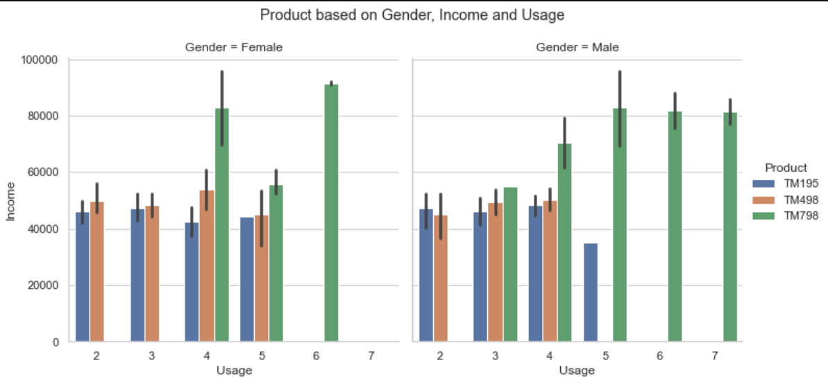
Visualize the Data : Multivariate Analysis
Observations:
Male customer with higher income ,bought TM798 Model and expect to use treadmill 4-6 /week
Customer who bought TM195 and TM498 are in same income range and expect to use treadmill 3-4 /week
Notes:
plt.figure(figsize=(12,7))
sns.catplot(x='Usage', y='Income', col='Gender',hue='Product' ,kind="bar", data=cgf_df)

Slide 45
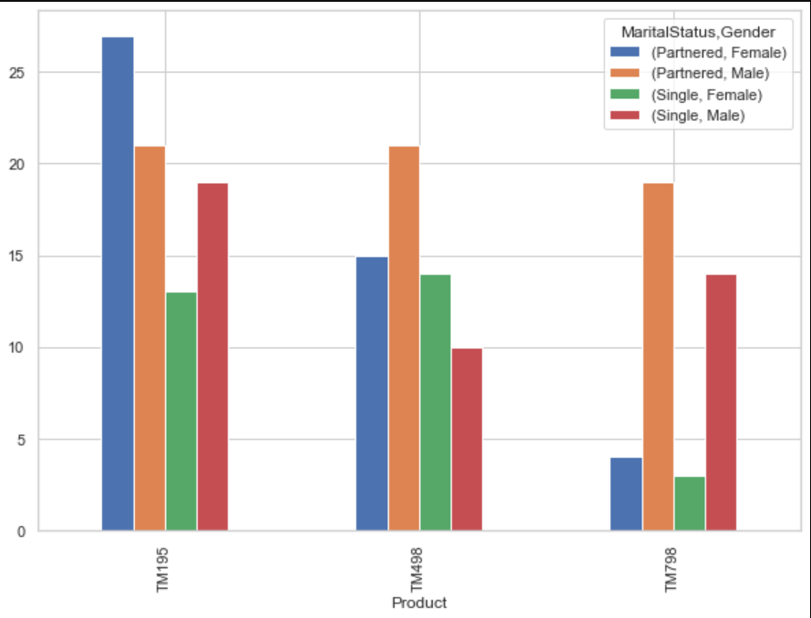
Visualize the Data : Multivariate Analysis
Observations:
Partnered Female bought TM195 Model compared to Partnered male.
Single Female customers bought TM498 model more than Single male customers.
Partnered Male customers bought TM798 model more than Single Male customers.
There are more single males buying Treadmill than single Females.
Single Male customers bought TM195 Model compared to Single Female.
Majority of people who buy the TM798 are man & partnered.
The majority of our buyers are male.
Notes:
prd_mar_gen= pd.crosstab(index=cgf_df["Product"],
columns=[cgf_df["MaritalStatus"],
cgf_df["Gender"]] ,
)
prd_mar_gen
prd_mar_gen.plot(kind='bar',figsize=(10,7))

Slide 46
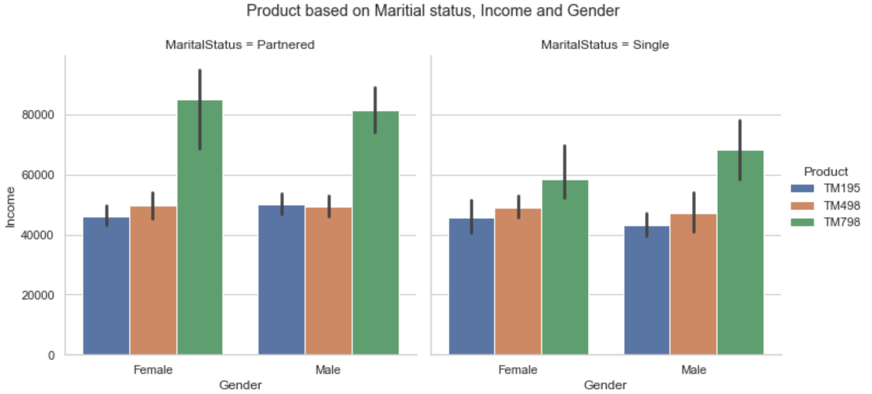
Visualize the Data : Multivariate Analysis
Observations:
TM 798 model was purchased more by males customer than female customers .
More partnered customer tend to buy TM798 than Single customers
Notes:
# Income by gender by product and by marital status
sns.catplot(x='Gender',y='Income', hue='Product', col='MaritalStatus', data=cgf_df,kind='bar');

Slide 47
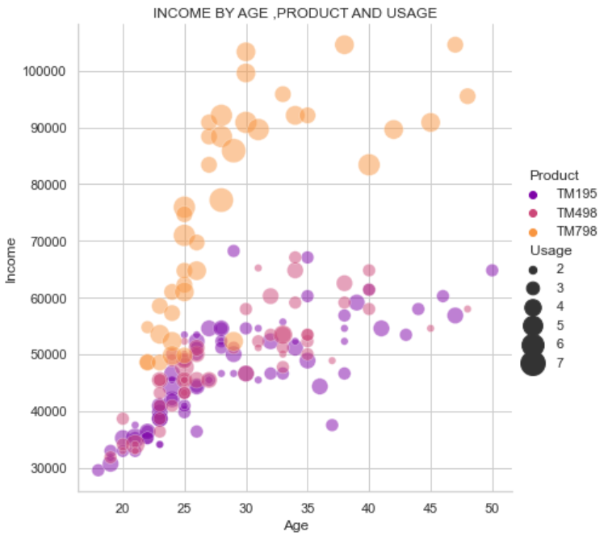
Visualize the Data : Multivariate Analysis
Observations:
Products TM195 and TM498 are bought by people with lower than 70K as income and age is concentrated more in range of 23-35
Product TM798 is mainly bought by people with higher than 70K income and age falls in range of 23-30.
Majority of people who buys the TM798 expect that they will run more than consumers of the other two products, on average.
Notes:
#scatter plot between income, age ,product and usage
sns.relplot(x="Age", y="Income", hue="Product", size="Usage",
sizes=(40, 400), alpha=.5, palette="plasma",
height=6, data=cgf_df).set(title='INCOME BY AGE ,PRODUCT AND USAGE');

Slide 48
Conclusion : Important Observations :
 | TM195 | TM498 | TM798
Popular | Most popular | Popular | Less popular
Income | 46K | 48K | 75K
Age | 28.5 | 28.9 | 29
Education | 15 years | 16 years | 17 years
Gender | Both | Single Female | Partnered
Fitness Level | Average | Average | Fit
Usage | 3-4 | 3-4 | 4-5

Slide 49
Recommendation:
TM195 & TM498 attracts people with income less than 60k , may be because of cost of both models. We should market these models as a budget Treadmill for all.
TM798 should be marketed as a high end Treadmill for professionals and athletes. Create a luxiurous brand image for this Treadmill.
Assuming TM 798 provides high margin of profit, we should brand it as Treadmill for athletes. We can also endorse some athlete to promote this Treadmill. This might increase there sales.
Considering above observations, We can attract customers to upgrade from their existing treadmill and switch to TM798 ,highlighting extra features this Treadmill provides.
To expand our sales with Female customers, We could run a marketing campaign during Women's days, Mothers days emphasizing on fitness and exercise.
The age of our customers are in the range of 35 years old and 18 years old. We need to research if there is any scope to increase sale with customers who are more than 35 years old.

Slide 50
Questions?

Slide 51
Thank You!!!

