Slide 1
Smart BI Agent
Intelligent Analytics Platform for Retail & Manufacturing
Prepared by: Mayuresh Prakash Badgujar
May 2026 | Version 1.0
Powered by Snowflake Cortex AI

Slide 2
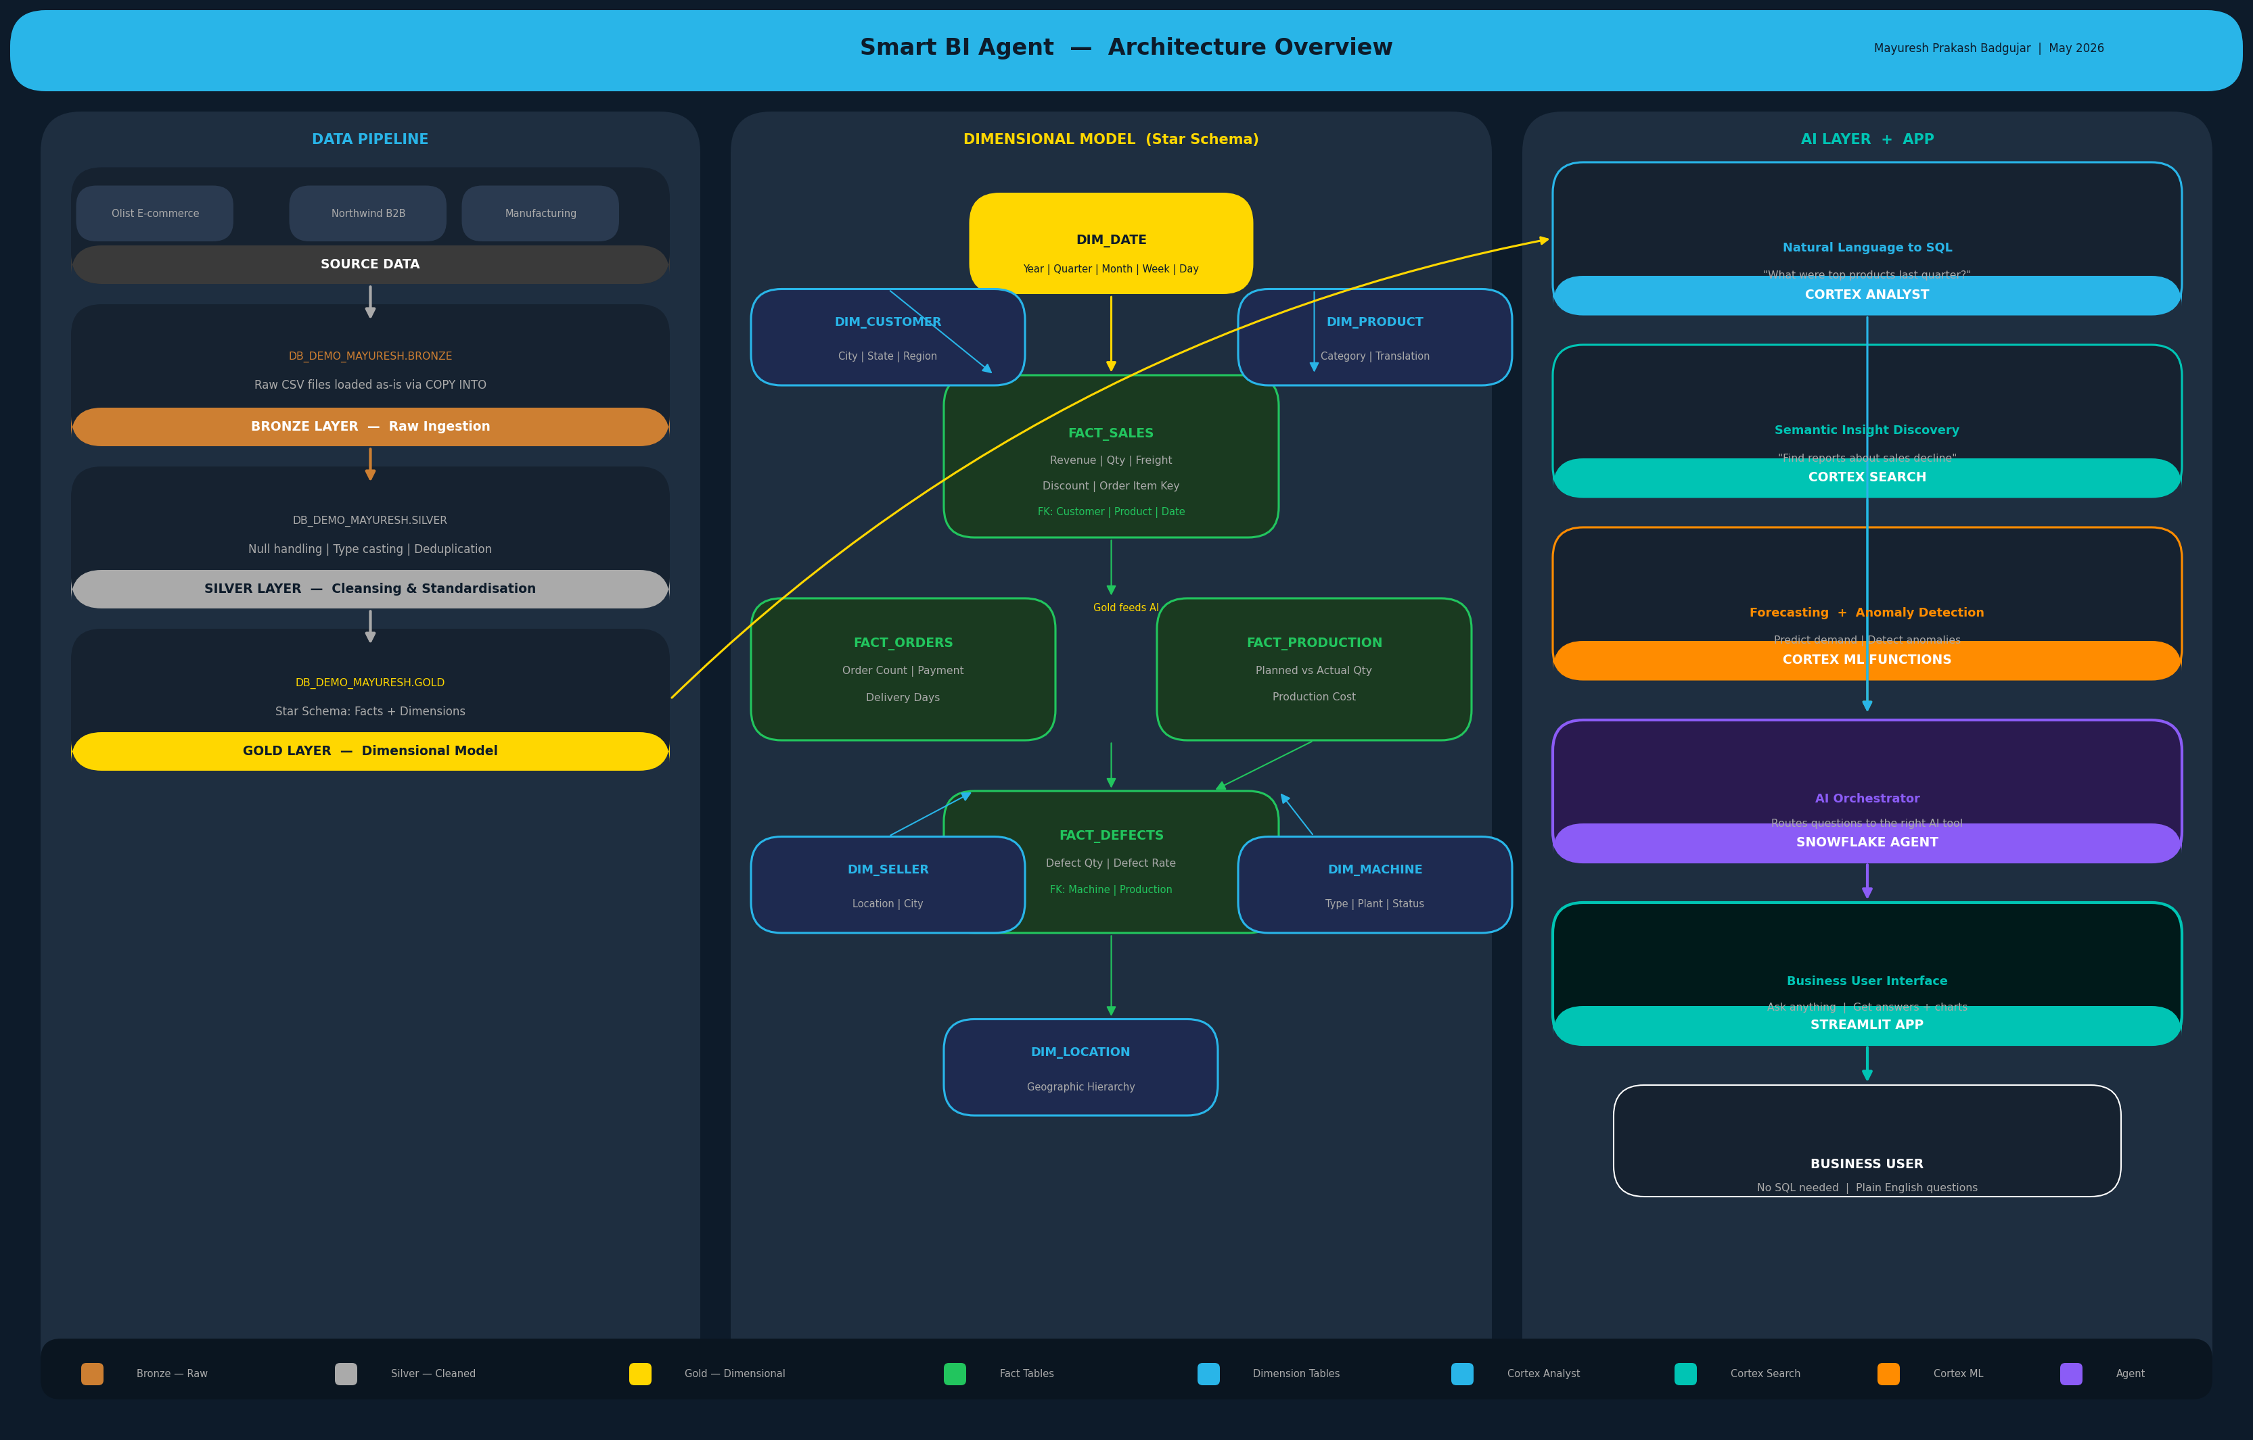
Architecture Overview — Single Page Visual

Slide 3
Executive Summary
What are we building and why?
The Challenge
The Solution
Business users cannot self-serve data. Analysts are overwhelmed. Decisions are delayed.
A single AI-powered analytics platform where anyone can ask questions in plain English and get instant answers.
The Platform
The Outcome
Built entirely on Snowflake — combining a Bronze/Silver/Gold data pipeline with Cortex AI, Cortex Search, and Cortex ML.
From hours to seconds. From analysts-only to everyone. From reactive to predictive.
2

Slide 4
The Problem
Why does this platform need to exist?
1
No Self-Service
2
Buried Insights
3
No Predictions
4
Fragmented Tools
Only analysts can query data. Business waits days for answers.
Reports exist but no one can find or search through them.
Teams react to problems. No forward-looking intelligence.
BI + ML + Apps are separate. High cost, inconsistent data.
3

Slide 5
Data Domain
One company — from factory floor to customer doorstep
E-commerce / Retail
B2B / Wholesale
Manufacturing
Orders | Customers | Payments Delivery | Reviews | Products
Suppliers | Product Catalogue Employees | Wholesale Orders
Machines | Production Orders Defects | Downtime | Inventory
Combined they represent a company that manufactures and sells products online — end to end.
4

Slide 6
Layered Architecture
Bronze → Silver → Gold → AI → App
SOURCE DATA
CSV files: Olist, Northwind, Manufacturing
▼
BRONZE
Raw data — exact copy, no transformations
▼
SILVER
Cleaned, typed, deduplicated, conformed
▼
GOLD
Dimensional model — Facts + Dimensions
▼
AI LAYER
Cortex Analyst + Cortex Search + Cortex ML
▼
STREAMLIT APP
Business user interface — ask anything
5

Slide 7
Gold Layer — Dimensional Model
Star Schema design for analytics and AI consumption
FACT TABLES
DIMENSION TABLES
FACT_SALES
DIM_DATE
DIM_CUSTOMER
Revenue, qty, freight, discount
Year, Quarter, Month, Week
Customer, city, state, region
FACT_ORDERS
Order count, payment, delivery days
DIM_PRODUCT
DIM_SELLER
FACT_PRODUCTION
Product, category, translation
Seller details and location
Planned vs actual qty, cost
FACT_DEFECTS
DIM_MACHINE
DIM_LOCATION
Defect qty, defect rate
Type, plant, status, capacity
Geographic hierarchy
6

Slide 8
AI Capabilities
Three AI engines working together
Cortex Analyst
Cortex Search
Cortex ML
Natural Language to SQL
Semantic Insight Search
Forecasting & Anomaly Detection
"What were top 10 products by revenue last quarter?"
"Find reports about sales decline in 2023"
"Forecast next quarter demand for top products"
Ask questions in plain English. Get SQL + results + charts instantly.
Search across historical reports and insights semantically.
Predict future trends. Detect anomalies automatically.
7

Slide 9
Technology Stack
Everything runs natively on Snowflake
Layer
Technology
Purpose
Cloud Platform
Snowflake
Single platform — storage, compute, AI, app
Data Pipeline
Bronze / Silver / Gold
Structured, layered data architecture
Dimensional Model
Star Schema
Optimised for analytics and AI consumption
Natural Language
Cortex Analyst
Business questions translated to SQL
Semantic Search
Cortex Search Service
Index and retrieve insights semantically
Predictive AI
Cortex ML Functions
Built-in forecasting and anomaly detection
Orchestration
Snowflake Cortex Agent
Intelligent routing across all AI tools
User Interface
Streamlit in Snowflake
Native app — no infrastructure required
8

Slide 10
Business Value
Measurable impact on speed, access, and intelligence
BEFORE
AFTER
Time to Answer
Hours / Days
-->
Seconds
Self-Service Users
Analysts Only
-->
Everyone
Forecast Access
Manual/Excel
-->
Automated
Anomaly Detection
Reactive
-->
Proactive
Tools Required
Multiple
-->
One
9

Slide 11
Delivery Phases
Step-by-step build sequence
Architecture & Design
Bronze Layer
Silver Layer
1
Define layers, data model, tech decisions
2
Ingest raw CSV data into Snowflake as-is
3
Clean, standardise and type-cast data
Gold Layer
Cortex Analyst
Cortex Search
4
Build dimensional model — facts + dimensions
5
Natural language interface on Gold layer
6
Semantic search across insights
Cortex ML
Snowflake Agent
Streamlit App
7
Forecasting and anomaly detection
8
Orchestrate all AI tools intelligently
9
Business user interface — all in one place
10

Slide 12
Let's Build It.
Traditional BI expertise meets Snowflake AI.
Mayuresh Prakash Badgujar
BI & Analytics | 10+ Years Experience | Snowflake Cortex AI
Built with Snowflake Cortex AI | Streamlit | Star Schema Dimensional Modelling

