Slide 1
BUSINESS INTELLIGENCE & DATA ANALYTICS
Ola Ride Booking Analysis
Sales & Operational Performance Analysis using SQL and Power BI
Reporting Period: July 1–31, 2024 · Tools: SQL, Microsoft Power BI
Objective: Analyze ride volume, revenue, vehicle performance, cancellations, customer behavior, and service quality.

Slide 2
OVERALL BUSINESS PERFORMANCE
Overall Business Performance
96,285
62.08%
Total Booking Requests
Successful Booking Rate
Strong demand across July 2024
Significant portion did not convert
28,933
₹53M
Cancelled Ride Requests
Total Booking Value
Largest operational opportunity
Generated in July 2024
Daily ride volume fluctuated between ~3,000–3,450 rides. Cancellations represent the most critical area for operational improvement.

Slide 3
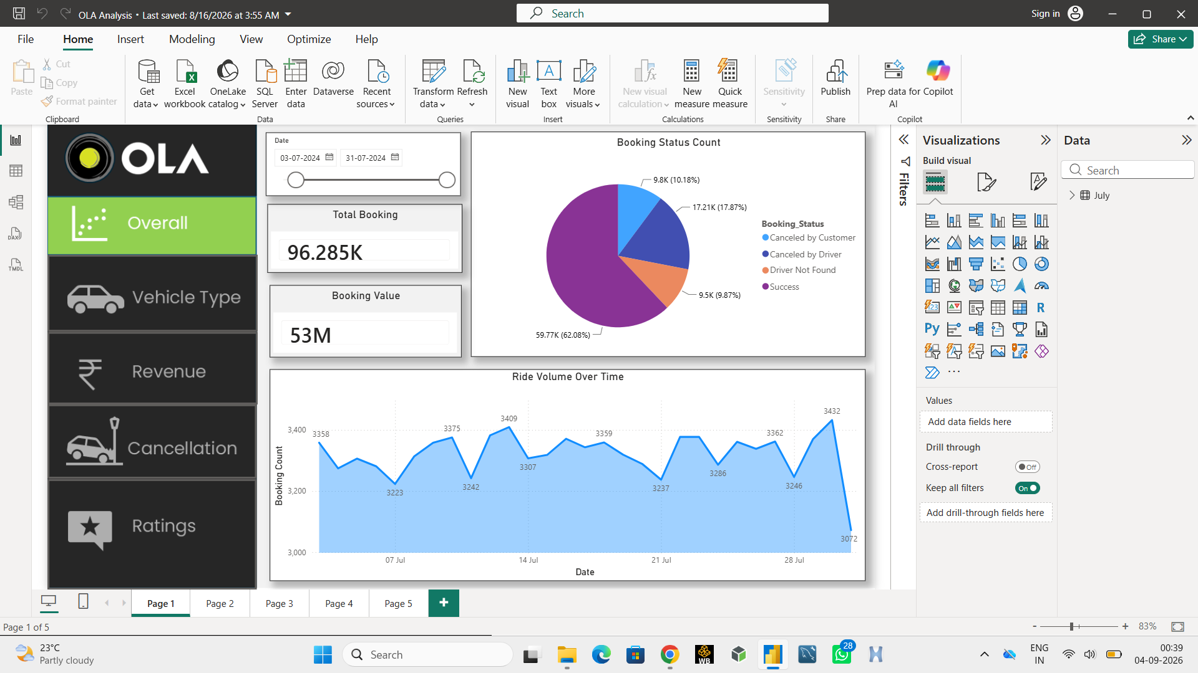

Slide 4
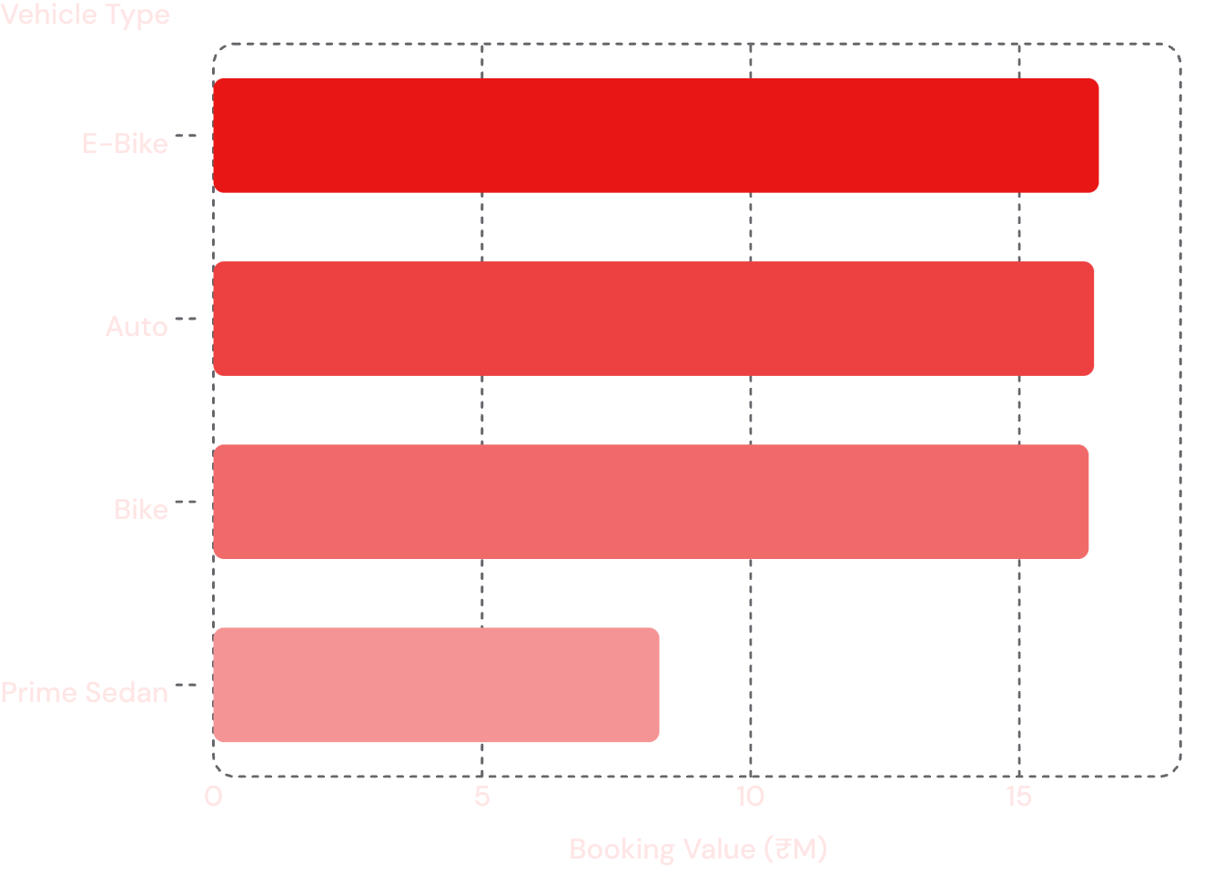
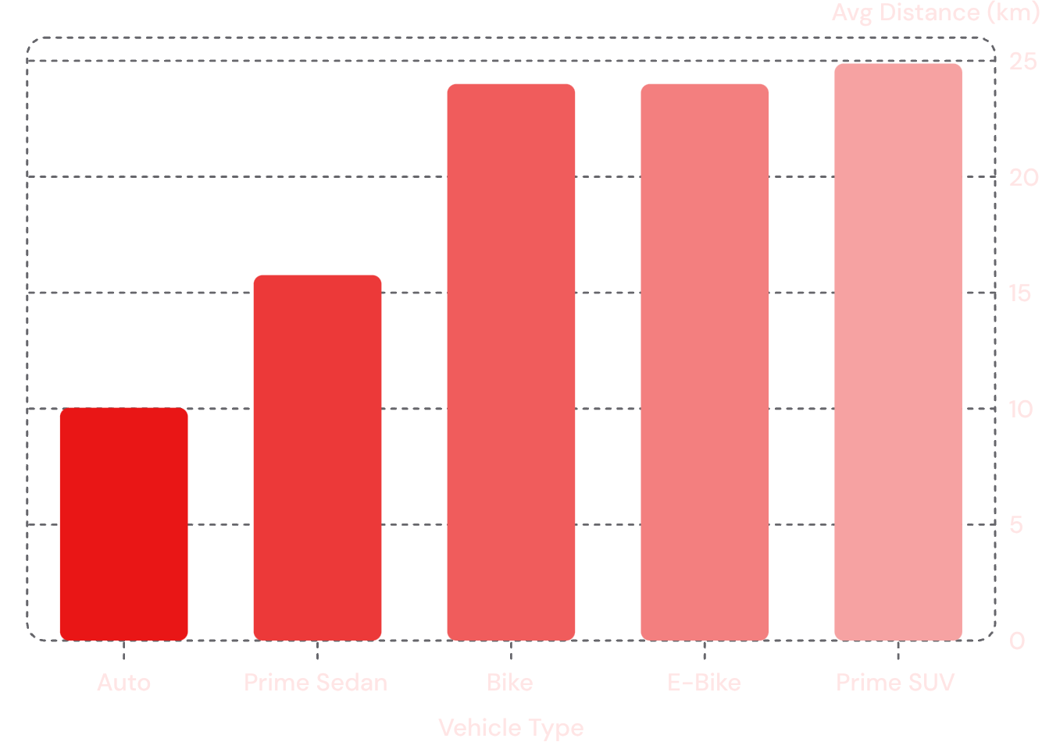
VEHICLE TYPE & DISTANCE ANALYSIS
Vehicle Type & Distance Analysis
Booking Value by Vehicle Type (₹ Million)
Average Ride Distance by Vehicle Type (km)
Autos serve short-distance urban travel; Bikes and E-Bikes support longer commutes. Each category addresses distinct customer needs.

Slide 5
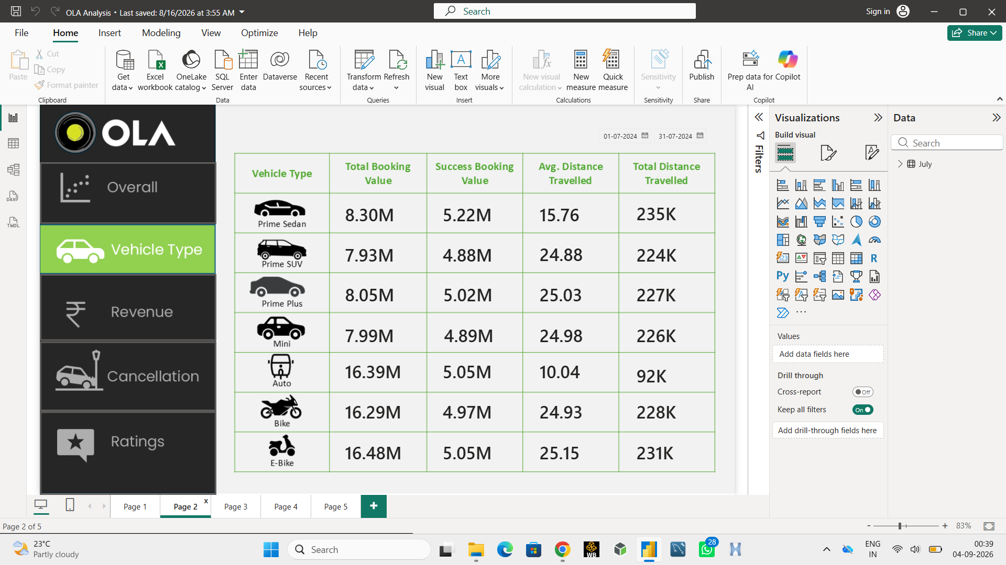

Slide 6
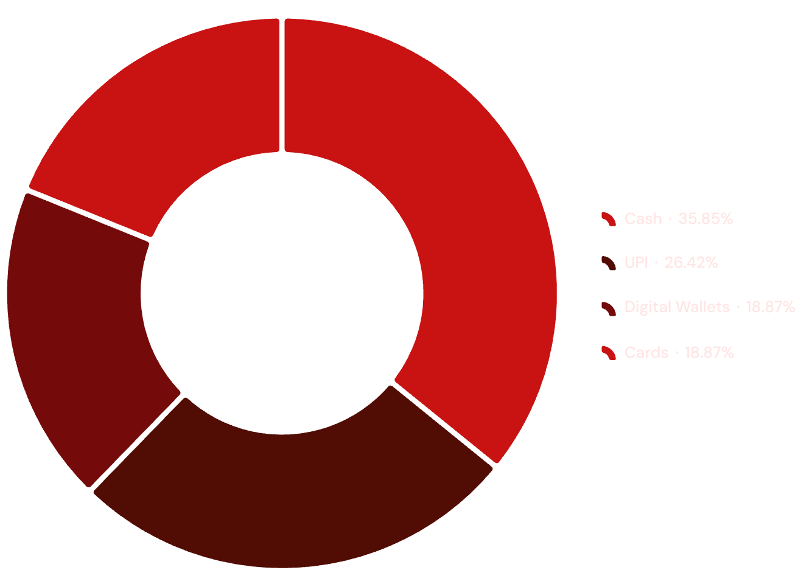
REVENUE COMPOSITION & CUSTOMER VALUE
Revenue Composition & Customer Value
Payment Method Contribution (₹ Million)
Key Revenue Insights
Cash leads at ₹19M+ — largest payment channel
UPI is the strongest digital payment (~₹14M)
Digital wallets contribute meaningfully; cards remain low
Accelerating digital payments improves reconciliation
Top High-Value Customers
CID308763
CID3553074
CID734557

Slide 7
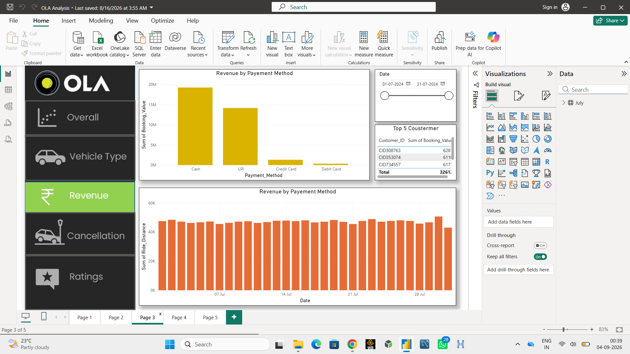

Slide 8

OPERATIONAL BOTTLENECK
Cancellation Analysis
28,933 ride requests cancelled — the most critical operational gap in July 2024.
Customer Cancellations
Driver not moving toward pickup location
Driver asking customer to cancel
Erodes trust and reduces ride conversion
Driver Cancellations
Personal and vehicle-related issues
Customer-related conflicts
Passenger capacity constraints
Business Impact
Lost booking revenue and opportunities
Lower successful booking rate
Poor customer experience and competitor switching

Slide 9
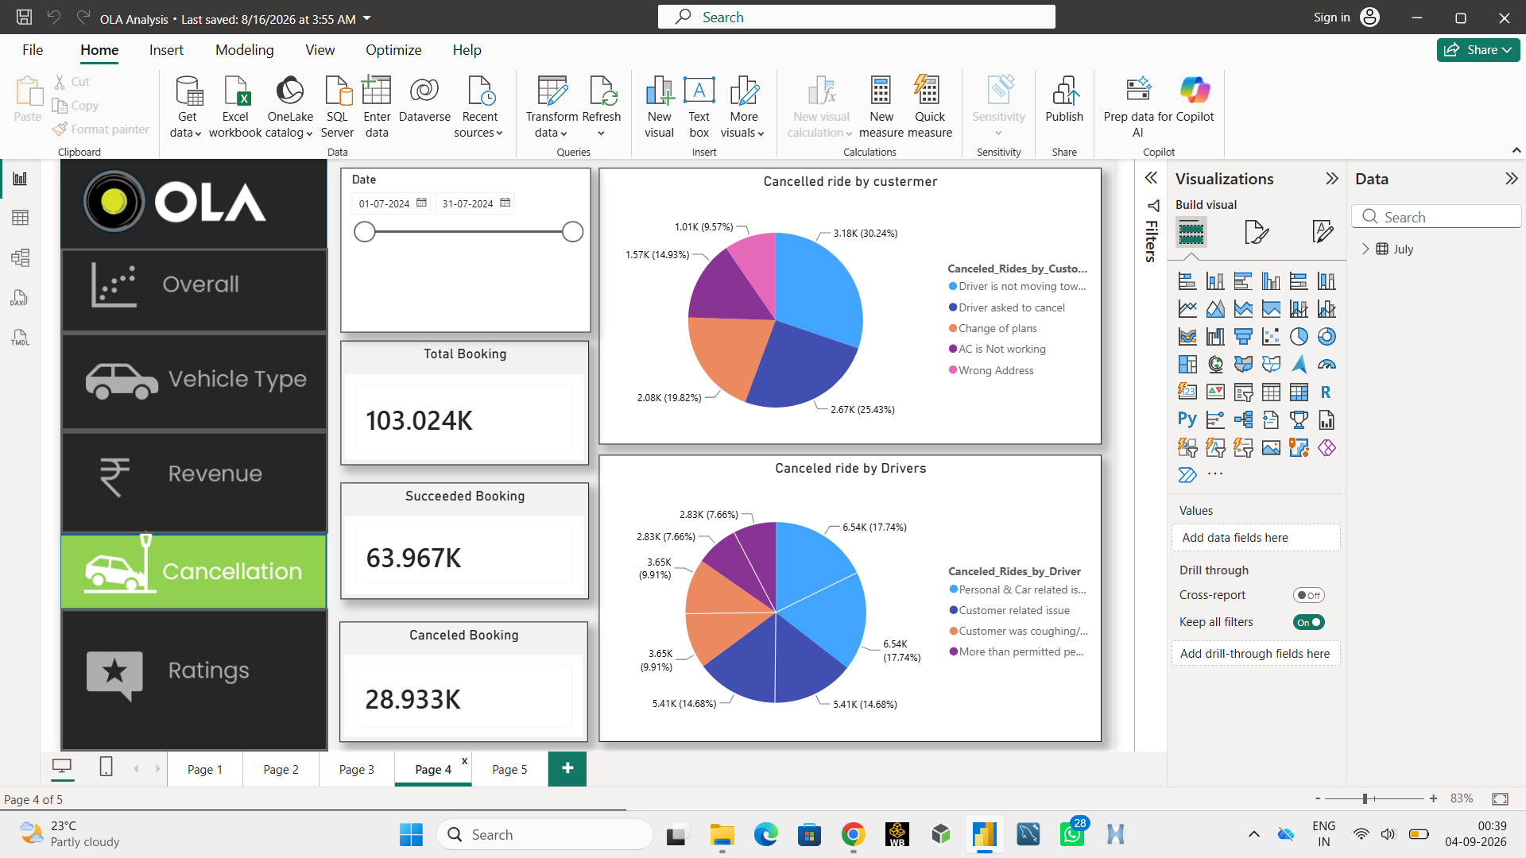


Slide 10
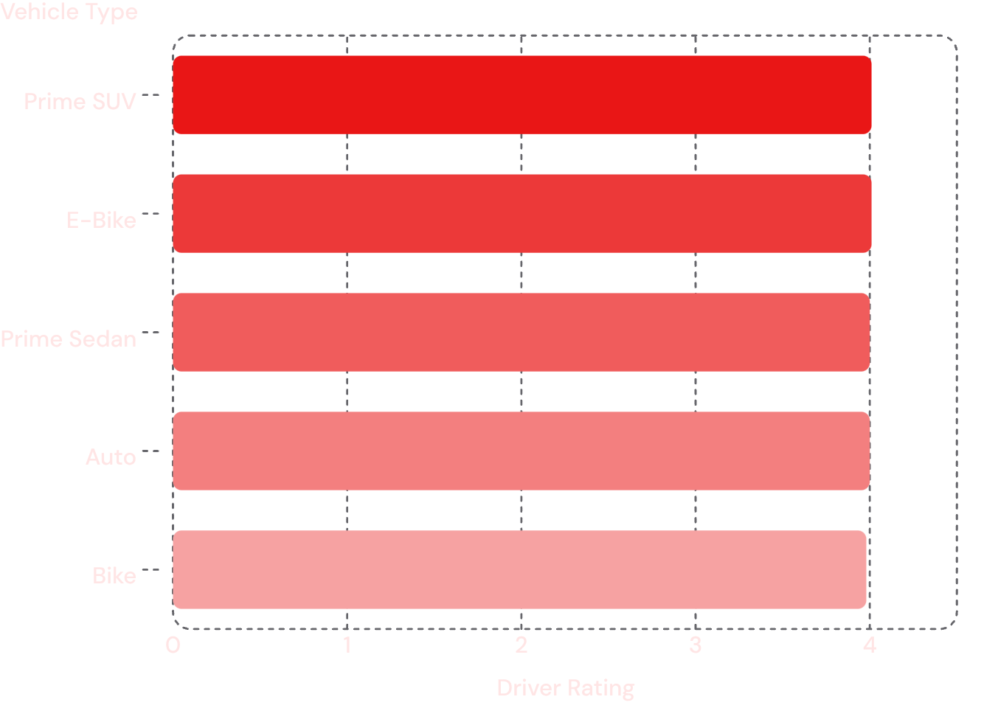
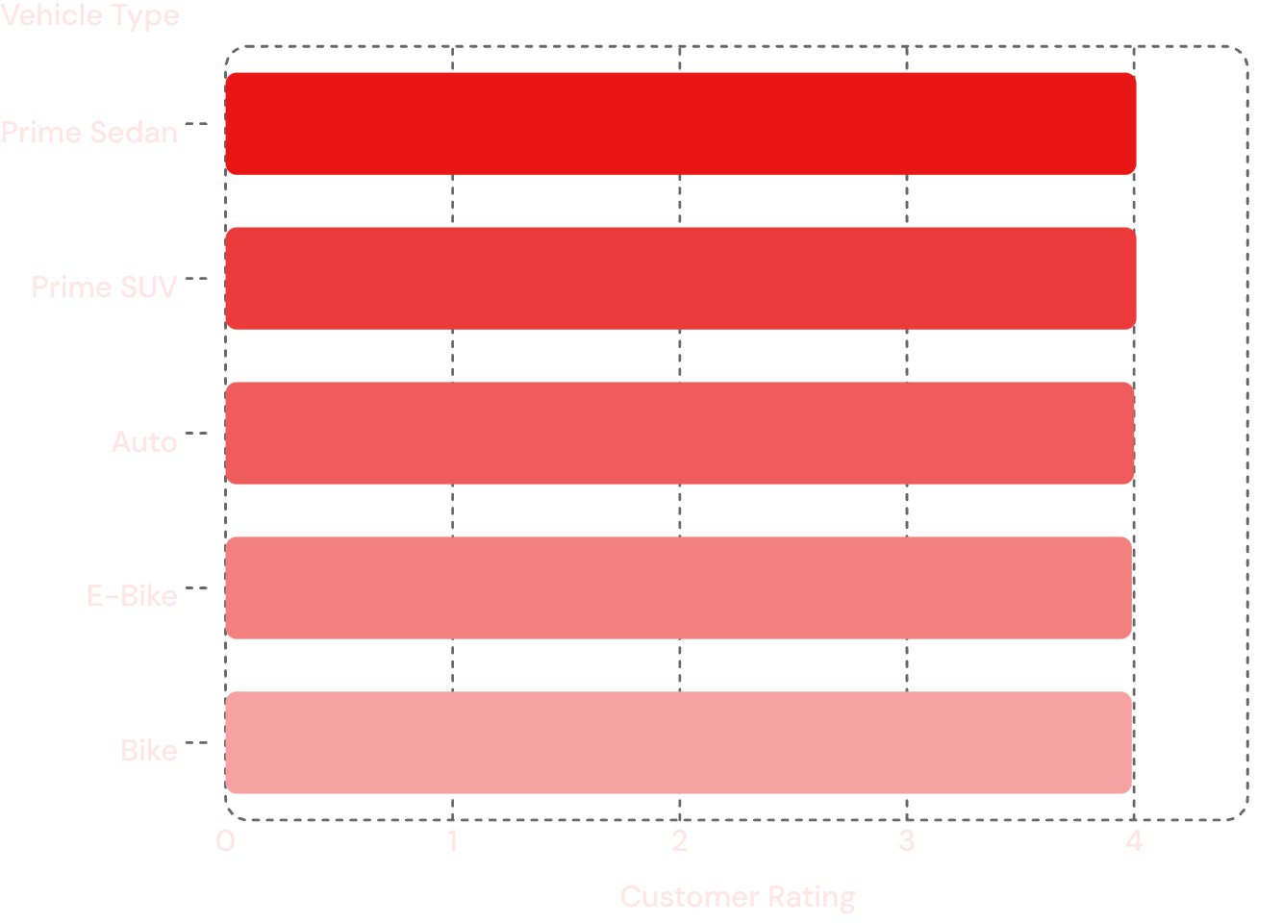
SERVICE QUALITY & RATING ANALYSIS
Service Quality & Rating Analysis
Driver Ratings by Vehicle Type (out of 5)
Customer Ratings by Vehicle Type (out of 5)
Overall service quality is healthy and consistent near 4.0/5. Two-wheeler categories show a slight gap — vehicle maintenance and driver support can close it.

Slide 11
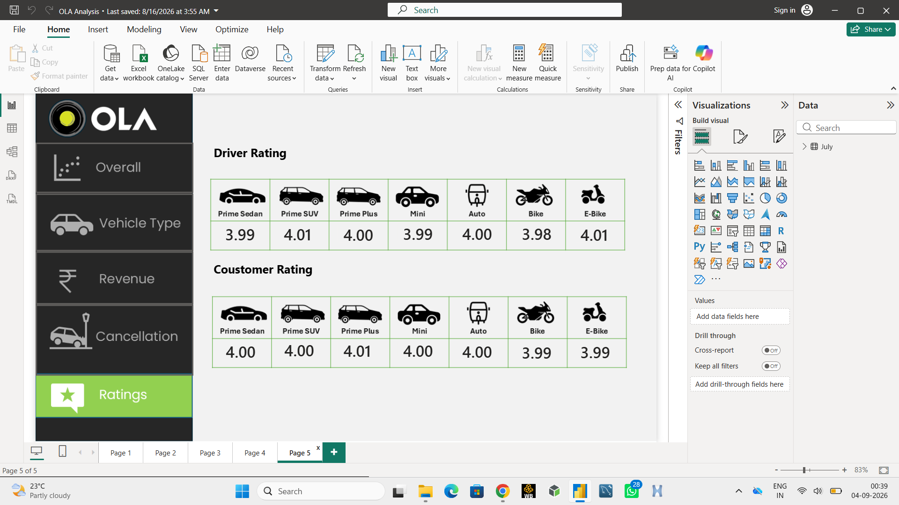


Slide 12

DATA ANALYTICS METHODOLOGY
Data Analytics Methodology
Raw Booking Data
SQL Cleaning
SQL Aggregation
Data Validation
SQL Tasks
Power BI Dashboard Pages
Filtering successful bookings
Calculating booking values
Aggregating vehicle performance
Analyzing cancellation reasons
Identifying top customers
Overall Health
Vehicle Types
Revenue
Cancellations
Ratings

Slide 13
KEY FINDINGS & STRATEGIC RECOMMENDATIONS
Key Findings & Strategic Recommendations
Key Findings
Strategic Recommendations
Strong demand — 96,285 booking requests
High cancellations — 28,933 lost rides
Two-wheeler & Auto strength — high booking value
Cash dependency — largest payment method
Healthy ratings — near 4/5 across fleet
High-value customers — concentrated booking value
Reduce cancellations — improve driver tracking
Enforce driver compliance — stricter trip allocation
Increase digital payments — UPI incentives
Improve two-wheeler quality — maintenance and safety
Build customer loyalty — personalized retention offers

Slide 14

CONCLUSION & BUSINESS IMPACT
Conclusion & Business Impact
Ola has strong demand and healthy service ratings, but operational inefficiencies prevent many bookings from becoming successful rides.
96,285
₹53M
Booking Requests
Total Booking Value
62.08%
~4.0/5
Successful Booking Rate
Average Ratings
Improving ride conversion — through better driver monitoring, digital payments, fleet quality, and customer retention — can grow revenue without relying on new customer acquisition.
Turning Ride Data into Business Decisions
Tools: SQL · Power BI · Data Analysis · Business Intelligence

