Slide 1
Chapter 10
Verification and Validation of Simulation Models
Banks, Carson, Nelson & Nicol
Discrete-Event System Simulation

Slide 2
Purpose & Overview
The goal of the validation process is:
  To produce a model that represents true behavior of the system closely enough for decision-making purposes
  To increase the model’s credibility to an acceptable level to be used by managers and other decision makers
Validation is an integral part of model development
  Verification – building the model correctly (correctly implemented with good input and structure)
  Validation – building the correct model (an accurate representation of the real system)

Slide 3
10.1 Model building, verification, and validation
First step in model building is observing the real system
  Interactions of components, collecting data
  Take advantage of people with special knowledge
Construct a conceptual model
  Assumptions about components - hypotheses
  Structure of the system
Implementation of an operational model using software
Not a linear process
  Will return to each step many times while building, verifying and validating the model

Slide 4
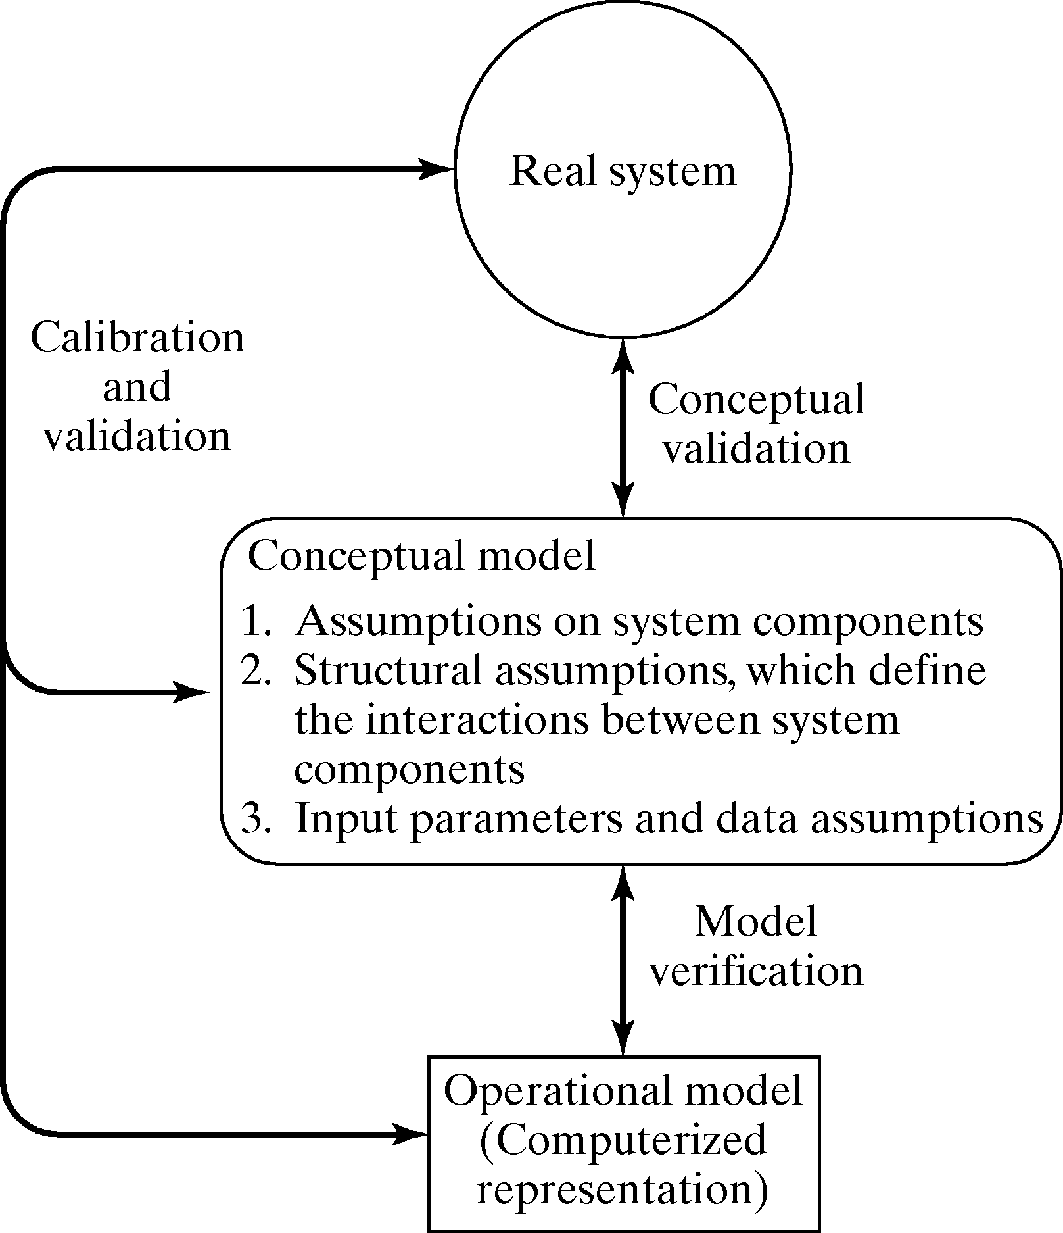
Modeling-Building, Verification & Validation

Slide 5
10.2 Verification
Purpose: ensure the conceptual model is reflected accurately in the computerized representation.
Conceptual model usually involves some abstraction or some amount of simplification of actual operations
Many common-sense suggestions, for example:
  Have someone else check the model.
  Make a flow diagram that includes each logically possible action a system can take when an event occurs.
  Closely examine the model output for reasonableness under a variety of input parameter settings. (Often overlooked!)
  Print the input parameters at the end of the simulation, make sure they have not been changed inadvertently.

Slide 6
Verification continued
  Verify the animation imitates the real system
  Monitor the simulation via a debugger
    Step it and check values
  Use graphical interfaces as a form of self documentation

Slide 7
Examination of Model Output for Reasonableness see page 392 [Verification]
Example: A model of a complex network of queues consisting many service centers.
  Response time is the primary interest, however, it is important to collect and print out many statistics in addition to response time.
    Two statistics that give a quick indication of model reasonableness are current contents and total counts, for example:
      If the current content grows in a more or less linear fashion as the simulation run time increases, it is likely that a queue is unstable
      If the total count for some subsystem is zero, indicates no items entered that subsystem, a highly suspect occurrence
      If the total and current count are equal to one, can indicate that an entity has captured a resource but never freed that resource.
    Compute certain long-run measures of performance, e.g. compute the long-run server utilization and compare to simulation results

Slide 8
Other Important Tools [Verification]
Documentation
  A means of clarifying the logic of a model and verifying its completeness
Use of a trace
  A detailed printout of the state of the simulation model over time.
    Gives the value of every variable in a program, every time one changes in value.
    Can use print/write statements
    Use a selective trace in eclipse

Slide 9
10.3 Calibration and Validation
Verification and validation are usually conducted simultaneously
Validation: the overall process of comparing the model and its behavior to the real system.
Calibration: the iterative process of comparing the model to the real system and making adjustments.
  Some tests subjective and other objective
    Objective tests require data on the system’s behavior and
    Corresponding data produced by the model

Slide 10
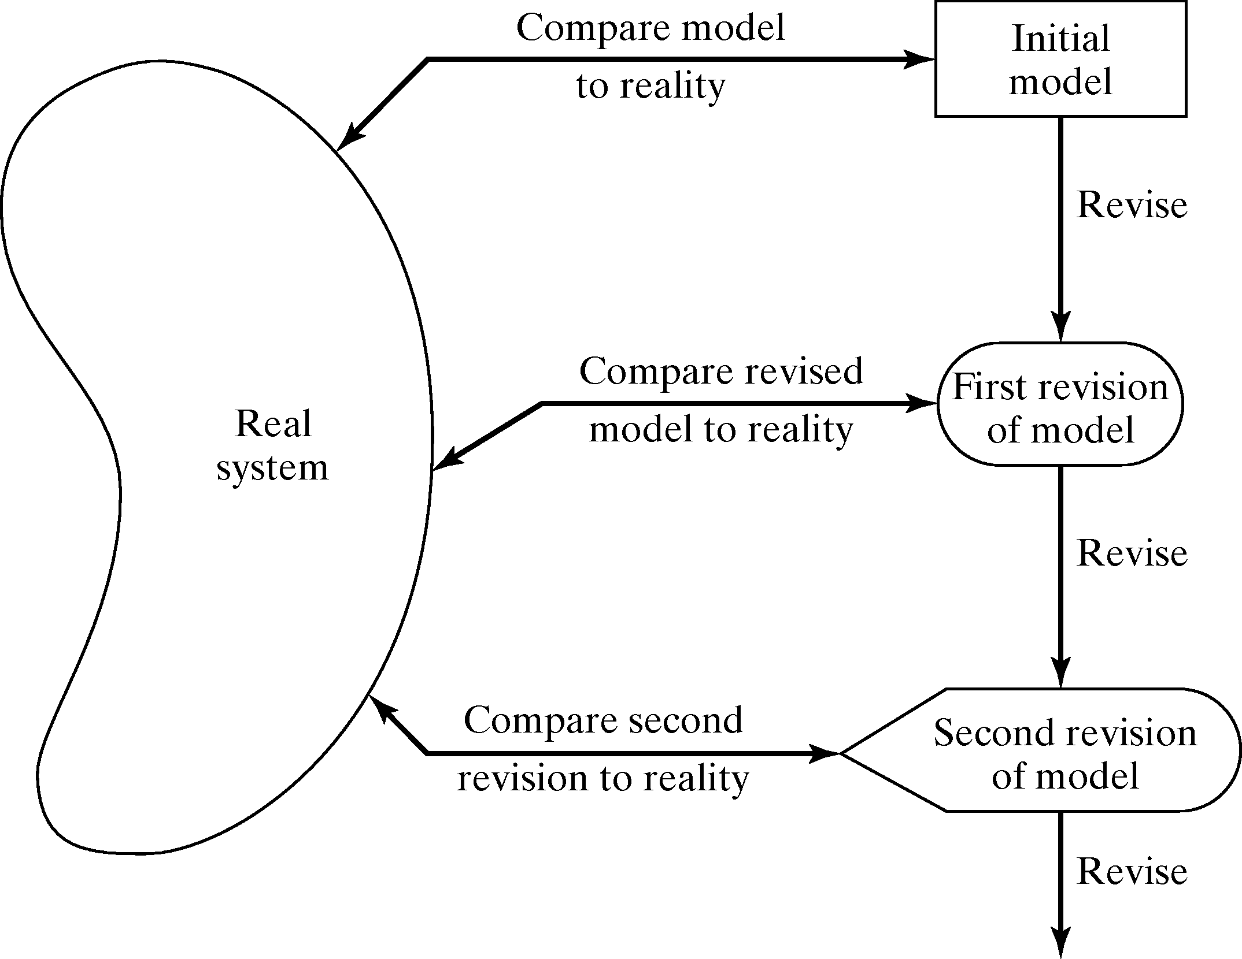
Calibration and Validation

Slide 11
Calibration and Validation
No model is ever a perfect representation of the system
  The modeler must weigh the possible, but not guaranteed, increase in model accuracy versus the cost of increased validation effort.
Three-step approach:
  Build a model that has high face validity.
  Validate model assumptions.
  Compare the model input-output transformations with the real system’s data.

Slide 12
10.3.1 High Face Validity [Calibration & Validation]
Ensure a high degree of realism: Potential users should be involved in model construction (from its conceptualization to its implementation).
Sensitivity analysis can also be used to check a model’s face validity.
  Example: In most queueing systems, if the arrival rate of customers were to increase, it would be expected that server utilization, queue length and delays would tend to increase.

Slide 13
10.3.2 Validate Model Assumptions [Cal & Val]
General classes of model assumptions:
  Structural assumptions: how the system operates.
  Data assumptions: reliability of data and its statistical analysis.
Bank example: customer queueing and service facility in a bank.
  Structural assumptions, e.g., customer waiting in one line versus many lines, served FCFS versus priority.
  Data assumptions, e.g., interarrival time of customers, service times for commercial accounts.
    Verify data reliability with bank managers.
    Test correlation and goodness of fit for data (see Chapter 9 for more details).

Slide 14
Analysis of input data from Chapter 9
Identify an appropriate probability distribution
Estimate the parameters of the hypothesized distribution
Validate the assumed statistical model by goodness-of-fit test, such as the chi-square or Kolmogorov-Smirnov test, and by graphical methods

Slide 15
10.3.3 Validate I-O Transformations [Cal & Val]
Goal: Validate the model’s ability to predict future behavior
  The only objective test of the model as a whole.
  If input variables were to increase or decrease, model should accurately predict what would happen in the real system
  The structure of the model should be accurate enough to make good predictions for the range of input data sets of interest.
In this process the model is viewed as an input-output transformation
One possible approach: use historical data that have been reserved for validation purposes only.
Criteria: use the main responses of interest.
  If model is used for different purpose later, revalidate it

