Slide 1
Chapter 11
Output Analysis for a Single Model
Banks, Carson, Nelson & Nicol
Discrete-Event System Simulation

Slide 2
Output Analysis
Output analysis is examination of data generated by simulation
Objective: Estimate system performance via simulation
Need for output analysis is based on the observation that the output data from a simulation exhibits random variability when random number generators are used to produce the values of the input variables.

Slide 3

Purpose
If θ is the system performance, the precision of the estimator can be measured by:
  The standard error of .
  The width of a confidence interval (CI) for θ.
Purpose of statistical analysis:
  To estimate the standard error or CI .
  To figure out the number of observations required to achieve desired error/CI.
Potential issues to overcome:
  Autocorrelation, e.g. inventory cost for subsequent weeks lack statistical independence.
  Initial conditions, e.g. inventory on hand and # of backorders at time 0 would most likely influence the performance of week 1.

Slide 4
Type of Simulations
Terminating verses non-terminating simulations
Terminating simulation:
  Runs for some duration of time T_{E}, where E is a specified event that stops the simulation.
  Starts at time 0 under well-specified initial conditions.
  Ends at the stopping time T_{E}.
  Bank example: Opens at 8:30 am (time 0) with no customers present and 8 of the 11 teller working (initial conditions), and closes at 4:30 pm (Time T_{E} = 480 minutes).
  The simulation analyst chooses to consider it a terminating system because the object of interest is one day’s operation.

Slide 5
Type of Simulations
Non-terminating simulation:
  Runs continuously, or at least over a very long period of time.
  Examples: assembly lines that shut down infrequently, telephone systems, hospital emergency rooms.
  Initial conditions defined by the analyst.
  Runs for some analyst-specified period of time T_{E}.
  Study the steady-state (long-run) properties of the system, properties that are not influenced by the initial conditions of the model.
Whether a simulation is considered to be terminating or non-terminating depends on both
  The objectives of the simulation study and
  The nature of the system.

Slide 6
Stochastic Nature of Output Data
Model output consist of one or more random variables (r. v.) because the model is an input-output transformation and the input variables are r.v.’s.
M/G/1 queueing example:
  Poisson arrival rate = 0.1 per minute;
  service time ~ N(μ = 9.5, σ =1.75).
  System performance: long-run mean queue length, L_{Q}(t).
  Suppose we run a single simulation for a total of 5,000 minutes
    Divide the time interval [0, 5000) into 5 equal subintervals of 1000 minutes.
    Average number of customers in queue from time (j-1)1000 to j(1000) is Y_{j} .

Slide 7
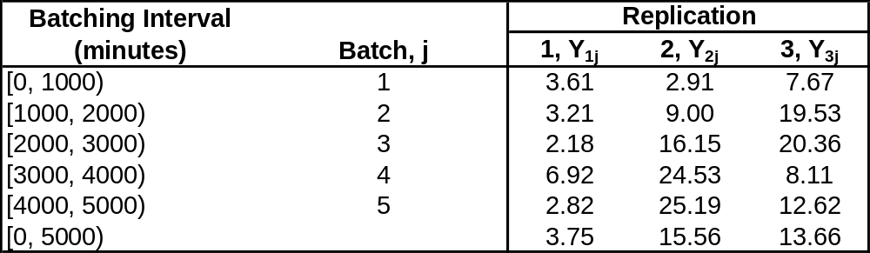

Stochastic Nature of Output Data
M/G/1 queueing example (cont.):
  Batched average queue length for 3 independent replications:
  Inherent variability in stochastic simulation both within a single replication and across different replications.
  The average across 3 replications, can be regarded as independent observations, but averages within a replication, Y₁₁, …, Y₁₅, are not.

Slide 8
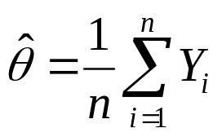


Measures of performance
Consider the estimation of a performance parameter, θ (or φ), of a simulated system.
  Discrete time data: [Y₁, Y₂, …, Y_{n}], with ordinary mean: θ
  Continuous-time data: {Y(t), 0 ≤ t ≤ T_{E}} with time-weighted mean: φ
Point estimation for discrete time data.
  The point estimator:
    Is unbiased if its expected value is θ, that is if:
    Is biased if:
Desired

Slide 9
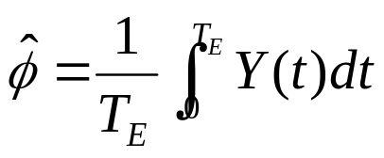

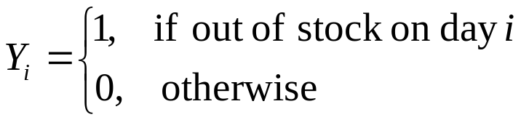
Point Estimator [Performance Measures]
Point estimation for continuous-time data.
  The point estimator:
    Time average of Y(t) over [0, T_{E}]
    Is biased in general where: .
    An unbiased or low-bias estimator is desired.
Usually, system performance measures can be put into the common framework of θ or φ:
  e.g., the proportion of days on which sales are lost through an out-of-stock situation, let:

Slide 10
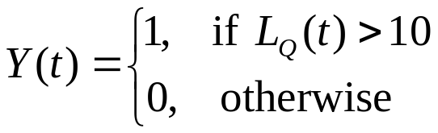
Point Estimator [Performance Measures]
  Second example : consider estimation of proportion of time queue length is greater than 10 customers. If LQ(t) represents the simulated queue length at time t, then define

Slide 11


Point Estimator [Performance Measures]
Performance measure that does not fit: quantile or percentile:
  Quantile describe the level of performance that can be delivered with the given probability p.
  Estimating quantiles: the inverse of the problem of estimating a proportion or probability.
  Consider a histogram of the observed values Y:
    Find such that 100p% of the histogram is to the left of (smaller than) .

Slide 12
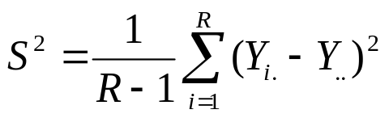
Confidence-Interval Estimation [Performance Measures]
To understand confidence intervals fully, it is important to distinguish between measures of error, and measures of risk, e.g., confidence interval versus prediction interval.
Suppose the model is the normal distribution with mean θ, variance σ² (both unknown).
  Let Y_{i} be the average cycle time for parts produced on the i^{th} replication of the simulation (its mathematical expectation is θ).
  Average cycle time will vary from day to day, but over the long-run the average of the averages will be close to θ.
  Sample variance across R replications:

Slide 13
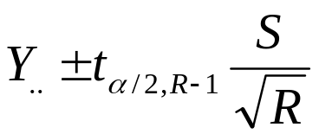

Confidence-Interval Estimation [Performance Measures]
Confidence Interval (CI):
  A measure of error.
  Where Y_{i.} are normally distributed.
  We cannot know for certain how far is from θ but CI attempts to bound that error.
  A CI, such as 95%, tells us how much we can trust the interval to actually bound the error between and θ .
  The more replications we make, the less error there is in (converging to 0 as R goes to infinity).

Slide 14
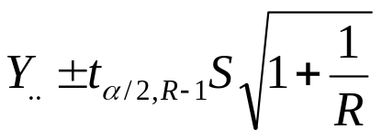
Confidence-Interval Estimation [Performance Measures]
Prediction Interval (PI):
  A measure of risk.
  A good guess for the average cycle time on a particular day is our estimator but it is unlikely to be exactly right.
  PI is designed to be wide enough to contain the actual average cycle time on any particular day with high probability.
  Normal-theory prediction interval:
  The length of PI will not go to 0 as R increases because we can never simulate away risk.

Slide 15
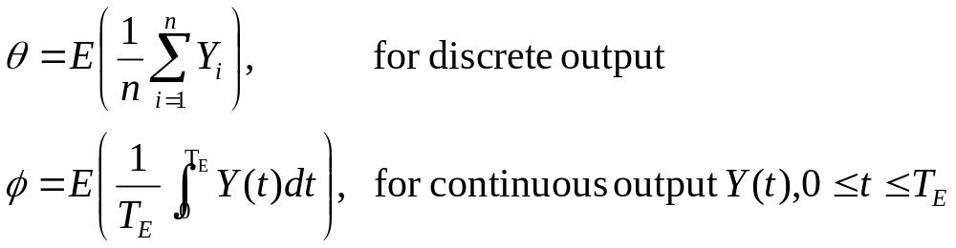
Output Analysis for Terminating Simulations
A terminating simulation: runs over a simulated time interval [0, T_{E}].
A common goal is to estimate:
In general, independent replications are used, each run using a different random number stream and independently chosen initial conditions.

Slide 16

Statistical Background [Terminating Simulations]
Important to distinguish within-replication data from across-replication data.
For example, simulation of a manufacturing system
  Two performance measures of that system: cycle time for parts and work in process (WIP).
  Let Y_{ij} be the cycle time for the j^{th} part produced in the i^{th} replication.
  Across-replication data are formed by summarizing within-replication data .

Slide 17
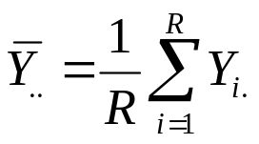
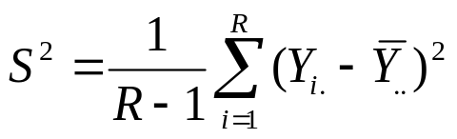
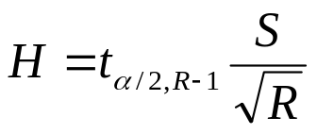
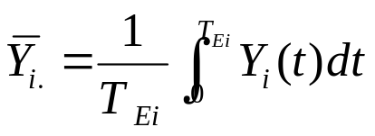
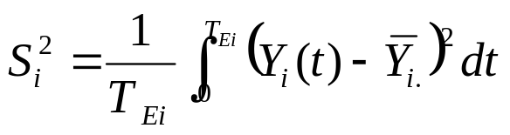
Statistical Background [Terminating Simulations]
Across Replication:
  For example: the daily cycle time averages (discrete time data)
    The average:
    The sample variance:
    The confidence-interval half-width:
Within replication:
  For example: the WIP (a continuous time data)
    The average:
    The sample variance:

Slide 18


Statistical Background [Terminating Simulations]
Overall sample average, , and the individual replication sample averages, , are always unbiased estimators of the expected daily average cycle time or daily average WIP.
Across-replication data are independent (different random numbers) and identically distributed (same model), but within-replication data do not have these properties.

Slide 19
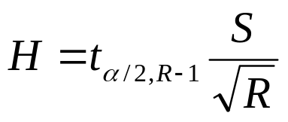
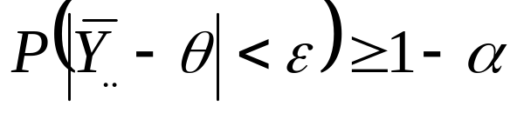
C.I. with Specified Precision [Terminating Simulations]
The half-length H of a 100(1 – α)% confidence interval for a mean θ, based on the t distribution, is given by:
Suppose that an error criterion ε is specified with probability 1 - α, a sufficiently large sample size should satisfy:
R is the # of replications
S² is the sample variance

Slide 20
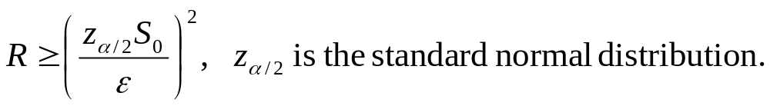
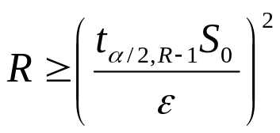
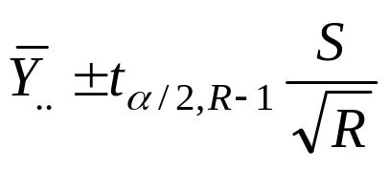
C.I. with Specified Precision [Terminating Simulations]
Assume that an initial sample of size R₀ (independent) replications has been observed.
Obtain an initial estimate S₀² of the population variance σ².
Then, choose sample size R such that R ≥ R₀:
  Since t_{α/2, R-1} ≥ z_{α/2}, an initial estimate of R:
  R is the smallest integer satisfying R ≥ R₀ and
Collect R - R₀ additional observations.
The 100(1-α)% C.I. for θ:

Slide 21
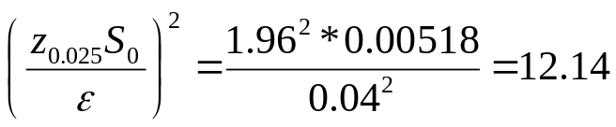
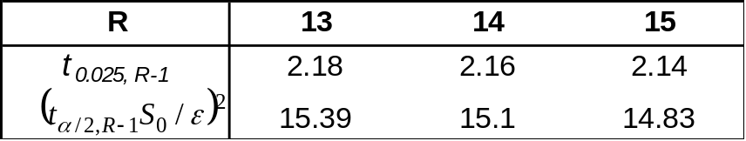
C.I. with Specified Precision [Terminating Simulations]
Call Center Example: estimate the agent’s utilization ρ over the first 2 hours of the workday.
  Initial sample of size R₀ = 4 is taken and an initial estimate of the population variance is S₀² = (0.072)² = 0.00518.
  The error criterion is ε = 0.04 and confidence coefficient is 1-α = 0.95, hence, the final sample size must be at least:
  For the final sample size:
  R = 15 is the smallest integer satisfying the error criterion, so R - R₀ = 11 additional replications are needed.
  After obtaining additional outputs, half-width should be checked.

Slide 22
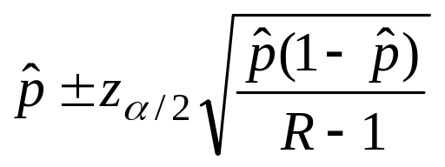
Quantiles [Terminating Simulations]
In this book, a proportion or probability is treated as a special case of a mean.
When the number of independent replications Y₁, …, Y_{R} is large enough that t_{α/2,n-1} = z_{α/2}, the confidence interval for a probability p is often written as:
A quantile is the inverse of the probability to the probability estimation problem:
The sample proportion
p is given
Find θ such that Pr(Y ≤ θ) = p

Slide 23
Quantiles [Terminating Simulations]
The best way is to sort the outputs and use the (R*p)^{th} smallest value, i.e., find θ such that 100p% of the data in a histogram of Y is to the left of θ.
  Example: If we have R=10 replications and we want the p = 0.8 quantile, first sort, then estimate θ by the (10)(0.8) = 8th smallest value (round if necessary).
5.6 ←sorted data
7.1
8.8
8.9
9.5
9.7
10.1
12.2 ←this is our point estimate
12.5
12.9

Slide 24
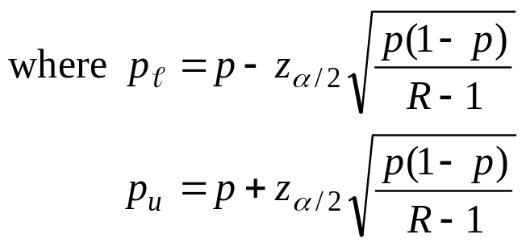
Quantiles [Terminating Simulations]
Confidence Interval of Quantiles: An approximate (1-α)100% confidence interval for θ can be obtained by finding two values θ_{l} and θ_{u}.
  θ_{l} cuts off 100p_{l}% of the histogram (the Rp_{l} smallest value of the sorted data).
  θ_{u} cuts off 100p_{u}% of the histogram (the Rp_{u} smallest value of the sorted data).

Slide 25
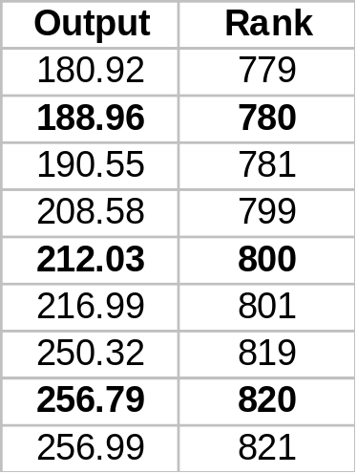
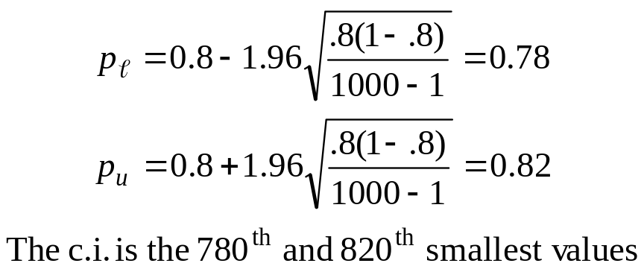
Quantiles [Terminating Simulations]
Example: Suppose R = 1000 reps, to estimate the p = 0.8 quantile with a 95% confidence interval.
  First, sort the data from smallest to largest.
  Then estimate of θ by the (1000)(0.8) = 800th smallest value, and the point estimate is 212.03.
  And find the confidence interval:
  The point estimate is The 95% c.i. is [188.96, 256.79]
A portion of the 1000 sorted values:

Slide 26
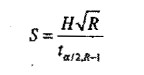
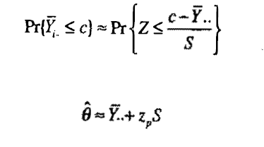
Estimating Probabilities and Quantile [Terminating Simulations]
If we know no. of replication , sample standard deviation can be extracted from H by :
Estimating probability and quantile :

Slide 27
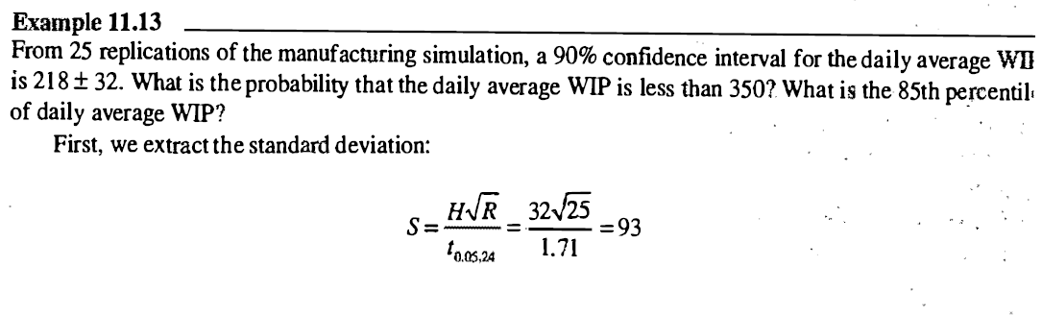
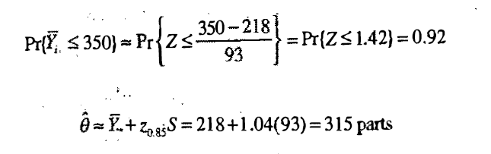
Estimating Probabilities and Quantile [Terminating Simulations]

Slide 28
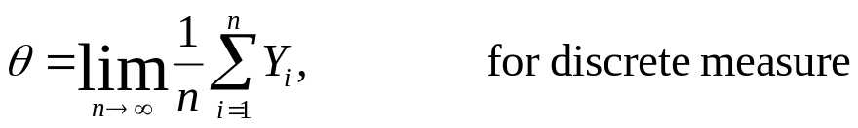
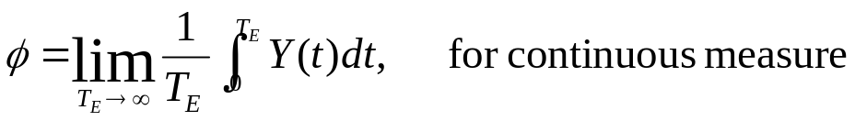
Output Analysis for Steady-State Simulation
Consider a single run of a simulation model to estimate a steady-state or long-run characteristics of the system.
  The single run produces observations Y₁, Y₂, ... (generally the samples of an autocorrelated time series).
  Performance measure:
    Independent of the initial conditions.
(with probability 1)
(with probability 1)

Slide 29
Output Analysis for Steady-State Simulation
The sample size is a design choice, with several considerations in mind:
  Any bias in the point estimator that is due to artificial or arbitrary initial conditions (bias can be severe if run length is too short).
  Desired precision of the point estimator.
  Budget constraints on computer resources.
Notation: the estimation of θ from a discrete-time output process.
  One replication (or run), the output data: Y₁, Y₂, Y₃, …
  With several replications, the output data for replication r: Y_{r1}, Y_{r2}, Y_{r3}, …

Slide 30
Initialization Bias [Steady-State Simulations]
Methods to reduce the point-estimator bias caused by using artificial and unrealistic initial conditions:
  Intelligent initialization.
  Divide simulation into an initialization phase and data-collection phase.
Intelligent initialization
  Initialize the simulation in a state that is more representative of long-run conditions.
  If the system exists, collect data on it and use these data to specify more nearly typical initial conditions.
  If the system can be simplified enough to make it mathematically solvable, e.g. queueing models, solve the simplified model to find long-run expected or most likely conditions, use that to initialize the simulation.

Slide 31
Initialization Bias [Steady-State Simulations]
Divide each simulation into two phases:
  An initialization phase, from time 0 to time T₀.
  A data-collection phase, from T₀ to the stopping time T₀+T_{E}.
  The choice of T₀ is important:
    After T₀, system should be more nearly representative of steady-state behavior.
  System has reached steady state: the probability distribution of the system state is close to the steady-state probability distribution (bias of response variable is negligible).

Slide 32
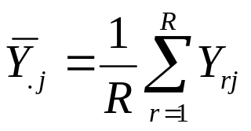
Initialization Bias [Steady-State Simulations]
M/G/1 queuing example: A total of 10 independent replications were made.
  Each replication beginning in the empty and idle state.
  Simulation run length on each replication was T₀+T_{E} = 15,000 minutes.
  Response variable: queue length, L_{Q}(t,r) (at time t of the rth replication).
  Batching intervals of 1,000 minutes, batch means
Ensemble averages:
  To identify trend in the data due to initialization bias
  The average corresponding batch means across replications:
  The preferred method to determine deletion point.
R replications

Slide 33
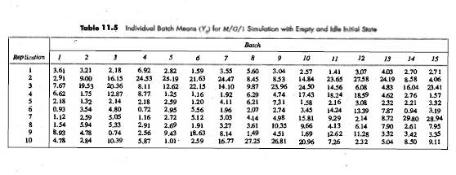

Slide 34
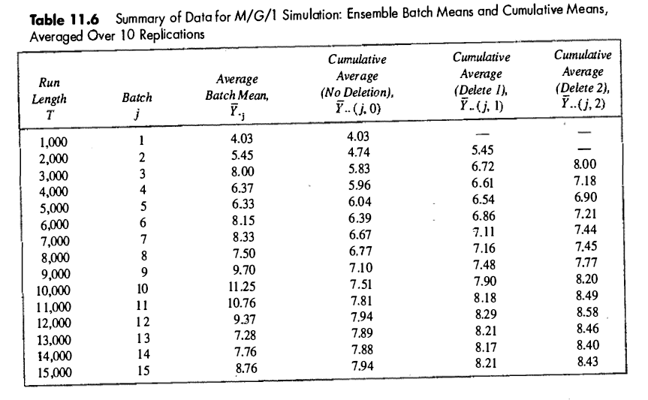

Slide 35

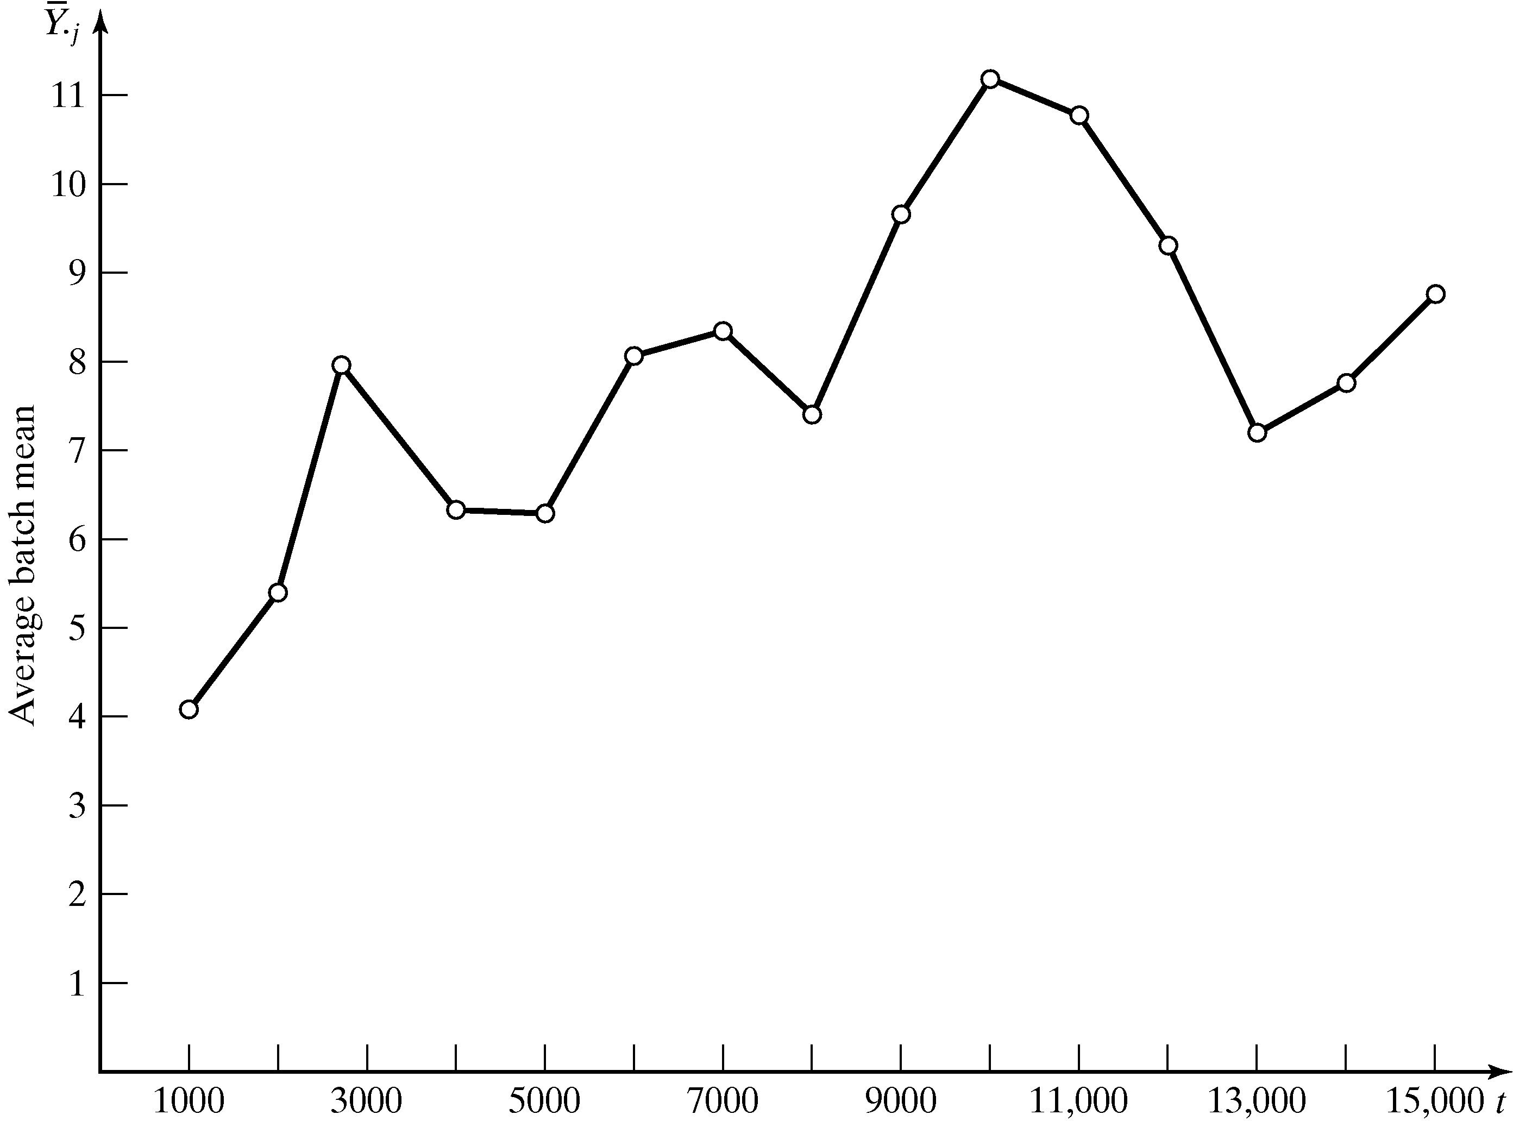
Initialization Bias [Steady-State Simulations]
A plot of the ensemble averages, , versus 1000j, for j = 1,2, …,15.
  Illustrates the downward bias of the initial observations.

Slide 36
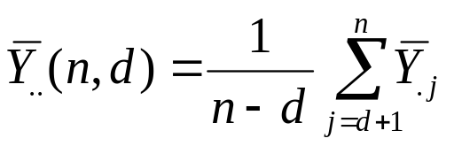
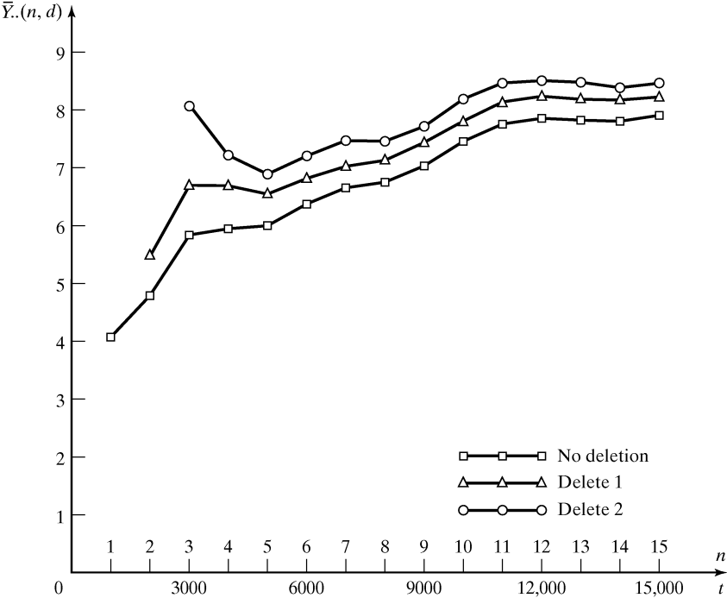
Initialization Bias [Steady-State Simulations]
Cumulative average sample mean (after deleting d observations):
  Not recommended to determine the initialization phase.
  It is apparent that downward bias is present and this bias can be reduced by deletion of one or more observations.

Slide 37

Initialization Bias [Steady-State Simulations]
No widely accepted, objective and proven technique to guide how much data to delete to reduce initialization bias to a negligible level.
Plots can, at times, be misleading but they are still recommended.
  Ensemble averages reveal a smoother and more precise trend as the # of replications, R, increases.
  Cumulative average becomes less variable as more data are averaged.
  The more correlation present, the longer it takes for to approach steady state.
  Different performance measures could approach steady state at different rates.

Slide 38
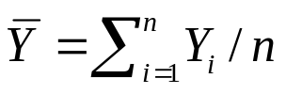

Error Estimation [Steady-State Simulations]
If {Y₁, …, Y_{n}} are not statistically independent, then S²/n is a biased estimator of the true variance.
  Almost always the case when {Y₁, …, Y_{n}} is a sequence of output observations from within a single replication (autocorrelated sequence, time-series).
Suppose the point estimator θ is the sample mean
  Variance of is almost impossible to estimate.
  For system with steady state, produce an output process that is approximately covariance stationary (after passing the transient phase).
    The covariance between two random variables in the time series depends only on the lag (the # of observations between them).

Slide 39

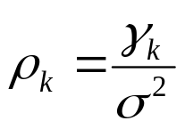
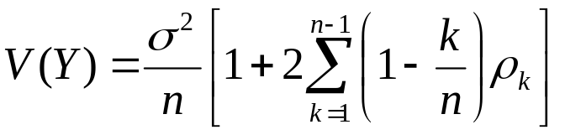
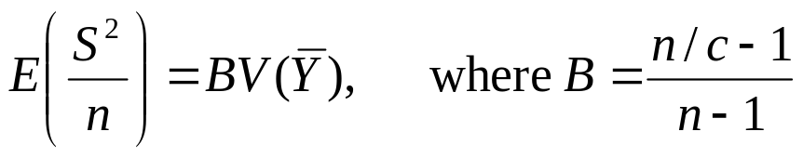
Error Estimation [Steady-State Simulations]
For a covariance stationary time series, {Y₁, …, Y_{n}}:
  Lag-k autocovariance is:
  Lag-k autocorrelation is:
If a time series is covariance stationary, then the variance of is:
The expected value of the variance estimator is:
c

Slide 40
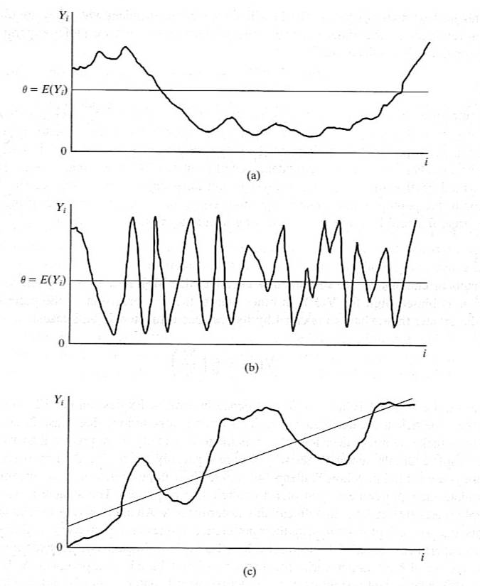
Error Estimation [Steady-State Simulations]
Stationary time series Y_{i} exhibiting positive autocorrelation.
Stationary time series Y_{i} exhibiting negative autocorrelation.
Nonstationary time series with an upward trend

Slide 41
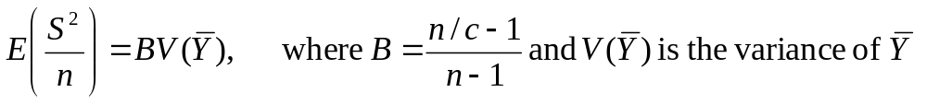


Error Estimation [Steady-State Simulations]
The expected value of the variance estimator is:
  If Y_{i} are independent, then S²/n is an unbiased estimator of
  If the autocorrelation ρ_{k} are primarily positive, then S²/n is biased low as an estimator of .
  If the autocorrelation ρ_{k} are primarily negative, then S²/n is biased high as an estimator of .

Slide 42
Replication Method [Steady-State Simulations]
Use to estimate point-estimator variability and to construct a confidence interval.
Approach: make R replications, initializing and deleting from each one the same way.
Important to do a thorough job of investigating the initial-condition bias:
  Bias is not affected by the number of replications, instead, it is affected only by deleting more data (i.e., increasing T₀) or extending the length of each run (i.e. increasing T_{E}).
Basic raw output data {Y_{rj}, r = 1, ..., R; j = 1, …, n} is derived by:
  Individual observation from within replication r.
  Batch mean from within replication r of some number of discrete-time observations.
  Batch mean of a continuous-time process over time interval j.

Slide 43
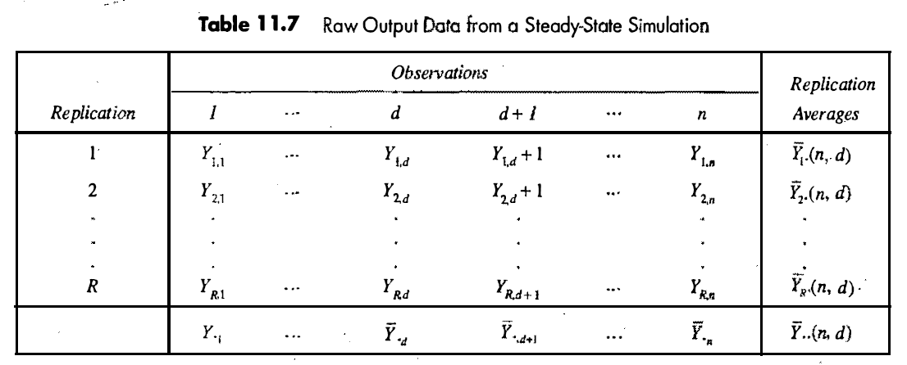

Slide 44
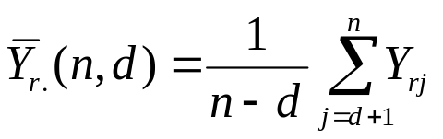
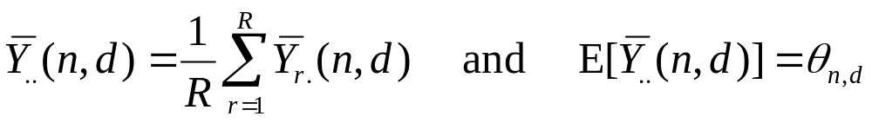


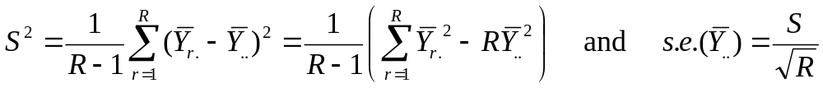
Replication Method [Steady-State Simulations]
Each replication is regarded as a single sample for estimating θ. For replication r:
The overall point estimator:
If d and n are chosen sufficiently large:
  θ_{n,d} ~ θ.
  is an approximately unbiased estimator of θ.
To estimate standard error of , the sample variance and standard error:

Slide 45

Replication Method [Steady-State Simulations]
Length of each replication (n) beyond deletion point (d):
(n - d) > 10d
Number of replications (R) should be as many as time permits, up to about 25 replications.
For a fixed total sample size (n), as fewer data are deleted ( d):
  C.I. shifts: greater bias.
  Standard error of decreases: decrease variance.
Reducing
bias
Increasing
variance
Trade off

Slide 46
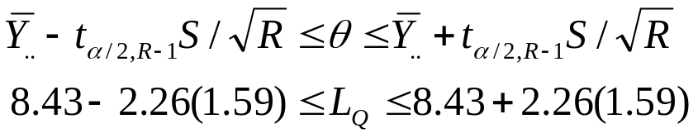
Replication Method [Steady-State Simulations]
M/G/1 queueing example:
  Suppose R = 10, each of length T_{E} = 15,000 minutes, starting at time 0 in the empty and idle state, initialized for T₀ = 2,000 minutes before data collection begins.
  Each batch means is the average number of customers in queue for a 1,000-minute interval.
  The 1st two batch means are deleted (d = 2).
  The point estimator and standard error are:
  The 95% C.I. for long-run mean queue length is:
  A high degree of confidence that the long-run mean queue length is between 4.84 and 12.02 (if d and n are “large” enough).

Slide 47
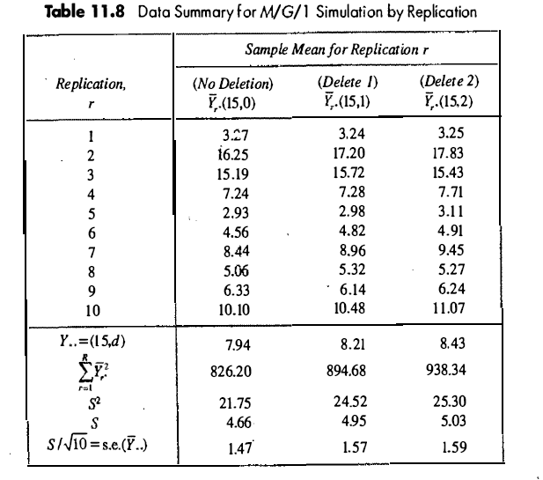

Slide 48

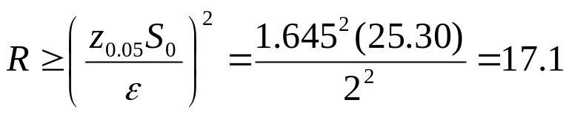

Sample Size [Steady-State Simulations]
To estimate a long-run performance measure, θ, within with confidence 100(1-α)%.
M/G/1 queueing example (cont.):
  We know: R₀ = 10, d = 2 and S₀² = 25.30.
  To estimate the long-run mean queue length, L_{Q}, within ε = 2 customers with 90% confidence (α = 10%).
  Initial estimate:
  Hence, at least 18 replications are needed, next try R = 18,19, … using . We found that:
  Additional replications needed is R – R₀ = 19-10 = 9.

Slide 49

Sample Size [Steady-State Simulations]
An alternative to increasing R is to increase total run length T₀+T_{E} within each replication.
  Approach:
    Increase run length from (T₀+T_{E}) to (R/R₀)(T₀+T_{E}), and
    Delete additional amount of data, from time 0 to time (R/R₀)T₀.
  Advantage: any residual bias in the point estimator should be further reduced.
  However, it is necessary to have saved the state of the model at time T₀+T_{E} and to be able to restart the model.

Slide 50


Batch Means for Interval Estimation
[Steady-State Simulations]
Disadvantage of replication : data is deleted on each replication (waste)
Using a single, long replication:
  Problem: data are dependent so the usual estimator is biased.
  Solution: large batch means.
Batch means: divide the output data from 1 replication (after appropriate deletion) into a few large batches and then treat the means of these batches as if they were independent.
A continuous-time process, {Y(t), T₀ ≤ t ≤ T₀+T_{E}}:
  k batches of size m = T_{E}/k, batch means:
A discrete-time process, {Y_{i}, i = d+1,d+2, …, n}:
  k batches of size m = (n – d)/k, batch means:

Slide 51




Batch Means for Interval Estimation
[Steady-State Simulations]
Starting either with continuous-time or discrete-time data, the variance of the sample mean is estimated by:
If the batch size is sufficiently large, successive batch means will be approximately independent, and the variance estimator will be approximately unbiased.
No widely accepted and relatively simple method for choosing an acceptable batch size m (see text for a suggested approach). Some simulation software does it automatically.
deleted

Slide 52
Summary
Stochastic discrete-event simulation is a statistical experiment.
  Purpose of statistical experiment: obtain estimates of the performance measures of the system.
  Purpose of statistical analysis: acquire some assurance that these estimates are sufficiently precise.
Distinguish: terminating simulations and steady-state simulations.
Steady-state output data are more difficult to analyze
  Decisions: initial conditions and run length
  Possible solutions to bias: deletion of data and increasing run length
Statistical precision of point estimators are estimated by standard-error or confidence interval
Method of independent replications was emphasized.

