Slide 1
Chapter 14
Simulation of Computer System
Banks, Carson, Nelson & Nicol
Discrete-Event System Simulation

Slide 2
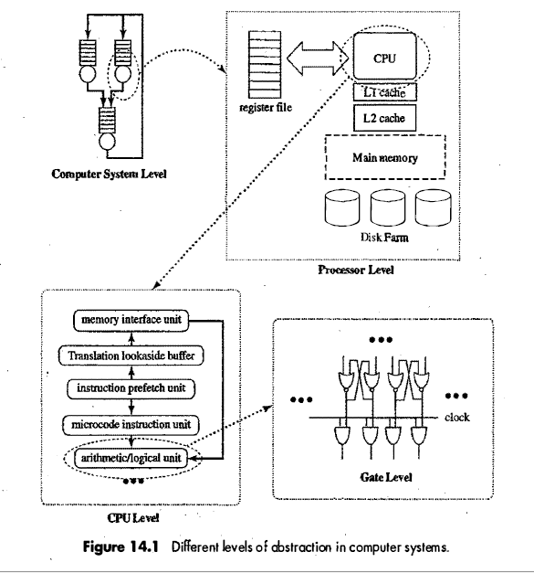
Introduction

Slide 3
Simulation Tools
VHDL
  VHDL (VHSIC Hardware Description Language) is a hardware description language used in electronic design automation to describe digital and mixed-signal systems such as FPGA and integrated circuits.
  VHDL serves both as a design specification and as a simulation specification
Drawback of VHDL
Big language
Require high end compiler
Focuses Commercial market
SimPack, C++SIM, CSIM, SSF etc

Slide 4
Process Orientation
A process-oriented view implies that the tool must support separately schedulable threads of control.
Fundamentally, a "thread" is a separately schedulable unit of execution control, implemented as part of a single executing process
A group of threads operate in the same process memory space, with each thread having allocated to it a relatively small portion of that space for its own use.
That space is used to contain the thread's state, which is the full set of all information needed to restart the thread after it is suspended.
Lock Protocol

Slide 5
Memory Hierarchy
Magnetic
tapes
I/O
Main
processor
memory
Magnetic
disks
CPU
Cache
memory
Register
Cache
Main Memory
Magnetic Disk
Magnetic Tape

Slide 6
Virtual Memory Referencing
Give the programmer the illusion that the system has a very large memory, even though the computer actually has a relatively small main memory
Address Space(Logical) Memory Space(Physical)
address space
memory space
virtual address
(logical address)
Mapping
physical address
address generated by programs actual main memory address

Slide 7
Virtual Memory Referencing
In such a system, the data and instructions used by the program are organized in units called pages. All pages are the same size, typically 2¹⁰ to 2¹² bytes in size.
The physical memory of a computer is divided into page frames, each capable of holding exactly one page
Page Fault : page not present in Main memory
Replacement Policy
Locality of reference

Slide 8
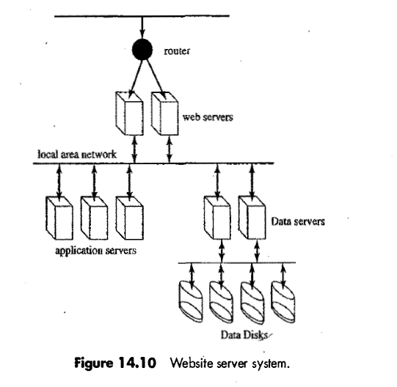
High Level Computer System Simulation

Slide 9
CPU Simulation
Lower level of abstraction
at the lower level we do the simulation to discover what the execution time is.
The input driving this simulation is a stream of instructions.
The simulation works through the mechanics of the CPU's logical design to find out what happens in response to that stream, how long it takes to execute the program, and where bottlenecks exist in the CPU design

Slide 10


CPU Simulation
The main challenge to making effective use of a CPU is to avoid stalling it;
stalling happens whenever the CPU commits to executing an instruction whose inputs are not all present
to allow the CPU to continue past a memory load, it is necessary to
(I) mark target register as unready,
(2) allow memory to load the target register while the CPU continues on
(3) stall the CPU if it attempts to read a register marked as unready,
(4) clear the unready status when the memory operation completes.

Slide 11
CPU Simulation
The technique of pipelining has long been recognized as a way of accelerating the execution of computer Instructions
Pipelining exploits the fact that each instruction goes sequentially through several stages in the course of being processed
Sequence of steps followed by ILP CPU
1. Instruction Fetch
2. Instruction Decode
3. Instruction issue : instruction cannot be issued until value present in register
4. Instruction Execute
5. Instruction Complete
6. Instruction Graduate : reorders the instruction

Slide 12
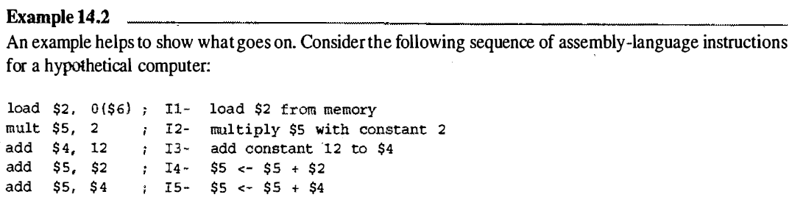
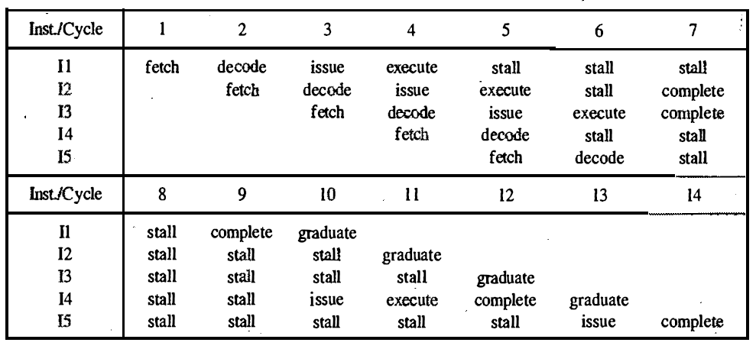
CPU Simulation

Slide 13
Memory Simulation
One of the great challenges of computer architecture is finding ways to deal effectively with the increasing gap in operation speed between CPUs and main memory
L1 Cache, L2 Cache, Main memory
Write Through, Write Back
Like paging systems, the principle measure of the quality of a memory hierarchy is its hit ratio at each level.
As with CPU models, to evaluate a memory hierarchy design, one must study the design in response to a very long string of memory references.

Slide 14
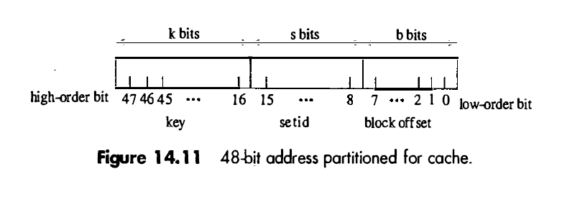
Memory Simulation
One role of simulation is to work out, for a given cache size, how the space ought to be partitioned into sets.
This is largely a cost consideration, for increasing the set size (thereby reducing the number of sets) typically increases the hit ratio

Slide 15
Memory Simulation
Least Recently Used (LRU)
Replacement policy in which during replacement the block selected for ejection is the one which, among all blocks in the set, was last referenced most distantly in the past
LRU is one of several replacement policies known as stack policies
These are characterized by the behavior that, for any reference in any reference string, if that reference misses in a cache of size n, then it also misses in every cache of size m < n, and that, if it hits in a cache of size m, then it hits in every cache of size n > m.

Slide 16
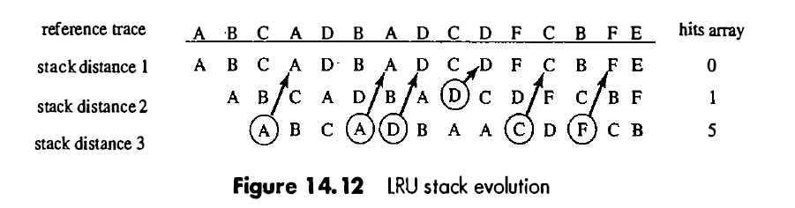
Memory Simulation
Least Recently Used (LRU)
Suppose that we do not wish to consider any set size larger than 64. Now we conduct the simulation with set sizes of 64.

Slide 17


