Slide 1
Chapter 15
Computer Networks
Banks, Carson, Nelson & Nicol
Discrete-Event System Simulation

Slide 2

INTRODUCTION ( OSI MODEL)

Slide 3
Traffic Modeling
modeling of the data traffic that the networks carry
two different levels of abstraction
application level
consideration of how commonly used network applications
create demand for a network
aggregated application flow
focus is on the Internet's core infrastructure, where the global
impact of global traffic needs to be represented.
Simulation studies that model file transfer typically are focused on the impact that the traffic has on servers holding the files

Slide 4
Media Access Control (MAC)
When a computer wishes to use the network to transmit some information, it engages In a Media Access Control (MAC) protocol.
A MAC protocol gives traffic specific qualities of latency and throughput.
Token Passing Protocol
  Polling Protocol
  Token Bus Protocol

Slide 5
Media Access Control (MAC)
POLLING :
controller selects a network device and sends it the token
If the recipient has "frames” buffered up, it sends them, up to a maximum number of frames
The controller listens to the network and detects when the token holder either has selected not to transmit or has finished transmission
The controller then selects another network device and sends it the token.
Devices are visited in round-robin fashion
Drawback :
controller is a device with separate functionality from the others

Slide 6
Media Access Control (MAC)
TOKEN BUS PROTOCOL:
A device is programmed to transmit frames when it receives a token, but is programmed to pass the token directly to a different specified network device after it is finished
No controller; the network devices pass the token among themselves, effectively creating a decentralized round robin polling scheme
Drawback of both protocol :
1) single failure can stop the network in its tracks
The overhead of access control is the time that network spends on transmitting the token and time that the network is idle long enough for a device to ascertain that a transmission has ended

Slide 7
Ethernet
Token-based access protocols have drawbacks, every time a device is added to or removed from the network, configuration actions must be taken to ensure that a new device gets the token and that a removed device is never again sent the token.
The Ethernet access protocol is a solution to this problem
Ethernet is a decentralized protocol, A device can "listen" to the Ethernet cable to see whether it is currently in use
two or more devices could independently and more or less simultaneously decide to transmit, shortly after which the transmission on the cable is garbled
Both devices can detect this "collision“
Carrier Sense Multiple Access/Collision Detection (CSMA/CD)

Slide 8
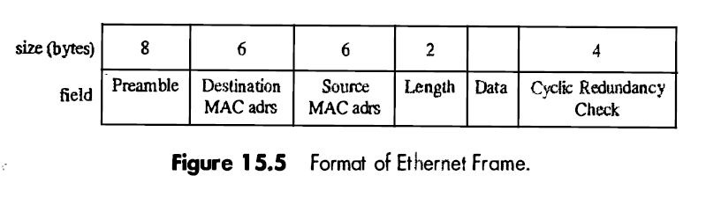
Ethernet
The 8-byte preamble is a special sequence of bits (alternating 1 's and O's, except for the last bit which is also a 'l') that listeners on the cable recognize and use to prepare to examine the next frame field
the frame is terminated with a 4-byte code used for error detection.

Slide 9
Ethernet
Ethernet specifications on network design ensure that any transmission will be heard by another device within δ = 25.6 micro second. This is called a slot time
A device with a frame to send listens to the cable and, if it hears nothing begins to transmit. If it successfully transmits the frame without collision and has another frame to send, it waits 2 slot times before making the attempt
The backoff period following a collision has been a topic of some study, one in which simulation has played an important role

Slide 10
Data Link Layer
Data traveling at the physical layer contains at least two addresses.
1) hardware address of intended endpoint of the current hop.
2) The ultimate destination's network address, (IP Address)
HUB ,
BRIDGE :
ROUTER : A router is a device that can connect more widely dispersed networks, by making its connections at the Network Layer

Slide 11
Data Link Layer
A router is one place where a frame might be lost, for, if the router experiences a temporary burst of traffic, all to be routed through a particular interface, buffers holding frames waiting to be forwarded could become exhausted
TCP
TCP reacts by significantly decreasing the rate at which it injects traffic into the network
RED (Random Early Detection)

Slide 12
TCP
establishes a connection between two devices, both of which view the communication as a stream of bytes.
TCP ensures error-free, in-order delivery of that stream
A number of TCP variants have been proposed and studied;
all of these studies use simulation extensively to determine the protocol's behavior under different operating conditions

Slide 13
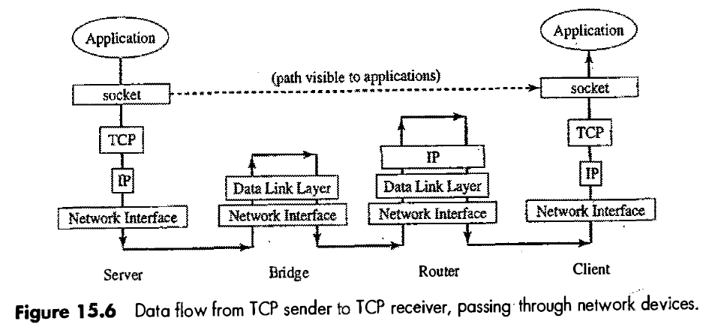
TCP

Slide 14
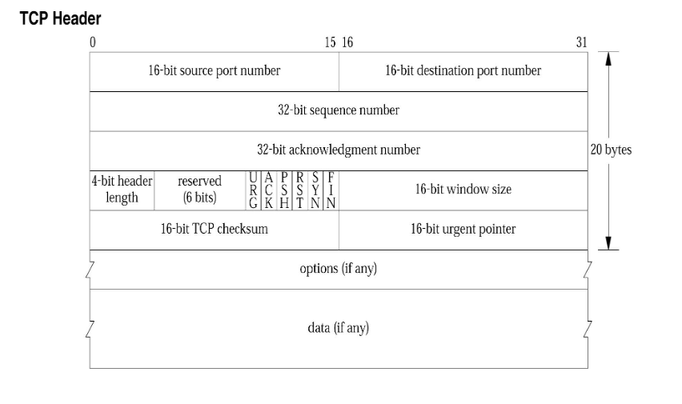

Slide 15
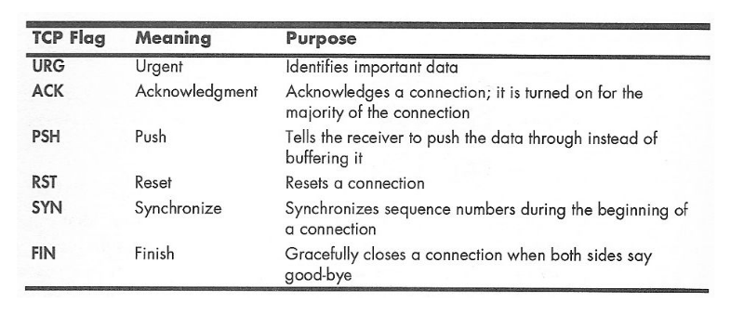

Slide 16
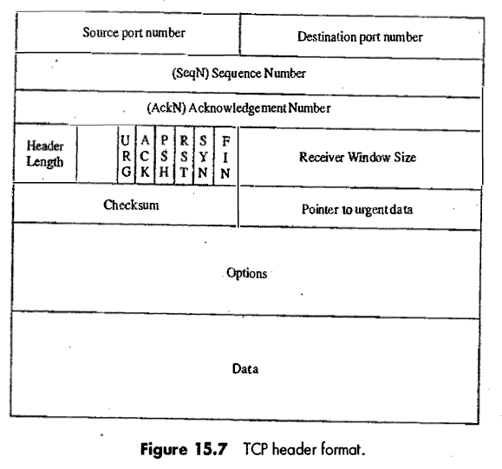
TCP

Slide 17


