Slide 1
Chapter 9
Input Modeling
Banks, Carson, Nelson & Nicol
Discrete-Event System Simulation

Slide 2
Purpose & Overview
Input models provide the driving force for a simulation.
The quality of the output is no better than the quality of inputs.
In this chapter, we will discuss the 4 steps of input model development:
  Collect data from the real system
  Identify a probability distribution to represent the input process
  Choose parameters for the distribution
  Evaluate the chosen distribution and parameters for goodness of fit.

Slide 3
9.1 Data Collection
One of the biggest tasks in solving a real problem.
Examples
  Stale data – time taken by nurse in clinic
  Unexpected data – metal detector delay
  Time-varying data – call center, NSPP
  Dependent data – drinks in season

Slide 4
Data Collection -
Suggestions that may enhance and facilitate data collection:
  Plan ahead: begin by a practice or pre-observing session, watch for unusual circumstances
  Analyze the data as it is being collected: check adequacy
  Combine homogeneous data sets, e.g. successive time periods, during the same time period on successive days
  Be aware of data censoring: the quantity is not observed in its entirety, danger of leaving out long process times
  Check for relationship between variables, e.g. build scatter diagram
  Check for autocorrelation
  Collect input data, not performance data

Slide 5
9.2 Identifying the Distribution
Histograms
Selecting families of distribution
Parameter estimation
Goodness-of-fit tests
Fitting a non-stationary process

Slide 6
Histograms [Identifying the distribution]
A frequency distribution or histogram is useful in determining the shape of a distribution
Divide the range of data into intervals.
  (Usually of equal length)
Label the horizontal axis to conform to the intervals selected.
Find the frequency of occurrences within each interval.
Label the vertical axis so that the total occurrences can be plotted for each interval.
Plot the frequencies on the vertical axis.

Slide 7
Histograms continued
The number of class intervals depends on:
  The number of observations
  The dispersion of the data
  Suggested: the square root of the sample size
For continuous data:
  Corresponds to the probability density function of a theoretical distribution
For discrete data:
  Corresponds to the probability mass function
If few data points are available: combine adjacent cells to eliminate the ragged appearance of the histogram
  Does this differ from homogeneity in Section 9.1?

Slide 8
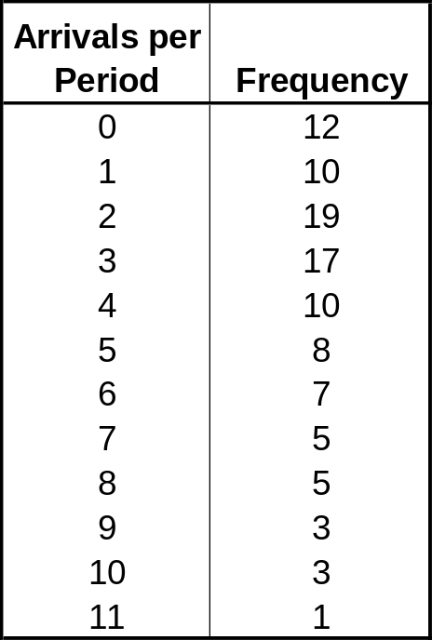
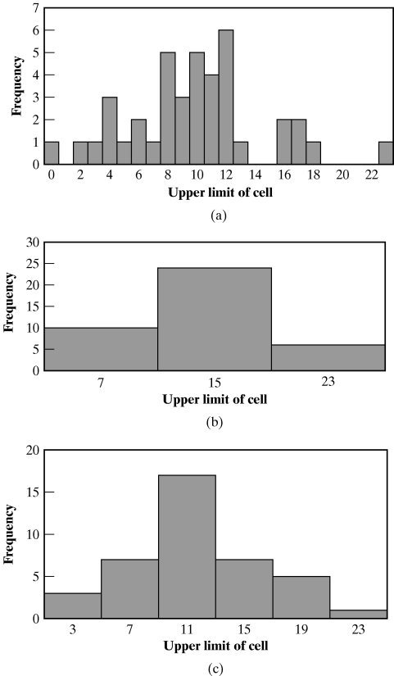
Histograms Ex 9.5 [Identifying the distribution]
Vehicle Arrival Example: # of vehicles arriving at an intersection between 7 am and 7:05 am was monitored for 100 random workdays.
There are ample data, so the histogram may have a cell for each possible value in the data range
Same data with different interval sizes

Slide 9
9.2.2 Selecting the Family of Distributions
[Identifying the distribution]
A family of distributions is selected based on:
  The context of the input variable
  Shape of the histogram
Frequently encountered distributions:
  Easier to analyze: exponential, normal and Poisson
  Harder to analyze: beta, gamma and Weibull

Slide 10
Selecting the Family of Distributions
[Identifying the distribution]
Use the physical basis of the distribution as a guide, for example:
  Binomial: # of successes in n trials
  Poisson: # of independent events that occur in a fixed amount of time or space
  Normal: dist’n of a process that is the sum of a number of component processes
  Exponential: time between independent events, or a process time that is memoryless
  Gamma : extremely flexible, used to model nonnegative number

Slide 11
Selecting the Family of Distributions
[Identifying the distribution]
  Beta: # Extremely flexible, used to model bounded ( fixed upper and lower limit) random variables
  Erlang : Model process that can be viewed as the sum of several exponentially distributed processes
  Weibull: time to failure for components
  Discrete or continuous uniform: models complete uncertainty
  Triangular: a process for which only the minimum, most likely, and maximum values are known
  Empirical: resamples from the actual data collected

Slide 12
Selecting the Family of Distributions
[Identifying the distribution]
Remember the physical characteristics of the process
  Is the process naturally discrete or continuous valued?
  Is it bounded?
There is no “true” distribution for any stochastic input process
Goal: obtain a good approximation
See exercises 6 – 12 for work with shapes

Slide 13
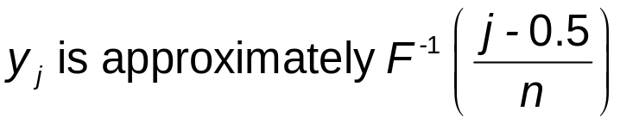
Quantile-Quantile Plots [Identifying the distribution]
Q-Q plot is a useful tool for evaluating the fit of the chosen distribution
If X is a random variable with cdf F, then the q-quantile of X is the γ such that
  When F has an inverse, γ = F⁻¹(q)
Let {x_{i}, i = 1,2, …., n} be a sample of data from X and {y_{j}, j = 1,2, …, n} be the observations in ascending order:
  where j is the ranking or order number

Slide 14
Quantile-Quantile Plots [Identifying the distribution]
The plot of y_{j} versus F⁻¹( (j-0.5)/n) is
  Approximately a straight line if F is a member of an appropriate family of distributions
  The line has slope 1 if F is a member of an appropriate family of distributions with appropriate parameter value
  If the assumed distribution is appropriate the points will deviate from the straight lines

Slide 15
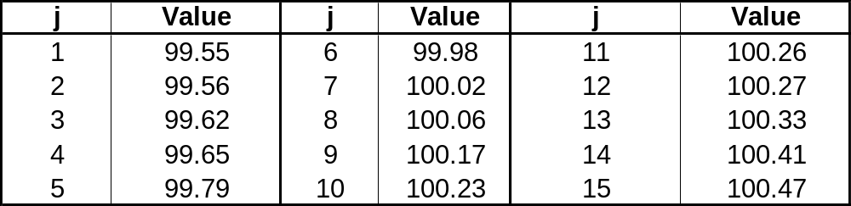
Quantile-Quantile Plots Ex 9.4 [Identifying the distribution]
Example: Check whether the door installation times follows a normal distribution.
  The observations are now ordered from smallest to largest:
  y_{j} are plotted versus F⁻¹( (j-0.5)/n) where F has a normal distribution with the sample mean (99.99 sec) and sample variance (0.2832² sec²)

Slide 16
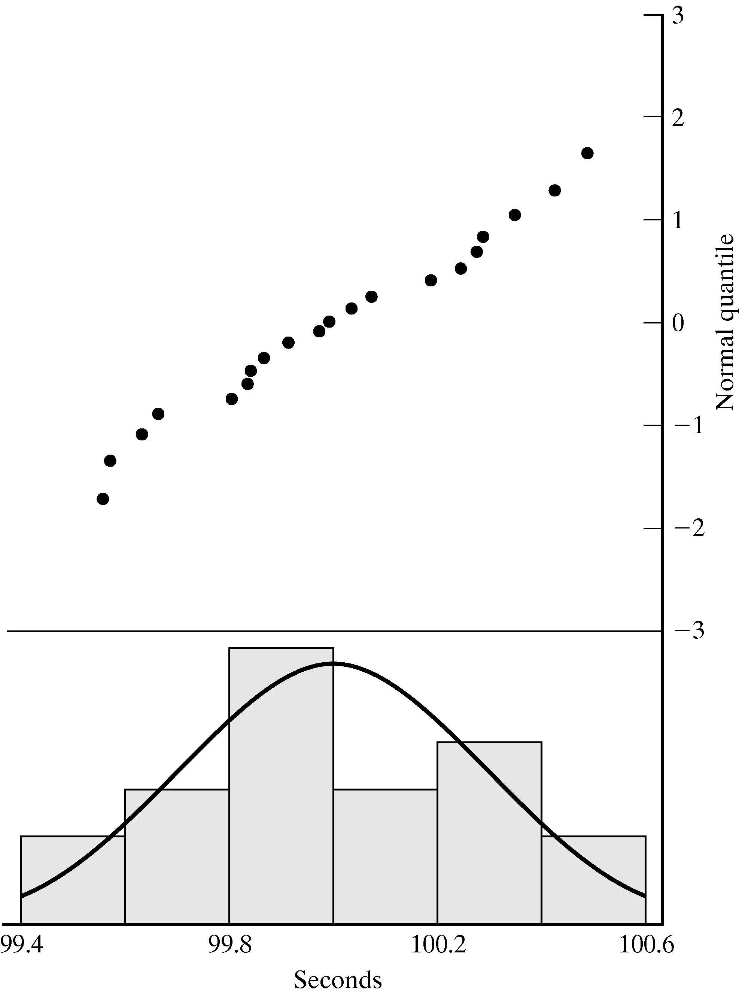
Quantile-Quantile Plots [Identifying the distribution]
Example (continued): Check whether the door installation times follow a normal distribution.
Straight line, supporting the hypothesis of a normal distribution
Superimposed density function of the normal distribution

Slide 17
Quantile-Quantile Plots [Identifying the distribution]
Consider the following while evaluating the linearity of a q-q plot:
  The observed values never fall exactly on a straight line
  The ordered values are ranked and hence not independent, unlikely for the points to be scattered about the line
  Variance of the extremes is higher than the middle. Linearity of the points in the middle of the plot is more important.
Q-Q plot can also be used to check homogeneity
  Check whether a single distribution can represent both sample sets
  Plotting the order values of the two data samples against each other

Slide 18
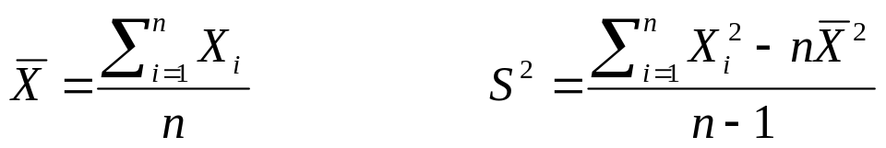
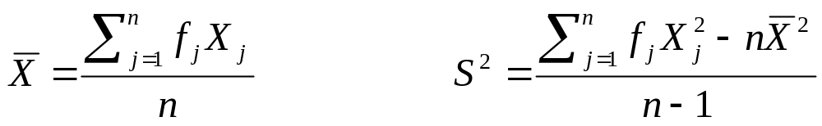
9.3 Parameter Estimation [Identifying the distribution]
This is the next step after selecting a family of distributions
If observations in a sample of size n are X₁, X₂, …, X_{n} (discrete or continuous), the sample mean and variance are:
If the data are discrete and have been grouped in a frequency distribution:
where f_{j} is the observed frequency of value X_{j}

Slide 19
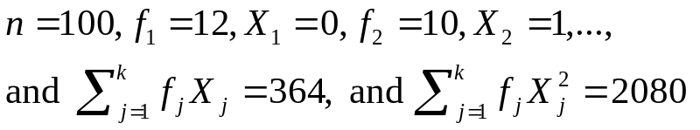
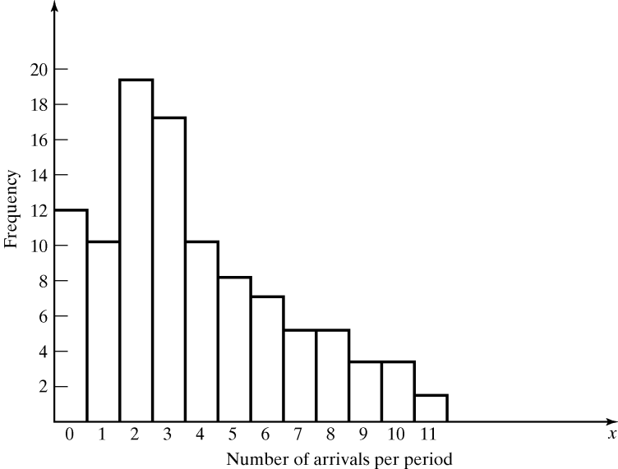
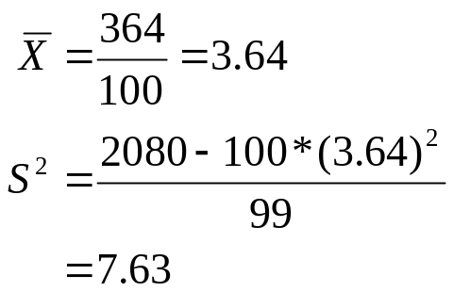
Grouped data – example 9.8 on page 350
[Parameter estimation - Identifying the distribution]
Vehicle Arrival Example (continued): Table in the histogram example on slide 6 (Table 9.1 in book) can be analyzed to obtain:
  The sample mean and variance are
  The histogram suggests X to have a Possion distribution
    However, note that sample mean is not equal to sample variance.
    Reason: each estimator is a random variable, is not perfect.

Slide 20
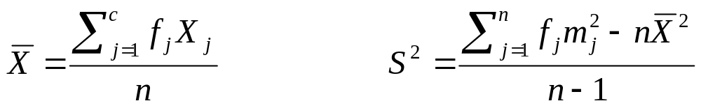
Parameter Estimation [Identifying the distribution]
When raw data are unavailable (data are grouped into class intervals), the approximate sample mean and variance are:
where f_{j} is the observed frequency of in the jth class interval
m_{j} is the midpoint of the jth interval, and c is the number of class intervals
A parameter is an unknown constant, but an estimator is a statistic.

Slide 21
9.3.2 on page 352
Numerical estimates of the distribution’s parameters are needed to
  reduce the family of distributions to a specific distribution
  test the resulting hypothesis

Slide 22
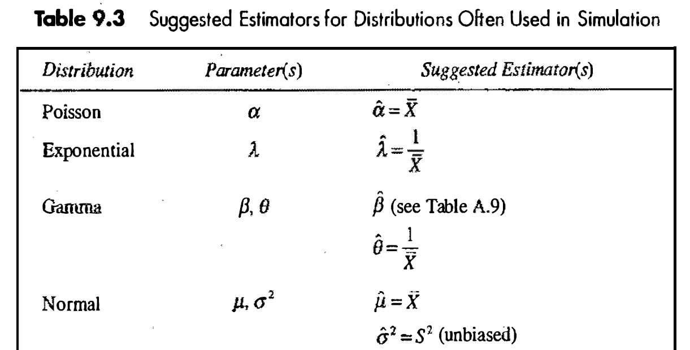
Suggested estimators

Slide 23
9.4 Goodness-of-Fit Tests [Identifying the distribution]
Conduct hypothesis testing on input data distribution using:
  Kolmogorov-Smirnov test
  Chi-square test
No single correct distribution in a real application exists.
  If very little data are available, it is unlikely to reject any candidate distributions
  If a lot of data are available, it is likely to reject all candidate distributions

Slide 24
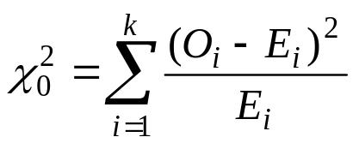
Chi-Square test [Goodness-of-Fit Tests]
Intuition: comparing the histogram of the data to the shape of the candidate density or mass function
Valid for large sample sizes when parameters are estimated by maximum likelihood
By arranging the n observations into a set of k class intervals or cells, the test statistics is:
  which approximately follows the chi-square distribution with k-s-1 degrees of freedom, where s = # of parameters of the hypothesized distribution estimated by the sample statistics.
Expected Frequency
E_{i} = n*p_{i}
where p_{i} is the theoretical prob. of the ith interval.
Suggested Minimum = 5
Observed Frequency

Slide 25

Chi-Square test [Goodness-of-Fit Tests]
The hypothesis of a chi-square test is:
H₀: The random variable, X, conforms to the distributional assumption with the parameter(s) given by the estimate(s).
H₁: The random variable X does not conform.
Critical value is found by looking at table for chi square at particular level of significance and degree of freedom. If calculated value larger than table value, null hypothesis rejected otherwise accepted
If the distribution tested is discrete and combining adjacent cell is not required (so that E_{i} > minimum requirement):
  Each value of the random variable should be a class interval, unless combining is necessary, and

Slide 26
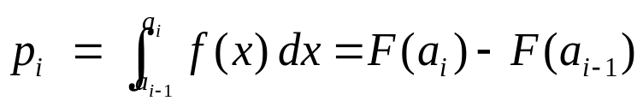
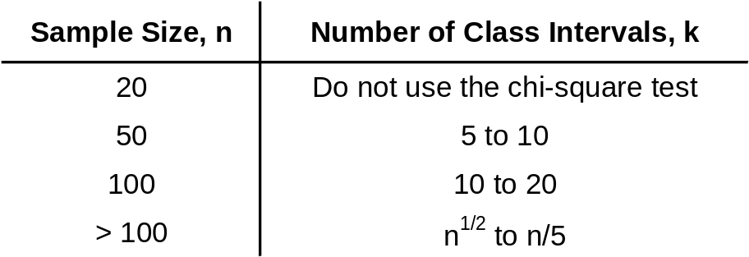
Chi-Square test [Goodness-of-Fit Tests]
If the distribution tested is continuous:
  where a_{i}-1 and a_{i} are the endpoints of the i^{th} class interval
  and f(x) is the assumed pdf, F(x) is the assumed cdf.
  Recommended number of class intervals (k):
  Caution: Different grouping of data (i.e., k) can affect the hypothesis testing result.

Slide 27
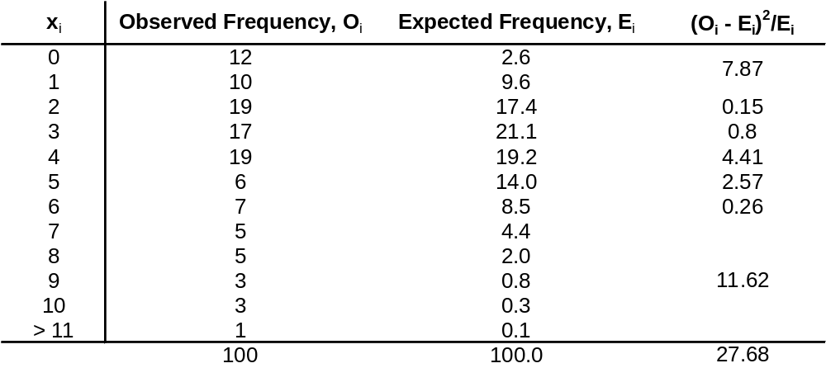
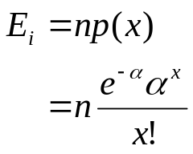
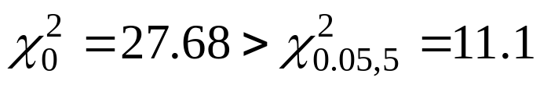
Chi-Square test Ex 9.5,9.12.9.17
Vehicle Arrival :
H₀: the random variable is Poisson distributed.
H₁: the random variable is not Poisson distributed.
  Degree of freedom is k-s-1 = 7-1-1 = 5, hence, the hypothesis is rejected at the 0.05 level of significance.
Combined because of min E_{i}

Slide 28
Kolmogorov-Smirnov Test
[Goodness-of-Fit Tests]
Intuition: formalize the idea behind examining a q-q plot
Recall from Chapter 7.4.1:
  The test compares the continuous cdf, F(x), of the hypothesized distribution with the empirical cdf, S_{N}(x), of the N sample observations.
  Based on the maximum difference statistics (Tabulated in A.8):
  D = max| F(x) - S_{N}(x)|
A more powerful test, particularly useful when:
  Sample sizes are small,
  No parameters have been estimated from the data.
When parameter estimates have been made:
  Critical values in Table A.8 are biased, too large.
  More conservative, i.e., smaller Type I error than specified.

Slide 29
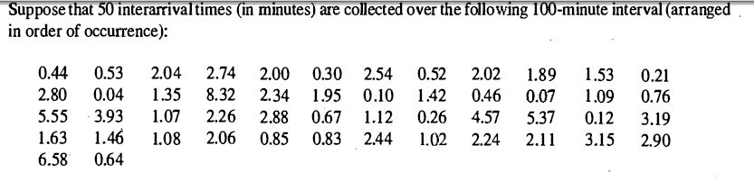
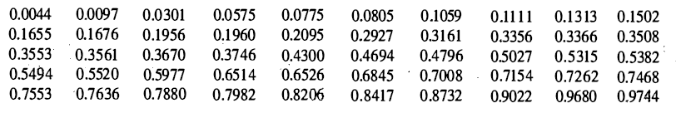
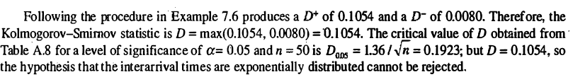
Kolmogorov-Smirnov Test
[Goodness-of-Fit Tests]

Slide 30
Kolmogorov-Smirnov Test
[Goodness-of-Fit Tests]
K.S Test have been modified where parameters are estimated from data
The computation of the test statistics is the same
But different tables of critical values are used for different distributional assumptions

Slide 31
Summary
In this chapter, we described the 4 steps in developing input data models:
  Collecting the raw data
  Identifying the underlying statistical distribution
  Estimating the parameters
  Testing for goodness of fit

