Slide 1
PRODUCT SPACE · ADVANCED AI PROGRAM · COHORT 11
Pentahouse
Real Estate Marketing & Conversion Intelligence Agent
A full-funnel, five-agent AI system that turns fragmented property inquiries into qualified site visits — with attribution from the ad rupee to the booking.
Listing
Ad
Lead
Nurture
Conversion
Abhishek Ranjan · APM, Hack2skill · arjha97@gmail.com

Slide 2
THE PROBLEM
Leads don't decay from scarcity.
They decay from silence.
Inquiries arrive with almost no context — and sales teams act blind. Without knowing why a buyer is here, executives call in sequence, send generic messages, and lose serious buyers to follow-up lag while chasing tyre-kickers.
What actually arrives
Name
Phone
Email
Project
What's missing — the intent
A buyer who shortlisted three projects gets spam calls from two — and a meaningful reply from only one.
Purpose
Budget
Config
Timeline
Locality
Financing
Visit-ready
Decider
Missing intent data is the root cause of funnel decay — the core problem, not lead supply.
Pentahouse
02

Slide 3
THE COST
A leaky funnel, not a lead shortage
~5 hrs
Rs 700–4,500
~12%
<30%
median first response to a new inquiry
spent per lead across portals & ads
of inquiries that ever get qualified
of bookings traceable to ad spend
The shape of the leak: 30,000+ annual inquiries to ~108 bookings. The rupees are spent. The follow-through isn't.
Figures from the project's India proptech market research.
Pentahouse
03

Slide 4
WHY NOW
Four shifts make this the moment
1
WhatsApp is the channel
2
Reasoning got cheap
Business API matured in Indian sales; buyers already compare brochures and floor plans over chat.
Gemini 2.5 Flash makes multi-step reasoning per lead affordable at under Rs 0.50 a decision.
3
Compliance demands a trail
4
Discovery moved online
The DPDP Act requires an auditable consent and messaging record — approval-gated AI is native to it.
Post-COVID, property search is digital-first, and mid-market launches outpace manual qualification.
Pentahouse
04

Slide 5
WHO IT'S FOR
Built for the people on the sales floor
RS
Sales Head
RJ
Sales Rep
MP
Marketing Lead
Approves every outbound message, protects the brand, and owns visit-to-booking conversion across the floor.
Works a ranked queue of who to call first, with the next best action and a reply already drafted.
Allocates spend by what actually converts — sees cost per lead, visit, and booking by channel.
Pentahouse
05

Slide 6
THE SOLUTION
One closed-loop, five-agent system
→
→
→
→
Listing
Ad
Lead
Nurture
Conversion
syncs & verifies inventory
drafts targeted campaigns
scores intent, decides next step
drafts WhatsApp, you approve
tracks visits & bookings
Feedback loop — visit & booking outcomes flow back into scoring and spend
Shared data plane: Supabase (Postgres + pgvector) · n8n orchestration · Gemini 2.5 Flash · Twilio WhatsApp · Google Calendar & Sheets
Pentahouse
06

Slide 7
ARCHITECTURE
How the pieces fit together
Inbound
Lead Agent
Nurture Agent
Conversion
Meta lead ad · portal · form
RAG match + score + route
drafts WhatsApp → approval
visits · objections · bookings
Listing + Ad Agents
inventory & campaigns
Data plane & observability: Supabase + pgvector · n8n events · Gemini (Flash + Pro fallback) + embeddings · Twilio · per-decision agent logs
Pentahouse
07

Slide 8
THE FIVE AGENTS
What each agent actually does
Listing Agent
Turns brochures, RERA pages and price sheets into a clean, verified inventory.
Gemini extraction + dedup
Ad Agent
Drafts platform-specific creative for Meta, Google and portals — copy, audience, budget.
Gemini, few-shot
Lead Agent
Normalizes any form, scores intent with retrieval, and routes every lead.
pgvector + Gemini + fallback
Nurture Agent
Drafts the WhatsApp reply — a gap-fill question or visit invite — for your approval, then sends.
Gemini + Twilio + human gate
Conversion Agent
Logs visits, extracts objections and sentiment, attributes each booking to its source.
Gemini + attribution chain
Lead is the moat — but the funnel only closes because all five hand off to each other.
Pentahouse
08

Slide 9
USER JOURNEY
The buyer's path — and where we step in
Inquiry
Qualification
Nurture & visit
Booking & beyond
Touchpoints
Meta / Google ad,
portal lead form
WhatsApp,
the scored lead card
WhatsApp thread,
visit invite + calendar
Booking note,
reminders, re-engage
Actions
Clicks an ad,
submits partial details
Answers one quick
WhatsApp question
Replies, picks a slot,
attends the visit
Books, or raises
an objection
Emotion
Curious, low effort
Wary: will they
spam me?
Reassured,
taken seriously
Confident,
or hesitant
Pain today
Thin data, ignored
for hours
Generic calls,
wrong rep
Spammed by two,
real reply from one
Objection forgotten,
no follow-up
Pentahouse helps
Scored in seconds,
never dropped
One smart question
fills the gaps
Rep-approved, timely;
auto visit + reminders
Objection captured,
booking attributed
Pentahouse
09

Slide 10
THE MOAT
The Lead Agent is the defensible core
Retrieval-grounded
Explainable
Embeds each inquiry and matches live inventory with pgvector — never invents a project.
Fit, Urgency and Visit-readiness, each with a plain-language reason a rep can trust.
Resilient
Decisive
A four-model fallback chain (Flash to Flash to Flash-Lite to Pro) survives free-tier limits.
Routes every lead to activate, ask for more, or escalate — a small state machine, not a guess.
"The conversion intelligence is the moat — not the WhatsApp template."
Pentahouse
10

Slide 11
CORE FLOW
Ad data in, the right question out
→
→
→
→
1
2
3
4
5
Lead arrives
Agent scores it
Asks what's missing
Reply re-scores
Activates
from a campaign — often with partial details
on intent and matches your inventory
one simple WhatsApp question, if needed
the buyer's answer fills the gap
hot + complete → a site-visit invite
A human approves every message · follow-ups are capped so buyers are never nagged · WhatsApp is a gap-filler the agent triggers, not a cold blast.
Pentahouse
11

Slide 12
WHAT AI ACTUALLY MEANS HERE
Five real techniques, not a label
Retrieval-augmented generation
Structured-output enforcement
Multi-model fallback
Gemini embeddings + pgvector retrieve relevant inventory before reasoning.
A responseSchema guarantees clean, parseable scores every time.
A retry chain across four Gemini models keeps scoring alive under load.
Intent normalization
Explainable scoring
Human-in-the-loop
Any ad form, however shaped, maps into one fixed scoring model.
Natural-language reasons, not a black-box hot-lead label.
Every buyer-facing message passes a manager approval gate.
Pentahouse
12

Slide 13
THE DESIGN CHOICE
No agent talks to a buyer
without a human
Every outbound message is drafted by AI and sent only after a manager approves it. That single gate is the difference between an AI tool the sales floor quietly sabotages, and one the sales head defends to her MD. It is also DPDP-native — an auditable record of who said what, and when.
AI drafts
v
Manager approves
v
Buyer receives
Pentahouse
13

Slide 14
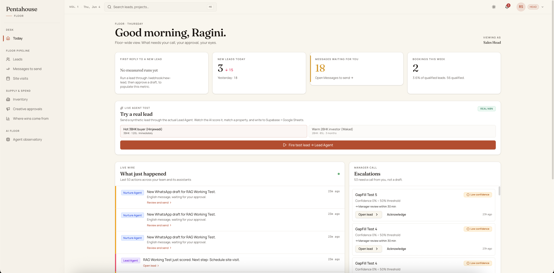
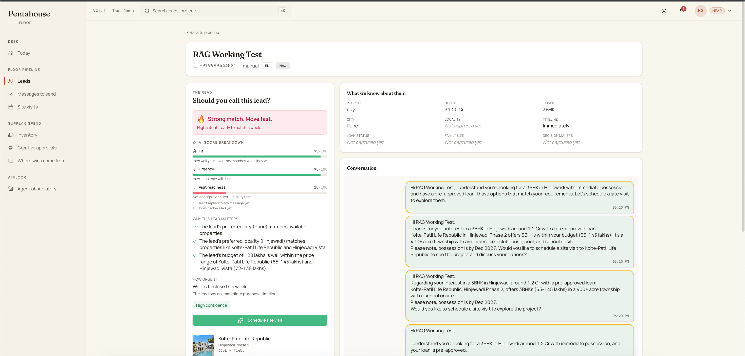
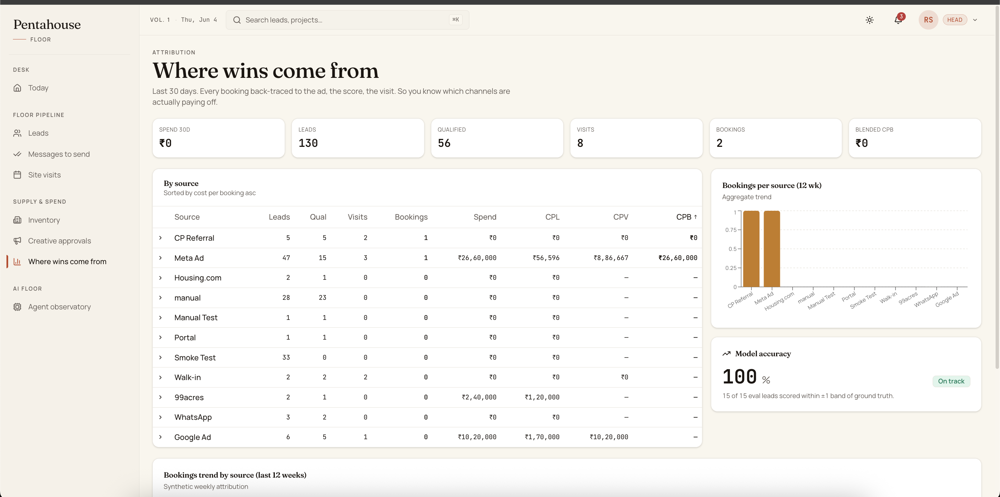
THE PRODUCT
A role-aware dashboard, built for non-technical teams
"Should you call this lead?"
Sales Head command center
Each persona sees only what their job needs — and the model names, agents, and jargon are stripped from every sales screen.
Where wins come from
Pentahouse
14

Slide 15
OUTCOMES
What good looks like
First qualifying response
Lead → visit
Visit → booking
~5 hrs to < 60 sec
conversion lifted, measured per source
tracked with AI-extracted objections
100%
15-lead eval
North star: median Time-to-Qualification
of bookings traced source → booking
scoring checked vs ground truth
Every metric on the dashboard is computed from real workflow runs — no hardcoded numbers.
Pentahouse
15

Slide 16
HONEST SCOPE
Shipped today vs the roadmap
Live now
Next — v2
Five n8n agents, event-wired
Live Meta / Google ad posting (API)
RAG scoring + four-model fallback
Multi-tenant aggregator portal
WhatsApp draft to approve to send (Twilio)
Drip sequences + inbound chat loop
Google Calendar visits + Sheets mirror
Closed-loop budget optimization
Meta lead-ad ingest (HMAC-verified)
Vector memory over long buyer threads
Three-persona dashboard + observability
Fine-tuned intent classifier
Lead dedup + source-to-booking attribution
Four of five concept-brief tool integrations are real and working today.
Pentahouse
16

Slide 17
GO TO MARKET
Who pays, and why
Who
Mid-tier residential developers — roughly 600 nationally, 50–500 units a year, running on portals and CRMs they don't love.
How they pay
SaaS per project or seat, plus an outcome fee on qualified site-visits and attributed bookings, plus a premium ad-management tier.
The motion
Paid pilots with Pune and Bangalore sales heads — speed-to-lead and attribution as the proof, before any deck math.
Pentahouse
17

Slide 18
Lead decay is the problem.
Intelligence is the cure.
Pentahouse turns every inquiry into a qualified visit — and traces every booking back to the rupee that paid for it.
Thank you · Abhishek Ranjan · arjha97@gmail.com
Product Space · Advanced AI Program · Cohort 11

