Slide 1
Continuum manipulator using 6 motors.
Badhon Kumar
Under Supervision of
Dr. Changyong (Chase) Cao
Assistant Professor, Department of Mechanical and Aerospace Engineering, Case Western Reserve University.
05 July, 2026

Slide 2
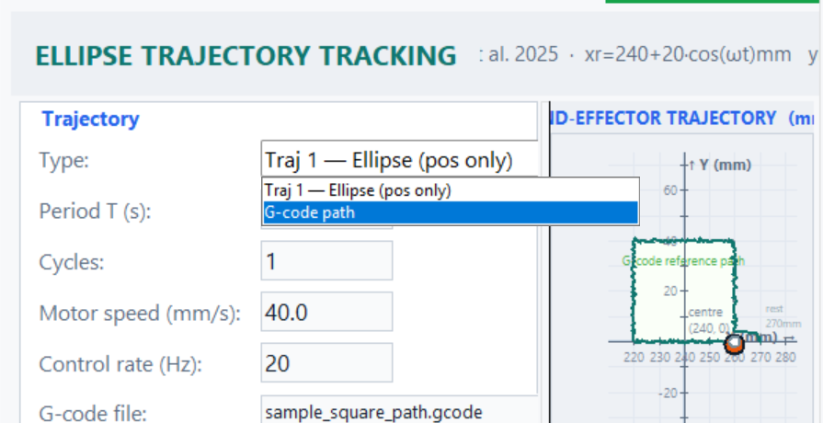
Development Goal
To add another input type :G-Code path along with the ellipsoid trajectory.

Slide 3
What Was Added
Added G-code path option in the GUI
Added sample_square_path.gcode.
Steps: Select G-code path – load the G-code file – run
The continuum manipulator can now follow custom paths from G-code.

Slide 4
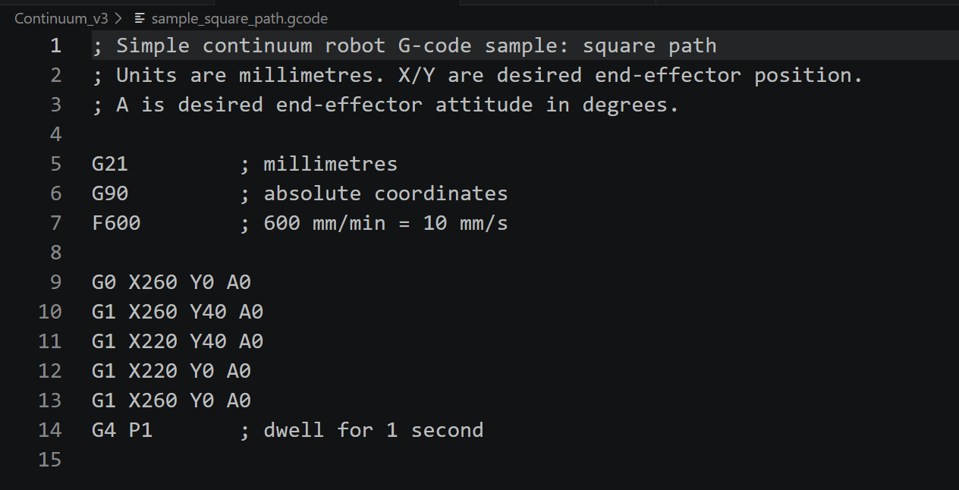
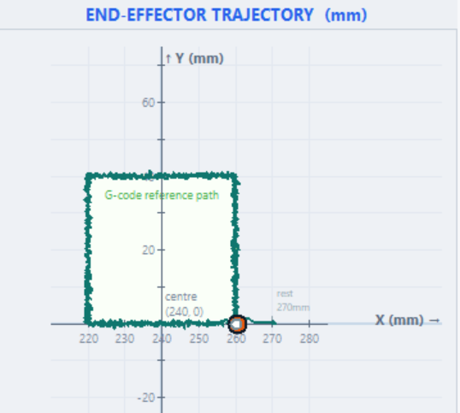
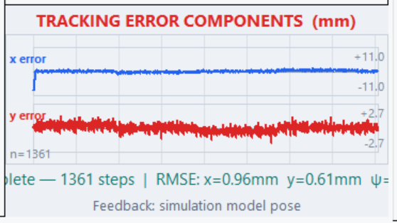
Current G-code Function
Sample square g-code has been added and tested: (260,0) -> (260,40) -> (220,40) -> (220,0) -> (260,0)

Slide 5
Simulation Workflow
Need to run only the continuum_ellipse.py
For simulation: ”python Continuum_v3/continuum_ellipse.py”
All the information – user guide and G-code description can be found in USER_GUIDE.md and G_CODE-GUIDE.md

Slide 6
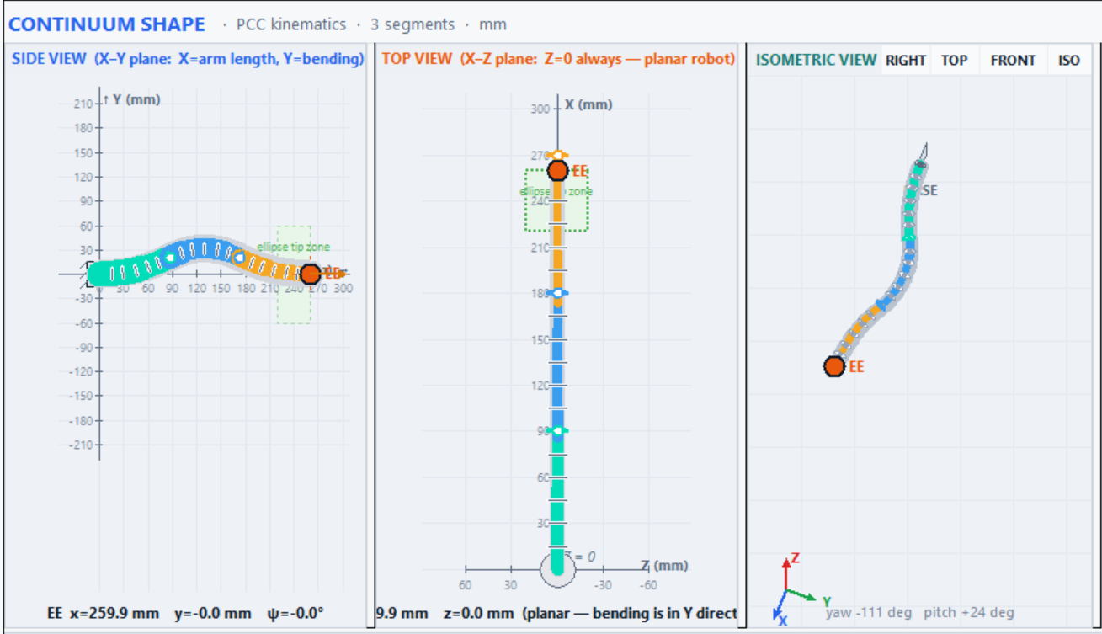
Important Fixes
Minimized errors of both x and y axis. It improves with increased steps – motor speed and control rate.
All the viewing windows can be resized to view properly and the isometric view can be rotated freely.

Slide 7
Limitations and Next Work
Current work is focused on simulation
Real camera/end-effector feedback is not yet used
G-code support is simple; no G2/G3 arcs yet

