Slide 1
Badji Mokhtar University
Annaba
Sentiments Analysis about
The #Brexit
Presented By:
Aissou Monder
Prof:
Mme.Benali

Slide 2
Plan:
Introduction
Definition of brexit
Different techniques used in our project
Some tweets about #brexit

Slide 3
Introduction A sentiments analysis
Sentiment analysis gives us insight into the things that automate mining of attitudes, opinions, views and emotions from text, speech, tweets and database sources. However, to fully explore the possibilities of this text analysis technique, we need data visualization tools to help organize the results. Visually representing the content of a text document is one of the most important tasks in the field of text mining.

Slide 4
Definition of brexit
Brexit was the withdrawal of the United Kingdom from the European Union at 23:00 GMT on 31 January 2020.

Slide 5
Different techniques used in our project
However, there are some gaps between visualizing unstructured (text) data and structured data. Many text visualizations do not represent the text directly, they represent an output of a language model. In this post, we will use tweets extracted using Twitter API, store tweets as text data, classify opinions in text into categories like positive, or negative or neutral, create a function to calculate the score of each type of opinion in the text and try to explore and visualize as much as we can, using R libraries.
Tweets can be imported into R using Twitter API, then the text data has to be cleaned before analysis, for example removing emoticons, removing URLs, etc.

Slide 6
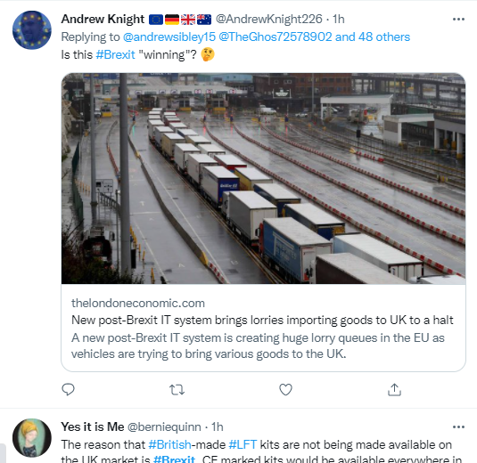
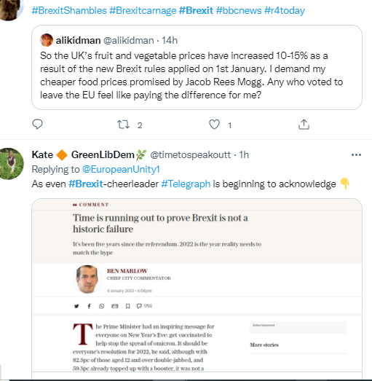
Some tweets about brexit

Slide 7
WorkPlan
Loading all the required R libraries.
Twitter authorization to extract tweets:
Extracting Global Warming tweets
Data cleaning
Frequency of Tweets
Estimating Sentiment Score
Loading sentiment word lists
Sentiment scoring function
Calculating the sentiment score
Histogram of sentiment scores
Barplot of sentiment type
Wordcloud
Word Frequency plot.
Network Analysis.
Bigram analysis and Network definition.
Network visualization.

Slide 8
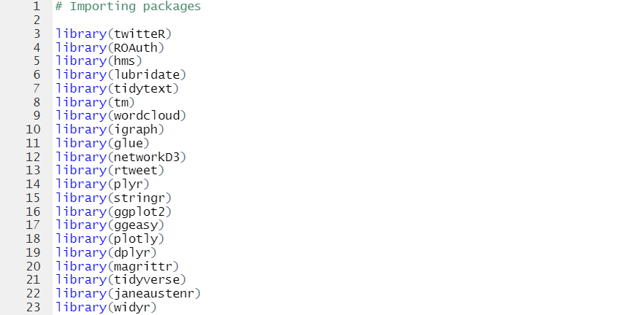
Loading all the required R libraries

Slide 9
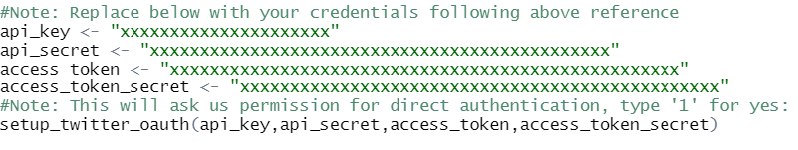
Twitter authorization to extract tweets:
As a first step, we need to get authorized credentials from Twitter to use the API for extracting the tweets. Steps involve creating a Twitter developer account, creating an app and then we have necessary credentials.

Slide 10
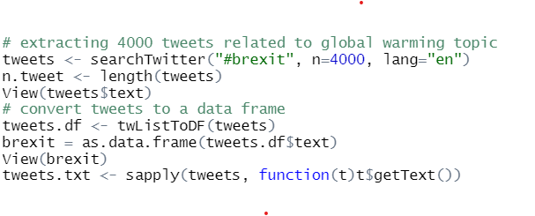
Extracting Brexit tweets

Slide 11
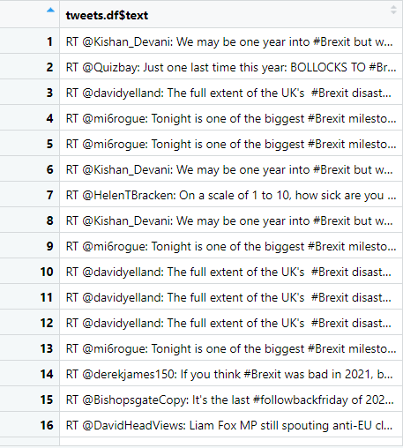
Here is some of our dataset

Slide 12
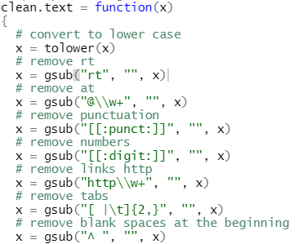
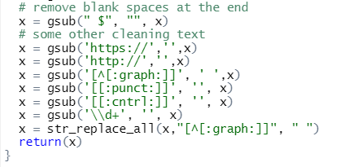
Data cleaning
In this step we should clean out data set(tweets) from links, punctuations, RT, @, numbers, tabs, blank spaces at the beginning, ………..etc, and also we should transfer all the characters to a lower case using the function bellow

Slide 13

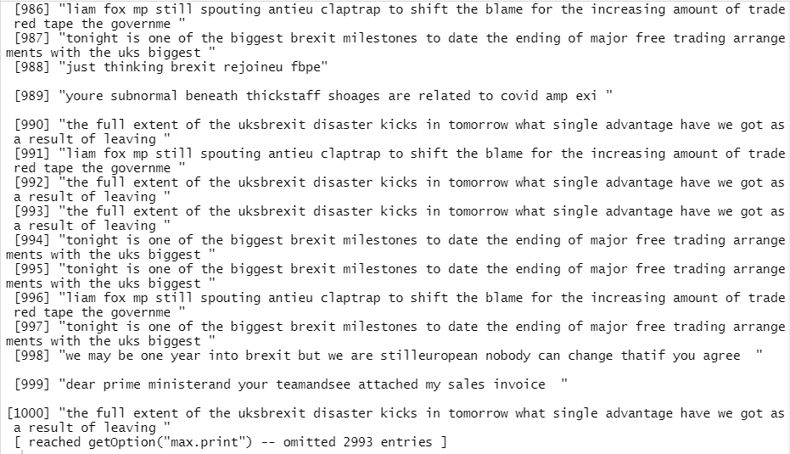
Data cleaning
After cleaning data we have to remove empty results using this code
Then that’s how will look our dataset

Slide 14


Frequency of tweets
The two following instructions will be appeared as when the oldest and the newest tweet on my dataset ware posted
After running these 2 instruction it apears this result

Slide 15
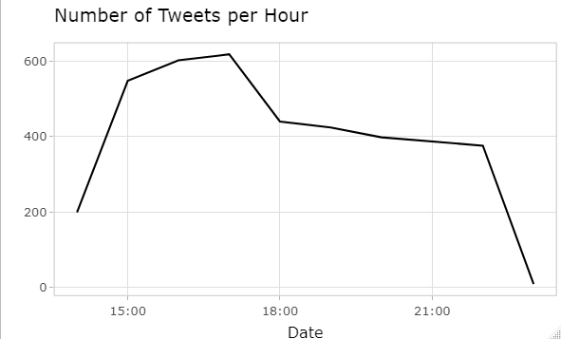
Frequency of tweets
This geometric line represents the number of tweets per hour according to the publication date

Slide 16
Estimating Sentiment Score
There are many resources describing methods to estimate sentiment. For the purpose of this tutorial, we will use a very simple algorithm which assigns sentiment score of the text by simply counting the number of occurrences of “positive” and “negative” words in a tweet.

Slide 17
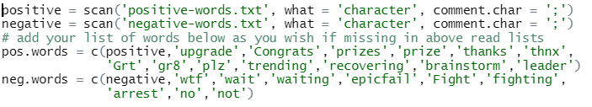
Estimating Sentiment Score
Loading sentiment word lists
Before starting i’ve downloaded an “Opinion Lexicon” that categorizes approximately 6,800 words as positive or negative which have published by Hu & Liu, it’s accessible on this link https://www.cs.uic.edu/~liub/FBS/sentiment-analysis.html
Then I added some words which doesn’t exist in the files. Using this code

Slide 18
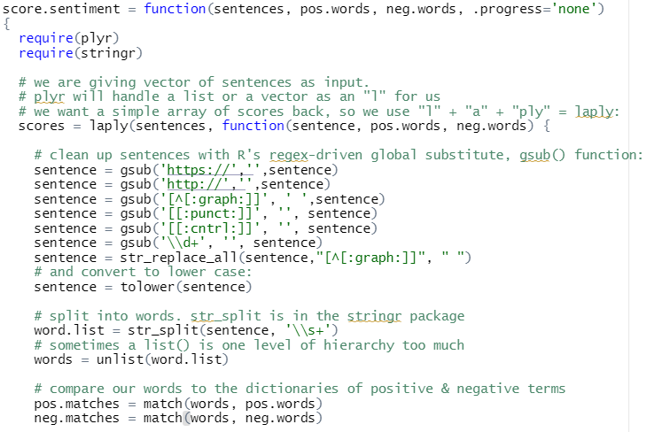
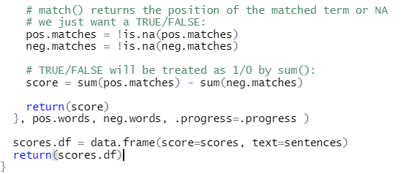
Estimating Sentiment Score
Sentiment scoring function: the following function is used to calculate the sentiment score wich will show as what twitter users think abount « brexit »

Slide 19

Estimating Sentiment Score
Calculating the sentiment score

Slide 20
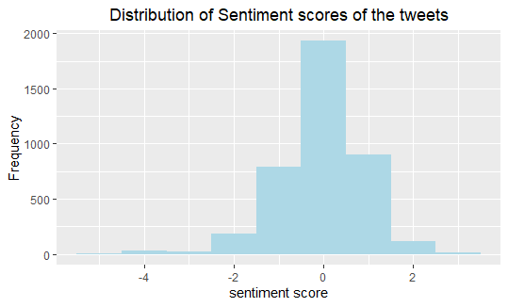
Histogram of sentiment scores:
Analysis: From the Histogram of Sentiment scores, we can see that around half of the tweets have sentiment score as zero i.e. Neutral and overall as expected, the distribution depicts negative sentiment in the tweets related to the brexit, since it is a major issue of concern.

Slide 21
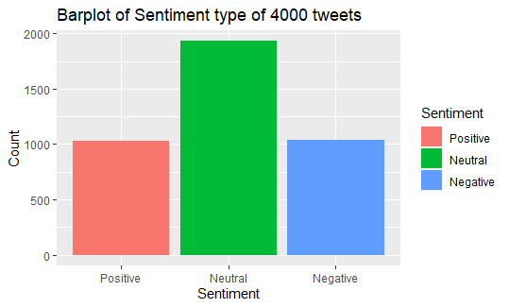
Barplot of sentiment type
Analysis: It is also clear from this barplot of sentiment type that around half of the tweets have sentiment score as zero i.e. Neutral and the number of positive tweets is equal to the number of negative tweets.
This barplot helps us to identify overall opinion of the people about global warming.

Slide 22
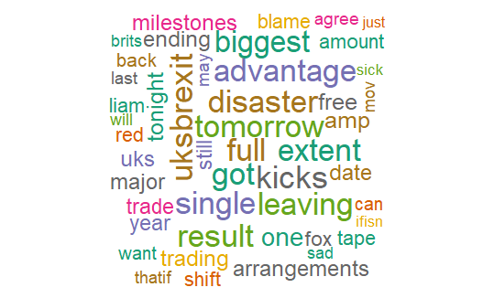
Wordcloud
Analysis: Wordcloud helps us to visually understand the important terms frequently used in the tweets related to brexit, here for example, “full”, ”leaving”, “single”,………….,etc

Slide 23
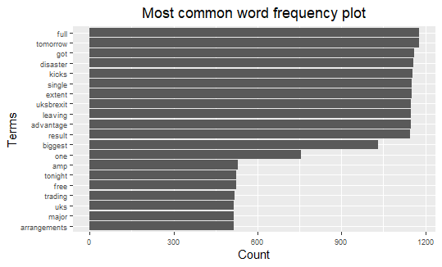
Word Frequency plot:
Analysis: we can infer that the most frequently used terms in the tweets related to global warming are,”full”, “tomorrow”, “got”, “desaster”,……………………,etc

Slide 24
Network analysis
We are using a weighted network (graph) to describe how to encode and visualize text data. In this section we are counting pairwise relative occurrence of words.

Slide 25
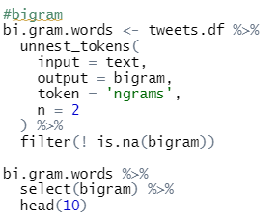
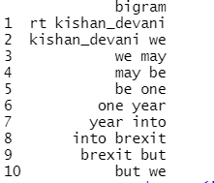
Network analysis
Bigram analysis and Network definition
Bigram counts pairwise occurrences of words which appear together in the text.
After filtering for stop words and remove white spaces, then grouping and counting by bigram. It appears the result which will be showed and ploted on the next screen

Slide 26
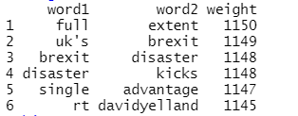
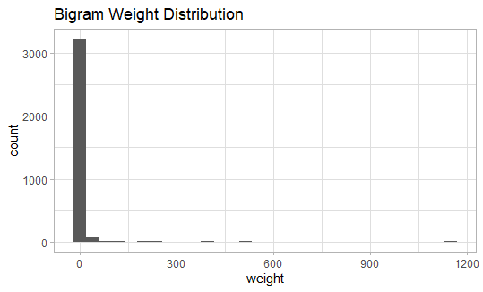
Note that it is very skewed, for visualization purposes it might be a good idea to perform a transformation, eg log transform:

Slide 27
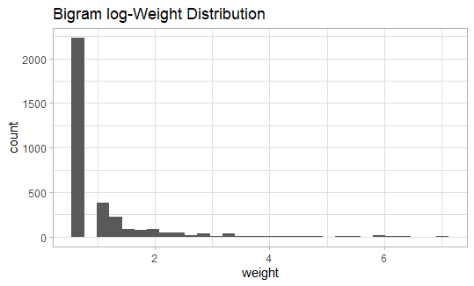
In order to define weighted network from a bigram count we used the following structure.
Each word is going to represent a node.
Two words are going to be connected if they appear as a bigram.
The weight of an edge is the number of times the bigram appears in the corpus.

Slide 28
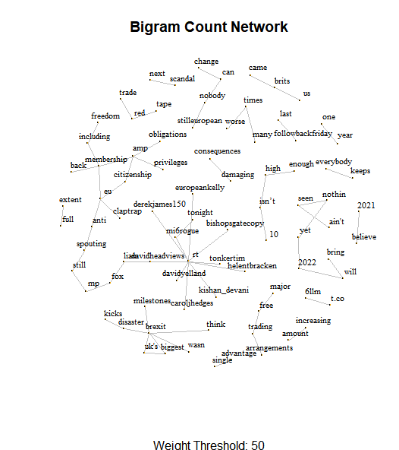
Network analysis
Network visualization:

Slide 29
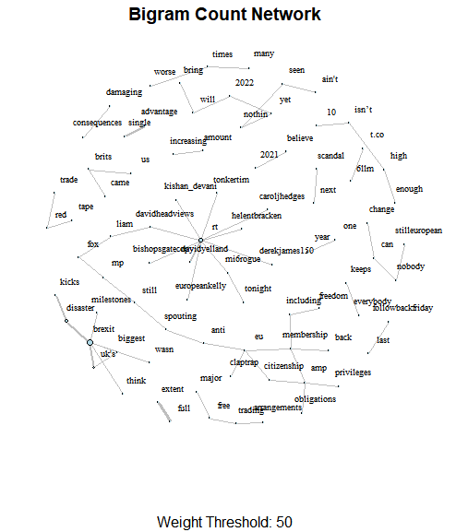
We can even improvise the representation by setting the sizes of the nodes and the edges by the degree and weight respectively.

Slide 30
We can go a step further and make our visualization more dynamic using the networkD3 library.
The result will be showed during the execution of the project

Slide 31
Conclusion
To finish, from our results of the sentiments analysis we see that the UK found a lot of advantages after the application of the brexit, and this politic helped UK in many fields.

Slide 32
Thanks for your attention

