Slide 1

Finding Donors
Başak Dilara Çevik
Original Author: Sajal Sharma
Project Link: GitHub

Slide 2
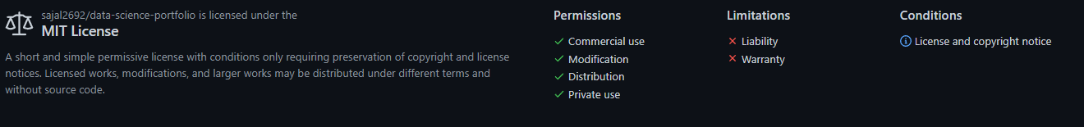
MIT License
Copyright (c) 2017 Sajal Sharma
Permission is hereby granted, free of charge, to any person obtaining a copy of this software and associated documentation files (the "Software"), to deal in the Software without restriction, including without limitation the rights to use, copy, modify, merge, publish, distribute, sublicense, and/or sell copies of the Software, and to permit persons to whom the Software is furnished to do so, subject to the following conditions:
The above copyright notice and this permission notice shall be included in all copies or substantial portions of the Software.
THE SOFTWARE IS PROVIDED "AS IS", WITHOUT WARRANTY OF ANY KIND, EXPRESS OR IMPLIED, INCLUDING BUT NOT LIMITED TO THE WARRANTIES OF MERCHANTABILITY, FITNESS FOR A PARTICULAR PURPOSE AND NONINFRINGEMENT. IN NO EVENT SHALL THE AUTHORS OR COPYRIGHT HOLDERS BE LIABLE FOR ANY CLAIM, DAMAGES OR OTHER LIABILITY, WHETHER IN AN ACTION OF CONTRACT, TORT OR OTHERWISE, ARISING FROM, OUT OF OR IN CONNECTION WITH THE SOFTWARE OR THE USE OR OTHER DEALINGS IN THE SOFTWARE.

Slide 3
1-) Loading the necessary libraries
2-) Project & Data Exploration
3-) Data Preparation
4-) Data Preprocessing
5-) Shuffle and Split Data
6-) Evaluating Model Performance
7-) Model Tuning
8-) Feature Importance
9-) Feature Selection
10-) References

Slide 4
1-) Loading the necessary libraries
numpy
pandas
time
IPython.display
visuals
seaborn
matplotlib.pyplot

Slide 5
2-) Project & Data Exploration
Dataset
The dataset was donated by Ron Kohavi and Barry Becker, after being published in the article "Scaling Up the Accuracy of Naive-Bayes Classifiers: A Decision-Tree Hybrid".
Project Goal
Categorical Columns Analysis
Numerical Columns Analysis

Slide 6
Dataset
Dua, D. and Graff, C. (2019). UCI Machine Learning Repository [http://archive.ics.uci.edu/ml]. Irvine, CA: University of California, School of Information and Computer Science
age: the age of an individual
Integer greater than 0. continuous
workclass: a general term to represent the employment status of an individual
Private, Self-emp-not-inc, Self-emp-inc, Federal-gov, Local-gov,
State-gov, Without-pay, Never-worked.
education: the highest level of education achieved by an individual.
Bachelors, Some-college, 11th, HS-grad, Prof-school, Assoc-acdm, Assoc-voc, 9th, 7th-8th, 12th, Masters, 1st-4th, 10th, Doctorate, 5th-6th, Preschool.
education-num: the highest level of education achieved in numerical form. (continuous)
marital-status: marital status of an individual. Married­civ­spouse corresponds to a civilian spouse while Married­AF­spouse is a spouse in the Armed Forces.
Married-civ-spouse, Divorced, Never-married, Separated, Widowed, Married-spouse-absent, Married-AF-spouse.
sex: the biological sex of the individual.
Female, Male.
occupation: the general type of occupation of an individual.
Tech-support, Craft-repair, Other-service, Sales, Exec-managerial, Prof-specialty, Handlers-cleaners, Machine-op-inspct, Adm-clerical, Farming-fishing, Transport-moving, Priv-house-serv, Protective-serv, Armed-Forces.
relationship: represents what this individual is relative to others.
Wife, Own-child, Husband, Not-in-family, Other-relative, Unmarried.
race: descriptions of an individual’s race.
White, Asian-Pac-Islander, Amer-Indian-Eskimo, Other, Black.
capital-gain: capital gains for an individual. (continuous)
capital-loss: capital loss for an individual. (continuous)
hours-per-week: the hours an individual has reported to work per week. (continuous)
native-country: country of origin for an individual.
United-States, Cambodia, England, Puerto-Rico, Canada, Germany, Outlying-US(Guam-USVI-etc), India, Japan, Greece, South, China, Cuba, Iran, Honduras, Philippines, Italy, Poland, Jamaica, Vietnam, Mexico, Portugal, Ireland, France, Dominican-Republic, Laos, Ecuador, Taiwan, Haiti, Columbia, Hungary, Guatemala, Nicaragua, Scotland, Thailand, Yugoslavia, El-Salvador, Trinadad&Tobago, Peru, Hong, Holand-Netherlands.
income: whether an individual makes more than $50,000 annually.
<=50K, >50K.

Slide 7
Project Goal
The goal of this project is to predict if an individual makes over than $50.000 a year according to data collected from the 1994 U.S. Census.
This implementation aims to construct a model for an accurate prediction.
It could be beneficial for donations in a non-profit setting.

Slide 8
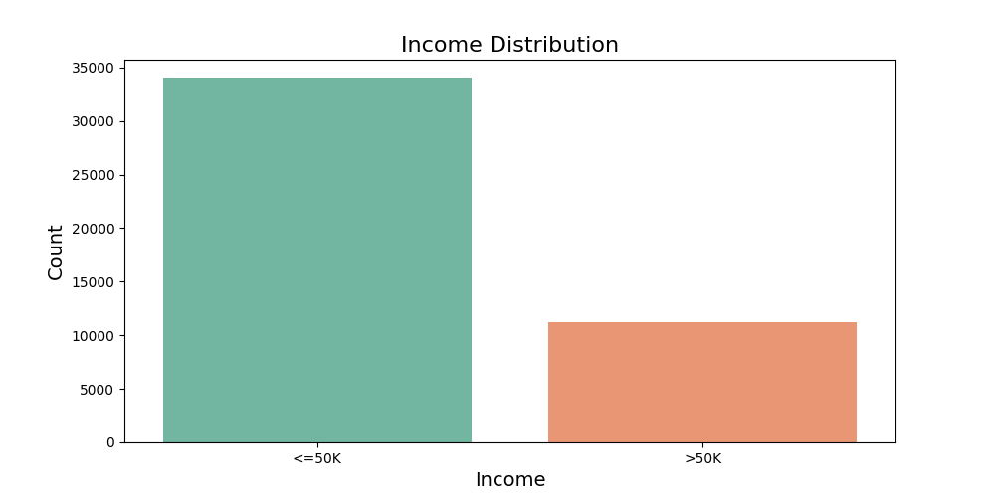
The number of people with income less than or equal to 50K is higher than the number of people with income more than 50K.
Categorical Columns Analysis

Slide 9
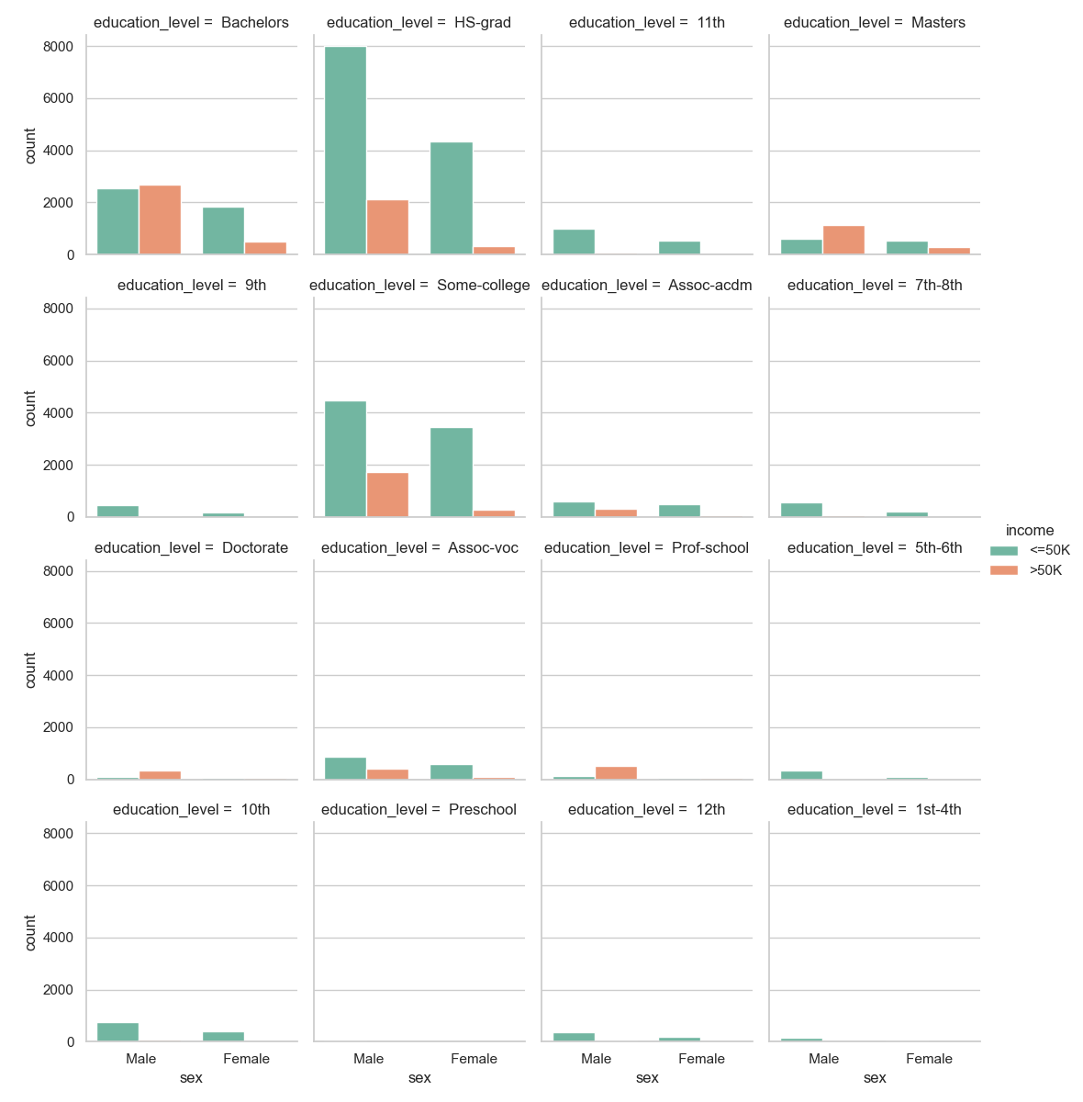

Slide 10
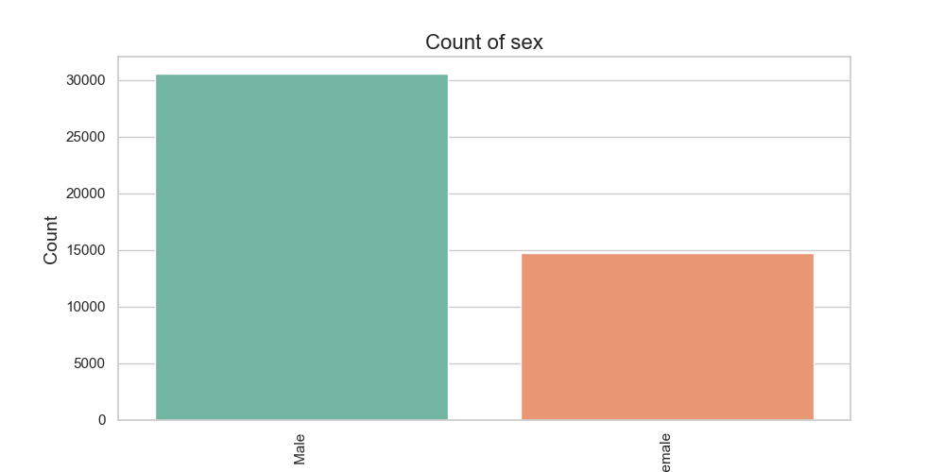
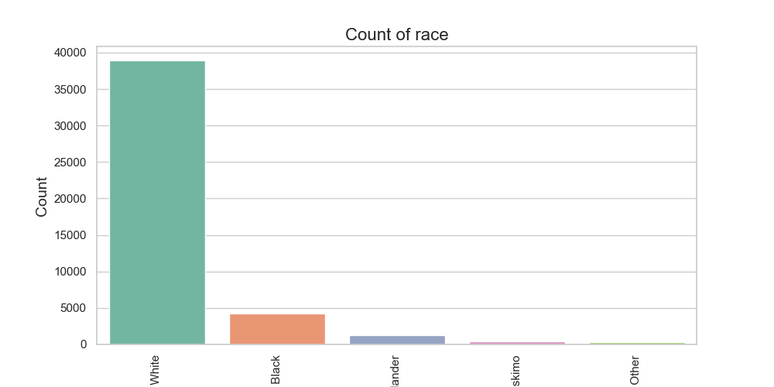
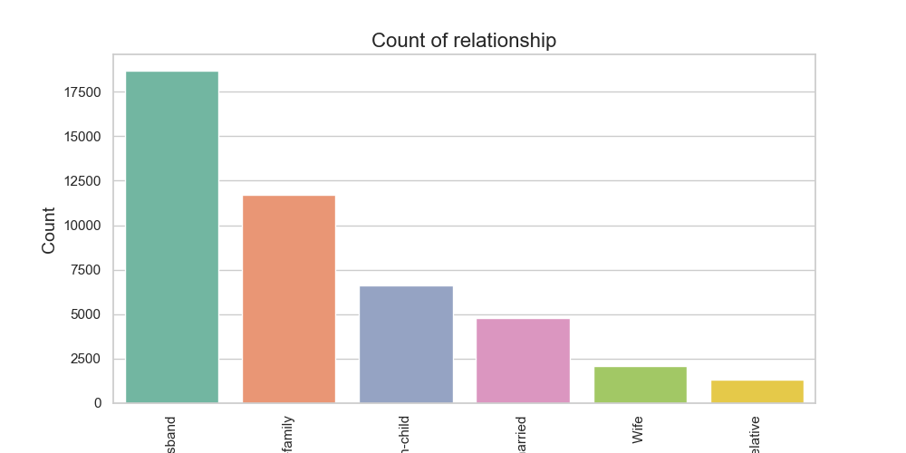
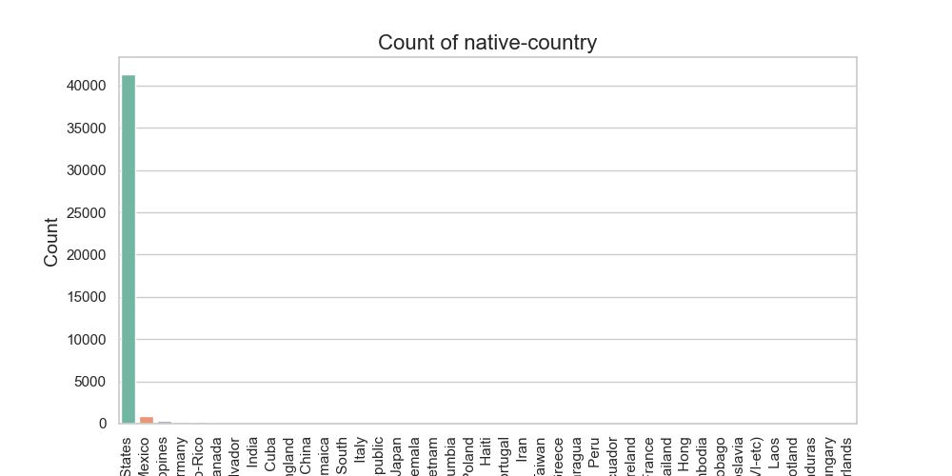

Slide 11
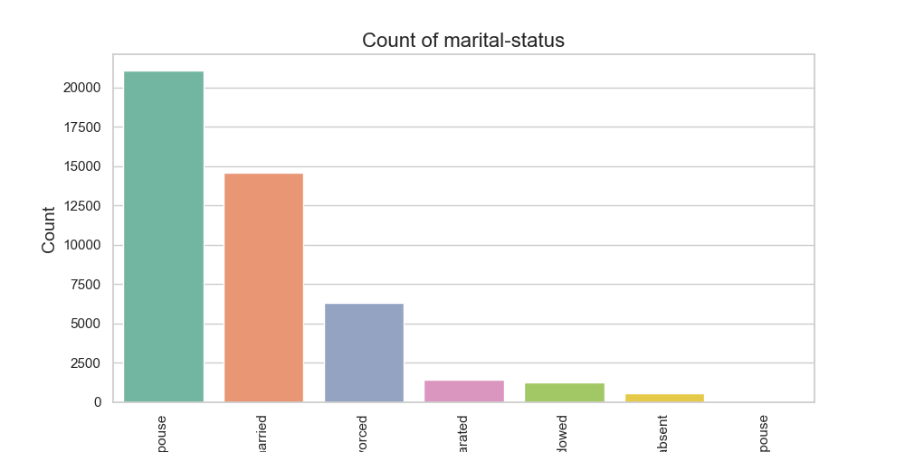
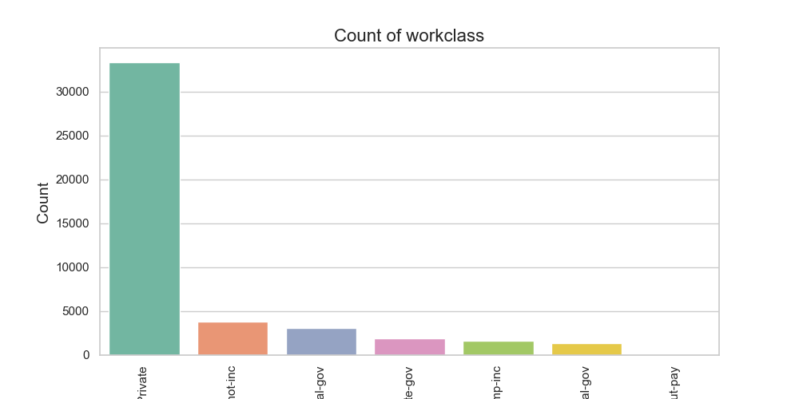
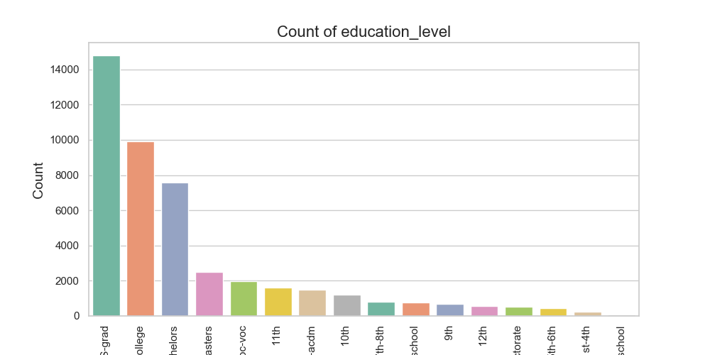
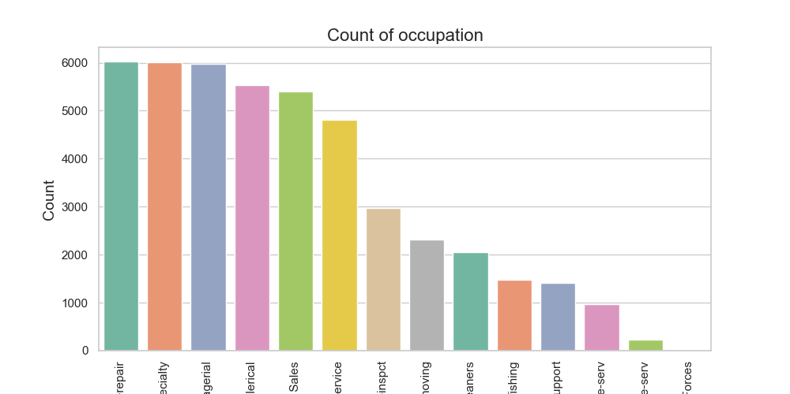

Slide 12
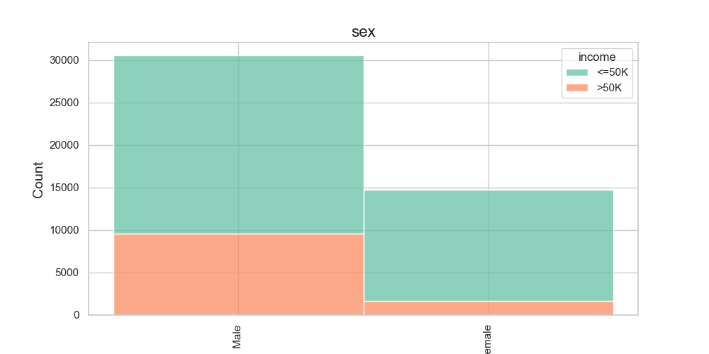
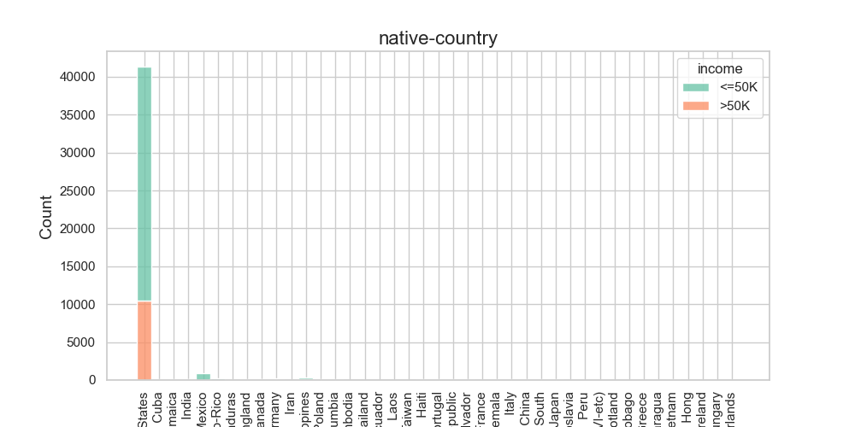
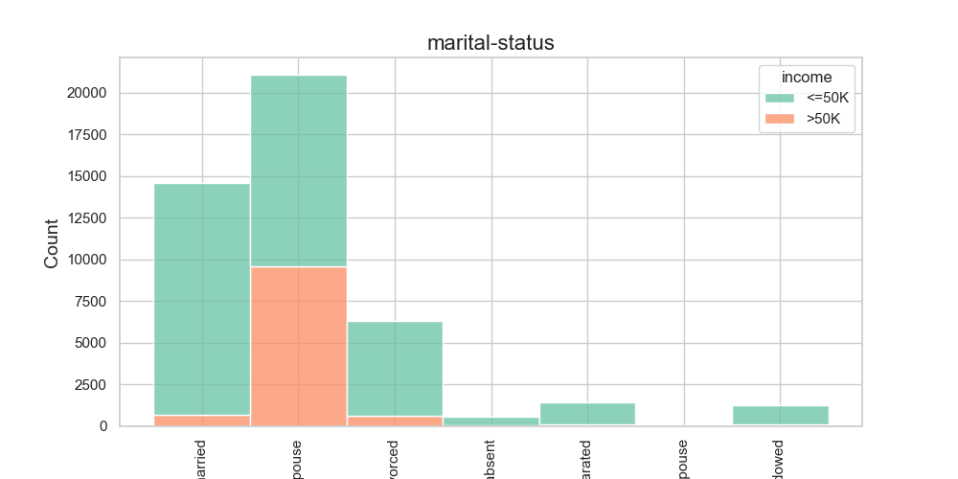
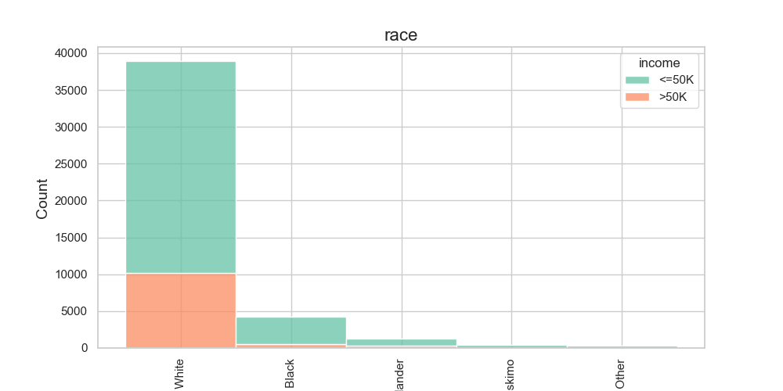
INCOME LEVELS FOR ALL CATEGORICAL VARIABLES

Slide 13
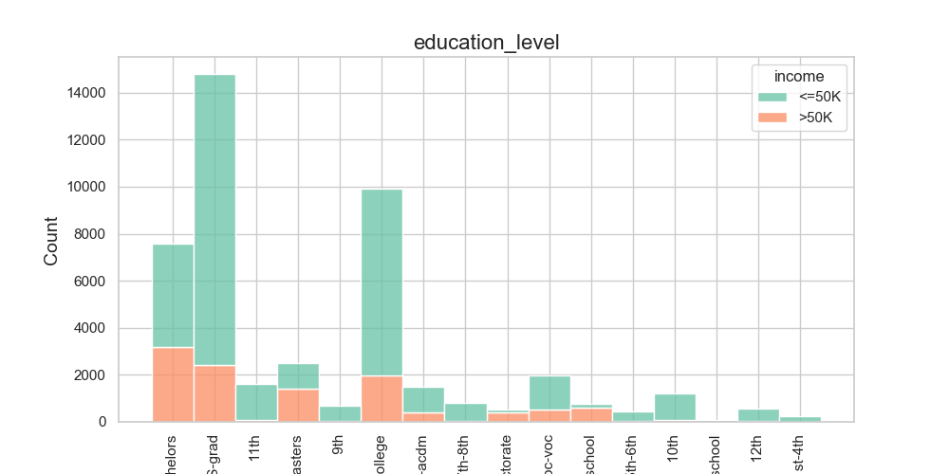
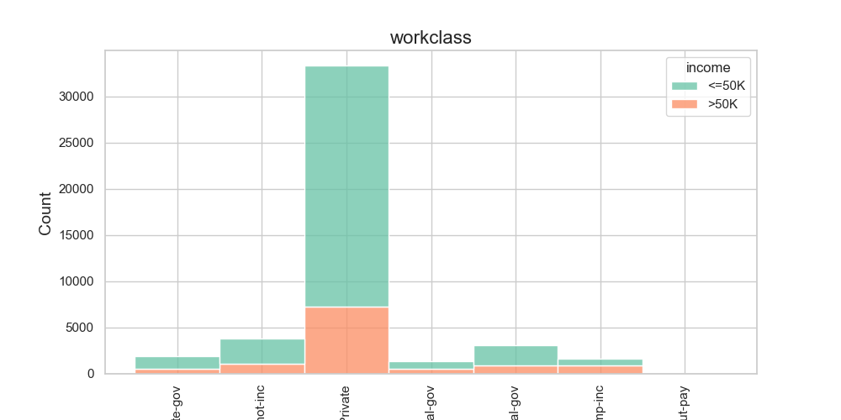
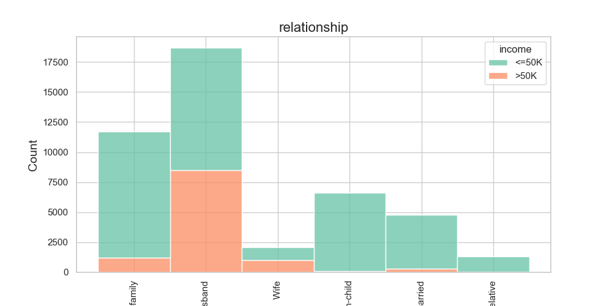
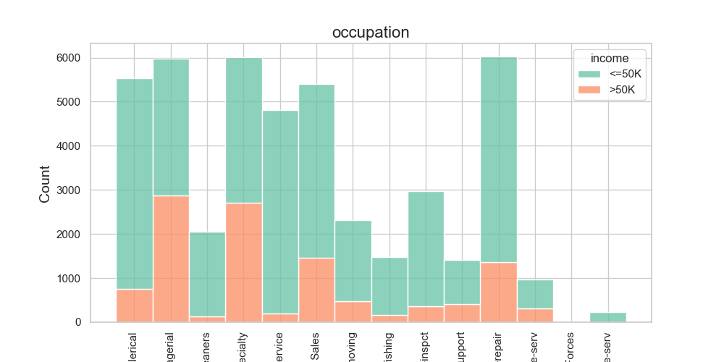

Slide 14
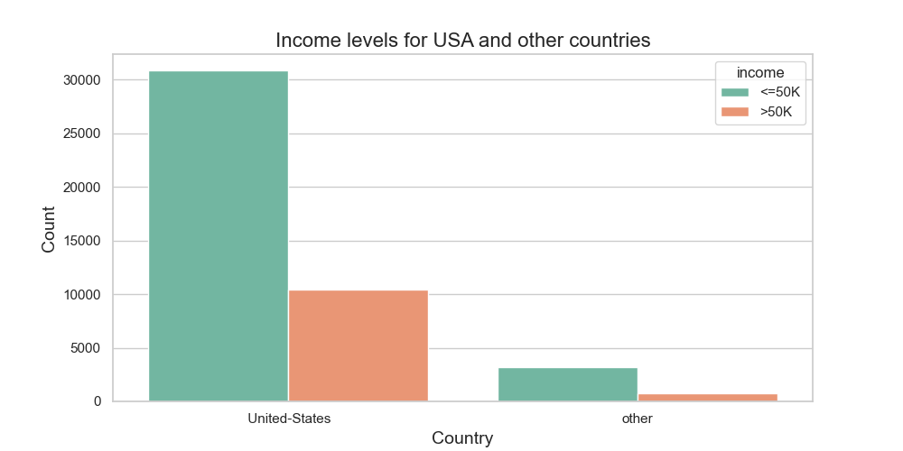
Income levels for USA and other countries

Slide 15
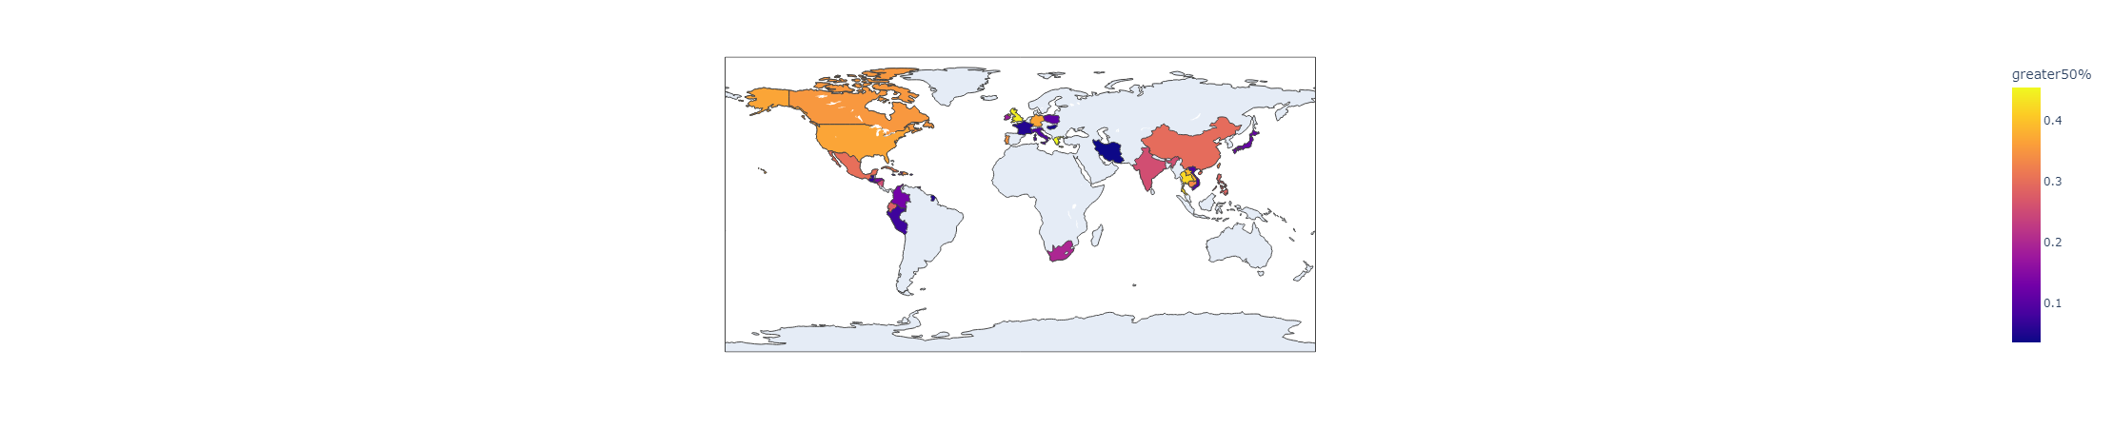

Slide 16
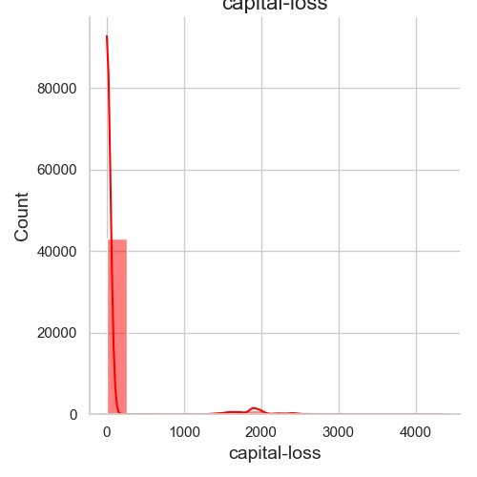
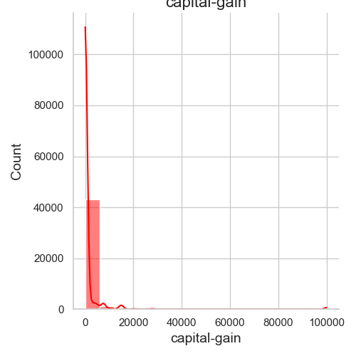
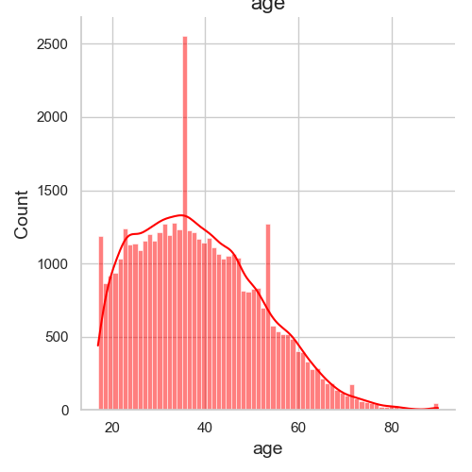
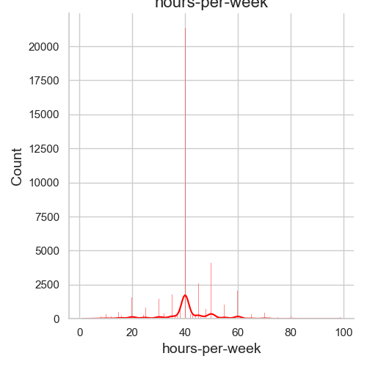
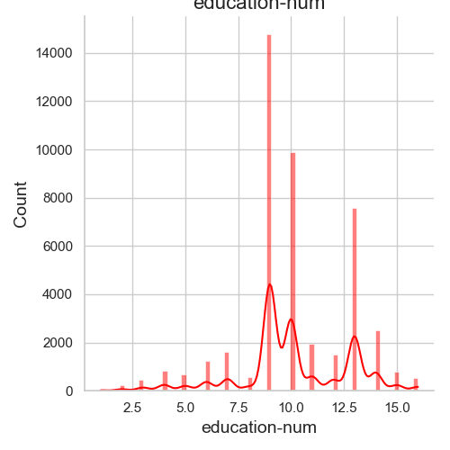
Numerical Columns Analysis

Slide 17
3-) Data Preparation
Log-transform the skewed features
Skewness indicates whether the data is concentrated on one side. If the mean is lower than the median it is left-skewed (negative skew). because outliers are to the left.
«Log transformation is a data transformation method in which it replaces each variable x with a log(x).
The most popular among the different types of transformations used to transform skewed data to approximately conform to normality.»
Normalizing numerical features
«Normalization typically means rescaling the values into a range of [0,1]
It aims to reduce the weight of higher numbers
If we know a variable is significantly more important than the other we shouldn’t use normalization or standardization.»

Slide 18
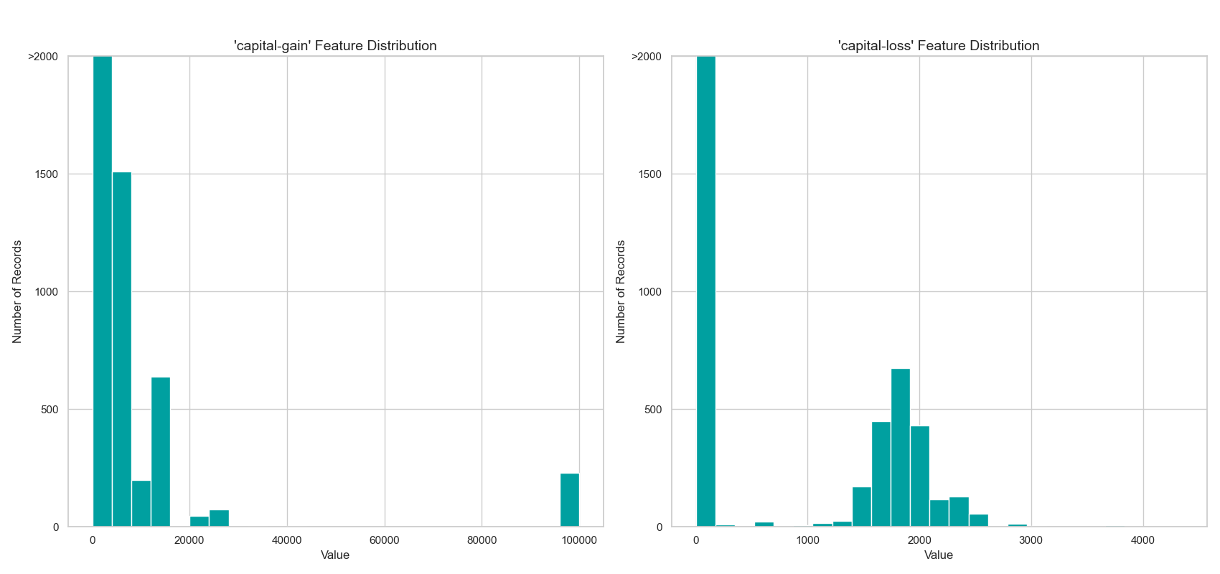
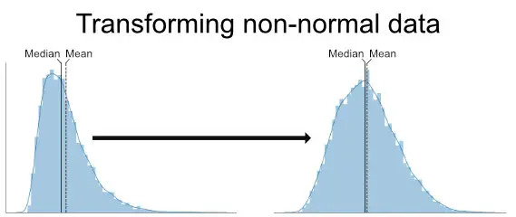
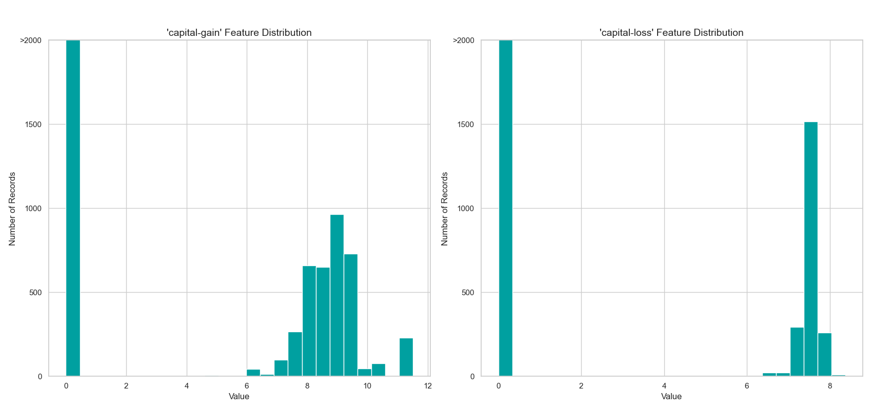
Transforming Skewed Continuous Features

Slide 19
4-) Data Preprocessing
one-hot-encoding: It converts categorical variables into numerical ones by creating a «dummy» variable for each possible category of its non-numeric features.
encoding: Encode the 'income_raw' data to numerical values. If income is greater than $50.000 it is equal to 1, otherwise it is equal to 0.
103 total features after one-hot encoding.

Slide 20
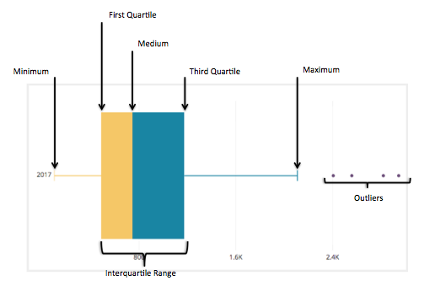
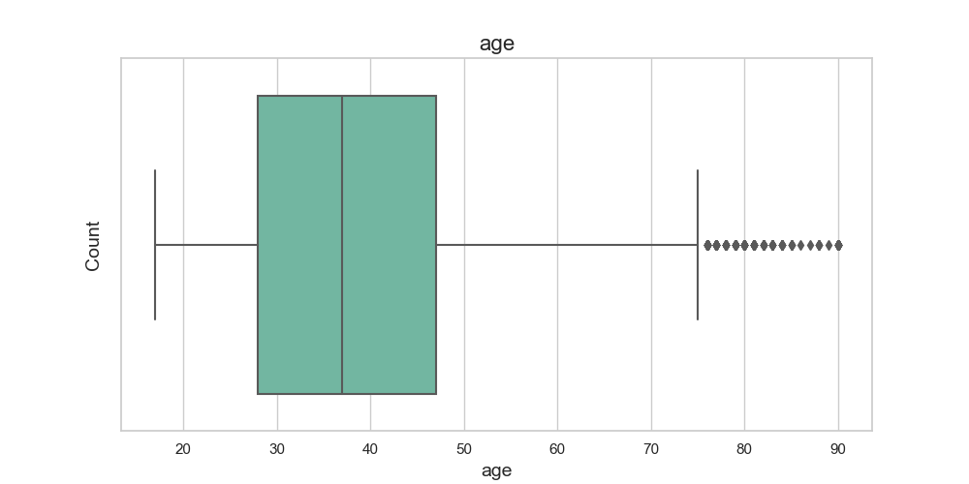
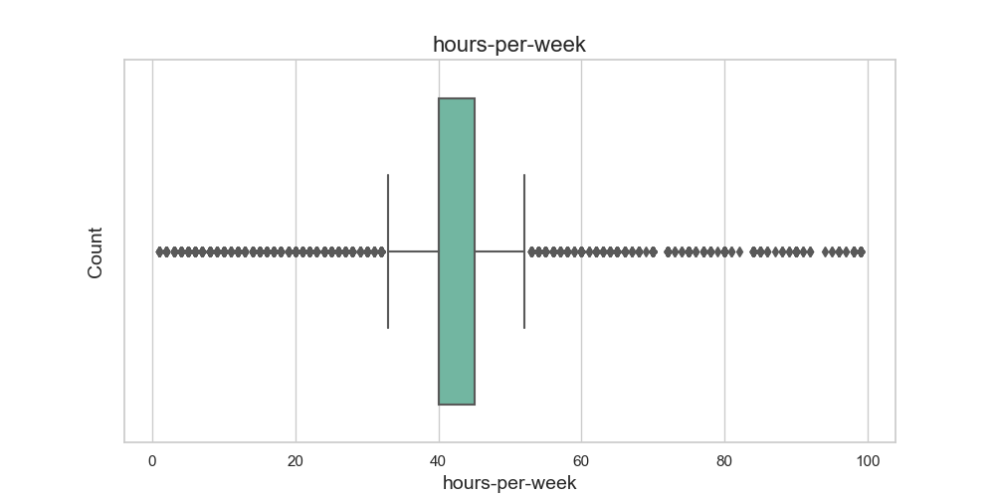
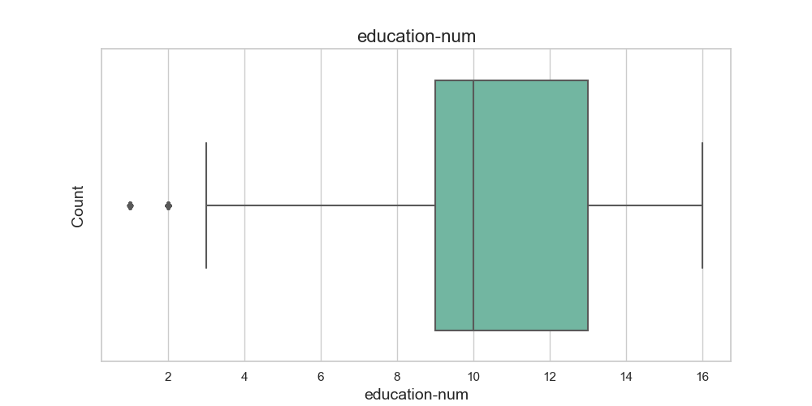
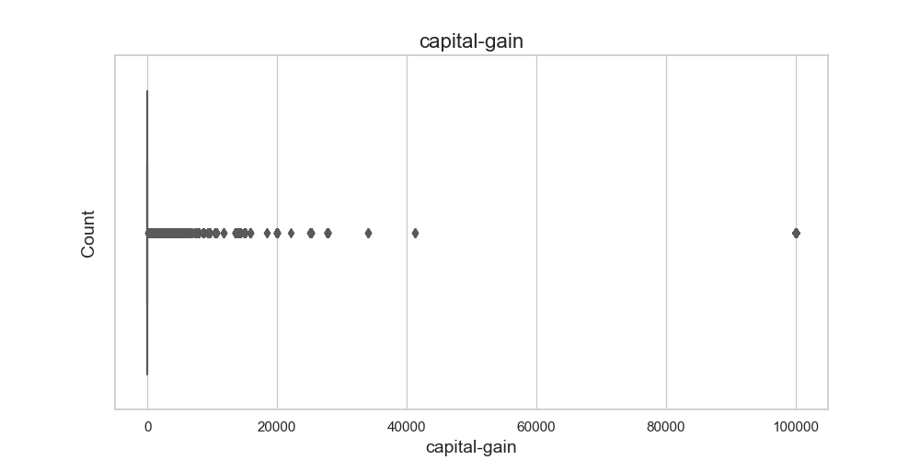
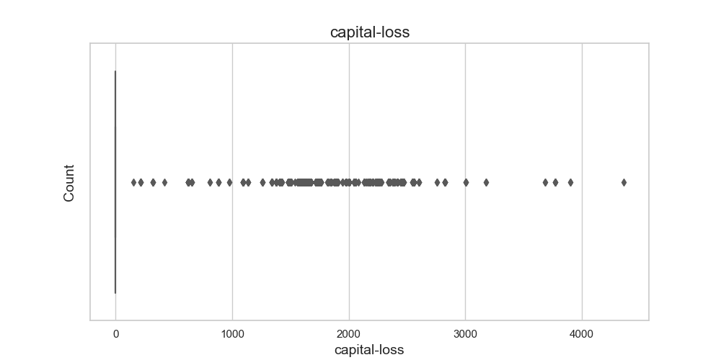
Outlier Detectionn

Slide 21
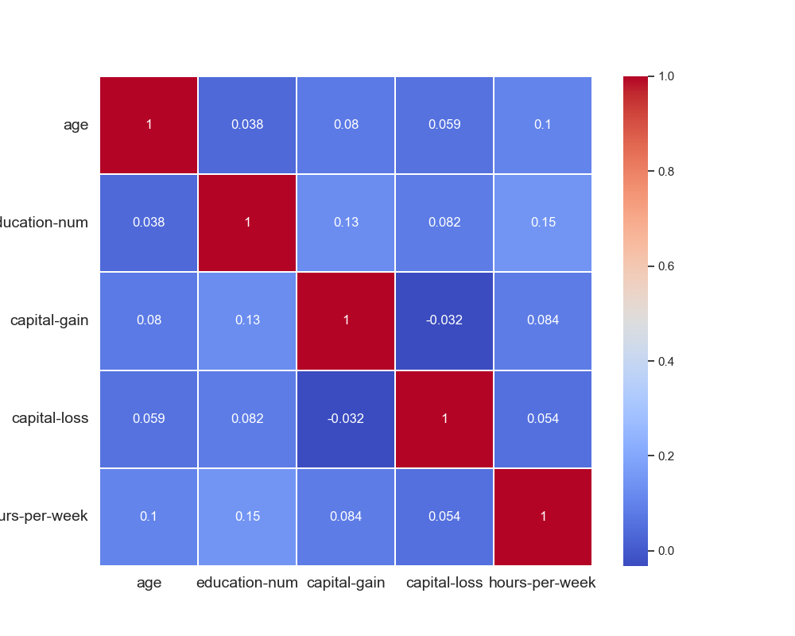
Correlation Matrix

Slide 22
5-) Shuffle and Split Data
80% of the data will be used for training and 20% for testing.
Training set has 36177 samples. Testing set has 9045 samples.

Slide 23
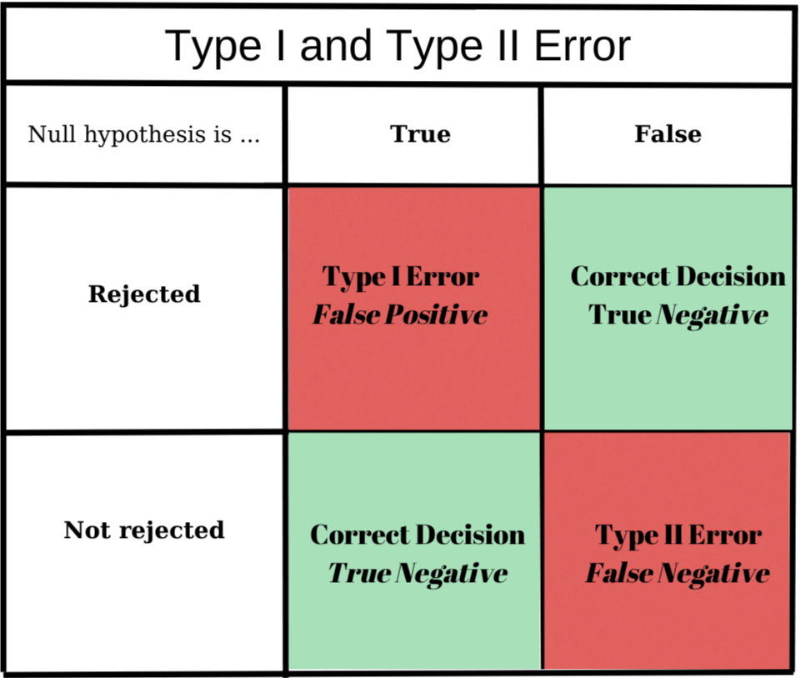
Recall – Precision – F1 Score - Accuraccy
Precision
Of all positive predictions,
how many are really positive?
TP/(TP+FP)
Recall
Of all real positive cases,
how many are predicted positive?
TP/(TP+FN)
Accuraccy
Of all predictions,
How many are true?
(TP+TN) /(TP+TN+FP+FN)
F-beta score
The weighted harmonic mean of precision and recall
F_{ß} = (1 + ß²) * (precision * recall) / (ß² * precision) + recall

Slide 24
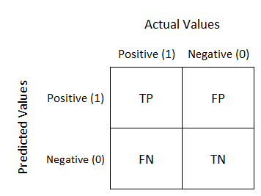
F0.5 score ( ß = 0.5): Such a beta makes a Precision value more important than a Recall one. It focuses on minimizing False Positives than minimizing False Negatives.
F1 score (ß = 1): True harmonic mean of Precision and Recall. In the best-case scenario, if Precision and Recall are equal to 1, the F-1 score will also be equal to 1.
F2 score (ß = 2): Such a beta makes a Recall value more important than a Precision one. It focuses on minimizing False Negatives than minimizing False Positives.
Predicted more than $50.000
Actually more than $50.000
Predicted more than $50.000
Actually less than $50.000
Predicted less than $50.000
Actually less than $50.000
Predicted less than $50.000
Actually more than $50.000

Slide 25

6-) Evaluating Model Performance
Naive Predictor [Accuracy score: 0.2478, F-score: 0.2917]
The F-beta score is the weighted harmonic mean of precision and recall, reaching its optimal value at 1 and its worst value at 0.
«A naive classifier model is one that does not use any sophistication (the quality of being complicated or made with great skill) in order to make a prediction, typically making a random or constant prediction. Such models are naive because they don't use any knowledge about the domain or any learning in order to make a prediction.»
Supervised Learning Models (Model Application)
Decision Trees
Support Vector Machines (SVM)
Ensemble methods: AdaBoost
Model Evaluation

Slide 26
Decision Trees
Support Vector Machines (SVM)
AdaBoost

Slide 27
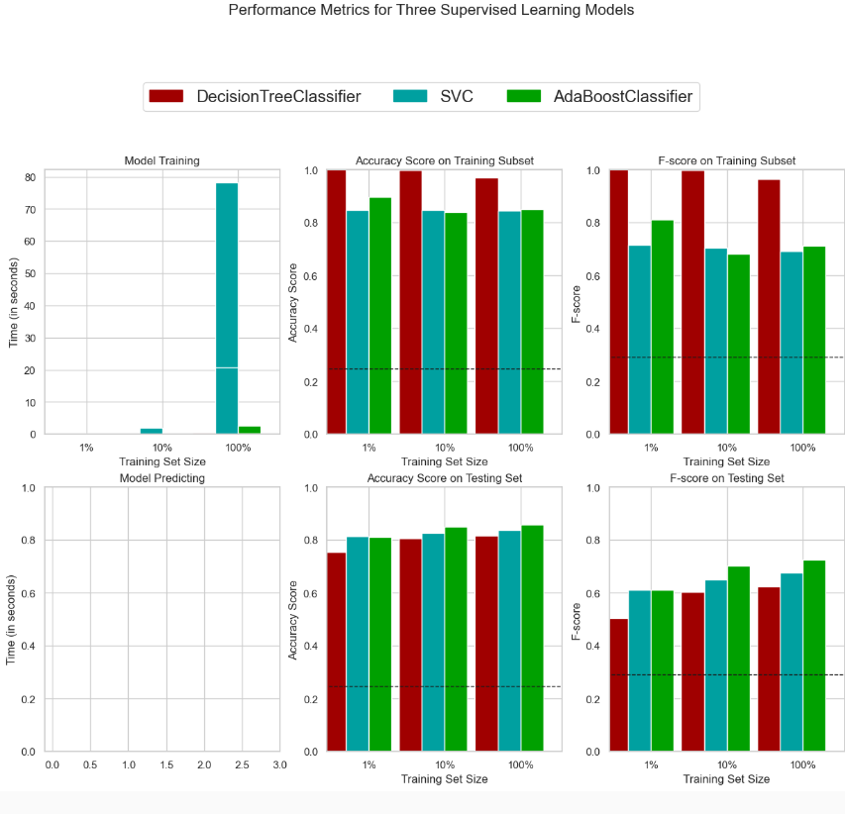

Slide 28
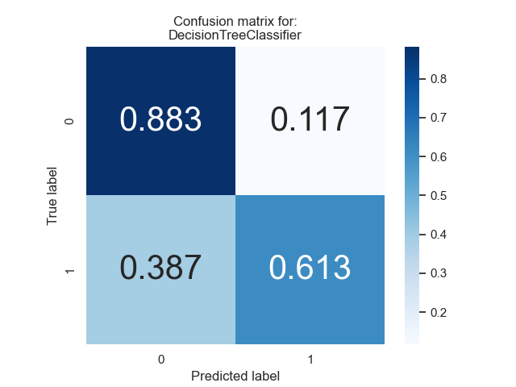
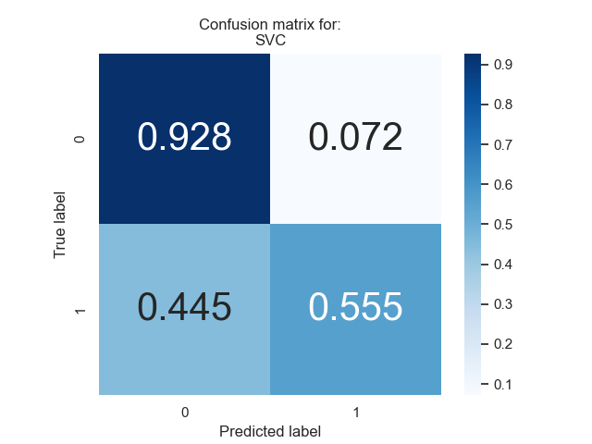


Slide 29
7-) Model Tuning
Final Model Evaluation
Metric | Benchmark Predictor | Unoptimized Model | Optimized Model
Accuracy Score | 0.2478 | 0.8398 | 0.8680
F-score | 0.2917 | 0.6745 | 0.7498

Slide 30
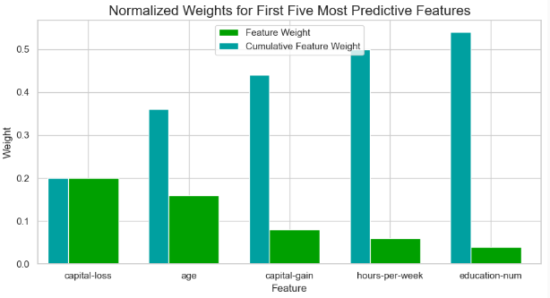
8-) Feature Importance

Slide 31
9-) Feature Selection

Slide 32
10-) References
https://cseweb.ucsd.edu/classes/sp15/cse190-c/reports/sp15/048.pdf
https://www.ncbi.nlm.nih.gov/pmc/articles/PMC4120293/#:~:text=The%20log%20transformation%20is%2C%20arguably,normal%20or%20near%20normal%20distribution.
https://machinelearningmastery.com/how-to-develop-and-evaluate-naive-classifier-strategies-using-probability/#:~:text=A%20naive%20classifier%20model%20is,order%20to%20make%20a%20prediction.

