Slide 1

Finding Donors
Başak Dilara Çevik
Original Author: Sajal Sharma
Project Link: GitHub

Slide 2

MIT License
Copyright (c) 2017 Sajal Sharma
Permission is hereby granted, free of charge, to any person obtaining a copy of this software and associated documentation files (the "Software"), to deal in the Software without restriction, including without limitation the rights to use, copy, modify, merge, publish, distribute, sublicense, and/or sell copies of the Software, and to permit persons to whom the Software is furnished to do so, subject to the following conditions:
The above copyright notice and this permission notice shall be included in all copies or substantial portions of the Software.
THE SOFTWARE IS PROVIDED "AS IS", WITHOUT WARRANTY OF ANY KIND, EXPRESS OR IMPLIED, INCLUDING BUT NOT LIMITED TO THE WARRANTIES OF MERCHANTABILITY, FITNESS FOR A PARTICULAR PURPOSE AND NONINFRINGEMENT. IN NO EVENT SHALL THE AUTHORS OR COPYRIGHT HOLDERS BE LIABLE FOR ANY CLAIM, DAMAGES OR OTHER LIABILITY, WHETHER IN AN ACTION OF CONTRACT, TORT OR OTHERWISE, ARISING FROM, OUT OF OR IN CONNECTION WITH THE SOFTWARE OR THE USE OR OTHER DEALINGS IN THE SOFTWARE.

Slide 3
1-) Loading the necessary libraries
2-) Project & Data Exploration
3-) Data Preparation
4-) Data Preprocessing
5-) Shuffle and Split Data
6-) Evaluating Model Performance
7-) Model Tuning
8-) Feature Importance
9-) Feature Selection
10-) References

Slide 4
1-) Loading the necessary libraries
numpy:
pandas:
time:
IPython.display:
visuals:
seaborn:
matplotlib.pyplot:

Slide 5
2-) Project & Data Exploration
Dataset
The dataset was donated by Ron Kohavi and Barry Becker, after being published in the article "Scaling Up the Accuracy of Naive-Bayes Classifiers: A Decision-Tree Hybrid".
Project Goal
Income Distribution
Education Levels

Slide 6
Dataset
Dua, D. and Graff, C. (2019). UCI Machine Learning Repository [http://archive.ics.uci.edu/ml]. Irvine, CA: University of California, School of Information and Computer Science
age: the age of an individual
Integer greater than 0. continuous
workclass: a general term to represent the employment status of an individual
Private, Self-emp-not-inc, Self-emp-inc, Federal-gov, Local-gov,
State-gov, Without-pay, Never-worked.
education: the highest level of education achieved by an individual.
Bachelors, Some-college, 11th, HS-grad, Prof-school, Assoc-acdm, Assoc-voc, 9th, 7th-8th, 12th, Masters, 1st-4th, 10th, Doctorate, 5th-6th, Preschool.
education-num: the highest level of education achieved in numerical form. (continuous)
marital-status: marital status of an individual. Married­civ­spouse corresponds to a civilian spouse while Married­AF­spouse is a spouse in the Armed Forces.
Married-civ-spouse, Divorced, Never-married, Separated, Widowed, Married-spouse-absent, Married-AF-spouse.
sex: the biological sex of the individual.
Female, Male.
occupation: the general type of occupation of an individual.
Tech-support, Craft-repair, Other-service, Sales, Exec-managerial, Prof-specialty, Handlers-cleaners, Machine-op-inspct, Adm-clerical, Farming-fishing, Transport-moving, Priv-house-serv, Protective-serv, Armed-Forces.
relationship: represents what this individual is relative to others.
Wife, Own-child, Husband, Not-in-family, Other-relative, Unmarried.
race: descriptions of an individual’s race.
White, Asian-Pac-Islander, Amer-Indian-Eskimo, Other, Black.
capital-gain: capital gains for an individual. (continuous)
capital-loss: capital loss for an individual. (continuous)
hours-per-week: the hours an individual has reported to work per week. (continuous)
native-country: country of origin for an individual.
United-States, Cambodia, England, Puerto-Rico, Canada, Germany, Outlying-US(Guam-USVI-etc), India, Japan, Greece, South, China, Cuba, Iran, Honduras, Philippines, Italy, Poland, Jamaica, Vietnam, Mexico, Portugal, Ireland, France, Dominican-Republic, Laos, Ecuador, Taiwan, Haiti, Columbia, Hungary, Guatemala, Nicaragua, Scotland, Thailand, Yugoslavia, El-Salvador, Trinadad&Tobago, Peru, Hong, Holand-Netherlands.
income: whether an individual makes more than $50,000 annually.
<=50K, >50K.

Slide 7
Project Goal
The goal of this project is to predict if an individual makes over than $50.000 a year according to data collected from the 1994 U.S. Census.
This implementation aims to construct a model for an accurate prediction.
It could be beneficial for donations in a non-profit setting.

Slide 8
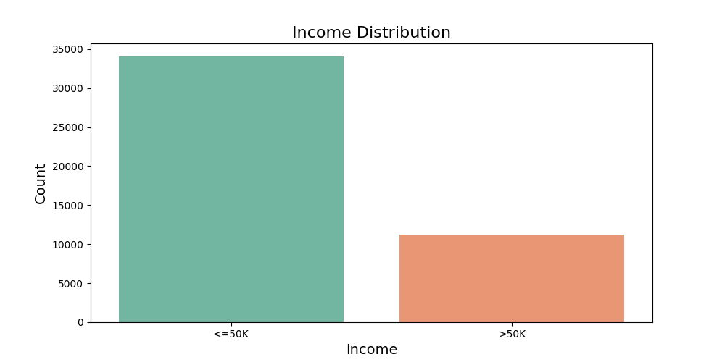
The number of people with income less than or equal to 50K is higher than the number of people with income more than 50K.

Slide 9
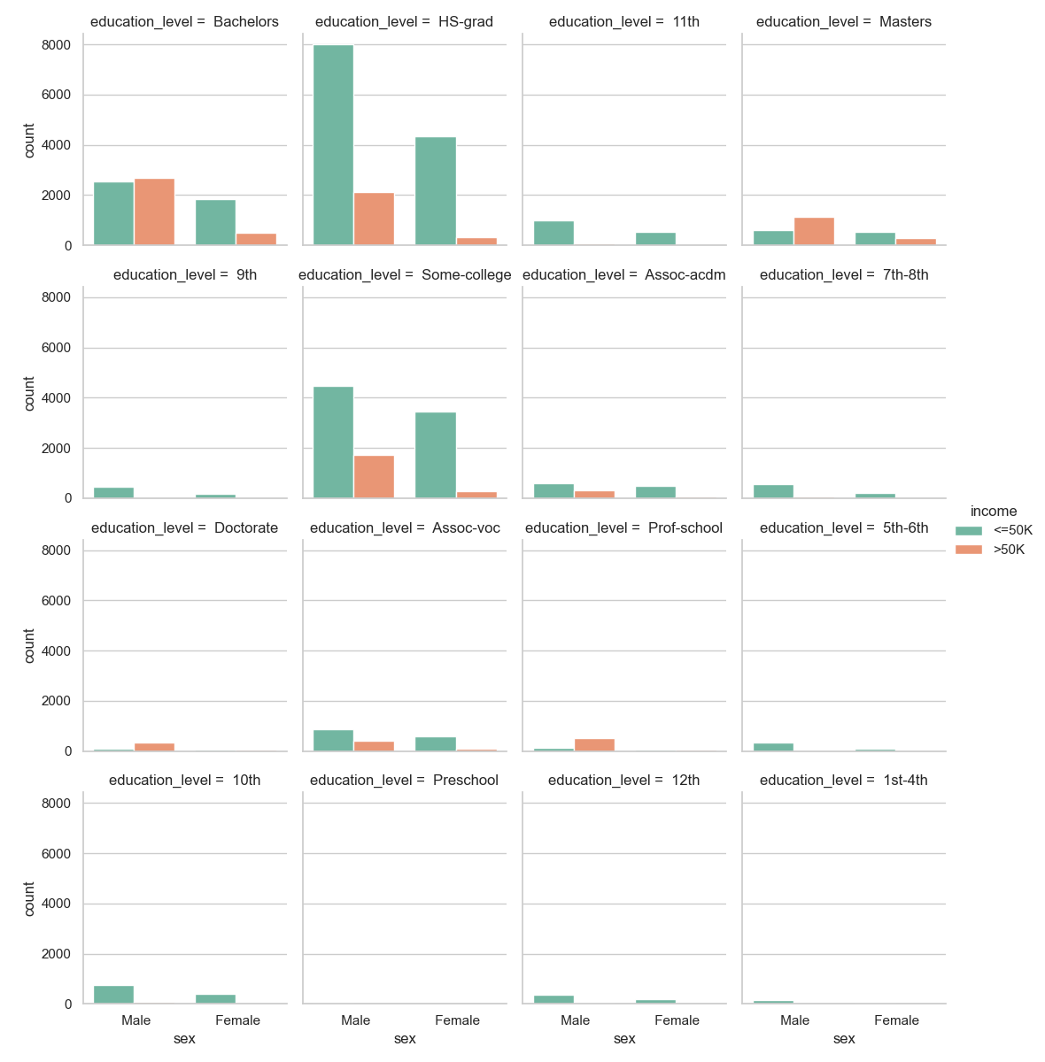

Slide 10
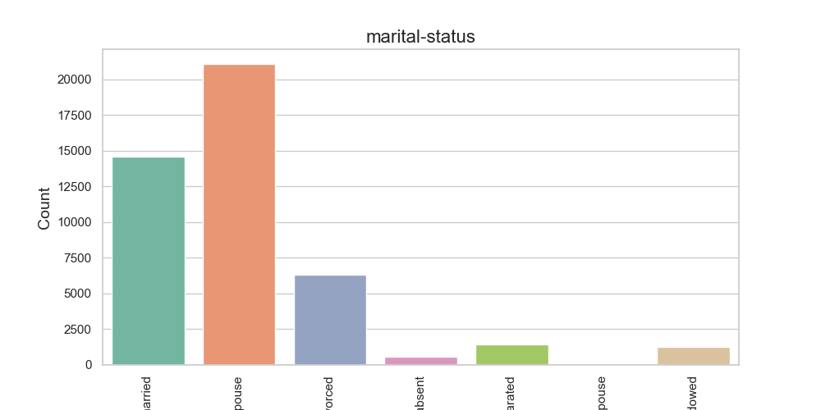
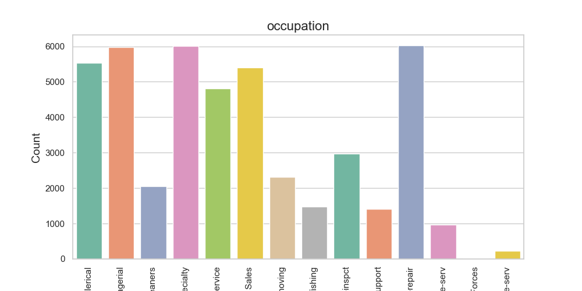
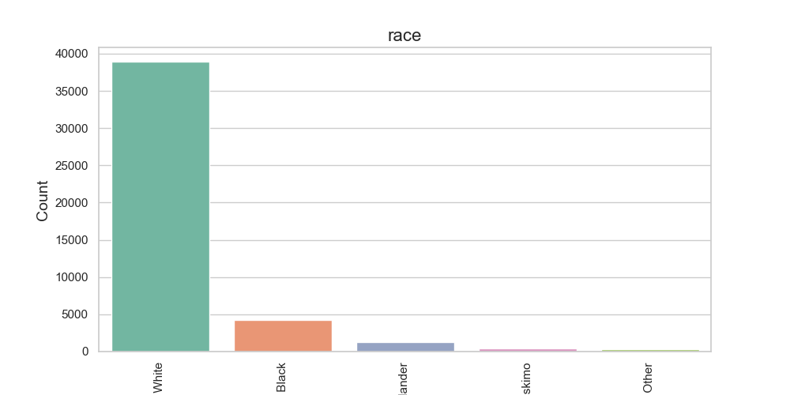
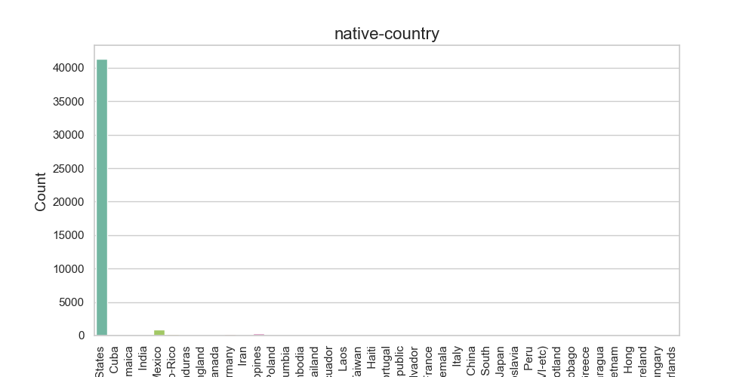

Slide 11
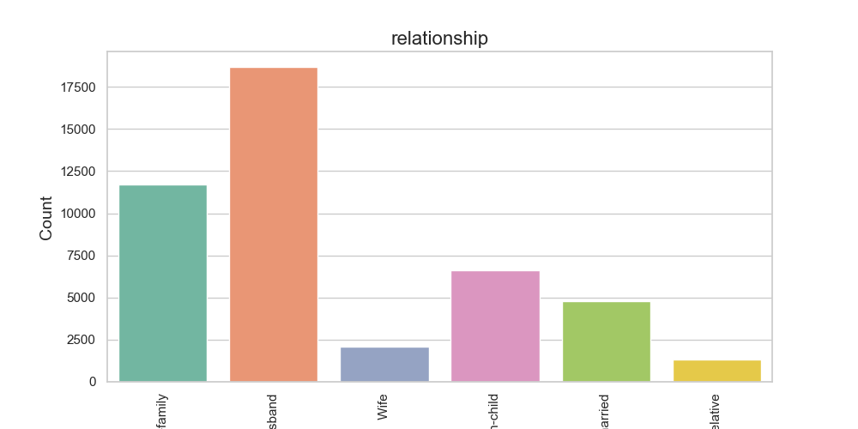
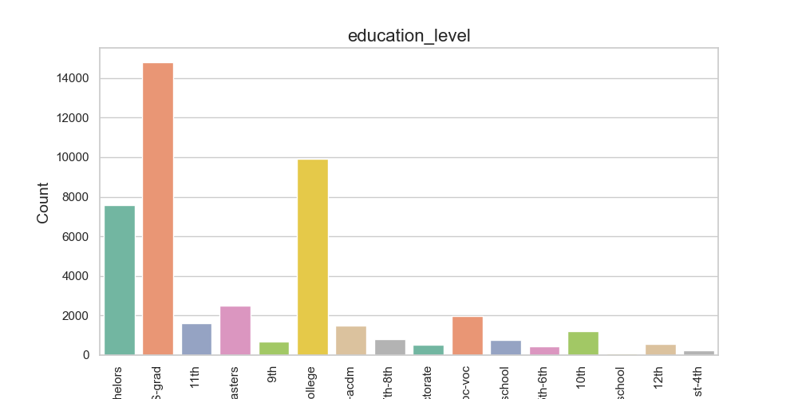
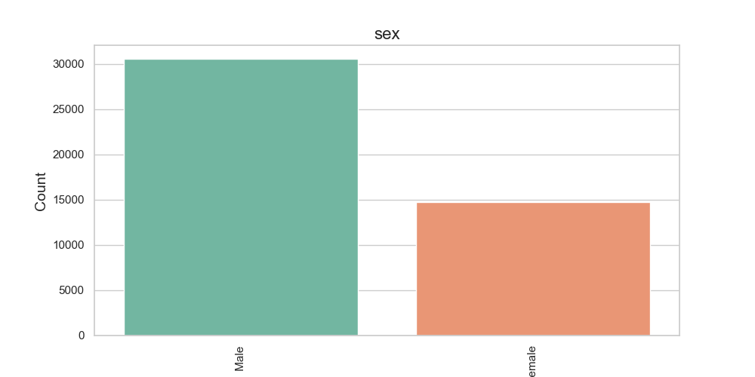
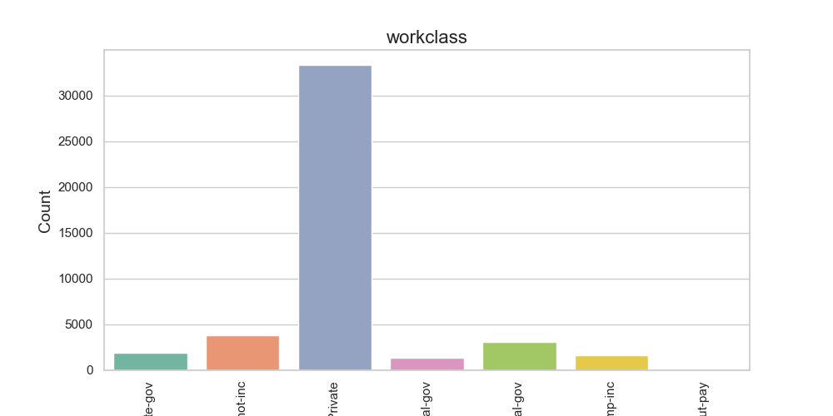

Slide 12
3-) Data Preparation
Log-transform the skewed features
Skewness indicates whether the data is concentrated on one side. If the mean is lower than the median it is left-skewed (negative skew). because outliers are to the left.
«Log transformation is a data transformation method in which it replaces each variable x with a log(x).
The most popular among the different types of transformations used to transform skewed data to approximately conform to normality.»
Normalizing numerical features
«Normalization typically means rescaling the values into a range of [0,1]
It aims to reduce the weight of higher numbers
If we know a variable is significantly more important than the other we shouldn’t use normalization or standardization.»

Slide 13
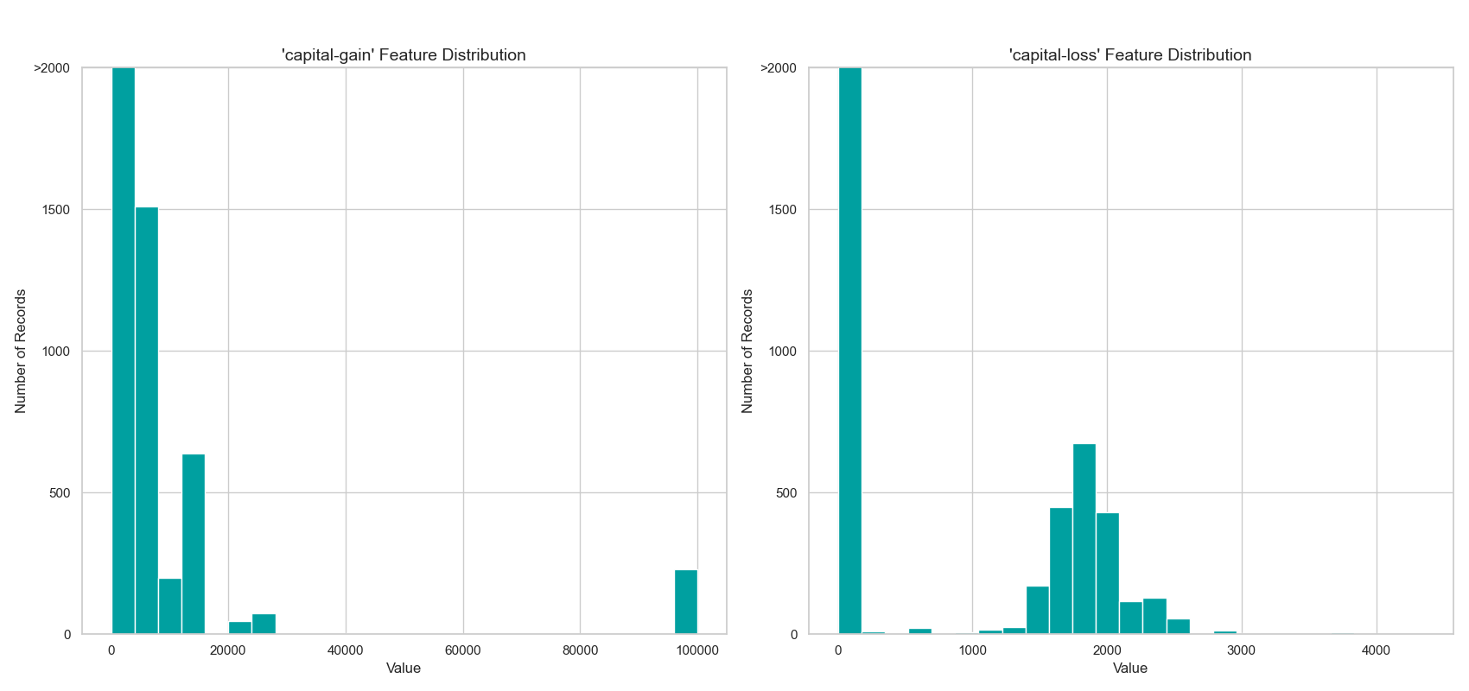
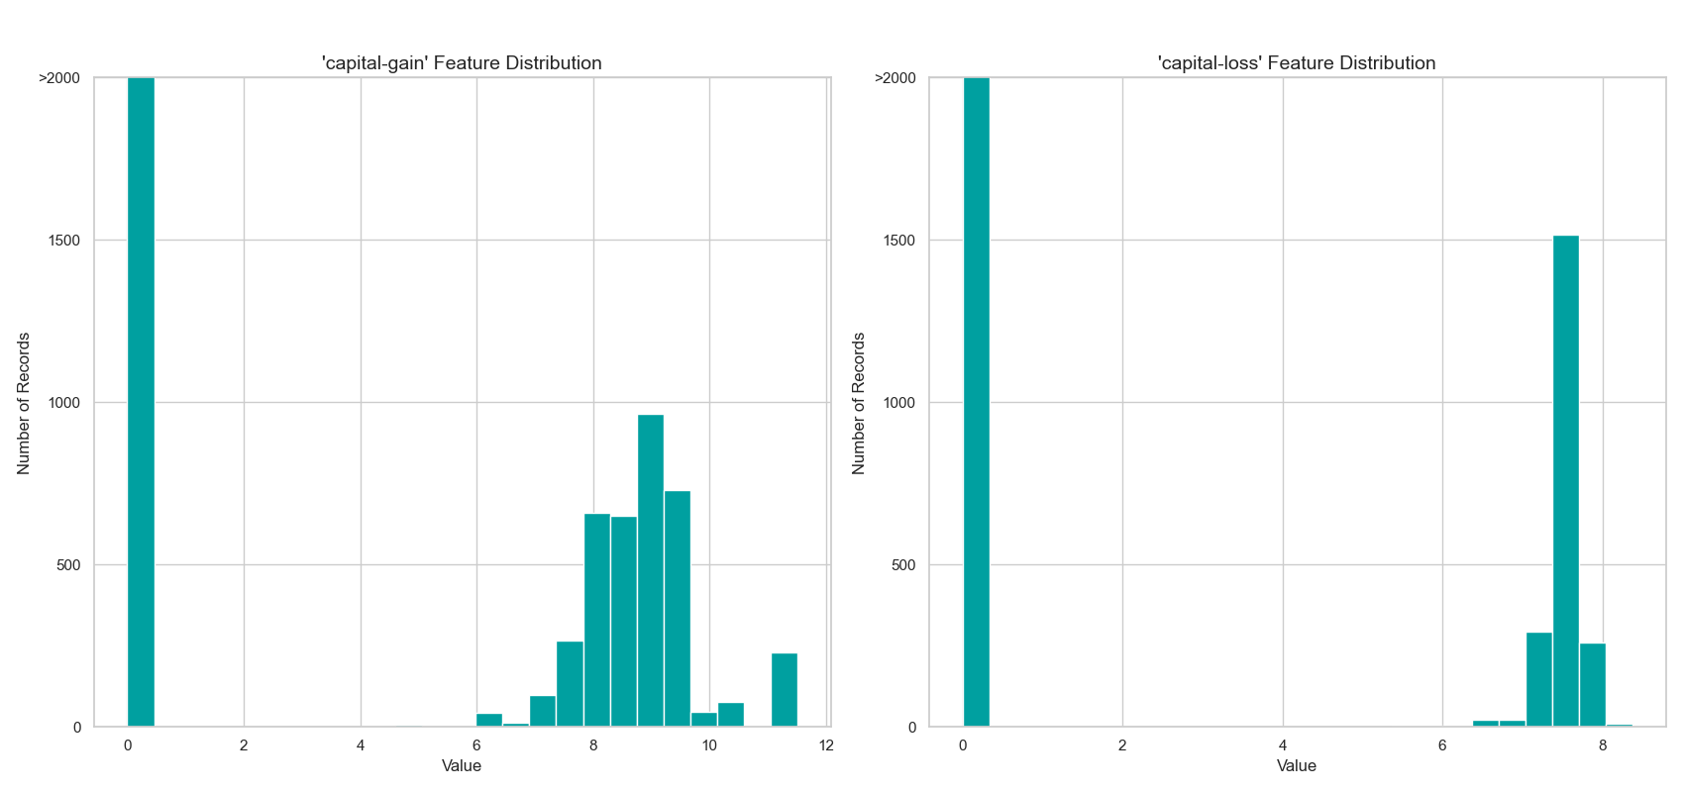

Slide 14
(' Federal-gov', '<=50K') 857
-----------------------
(' Federal-gov', '>50K') 549
-----------------------
(' Local-gov', '<=50K') 2185
-----------------------
(' Local-gov', '>50K') 915
-----------------------
(' Private', '<=50K') 26056
-----------------------
(' Private', '>50K') 7251
(' Self-emp-inc', '<=50K') 734
-----------------------
(' Self-emp-inc', '>50K') 912
-----------------------
(' Self-emp-not-inc', '<=50K') 2737
-----------------------
(' Self-emp-not-inc', '>50K') 1059
-----------------------
(' State-gov', '<=50K') 1426
-----------------------
(' State-gov', '>50K') 520
-----------------------
(' Without-pay', '<=50K') 19
-----------------------
(' Without-pay', '>50K') 2

Slide 15
4-) Data Preprocessing
one-hot-encoding: It converts categorical variables into numerical ones by creating a «dummy» variable for each possible category of its non-numeric features.
encoding: Encode the 'income_raw' data to numerical values. If income is greater than $50.000 it is equal to 1, otherwise it is equal to 0.
103 total features after one-hot encoding.

Slide 16
5-) Shuffle and Split Data
80% of the data will be used for training and 20% for testing.

Slide 17
6-) Evaluating Model Performance
Naive Predictor
Supervised Learning Models (Model Application)
Decision Trees
Support Vector Machines (SVM)
Ensemble methods: AdaBoost
Model Evaluation

Slide 18
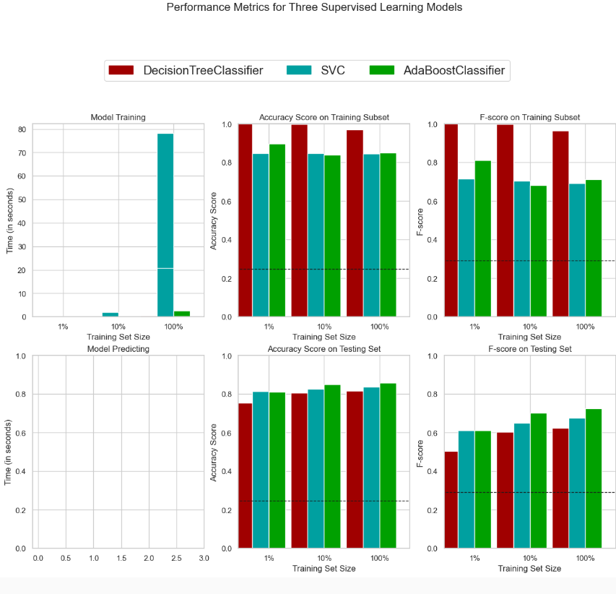

Slide 19
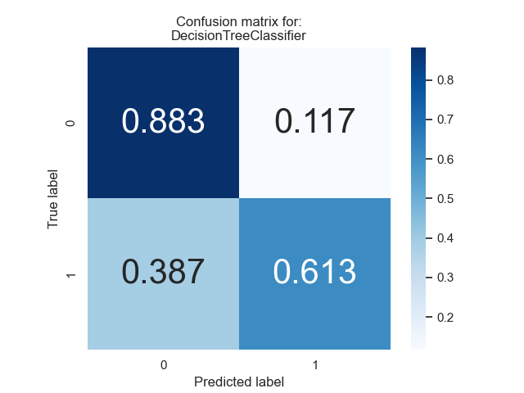
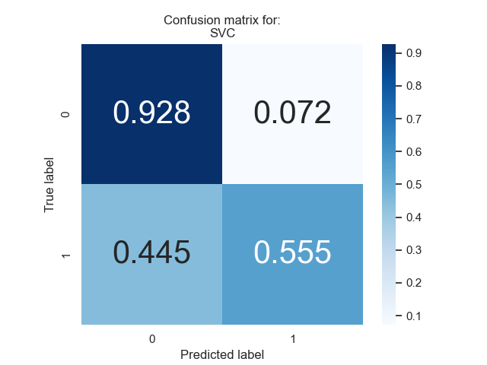


Slide 20
7-) Model Tuning
Final Model Evaluation

Slide 21
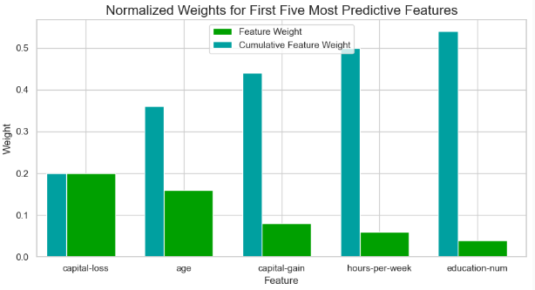
8-) Feature Importance

Slide 22
9-) Feature Selection

Slide 23
10-) References
1-)
2-) https://www.ncbi.nlm.nih.gov/pmc/articles/PMC4120293/#:~:text=The%20log%20transformation%20is%2C%20arguably,normal%20or%20near%20normal%20distribution.

