Slide 1
Robotics Studio MECE 4611 Fall 2021, Assignment 1
William Xie
wx2214
Submission Date:
Grace Hours Used:

Slide 2
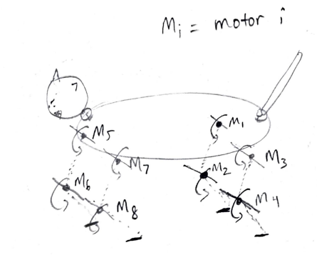
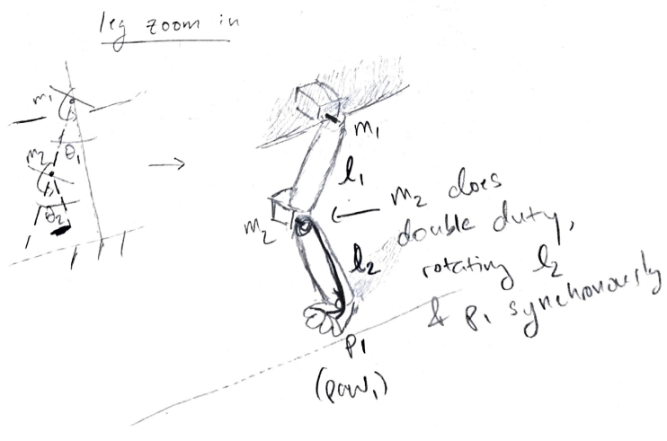
Concept 1 - Little Kitten

Slide 3
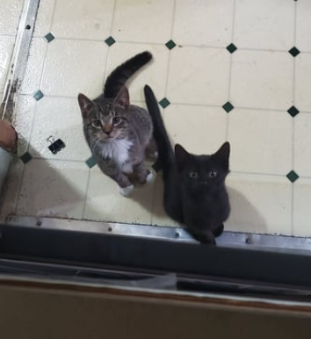
Concept 1 - Inspiration
My cats, when they were kittens. I want to make a friend for them!
They would probably hate this robot.

Slide 4
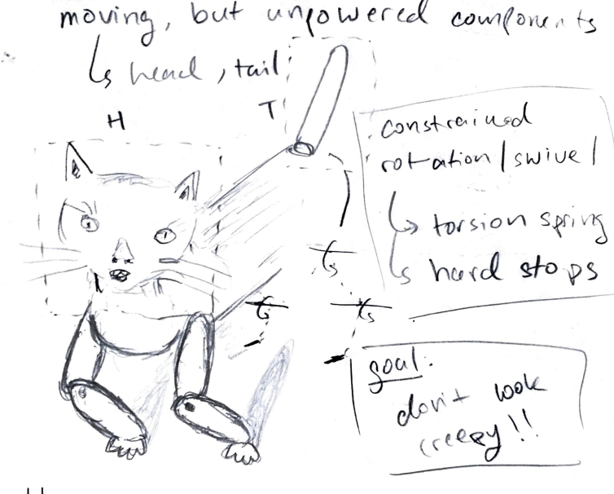
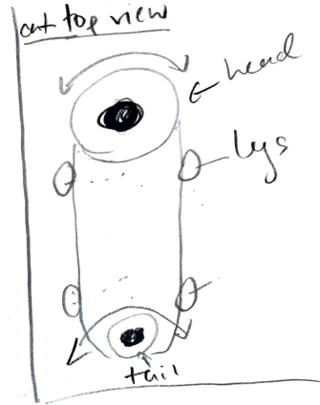
Concept 1
This face looks really creepy, so I already failed to achieve my goals.

Slide 5
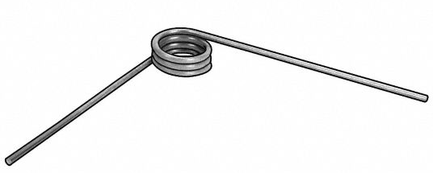

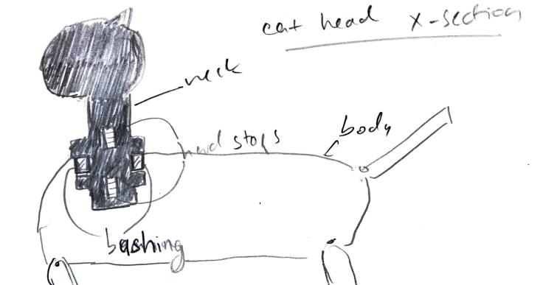
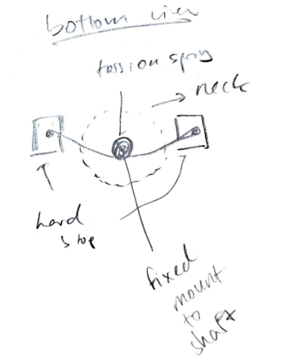
Concept 1 – Passive Joints

Slide 6
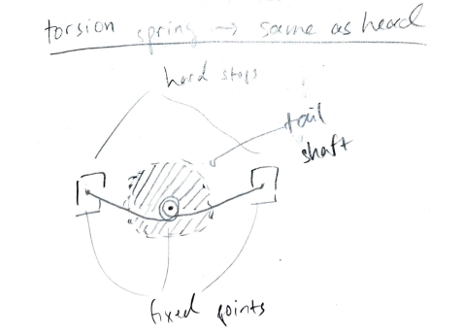

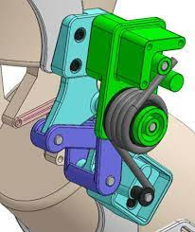
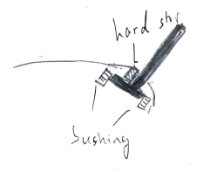
Concept 1
“Passive knee exoskeleton using torsion spring for cycling assistance”, Chaichaowarat et al. (2017)

Slide 7
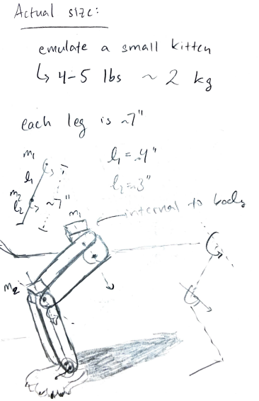

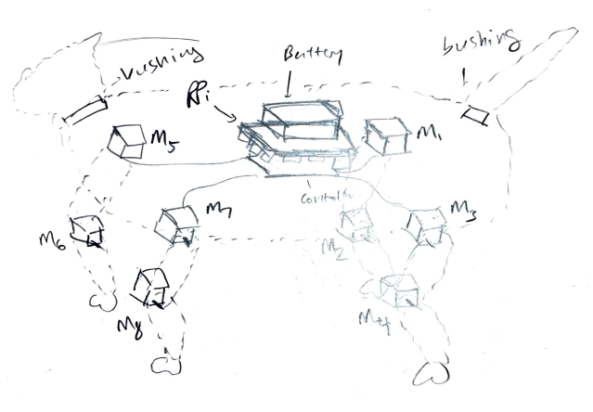
Concept 1

Slide 8
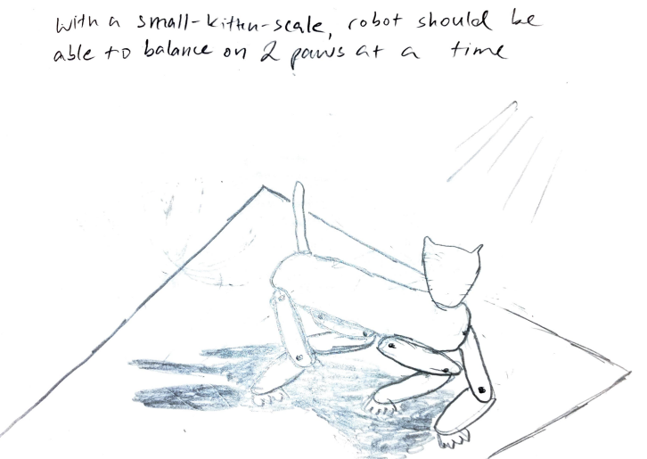
Concept 1

Slide 9
Concept 2 – Unfolding Ball/Egg

Slide 10
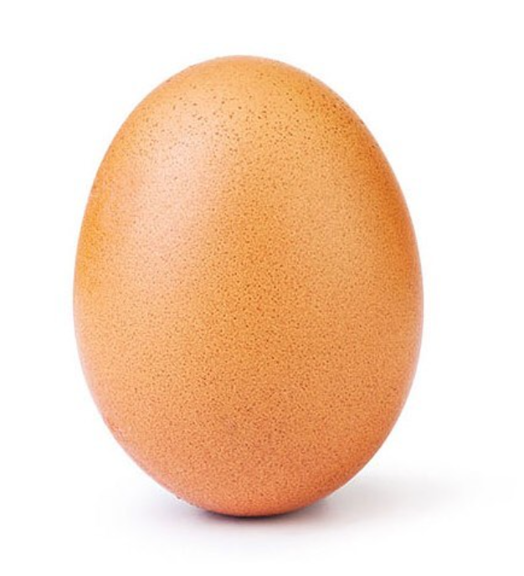
Concept 2

Slide 11
Concept 3 – UFO / Flying Saucer

Slide 12
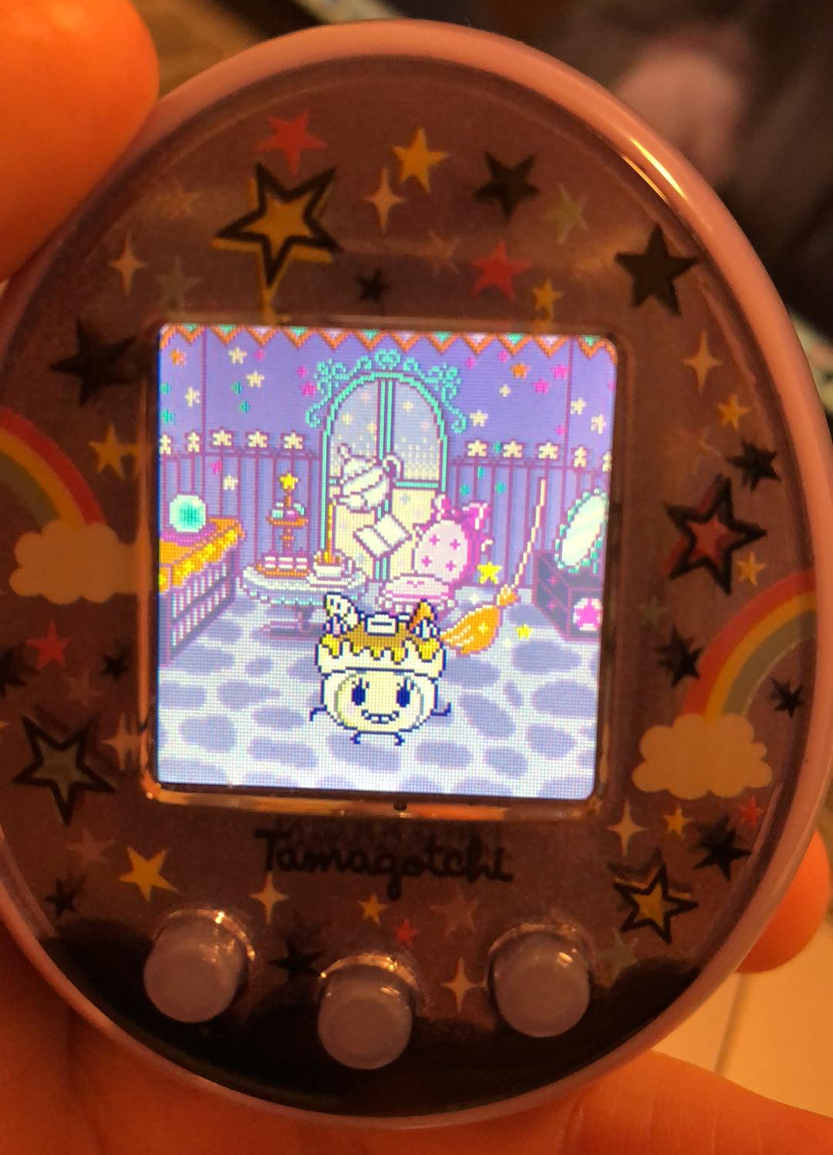
Concept 4 – Tamagotchi

Slide 13
References
R. Chaichaowarat, D. F. P. Granados, J. Kinugawa and K. Kosuge, "Passive knee exoskeleton using torsion spring for cycling assistance," 2017 IEEE/RSJ International Conference on Intelligent Robots and Systems (IROS), 2017, pp. 3069-3074, doi: 10.1109/IROS.2017.8206146.

