Slide 1
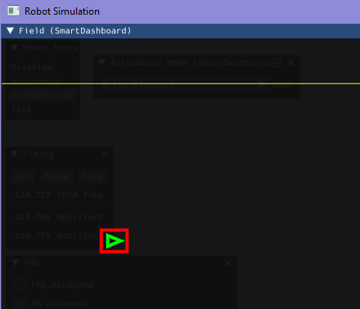


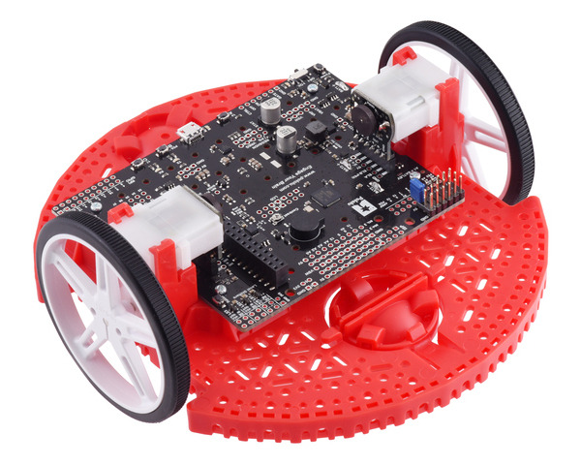
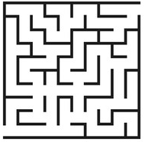
S1-4
1. Prompt Description
2. AI Generated Code
3. Manual Modification
S5-8
S9-12

Slide 2


