Slide 1
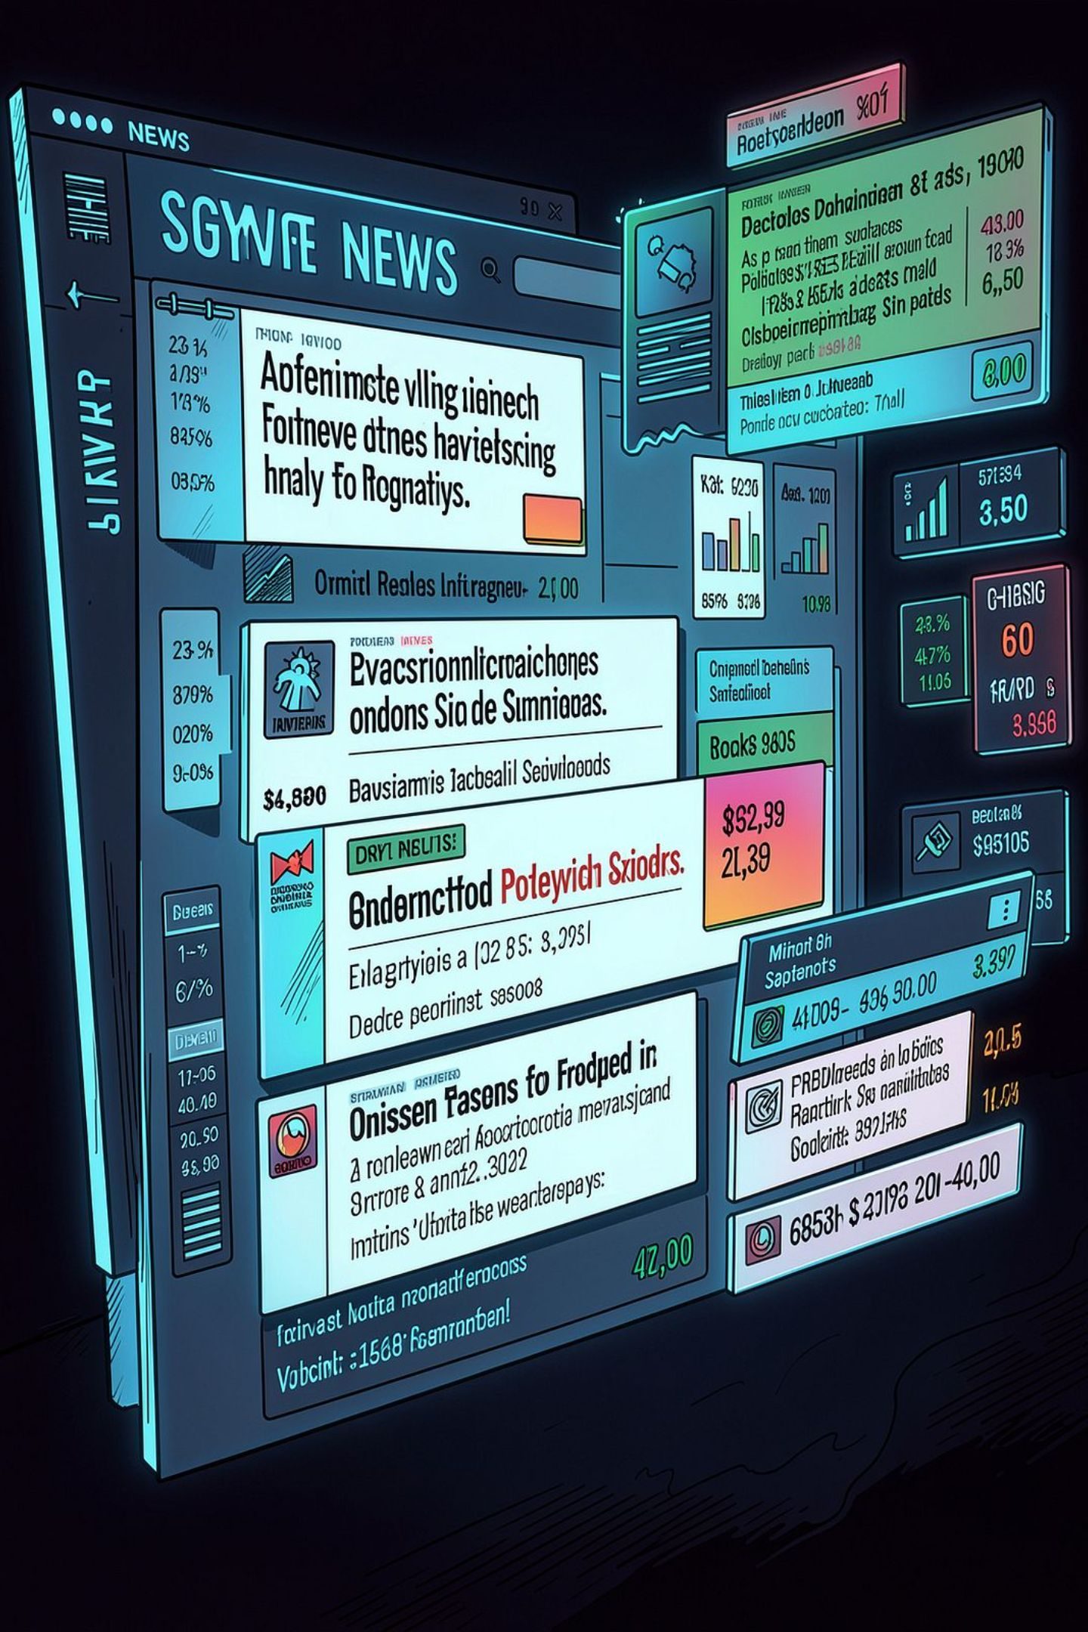
Automated News Article Classification
A system powered by Natural Language Processing and Machine Learning — transforming how digital media platforms organize, manage, and deliver news content at scale.

Slide 2

The Challenge: News at Scale
Digital news platforms publish thousands of articles daily. Manual categorization cannot keep pace — creating bottlenecks, inconsistencies, and lost editorial efficiency.
Manual Categorization
Editors spend hours tagging articles by hand, slowing publication and introducing inconsistency.
Inconsistent Classification
Subjective human tagging produces unreliable category assignments across teams.
Delayed Organization
Articles go live without proper categorization, hurting discoverability and user experience.
Scaling Effort
As content volume grows, administrative overhead increases without intelligent automation.

Slide 3

Introducing the Solution
An end-to-end Automated News Classification System that uses NLP and machine learning to categorize articles into predefined topics — accurately, consistently, and at scale.
Article Collection
Text Preprocessing
Feature Extraction
ML Classification
Content Management
The system analyzes headlines, body text, and contextual signals to assign each article to one of eight categories: Politics, Sports, Business, Entertainment, Technology, Health, Education, and Science.

Slide 4
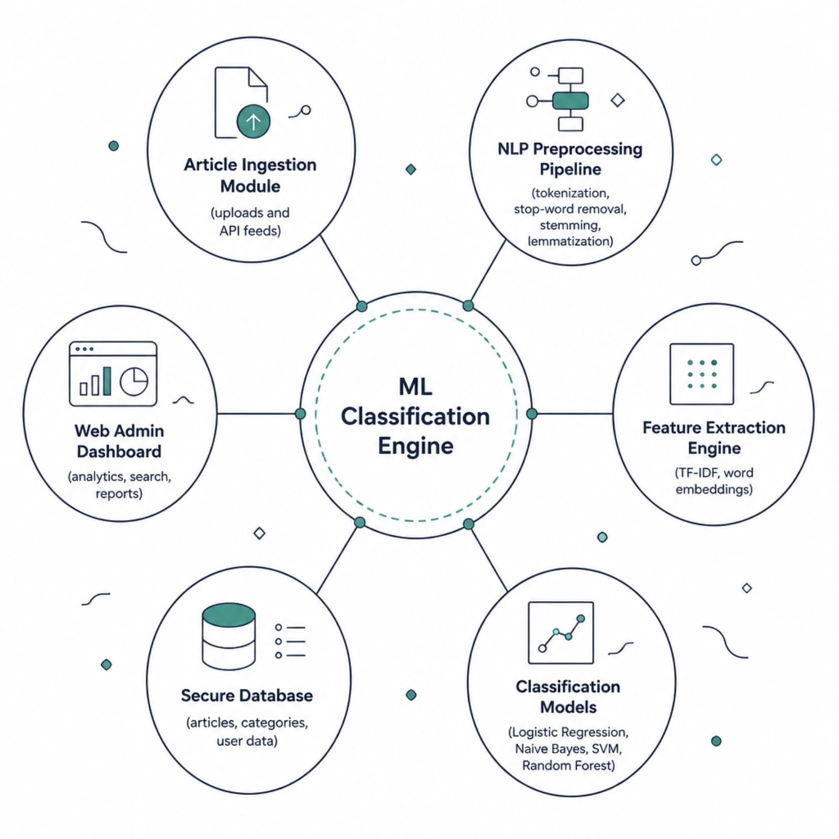
System Architecture
How It Works
Articles enter through ingestion, flow through the NLP preprocessing and feature extraction pipeline, then pass to the classification engine. Results are stored in a secure database and surfaced through a web-based admin dashboard — enabling editors to search, filter, and manage all classified content in real time.

Slide 5

NLP Text Processing Pipeline
Stop-Word Removal
Stemming
Filter common words like 'the' and 'is'.
Reduce words to root forms like 'running'→'run'.
Tokenization
Lemmatization
Split text into words and tokens.
Normalize to dictionary base forms for accuracy.
Each article's raw text is cleaned and normalized through this four-step pipeline, removing noise and reducing vocabulary complexity — preparing content for accurate feature extraction and reliable classification.

Slide 6
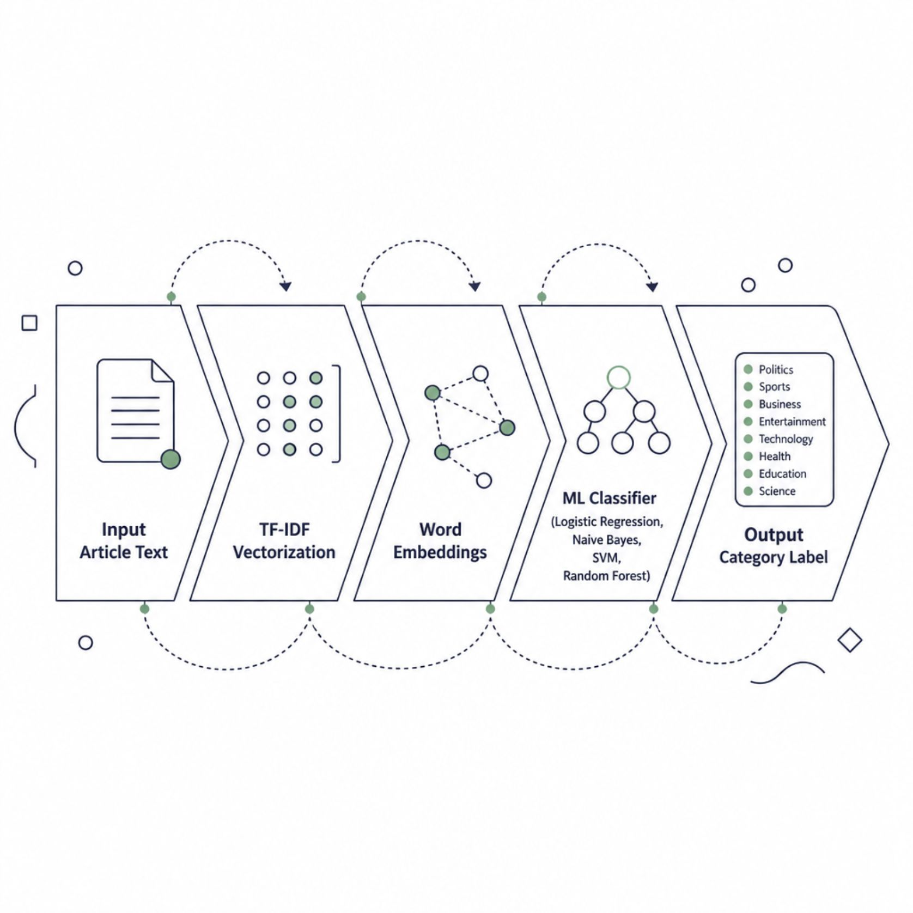
Feature Extraction & ML Classification
From Text to Vectors
Preprocessed text is converted into numerical representations using TF-IDF and word embeddings, capturing semantic meaning and term importance across the corpus.
Classification Algorithms
Logistic Regression — interpretable, fast baseline
Naive Bayes — probabilistic, effective for text
SVM — high-dimensional accuracy
Random Forest — ensemble robustness

Slide 7
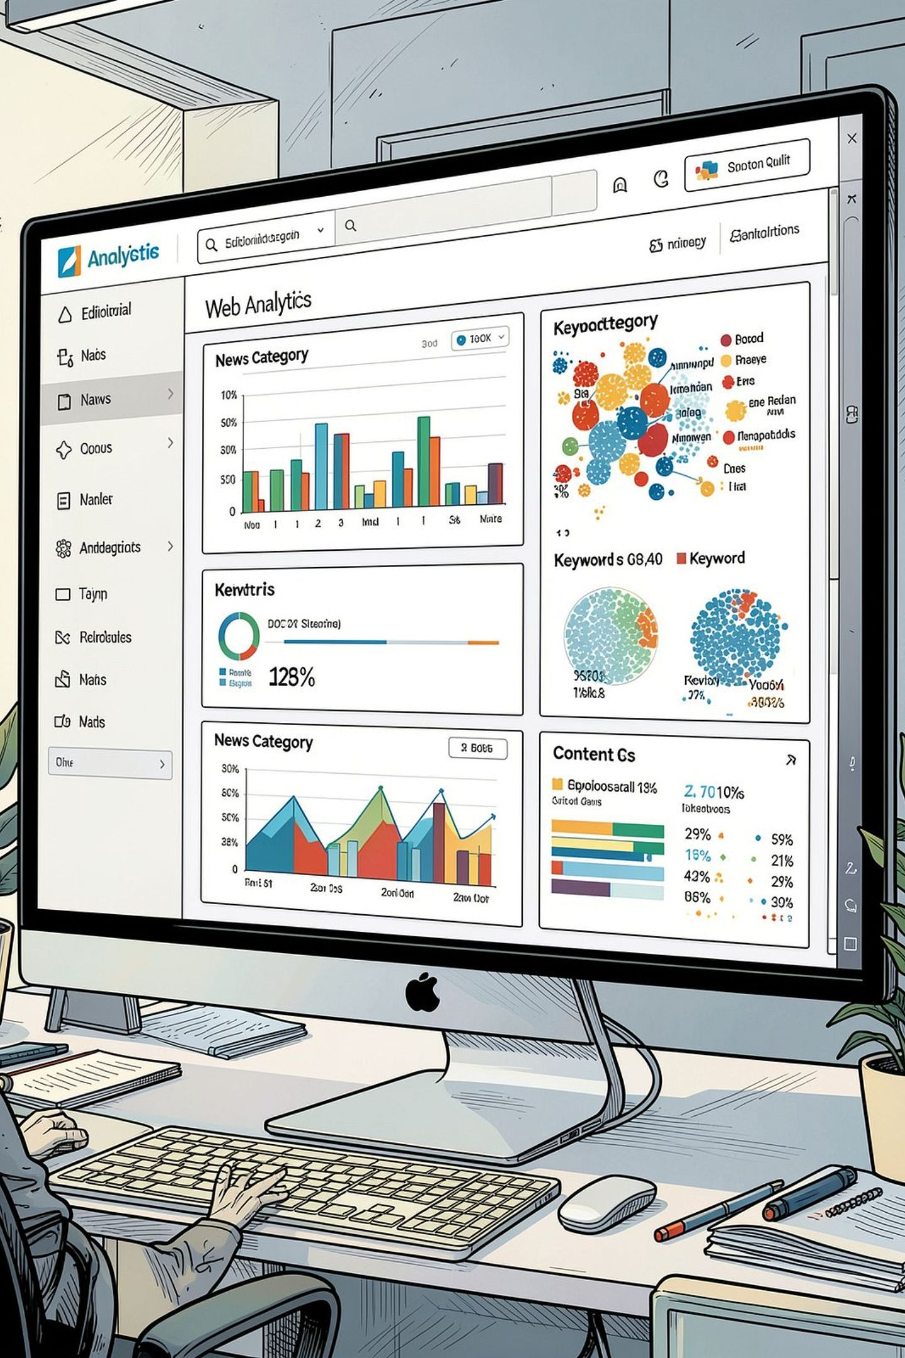




Platform Features
Article Upload & Processing
Upload articles manually or via API; the system processes and classifies content automatically in real time.
Search & Filter
Advanced search across headlines, keywords, categories, and full article text with instant filtering.
Analytics Dashboard
Visualize category distribution, keyword trends, classification accuracy, and historical content records.
Secure Administration
Role-based access control, secure authentication, and audit logs protect content and user data.

Slide 8
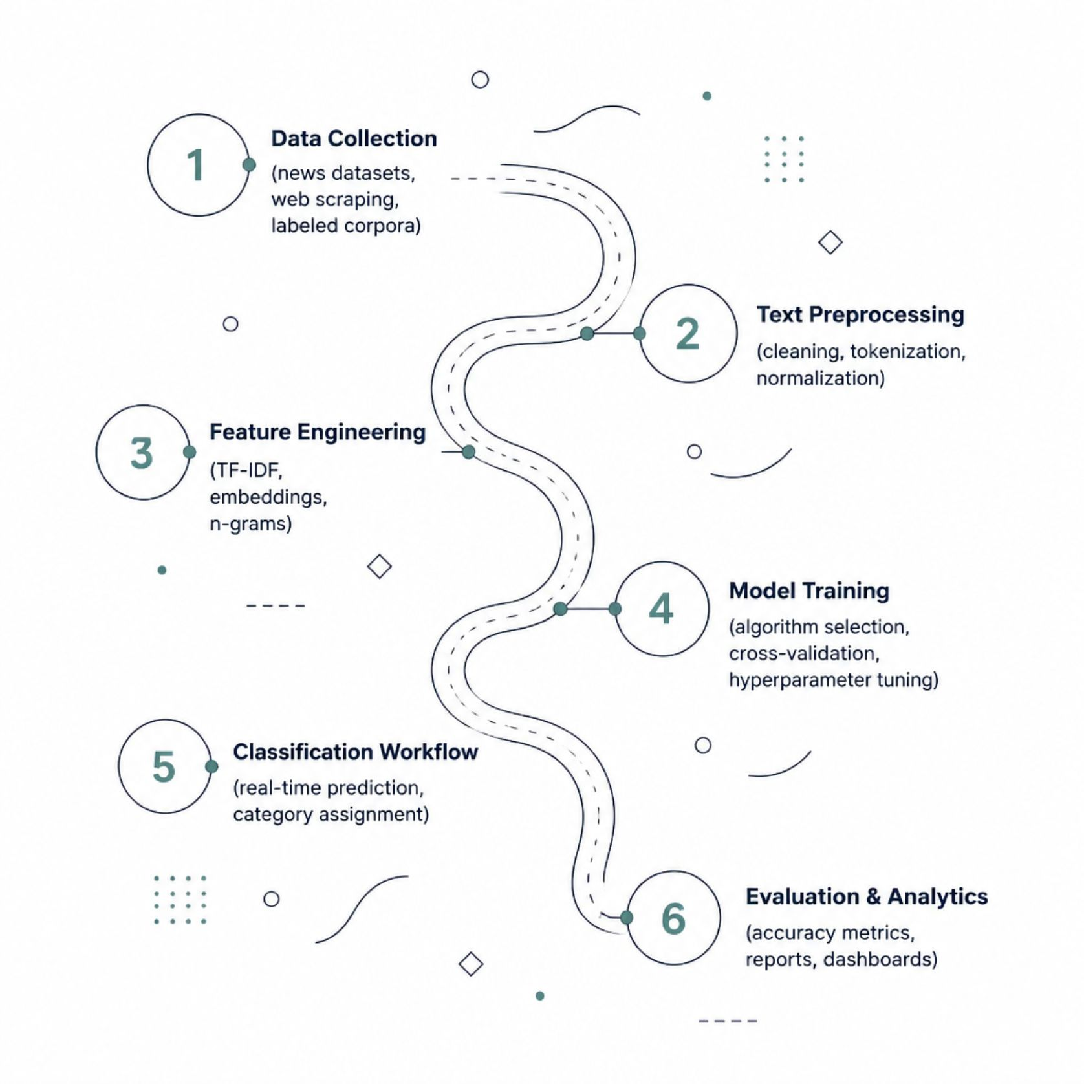

Implementation Methodology
Built for Performance
The system is engineered for scalability — handling large-scale datasets with consistent prediction accuracy. Evaluation metrics including precision, recall, F1-score, and confusion matrices ensure model reliability and interpretability across all eight news categories.
Cross-validation and held-out test sets verify generalization before deployment.

Slide 9
Measurable Benefits
8
4
News Categories
ML Algorithms
Politics, Sports, Business, Entertainment, Technology, Health, Education, and Science — automatically assigned.
Multiple classifiers evaluated for optimal accuracy, interpretability, and speed.
100%
24/7
Automated
Always-On
End-to-end classification with no manual tagging required after initial setup.
Continuous processing of incoming articles with real-time categorization and analytics.
The system delivers consistent classification, faster information retrieval, reduced editorial effort, and data-driven content management — empowering teams to focus on journalism, not administration.

Slide 10

The Road Ahead
Future enhancements will extend the system's intelligence, reach, and real-time capabilities — positioning it as a next-generation content management platform.
Advanced NLP
Real-Time Intelligence
Transformer-based models (BERT, GPT), multilingual classification, sentiment analysis, and AI-powered summarization.
Live news stream processing, personalized recommendations, topic modeling, and fake news detection.
Cloud & Integration
Scalable cloud deployment, CMS integration, advanced analytics dashboards, and enterprise-grade APIs.

