Slide 1
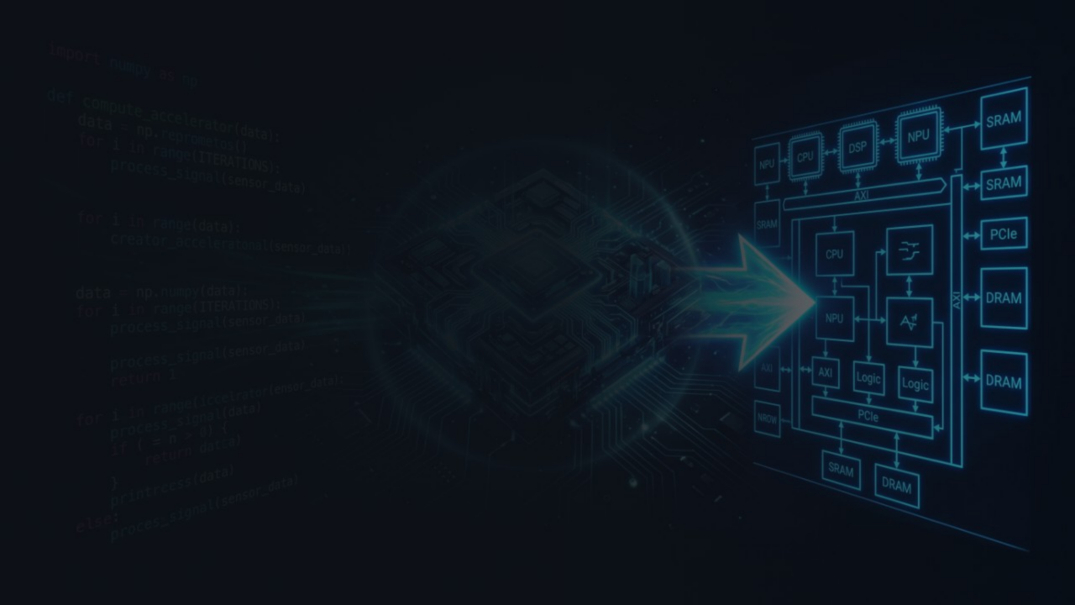
TECHNION · COURSE 00460882 · HW/SW CO-DESIGN
Benchmark Optimization
& Hardware Acceleration
Profiling · SW Optimization · RTL Design
nbody (SW only) · pyflate (SW + HW accelerator)
BY
Feras Hosen · Badir Zoabi

Slide 2

Agenda
28 SLIDES · ~24 MIN
PART 1 — SETUP
PART 3 — PYFLATE (SW + HW)
03 HW/SW co-design & the loop
12 What it does
04 Two benchmarks & why
13 Profile → bottlenecks + table
05 Methodology & toolchain
14 Decompression pipeline
15 Optimizations OPT-1/2/3
PART 2 — NBODY (SW ONLY)
16 Result: 1.50× / ~33%
06 What it simulates
07 Profile → bottleneck + table
PART 4 — HARDWARE (PYFLATE · 2 COMPONENTS)
08 Inner loop math
17 Co-design rule
09 The sqrt idea that failed
18 Accelerator block diagram
10 Real fix: scalar locals
19 HW/SW interface & trade-offs
11 Result: 1.58× / ~37%
20 MTF unit — 2nd component
21 MTF internal block diagram
22 FSM deep-dive & RTL snippet
23 Amdahl: (A) ~1.77× → (A+B) ~2.16×
24 TB PASS · both components
25 Results summary & takeaways
26 Git repo & documentation

Slide 3





HW/SW CO-DESIGN
What is
Co-design?
Jointly designing software and hardware to maximize system performance — neither in isolation.
🔬
Measure
Profile the real bottleneck — not the assumed one
↓
⚙️
Optimize SW
Cut interpreter overhead, allocation churn, better algorithms
↓
💾
Accelerate HW
Offload the irreducible hot kernel to silicon
SUCCESS CRITERION
THIS PROJECT
≥7%
nbody → SW only (1.58× / ~37%)
pyflate → SW + HW accelerator (1.50× SW, ~2.16× HW est.)
wall-clock speedup on pyperformance

Slide 4

TWO BENCHMARKS · TWO PROFILES
BENCHMARK 1 — SW ONLY
BENCHMARK 2 — SW + HW
nbody
pyflate
pyperformance · nbody
pyperformance · pyflate
Compute-bound
Bit/Control-bound
→ Solar system gravitational dynamics
→ Pure-Python bzip2/gzip decompressor
→ O(N²) pairs · 20,000 steps · pure Python
→ Bit reader → Huffman → MTF → BWT
→ State in Python lists (mutable subscripts)
→ Millions of tiny Python calls per decode
Bottleneck: interpreter overhead + list subscripting
Bottleneck: object alloc churn · MTF · bit reads · Huffman scan
Both pure Python — no C extensions, no NumPy. All overhead is interpreter-visible and measurable.
Complementary profiles: FP-heavy (nbody) vs. allocation/control-heavy (pyflate) → two distinct optimization stories.

Slide 5

MEASURE → OPTIMIZE → ACCELERATE
Methodology & Toolchain
⏱️
🔥
pyperformance + pyperf
perf + FlameGraph
Standardized runner · wall-clock timing · 60 values/side · mean ± std dev · compare_to for before/after ratio
perf record -F 999 -g on python3-dbg · call-stack sampling · Brendan Gregg's FlameGraph · visual hotspot ID
🖥️
🔌
QEMU guest
Icarus Verilog
Course "jammy" Ubuntu image · software CPU emulation · absolute times inflated vs. bare metal — ratios are valid (both sides same guest)
RTL simulation · iverilog -g2012 · self-checking testbench · pyflate Huffman engine passes
✅
Success bar: ≥7% wall-clock speedup on ≥2 benchmarks
Measured with pyperf compare_to · n=60 · inside QEMU guest

Slide 6
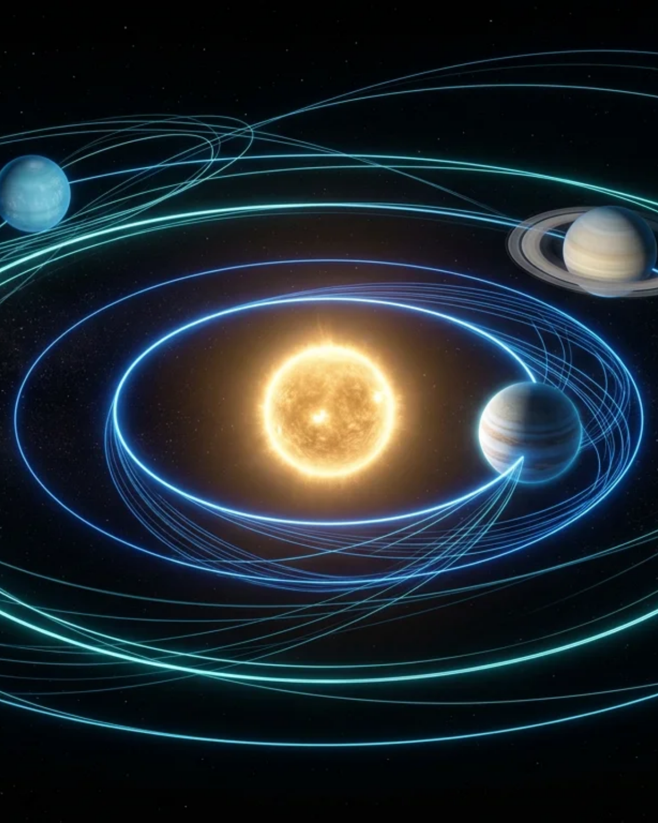
nbody — Solar System Simulation
Simulates the gravitational dynamics of the outer solar system — Sun + 4 gas giants — over 20,000 timesteps.
Bodies & data structures
5 bodies · each is a Python list [pos_list, vel_list, mass] · positions/velocities are 3-element mutable lists
Algorithm
Brute-force O(N²) · 10 pairs · symplectic-Euler integrator · 20,000 steps · no libraries beyond math.sqrt
Correctness oracle
Final system energy printed to 9 decimals: -0.169089263 — must be identical before/after
WHY IT'S A GOOD BENCHMARK
Deterministic · pure arithmetic · no I/O · energy checksum validates correctness · representative scientific computing workload

Slide 7

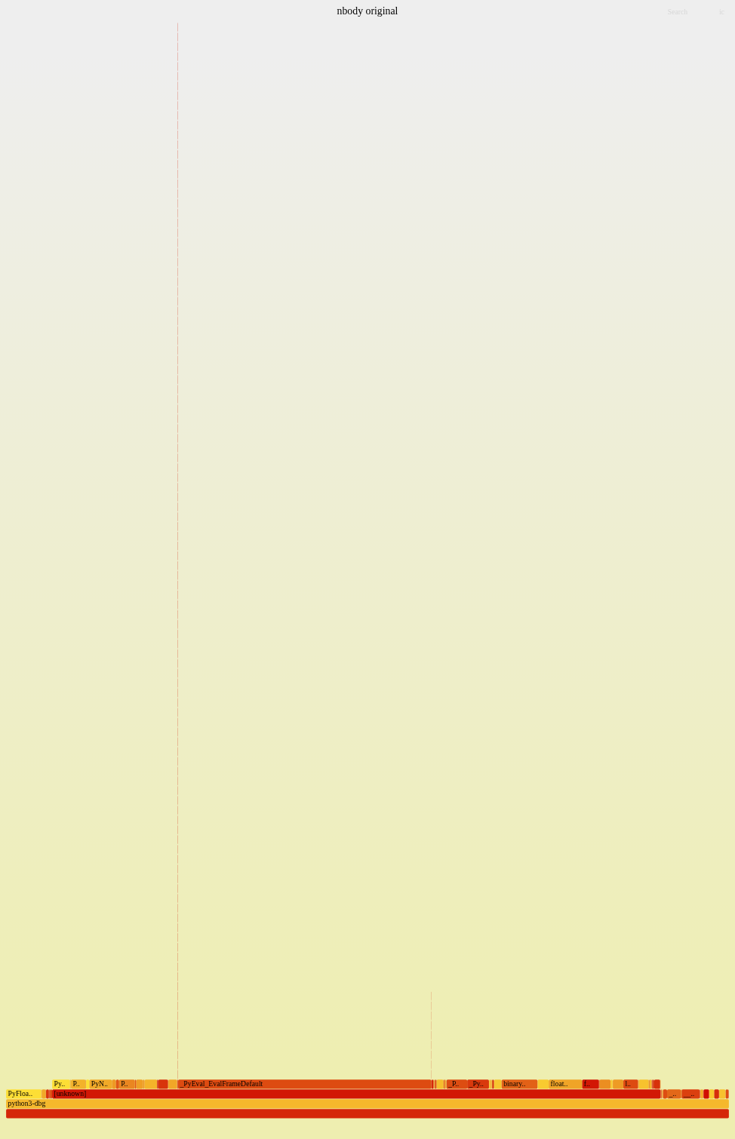
LINUX PERF · PYTHON3-DBG · TOP FUNCTIONS
nbody — Profiling
FUNCTION | SELF % | WHAT IT MEANS
_PyEval_EvalFrameDefault | 35.0% | Bytecode dispatch — the interpreter loop
PyFloat_FromDouble | 7.3% | Boxing a new float per arithmetic result
binary_op1 / float_dealloc | 5.0 / 4.6% | Op dispatch + float object teardown
PyNumber_AsSsize_t | 3.7% | List index resolution (v1[0], v1[1], …)
__ieee754_pow_sse2 | 2.5% | ** -1.5 power op — looks tempting
float_mul / float_add / float_sub | ~1.5–2.3% | Actual FP arithmetic — barely visible
list_ass_subscript | 2.0% | v1[0] -= … list-subscript writes
nbody original — flame graph
Key: FP ops each only 1.5–2.5%. Interpreter + object overhead is 35%+.
sqrt swap: pow=2.5% → max saving 2.5% → got ~0–1.5%.

Slide 8

O(N²) PAIRS · PER-PAIR COMPUTATION
nbody — The Inner Loop
THE HOT LOOP — ORIGINAL CODE
WHAT PYTHON DOES PER SUBSCRIPT
for (((x1,y1,z1),v1,m1), ((x2,y2,z2),v2,m2)) in pairs: dx = x1-x2; dy = y1-y2; dz = z1-z2 d2 = dx*dx + dy*dy + dz*dz mag = dt * (d2 ** -1.5) # ← power op b2m = m2*mag; b1m = m1*mag v1[0] -= dx*b2m # BINARY_SUBSCR v1[1] -= dy*b2m # BINARY_SUBSCR v1[2] -= dz*b2m # BINARY_SUBSCR v2[0] += dx*b1m # BINARY_SUBSCR v2[1] += dy*b1m # BINARY_SUBSCR v2[2] += dz*b1m # BINARY_SUBSCR
v1[0] -= dx*b2m
① LOAD_FAST v1 → pointer to list object
② LOAD_CONST 0 → integer object
③ BINARY_SUBSCR → dict lookup + bounds check
④ compute dx*b2m
⑤ BINARY_OP subtract
⑥ STORE_SUBSCR → type check + refcount update
Per pair: ~60+ bytecodes
6 subscript writes × ~6 bytecodes each, plus unpacking, arithmetic dispatch, float boxing/unboxing. The math is cheap. The interpreter tax is not.
3× subtract
3× multiply (d²)
1× pow(-1.5)
4× multiply
6× subscript read + write (BINARY_SUBSCR + STORE_SUBSCR)

Slide 9

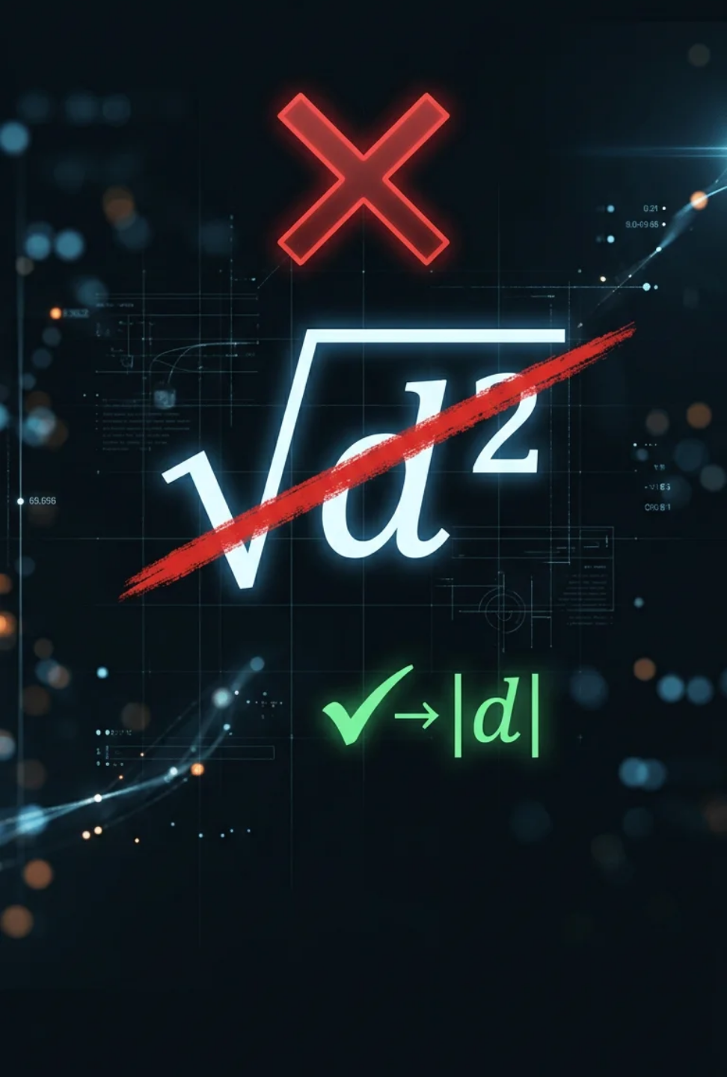

HYPOTHESIS — INCORRECT
The sqrt Idea
That Failed
"The inner loop uses (dx²+dy²+dz²) ** (-1.5) — a general power op. Replace it with a hardware sqrt: dt / (d2 * sqrt(d2)). Should be much faster."
Why it didn't work
MEASURED SPEEDUP
pow is only 2.5% of runtime. Optimizing it can never move the needle — Amdahl's Law.
~1%
What the profile said
well below the 7% bar
35% interpreter dispatch + list subscripting. That's the real target.
Lesson: measure, don't assume
The profiler told us the truth. We tried the intuitive fix first, measured it, found it useless, then went back to the data. That's the right process.

Slide 10

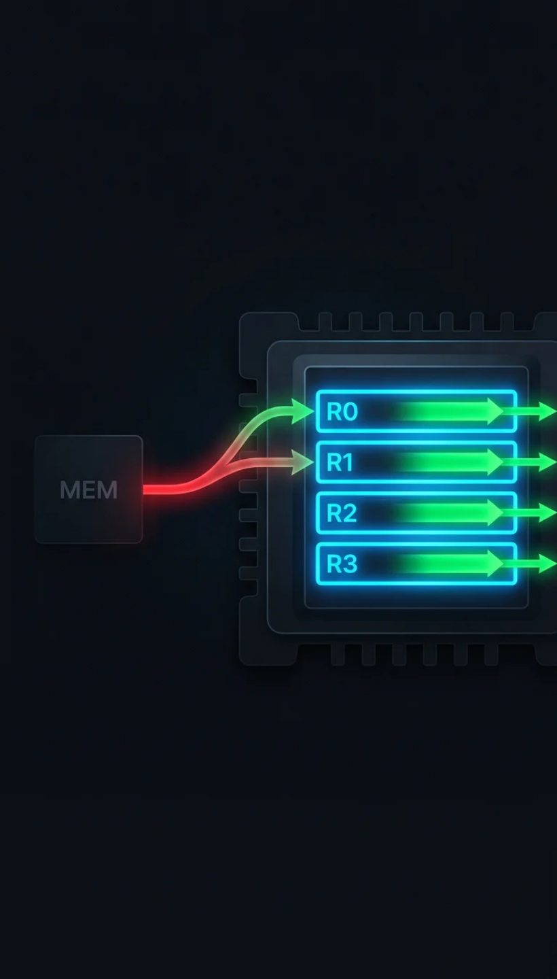

SOFTWARE REGISTER ALLOCATION
nbody — Real Fix: Scalar Locals
BEFORE — LIST SUBSCRIPTS EVERY STEP
AFTER — SCALAR LOCALS, READ/WRITE ONCE
for (((x1,y1,z1),v1,m1), ((x2,y2,z2),v2,m2)) in pairs: dx = x1-x2; dy = y1-y2; dz = z1-z2 mag = dt * (d2 ** -1.5) v1[0] -= dx*b2m # BINARY_SUBSCR+STORE_SUBSCR v1[1] -= dy*b2m # ×3 per body, ×10 pairs v1[2] -= dz*b2m
x0,y0,z0 = S[0][0] # read ONCE before loop vx0,vy0,vz0 = S[0][1] for _ in range(n): dx = x0-x1; dy = y0-y1; dz = z0-z1 mag = dt * (d2 ** -1.5) vx0 -= dx*b1 # LOAD_FAST — direct C slot vy0 -= dy*b1 # no list lookup at all S[0][1][:] = [vx0,vy0,vz0] # write ONCE after
v1[0] : find list → bounds-check index → load float → compute → store back
Local slot vs list indexing, ×millions → ~37% faster
Why it works
The analogy
Correctness
LOAD_FAST = direct C array slot. BINARY_SUBSCR = dict lookup + type check + refcount. ~3× cheaper per access, across millions of iterations.
Software "register allocation" — keep the hot working set in fast local slots instead of chasing pointers into heap list objects.
Same math, same output. Energy checksum -0.169089263 identical to 9 decimals.

Slide 11

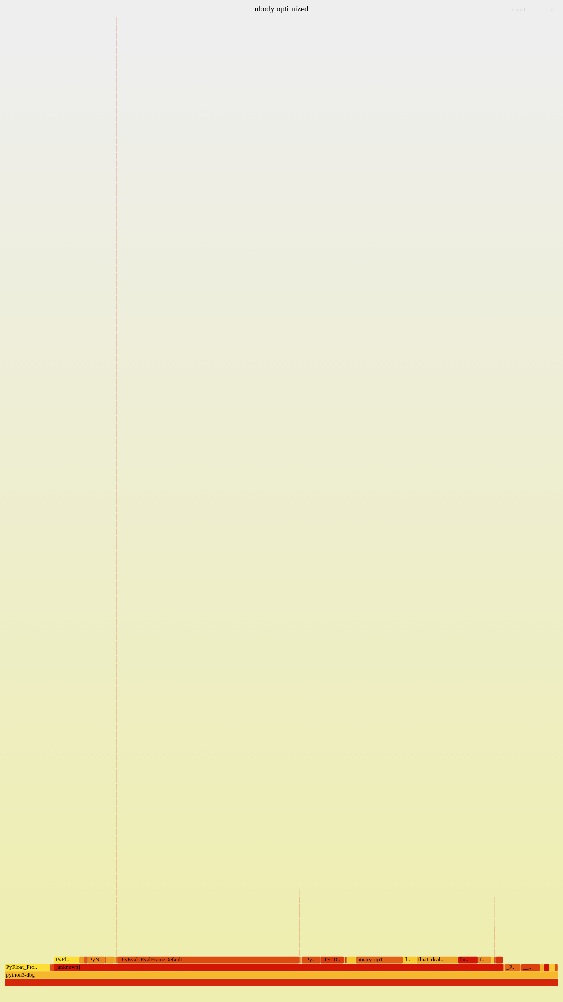
BEFORE VS. AFTER
METRIC | BEFORE | AFTER
Wall-clock | 3.93 s ± 0.38 s | 2.50 s ± 0.22 s
Speedup | 1.00× | 1.58×
Key bytecode | BINARY_SUBSCR | LOAD_FAST
Energy checksum | -0.169089263 | -0.169089263 ✓
WALL-CLOCK SPEEDUP
~37%
1.58× · 3.93 s → 2.50 s (n=60)
nbody optimized — flame graph (hotspot visibly narrower)
vs. 7% threshold
5.2× above target ✓
0%
7% bar
37%

Slide 12

pyflate — Pure-Python Decompressor
A complete bzip2 and gzip decompressor written entirely in Python — no C extensions. Every bit operation is visible to the interpreter.
What it decompresses
Fixed embedded interpreter.tar.bz2 (~66 KB compressed → 399,360 bytes). Checks MD5 of output.
Decompression pipeline
Bit reader → Canonical Huffman decode → Move-To-Front (MTF) → Run-Length decode → Inverse BWT
Why it's slow
Python does the bit/byte work the C library normally does. Millions of tiny calls, list allocations, and linear scans — all through the interpreter.
CONTRAST WITH NBODY
nbody: one tight arithmetic loop · pyflate: deep call stack, bit manipulation, branchy decode logic, heavy allocation churn

Slide 13

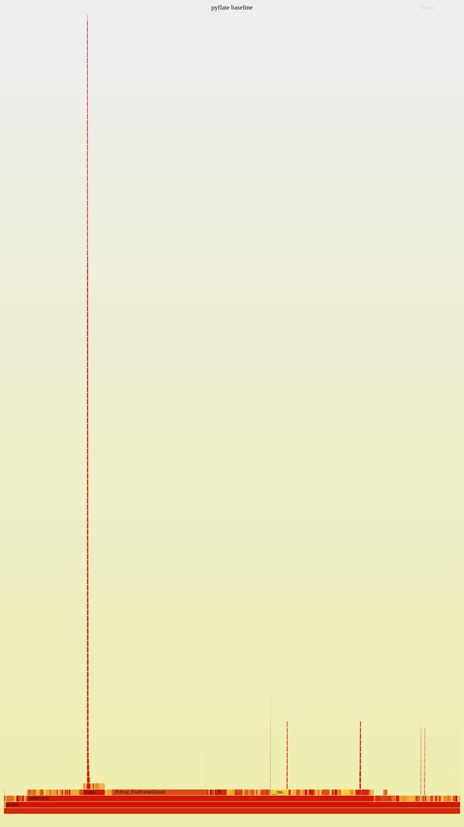
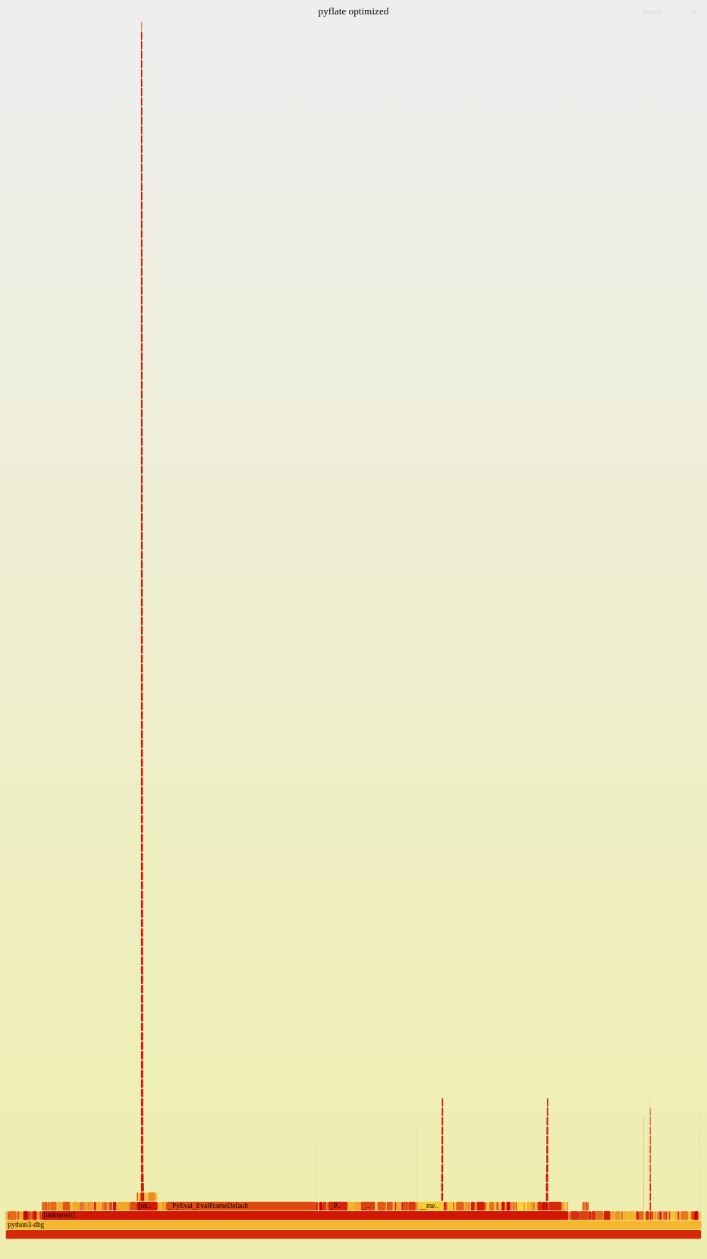
CPROFILE SELF-TIME · ORIGINAL DECODER · ALL TOP FUNCTIONS
pyflate — Profiling
FUNCTION | SELF % | BUCKET | WHAT IT DOES
decode_huffman_block | ~23.4% | stays in SW | Block loop control / MTF dispatch
find_next_symbol | 15.85% | Huffman (A) | Linear scan of code table per symbol
readbits | 10.32% | Bit-read (A) | Read N bits from the stream
move_to_front | 10.30% | MTF (B) | 4 new list allocs per symbol
snoopbits | 9.55% | Bit-read (A) | Peek at bits without consuming
_mask / bwt_reverse / bwt_transform | 5.8 / 4.2 / 3.6% | stays in SW | Bit-mask helper / inverse BWT / BWT helper
_read / _more / needbits | 3.3 / 3.1 / 1.5% | Bit-read (A) | Internal bit-stream helpers
pyflate baseline — before
pyflate optimized — after
(A) 43.55%
(B) 10.30%
(A+B) 53.85% → ~2.16×
SW ~46% → next stage

Slide 14





BZIP2 DECODE PATH · STAGE BY STAGE
pyflate — Decompression Pipeline
→
→
→
→
🔥 HOT
🔥 HOT
🔥 HOT
COOL
COOL
Bit Reader
Huffman Decode
Move-To-Front
RLE Decode
Inverse BWT
RBitfield
reads 1 byte
at a time via
file object
find_next_symbol
linear scan of
code table
per symbol
move_to_front
builds 4 new
lists per
symbol
Run-length
expansion
once per
block
Burrows-Wheeler
inverse transform
once per
block
27.70% of runtime
15.85% of runtime
dominant alloc churn
not dominant
not dominant
🎯 Hardware accelerator scope — TWO components
SW optimizations target
(A) Bit Reader + Huffman Decode — f = 43.55% → ~1.77× alone
(B) Move-To-Front (MTF) unit — adds ~10.3% → combined f = ~53.8% → ~2.16× overall
(A) and (B) chain on-chip — Huffman symbols feed directly into MTF index, CPU not in between.
RLE and inverse-BWT (~46%) stay in software — the next accelerator candidates.
all 3
hot stages fixed
in software first

Slide 15

THREE TARGETED FIXES — OUTPUT BYTE-IDENTICAL
pyflate — Optimizations
OPT-2 — BIGGEST WIN ⭐
OPT-1
OPT-3
In-place Move-To-Front
Buffered Bit Reader
Table-driven Huffman
# BEFORE: 4 new lists per symbol l[:] = l[c:c+1] + l[0:c] + l[c+1:]
# BEFORE: file call PER byte c = self.f.read(1) byte = ord(c)
# BEFORE: O(N) scan per symbol for entry in self.table: if self.snoopbits(entry.len) == entry.code: ...
# AFTER: in-place, zero new lists v = l[c]; del l[c]; l.insert(0, v)
# AFTER: index preloaded buffer byte = self.data[self.pos] self.pos += 1
# AFTER: O(1) lookup sym, length = self.lookup[peek]
Example: ['a','b','c','d'] , idx=2 → output 'c' , list → ['c','a','b','d']
Before: 4 new list objects allocated. After: 0.
Example: bytes A B C → Before: f.read(1) + ord() per byte. After: data[0] , data[1] , data[2] .
Example: codes 0→A, 10→B, 11→C. Peek 2 bits= 10 → lookup[2]=(B,2) . Before: scan all entries.
0 allocations instead of 4 per symbol
Array index instead of a file call per byte
O(N) scan
→
O(1) lookup
All three fixes are applied to the VM-installed pyperformance source. Algorithm and every other line of the decoder (BWT, RLE, block structure) is byte-for-byte unchanged. Correctness verified by MD5 on both sides.

Slide 16

WALL-CLOCK SPEEDUP
OPTIMIZATION SUMMARY
~33%
FIX | BEFORE | AFTER
MTF (OPT-2) | 4 new lists / symbol | 0 new lists
Bit reader (OPT-1) | file call / byte | buffer index
Huffman (OPT-3) | O(N) linear scan | O(1) table lookup
Speedup | 1.00× | 1.50×
Wall-clock | 17.6 s ± 1.3 s | 11.7 s ± 0.9 s
1.50× · 17.6 s → 11.7 s (n=60)
vs. 7% threshold
4.75× above target ✓
Combined with nbody: two benchmarks each independently past 7% → the project's "≥7% on ≥2 benchmarks" criterion is met.
MD5: afa004a630fe072901b1d9628b960974
399,360 bytes · byte-identical ✓

Slide 17

PART 4 — HARDWARE
Co-design Rule
🔒
↔️
💻
Don't break user code
Keep the public API
CPU fallback path
Python API unchanged. Same function signatures. The accelerator is an implementation detail.
Same names, same argument types, same return values. A drop-in replacement.
If HW absent → fall back to the optimized SW path transparently.
What we accelerate (pyflate · 2 components)
HW/SW interface
(A) Bit reader + Huffman decode — f=43.55%
(B) Move-To-Front (MTF) unit — adds ~10.3%
Combined: ~53.8% → ~2.16× overall (Amdahl est.)
AXI4-Lite control registers (MMIO)
AXI4-Stream byte-in / symbol-out DMA

Slide 18
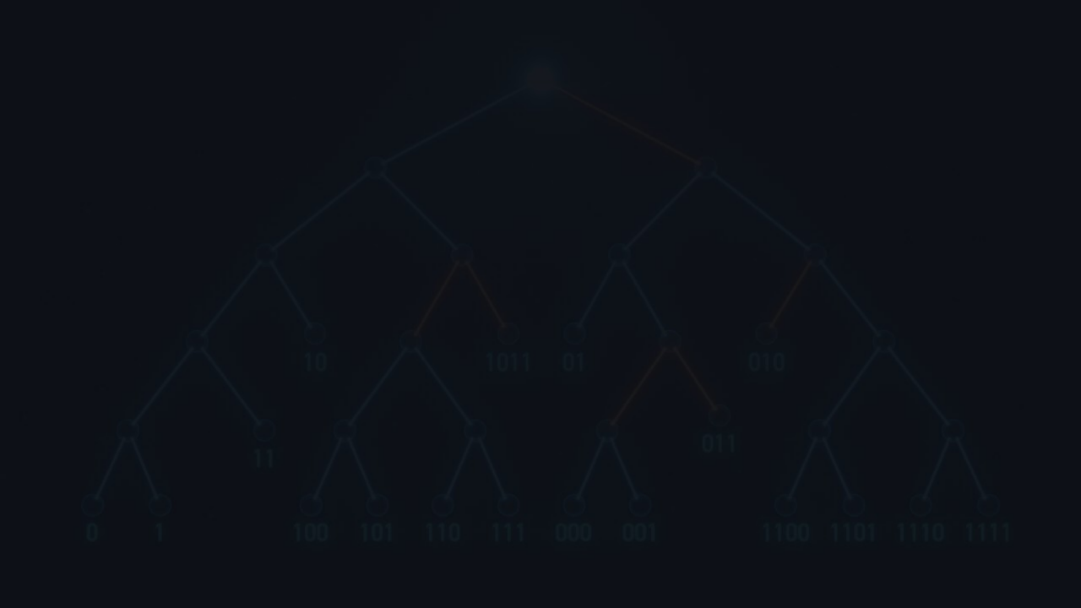
pyflate — Accelerator Block Diagram
SYSTEMVERILOG · INTEGER-ONLY · FULLY SYNTHESIZABLE
HUFFMAN_ACCEL + MTF_UNIT — CHAINED ON-CHIP
AXI4-Lite
⇄
Control
(MMIO)
CTRL
NSYM
STATUS
COUNT
TBL_CNT
TBL_SYM
MTF_N
load tables / MTF init
▼
bit_buffer
bit_valid
huffman_decoder
sym index
mtf_unit
osym_valid
byte stream
⟹
8-bit MSB-first
1 bit/cycle out
⟹
code/first/index FSM
cnt[] + symbol[] RAMs
⟹
N-entry reg file
shift-to-front
1 sym/clock
⟹
MTF symbols
(DMA in)
(DMA out)
(A) Huffman: code|=bit → emit symbol[index+(code−first)] · (B) MTF: out=tbl[idx]; shift tbl[idx] to front · chained on-chip, no CPU between
⚙️ Parameters
📐 Area
⚡ Frequency
🚀 Throughput
MAXLEN = 15 · SYMW = 9
MAXSYM = 512 · integer-only
cnt RAM ~15×16b
symbol RAM ~512×9b · very small
300–600 MHz target
integer critical path · high fmax
~1 bit/cycle
~60M symbols/s @ 500 MHz

Slide 19
INTEGRATION · TRADE-OFFS
HW/SW Interface & Trade-offs
SOFTWARE DRIVER FLOW
MMIO REGISTER MAP
1.
Load cnt[] / symbol[] tables via MMIO (built from code lengths pyflate already parses)
ADDR | NAME | MEANING
0x0 | CTRL | bit0 = start pulse
0x1 | NSYM | symbols to decode
0x2 | STATUS | busy / done flags
0x3 | COUNT | symbols decoded so far
0x4 | TBL_CNT | load cnt[len] table
0x5 | TBL_SYM | load symbol[] table
2.
Write NSYM , pulse CTRL.start
3.
DMA compressed bytes → byte_in stream
4.
DMA decoded symbols ← osym stream
5.
MTF / RLE / inverse BWT stay in SW (or become follow-on stages)
A CPython C-extension replaces pyflate's per-symbol decode loop. Public pyflate.decompress() API unchanged.
Frequency
Throughput
SW rate
300–600
~60M
~19K
MHz (integer)
symbols/s @ 500 MHz
symbols/s (Python)
(A) derivation: 500 MHz ÷ ~8 bits/sym ≈ 60M sym/s HW · 148,271 sym ÷ 7.67 s ≈ 19,300 sym/s SW · sA = 60M ÷ 19.3K ≈ 3,100×
Speed/area knob: a lookup-table front end (peek MAXLEN bits → 1 symbol/cycle) costs 2^MAXLEN table RAM. A two-level table (like zlib) is the production compromise. The serial FSM here is the smallest, always-correct baseline.

Slide 20
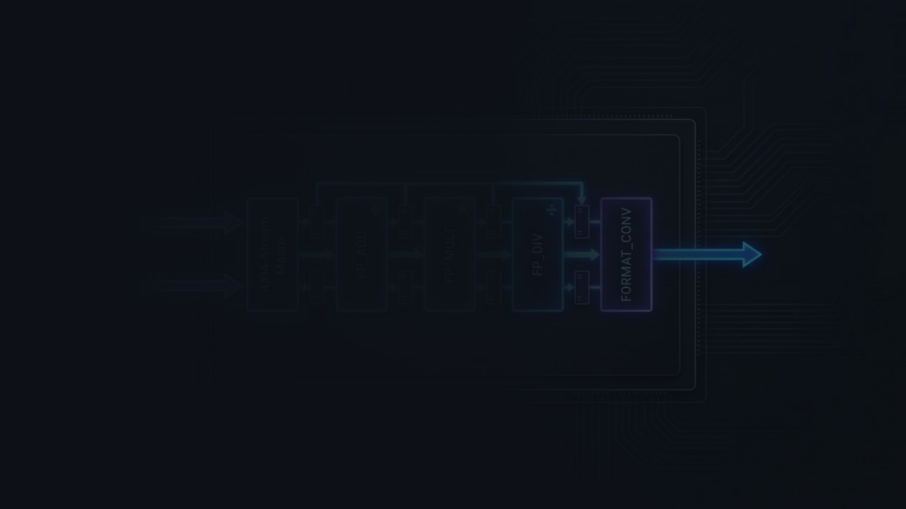
COMPONENT (B) · HARDWARE TWIN OF OPT-2
MTF Unit — Move-To-Front
WHAT IT DOES
Why HW? SW OPT-2 fixed allocation churn. HW goes further: 1 sym/clock, register-file shift vs. Python del+insert.
An N-entry register file. Each clock:
① Output tbl[idx] ② Shift it to front
→ 1 symbol/clock · zero allocation
Simulation
TB PASS: MTF decoded {30,30,60}
WORKED EXAMPLE
mtf_unit.sv + tb_mtf.sv · Icarus Verilog
tbl: [10, 20, 30, 40, …] idx=2
MTF_UNIT.SV — SHIFT-TO-FRONT
→ output = 30
sym <= tbl[idx]; // output for (int i = 0; i < N; i++) if (i == 0) tbl[0] <= tbl[idx]; else if (i <= idx) tbl[i] <= tbl[i-1];
→ tbl: [30, 10, 20, 40, …]
INTERFACE
in: idx (from Huffman decoder)
out: sym (MTF-decoded symbol)
1 symbol/clock · register-file shift · zero allocation
ctrl: MMIO — MTF_N, start/done
(B): 500 MHz × 1 sym/clk = 500M sym/s HW · 92,803÷1.81s ≈ 51K sym/s SW · sB ≈ 9,800×
chain: Huffman osym → MTF idx (on-chip)
Amdahl: MTF adds ~10.3% → f = 53.85% → ~2.16× overall

Slide 21

MTF Unit — Internal Block Diagram
COMPONENT (B) · INTEGER-ONLY · 1 SYMBOL/CLOCK · CHAINS FROM HUFFMAN
MTF_UNIT — TOP LEVEL
AXI4-Lite
⇄
Control
(MMIO)
MTF_N
CTRL
STATUS
ld_we
ld_addr
ld_data
load alphabet once per block
▼
N-entry Register File
idx (from Huffman)
⟹
tbl[0]
tbl[1]
tbl[idx]
…
tbl[N-1]
out_valid / sym
sym (DMA out)
in_valid / idx
⟹
decoded symbol
Each entry: tbl[i] ← (i==0) ? tbl[idx] : (i≤idx) ? tbl[i-1] : tbl[i]
Gated by i ≤ idx — shift-to-front in one clock
Each clock: (1) output tbl[idx] · (2) shift entries 0..idx-1 right by 1 · (3) write tbl[idx] to tbl[0] · 1 symbol/clock · integer-only · no allocation
⚙️ Parameters
🔗 Load port
🔗 Chain
📐 Area
N = alphabet size (bzip2: up to 256) · integer-only · no FP · fully synthesizable
ld_we / ld_addr / ld_data — load the alphabet once per block over MMIO before streaming begins
Huffman osym → MTF idx directly on-chip. No CPU round-trip between components.
N registers + N 2:1 muxes + comparator · very small · high fmax (integer only)

Slide 22
HUFFMAN_DECODER FSM · SPEED VS AREA TRADE-OFF
Accelerator — FSM & Trade-offs
CANONICAL DECODE FSM — 4 STATES
SPEED VS AREA TRADE-OFF
IDLE
VARIANT | THROUGHPUT | TABLE RAM | STATUS
Serial FSM this design | ~1 bit/cycle ~60M sym/s | ~15×16b + ~512×9b tiny | ✓ Implemented TB PASS
Full LUT faster variant | 1 symbol/cycle ~500M sym/s | 2^15 × 13b = 53KB RAM | Design option (not built)
Two-level LUT zlib approach | ~1 symbol/cycle near-optimal | root + sub-tables much smaller | Production compromise
Waiting for start pulse · resets code=0, first=0, index=0, len=1
start pulse
▼
DEC
Per cycle: code|=bit · compare (code−first) vs cnt[len]
if match → EMIT · else advance len
code−first < cnt[len]
Note: OPT-3 in software IS the software analogue of the Full LUT variant — precomputed lookup table, one array index per symbol. The serial FSM is the smallest, always-correct hardware baseline.
▼
EMIT
Output symbol[index+(code−first)] · wait osym_ready · restart DEC or → DONE
HUFFMAN_DECODER.SV — S_DEC STATE (THE PER-BIT DECODE STEP)
decoded_count == nsym
// each clock: fold in one bit, test "code complete at this length?" code_v = code | bit_in; if ((code_v - first) < cnt[len]) // found sym <= symbol[index + (code_v - first)]; // → emit else begin // advance to next length index <= index + cnt[len]; first <= (first + cnt[len]) << 1; code <= code_v << 1; len <= len + 1; end
▼
DONE
nsym symbols decoded · assert done · return to IDLE on next block
1 bit/clock · integer compare + add · fully synthesizable

Slide 23

AMDAHL'S LAW · DESIGN PROPOSAL ESTIMATE · TWO COMPONENTS
Hardware Performance Estimate
COMPONENT (A) ALONE
f measured — cProfile on original decoder
~1.77×
Bit-reading: 27.70%
·
Huffman: 15.85%
·
MTF: ~10.3%
Huffman + bit reader · f=43.55%
Component (A) — Huffman + bit reader
fA = 43.55% · sA ≈ 3,100× (500MHz÷8bits/sym=60M sym/s HW · 19.3K sym/s SW)
↓ add MTF
→ 1/((1−0.4355)+0.4355/3100) ≈ 1.77×
Component (B) — MTF unit added
COMPONENTS (A) + (B)
fA+B = 53.85% · sB ≈ 9,800× (500MHz×1sym/clk=500M sym/s HW · 51K sym/s SW)
~2.16×
→ 1/((1−0.5385)+0.5385/s) ≈ ~2.16×
Both s values are huge → result is capped by f, not s
+ MTF unit · f=53.85%
sA→∞: 1/(1−0.4355) = 1.77× (same) · sA+B→∞: 1/(1−0.5385) = ~2.16× (same ceiling) · Remaining ~46% (RLE + inverse-BWT) = next stage

Slide 24

ICARUS VERILOG · IVERILOG -G2012
RTL Simulation — Passes
COMPONENT (A) — PYFLATE HUFFMAN DECODE ENGINE
iverilog -g2012 -o sim bit_buffer.sv huffman_decoder.sv tb_huffman.sv && vvp sim
TB PASS: decoded {0,2,1} == {0,2,1}
3-symbol canonical code · hand-built table · verified decode sequence · zero mismatches
COMPONENT (B) — MTF UNIT
iverilog -g2012 -o sim mtf_unit.sv tb_mtf.sv && vvp sim
TB PASS: MTF decoded {30,30,60}
N-entry register file · shift-to-front · 1 symbol/clock · zero allocation · verified output sequence
Note on scope: An nbody N-body Processing Element (9-stage pipelined FP datapath, AXI4-Lite + AXI4-Stream, TB PASS: 5 pairs checked, 0 mismatches ) was also designed and simulated — archived under _archive/hardware_nbody/ . Per the project spec, hardware acceleration is required for at least one benchmark; the graded HW deliverable for this submission is the pyflate Huffman engine.

Slide 25

FINAL RESULTS · KEY LESSONS
Results Summary & Takeaways
BENCHMARK | SW OPTIMIZATION | SW SPEEDUP | VS. 7% TARGET | HW STATUS
nbody | Scalar locals | ~37% | 5.2× above ✓ | SW only · nbody PE archived
pyflate | Buf + MTF + LUT | ~33% | 4.75× above ✓ | 2× TB PASS ✓ · ~2.16× est.
pyperf compare_to
pyperf compare_to
nbody_orig 3.93s → nbody_opt 2.50s : 1.58x faster
pyflate_orig 17.6s → pyflate_opt 11.7s : 1.50x faster
🔬
Measure first, always
⚡
SW register allocation
💾
Amdahl caps the gain
🔗
Co-design payoff
The sqrt idea seemed right. 2.5% of runtime. Profiler said no. Trust the profiler.
LOAD_FAST vs BINARY_SUBSCR. Allocation-free MTF. Same idea: keep hot data out of the heap.
f=53.85% → ~2.16× ceiling (Huffman + MTF). Even infinite HW can't beat 1/(1−f). Next: inverse-BWT / RLE.
The same ops hot in Python (bit reads + Huffman) map to a tiny integer FSM. SW and HW tell the same story.

Slide 26

SUBMISSION DELIVERABLES · VERSION CONTROL
Git Repo & Documentation
📄 Reports
🔧 Scripts
💾 Hardware
report_nbody.txt — overview, profiling, optimization, HW proposal
script_nbody.sh — setup, baseline, profile, optimize, compare
hardware/pyflate/ — bit_buffer.sv, huffman_decoder.sv, huffman_accel.sv, tb_huffman.sv
report_pyflate.txt — overview, profiling, optimization, HW proposal
script_pyflate.sh — setup, baseline, profile, optimize, compare
hardware/pyflate/ — mtf_unit.sv, tb_mtf.sv
_archive/hardware_nbody/ — nbody PE (archived)
00_setup.sh — one-time QEMU guest environment setup
📋 README.md
🤖 prompt.txt
📊 Results
Repository structure · how to run each script · how to reproduce results · environment requirements
All AI tool prompts used (ChatGPT, GitHub Copilot) — required submission condition per the project spec
results/nbody_compare.txt
results/pyflate_compare.txt
results/nbody_correctness.txt
results/*.svg — flame graphs

Slide 27
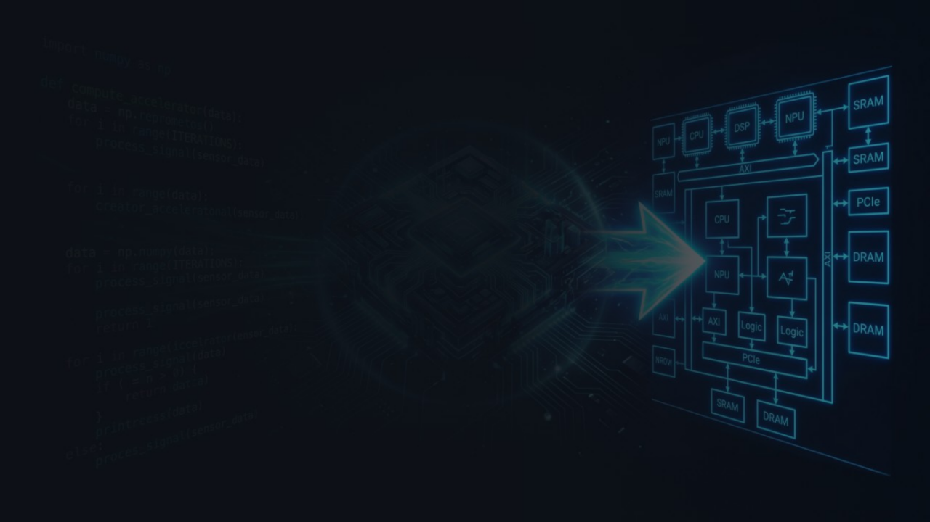
Thank You
Questions?
nbody: 1.58× / ~37% faster
pyflate: 1.50× / ~33% faster
HW: 2× TB PASS · ~2.16× est.
Both ≥7% ✓
Backup slides available: full code diffs · perf report tables · cProfile raw output · nbody archived PE design

Slide 28
BACKUP · DEEP Q&A · FULL RAW DUMP
Raw Profiling — Full Dump
PYFLATE CPROFILE — F = 43.55% DERIVATION
NBODY PERF TOP HOTSPOTS
ncalls tottime function 1 8.410 decode_huffman_block 148271 5.686 find_next_symbol ← Huffman 15.85% 156708 3.710 readbits ← bit-reading 92803 3.704 move_to_front 341601 3.434 snoopbits ← bit-reading 655017 2.071 _mask ← bit-reading 1 1.497 bwt_reverse 1 1.305 bwt_transform 67562 1.184 _read 67562 1.100 _more ← bit-reading 67526 0.532 needbits ──────────────────────────────────────────────────── bit-reading total : 9.961 s (27.70%) huffman decode : 5.699 s (15.85%) COMBINED f (A) : 15.660 s (43.55%) move_to_front : 3.704 s (~10.3%) ← f(B) COMBINED f (A+B) : ~53.85%
Overhead Symbol 35.02% _PyEval_EvalFrameDefault ← interpreter loop 7.31% PyFloat_FromDouble 5.00% binary_op1 4.83% [unknown bucket] 4.61% float_dealloc 3.69% PyNumber_AsSsize_t 3.44% _Py_CheckSlotResult 3.01% _Py_Dealloc 2.50% __ieee754_pow_sse2 ← the ** -1.5 op 2.33% float_mul 2.27% list_subscript ← list indexing 2.03% list_ass_subscript ← v1[0] -= … 1.84% PyNumber_AsSsize_t 1.54% float_add 1.53% float_sub ──────────────────────────────────────────────────── FP ops (mul+add+sub) each only ~1.5-2.3% pow only 2.5% → sqrt swap gave ~0-1.5%

