Slide 1
HIVE
BY:
Lakshmi SESHU KALVAKURI
SAI KUMAR NALIVELA
SAI RAM BADISA
KARUN BOURISETTY
MALLIKARJUN Bodepudi

Slide 2





Karun Bourishetty
Saikumar Nalivela
Sairam Badisa
Mallikarjuna Bodepudi
Lakshmi Seshu Kalvakuri

Slide 3
Content
Introduction
Features of Hive
Hive Architecture
Job execution inside Hive
Hive vs RDBMS
Lakshmi Seshu Kalvakuri

Slide 4
Introduction
Before going into the hive, lets brief about the topics
Big Data.
Hadoop.
Big Data is used for collections of large datasets which include
Huge volume.
High velocity.
Variety of data.
Hadoop is an open-source framework.
MapReduce.
Hadoop Distributed File System.
Lakshmi Seshu Kalvakuri

Slide 5
Introduction
The Hadoop ecosystem contains different sub-projects
Sqoop.
Pig.
Hive.
Hive is a platform used to develop the SQL type scripts to do MapReduce operations.
Lakshmi Seshu Kalvakuri
Notes:
Hive as data warehouse designed for managing and querying only structured data that is stored in tables.
Sqoop is used to import and export data btwn HDFS and RDBMS.
Pig is a procedural language to develop a script for MapReduce operations.

Slide 6
What is hive?
A data warehouse infrastructure tool.
To process structure data in Hadoop and make querying and analyzing easy.
Initially developed y Facebook. Later the Apache software foundation took it up and developed it further as an open source under the name of apache hive
Lakshmi Seshu Kalvakuri
Notes:
Initially developed by facebook. Later the Apache software foundation took it up and developed it further as open source under the name APACHE HIVE.

Slide 7
FEATURES OF HIVE
It stores schema in database and processed data into HDFS(Hadoop Distributed System)
It is designed for online analytical processing( )
Provides SQL type querying called HiveQL or HQL.
It is familiar, fast, scalable and extensible.
Lakshmi Seshu Kalvakuri
Notes:
1. While dealing with structured data, Map Reduce doesn't have optimization and usability features like user defined functions but Hive framework does.
2. Query optimization refers to an effective way of query execution in terms of performance.
3. It reuses familiar concepts from the relational database world, such as tables, rows, columns and schema, etc. for ease of learning.
4. Scalable – easily expandable
5. A new and important component of Hive i.e. Metastore used for storing schema information. This Metastore typically resides in a relational database. We can interact with Hive using methods likeWeb GUI
Java Database Connectivity (JDBC) interface

Slide 8
HIve is Not
A relational database.
A design for OnLine Transaction Processing (OLTP).
A languages for real-time queries and row-level updates.
Lakshmi Seshu Kalvakuri

Slide 9
Internal Components
Internal Components
Compiler and Planner
It compiles and checks the input query.
It creates an execution plan.
Optimizer
It optimizes the execution plans before it runs.
Execution Engine
Runs the execution plan.
Guarantees that execution plan is DAG.
Lakshmi Seshu Kalvakuri
Notes:
DAG – direct acyclic graph. It means that there is no cyclic dependency.

Slide 10
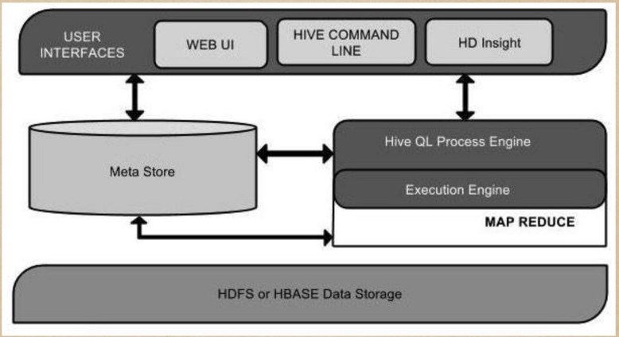
HIVE ARCHITECTURE
Lakshmi Seshu Kalvakuri
Notes:
Hive Consists of Mainly 3 core parts
Hive Clients
Hive Services
Hive Storage and Computing
2. Hive provides different drivers for communication with a different type of applications
3. If the client wants to perform any query related operations in Hive, it has to communicate through Hive Services.
4. Hive services such as Meta store, File system, and Job Client in turn communicates with Hive storage and performs actions like
Metadata information of tables created in Hive is stored in Hive "Meta storage database".
Query results and data loaded in the tables are going to be stored in Hadoop cluster on HDFS
5. Hadoop distributed file system or HBASE are the data storage techniques to store data into file system.

Slide 11
HIVE ARCHITECTURE
User Interface
Meta Store
HiveQL Process Engine
Execution Engine
HDFS or HBASE
Sairam Badisa

Slide 12
Architecture of Hive
3 Major Components:
Hive Clients.
Hive Services.
Meta Store.
Under Hive Client:
Thrift Client.
ODBC Driver.
JDBC Driver.
Sairam Badisa

Slide 13
Architecture of Hive
Thrift Client – bindings for Hive are available for
C++.
JAVA
PHP Scripts.
Python.
Ruby
JDBC and ODBC – They can be used for communication between Hive client and hive servers for compatible options.
Sairam Badisa

Slide 14
Architecture of Hive
Hive Services:
CLI- the command line interface to Hive is the default service.
Hive server – runs hive as a server exposing a thrift service.
Hwi – Hive web interface.
Sairam Badisa
Notes:
Hive server – enabling the access from a range of clients written in different languages.
Hwi - is a simple graphical user interface (GUI).

Slide 15
Architecture of Hive
Metastore – central repository of Hive metadata.
By default, it runs in the same JVM as the HIVE service.
It contains information about the partition and tables in warehouse.
Data necessary to perform read and write functions.
Located in HDFS files and various data locations.
Sairam Badisa

Slide 16
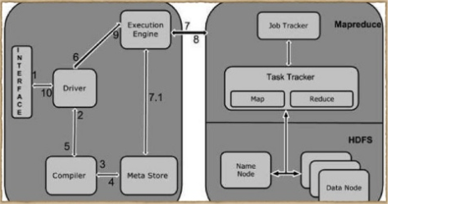
WORKING OF HIVE
Sairam Badisa

Slide 17
WoRking of hive
Execute Query
Get plan
Get Metadata
Send Metadata
Send Plan
Execute Plan
Execute Job
Metadata Ops
Fetch Result
Send Results
Send Results
Sairam Badisa

Slide 18
Job execution inside Hive
Steps:
Execute Query – Hive uses CLI or web UI sends query to driver to execute.
Get Plan – It parses the query to check the syntax.
Get Metadata – compiler sends metadata request to Metastore.
Send Metadata – sends metadata as a response to the compiler.
Send Plan – compiler checks the requirement and resend the plan to driver.
Sairam Badisa
Notes:
Get plan – query plan or the requirement of the query.
Send plan – Upto here, the parsing and compiling of a query is complete.

Slide 19
Job execution inside Hive
Execute
Execute plan – driver sends the execution plan to execution engine.
Execute
Execute Job – process of execution is a MapReduce job.
Metadata Ops – the execution engine can execute metadata operations with metastore.
Fetch
Fetch Result – execution engine receives the results from data Nodes.
Send
Send Result – execution engine sends those resultant values to the driver.
Sairam Badisa
Notes:
Execute job – the execution job sends the jobTracker, which is name node and it assigns this job to task tracker which is in data node.
Here, the query executes MapReduce job.
Send results – sends the results to Hive interfaces.

Slide 20
HIVE DATA TYPES
Column Types
Literals
Null Values
Complex Types
Mallikarjuna Bodepudi

Slide 21
Column types
Integer Types
INT
BIGINT
SMALLINT
TINYINT
String Types – ( ‘ ’ ), ( “ “ )
CHAR
VARCHAR
Mallikarjuna Bodepudi

Slide 22
COLUMN TYPES
Timestamp
Dates
Decimals
Union Types
Mallikarjuna Bodepudi

Slide 23
Literals
Floating Point Types
Composed of DOUBLE datatype
Decimal Type
Higher range than DOUBLE data type
Mallikarjuna Bodepudi

Slide 24
Complex TYPES
Arrays
Maps
Structs
Mallikarjuna Bodepudi

Slide 25
Controlling data locality with hive
Bucketing:
Hash partitions values into a configurable number of buckets.
Usually coupled with sorting.
Skews:
Split values out into separate files.
Used when certain values are frequently seen.
Replication factor:
Increase the replication factor to accelerate needs.
Controlled the HDFS Layer.
Sorting:
Sort the values with in a given column.
Accelerates the query used with the ORC File filter.
Mallikarjuna Bodepudi

Slide 26
Hive Vs relational database
HIVE | Relational Database
It is not a full Database, it can be data warehouse. | They are always a full database.
It is “Schema on READ Only”. It is not possible to update and modify the data. | It depends on “Schema on READ” and “Schema on Write”. Insertions, Updates and Modifications can be performed.
It is easily scalable at low cost. | It is not easily scalable.
Hive can handle up to 100s of Petabytes. | In RDBMS, the max data will be only 10s of Tb.
Mallikarjuna Bodepudi

Slide 27
Hive Vs relational database
HIVE | Relational Database
It is based on the notation of Write once Read many times. | It is based on the notation Read once, Write many times.
Record level insertions, deletions and updates are not possible. | Record level insertions, deletions and updates are possible.
It is best suited for the data warehouse applications. | It is best suited for the dynamic data analysis.
Mallikarjuna Bodepudi

Slide 28
LOADING DATA Into hive
Sqoop
Data transfer from the external RDBMS to Hive.
Sqoop can load data to/from HCatalog.
Hive LOAD
Load files from the HDFS or local file system.
Format must agree with table format.
Insert from query.
CREATE TABLE AS SELECT or INSERT INTO.
WebHDFS + WebHCat
Load data via REST APIs.
Mallikarjuna Bodepudi

Slide 29
ACID Properties
Data loaded into Hive partition-or table-at-a-time.
No INSERT or UPDATE statement. No transactions.
Atomicity:
Partition loads are atomic through directory renames in HDFS.
Consistency:
Ensured by HDFS. All nodes see the same partitions all the time.
Immutable data
Isolation:
Read committed with an exception for partition deletes.
Partitions can be deleted during queries.
Durability:
Data is durable in HDFS before partition exposed to Hive.
Karun Bourishetty

Slide 30
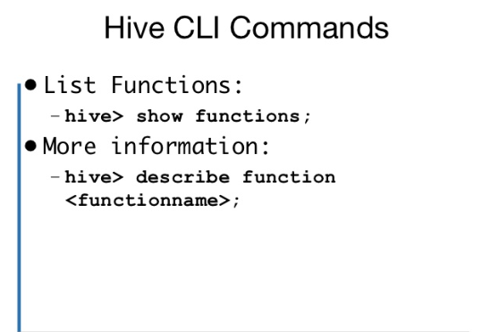
Hive Commands
Karun Bourishetty

Slide 31
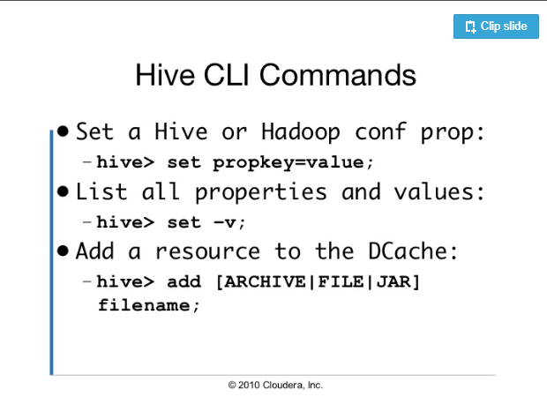
Hive commands
Karun Bourishetty

Slide 32
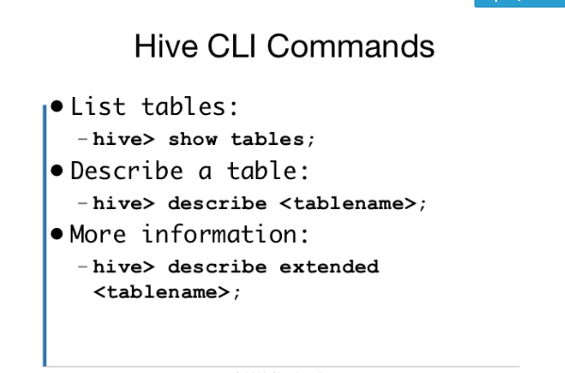
Hive commands
Karun Bourishetty

Slide 33
Hive commands
Karun Bourishetty

Slide 34
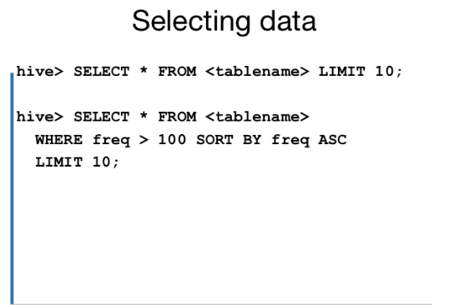
Hive commands
Karun Bourishetty

Slide 35
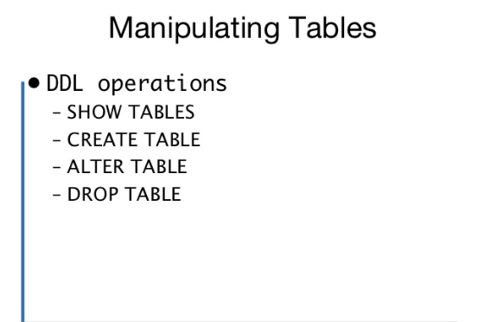
Hive commands
Karun Bourishetty

Slide 36
DEMO
Karun Bourishetty
Saikumar Nalivela

Slide 37
ANY QUESTIONS ? THANK YOU

Slide 38
Rferences
https://www.slideshare.net/AbhinavTyagi16/hiveppt
https://hive.apache.org/

