Slide 1
Matrix Multiplication & Transposition on Hypercube
Brett Duncan

Slide 2
Parallel Matrix Multiplication on Hypercube
Use processors, where .
Can visualize the processors as being arranged in an array, with processor occupying position , where and
  The binary representation of is
  The binary representations of , , and are
  , ,
  Processors agreeing on one or two of the coordinates form a hypercube.
  Processors agreeing on one coordinate form a hypercube with processors.
  Processors agreeing on two coordinates form a hypercube with processors.

Slide 3
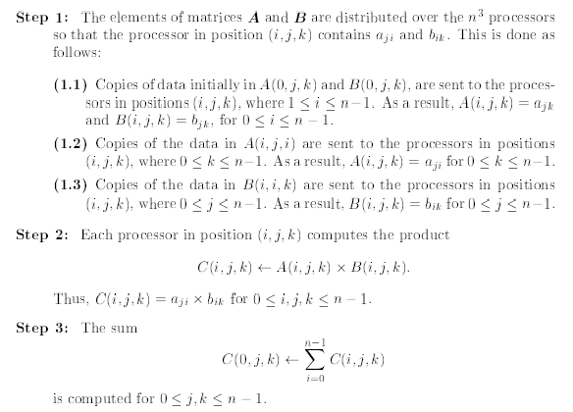
Parallel Matrix Multiplication on Hypercube

Slide 4
Parallel Matrix Multiplication on Hypercube
(The idea)
Example: Multiplying matrices
Step 1.1: Data in and are sent to processors in positions , where .
Indexing
1,5
2,6
100
101
1,5
2,6
000
001
3,7
4,8
110
111
3,7
4,8
010
011

Slide 5
Parallel Matrix Multiplication on Hypercube
(The idea)
Step 1.2: Copies of data in are sent to the processors in positions , where .
2
Indexing
1,5
2,6
100
101
1
1,5
2,6
000
001
2,6
3,7
4,8
110
111
3,7
4,8
4
010
011
3
Notes:
6

Slide 6
Parallel Matrix Multiplication on Hypercube
(The idea)
Step 1.3: Copies of data in are sent to the processors in positions , where .
7
8
Indexing
2,5
2,6
100
101
1,5
2,6
000
001
1,6
4,7
4,8
110
111
3,7
3,8
010
011
6
5
Notes:
Each processor is now dedicated to compute one of the products needed.
7

Slide 7
Parallel Matrix Multiplication on Hypercube
(The idea)
Step 2: Each processor computes the product of their local and registers.
14
16
5
6
Indexing
2,7
2,8
100
101
1,5
2,6
000
001
1,6
4,7
4,8
110
111
3,5
3,6
010
011
28
32
15
18
Notes:
8

Slide 8
Parallel Matrix Multiplication on Hypercube
(The idea)
Step 3: The sum
is computed for .
Indexing
14
16
100
101
5
2,6
000
001
6
28
32
110
111
15
18
010
011
Notes:
9

Slide 9
Parallel Matrix Multiplication on Hypercube
(The idea)
Step 3: The sum
is computed for .
Indexing
100
101
19
2,6
000
001
22
110
111
43
50
010
011
Notes:
10

Slide 10
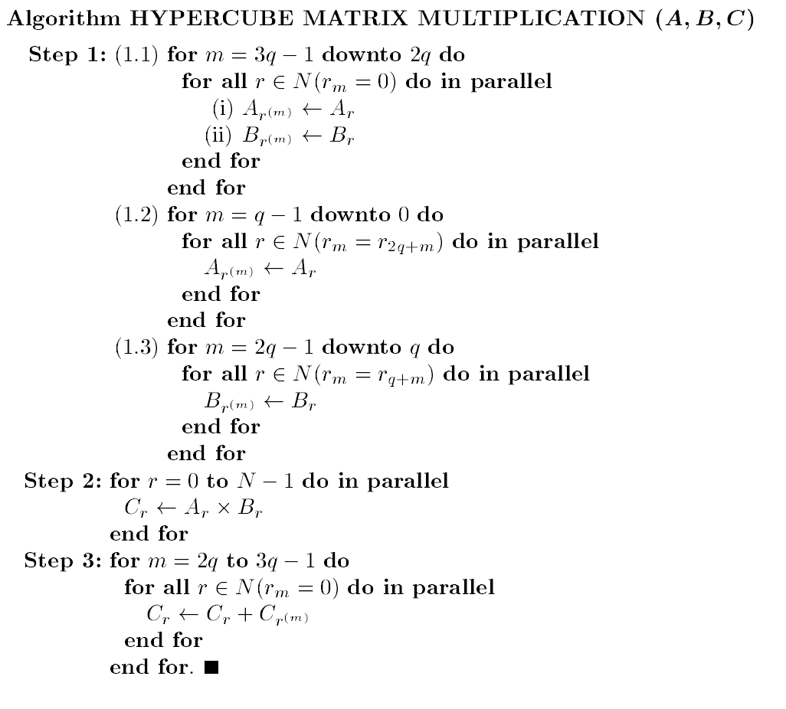
Parallel Matrix Multiplication on Hypercube
Use processors.
,
1,5
2,6
2,6
3,7
4,8
Indexing
100
101
000
001
110
111
010
011
Notes:
11

Slide 11
Parallel Matrix Multiplication on Hypercube
Use processors.
,
1
2
1,5
2,6
2,6
3
4
3,7
4,8
Indexing
100
101
000
001
110
111
010
011
Notes:
12

Slide 12
Parallel Matrix Multiplication on Hypercube
Use processors.
,
1,5
2,6
1,5
2,6
2,6
3,7
4,8
3,7
4,8
Indexing
100
101
000
001
110
111
010
011
Notes:
13

Slide 13
Parallel Matrix Multiplication on Hypercube
Use processors.
,
1,5
2,6
1,5
2,6
2,6
3,7
4,8
3,7
4,8
Indexing
100
101
000
001
110
111
010
011
Notes:
14

Slide 14
Parallel Matrix Multiplication on Hypercube
Use processors.
,
2,5
2,6
1,5
2,6
1,6
4,7
4,8
3,7
3,8
Indexing
100
101
000
001
110
111
010
011
Notes:
15

Slide 15
Parallel Matrix Multiplication on Hypercube
Use processors.
,
2,5
2,6
1,5
2,6
1,6
4,7
4,8
3,7
3,8
Indexing
100
101
000
001
110
111
010
011
Notes:
16

Slide 16
Parallel Matrix Multiplication on Hypercube
Use processors.
,
2,7
2,8
1,5
2,6
1,6
4,7
4,8
3,5
3,6
Indexing
100
101
000
001
110
111
010
011
Notes:
17

Slide 17
Parallel Matrix Multiplication on Hypercube
Use processors.
,
2x7
2x8
1x5
2,6
1x6
4x7
4x8
3x5
3x6
Indexing
100
101
000
001
110
111
010
011
Notes:
18

Slide 18
Parallel Matrix Multiplication on Hypercube
Use processors.
,
14
16
5
2,6
6
28
32
15
18
Indexing
100
101
000
001
110
111
010
011
Notes:
19

Slide 19
Parallel Matrix Multiplication on Hypercube
Use processors.
,
14
16
5
2,6
6
28
32
15
18
Indexing
100
101
000
001
110
111
010
011
Notes:
20

Slide 20
Parallel Matrix Multiplication on Hypercube
Use processors.
,
14
16
19
2,6
22
28
32
43
50
Indexing
100
101
000
001
110
111
010
011
Notes:
21

Slide 21
Parallel Matrix Multiplication on Hypercube
Analysis:
Steps 1.1, 1.2, 1.3, and step 3 require q iterations.
Step 2 is in constant time.
Time complexity is . (how?)
, so cost is . This is not cost optimal because the straightforward RAM algorithm takes multiplications.
Notes:
22

Slide 22
Hypercube Matrix Transpose
is an matrix whose transpose is.
  Each element of is such that .
The transpose can be computed on a hypercube with processors.
Can visualize the processors as being arranged in an array in row-major order.
Processor holds position , where and .

Slide 23
Hypercube Matrix Transpose
Initially, every element of is in processor in a register , where . After the matrix transpose algorithm, element of will be in processor , in register , where
The binary representations of and are and .
  is the binary representation for .
  is the binary representation for .
  is the binary representation for .
  is the binary representation for .
Thus,
and
Thus, an element can be routed from to in at most steps.

Slide 24
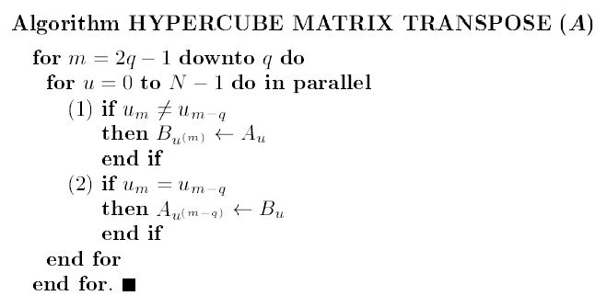
Hypercube Matrix Transpose
of is assumed to hold initially element of , where .
When the algorithm is done, holds .
An additional register is used by for routing data sent to it by other processors.

Slide 25
Hypercube Matrix Transpose
How it works:
Suppose the matrix is subdivided into four submatrices.
The elements of the bottom left submatrix are swapped with the corresponding elements of the top right submatrix. The other two submatrices are untouched.
Next, the same step is applied recursively to each of the four matrices. Each of the matrices, are subdivided into four matrices.

Slide 26
Hypercube Matrix Transpose
(The idea)
Example: Transposing a matrix
Divide into four or submatrices.
Swap the elements of the top right submatrix with the elements of the bottom left submatrix.

Slide 27
Hypercube Matrix Transpose
(The idea)
Example: Transposing a matrix
Divide into four or submatrices.
Swap the elements of the top right submatrix with the elements of the bottom left submatrix.

Slide 28
Hypercube Matrix Transpose
(The idea)
Example: Transposing a matrix
Recursively divide each submatrix into four submatrices.
Swap the elements of the top right submatrix with the elements of the bottom left submatrix.

Slide 29
Hypercube Matrix Transpose
(The idea)
Example: Transposing a matrix
Recursively divide each submatrix into four submatrices.
Swap the elements of the top right submatrix with the elements of the bottom left submatrix.

Slide 30
Hypercube Matrix Transpose
(The idea)
Example: Transposing a matrix
Recursively divide each submatrix into four submatrices.
Swap the elements of the top right submatrix with the elements of the bottom left submatrix.

Slide 31
Hypercube Matrix Transpose
(The idea)
Example: Transposing a matrix
Recursively divide each submatrix into four submatrices.
Swap the elements of the top right submatrix with the elements of the bottom left submatrix.

Slide 32
Hypercube Matrix Transpose
(The idea)
Example: Transposing a matrix
Recursively divide each submatrix into four submatrices.
Swap the elements of the top right submatrix with the elements of the bottom left submatrix.

Slide 33
Hypercube Matrix Transpose
(The idea)
Example: Transposing a matrix
Recursively divide each submatrix into four submatrices.
Swap the elements of the top right submatrix with the elements of the bottom left submatrix.

Slide 34
Hypercube Matrix Transpose
(The idea)
Example: Transposing a matrix
Recursively divide each submatrix into four submatrices.
Swap the elements of the top right submatrix with the elements of the bottom left submatrix.

Slide 35
Hypercube Matrix Transpose
(The idea)
Example: Transposing a matrix
Recursively divide each submatrix into four submatrices.
Swap the elements of the top right submatrix with the elements of the bottom left submatrix.

Slide 36
Hypercube Matrix Transpose
With the algorithm: , so .
0000 0001 0010 0011
0100 0101 0110 0111
1000 1001 1010 1011
1100 1101 1110 1111
m=2(2)-1=3
m-q=3-2=1

Slide 37
Hypercube Matrix Transpose
With the algorithm: , so .
0000 0001 0010 0011
0100 0101 0110 0111
1000 1001 1010 1011
1100 1101 1110 1111
m=2(2)-1=3
m-q=3-2=1
Notes:
38

Slide 38
Hypercube Matrix Transpose
With the algorithm: , so .
0000 0001 0010 0011
0100 0101 0110 0111
1000 1001 1010 1011
1100 1101 1110 1111
m=2(2)-1=3
m-q=3-2=1
Notes:
39

Slide 39
Hypercube Matrix Transpose
With the algorithm: , so .
0000 0001 0010 0011
0100 0101 0110 0111
1000 1001 1010 1011
1100 1101 1110 1111
m=2(2)-1=3
m-q=3-2=1
Notes:
40

Slide 40
Hypercube Matrix Transpose
With the algorithm: , so .
0000 0001 0010 0011
0100 0101 0110 0111
1000 1001 1010 1011
1100 1101 1110 1111
m=2(2)-1=3
m-q=3-2=1
Notes:
41

Slide 41
Hypercube Matrix Transpose
With the algorithm: , so .
0000 0001 0010 0011
0100 0101 0110 0111
1000 1001 1010 1011
1100 1101 1110 1111
m=2(2)-1=3
m-q=3-2=1
Notes:
42

Slide 42
Hypercube Matrix Transpose
With the algorithm: , so .
0000 0001 0010 0011
0100 0101 0110 0111
1000 1001 1010 1011
1100 1101 1110 1111
m=2
m-q=2-2=0
Notes:
43

Slide 43
Hypercube Matrix Transpose
With the algorithm: , so .
0000 0001 0010 0011
0100 0101 0110 0111
1000 1001 1010 1011
1100 1101 1110 1111
m=2
m-q=2-2=0
Notes:
44

Slide 44
Hypercube Matrix Transpose
With the algorithm: , so .
0000 0001 0010 0011
0100 0101 0110 0111
1000 1001 1010 1011
1100 1101 1110 1111
m=2
m-q=2-2=0
Notes:
45

Slide 45
Hypercube Matrix Transpose
With the algorithm: , so .
0000 0001 0010 0011
0100 0101 0110 0111
1000 1001 1010 1011
1100 1101 1110 1111
m=2
m-q=2-2=0
Notes:
46

Slide 46
Hypercube Matrix Transpose
With the algorithm: , so .
0000 0001 0010 0011
0100 0101 0110 0111
1000 1001 1010 1011
1100 1101 1110 1111
m=2
m-q=2-2=0
Notes:
47

Slide 47
Hypercube Matrix Transpose
Analysis:
There are constant time iterations. The run time is . (how?)
, so the cost is . Not cost optimal because the RAM algorithm only needs operations.

