Slide 1
Matrix Multiplication & Transposition on Hypercube
Presented by Brett Duncan

Slide 2
Matrix Multiplication Applications
Many problems can be solved using matrix multiplication or a variation of it. [1]
Finding the shortest distance between all pairs of vertices in a graph.
Transitive closure
Finding the radius, diameter, and centers of a graph.
Finding a breadth-first spanning tree
Topological sort

Slide 3
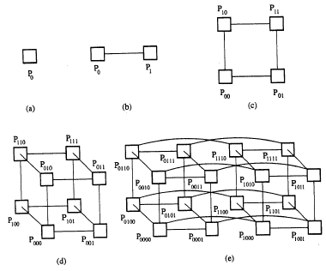
Hypercube Interconnection Network

Slide 4
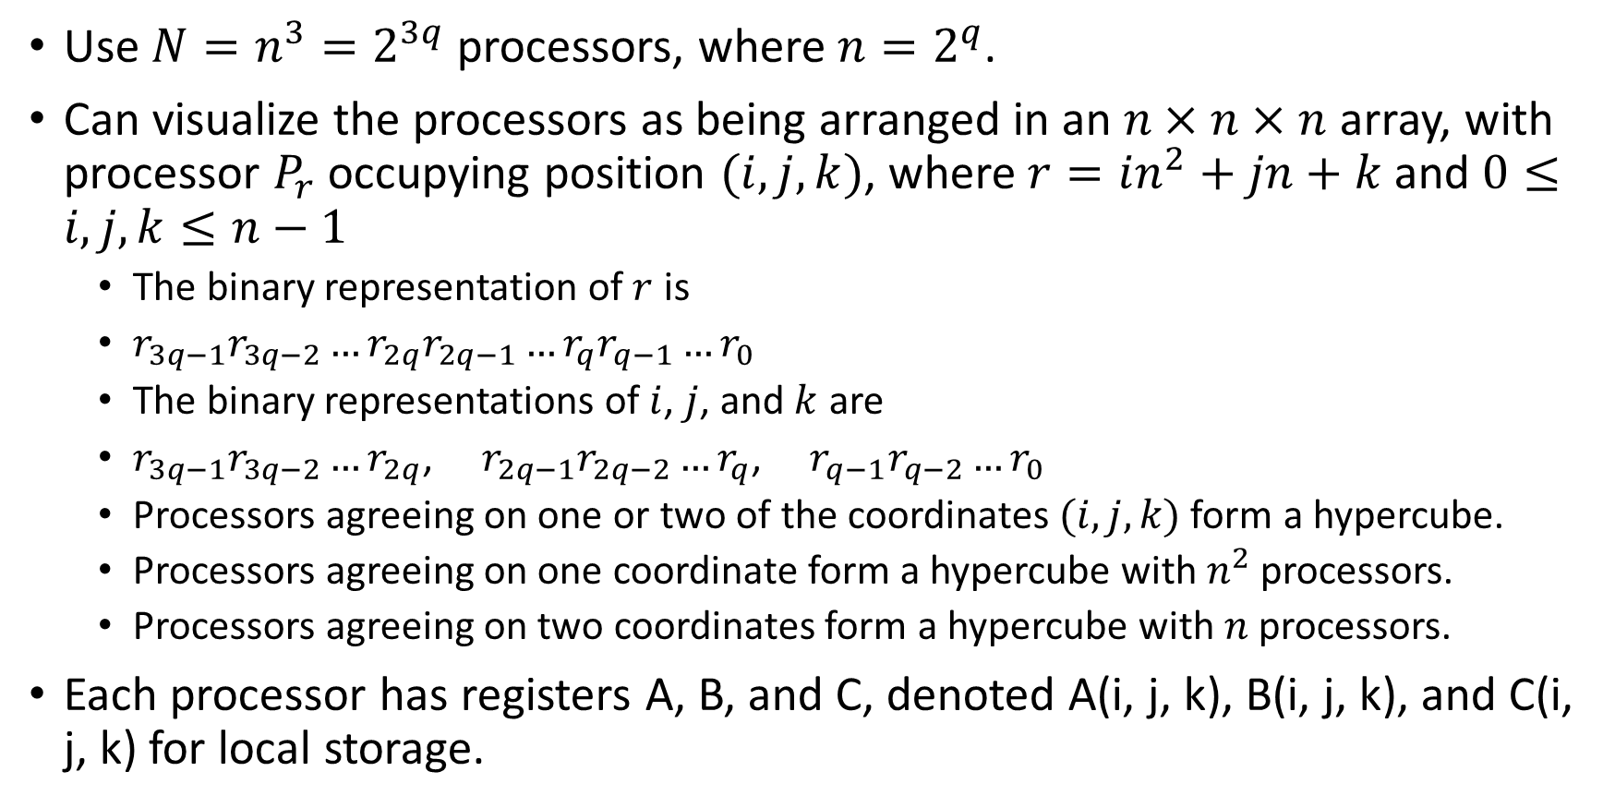
Parallel Matrix Multiplication on Hypercube
Use $N=n^{3}=2^{3q}$ processors, where $n=2^{q}$.
Can visualize the processors as being arranged in an $n×n×n$ array, with processor $P_{r}$ occupying position $(i, j, k)$, where $r=in^{2}+jn+k$ and $0≤i,j,k≤n−1$
The binary representation of $r$ is
$r_{3q−1}r_{3q−2}…r_{2q}r_{2q−1}…r_{q}r_{q−1}…r_{0}$
The binary representations of $i$, $j$, and $k$ are
$r_{3q−1}r_{3q−2}…r_{2q}$, $r_{2q−1}r_{2q−2}…r_{q}$, $r_{q−1}r_{q−2}…r_{0}$
Processors agreeing on one or two of the coordinates $(i, j, k)$ form a hypercube.
Processors agreeing on one coordinate form a hypercube with $n^{2}$ processors.
Processors agreeing on two coordinates form a hypercube with $n$ processors.
Each processor has registers A, B, and C, denoted A(i, j, k), B(i, j, k), and C(i, j, k) for local storage.

Slide 5
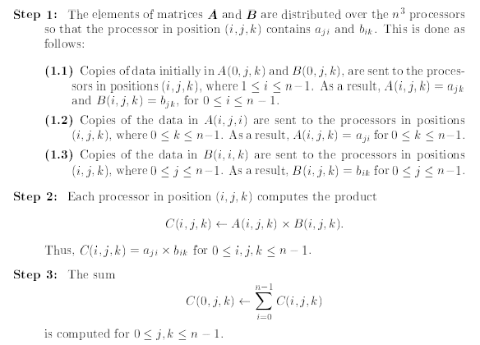
Parallel Matrix Multiplication on Hypercube

Slide 6
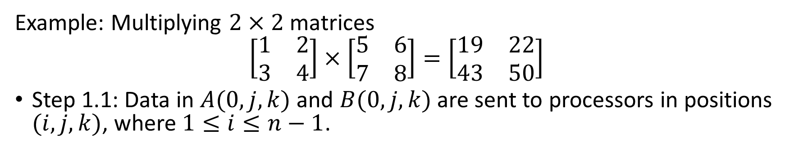
Parallel Matrix Multiplication on Hypercube (The idea)
Example: Multiplying $2×2$ matrices
$$\left[\begin{matrix}1 & 2 \\ 3 & 4\end{matrix}\right]×\left[\begin{matrix}5 & 6 \\ 7 & 8\end{matrix}\right]=\left[\begin{matrix}19 & 22 \\ 43 & 50\end{matrix}\right]$$
Step 1.1: Data in $A(0, j, k)$ and $B(0, j, k)$ are sent to processors in positions $(i, j, k)$, where $1≤i≤n−1$.
Indexing (i, j, k)
1,5
2,6
100
101
1,5
2,6
000
001
3,7
4,8
110
111
3,7
4,8
010
011

Slide 7
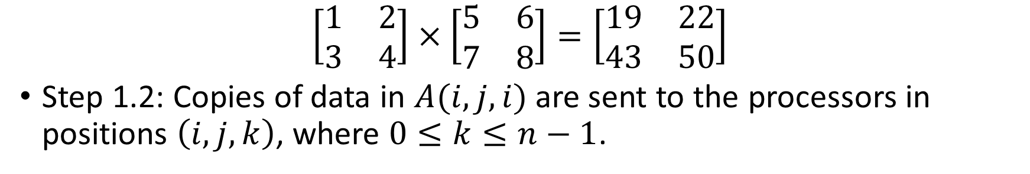
Parallel Matrix Multiplication on Hypercube (The idea)
$$\left[\begin{matrix}1 & 2 \\ 3 & 4\end{matrix}\right]×\left[\begin{matrix}5 & 6 \\ 7 & 8\end{matrix}\right]=\left[\begin{matrix}19 & 22 \\ 43 & 50\end{matrix}\right]$$
Step 1.2: Copies of data in $A(i, j, i)$ are sent to the processors in positions $\left(i, j,k\right)$, where $0≤k≤n−1$.
2
Indexing (i, j, k)
1,5
2,6
100
101
1
1,5
2,6
000
001
2,6
3,7
4,8
110
111
3,7
4,8
4
010
011
3

Slide 8
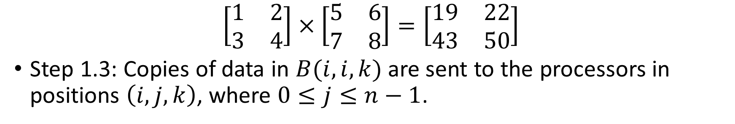
Parallel Matrix Multiplication on Hypercube (The idea)
$$\left[\begin{matrix}1 & 2 \\ 3 & 4\end{matrix}\right]×\left[\begin{matrix}5 & 6 \\ 7 & 8\end{matrix}\right]=\left[\begin{matrix}19 & 22 \\ 43 & 50\end{matrix}\right]$$
Step 1.3: Copies of data in $B(i, i,k)$ are sent to the processors in positions $\left(i, j,k\right)$, where $0≤j≤n−1$.
7
8
Indexing (i, j, k)
2,5
2,6
100
101
1,5
2,6
000
001
1,6
4,7
4,8
110
111
3,7
3,8
010
011
6
5
Notes:
Each processor is now dedicated to compute one of the $n^{3}$ products needed.

Slide 9
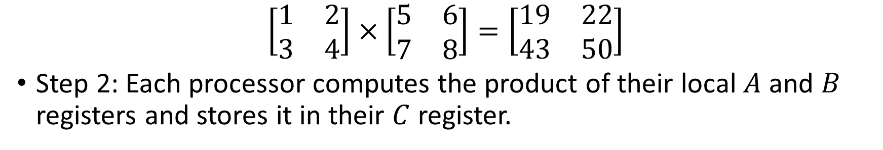
Parallel Matrix Multiplication on Hypercube (The idea)
$$\left[\begin{matrix}1 & 2 \\ 3 & 4\end{matrix}\right]×\left[\begin{matrix}5 & 6 \\ 7 & 8\end{matrix}\right]=\left[\begin{matrix}19 & 22 \\ 43 & 50\end{matrix}\right]$$
Step 2: Each processor computes the product of their local $A$ and $B$ registers and stores it in their $C$ register.
14
16
5
6
Indexing (i, j, k)
2,7
2,8
100
101
1,5
2,6
000
001
1,6
4,7
4,8
110
111
3,5
3,6
010
011
28
32
15
18

Slide 10
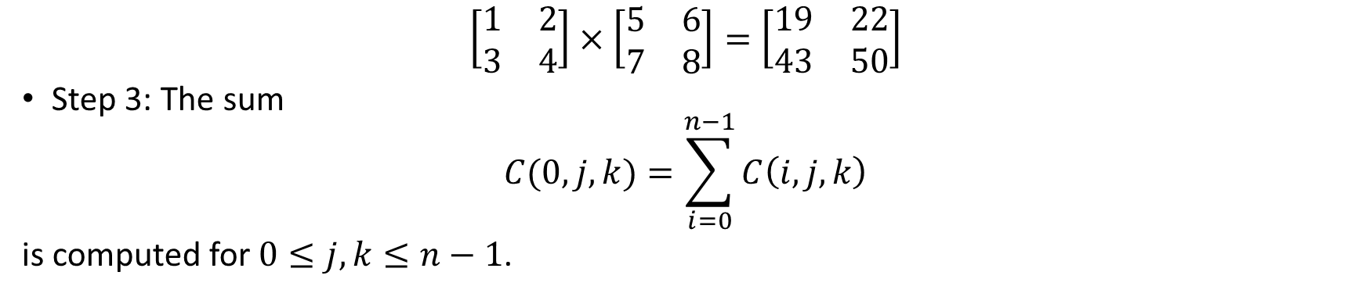
Parallel Matrix Multiplication on Hypercube (The idea)
$$\left[\begin{matrix}1 & 2 \\ 3 & 4\end{matrix}\right]×\left[\begin{matrix}5 & 6 \\ 7 & 8\end{matrix}\right]=\left[\begin{matrix}19 & 22 \\ 43 & 50\end{matrix}\right]$$
Step 3: The sum
$$C(0,j,k)=\sum_{i=0}^{n−1}{C\left(i,j,k\right)}$$
is computed for $0≤j,k≤n−1$.
Indexing (i, j, k)
14
16
100
101
5
2,6
000
001
6
28
32
110
111
15
18
010
011

Slide 11
Parallel Matrix Multiplication on Hypercube (The idea)
$$\left[\begin{matrix}1 & 2 \\ 3 & 4\end{matrix}\right]×\left[\begin{matrix}5 & 6 \\ 7 & 8\end{matrix}\right]=\left[\begin{matrix}19 & 22 \\ 43 & 50\end{matrix}\right]$$
Step 3: The sum
$$C(0,j,k)=\sum_{i=0}^{n−1}{C\left(i,j,k\right)}$$
is computed for $0≤j,k≤n−1$.
Indexing (i, j, k)
100
101
19
2,6
000
001
22
110
111
43
50
010
011

Slide 12
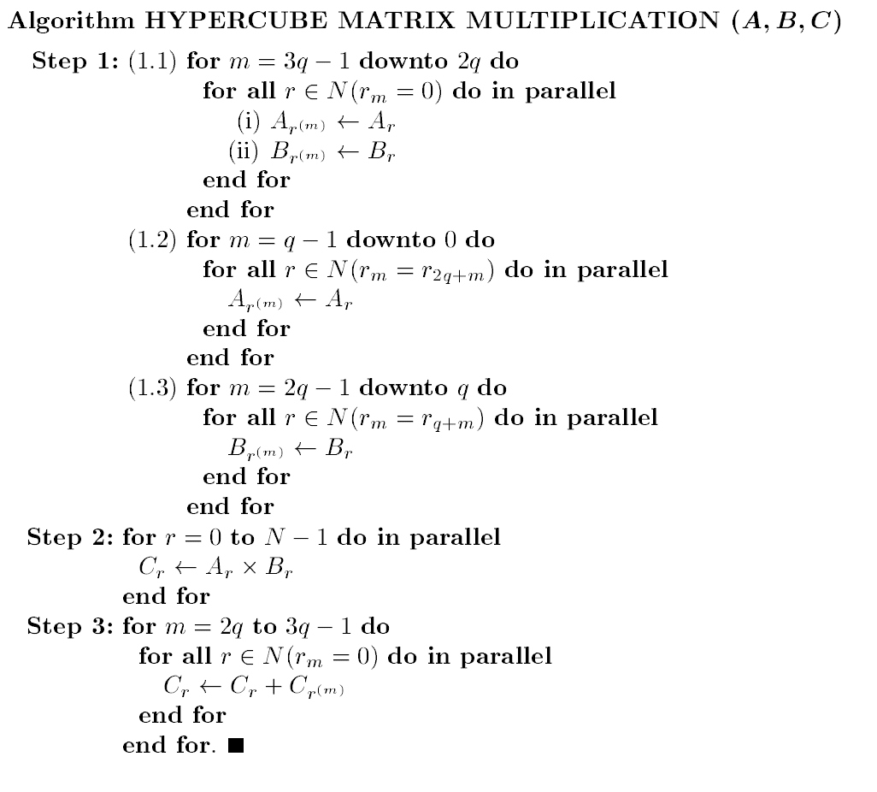
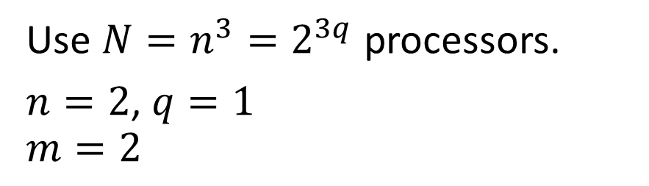
Parallel Matrix Multiplication on Hypercube
Use $N=n^{3}=2^{3q}$ processors.
$n=2$, $q=1$
$$m=2$$
1,5
2,6
2,6
3,7
4,8
Binary Indexing
100
101
000
001
110
111
010
011

Slide 13
Parallel Matrix Multiplication on Hypercube
Use $N=n^{3}=2^{3q}$ processors.
$n=2$, $q=1$
$$m=2$$
1
2
1,5
2,6
2,6
3
4
3,7
4,8
Binary Indexing
100
101
000
001
110
111
010
011

Slide 14
Parallel Matrix Multiplication on Hypercube
Use $N=n^{3}=2^{3q}$ processors.
$n=2$, $q=1$
$$m=2$$
1,5
2,6
1,5
2,6
2,6
3,7
4,8
3,7
4,8
Binary Indexing
100
101
000
001
110
111
010
011

Slide 15
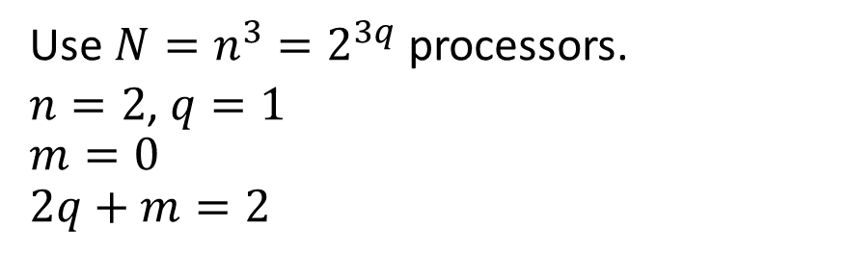
Parallel Matrix Multiplication on Hypercube
Use $N=n^{3}=2^{3q}$ processors.
$n=2$, $q=1$
$$m=0$$
$$2q+m=2$$
1,5
2,6
1,5
2,6
2,6
3,7
4,8
3,7
4,8
Binary Indexing
100
101
000
001
110
111
010
011

Slide 16
Parallel Matrix Multiplication on Hypercube
Use $N=n^{3}=2^{3q}$ processors.
$n=2$, $q=1$
$$m=0$$
$$2q+m=2$$
2,5
2,6
1,5
2,6
1,6
4,7
4,8
3,7
3,8
Binary Indexing
100
101
000
001
110
111
010
011

Slide 17
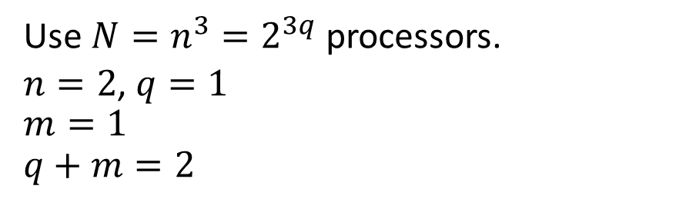
Parallel Matrix Multiplication on Hypercube
Use $N=n^{3}=2^{3q}$ processors.
$n=2$, $q=1$
$$m=1$$
$$q+m=2$$
2,5
2,6
1,5
2,6
1,6
4,7
4,8
3,7
3,8
Binary Indexing
100
101
000
001
110
111
010
011

Slide 18
Parallel Matrix Multiplication on Hypercube
Use $N=n^{3}=2^{3q}$ processors.
$n=2$, $q=1$
$$m=1$$
$$q+m=2$$
2,7
2,8
1,5
2,6
1,6
4,7
4,8
3,5
3,6
Binary Indexing
100
101
000
001
110
111
010
011

Slide 19
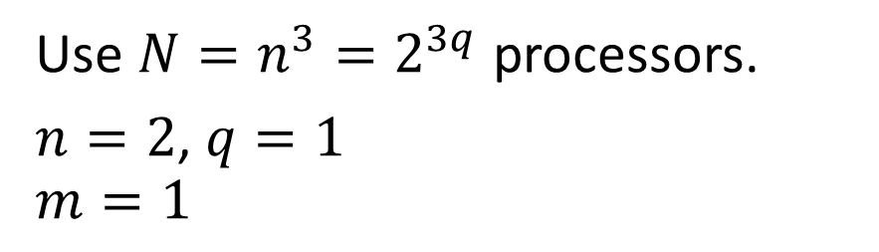
Parallel Matrix Multiplication on Hypercube
Use $N=n^{3}=2^{3q}$ processors.
$n=2$, $q=1$
$$m=1$$
2x7
2x8
1x5
2,6
1x6
4x7
4x8
3x5
3x6
Binary Indexing
100
101
000
001
110
111
010
011

Slide 20
Parallel Matrix Multiplication on Hypercube
Use $N=n^{3}=2^{3q}$ processors.
$n=2$, $q=1$
$$m=1$$
14
16
5
2,6
6
28
32
15
18
Binary Indexing
100
101
000
001
110
111
010
011

Slide 21
Parallel Matrix Multiplication on Hypercube
Use $N=n^{3}=2^{3q}$ processors.
$n=2$, $q=1$
$$m=1$$
14
16
5
2,6
6
28
32
15
18
Binary Indexing
100
101
000
001
110
111
010
011

Slide 22
Parallel Matrix Multiplication on Hypercube
Use $N=n^{3}=2^{3q}$ processors.
$n=2$, $q=1$
$$m=1$$
14
16
19
2,6
22
28
32
43
50
Binary Indexing
100
101
000
001
110
111
010
011

Slide 23
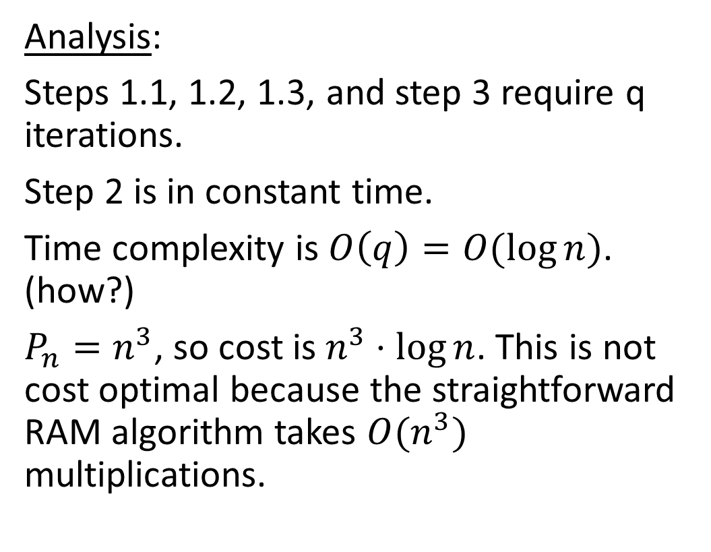
Parallel Matrix Multiplication on Hypercube
Analysis:
Steps 1.1, 1.2, 1.3, and step 3 require q iterations.
Step 2 is in constant time.
Time complexity is $O\left(q\right)=O(\log{n})$. (how?)
$P_{n}=n^{3}$, so cost is $n^{3}⋅\log{n}$. This is not cost optimal because the straightforward RAM algorithm takes $O(n^{3})$ multiplications.

Slide 24
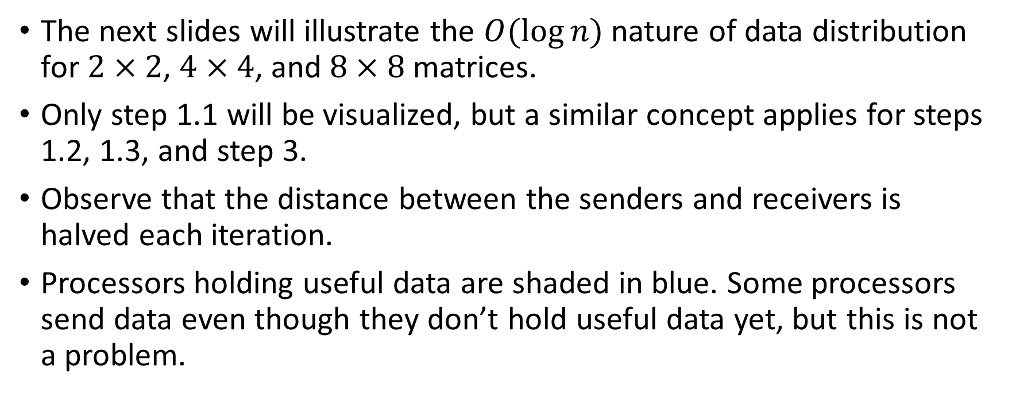
Parallel Matrix Multiplication on Hypercube
The next slides will illustrate the $O(\log{n})$ nature of data distribution for $2×2$, $4×4$, and $8×8$ matrices.
Only step 1.1 will be visualized, but a similar concept applies for steps 1.2, 1.3, and step 3.
Observe that the distance between the senders and receivers is halved each iteration.
Processors holding useful data are shaded in blue. Some processors send data even though they don’t hold useful data yet, but this is not a problem.

Slide 25
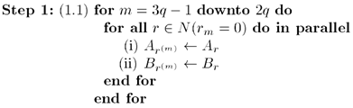
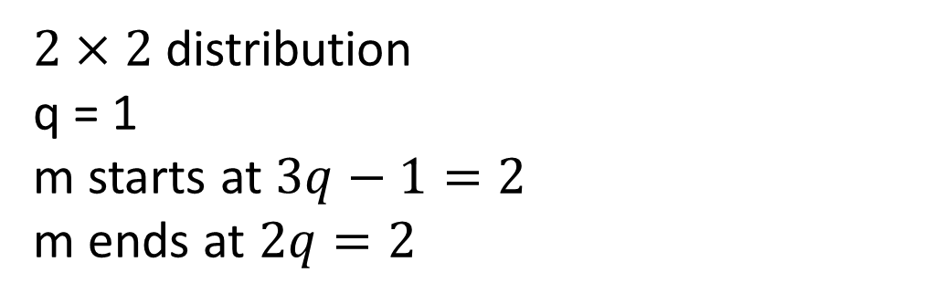
Parallel Matrix Multiplication on Hypercube (log n distribution example)
$2×2$ distribution
q = 1
m starts at $3q−1=2$
m ends at $2q=2$
For all where
the mth bit
is 0
Send to
neighboring
processor by
flipping bit m
Binary coordinates:
100 101
110 111
Binary coordinates:
000 001
010 011

Slide 26
Parallel Matrix Multiplication on Hypercube (log n distribution example)
$2×2$ distribution
q = 1
m starts at $3q−1=2$
m ends at $2q=2$
For all where
the mth bit
is 0
Send to
neighboring
processor by
flipping bit m
Binary coordinates:
100 101
110 111
Binary coordinates:
000 001
010 011

Slide 27
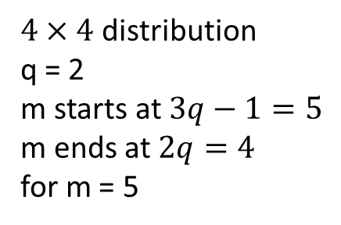
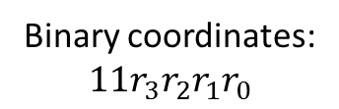
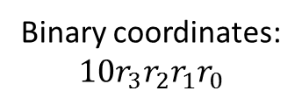
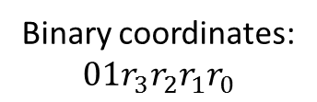
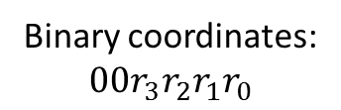
Parallel Matrix Multiplication on Hypercube (log n distribution example)
$4×4$ distribution
q = 2
m starts at $3q−1=5$
m ends at $2q=4$
for m = 5
Binary coordinates:
$$00r_{3}r_{2}r_{1}r_{0}$$
Binary coordinates:
$$11r_{3}r_{2}r_{1}r_{0}$$
Binary coordinates:
$$10r_{3}r_{2}r_{1}r_{0}$$
Binary coordinates:
$$01r_{3}r_{2}r_{1}r_{0}$$

Slide 28
Parallel Matrix Multiplication on Hypercube (log n distribution example)
$4×4$ distribution
q = 2
m starts at $3q−1=5$
m ends at $2q=4$
for m = 5
Binary coordinates:
$$00r_{3}r_{2}r_{1}r_{0}$$
Binary coordinates:
$$11r_{3}r_{2}r_{1}r_{0}$$
Binary coordinates:
$$10r_{3}r_{2}r_{1}r_{0}$$
Binary coordinates:
$$01r_{3}r_{2}r_{1}r_{0}$$

Slide 29
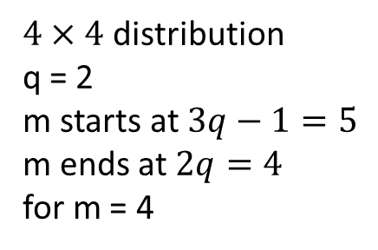
Parallel Matrix Multiplication on Hypercube (log n distribution example)
$4×4$ distribution
q = 2
m starts at $3q−1=5$
m ends at $2q=4$
for m = 4
Binary coordinates:
$$00r_{3}r_{2}r_{1}r_{0}$$
Binary coordinates:
$$11r_{3}r_{2}r_{1}r_{0}$$
Binary coordinates:
$$10r_{3}r_{2}r_{1}r_{0}$$
Binary coordinates:
$$01r_{3}r_{2}r_{1}r_{0}$$

Slide 30
Parallel Matrix Multiplication on Hypercube (log n distribution example)
$4×4$ distribution
q = 2
m starts at $3q−1=5$
m ends at $2q=4$
for m = 4
Binary coordinates:
$$00r_{3}r_{2}r_{1}r_{0}$$
Binary coordinates:
$$11r_{3}r_{2}r_{1}r_{0}$$
Binary coordinates:
$$10r_{3}r_{2}r_{1}r_{0}$$
Binary coordinates:
$$01r_{3}r_{2}r_{1}r_{0}$$

Slide 31

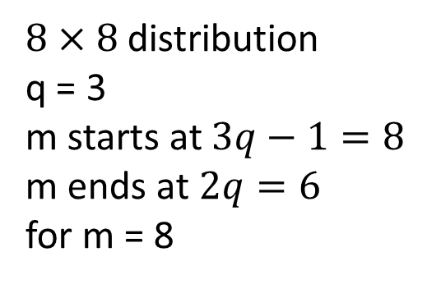







Parallel Matrix Multiplication on Hypercube (log n distribution example)
$8×8$ distribution
q = 3
m starts at $3q−1=8$
m ends at $2q=6$
for m = 8
$$110r_{5}…r_{0}$$
$$111r_{5}…r_{0}$$
$$101r_{5}…r_{0}$$
$$100r_{5}…r_{0}$$
$$011r_{5}…r_{0}$$
$$010r_{5}…r_{0}$$
$$001r_{5}…r_{0}$$
$$000r_{5}…r_{0}$$

Slide 32
Parallel Matrix Multiplication on Hypercube (log n distribution example)
$8×8$ distribution
q = 3
m starts at $3q−1=8$
m ends at $2q=6$
for m = 8
$$110r_{5}…r_{0}$$
$$111r_{5}…r_{0}$$
$$101r_{5}…r_{0}$$
$$100r_{5}…r_{0}$$
$$011r_{5}…r_{0}$$
$$010r_{5}…r_{0}$$
$$001r_{5}…r_{0}$$
$$000r_{5}…r_{0}$$

Slide 33
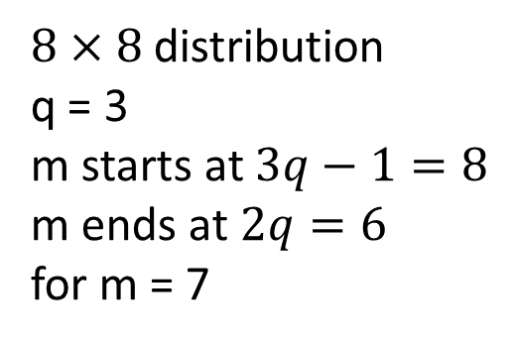
Parallel Matrix Multiplication on Hypercube (log n distribution example)
$8×8$ distribution
q = 3
m starts at $3q−1=8$
m ends at $2q=6$
for m = 7
$$110r_{5}…r_{0}$$
$$111r_{5}…r_{0}$$
$$101r_{5}…r_{0}$$
$$100r_{5}…r_{0}$$
$$011r_{5}…r_{0}$$
$$010r_{5}…r_{0}$$
$$001r_{5}…r_{0}$$
$$000r_{5}…r_{0}$$

Slide 34
Parallel Matrix Multiplication on Hypercube (log n distribution example)
$8×8$ distribution
q = 3
m starts at $3q−1=8$
m ends at $2q=6$
for m = 7
$$110r_{5}…r_{0}$$
$$111r_{5}…r_{0}$$
$$101r_{5}…r_{0}$$
$$100r_{5}…r_{0}$$
$$011r_{5}…r_{0}$$
$$010r_{5}…r_{0}$$
$$001r_{5}…r_{0}$$
$$000r_{5}…r_{0}$$

Slide 35
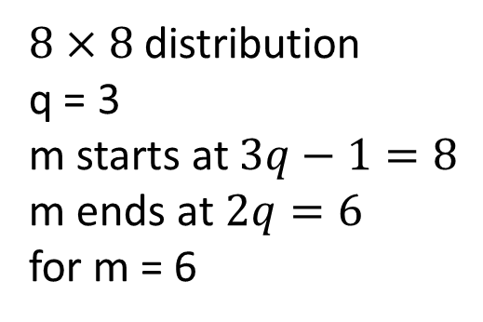
Parallel Matrix Multiplication on Hypercube (log n distribution example)
$8×8$ distribution
q = 3
m starts at $3q−1=8$
m ends at $2q=6$
for m = 6
$$110r_{5}…r_{0}$$
$$111r_{5}…r_{0}$$
$$101r_{5}…r_{0}$$
$$100r_{5}…r_{0}$$
$$011r_{5}…r_{0}$$
$$010r_{5}…r_{0}$$
$$001r_{5}…r_{0}$$
$$000r_{5}…r_{0}$$

Slide 36
Parallel Matrix Multiplication on Hypercube (log n distribution example)
$8×8$ distribution
q = 3
m starts at $3q−1=8$
m ends at $2q=6$
for m = 6
$$110r_{5}…r_{0}$$
$$111r_{5}…r_{0}$$
$$101r_{5}…r_{0}$$
$$100r_{5}…r_{0}$$
$$011r_{5}…r_{0}$$
$$010r_{5}…r_{0}$$
$$001r_{5}…r_{0}$$
$$000r_{5}…r_{0}$$

Slide 37
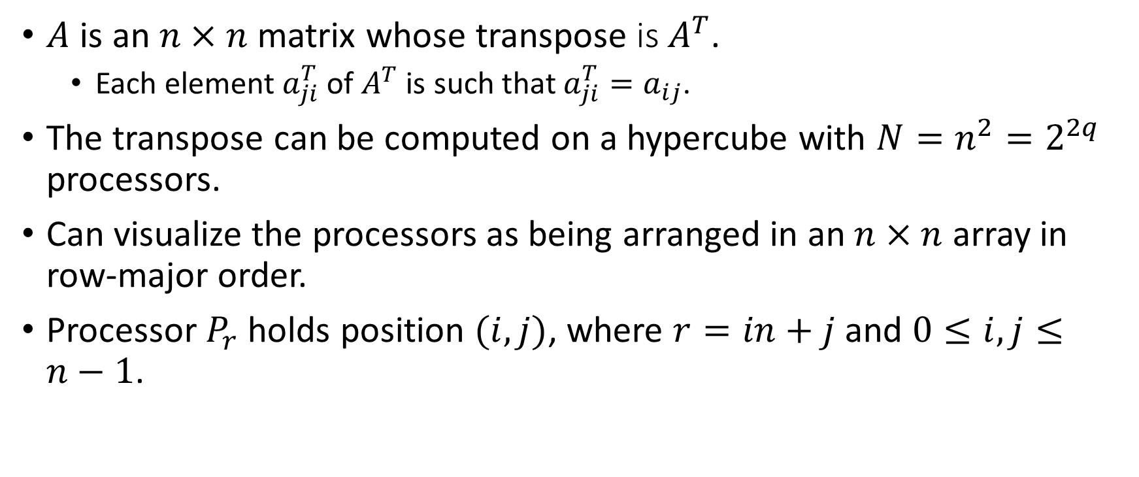
Hypercube Matrix Transpose
$A$ is an $n×n$ matrix whose transpose is$A^{T}$.
Each element $a_{ji}^{T}$ of $A^{T}$ is such that $a_{ji}^{T}=a_{ij}$.
The transpose can be computed on a hypercube with $N=n^{2}=2^{2q}$ processors.
Can visualize the processors as being arranged in an $n×n$ array in row-major order.
Processor $P_{r}$ holds position $(i, j)$, where $r=in+j$ and $0≤i,j≤n−1$.

Slide 38
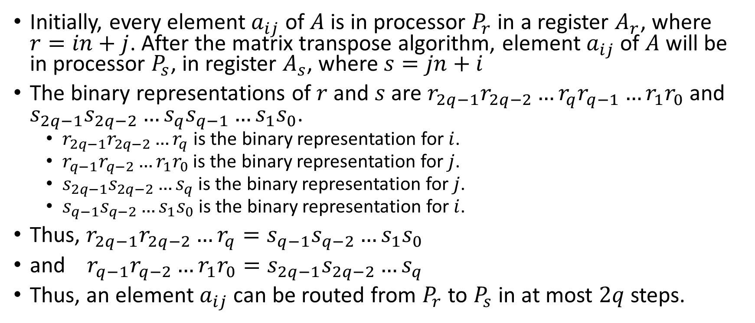
Hypercube Matrix Transpose
Initially, every element $a_{ij}$ of $A$ is in processor $P_{r}$ in a register $A_{r}$, where $r=in+j$. After the matrix transpose algorithm, element $a_{ij}$ of $A$ will be in processor $P_{s}$, in register $A_{s}$, where $s=jn+i$
The binary representations of $r$ and $s$ are $r_{2q−1}r_{2q−2}…r_{q}r_{q−1}…r_{1}r_{0}$ and $s_{2q−1}s_{2q−2}…s_{q}s_{q−1}…s_{1}s_{0}$.
$r_{2q−1}r_{2q−2}…r_{q}$ is the binary representation for $i$.
$r_{q−1}r_{q−2}…r_{1}r_{0}$ is the binary representation for $j$.
$s_{2q−1}s_{2q−2}…s_{q}$ is the binary representation for $j$.
$s_{q−1}s_{q−2}…s_{1}s_{0}$ is the binary representation for $i$.
Thus, $r_{2q−1}r_{2q−2}…r_{q}=s_{q−1}s_{q−2}…s_{1}s_{0}$
and $r_{q−1}r_{q−2}…r_{1}r_{0}=s_{2q−1}s_{2q−2}…s_{q}$
Thus, an element $a_{ij}$ can be routed from $P_{r}$ to $P_{s}$ in at most $2q$ steps.

Slide 39
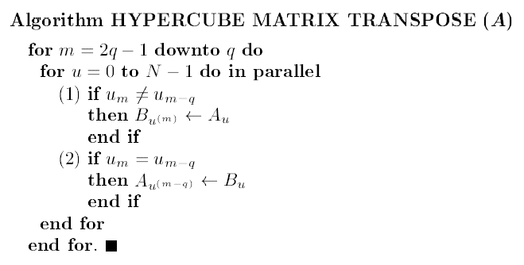
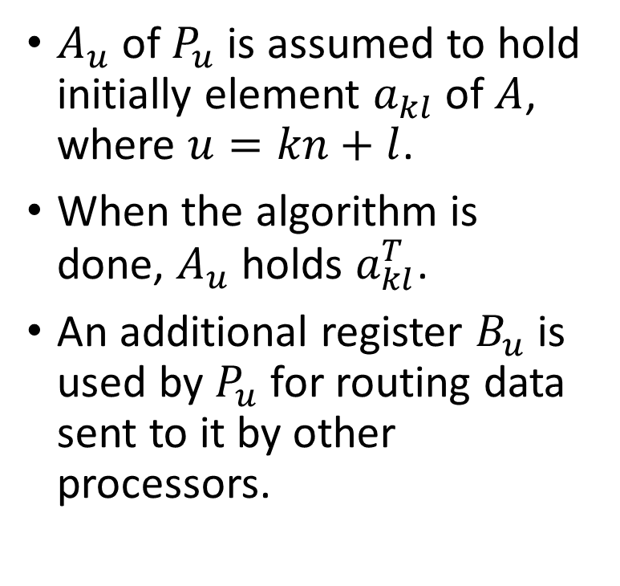
Hypercube Matrix Transpose
$A_{u}$ of $P_{u}$ is assumed to hold initially element $a_{kl}$ of $A$, where $u=kn+l$.
When the algorithm is done, $A_{u}$ holds $a_{kl}^{T}$.
An additional register $B_{u}$ is used by $P_{u}$ for routing data sent to it by other processors.

Slide 40
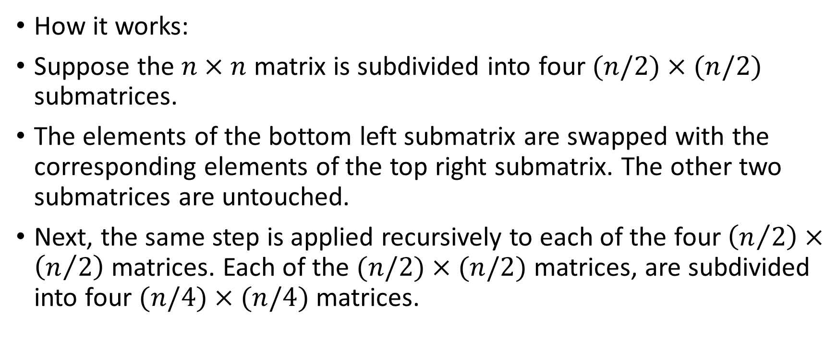
Hypercube Matrix Transpose
How it works:
Suppose the $n×n$ matrix is subdivided into four $(n/2)×(n/2)$ submatrices.
The elements of the bottom left submatrix are swapped with the corresponding elements of the top right submatrix. The other two submatrices are untouched.
Next, the same step is applied recursively to each of the four $\left(n/2\right)×\left(n/2\right)$ matrices. Each of the $(n/2)×(n/2)$ matrices, are subdivided into four $(n/4)×(n/4)$ matrices.

Slide 41
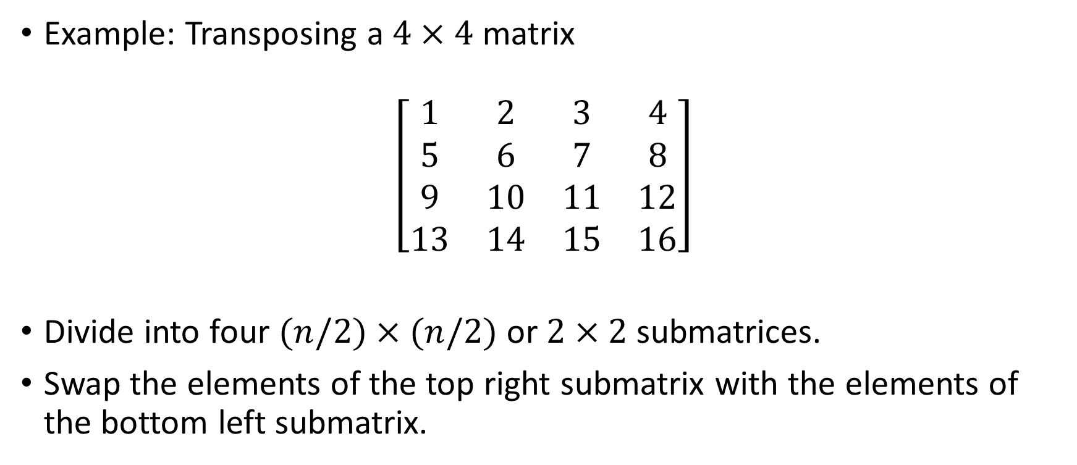
Hypercube Matrix Transpose (The idea)
Example: Transposing a $4×4$ matrix
$$\left[\begin{matrix}1 & 2 & 3 & 4 \\ 5 & 6 & 7 & 8 \\ 9 & 10 & 11 & 12 \\ 13 & 14 & 15 & 16\end{matrix}\right]$$
Divide into four $(n/2)×(n/2)$ or $2×2$ submatrices.
Swap the elements of the top right submatrix with the elements of the bottom left submatrix.

Slide 42
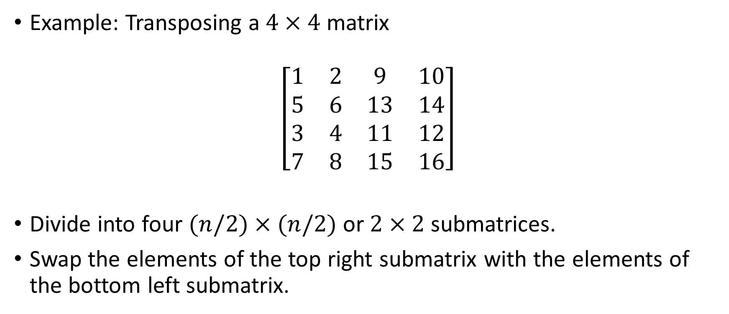
Hypercube Matrix Transpose (The idea)
Example: Transposing a $4×4$ matrix
$$\left[\begin{matrix}1 & 2 & 9 & 10 \\ 5 & 6 & 13 & 14 \\ 3 & 4 & 11 & 12 \\ 7 & 8 & 15 & 16\end{matrix}\right]$$
Divide into four $(n/2)×(n/2)$ or $2×2$ submatrices.
Swap the elements of the top right submatrix with the elements of the bottom left submatrix.

Slide 43
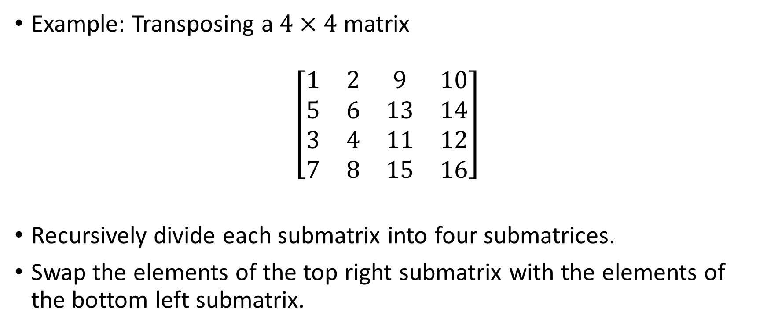
Hypercube Matrix Transpose (The idea)
Example: Transposing a $4×4$ matrix
$$\left[\begin{matrix}1 & 2 & 9 & 10 \\ 5 & 6 & 13 & 14 \\ 3 & 4 & 11 & 12 \\ 7 & 8 & 15 & 16\end{matrix}\right]$$
Recursively divide each submatrix into four submatrices.
Swap the elements of the top right submatrix with the elements of the bottom left submatrix.

Slide 44
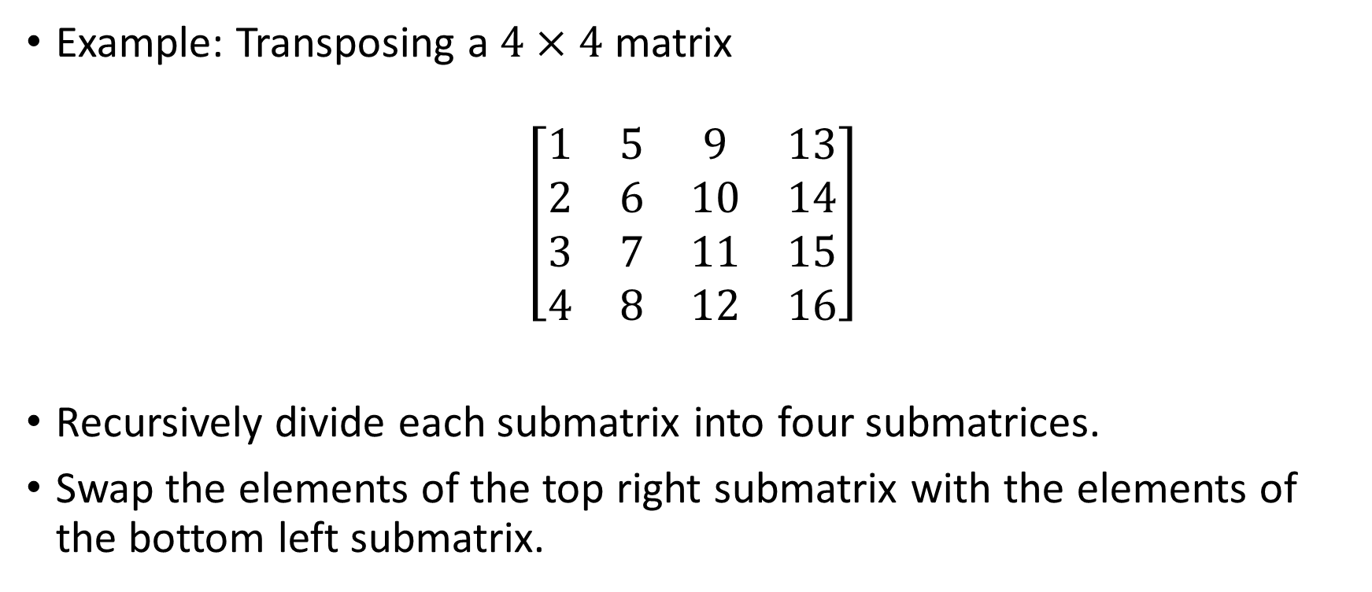
Hypercube Matrix Transpose (The idea)
Example: Transposing a $4×4$ matrix
$$\left[\begin{matrix}1 & 5 & 9 & 13 \\ 2 & 6 & 10 & 14 \\ 3 & 7 & 11 & 15 \\ 4 & 8 & 12 & 16\end{matrix}\right]$$
Recursively divide each submatrix into four submatrices.
Swap the elements of the top right submatrix with the elements of the bottom left submatrix.

Slide 45

Hypercube Matrix Transpose
With the algorithm: $N=n^{2}=2^{2q}$, so $q=2$.
$\left[\begin{matrix}1 & 2 & 3 & 4 \\ 5 & 6 & 7 & 8 \\ 9 & 10 & 11 & 12 \\ 13 & 14 & 15 & 16\end{matrix}\right]$
0000 0001 0010 0011
0100 0101 0110 0111
1000 1001 1010 1011
1100 1101 1110 1111
m=3
m-q=1

Slide 46
Hypercube Matrix Transpose
With the algorithm: $N=n^{2}=2^{2q}$, so $q=2$.
$\left[\begin{matrix}1 & 2 & 3 & 4 \\ 5 & 6 & 7 & 8 \\ 9 & 10 & 11 & 12 \\ 13 & 14 & 15 & 16\end{matrix}\right]$
0000 0001 0010 0011
0100 0101 0110 0111
1000 1001 1010 1011
1100 1101 1110 1111
m=3
m-q=1

Slide 47

Hypercube Matrix Transpose
With the algorithm: $N=n^{2}=2^{2q}$, so $q=2$.
$\left[\begin{matrix}1,9 & 2,10 & 3 & 4 \\ 5,13 & 6,14 & 7 & 8 \\ 9 & 10 & 11,3 & 12,4 \\ 13 & 14 & 15,7 & 16,8\end{matrix}\right]$
0000 0001 0010 0011
0100 0101 0110 0111
1000 1001 1010 1011
1100 1101 1110 1111
m=3
m-q=1

Slide 48
Hypercube Matrix Transpose
With the algorithm: $N=n^{2}=2^{2q}$, so $q=2$.
$\left[\begin{matrix}1,9 & 2,10 & 3 & 4 \\ 5,13 & 6,14 & 7 & 8 \\ 9 & 10 & 11,3 & 12,4 \\ 13 & 14 & 15,7 & 16,8\end{matrix}\right]$
0000 0001 0010 0011
0100 0101 0110 0111
1000 1001 1010 1011
1100 1101 1110 1111
m=3
m-q=1

Slide 49
Hypercube Matrix Transpose
With the algorithm: $N=n^{2}=2^{2q}$, so $q=2$.
$\left[\begin{matrix}1,9 & 2,10 & 3 & 4 \\ 5,13 & 6,14 & 7 & 8 \\ 9 & 10 & 11,3 & 12,4 \\ 13 & 14 & 15,7 & 16,8\end{matrix}\right]$
0000 0001 0010 0011
0100 0101 0110 0111
1000 1001 1010 1011
1100 1101 1110 1111
m=3
m-q=1

Slide 50

Hypercube Matrix Transpose
With the algorithm: $N=n^{2}=2^{2q}$, so $q=2$.
$\left[\begin{matrix}1 & 2 & 9 & 10 \\ 5 & 6 & 13 & 14 \\ 3 & 4 & 11 & 12 \\ 7 & 8 & 15 & 16\end{matrix}\right]$
0000 0001 0010 0011
0100 0101 0110 0111
1000 1001 1010 1011
1100 1101 1110 1111
m=3
m-q=1

Slide 51
Hypercube Matrix Transpose
With the algorithm: $N=n^{2}=2^{2q}$, so $q=2$.
$\left[\begin{matrix}1 & 2 & 9 & 10 \\ 5 & 6 & 13 & 14 \\ 3 & 4 & 11 & 12 \\ 7 & 8 & 15 & 16\end{matrix}\right]$
0000 0001 0010 0011
0100 0101 0110 0111
1000 1001 1010 1011
1100 1101 1110 1111
m=2
m-q=0

Slide 52
Hypercube Matrix Transpose
With the algorithm: $N=n^{2}=2^{2q}$, so $q=2$.
$\left[\begin{matrix}1 & 2 & 9 & 10 \\ 5 & 6 & 13 & 14 \\ 3 & 4 & 11 & 12 \\ 7 & 8 & 15 & 16\end{matrix}\right]$
0000 0001 0010 0011
0100 0101 0110 0111
1000 1001 1010 1011
1100 1101 1110 1111
m=2
m-q=0

Slide 53

Hypercube Matrix Transpose
With the algorithm: $N=n^{2}=2^{2q}$, so $q=2$.
$\left[\begin{matrix}1,5 & 2 & 9,13 & 10 \\ 5 & 6,2 & 13 & 14,10 \\ 3,7 & 4 & 11,15 & 12 \\ 7 & 8,4 & 15 & 16,12\end{matrix}\right]$
0000 0001 0010 0011
0100 0101 0110 0111
1000 1001 1010 1011
1100 1101 1110 1111
m=2
m-q=0

Slide 54
Hypercube Matrix Transpose
With the algorithm: $N=n^{2}=2^{2q}$, so $q=2$.
$\left[\begin{matrix}1,5 & 2 & 9,13 & 10 \\ 5 & 6,2 & 13 & 14,10 \\ 3,7 & 4 & 11,15 & 12 \\ 7 & 8,4 & 15 & 16,12\end{matrix}\right]$
0000 0001 0010 0011
0100 0101 0110 0111
1000 1001 1010 1011
1100 1101 1110 1111
m=2
m-q=0

Slide 55

Hypercube Matrix Transpose
With the algorithm: $N=n^{2}=2^{2q}$, so $q=2$.
$\left[\begin{matrix}1 & 5 & 9 & 13 \\ 2 & 6 & 10 & 14 \\ 3 & 7 & 11 & 15 \\ 4 & 8 & 12 & 16\end{matrix}\right]$
0000 0001 0010 0011
0100 0101 0110 0111
1000 1001 1010 1011
1100 1101 1110 1111
m=2
m-q=0

Slide 56
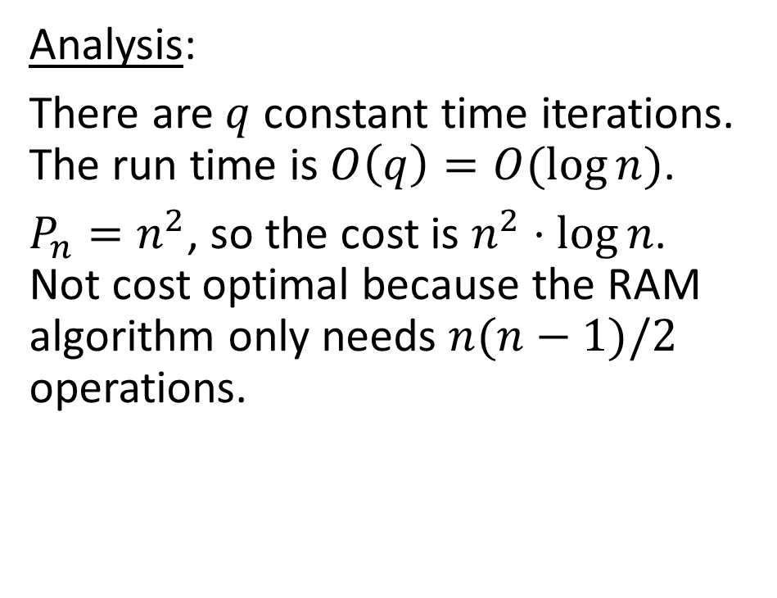
Hypercube Matrix Transpose
Analysis:
There are $q$ constant time iterations. The run time is $O\left(q\right)=O(\log{n})$.
$P_{n}=n^{2}$, so the cost is $n^{2}⋅\log{n}$. Not cost optimal because the RAM algorithm only needs $n(n−1)/2$ operations.

Slide 57
References
[1] E. Dekel, D. Nassimi and S. Sahni, "Parallel Matrix and Graph Algorithms," SIAM Journal on Computing, vol. 10, no. 4, pp. 657-819, 1981.
[2] S. G. Akl, Parallel Computation: Models and Methods, Prentice Hall, 1997.

