Slide 1
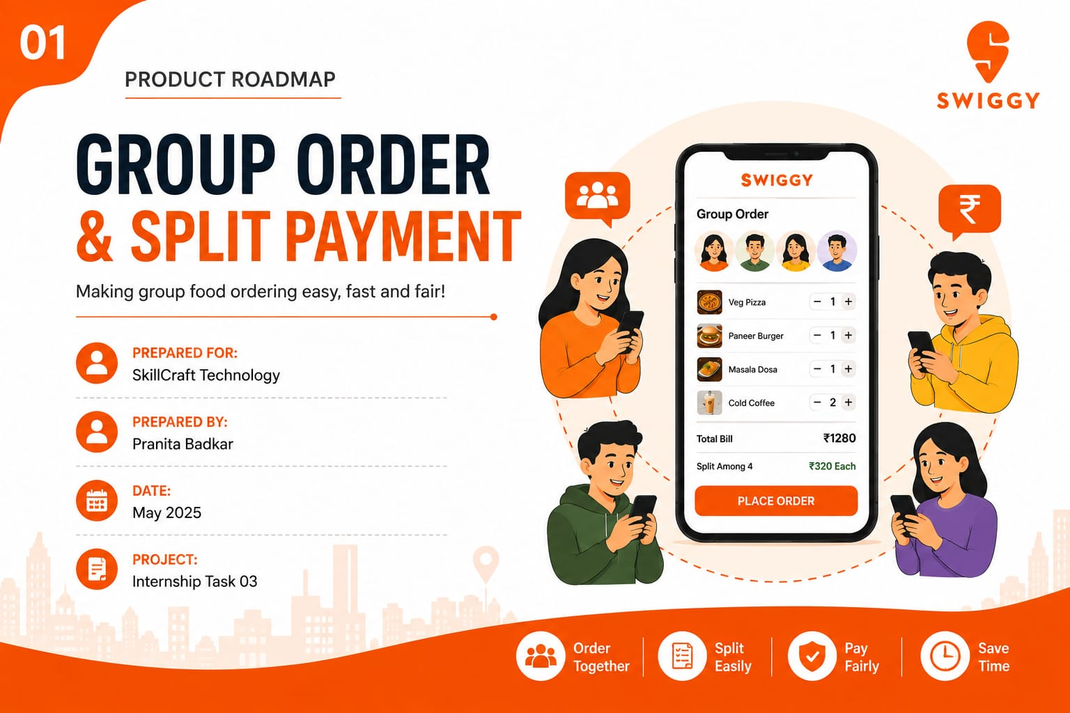

Slide 2
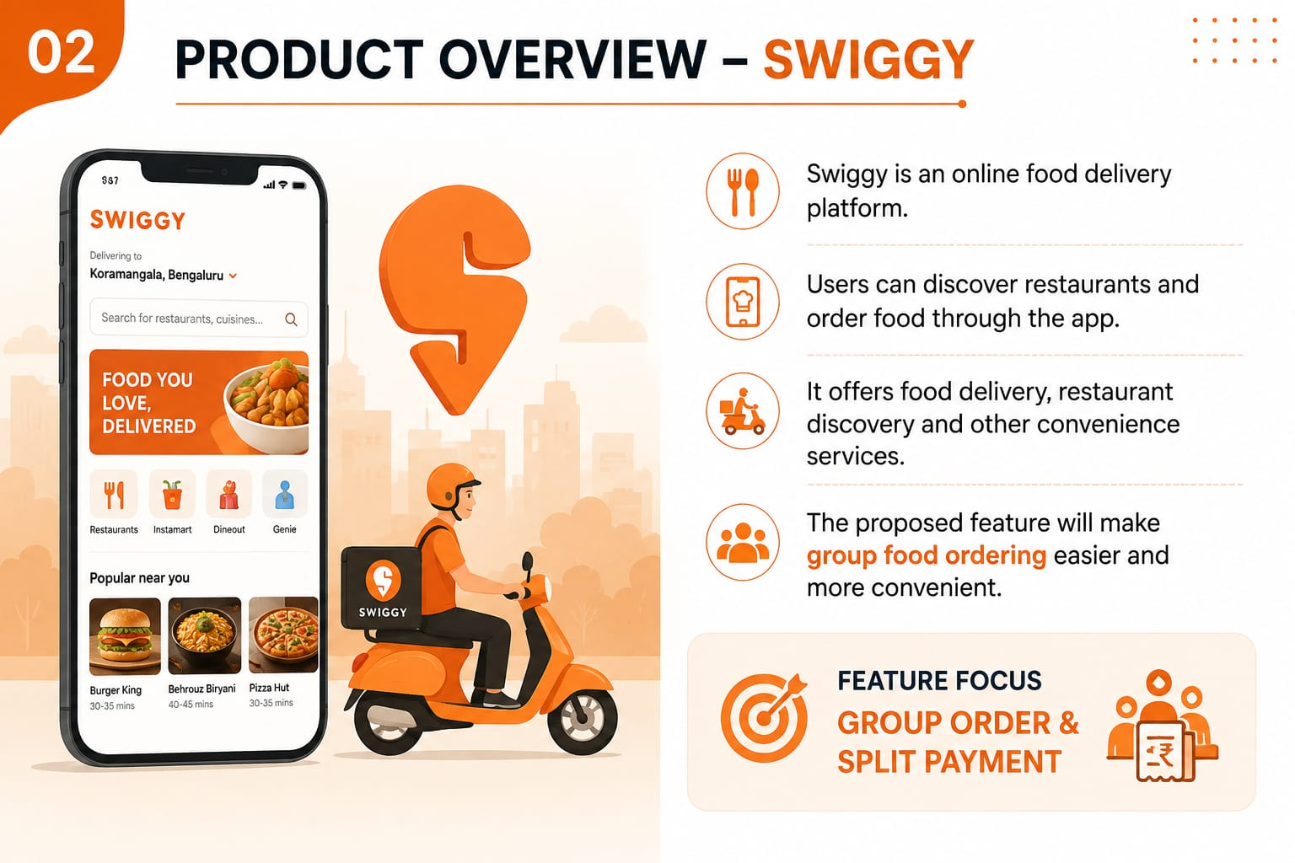
Swiggy An online food delivery platform that helps users discover restaurants and order food easily.
🍔 Food Ordering Users can browse menus, select dishes and place food orders through the app.
🚚 Food Delivery Orders are delivered from restaurants directly to customers.
👥 Group Ordering The proposed feature will make ordering food with friends and family easier.
💡 Feature Focus
Group Order & Split Payment – Users can order together and share the bill easily.

Slide 3
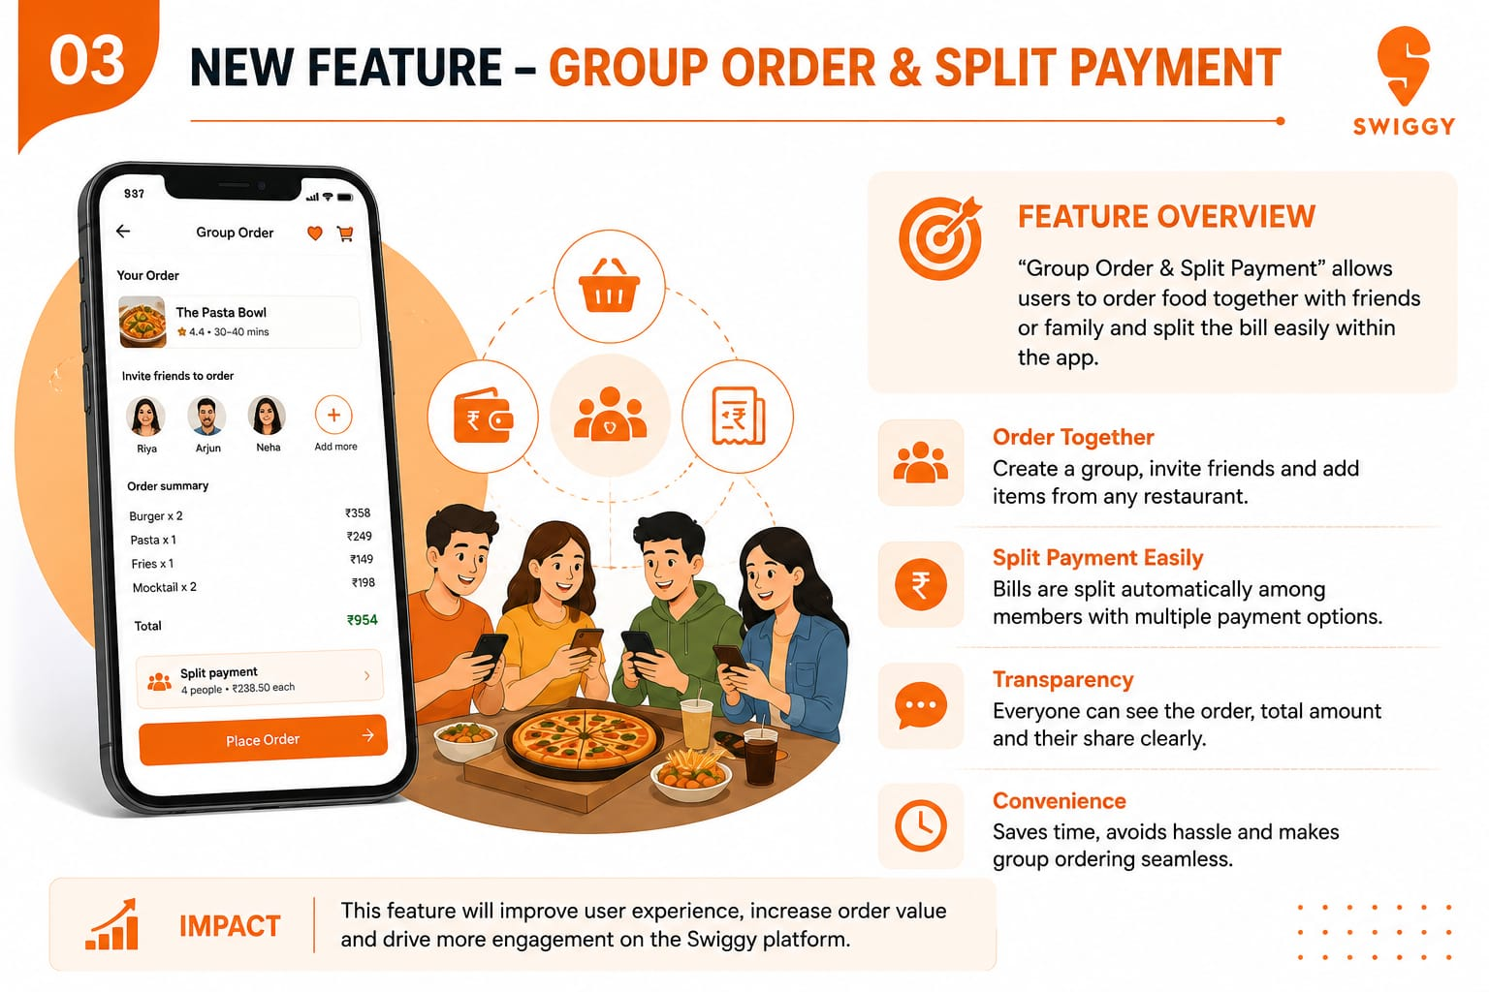

👥 Order Together
Create a group and invite friends or family to add their food items.
--------------------------------------------------
💰 Split Payment
The total bill can be divided among all group members easily.
----------------------------------------------------
👁️ Transparency
Each member can see the items ordered and their share of the bill.
--------------------------------------------------
⏱️ Convenience
Saves time and avoids the hassle of collecting money from everyone.
----------------------------------------------------------
🎯 Main Goal
Make group food ordering easy, quick and
convenient.

Slide 4
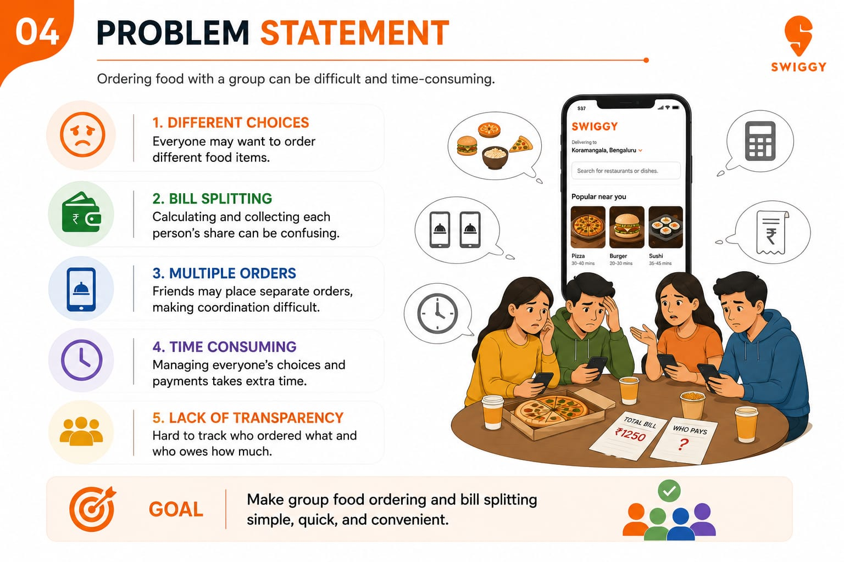
😕 Current Problem
Ordering food with a group can be difficult and time-consuming.
--------------------------------------------------------
🍔 Different Choices
Everyone may want to order different food items.
-------------------------------------------------------
💰 Bill Splitting
Calculating and collecting each person's share can be confusing.
-------------------------------------------------------
📱 Multiple Orders
Friends may place separate orders, making coordination difficult.
--------------------------------------------------------
⏳ Time Consuming
Managing everyone's choices and payments takes extra time.

Slide 5
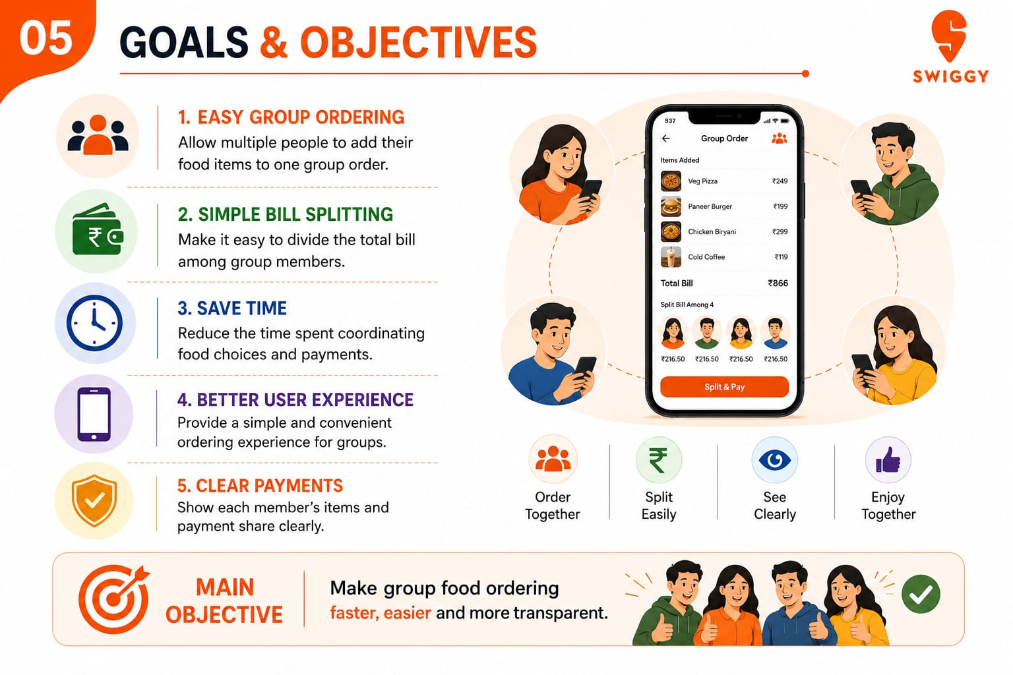
👥 Easy Group Ordering
Allow multiple people to add their food items to one group order.
-----------------------------------------------------------
💰 Simple Bill Splitting
Make it easy to divide the total bill among group members.
-----------------------------------------------------------
⏱️ Save Time
Reduce the time spent coordinating food choices and payments.
-----------------------------------------------------------
📱 Better User Experience
Provide a simple and convenient ordering experience for groups.
-----------------------------------------------------------
🔒 Clear Payments
Show each member’s items and payment share clearly.

Slide 6
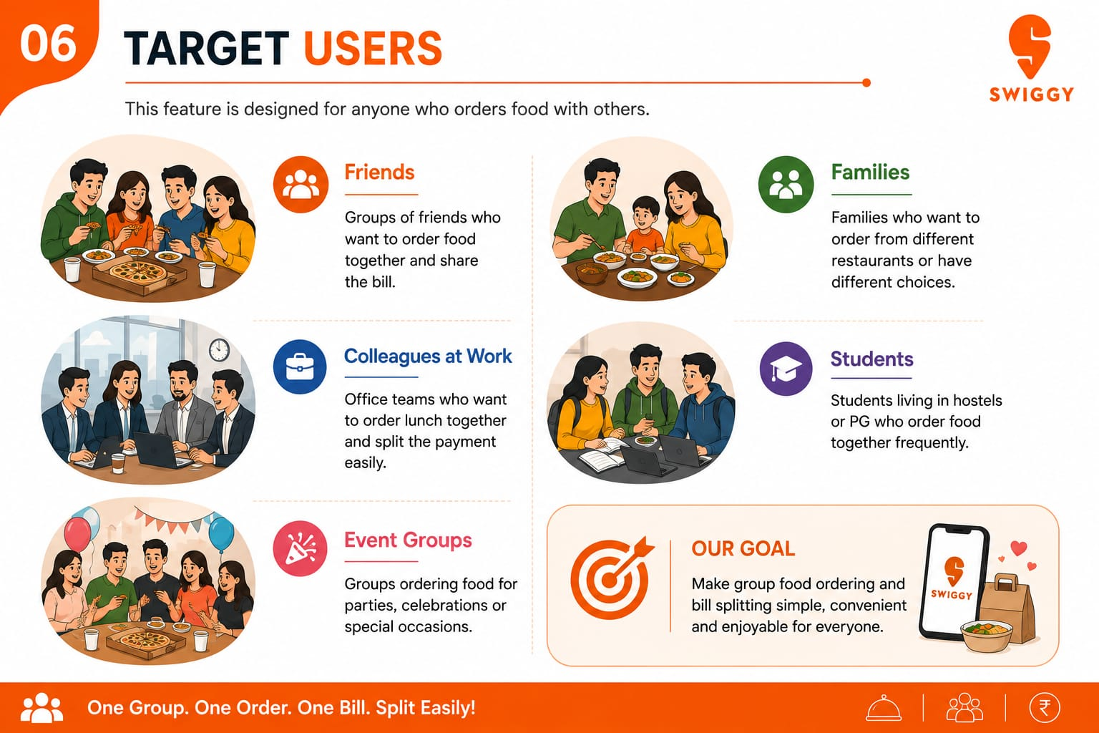
Friends
Groups of friends who want to order food together and share the bill.
---------------------------------------
Colleagues at Work
Officer teams who want to order lunch together and split the payment easily.
---------------------------------------
Event Groups
Groups ordering food for parties , celebrations or special occasions.

Slide 7
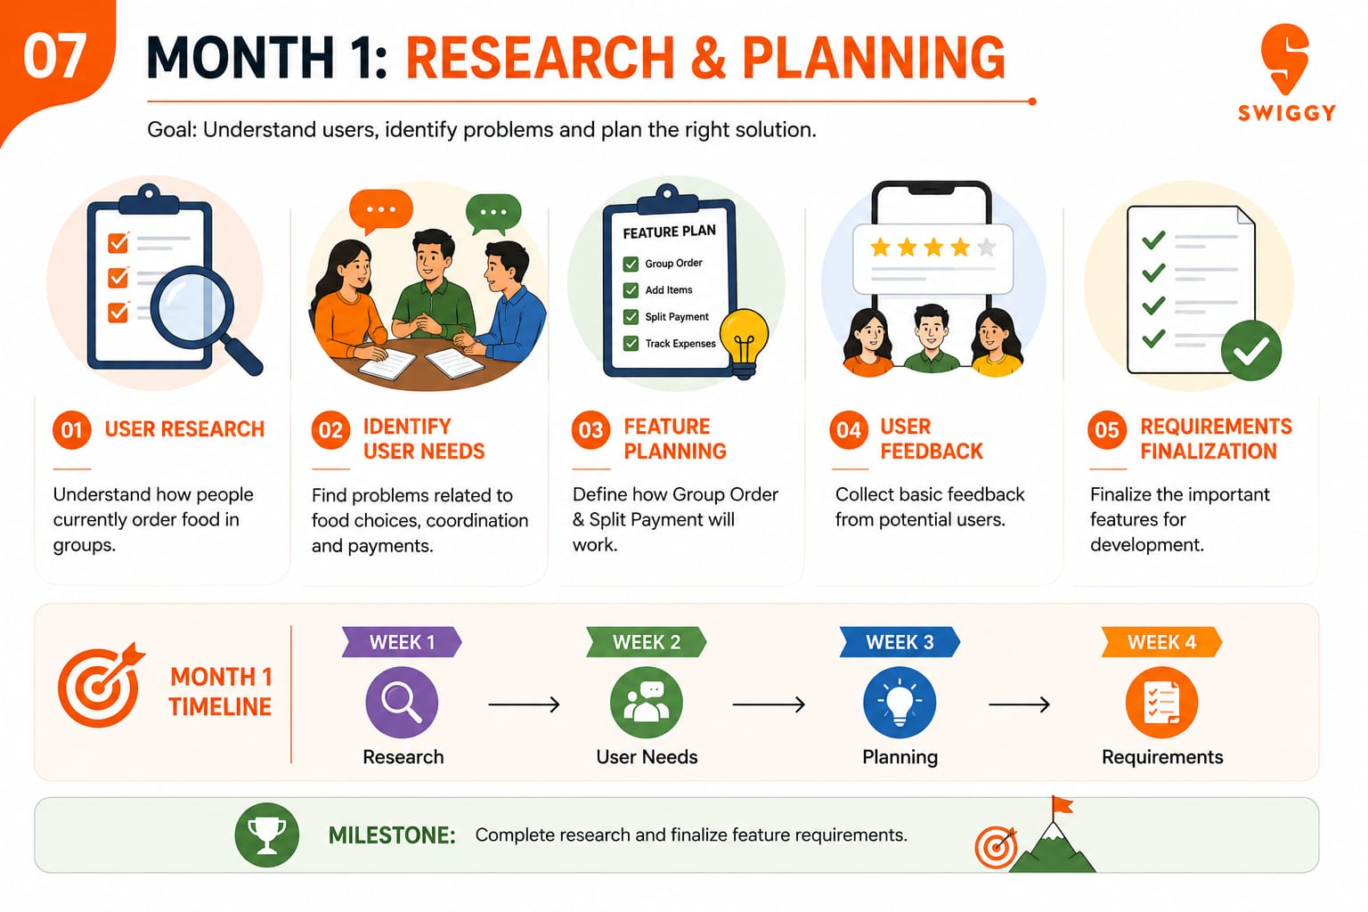
01) 🔍 User Research 02)📝 Identify User 03) 💡 Feature 04)👥 User Feedback 05)📋 Requirements Understand how people Find Problems related planning define how Collect basic feedback Finalization- finalize
Currently order food in to food choices, Group order & split from potential users. The important feature
Groups. Coordination and payment will work. For development

Slide 8
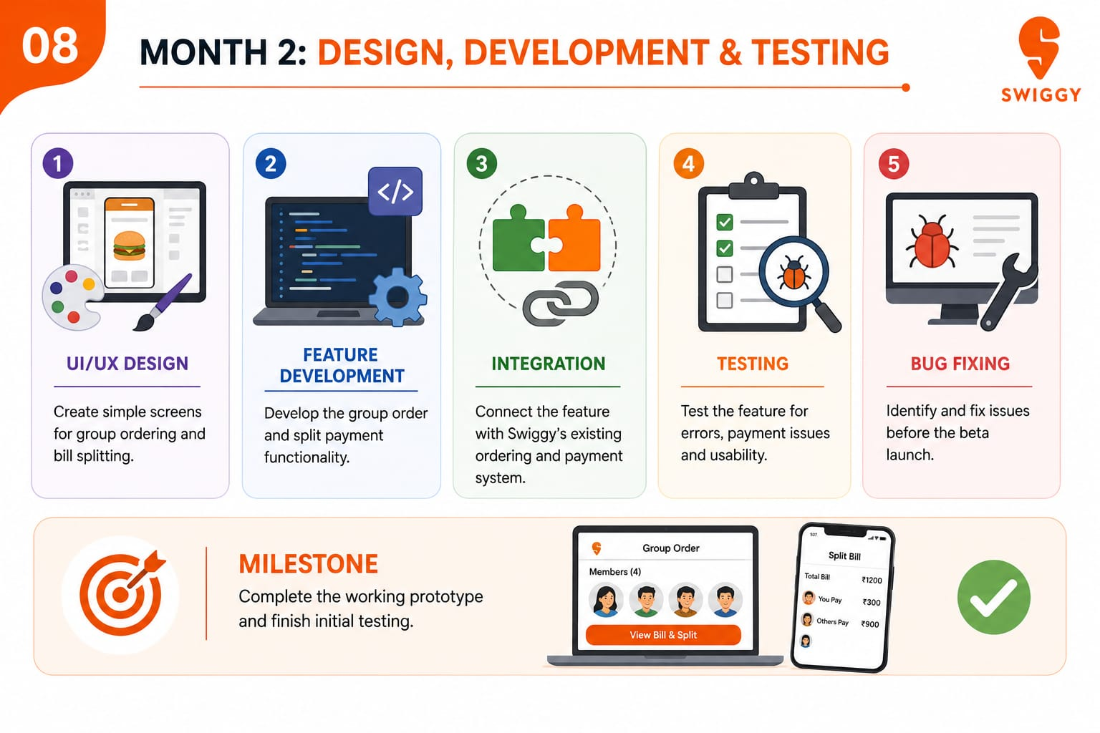

Slide 9
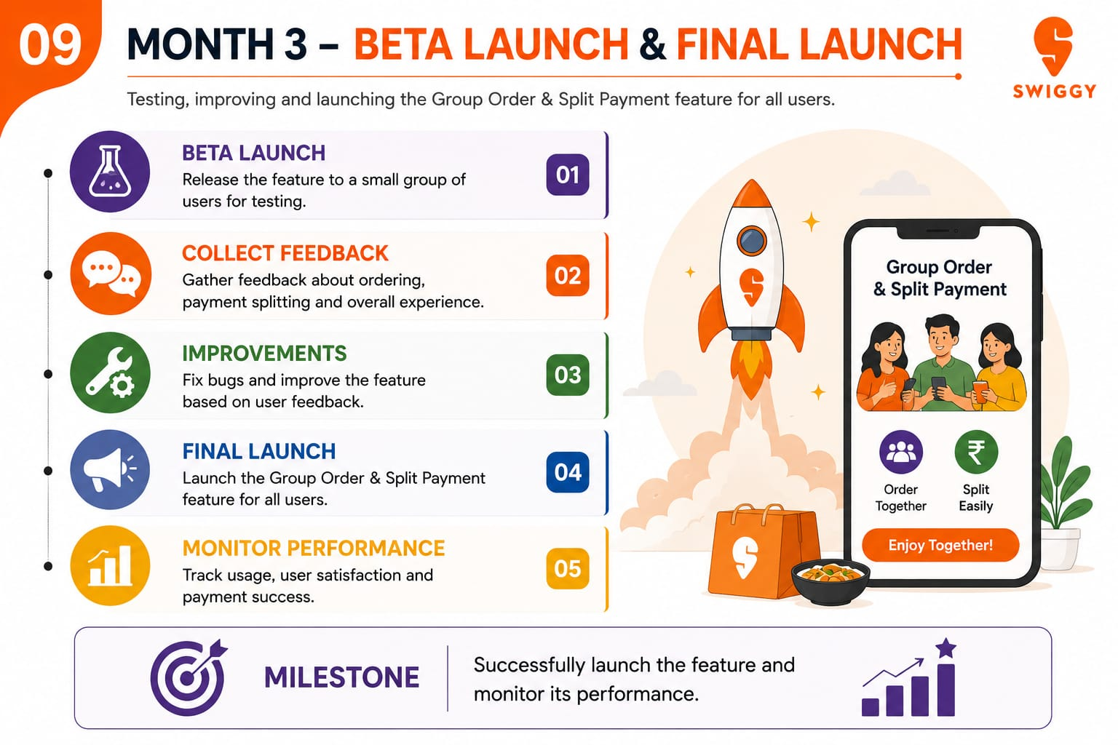

Slide 10
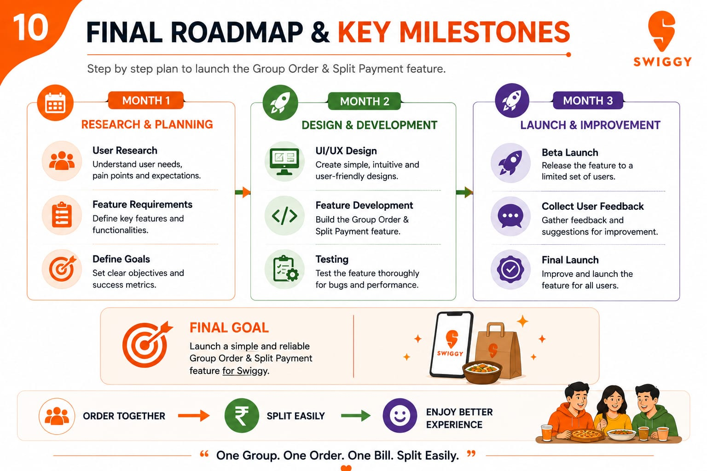

Slide 11
Thank you.

