Slide 1
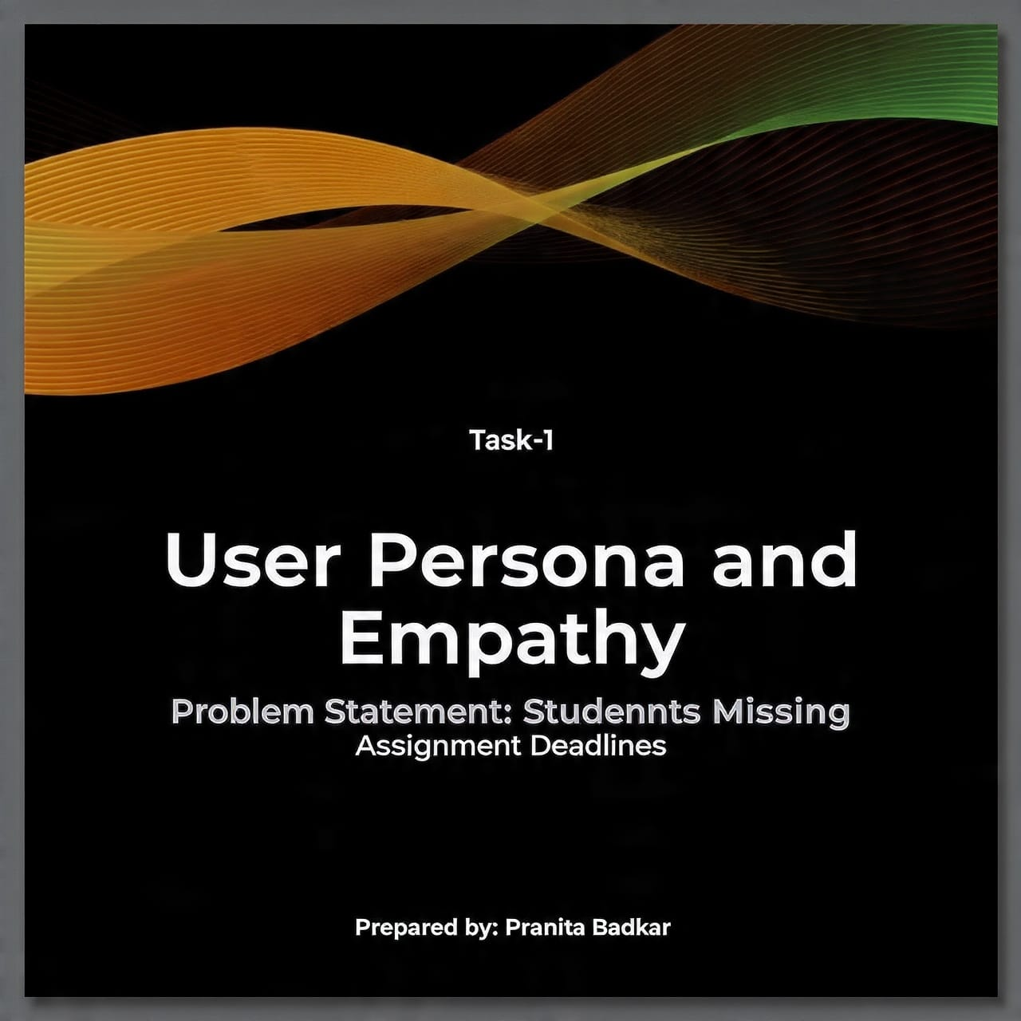

Slide 2
Introduction :
Many college students miss the assignment because they have multiple subjects , busy schedules and poor time management.
Missing deadlines affects their grades , confidence and academic performance.
This leads to stress, lower grades . affects their overall academic performance.

Slide 3
Problem statement:
Student often struggle to remember assignment deadlines due to:--
Multiple assignments from different subjects.
Lack of reminders.
Poor time management.
Busy academic schedule.

Slide 4
Target audience :
Primary Target Audience:
College and University Students.
Who are they?
Students managing multiple subjects and assignments.
Students who struggle with time management.
Students who sometimes forget assignment deadlines.
Student who use smartphones regularly
Main goal:
Help students stay organized and submit assignment on time

Slide 5
User persona :
Name :- Rohit Sharma.
Age :- 20 years.
Occupation :- B.Tech Student.
Education :- 2nd year Engineering Student .
Location :- India.
Personality :- Responsible, but sometimes forgetful and busy.
Technology Usage :- Smartphones, laptop, Google Calender and messaging apps.
Quote:
“I want to submit all my assignment on time but sometimes I forget the deadlines.”

Slide 6
User goals and needs :
User goals:
Submit assignments on time.
Improve academic performance.
3. Manage study time effectively .
4. Stay organized with multiple assignments.
User needs:
Timely assignment reminders .
Easy task and deadline tracking .
A simple and organized interface .
Calender-based scheduling.

Slide 7
Pain points :
Often forget assignment deadlines.
Has multiple assignments from different subjects.
Finds it difficult to manage time effectively.
Receives reminders too late or not at all.
Feels stressed when deadlines are approaching.
Sometimes has to complete assignments at the last minute .

Slide 8
Empathy map : think & says
Think
says
“I often forget my assignment deadline.”
“I have too many assignments to manage.”
“I wish all my deadlines were in one place.”
“I need reminders before the deadline.”
”I should manage my time better.”
“what if I miss another deadlines?”.
“ A reminder would help me stay on track”.
“I need an easier way to organize my assignment

Slide 9
Empathy map : does & feels
Does
Feels
Uses phone notes or a calendar to track deadlines.
Asks classmates about assignment deadlines.
Checks message and college platforms for updates.
Often compete assignments at the last.
Feels stressed when deadlines are approaching .
Feels worried about missing submission.
Feels frustrated when managing multiple assignments.
Feels happy and confident when assignment are submitted on time .

Slide 10
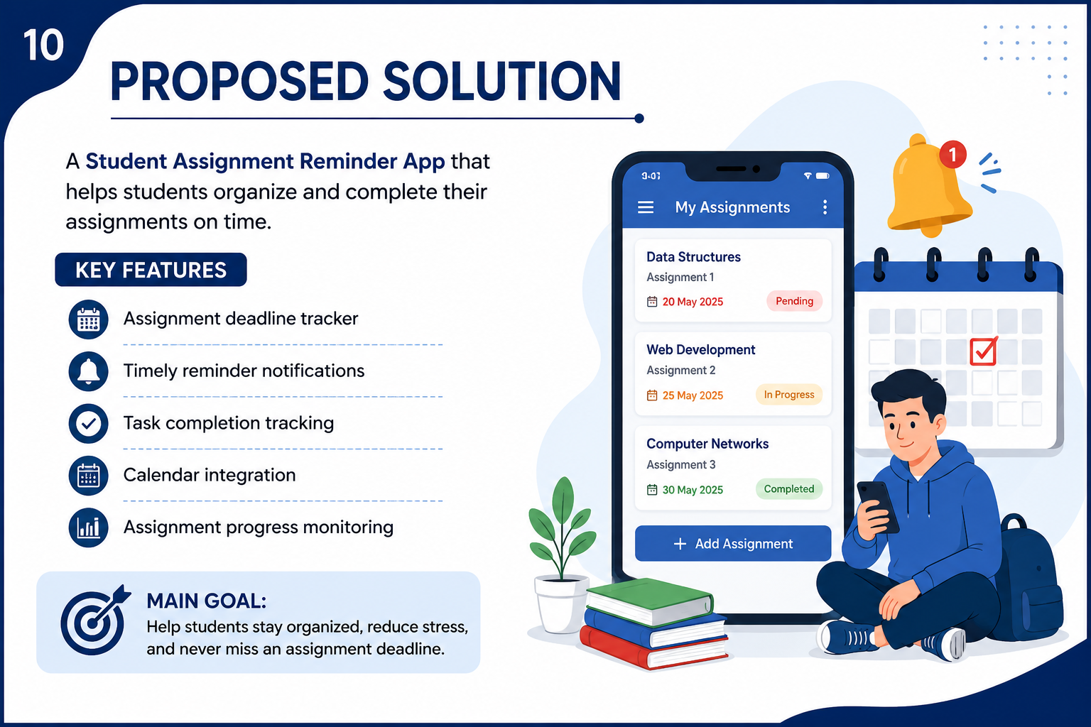
Proposed Solution:
A Student Assignment Reminder App that helps students organize and complete their assignments on time.
Key Features:
📅 Assignment deadline tracker
🔔 Timely reminder notifications
✅ Task completion tracking
🗓️ Calendar integration
📊 Assignment progress monitoring
Main Goal:
Help students stay organized, reduce stress, and never miss an assignment deadline

Slide 11
Benefits :
Better time management .
Fewer missed deadlines.
Reduced academic stress.
Improved productivity.
Better assignment organization.
Improved academic performance.

Slide 12
Conclusion :
Understanding students through a User Persona and Empathy Map helps us identify their problems , needs, and emotions.
A Student Assignment Reminder App can help
Students:
Stay organized.
Manage their time effectively.
Reduce academic stress.
Avoid missing deadlines and submit assignments on time.
Final message-
“Better planning leads to better performance.”

Slide 13
Thank you.

