Slide 1
狙击项目
By Mikhail Dergai

Slide 2
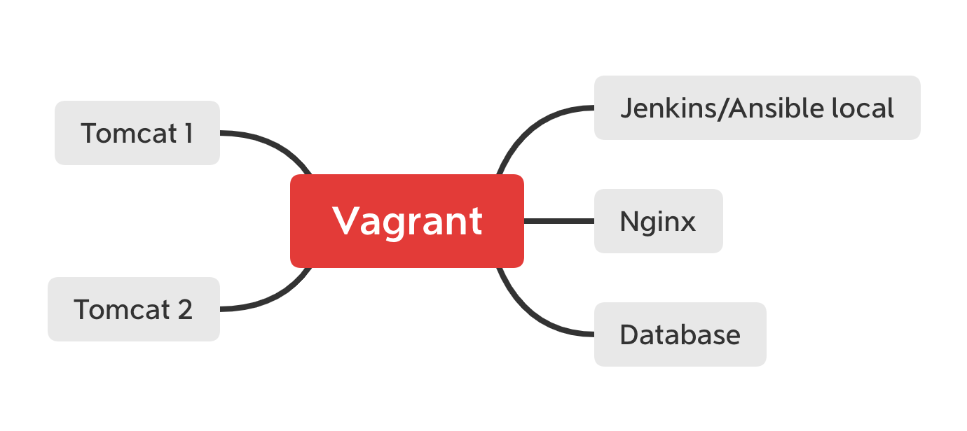
Environment schema

Slide 3
Components details
Database – Ubuntu 18.04, Mysql Ver 14.14 Distrib 5.7.28
Tomcat – Ubuntu 18.04, Tomcat v. 9.0.29
Nginx – Ubuntu 18.04, Nginx 1.14.0
Jenkins – Ubuntu 18.04, Ansible 2.9.1, Jenkins 2.190.3

Slide 4
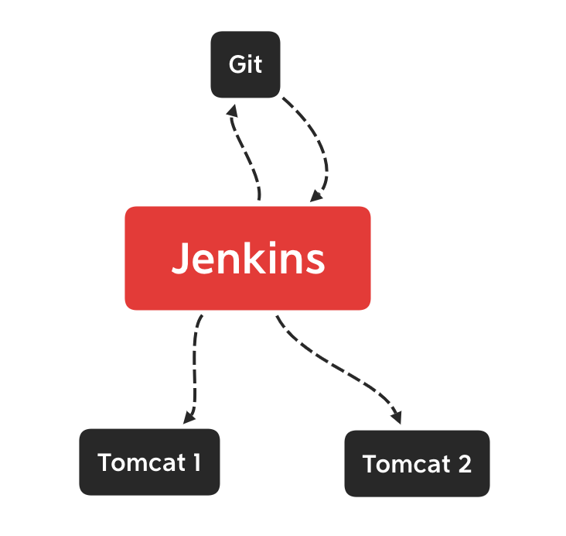
Deployment diagram

Slide 5
QUESTIONS?

